Slide 1
Section 1.3
Linear Inequalities in One Variable

Slide 2
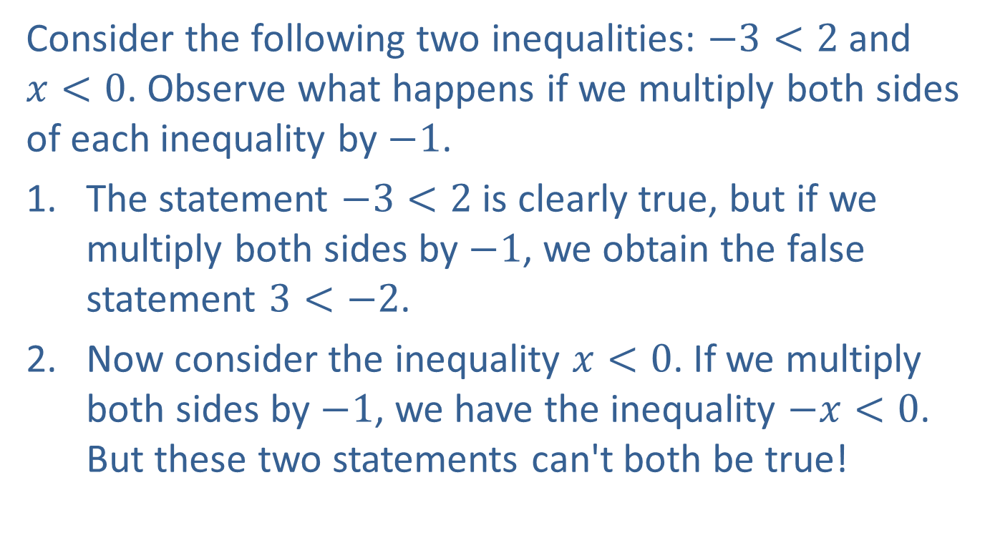
Example 1: Multiplying Inequalities by Negative Numbers
Consider the following two inequalities: $−3<2$ and $x<0$. Observe what happens if we multiply both sides of each inequality by $−1$.
The statement $−3<2$ is clearly true, but if we multiply both sides by $−1$, we obtain the false statement $3<−2$.
Now consider the inequality $x<0$. If we multiply both sides by $−1$, we have the inequality $−x<0$. But these two statements can't both be true!

Slide 3
Example 1: Multiplying Inequalities by Negative Numbers (cont.)
These examples show that multiplicative cancellation must behave a bit differently for linear inequalities. Note that if we reverse the inequality sign in our results, we actually get true statements. This provides a clue to how we approach multiplicative cancellation in the case of linear inequalities.

Slide 4
Solving Linear Inequalities
Cancellation Properties for Inequalities
In these properties, A, B, and C represent algebraic expressions and D represents a nonzero constant. Each of the properties is stated for the inequality symbol <, but they are also true for the other three symbols with the appropriate changes made.

Slide 5
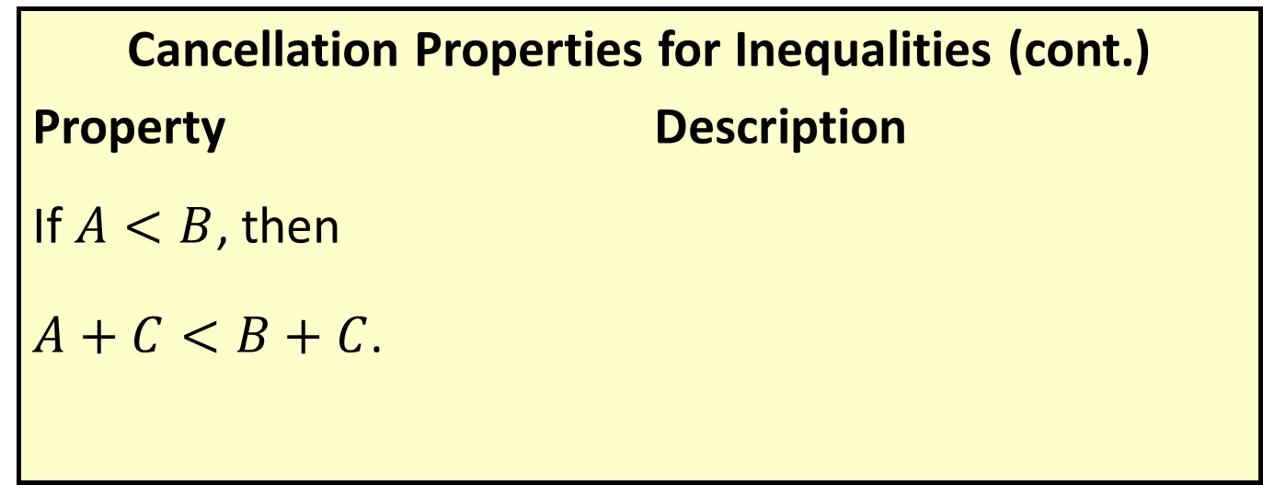
Solving Linear Inequalities
Cancellation Properties for Inequalities (cont.)
Property Description
If $A<B$, then
$A+C<B+C$.
Adding the same quantity to both sides of an inequality results in an equivalent inequality.

Slide 6
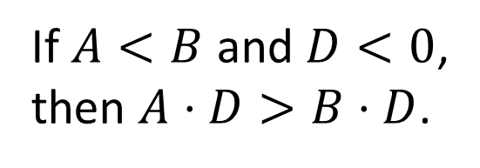
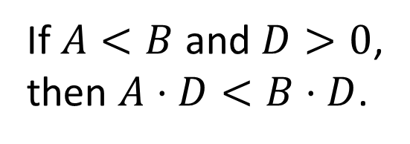
Solving Linear Inequalities
Cancellation Properties for Inequalities (cont.)
Property Description
If $A<B$ and $D>0$,
then $A⋅D<B⋅D$.
If both sides of an inequality are multiplied by a positive constant, the sense of the inequality is unchanged.
If both sides are multiplied by a negative constant, the sense of the inequality is reversed.
If $A<B$ and $D<0$,
then $A⋅D>B⋅D$.

Slide 7
Example 2: Solving Linear Inequalities
Solve the following inequalities, using interval notation to describe the solution set.

Slide 8
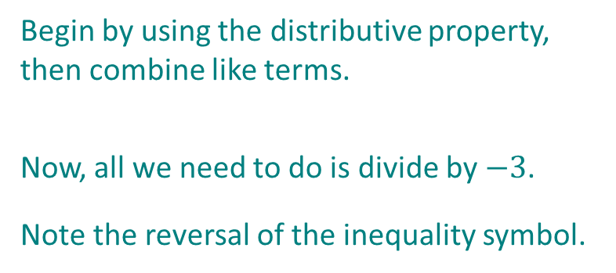
Example 2: Solving Linear Inequalities (cont.)
Solution
Begin by using the distributive property, then combine like terms.
Now, all we need to do is divide by $−3$.
Note the reversal of the inequality symbol.

Slide 9
Example 2: Solving Linear Inequalities (cont.)
Just as with equations, fractions in inequalities can be eliminated by multiplying both sides by the least common denominator.
Since we do not need to multiply or divide by a negative value, the sense of the inequality does not change.
Thus, in interval notation, the solution is

Slide 10
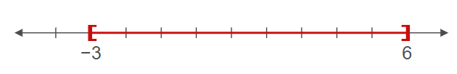
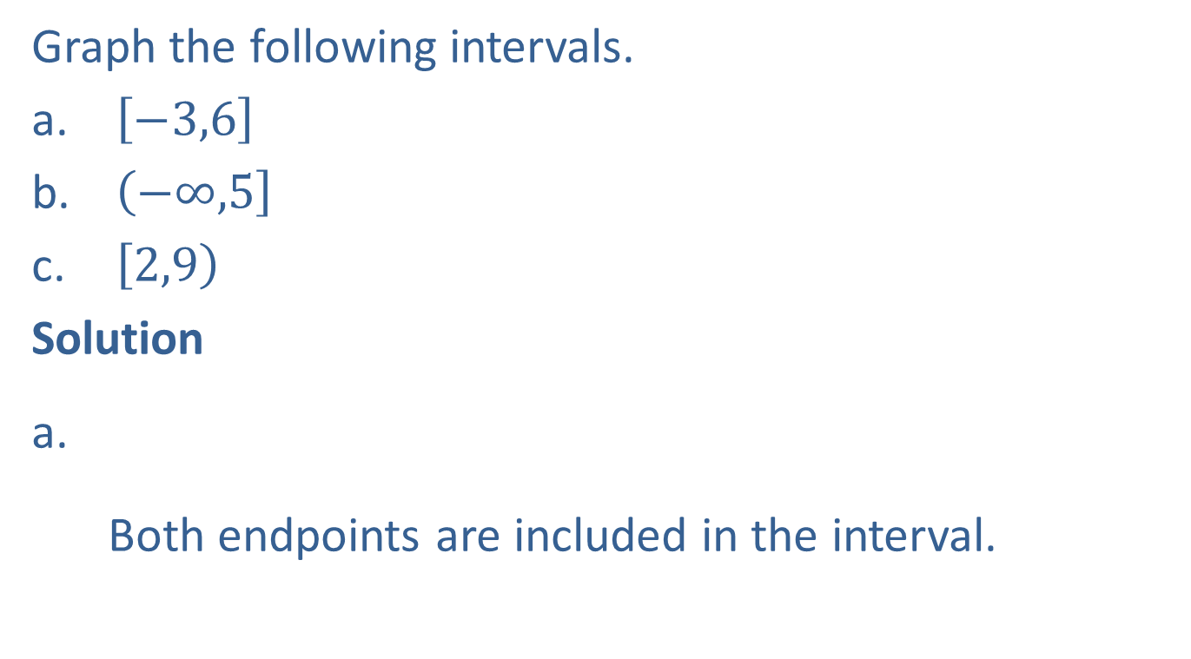
Example 3: Graphing Intervals of Real Numbers
Graph the following intervals.
$\left[−3,6\right]$
$\left(−∞,\right.\left.5\right]$
$\left[2,\right.\left.9\right)$
Solution
Both endpoints are included in the interval.

Slide 11
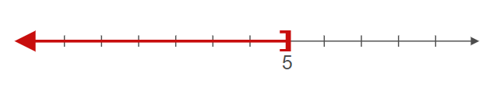
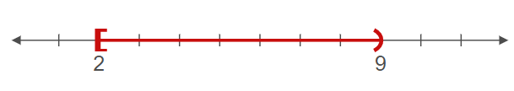
Example 3: Graphing Intervals of Real Numbers (cont.)
The left-hand side of the graph extends to negative infinity.
The left endpoint is included in the solution, while the right endpoint is excluded.

Slide 12

Example 4: Calculating Final Grades
The final grade in a class depends on the grades of $5$ exams, each worth a maximum of $100$points. Suppose Janice's scores on the first four tests are $67$, $82$, $73$ and $85$. What scores can she make on the fifth test to get a B in the class?

Slide 13
Note
We follow the same process in solving compound inequalities as we do for standard ones. The only difference is that operations are applied to all three "sides" of the statements.

Slide 14
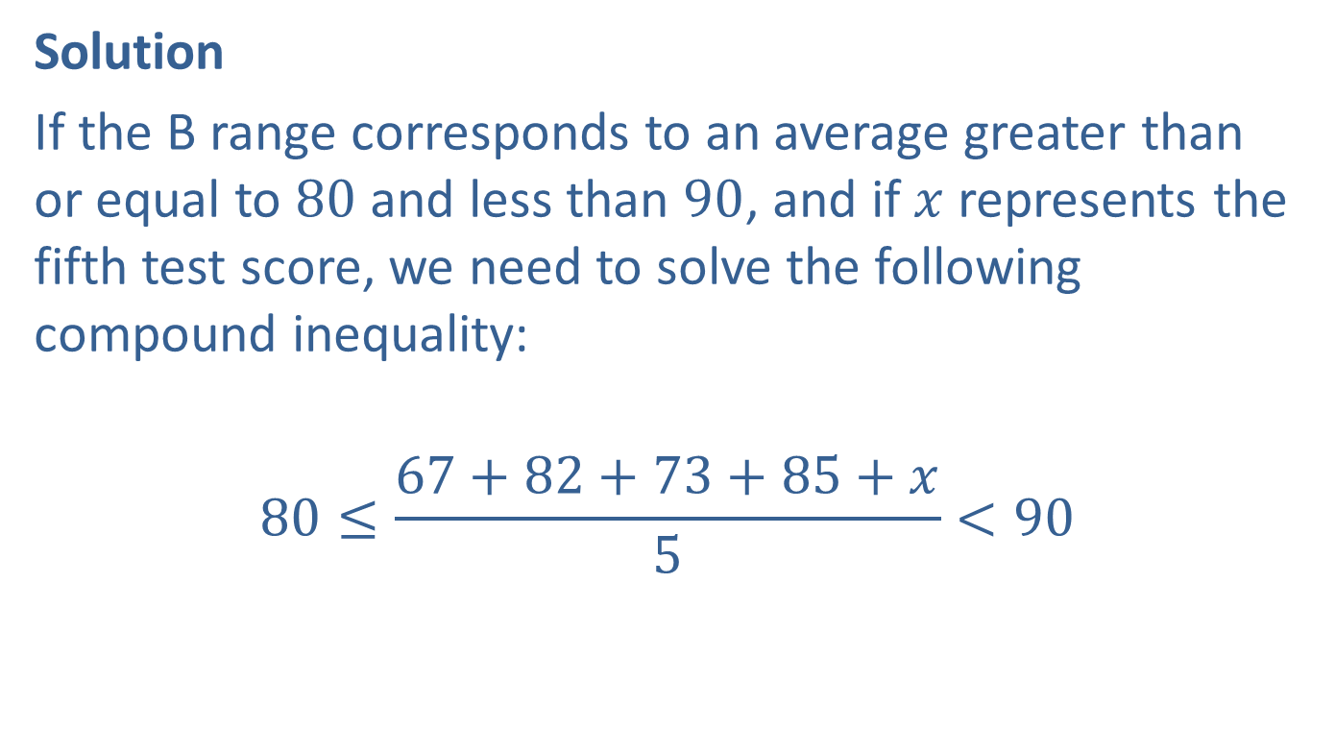
Example 4: Calculating Final Grades (cont.)
Solution
If the B range corresponds to an average greater than or equal to $80$ and less than $90$, and if $x$ represents the fifth test score, we need to solve the following compound inequality:
$$80≤\frac{67+82+73+85+x}{5}<90$$

Slide 15
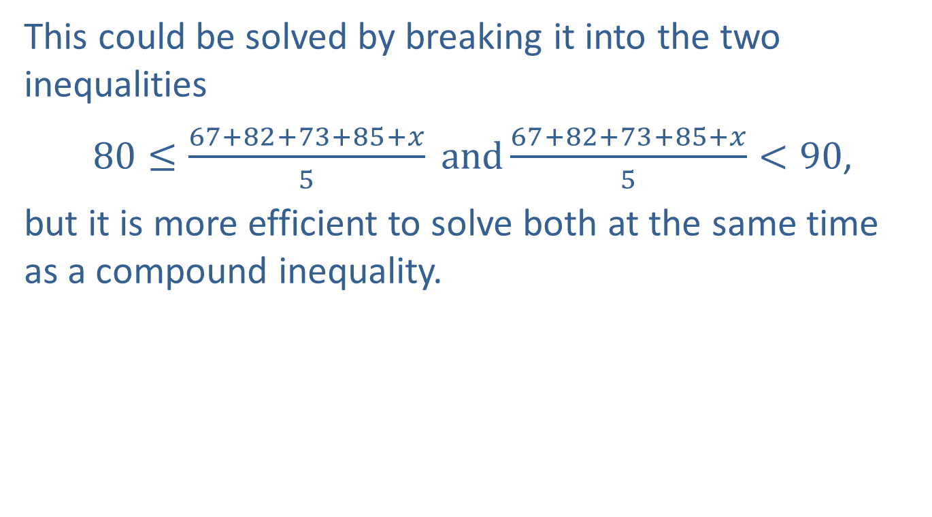
Example 4: Calculating Final Grades (cont.)
This could be solved by breaking it into the two inequalities
$80≤\frac{67+82+73+85+x}{5} and\frac{67+82+73+85+x}{5}<90$,
but it is more efficient to solve both at the same time as a compound inequality.

Slide 16
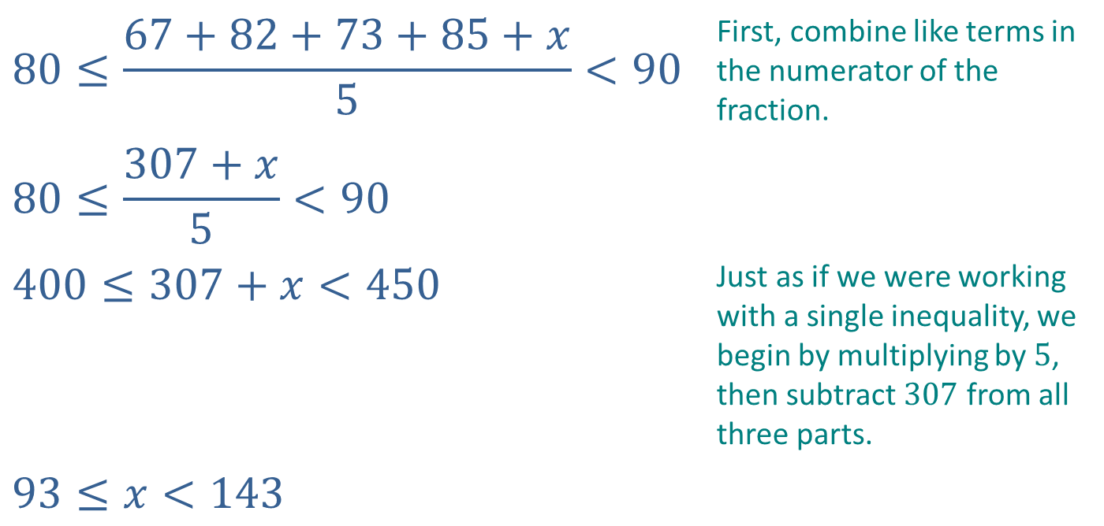
Example 4: Calculating Final Grades (cont.)
$$80≤\frac{67+82+73+85+x}{5}<90$$ | First, combine like terms in the numerator of the fraction.
$$80≤\frac{307+x}{5}<90$$
$$400≤307+x<450$$ | Just as if we were working with a single inequality, we begin by multiplying by $5$, then subtract $307$ from all three parts.
$$93≤x<143$$

Slide 17

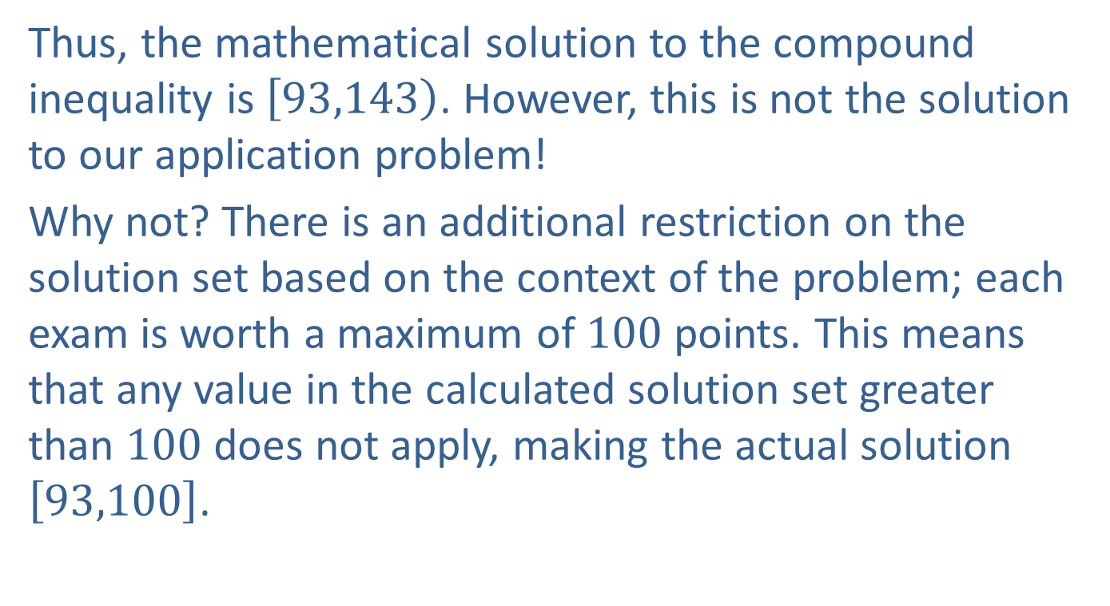
Example 4: Calculating Final Grades (cont.)
Thus, the mathematical solution to the compound inequality is $\left[93,\right.\left.143\right)$. However, this is not the solution to our application problem!
Why not? There is an additional restriction on the solution set based on the context of the problem; each exam is worth a maximum of $100$ points. This means that any value in the calculated solution set greater than $100$ does not apply, making the actual solution $\left[93,100\right]$.

Slide 18

Example 5: Compound Linear Inequalities
Solve the following compound inequalities.
$−1<3−2x≤5$
$2\left(2x−1\right)≤4x+2≤4(x+1)$

Slide 19
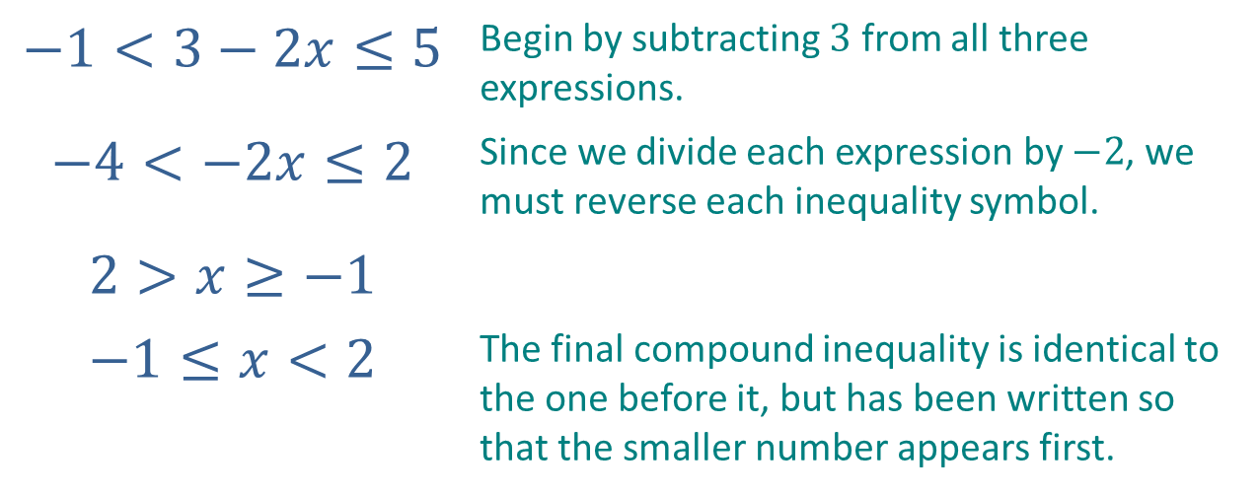

Example 5: Compound Linear Inequalities (cont.)
Solution
In interval notation, the solution is $\left[−1\right.\left.,2\right)$.
$$−1<3−2x≤5$$ | Begin by subtracting $3$ from all three expressions.
$$−4<−2x≤2$$ | Since we divide each expression by $−2$, we must reverse each inequality symbol.
$$2>x≥−1$$
$$−1≤x<2$$ | The final compound inequality is identical to the one before it, but has been written so that the smaller number appears first.

Slide 20
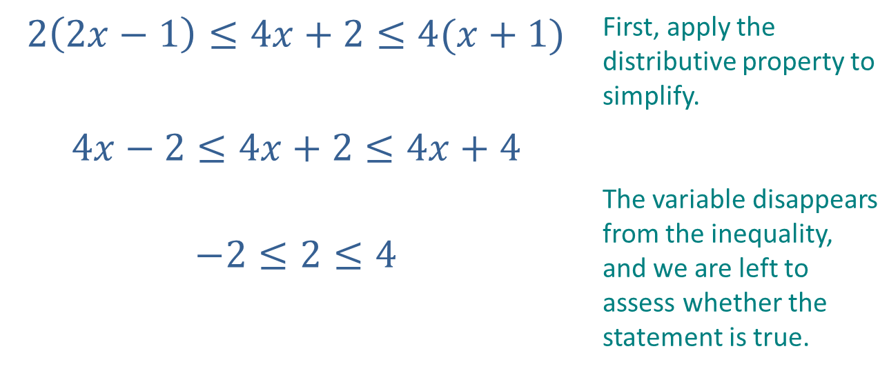
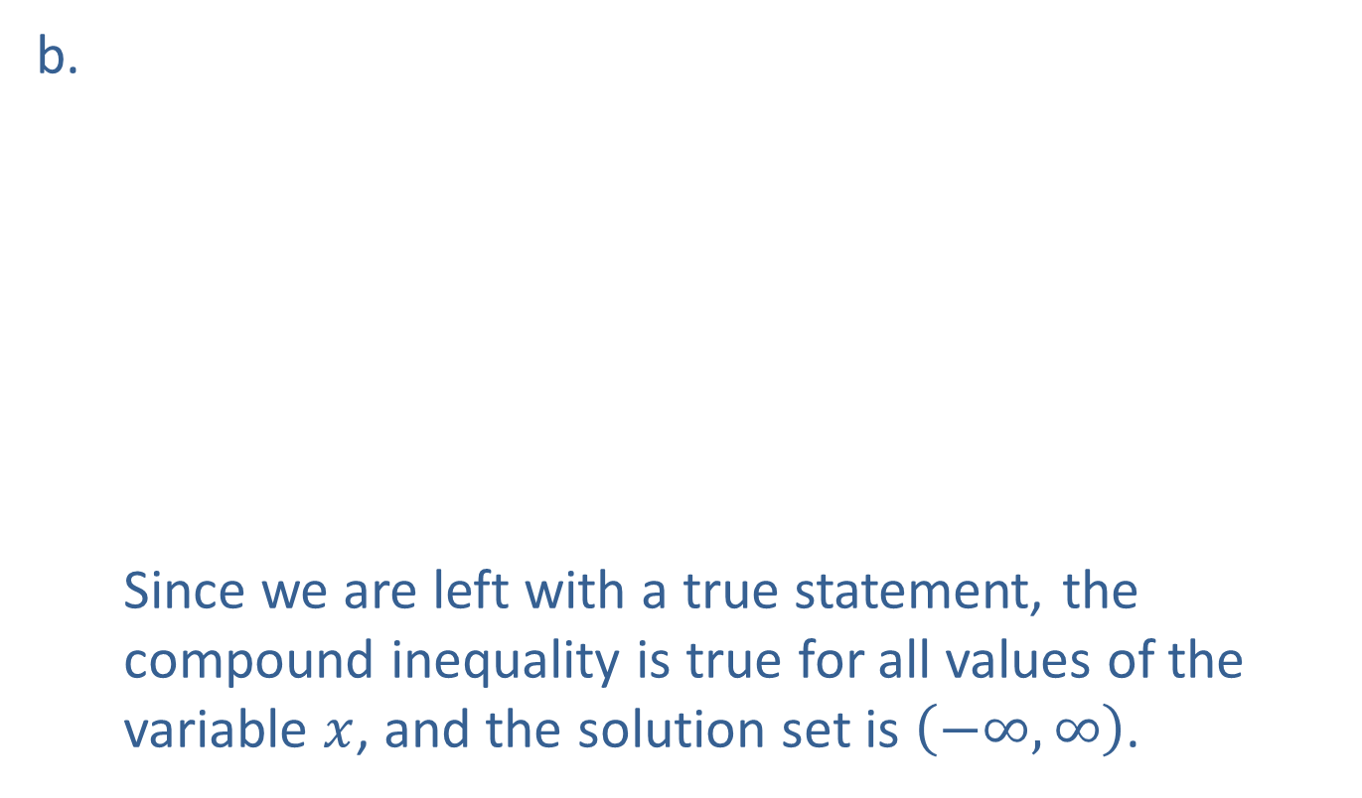
Example 5: Compound Linear Inequalities (cont.)
Since we are left with a true statement, the compound inequality is true for all values of the variable $x$, and the solution set is $\left(−∞,∞\right)$.
$$2\left(2x−1\right)≤4x+2≤4(x+1)$$ | First, apply the distributive property to simplify.
$$4x−2≤4x+2≤4x+4$$
$$−2≤2≤4$$ | The variable disappears from the inequality, and we are left to assess whether the statement is true.

Slide 21

Example 6: Absolute Value Inequalities
Solve the following absolute value inequalities.
$\left|4−2x\right|>6$
$2\left|3y−2\right|+3≤11$
$\left|5+2s\right|≤−3$
$\left|5+2s\right|≥−3$

Slide 22
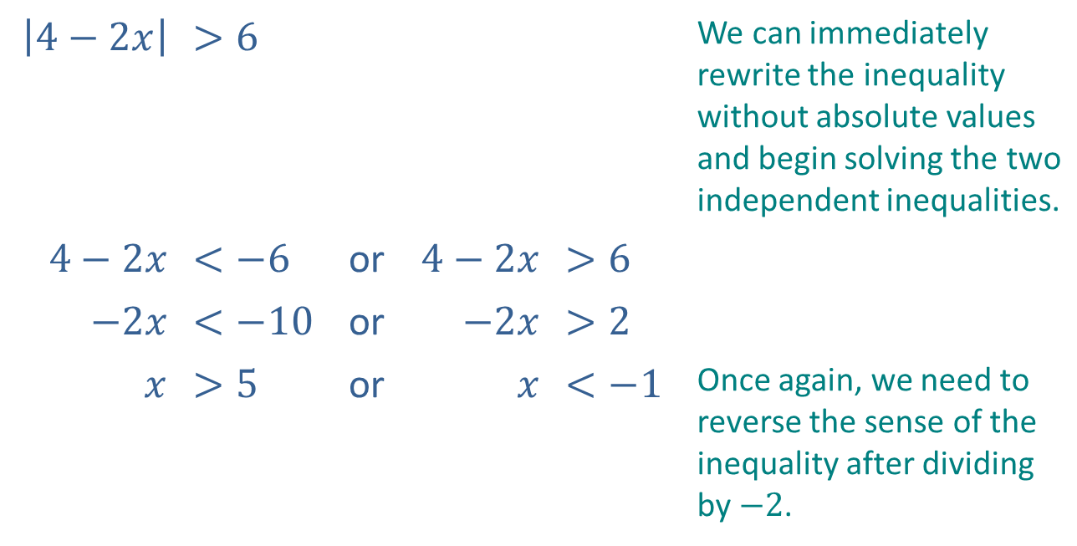
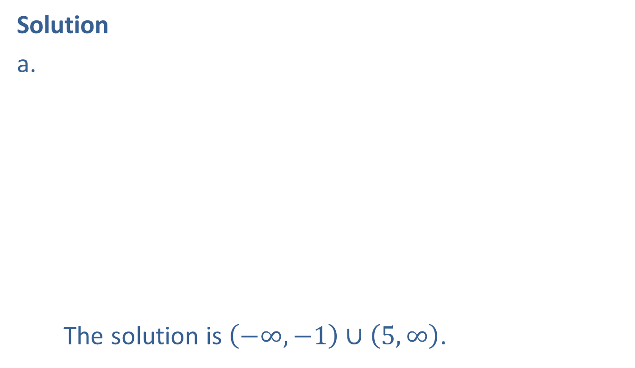
Example 6: Absolute Value Inequalities (cont.)
Solution
The solution is $\left(−∞,−1\right)∪\left(5,∞\right)$.
$$\left|4−2x\right|$$ | $$>6$$ |  |  |  | We can immediately rewrite the inequality without absolute values and begin solving the two independent inequalities.
$$4−2x$$ | $$<−6$$ | or | $$4−2x$$ | $$>6$$
$$−2x$$ | $$<−10$$ | or | $$−2x$$ | $$>2$$
$$x$$ | $$>5$$ | or | $$x$$ | $$<−1$$ | Once again, we need to reverse the sense of the inequality after dividing by $−2$.

Slide 23

Example 6: Absolute Value Inequalities (cont.)
The graph of the solution is:

Slide 24
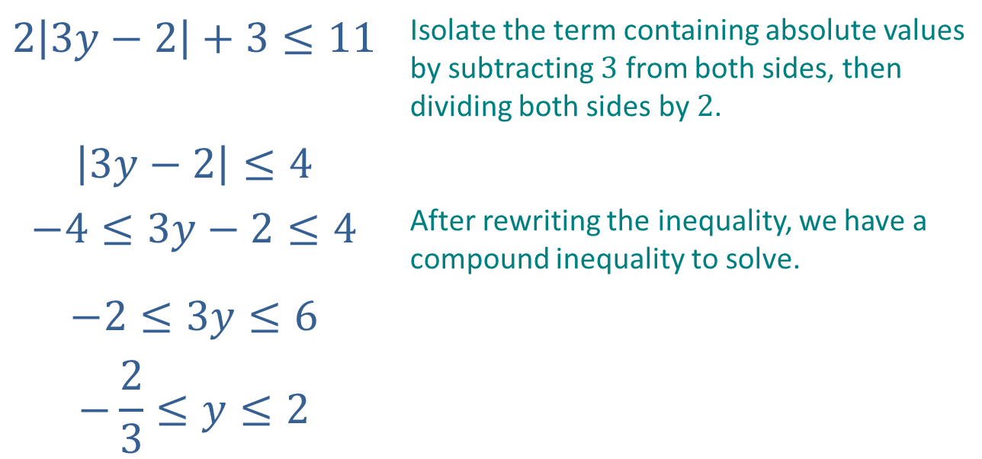

Example 6: Absolute Value Inequalities (cont.)
$$2\left|3y−2\right|+3≤11$$ | Isolate the term containing absolute values by subtracting $3$ from both sides, then dividing both sides by $2$.
$$\left|3y−2\right|≤4$$
$$−4≤3y−2≤4$$ | After rewriting the inequality, we have a compound inequality to solve.
$$−2≤3y≤6$$
$$−\frac{2}{3}≤y≤2$$
Thus, the solution is $\left[−\frac{2}{3},2\right]$.

Slide 25
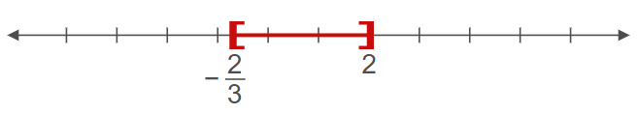
Example 6: Absolute Value Inequalities (cont.)
Graphically, the solution can be written as:

Slide 26
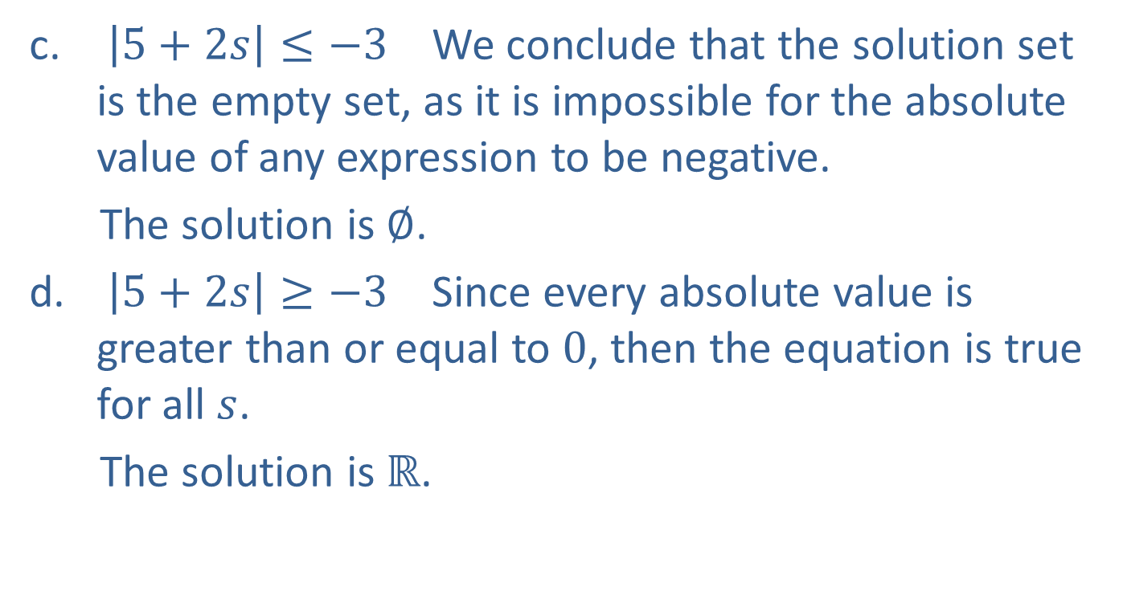
Example 6: Absolute Value Inequalities (cont.)
$\left|5+2s\right|≤−3$ We conclude that the solution set is the empty set, as it is impossible for the absolute value of any expression to be negative.
The solution is $∅$.
$\left|5+2s\right|≥−3$ Since every absolute value is greater than or equal to $0$, then the equation is true for all $s$.
The solution is $ℝ$.

Slide 27
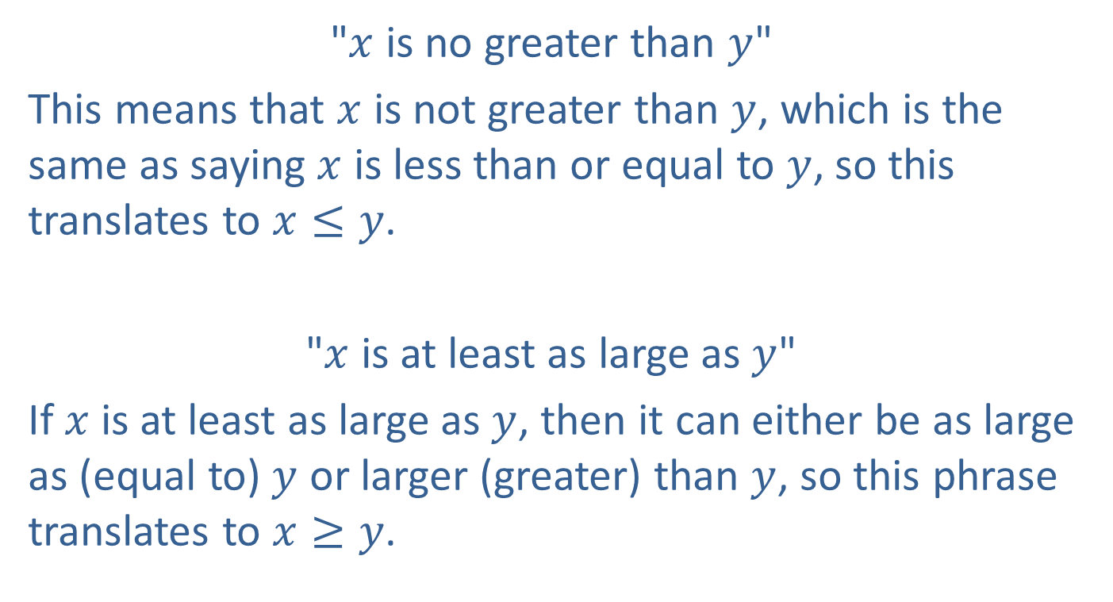
Example 7: Translating Inequality Phrases
"$x$ is no greater than $y$"
This means that $x$ is not greater than $y$, which is the same as saying $x$ is less than or equal to $y$, so this translates to $x≤y$.
"$x$ is at least as large as $y$"
If $x$ is at least as large as $y$, then it can either be as large as (equal to) $y$ or larger (greater) than $y$, so this phrase translates to $x≥y$.

Slide 28
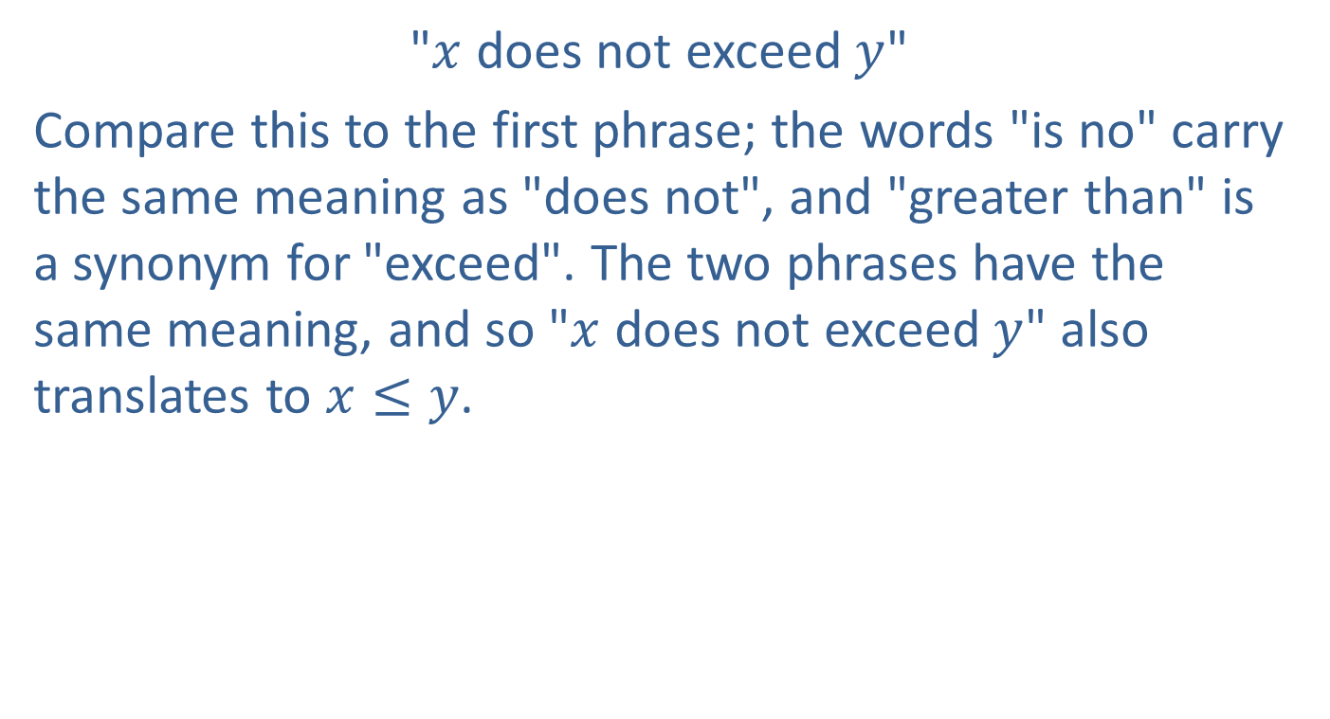
Example 7: Translating Inequality Phrases (cont.)
"$x$ does not exceed $y$"
Compare this to the first phrase; the words "is no" carry the same meaning as "does not", and "greater than" is a synonym for "exceed". The two phrases have the same meaning, and so "$x$ does not exceed $y$" also translates to $x≤y$.

Slide 29
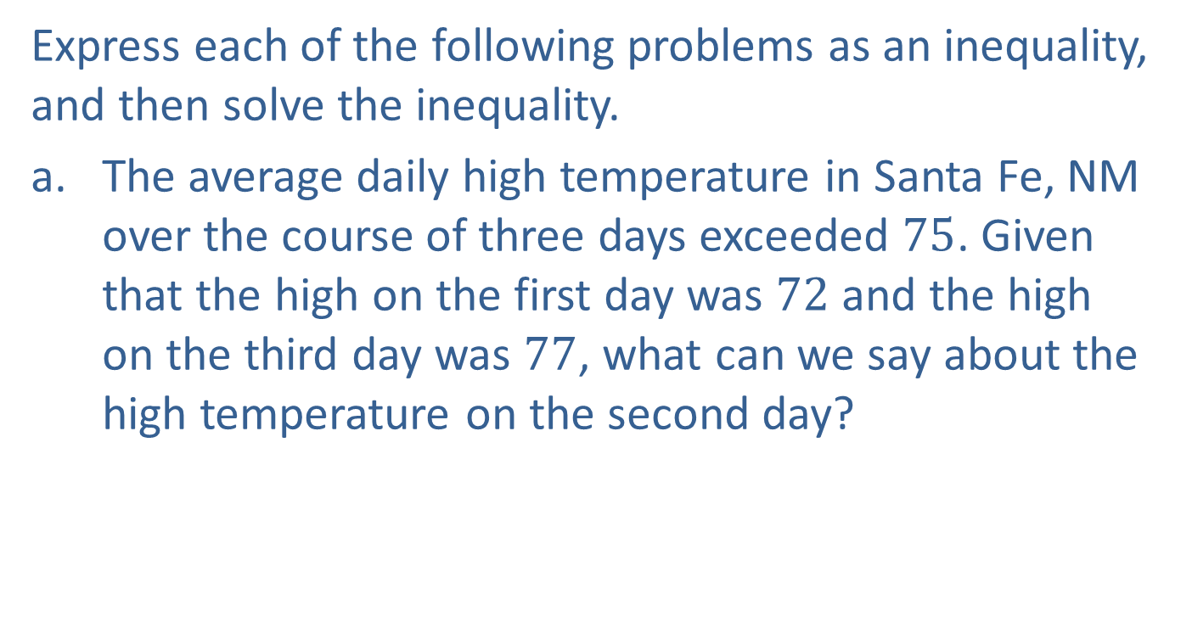
Example 8: Applications of Inequalities
Express each of the following problems as an inequality, and then solve the inequality.
The average daily high temperature in Santa Fe, NM over the course of three days exceeded $75$. Given that the high on the first day was $72$ and the high on the third day was $77$, what can we say about the high temperature on the second day?

Slide 30
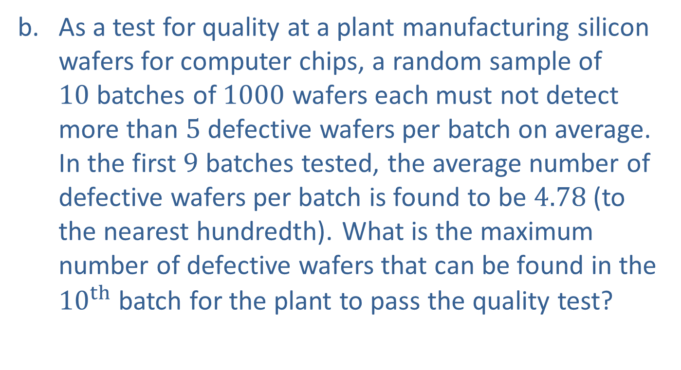
Example 8: Applications of Inequalities (cont.)
As a test for quality at a plant manufacturing silicon wafers for computer chips, a random sample of $10$ batches of $1000$ wafers each must not detect more than $5$ defective wafers per batch on average. In the first $9$ batches tested, the average number of defective wafers per batch is found to be $4.78$ (to the nearest hundredth). What is the maximum number of defective wafers that can be found in the ${10}^{th}$ batch for the plant to pass the quality test?

Slide 31
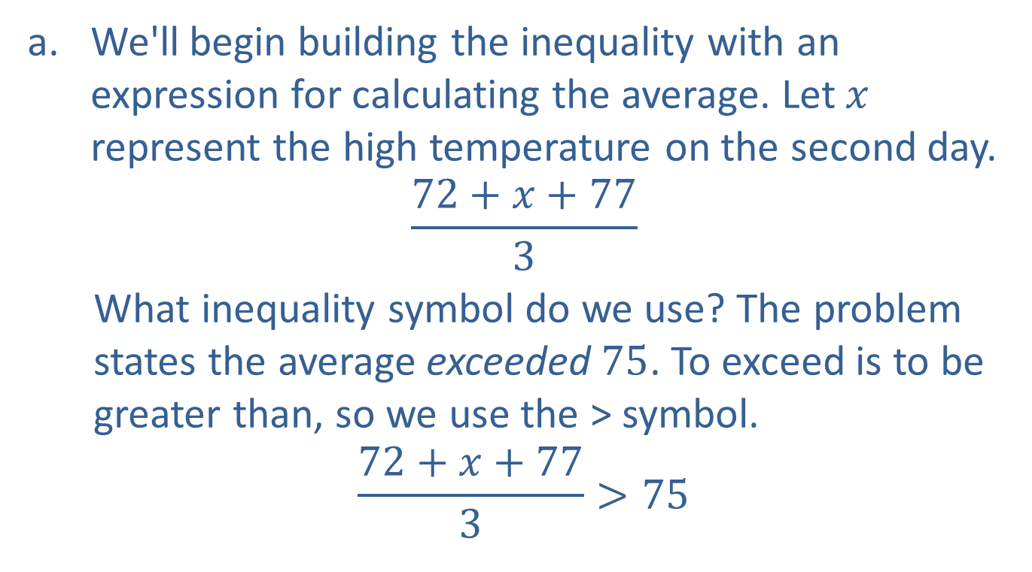
Example 8: Applications of Inequalities (cont.)
We'll begin building the inequality with an expression for calculating the average. Let $x$ represent the high temperature on the second day.
$$\frac{72+x+77}{3}$$
What inequality symbol do we use? The problem states the average exceeded $75$. To exceed is to be greater than, so we use the > symbol.
$$\frac{72+x+77}{3}>75$$

Slide 32
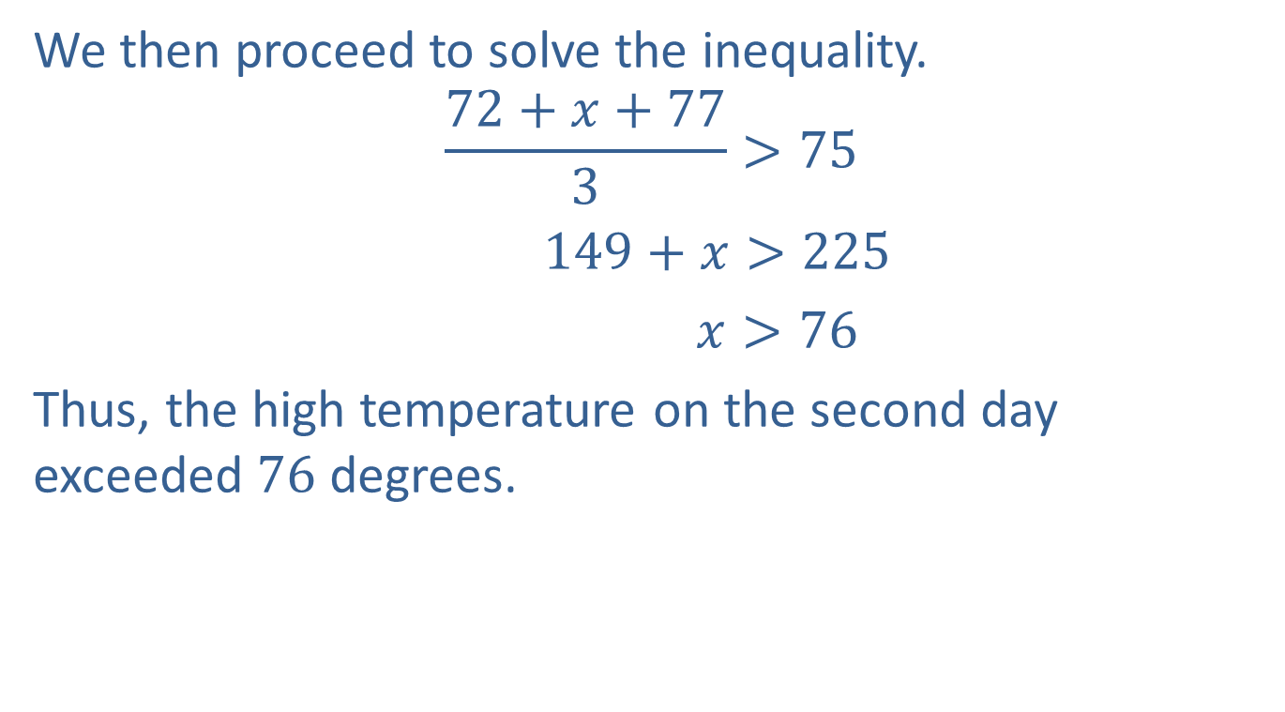
Example 8: Applications of Inequalities (cont.)
We then proceed to solve the inequality.
$$\frac{72+x+77}{3}>75$$
$149+x>225$
$x>76$
Thus, the high temperature on the second day exceeded $76$ degrees.

Slide 33
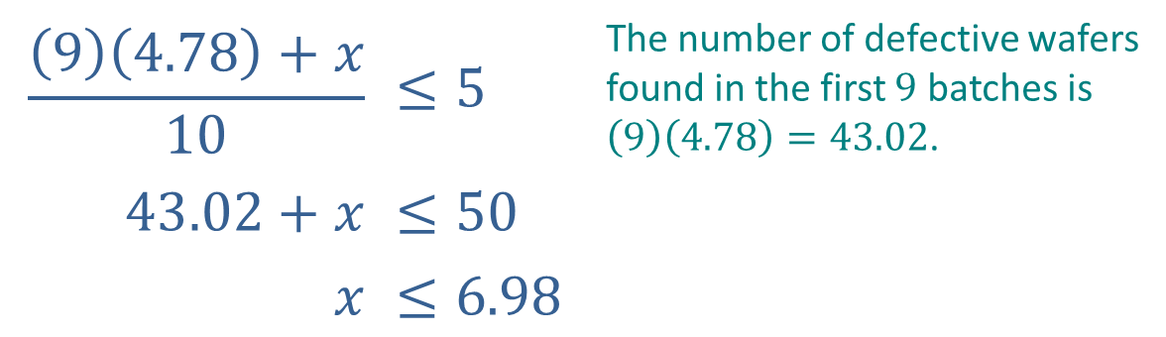

Example 8: Applications of Inequalities (cont.)
The phrase "must not detect more than $5$ defective wafers per batch on average" means the average number must be less than or equal to $5$. Let $x$ denote the maximum number of defective wafers in the last batch.
$$\frac{\left(9\right)\left(4.78\right)+x}{10}$$ | $$≤5$$ | The number of defective wafers found in the first $9$ batches is $\left(9\right)\left(4.78\right)=43.02$.
$$43.02+x$$ | $$≤50$$
$$x$$ | $$≤6.98$$

Slide 34

Example 8: Applications of Inequalities (cont.)
Since it is not possible to have a fractional number of wafers, there must have been $43$ defective wafers in the first $9$ batches, so the maximum allowable number of defective wafers in the final batch is $7$.

