Slide 1
Section 1.4
Quadratic Equations in One Variable

Slide 2
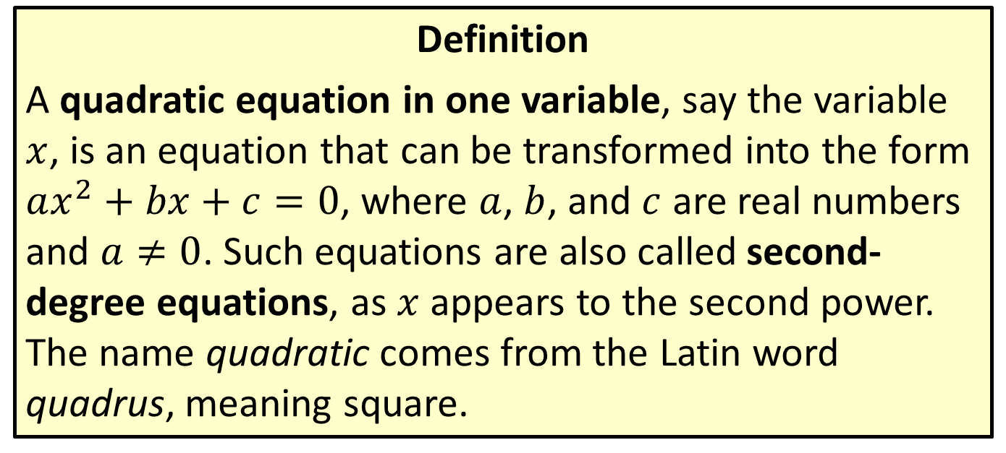
Quadratic Equations
Definition
A quadratic equation in one variable, say the variable $x$, is an equation that can be transformed into the form $ax^{2}+bx+c=0$, where $a$, $b$, and $c$ are real numbers and $a≠0$. Such equations are also called second-degree equations, as $x$ appears to the second power. The name quadratic comes from the Latin word quadrus, meaning square.

Slide 3
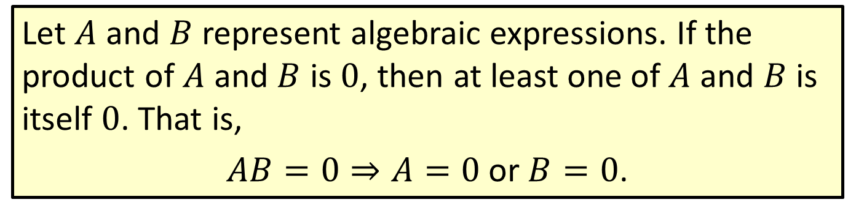
Zero-Factor Property
Let $A$ and $B$ represent algebraic expressions. If the product of $A$ and $B$ is 0, then at least one of $A$ and $B$ is itself 0. That is,
$AB=0⇒A=0 \text{or} B=0$.

Slide 4

Example 1: Solving Quadratic Equations by Factoring
Solve the following quadratic equations by factoring.
​$x^{2}+\frac{11x}{3}=\frac{4}{3}$
​
​

Slide 5
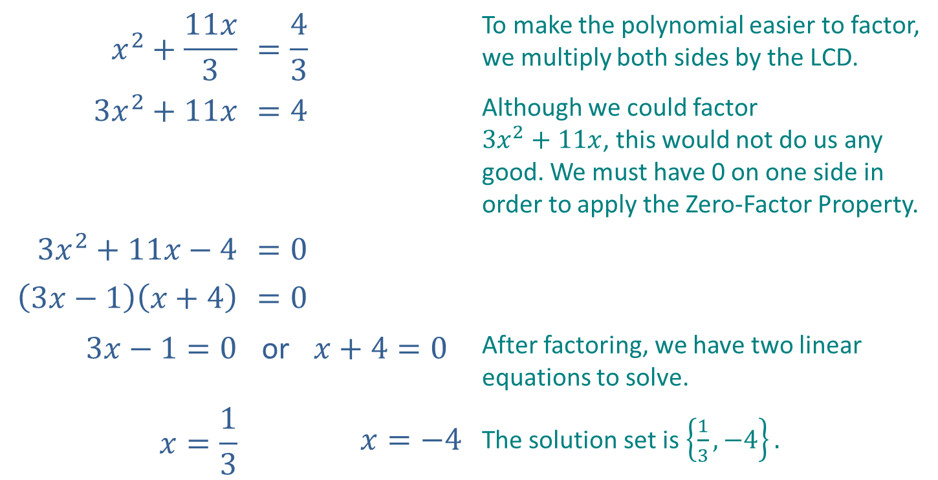
Example 1: Solving Quadratic Equations by Factoring (cont.)
Solution
$$x^{2}+\frac{11x}{3}$$ | $$=\frac{4}{3}$$ |  | To make the polynomial easier to factor, we multiply both sides by the LCD.
$$3x^{2}+11x$$ | $$=4$$ |  | Although we could factor $3x^{2}+11x$, this would not do us any good. We must have 0 on one side in order to apply the Zero-Factor Property.
$${3x}^{2}+11x−4$$ | $$=0$$
$$\left(3x−1\right)\left(x+4\right)$$ | $$=0$$
$$3x−1=0$$ | or | $x+4=0$ | After factoring, we have two linear equations to solve.
$$x=\frac{1}{3}$$ |  | $$x=−4$$ | The solution set is $\left\{\frac{1}{3},−4\right\}.$

Slide 6

Example 1: Solving Quadratic Equations by Factoring (cont.)
​$s^{2}+25=10s$
​

Slide 7
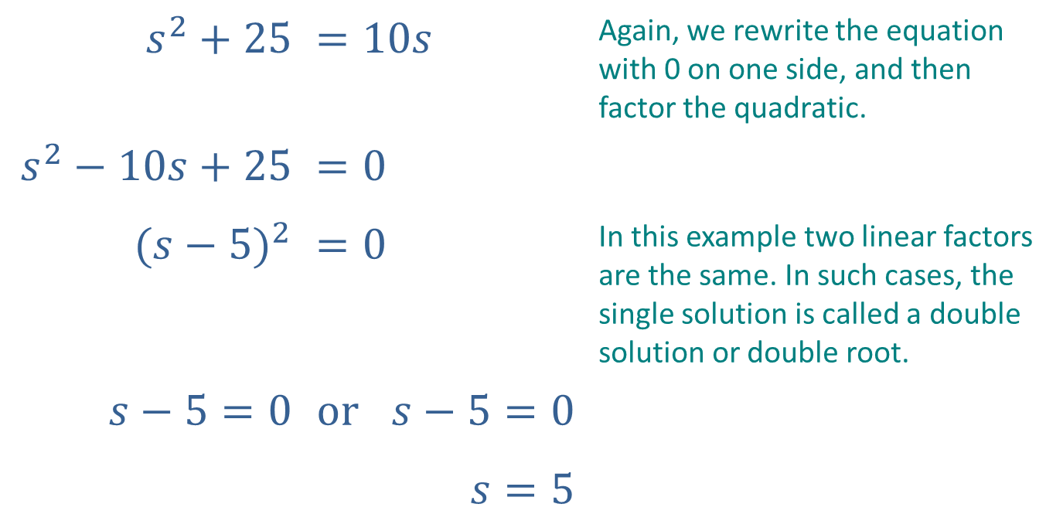
Example 1: Solving Quadratic Equations by Factoring (cont.)
Solution
$$s^{2}+25$$ | $$=10s$$ |  | Again, we rewrite the equation with 0 on one side, and then factor the quadratic.
$$s^{2}−10s+25$$ | $$=0$$
$${(s−5)}^{2}$$ | $$=0$$ |  | In this example two linear factors are the same. In such cases, the single solution is called a double solution or double root.
$$s−5=0$$ | $$or$$ | $$s−5=0$$
 |  | $$s=5$$

Slide 8

Example 1: Solving Quadratic Equations by Factoring (cont.)
​$4x^{2}+28x=0$
​

Slide 9
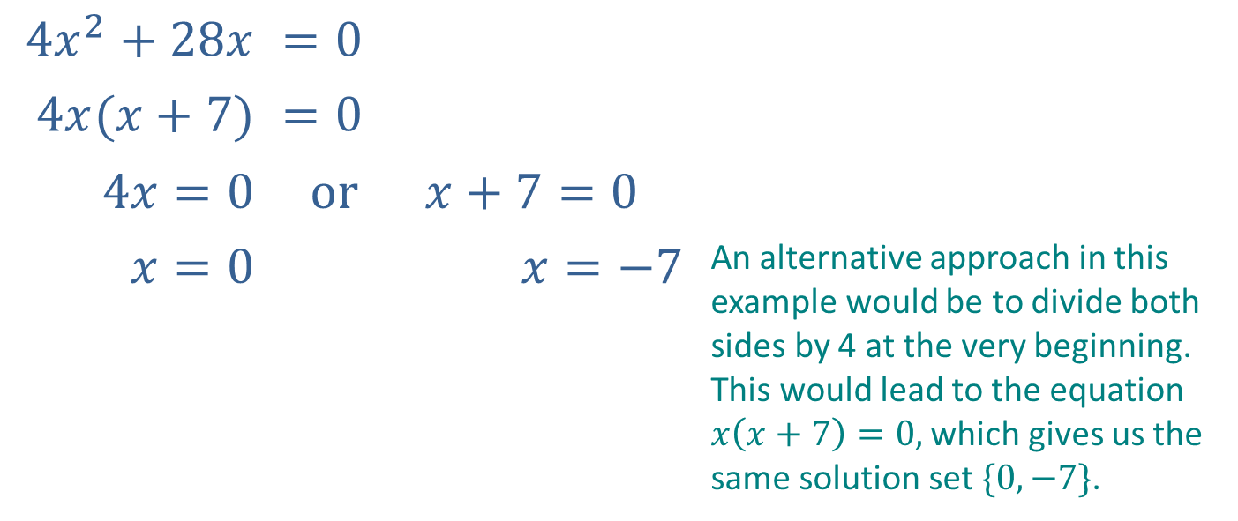
Example 1: Solving Quadratic Equations by Factoring (cont.)
​Solution
$$4x^{2}+28x$$ | $$=0$$
$$4x(x+7)$$ | $$=0$$
$$4x=0$$ | $$or$$ | $$x+7=0$$
$$x=0$$ |  | $$x=−7$$ | An alternative approach in this example would be to divide both sides by 4 at the very beginning. This would lead to the equation $x\left(x+7\right)=0,$ which gives us the same solution set $\{0,−7\}$.

Slide 10

Example 2: "Perfect Square" Quadratic Equations
Solve the following quadratic equations by taking square roots.
​${\left(2x+5\right)}^{2}=12$
​
​

Slide 11
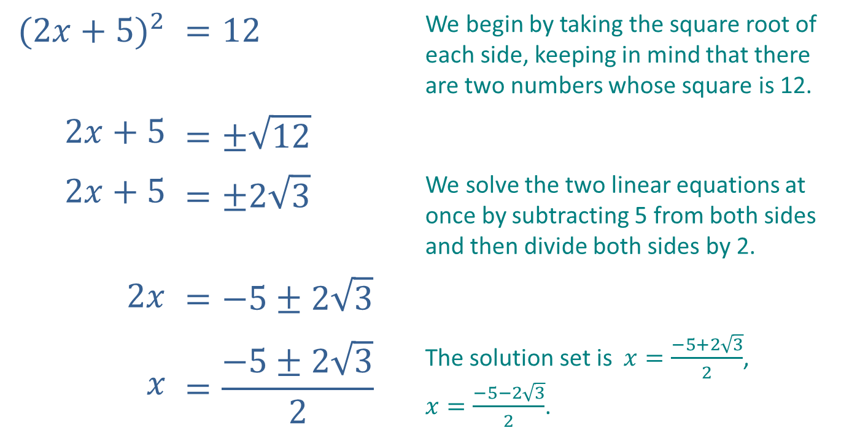
Example 2: "Perfect Square" Quadratic Equations (cont.)
Solution
$${(2x+5)}^{2}$$ | $$=12$$ | We begin by taking the square root of each side, keeping in mind that there are two numbers whose square is 12.
$$2x+5$$ | $$=±\sqrt{12}$$
$$2x+5$$ | $$=±2\sqrt{3}$$ | We solve the two linear equations at once by subtracting 5 from both sides and then divide both sides by 2.
$$2x$$ | $$=−5±2\sqrt{3}$$
$$x$$ | $$=\frac{−5±2\sqrt{3}}{2}$$ | The solution set is$x=\frac{−5+2\sqrt{3}}{2}$, $x=\frac{−5−2\sqrt{3}}{2}$.

Slide 12

Example 2: "Perfect Square" Quadratic Equations (cont.)
​${\left(x−6\right)}^{2}−7=0$
​
​

Slide 13
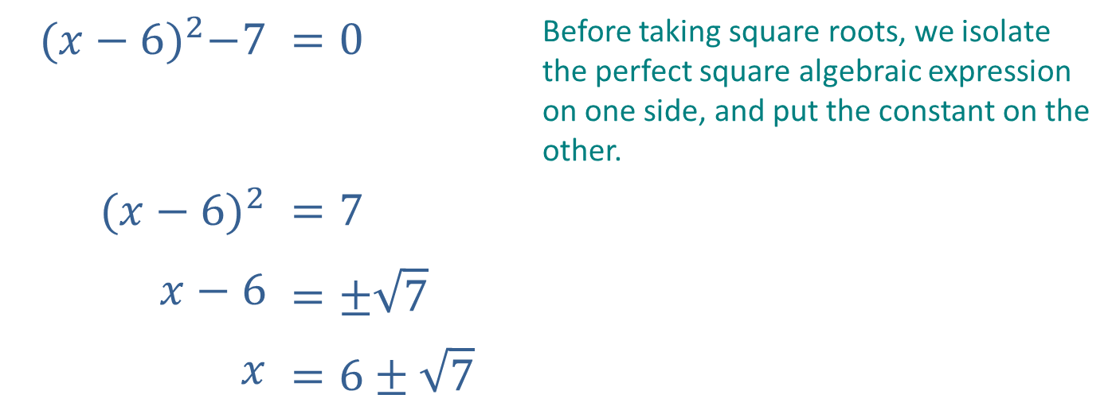
Example 2: "Perfect Square" Quadratic Equations (cont.)
Solution
$${(x−6)}^{2}−7$$ | $$=0$$ | Before taking square roots, we isolate the perfect square algebraic expression on one side, and put the constant on the other.
$${(x−6)}^{2}$$ | $$=7$$
$$x−6$$ | $$=±\sqrt{7}$$
$$x$$ | $$=6±\sqrt{7}$$

Slide 14
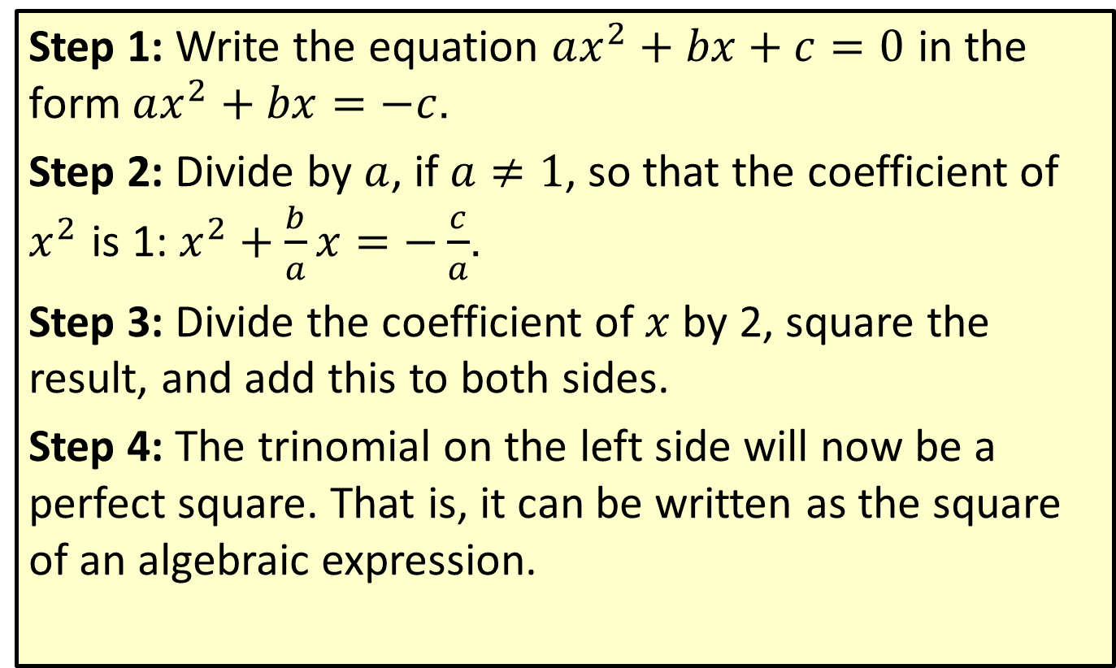
Method of Completing the Square
Step 1: Write the equation $ax^{2}+bx+c=0$ in the form $ax^{2}+bx=−c$.
Step 2: Divide by $a$, if $a≠1$, so that the coefficient of $x^{2}$ is 1: $x^{2}+\frac{b}{a}x=−\frac{c}{a}$.
Step 3: Divide the coefficient of $x$ by 2, square the result, and add this to both sides.
Step 4: The trinomial on the left side will now be a perfect square. That is, it can be written as the square of an algebraic expression.

Slide 15

Example 3: Completing the Square
Solve the following quadratic equations by completing the square.
​$x^{2}−6x−2=0$
​

Slide 16
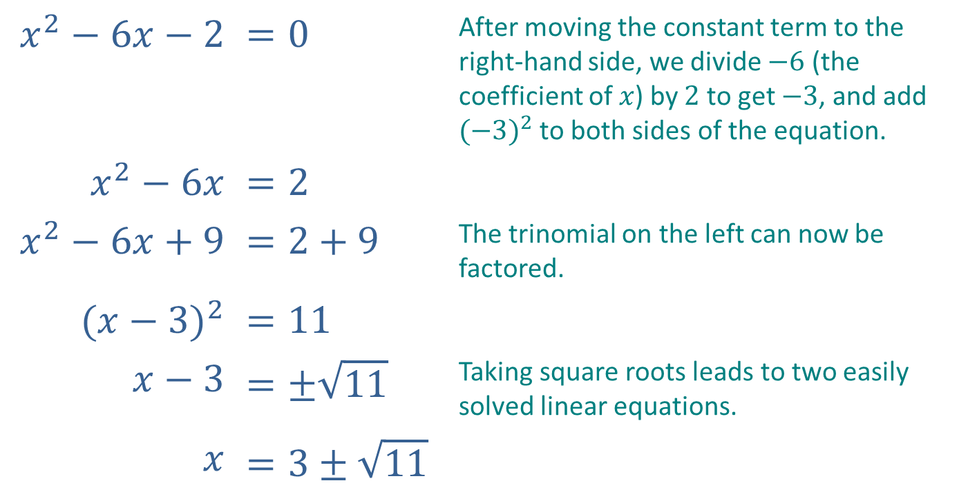
Example 3: Completing the Square (cont.)
Solution
$$x^{2}−6x−2$$ | $$=0$$ | After moving the constant term to the right-hand side, we divide $−6$ (the coefficient of $x$) by $2$ to get $−3$, and add ${(−3)}^{2}$ to both sides of the equation.
$$x^{2}−6x$$ | $$=2$$
$$x^{2}−6x+9$$ | $$=2+9$$ | The trinomial on the left can now be factored.
$${(x−3)}^{2}$$ | $$=11$$
$$x−3$$ | $$=±\sqrt{11}$$ | Taking square roots leads to two easily solved linear equations.
$$x$$ | $$=3±\sqrt{11}$$

Slide 17

Example 3: Completing the Square (cont.)
​$25x^{2}+5x=6$
​​

Slide 18
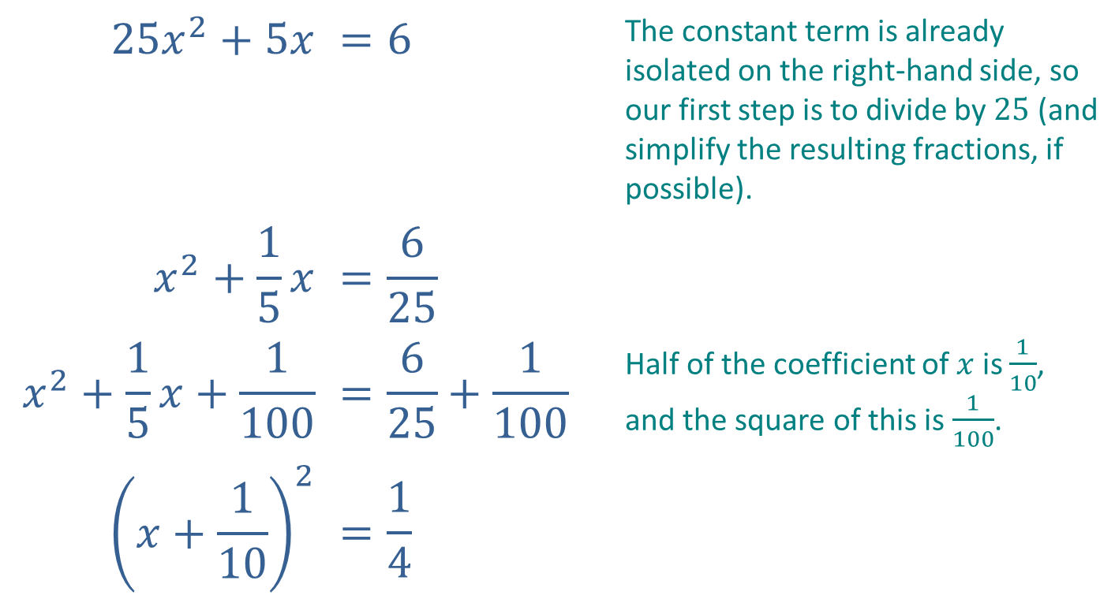
Example 3: Completing the Square (cont.)
Solution
$$25x^{2}+5x$$ | $$=6$$ | The constant term is already isolated on the right-hand side, so our first step is to divide by $25$ (and simplify the resulting fractions, if possible).
$$x^{2}+\frac{1}{5}x$$ | $$=\frac{6}{25}$$
$$x^{2}+\frac{1}{5}x+\frac{1}{100}$$ | $$=\frac{6}{25}+\frac{1}{100}$$ | Half of the coefficient of $x$ is $\frac{1}{10}$, and the square of this is $\frac{1}{100}$.
$${\left(x+\frac{1}{10}\right)}^{2}$$ | $$=\frac{1}{4}$$

Slide 19
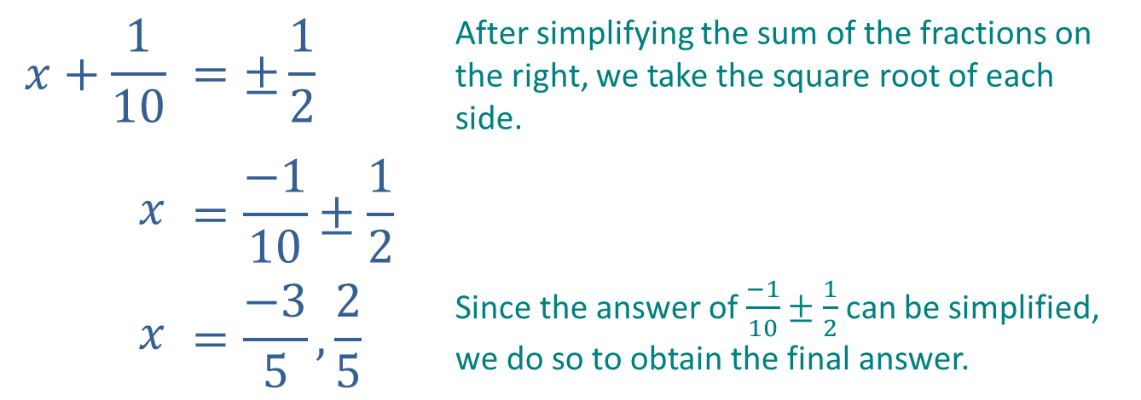
Example 3: Completing the Square (cont.)
Solution
$$x+\frac{1}{10}$$ | $$=±\frac{1}{2}$$ | After simplifying the sum of the fractions on the right, we take the square root of each side.
$$x$$ | $$=\frac{−1}{10}±\frac{1}{2}$$
$$x$$ | $$=\frac{−3}{5}, \frac{2}{5}$$ | Since the answer of $\frac{−1}{10}±\frac{1}{2}$ can be simplified, we do so to obtain the final answer.

Slide 20
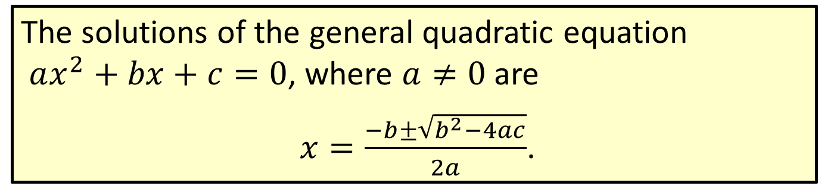
The Quadratic Formula
The solutions of the general quadratic equation $ax^{2}+bx+c=0$, where $a≠0$ are
$x=\frac{−b±\sqrt{b^{2}−4ac}}{2a}$.

Slide 21

Example 4: The Quadratic Formula
Solve the following quadratic equations by using the quadratic formula.
​$6y^{2}−5y=1$
​
​

Slide 22
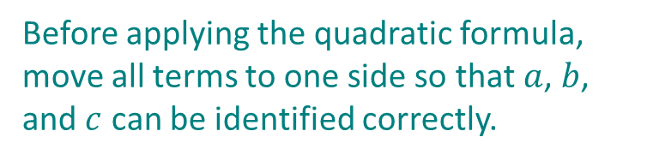
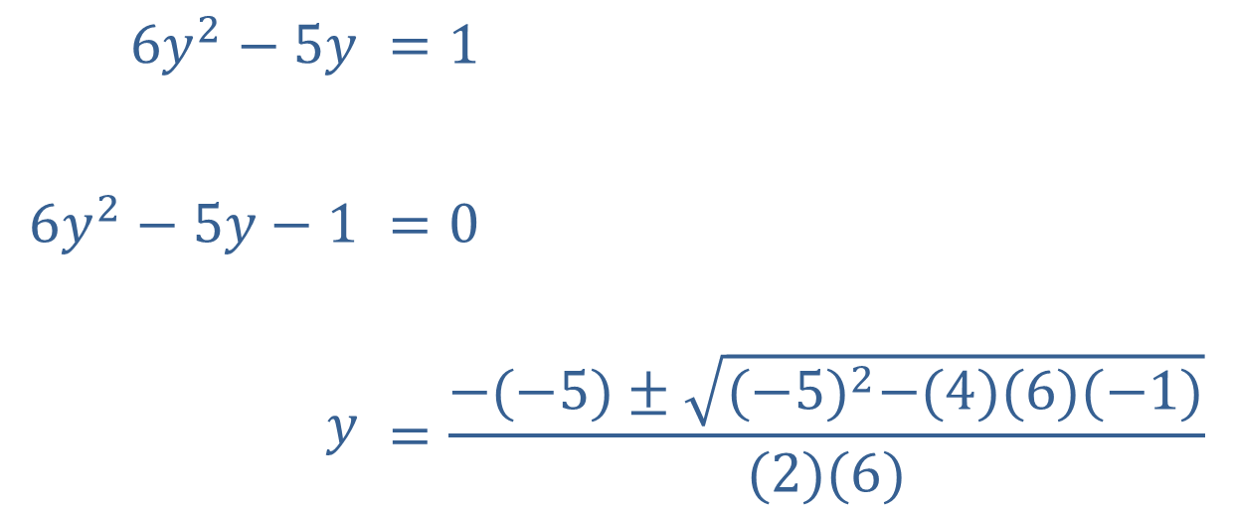
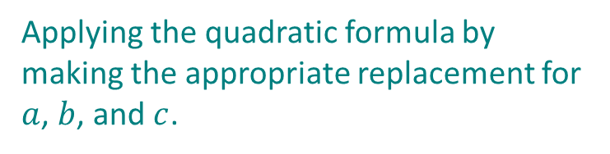
Example 4: The Quadratic Formula (cont.)
Solution
$$6y^{2}−5y$$ | $$=1$$
$$6y^{2}−5y−1$$ | $$=0$$
$$y$$ | $$=\frac{−(−5)±\sqrt{{(−5)}^{2}−(4)(6)(−1)}}{(2)(6)}$$
Before applying the quadratic formula, move all terms to one side so that $a$, $b$, and $c$ can be identified correctly.
Applying the quadratic formula by making the appropriate replacement for $a$, $b$, and $c$.

Slide 23
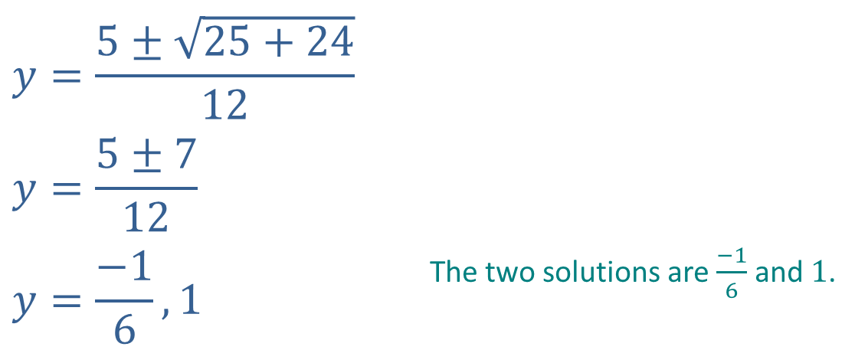
Example 4: The Quadratic Formula (cont.)
$$y=\frac{5±\sqrt{25+24}}{12}$$
$$y=\frac{5±7}{12}$$
$$y=\frac{−1}{6},1$$ | The two solutions are $\frac{−1}{6}$ and $1$.

Slide 24

Example 4: The Quadratic Formula (cont.)
​$t^{2}+8t−12=0$
​
​

Slide 25
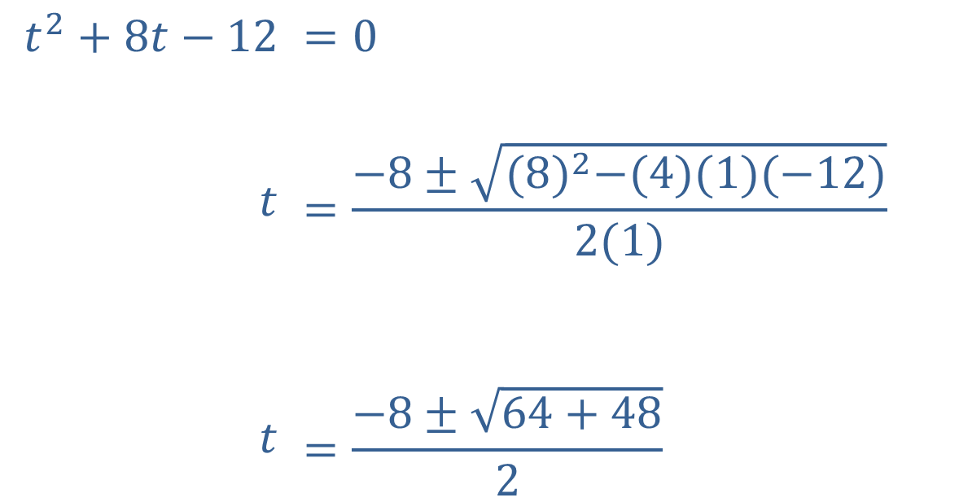
Example 4: The Quadratic Formula (cont.)
Solution
The equation is already in the proper form to apply the quadratic formula.
$$t^{2}+8t−12$$ | $$=0$$
$$t$$ | $$=\frac{−8±\sqrt{{(8)}^{2}−(4)(1)(−12)}}{2(1)}$$
$$t$$ | $$=\frac{−8±\sqrt{64+48}}{2}$$

Slide 26
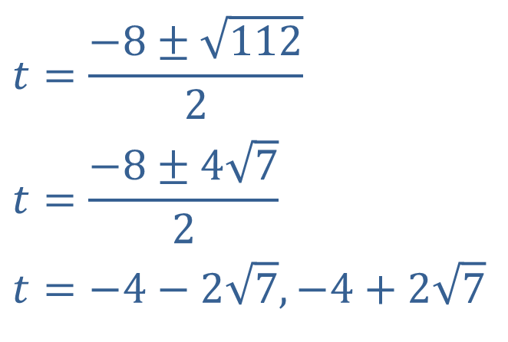
Example 4: The Quadratic Formula (cont.)
Solution
$$t=\frac{−8±\sqrt{112}}{2}$$
$$t=\frac{−8±4\sqrt{7}}{2}$$
$$t=−4−2\sqrt{7},−4+2\sqrt{7}$$

