Slide 1
Section 10.2
Limits

Slide 2
Objectives
Determine if a limit of a function exists as x approaches a real number a.

Slide 3
Limits
Limit Defined Informally
If the values of f(x) get closer and closer to some number L as values of x that are smaller than some number t and values of x that are larger than t get closer and closer to t (but not equal to t), then L is the limit of f(x) as x approaches t.

Slide 4
Limits
Limit Defined Symbolically
For a function f and a real number t, if
where L is a real number, then

Slide 5
Limits
Existence of a Limit
1. We say that the limit of a function f as x approaches a real number t exists if and only if where L is a real number.
2. If does not exist
3. If
does not exist.

Slide 6
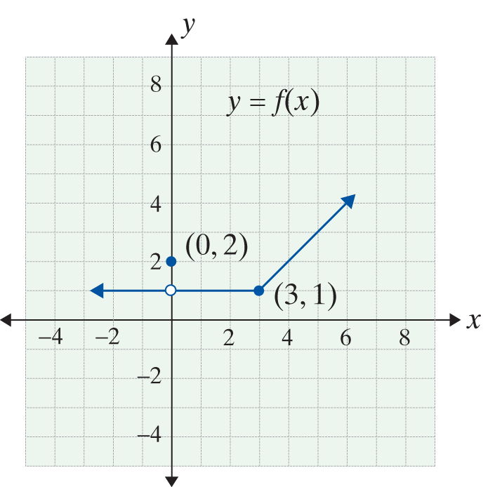
Example 1: Finding a Limit Using a Graph
Use the graph of y = f(x) in the figure to find

Slide 7
Example 1: Finding a Limit Using a Graph (cont.)
Solutions:
a. We see that
Therefore,
b. We see that
So, even though f(0) = 2,

Slide 8
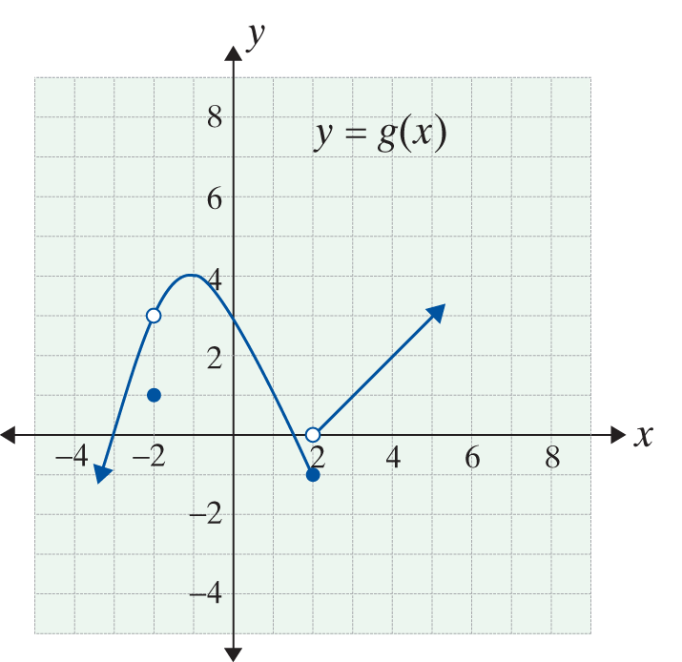
Example 2: Finding a Limit Using a Graph
Use the graph of y = g(x) in the figure to find
if the limits exist.

Slide 9
Example 2: Finding a Limit Using a Graph (cont.)
Solutions:

Slide 10
Example 3: Finding Limits Algebraically
a. Determine by using an
algebraically equivalent expression.
Solution:
We first factor the numerator and
simplify the fraction:
The numerical approach, with a table of x-values converging to 2, suggests a limit exists.

Slide 11
Example 3: Finding Limits Algebraically (cont.)
Since, for any number x (where x ≠ 2), the fractions
and 10(x + 2) will be equal, we may replace the given expression with the simplified one. Thus

Slide 12
Example 3: Finding Limits Algebraically (cont.)
b. Determine algebraically.
Solution: We factor the numerator:
The numerator is a difference of two cubes: that can be factored into

Slide 13
Example 3: Finding Limits Algebraically (cont.)
Then the given limit, if it exists, is equivalent to
However, the numerator does not
have a limit of zero, but the limit of the denominator is zero. Thus the limit fails to exist.

Slide 14
Example 3: Finding Limits Algebraically (cont.)
c. Determine algebraically.
Solution: We factor first:

Slide 15
Indeterminate Forms and Algebraic Solutions
Indeterminate Form
A limit expression of the type is called an
indeterminate form of type if and

