Slide 1
Section 10.4
Continuity

Slide 2
Objectives
Categorize types of discontinuities.
Identify continuous functions.

Slide 3
Continuity
Continuity
A function y = f(x) is continuous at x = a if all of the following conditions are true:
1. f(a) exists. (f(a) is a real number.)
2. (The limit is a real number.)
3. (The limit is equal to the value of the function at x = a.)

Slide 4
Continuity
Continuity (cont.)
If a function fails to satisfy any one of the three conditions of the definition, then it is not continuous at x = a and is said to be discontinuous at x = a.

Slide 5
Example 1: Continuity
Use the definition of continuity to determine whether
the function is continuous at a. x = 2, and b. x = 3.
Solutions:
a.
Thus f (2) exists, and Condition 1 of the definition is met.
Check Condition 1 by substituting x = 2.

Slide 6
Example 1: Continuity (cont.)
Since all three conditions are met, f(x) is continuous at x = 2.
Check Condition 2 by finding the limit at
x = 2.
The limit exists, so Condition 2 of the definition is met.
Check Condition 3 by seeing if Conditions 1 and 2 equal one another.

Slide 7
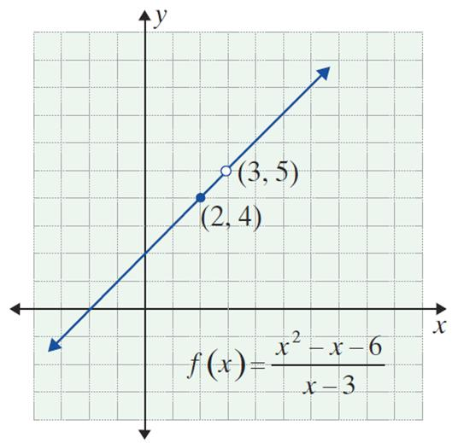
Example 1: Continuity (cont.)
Since is undefined,
f (x) is not continuous at x = 3.
The graph to the right shows a
missing point discontinuity at
x = 3.
Check Condition 1 by substituting x = 3.

Slide 8
Example 2: Graphing a Discontinuous Function
a. Use the definition of continuity to determine
whether the function continuous at x = 0.
Solution: Since is undefined, g is not
continuous at x = 0.
b. Draw the graph of g(x).
Solution: The graph can be found by using the definition of | x | (see Section 1.1) and rewriting the function as follows:

Slide 9
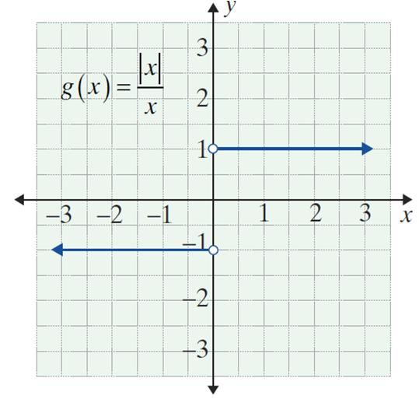
Example 2: Graphing a Discontinuous Function (cont.)
The graph shows that g(x) has a jump discontinuity at x = 0.

Slide 10
Continuity
NOTES
Analysis shows, polynomial functions have no points of discontinuity. That is, for a polynomial function p,
for every real number a.

Slide 11
Continuity
Greatest-Integer Function
The function h(x) = [x] is called the greatest-integer function and is defined as follows:
h(x) = [x] = the greatest integer ≤ x.
Informally, h(x) = [x] is the integer closest to x but still less than or equal to x.

Slide 12
Example 3: Making a Function Continuous
Find a value for k so that the function
will be continuous at x = 2.
Solution:
f is defined in pieces, and each piece is a polynomial function. We must determine a value for k so that both pieces will have the same value when x = 2.

Slide 13
Example 3: Making a Function Continuous (cont.)
Set x² = −3x + k and substitute x = 2:
Thus the function f is continuous at x = 2.

Slide 14
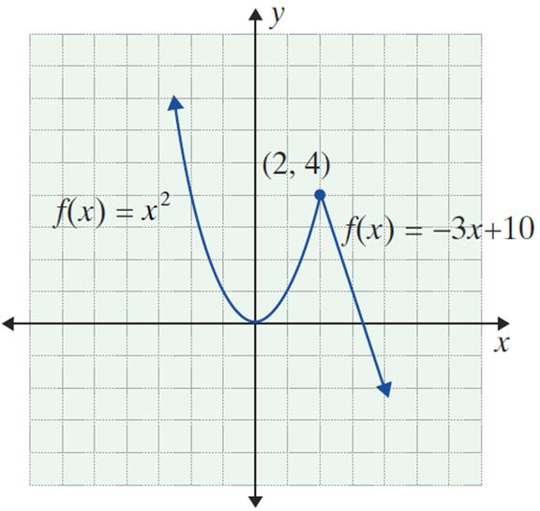
Example 3: Making a Function Continuous (cont.)
Graphically, we see that the two pieces “fit” together at the point (2, 4).

