Slide 1
Section 10.5
Average Rates of Change

Slide 2
Objectives
Determine the average rate of change.

Slide 3
Average Rate of Change
Average Rate of Change
If y = f(x) then the ratio
is called the average rate of change of y with respect to x as x changes from x₁ to x₂.

Slide 4
Example 1: Finding the Average Rate of Change
For the function y = 2x + 1, find the average rate of
change of y with respect to x, as x changes from 0
to 3.
Solution:
For x₁ = 0 and x₂ = 3, the corresponding values of y are:
and

Slide 5
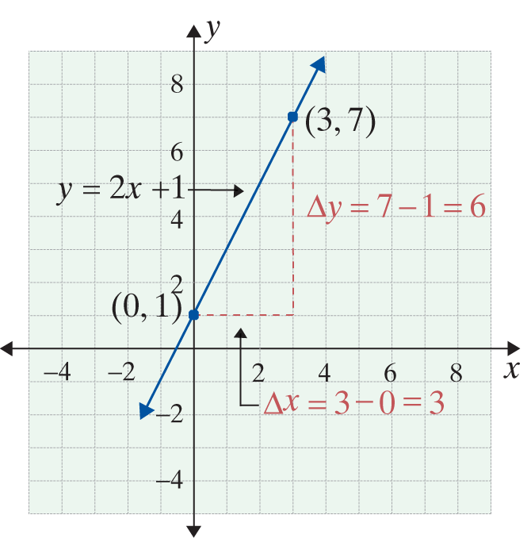
Example 1: Finding the Average Rate of Change (cont.)
Thus
and the average rate of
change is
Any other distinct choices for
x₁ and x₂ will show that
the slope of the line.

Slide 6
Example 2: Average Rate of Change
Let Find and simplify the expression that
represents the average rate of change of f between x and x + h.
Solution:
Here x₁ = x and x₂ = x + h.
Therefore,

Slide 7
Example 2: Average Rate of Change (cont.)

Slide 8
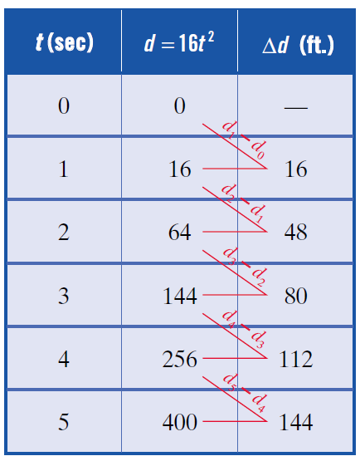
Example 3: A Falling Object
A ball is dropped from an airplane. The distance d that it falls in t seconds is given by the function d = 16t². The table shows the distance the ball falls and the change in distance Δd for 1-second time intervals during the first 5 seconds of its descent.

Slide 9
Example 3: A Falling Object (cont.)
a. How far does the ball fall during the first 3 seconds?
b. What is the average velocity of the ball during the first 3 seconds? (Velocity is the rate of change of distance with respect to time.)
c. How fast is the ball traveling when t = 3?

Slide 10
Example 3: A Falling Object (cont.)
Solutions:
c. We do not know how fast the ball is traveling when t = 3 seconds. This is a question of instantaneous velocity, which we will discuss later in this section.

