Slide 1
Section 2.3
Definition of the Derivative and the Power Rule

Slide 2
Objectives
Find derivatives of functions by using the Power Rule.

Slide 3
Slope and Rate of Change Considered Algebraically
Derivative
For any given function y = f(x), the derivative of f at x is defined to be
provided this limit exists. (Note: )

Slide 4
Slope and Rate of Change Considered Algebraically
The Three-Step Method for Finding a Derivative
1. Form the ratio called the difference
quotient.
2. Simplify the difference quotient algebraically.
3. Calculate if it exists.

Slide 5
Example 1: Finding a Derivative
Use the Three-Step Method to find
Solution:
Step 1:
Form the difference quotient.

Slide 6
Example 1: Finding a Derivative (cont.)
Step 2:
Simplify the difference quotient.

Slide 7
Example 1: Finding a Derivative (cont.)
Step 3:
Find the limit.

Slide 8
Existence of Derivatives
Conditions of a Non-Differentiable Function
A function f(x) is not differentiable at x = a if any of the following is true:
1. f(x) is discontinuous at x = a.
2. The graph of f(x) has a sharp corner at x = a.
3. The tangent line at x = a is a vertical line.

Slide 9
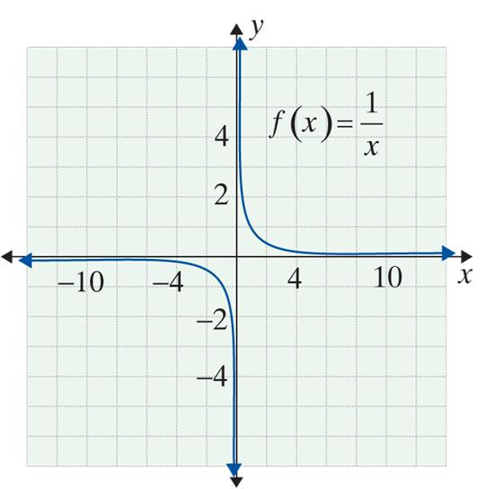
Example 2: Non-Differentiable Functions
a. is not defined at
x = 0. Thus there cannot be a tangent line at x = 0 and similarly the limit does not exist.

Slide 10
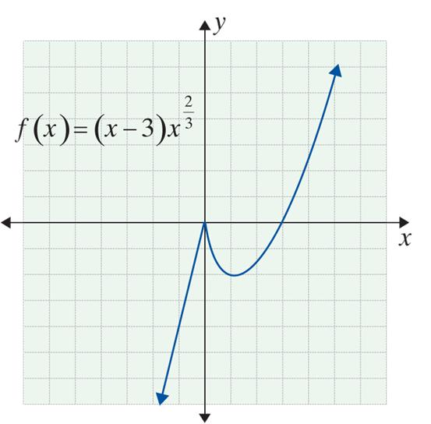
Example 2: Non-Differentiable Functions (cont.)
b. has a sharp point at x = 0, and so is not differentiable at x = 0.
Note: the limit of a set of secant lines from the right of x = 0 will have negative slope, but from the left, the limit will have positive slope.

Slide 11
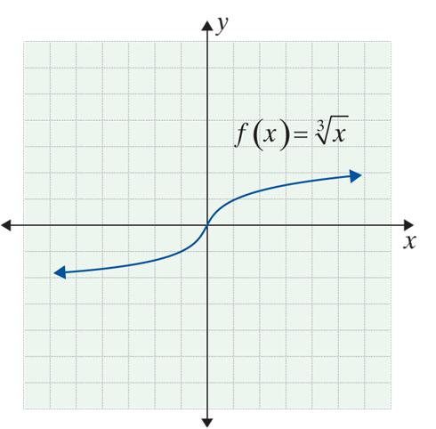
Example 2: Non-Differentiable Functions (cont.)
c. has a vertical
tangent at x = 0. Since
vertical lines have no slope,
f ′(0) is not defined.
For this function, f ′(x) exists at every point except for x = 0. In general, the functions usually studied in introductory and intermediate algebra or college algebra are “well‑behaved” from the calculus point of view. They usually are differentiable except at obvious points.

Slide 12
The Power Rule
Continuity at x = a
The function f is continuous at x = a if and only if

Slide 13
The Power Rule
Note
Informally, continuous functions can be drawn without lifting one’s pencil from the paper. Every differentiable function is continuous, but not every continuous function is differentiable (see Example 2b). Put another way, differentiability is a more restrictive condition − it requires that a function be both continuous, smooth, and without vertical tangents.

Slide 14
The Power Rule
Continuous Function on an Interval
A function f is continuous on an interval (x₁, x₂) provided the function is continuous at x = a for every number a with x₁ < a < x₂.

Slide 15
Example 3: Using the Definition of Derivative
Use the definition of derivative to find
Solution:
Step 1:
Form the difference quotient,
Here we begin with the two points (x, f(x)) and
(x + h, f(x + h)).

Slide 16
Example 3: Using the Definition of Derivative (cont.)
Inserting these expressions into the difference quotient, we get:

Slide 17
Example 3: Using the Definition of Derivative (cont.)
Step 2: Simplify the difference quotient.

Slide 18
Example 3: Using the Definition of Derivative (cont.)
Step 3: Compute or determine the limit as h → 0.
It is easy to see that, at any point on the line y = x, the slope is 1. We now put several results in a table and we see a pattern:
y | y′
x | 1
x² | 2x
x³ | 3x²

Slide 19
Example 3: Using the Definition of Derivative (cont.)
The pattern suggests that if f(x) = x⁴, then f ′(x) = 4x³. This is exactly what happens for y = x⁴. Similarly, if y = x⁵, then y′= 5x⁴. We are now able to state one of the most useful and striking formulas in mathematics.

Slide 20
The Power Rule
The Power Rule
For the function f(x) = x^{r}, where r is any real number, then

Slide 21
The Power Rule
Basic Rule of the Derivative of a Linear Function
For y = mx + b,
y′ = m.

Slide 22
The Power Rule
Two Special Cases of the Basic Rule
1. If f(x) = c, then f ′(x) = 0. Has slope 0 (constant functions are horizontal lines).
2. If f(x) = x, then f ′(x) = 1. Has slope 1.

Slide 23
Polynomial and Polynomial-Like Functions
Polynomial Functions
A polynomial function is a function of the form
where a₀, a₁, a₂, …, a_{n} are real numbers and the exponents are positive integers.
Also, for any real number a, and
therefore, f(x) is continuous everywhere.

Slide 24
Polynomial and Polynomial-Like Functions
Power Rule (General Case)
For the function f(x) = c ⋅ x^{r}, where c and r are any real numbers,

Slide 25
Example 4: Finding the Derivatives of Functions
Find the derivative of each of the following functions.
a. f(x) = 5
Solution:
f(x) = 5 is a constant function, so f ′(x) = 0.
b. f(x) = 5x³
Solution:
This is the first special case of the Basic Rule.
Here we use the general Power Rule, where c = 5 and r = 3.

Slide 26
Example 4: Finding the Derivatives of Functions (cont.)
Solution:
We can use the Power Rule with this
polynomial-like function because is a real number.

Slide 27
Example 5: Rewriting a Fraction to Find the Derivative
Find the derivative of g(x) given that
Solution:
We first rewrite the fraction in a form with a negative exponent and then apply the Power Rule.

Slide 28
Example 6: Using Derivative Notation
Solution:
Rewrite the expression to be a polynomial-like function.
Use the Power Rule where and c = 18 to find the derivative.

