Slide 1
Section 10.8
Techniques for Finding Derivatives

Slide 2
Objectives
Apply the Constant Times a Function Rule and the Sum and Difference Rule.
Find the tangent line to a function at a given point.

Slide 3
The Sum and Difference Rule
Constant Times a Function Rule
If f(x) is a differentiable function, c is a real constant, and y = c ⋅ f(x), then
In words, the derivative of a constant times a function is the constant times the derivative of the function. (The power rule is a special case of this rule.)

Slide 4
The Sum and Difference Rule
The Sum and Difference Rule
If f(x) and g(x) are differentiable functions and y = f(x) ± g(x), then
In words, the derivative of a sum (or difference) of two functions is the sum (or difference) of their derivatives.

Slide 5
Example 1: Using the Rules
Find the derivative of each of the following functions.
a. y = 5x²
Solution:
Rewrite the equation of the derivative by pulling the constant, 5, out in front. By doing so, we have used the Constant Times a Function Rule.
Apply the Power Rule to x².

Slide 6
Example 1: Using the Rules (cont.)
b. y = −4x
Solution:
Rewrite the equation of the derivative by pulling the constant, −4, out in front. By doing so, we have used the Constant Times a Function Rule.
Apply the Power Rule to x¹.

Slide 7
Example 1: Using the Rules (cont.)
c. y = 5x² − 4x
Solution:
Notice that this function is actually the sum of the functions in Examples 7a. and 7b. Therefore, to find the derivative of this function we will use the results from 7a. and 7b.

Slide 8
Example 1: Using the Rules (cont.)
Rewrite the equation of the derivative as a sum of the two differentiable functions so we can use the rule.
Using the Sum and Difference Rule, we can take the sum of the derivatives of the functions (found in Examples 7a. and 7b.).

Slide 9
Example 1: Using the Rules (cont.)
Solution:
First, re-write using exponents. Next, use the Sum and Difference Rule to rewrite the equation of the derivative. Then apply the Constant Times a Function Rule to extract the constants.

Slide 10
Example 1: Using the Rules (cont.)
Lastly, use the Power Rule.

Slide 11
Example 2: Algebraic Manipulations
Solution:
Multiply and simplify.

Slide 12
Example 2: Algebraic Manipulations (cont.)
Use both the Sum and Difference Rule and the Constant Times a Function Rule.
Apply the Power Rule.

Slide 13
Example 2: Algebraic Manipulations (cont.)
Solution:
Simplify by first dividing each
term in the numerator by

Slide 14
Example 2: Algebraic Manipulations (cont.)
Use the Sum and Difference Rule.
Apply the Power Rule.
Or, we can factor and write the answer in fraction form with a single denominator, as shown below:

Slide 15
Example 3: Tangent Lines
For the function f(x) = 8x – x² :
a. Find the slope of the tangent lines at x = 2, x = 4, and x = 5.
b. Find the equation of the tangent lines at x = 2, x = 4, and x = 5.
c. Sketch the curve and the three tangent lines.

Slide 16
Example 3: Tangent Lines (cont.)
Solutions:
a. First, find the derivative of the function:
Then evaluate the derivative at each point to find the slope of the tangent line at that point.
At x = 2 → f ′(2) = 8 − 4 = 4.
At x = 4 → f ′(4) = 8 − 8 = 0.
At x = 5 → f ′(5) = 8 − 10 = −2.

Slide 17
Example 3: Tangent Lines (cont.)
b. To find the equation of the tangent lines at each of the points, use the point-slope formula for the equation of a line, y – y₁ = m(x – x₁). Insert each value of x into the function to find its corresponding y-value.

Slide 18
Example 3: Tangent Lines (cont.)
At x = 2 → x₁ = 2, so y₁ = f(2) = 8 ⋅ 2 – 2² = 12. From part a., we know that f ′(2) = 4 = m.
Putting this information into the point-slope formula, we get:

Slide 19
Example 3: Tangent Lines (cont.)
At x = 4 → x₁ = 4, so y₁ = f(4) = 8 ⋅ 4 – 4² = 16. From part a., we know that f ′(4) = 0 = m.
Putting this information into the point-slope formula, we get:

Slide 20
Example 3: Tangent Lines (cont.)
At x = 5 → x₁ = 5, so y₁ = f(5) = 8 ⋅ 5 – 5² = 15. From part a., we know that f ′(5) = –2 = m.
Putting this information into the point-slope formula, we get:

Slide 21
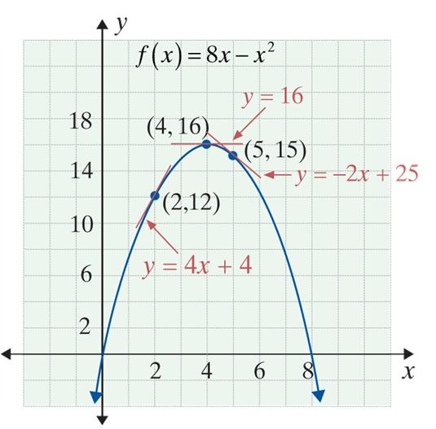
Example 3: Tangent Lines (cont.)
c. The graph is a parabola that opens downward. The vertex of the parabola occurs at (4, 16), where the tangent line has slope 0.

Slide 22
Example 4: Velocity
Suppose that a sailboat is observed, over a period of
5 minutes, to travel a distance from a starting point according to the function where t is time in minutes and s is the distance traveled in meters.
a. How fast is the boat moving at the starting point?
b. How fast is the boat moving at the end of 3 minutes?

Slide 23

Example 4: Velocity (cont.)
Solutions:
a. The velocity at time t is
The boat is at the starting point when t = 0.
b. When t = 3,

Slide 24
Example 5: Identifying Derivatives in Real-Life
Determine which of the following represent (or might represent) the value of a derivative at a point, and if so, give a suitable description of a function f.
a. 30 miles per hour. b. 6 fish per day.
c. 23 ears of corn. d. 19 neutrons per millisecond.
Solutions:
a. 30 miles per hour is a rate of change; therefore, it is a possible derivative. A suitable function is f(x) where f is the total distance from an origin and x is the time of travel.

Slide 25
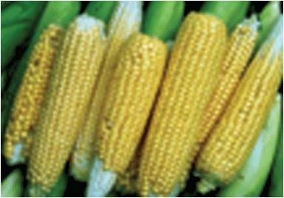
Example 5: Identifying Derivatives in
Real-Life (cont.)
b. 6 fish per day is also a rate of change, and therefore is a possible derivative. A suitable function f(x) is the total number of fish sold by a pet store during June and x is the number of days since June 1.
c. 23 ears of corn is a quantity rather than a rate. Thus it is not a derivative.

Slide 26
Example 5: Identifying Derivatives in
Real-Life (cont.)
d. 19 neutrons per millisecond is a rate of change; therefore, it is a possible derivative. A suitable function f(x) is the total number of neutrons emitted by a nuclear sample, and x is the time since the sample arrived at the college physics laboratory.

