Slide 1
Section 11.4
Increasing and Decreasing Intervals

Slide 2
Objectives
Define the increasing and decreasing intervals of a function.

Slide 3
Increasing and Decreasing Functions
Increasing and Decreasing Intervals of a Function
Suppose that a function f is defined on the interval
(a, b).
1. If implies for every in (a, b), then f(x) is increasing on (a, b).
2. If implies for every in (a, b), then f(x) is decreasing on (a, b).

Slide 4
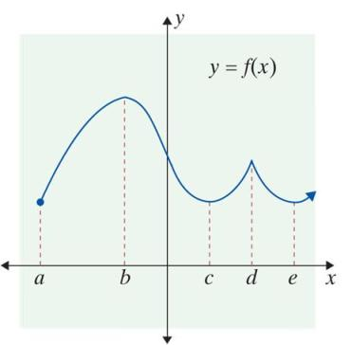
Example 1: Increasing and Decreasing Intervals
The graph of y = f(x) is given. Find the intervals on which a. f is increasing, and b. f is decreasing.
Solutions:
a. f is increasing on the intervals
(a, b), (c, d), and (e, +∞).
b. f is decreasing on the intervals
(b, c) and (d, e).

Slide 5
Increasing and Decreasing Functions
Notes
Positive values for the derivative indicate positive slopes for the tangent lines which in turn imply that the function is increasing. Negative values for the derivative indicate negative slopes for the tangent lines which imply that the function is decreasing.

Slide 6
Increasing and Decreasing Functions
Theorem
Suppose that f(x) is differentiable on the interval (a, b).
If is positive for all x in (a, b), then f is increasing on (a, b).
If is negative for all x in (a, b), then f is decreasing on (a, b).
Note: The values of x for which a function is increasing (or decreasing) are always presented as open intervals. These intervals are part (or all) of the domain of the function.

Slide 7
Example 2: Graphing a Function
For the function
a. Find all values of x that correspond to horizontal tangent lines. These values occur where the derivative is 0.
b. Use the values from part a. to find the open intervals on which the function is increasing and the open intervals on which the function is decreasing.
c. Sketch the graph of the function.

Slide 8
Example 2: Graphing a Function (cont.)
Solutions:
We set f ′(x) = 0 and solve for x:
Horizontal tangent lines occur at x = −2 and x = 2.
Find the derivative of f (x).

Slide 9
Example 2: Graphing a Function (cont.)
b. We can use a number line to help determine the intervals on which f ′(x) > 0 (and so f (x) is increasing) and those on which f ′(x) < 0 (and so f(x) is decreasing).
Mark the values for x where f ′(x) = 0 on a number line. In this case, they are x = 2 and x = −2 (this was determined in part a.). Then select any one test point in each interval and find the sign of f ′(x) at these test points by substituting the value into f ′(x).

Slide 10
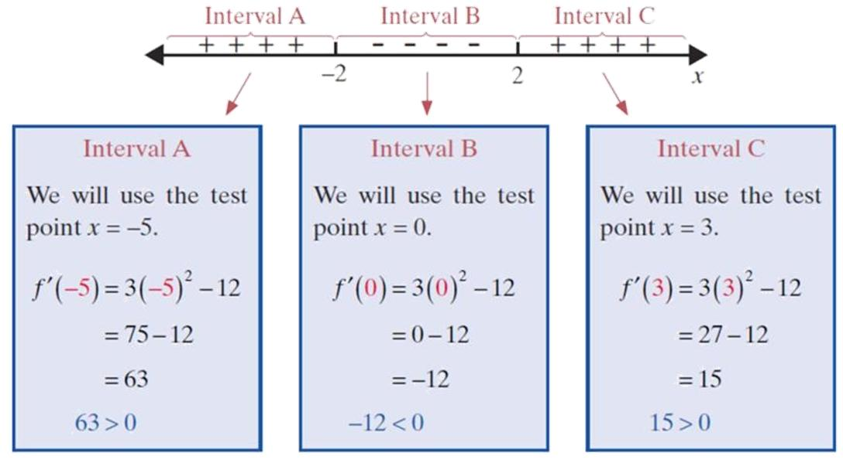
Example 2: Graphing a Function (cont.)

Slide 11
Example 2: Graphing a Function (cont.)
Since f ′(−5) is positive, mark interval A with + signs. Since f ′(0) is negative, mark interval B with − signs. Since f ′(3) is positive, mark interval C with + signs. Note that positive values for the derivative indicate that the function is increasing, and negative values for the derivative indicate that the function is decreasing.

Slide 12
Example 2: Graphing a Function (cont.)
c. The goal for the student is to use the information from parts a. and b. to sketch the curve without using a calculator. A secondary goal is to sketch the graph using as few (x, y)-coordinates as possible. We do need the important y-values corresponding to the maximum and to the minimum points (which have the horizontal tangents). We have f(−2) = 17 and f(2) = −15. We recommend in general that the student note the value of the y-intercept, f(0). Here f(0) = 1. With only these three coordinates, a smooth curve can be drawn (on one's paper).

Slide 13
Example 2: Graphing a Function (cont.)
The analysis shows that f increases left-to-right until
x = −2. At this value f reaches a local maximum of 17. Then f declines until, for x = 2, the value −15 is reached. Then f increases without bound.

Slide 14
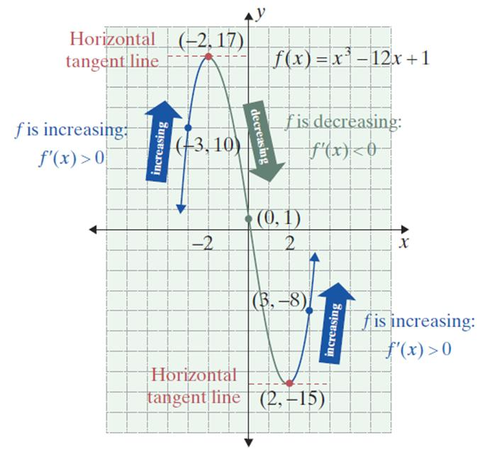
Example 2: Graphing a Function (cont.)
Notice how the pattern of the arrows from the final line graph in part
b. outlines the general shape of the curve sketched in part c.

Slide 15
Example 3: Graphing a Function
For the function
a. Find all values of x where the derivative is 0.
b. Determine where the function is increasing and where it is decreasing.
c. Sketch its graph.

Slide 16
Example 3: Graphing a Function (cont.)
Solutions:
A horizontal tangent line occurs at x = 0.

Slide 17
Example 3: Graphing a Function (cont.)
b. Mark the values for x where on a number
line. In this case, there is only one such point: x = 0 (this was determined in part a.). Select a test point
in each of the two intervals and find the sign of
at these test points by substituting the value into

Slide 18
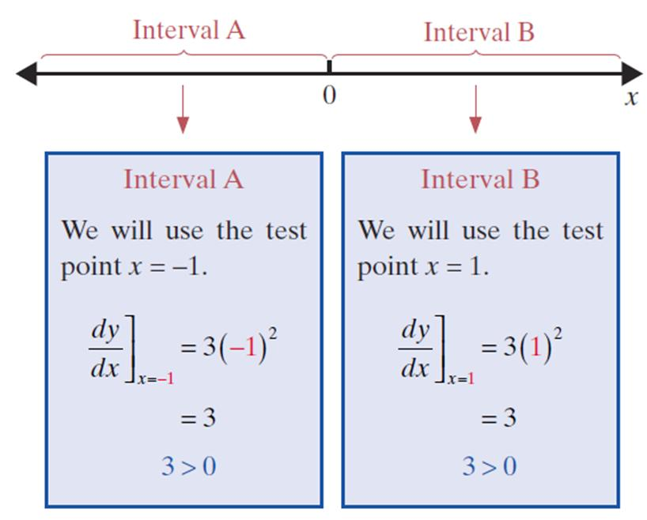
Example 3: Graphing a Function (cont.)

Slide 19
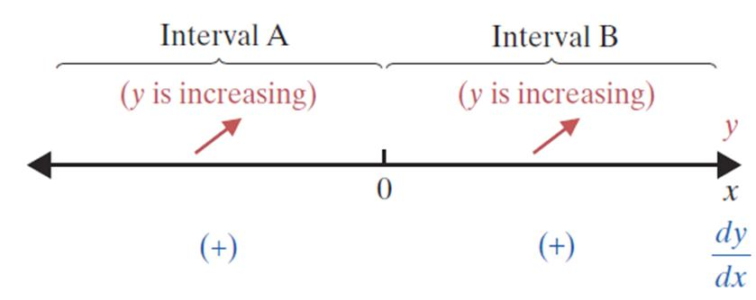
Example 3: Graphing a Function (cont.)

Slide 20
Example 3: Graphing a Function (cont.)
c. Part a. determined a horizontal tangent at x = 0, and part b. showed that y is increasing on the interval (−∞, +∞). (Note: since y is increasing on either side of 0, it is also increasing on any interval that contains 0.)

Slide 21
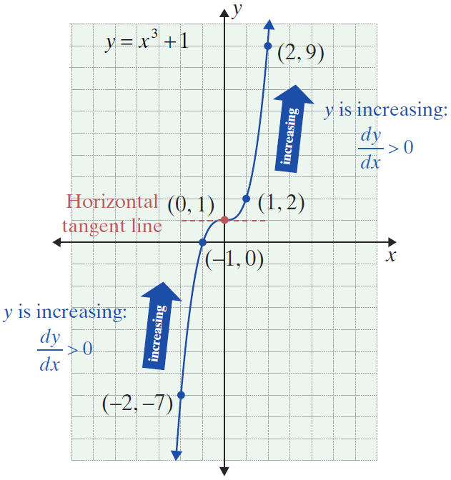
Example 3: Graphing a Function (cont.)

Slide 22
Example 4: Graphing a Function
For the function
a. Find all values of x where the derivative is 0.
b. Determine where the function is increasing and where it is decreasing.
c. Sketch its graph.
Solutions:
Rewrite f(x) using exponents.
Find the derivative of f(x).

Slide 23
Example 4: Graphing a Function (cont.)
There are no horizontal tangent lines. There are no x-values which will make the slope equal to 0 in the formula for f ′. However, we note there is no slope defined for x = 0. It turns out that we need to put on our slope analysis line not only x-values which make
f ′(x) = 0 but also any x-values for which f ′ is not defined. In this problem, x = 0 is the only point in either category, and we put x = 0 as the only point on the analysis line.

Slide 24
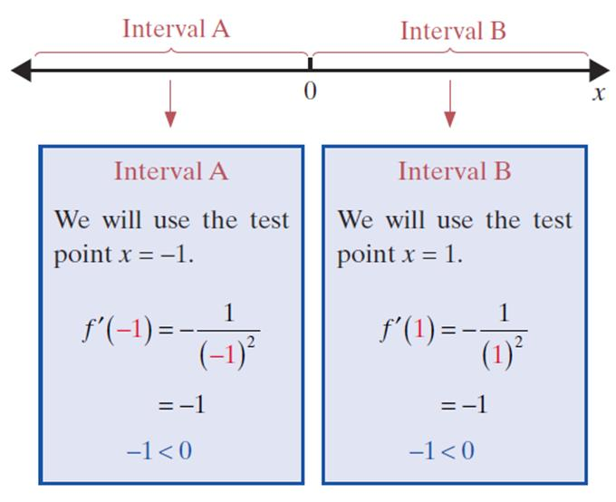
Example 4: Graphing a Function (cont.)
b. Note that we still investigate the derivative on either side of 0 to help determine the nature of the graph.

Slide 25
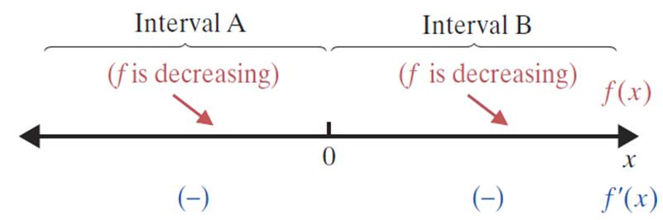
Example 4: Graphing a Function (cont.)

Slide 26
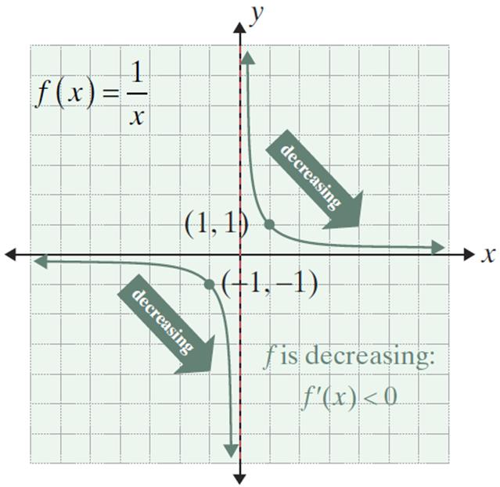
Example 4: Graphing a Function (cont.)
c.
The line x = 0 is a vertical asymptote. The curve approaches this line without touching it. There is also a horizontal asymptote at y = 0.

Slide 27
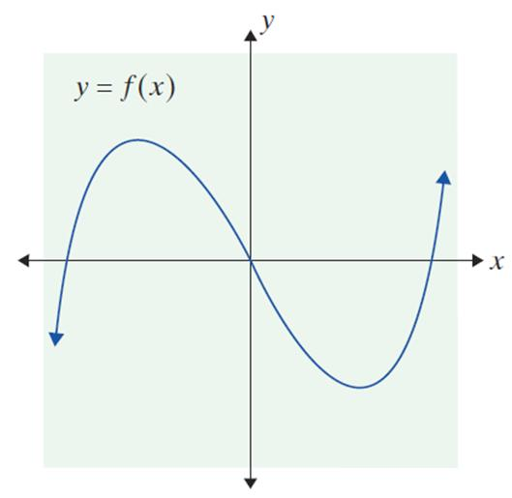
Example 5: Graphing f ’(x)
The graph for y = f(x) is given below. Mark the portions which show where f ′(x) is negative, positive, or zero. Draw a possible f ′(x) by
estimating the absolute values
of the slopes on f(x).

Slide 28
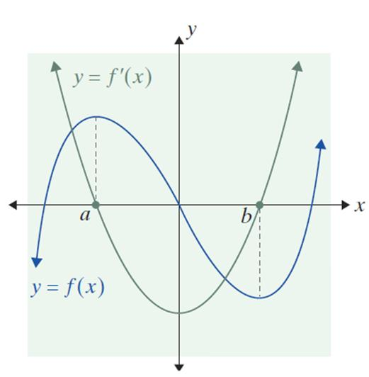
Example 5: Graphing f ’(x) (cont.)
Solution:
Let x = a and x = b (say a < b) denote the two x-values corresponding to the two
local extremes.
Then f ′(a) = f ′(b) = 0.
In between a and b, the y-values
decrease on the interval (a, b);
therefore y′ is negative. At x = b,
the y-values start to increase
(and y′ becomes positive).

Slide 29
Example 5: Graphing f ’(x) (cont.)
Thus the graph of y′ includes points (a, 0) and (b, 0) and lies below the x-axis (as y′ is negative) from x = a to
x = b. For x > b and x < a, the graph of y′ lies above the x-axis. We draw a smooth curve from (a, 0) to (b, 0) and extend it in both directions above the x-axis. The low point for y′ seems to occur near x = 0 because the graph of y is steepest near (0, 0).

