Slide 1
Section 11.5
Critical Points and the First Derivative Test

Slide 2
Objectives
Determine the critical values of a function.
Use the First Derivative Test to find local extrema of a function and use this information to sketch a graph of the function.

Slide 3
Critical Values
Local Maximum and Local Minimum
Let f be a function defined at x = c.
1. f(c) is called a local maximum (or relative maximum) if there exists some interval (a, b) that contains c such that
for all x in (a, b). (We say a local maximum occurs at x = c.)

Slide 4
Critical Values
Local Maximum and Local Minimum (cont.)
2. f(c) is called a local minimum (or relative minimum) if there exists some interval (a, b) that contains c such that
for all x in (a, b). (We say a local minimum occurs at x = c.)

Slide 5
Critical Values
Local Maximum and Local Minimum (cont.)
Note: We also say that a local extremum occurs at the point (c, f(c)) or that the point (c, f(c)) is a local extremum, with the understanding that the y-value, f (c), is actually the local extremum.

Slide 6
Critical Values
Theorem of Local Extrema
If a function f is continuous on the interval (a, b) and c is in (a, b) and f(c) is either a local maximum or a local minimum, then
1. f ′(c) = 0, or
2. f ′(c) does not exist.

Slide 7
Critical Values
Critical Values
Critical values of x are those values c in the domain of f where f ′(c) = 0 (indicating horizontal tangent lines) or
f ′(c) does not exist (indicating vertical tangent lines or sharp points).

Slide 8
The First Derivative Test
The First Derivative Test for Local Extrema
To determine the local extrema for a nonconstant function f continuous on the interval (a, b):
1. Find the critical values, x-values c in (a, b) such that
f ′(c) = 0 or f ′(c) is undefined.

Slide 9
The First Derivative Test
The First Derivative Test for Local Extrema (cont.)
2. Draw an analysis line, and mark all critical x-values on it. Check the sign of f ′(x) on each side of x = c. If the sign changes,
i. from + to −, then f(c) is a local maximum.
ii. from – to +, then f(c) is a local minimum.
3. If there is no sign change for f′(x) from the left side of x = c to the right side, then f(c) is not a local extremum.

Slide 10
Example 1: Using the First Derivative Test
Let
a. Find the critical values of f.
b. Use the First Derivative Test to find any local extrema.
c. Sketch the graph of f.
Solutions:
Find the derivative of f(x).

Slide 11
Example 1: Using the First Derivative Test (cont.)
Set f ′(x) = 0 to find the critical values.
Thus the critical values are x = −1 and x = 3.
Multiply both sides by −1.
Factor.

Slide 12
Example 1: Using the First Derivative Test (cont.)
b. Step 1 of the First Derivative Test was completed in part a. Now we need to check the sign of f ′(x) on either side of the critical values (Step 2). Use the technique developed in Examples 1 − 4.

Slide 13
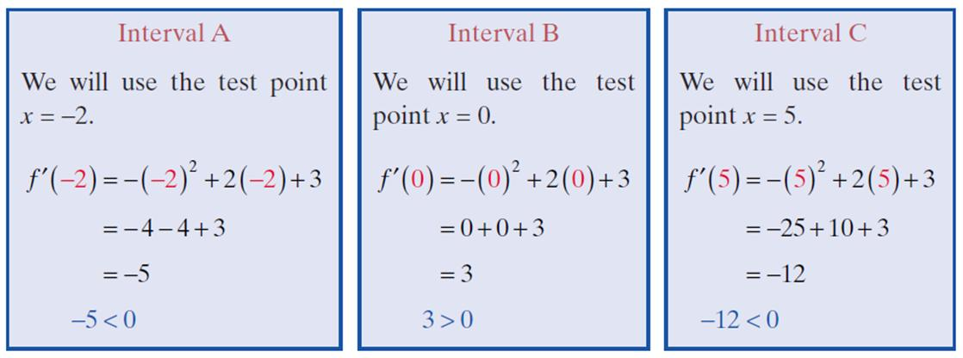
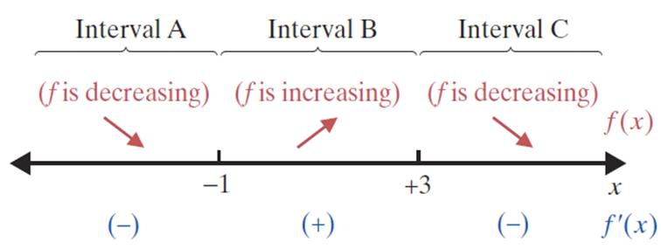
Example 1: Using the First Derivative Test (cont.)

Slide 14
Example 1: Using the First Derivative Test (cont.)
For both of the critical values, there is a sign change from one side of the value to the other. Therefore, local extrema occur at both x = −1 and x = 3 (Step 3).
We compute the y-values:
At x = −1:

Slide 15
Example 1: Using the First Derivative Test (cont.)
At x = 3:
(3, 10) is a local maximum.

Slide 16
Example 1: Using the First Derivative Test (cont.)
c. Use the following summary of information (from parts a. and b.) to sketch the curve.
1. f is decreasing on (−∞, −1).
2. f is increasing on (−1, 3).
3. f is decreasing on (3, +∞).
4. A local minimum occurs at the point
5. A local maximum occurs at the point (3, 10).

Slide 17
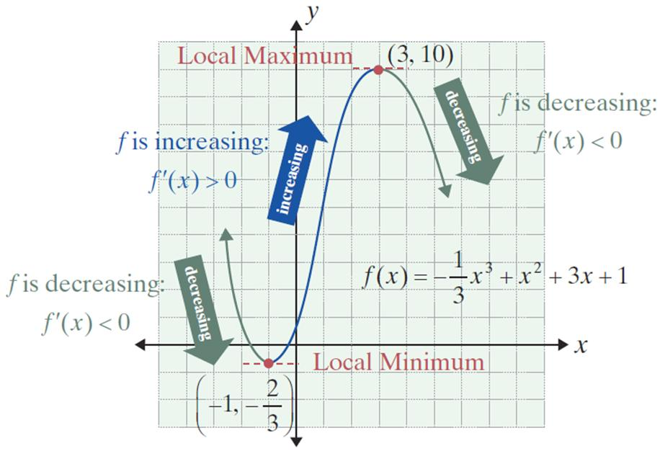
Example 1: Using the First Derivative Test (cont.)

Slide 18
Example 2: Using the First Derivative Test
Let
a. Find the critical values of f.
b. Use the First Derivative Test to find any local extrema.
c. Sketch the graph of f.
Solutions:
Set f ′(x) = 0 to find the critical values.
Find the derivative of f(x).

Slide 19
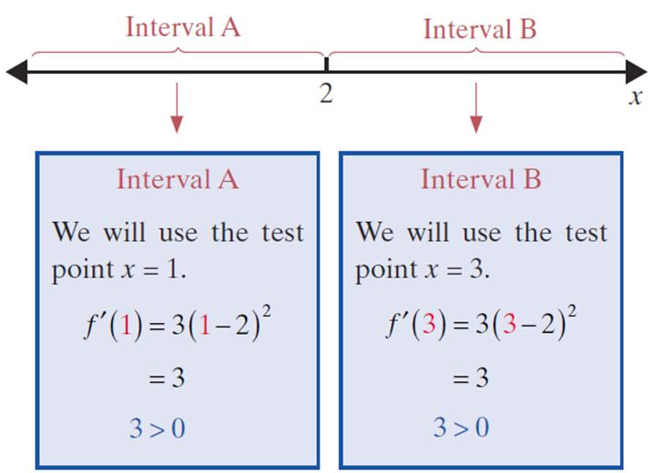
Example 2: Using the First Derivative Test (cont.)
b. Step 1 of the First Derivative Test was completed in part a. Now we need to check the sign of f ′(x) on either side of the critical value (Step 2).

Slide 20
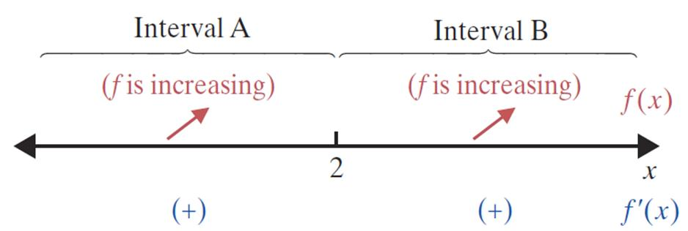
Example 2: Using the First Derivative Test (cont.)
Now we have, for all x. Since there is no sign change from one side of the critical value to the other, x = 2 is not a local extremum (Step 3).

Slide 21
Example 2: Using the First Derivative Test (cont.)
c. Use the following summary of information (from parts a. and b.) to sketch the curve.
1. f is increasing on (−∞, +∞).
2. f ′(2) = 0, but the point (2, 1) is not a local extremum.

Slide 22
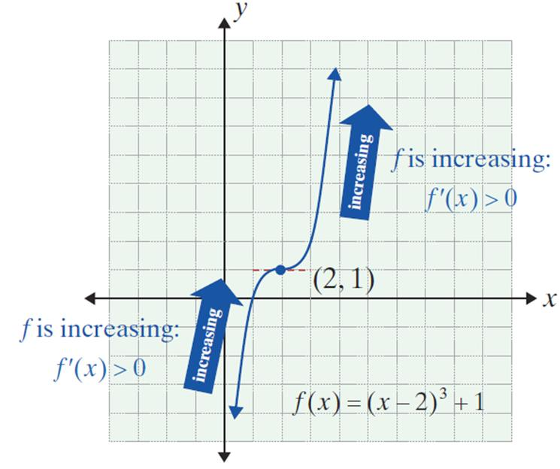
Example 2: Using the First Derivative Test (cont.)

Slide 23
Example 3: Critical Values
Find the critical values for the function
Solution:
Rewrite y using exponents.
Find the derivative of y.
y′ cannot equal 0. Recall, an algebraic fraction can be zero if and only if its numerator is zero.

Slide 24
Example 3: Critical Values (cont.)
Note that is undefined at x = 2 (and defined for all
other values of x). The original function, is also not defined at x = 2.
Therefore, x = 2 is not in the domain of the function and is not a critical value. There are no critical values. However, x = 2 is the only x-value "marked" on the analysis line because the derivative can change signs from positive to negative or vice versa only at x = 2.

Slide 25
Example 4: Critical Values
Find the critical values for the function
Solution:
In this case, y′ is not defined at x = 0. However, since x = 0 is in the domain of the original function, x = 0 is a critical value.
Find the derivative of y. Note: y′ cannot equal 0 since the numerator cannot equal 0.

Slide 26
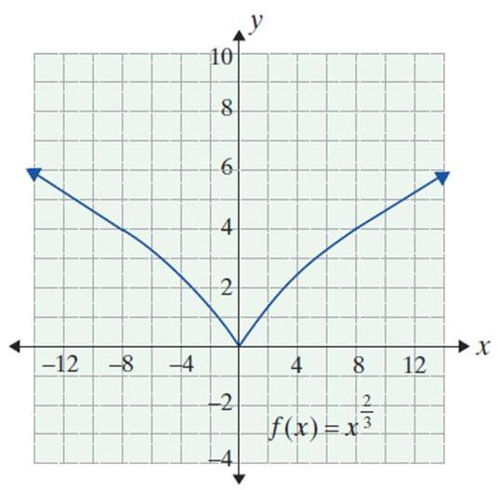
Example 4: Critical Values (cont.)
Also, because y′ is never equal to 0, there are no other critical values; only x = 0.
To the left of x = 0, f ′ is negative (y decreases).
To the right of x = 0, f ′ is positive (y increases). Near x = 0, the absolute values of slope are huge. We conclude there is a sharp point at x = 0, where x = 0 is a critical value.

