Slide 1
Section 11.6
Absolute Maximum and Minimum

Slide 2
Objectives
Find the absolute maximum and absolute minimum of a function.
Determine maxima and minima in real-life applications.

Slide 3
Absolute Maximum and Minimum
Absolute Extrema
If c is in the domain of f and, for all x in the domain of f, we have
1. f(x) ≤ f(c), then f(c) is called the absolute maximum of f.
2. f(x) ≥ f(c), then f(c) is called the absolute minimum of f.

Slide 4
Absolute Maximum and Minimum
Theorem of Absolute Extrema of a Continuous Function
If a function f is continuous on a closed interval [a, b], then f will have an absolute maximum value and an absolute minimum value on [a, b].

Slide 5
Absolute Maximum and Minimum
Notes
Although a particular discontinuous function may have an absolute maximum and an absolute minimum on a closed interval, such extrema cannot be guaranteed for all discontinuous functions or for open intervals. For
example, on the interval has no
extrema.

Slide 6
Absolute Maximum and Minimum
Finding the Absolute Extrema of a Continuous Function f on the closed interval [a, b]
1. Find all the critical values for f in [a, b]. That is, find all c in [a, b] where
a. f ′(c) = 0 or
b. f ′(c) is undefined.
2. Evaluate f(a), f(b), and f(c) for all critical values c.
3. The largest value found in step 2 is the absolute maximum. The smallest value found in step 2 is the absolute minimum.

Slide 7
Example 1: Finding Absolute Extrema
Find the absolute extrema for on the interval [0, 5].
Solution:
Step 1: Find all the critical values for f(x) in [0, 5].
Find the critical values of f by setting f ′(x) = 0 and solving for x.
Make sure both critical numbers x = 1, 4 are in the interval [0, 5].

Slide 8
Example 1: Finding Absolute Extrema (cont.)
Step 2: Evaluate f(a), f(b), and f(c) for all c in the given interval.
Both the critical values, x = 1 and x = 4, are in the interval [0, 5]. Therefore, evaluate f(x) at x = 0, x = 1, x = 4, and x = 5.

Slide 9
Example 1: Finding Absolute Extrema (cont.)
x = 0
x = 1
x = 4
x = 5

Slide 10
Example 1: Finding Absolute Extrema (cont.)
Step 3: The largest value found in Step 2 is the absolute maximum and the smallest value is the absolute minimum.
So the absolute maximum is f(1) = 17 and occurs at x = 1. The absolute minimum is
f (4) = −10 and occurs at x = 4.

Slide 11
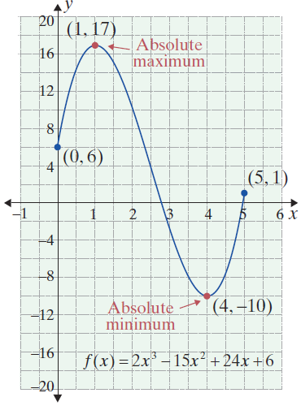
Example 1: Finding Absolute Extrema (cont.)
Note: The full graph of f on [0, 5] is shown to help your understanding of the problem.
Note: the full graph is easy to draw using only the analysis and the four (x, y)-coordinates (without a calculator).

Slide 12
Example 2: Finding Absolute Extrema
Find the absolute extrema for f(x) = −2x + 10 on the interval [1, 3].
Solution:
Step 1: Find all the critical values for f(x) in [1, 3].
There are no critical values. Furthermore, since f ′(x) = −2 < 0, f is decreasing for all x.
Find the critical values of f by setting f ′(x) = 0 and solving for x.

Slide 13
Example 2: Finding Absolute Extrema (cont.)
Step 2: Evaluate f(a), f(b), and f(c) for all c in the given interval.
Again, there are no critical values, c. Therefore, only the endpoints of the interval, x = 1 and x = 3, need to be evaluated.
x = 1
x = 3

Slide 14
Example 2: Finding Absolute Extrema (cont.)
Step 3: The largest value found in Step 2 is the absolute maximum and the smallest value is the absolute minimum.
So the absolute maximum is f(1) = 8 and the absolute minimum is f(3) = 4.

Slide 15
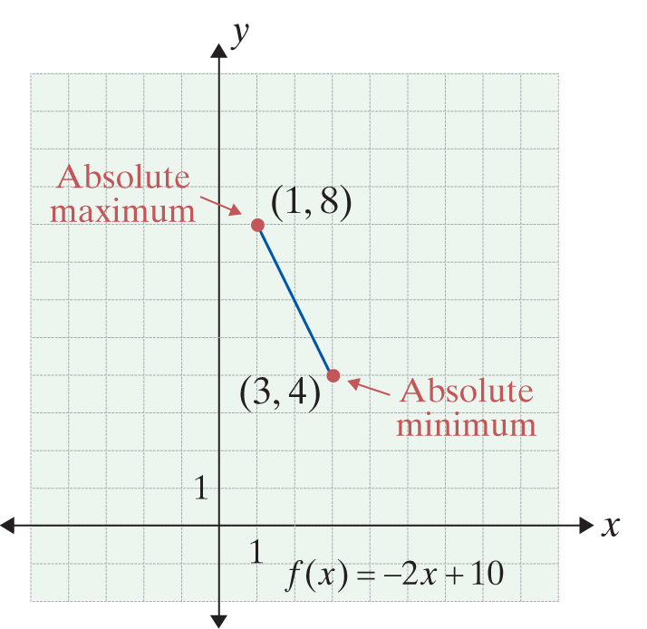
Example 2: Finding Absolute Extrema (cont.)
The graph of f on (1, 3) is a straight line.

Slide 16
Example 3: Finding Absolute Extrema
Find the absolute extrema for on the interval [−8, 8].
Solution:
Step 1: Find all the critical values for f(x) in [−8, 8].
Since f ′(0) is undefined, x = 0 is a critical value. In this case, x = 0 is the only critical value.
Find the critical values of f by setting f ′(x) = 0 and solving for x.

Slide 17
Example 3: Finding Absolute Extrema (cont.)
Step 2: Evaluate f(a), f(b), and f(c) for all c in the given interval.
Now evaluate f(x) at x = −8, x = 0, and x = 8.
x = −8
x = 0
x = 8

Slide 18
Example 3: Finding Absolute Extrema (cont.)
Step 3: The largest value found in Step 2 is the absolute maximum and the smallest value is the absolute minimum.
In this case, there are two x-values that result in the absolute maximum. These are x = −8 and x = 8 (note that these are the end points) and the value of the absolute maximum is 5. The absolute minimum is f(0) = 1.

Slide 19
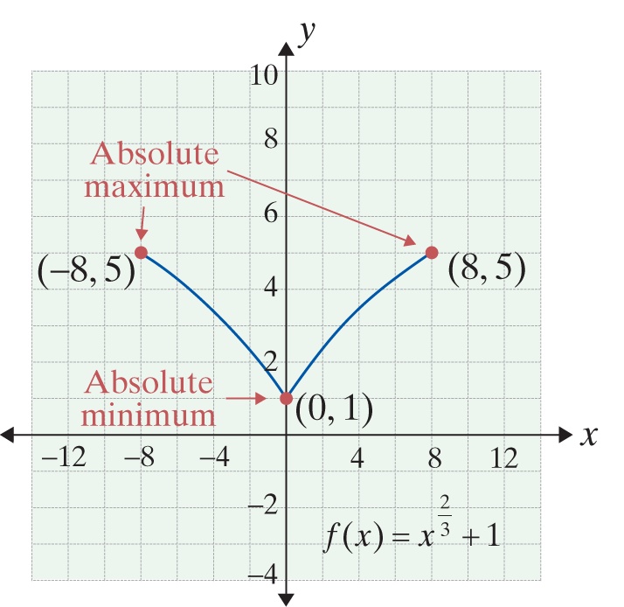
Example 3: Finding Absolute Extrema (cont.)

Slide 20
Example 4: Finding Absolute Extrema
Find the absolute extrema for on the interval [0, 4].
Solution:
Step 1: Find all the critical values for f (x) in [0, 4].
Although x = −3 and x = 3 are critical values for the function, x = −3 is not in the interval [0, 4], and must be disregarded.
Find the critical values of f by setting f ′(x) = 0 and solving for x.

Slide 21
Example 4: Finding Absolute Extrema (cont.)
Step 2: Evaluate f(a), f(b), and f(c) for all c in the given interval.
Since the critical value x = −3 is not in the interval, evaluate f(x) only at x = 0, x = 3, and x = 4.

Slide 22
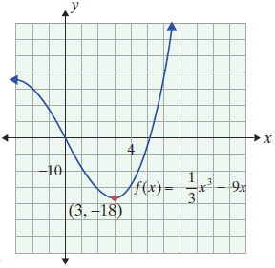
Example 4: Finding Absolute Extrema (cont.)
x = 0
x = 3
x = 4

Slide 23
Example 4: Finding Absolute Extrema (cont.)
Step 3: The largest value found in Step 2 is the absolute maximum and the smallest value is the absolute minimum. So the absolute maximum is f(0) = 0 and the absolute minimum is f(3) = −18.

Slide 24
Example 5: Maximizing Profits
A company finds that its profit in dollars for producing x units of a product in one week is given by If the company is set up so that no more than 500 units can be manufactured in any one week, how many units should the company produce to maximize profit?

Slide 25
Example 5: Maximizing Profits (cont.)
Solution:
The production restrictions indicate that x is in the closed interval [0, 500]. Find the critical values by setting P′(x) = 0 and solving for x (Step 1).
Now evaluate P(x) for x = 0, x = 400, and x = 500
(Step 2).

Slide 26
Example 5: Maximizing Profits (cont.)
x = 0
x = 400
x = 500
The profit is maximized at $320,000 when 400 units are produced (Step 3).

