Slide 1
Section 12.2
The Second Derivative Test

Slide 2
Objectives
Use the second derivative of a function to find its local extrema.

Slide 3
Second Derivative Test for Local Extrema
Second Derivative Test for Local Extrema
Suppose that f is a function, f ′ and f ′′ exist on the interval (a, b), c is in (a, b), and f ′(c) = 0.
1. If f ′′(c) > 0, then f(c) is a local minimum.
(See Figure 4.1.8(a).)
2. If f ′′(c) < 0, then f(c) is a local maximum.
(See Figure 4.1.8(b).)
3. If f ′′(c) = 0, then the test fails to give any information about local extrema.

Slide 4
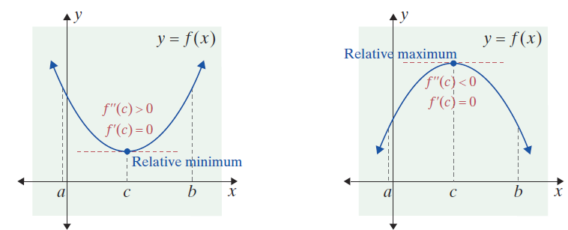
Second Derivative Test for Local Extrema
Figure 4.1.8
(a) Figure 4.1.8(a) suggests that f (x) must be concave upward
(f ′′(c) > 0) if it has a relative minimum at x = c.
(b) Similarly, Figure 4.1.8(b) shows that at a relative maximum, x = c, f (x) must be concave downward (f ′′(c) < 0).

Slide 5
Second Derivative Test for Local Extrema
NOTES
The principle being applied in the Second Derivative Test is really very simple. If f ′′(c) is defined at a local maximum (c, f(c)), a curve is concave down. If f ′′(c) is defined at a local minimum (c, f(c)), a curve is concave up.

Slide 6
Example 1: Using the Second Derivative Test
For the function
a. Locate the local extrema.
b. Locate the points of inflection.
Solutions:
a. We will use the Second Derivative Test to find all local extrema of f (x).
First, find all values x = c so that f ′(c) = 0.

Slide 7
Example 1: Using the Second Derivative Test (cont.)
Substituting these x-values into f (x), the corresponding y-values are f (−3) = −81, f (0) = 0, and f (3) = −81.
Find the derivative of f (x).
Set f ′(x) = 0.

Slide 8
Example 1: Using the Second Derivative Test (cont.)
Now we need to determine how f′′(x) responds at these x-values.
Use the method for determining concavity in addition to the Second Derivative Test to interpret these results:
Find f ′′(x).
Substitute each of the values found for c: −3, 0, and 3.

Slide 9
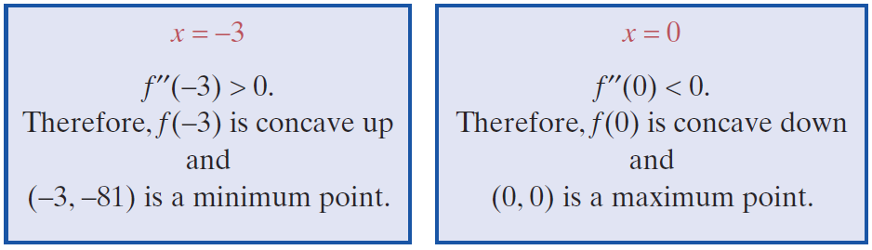
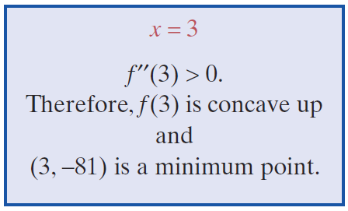
Example 1: Using the Second Derivative Test (cont.)

Slide 10
Example 1: Using the Second Derivative Test (cont.)
b. The points of inflection come from setting f ′′(x) = 0 and solving for x:
Set f ′′(x) = 0.

Slide 11
Example 1: Using the Second Derivative Test (cont.)
The corresponding y-values are
So the points of inflection are

Slide 12
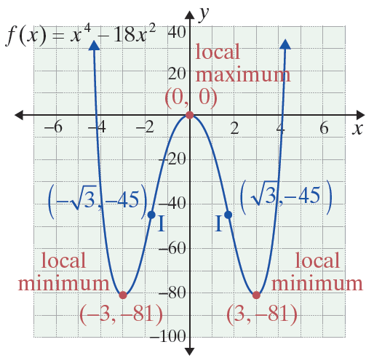
Example 1: Using the Second Derivative Test (cont.)
We point out that it is easy (without a graphing calculator) to sketch y = x⁴ − 18x². We need only the coordinates of the three extreme points, and we may sketch a smooth curve only knowing which is a maximum and/or a minimum. In this example, the potential inflection points occur between a maximum and a minimum point and so we “know” the concavity changes at these points.

Slide 13
Example 2: Locating Local Extrema
Locate the local extrema for the function
and sketch a graph of the function.
Solution:
Find f ′(x) and all values x = c where f ′(c) = 0.

Slide 14
Example 2: Locating Local Extrema (cont.)
Determine the corresponding y-values of x = 0 and x = 2.

Slide 15
Example 2: Locating Local Extrema (cont.)
Now find f ′′(0) and f ′′(2) and apply the Second Derivative Test to interpret these points.
Substitute x = 0 and x = 2 into f ″(x).
Since f ′′(0) = 0, the Second Derivative Test fails at this point.

Slide 16
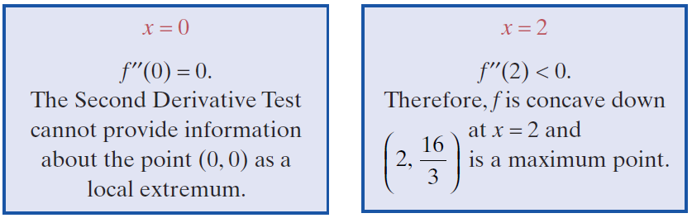
Example 2: Locating Local Extrema (cont.)
A local maximum occurs at the point

Slide 17
Example 2: Locating Local Extrema (cont.)
Because the Second Derivative Test provides no information about the point (0, 0) as a local extremum, we must use the First Derivative Test. Let us check the sign of f ′(x) on either side of 0 (Step 2 and Step 3 of the test). Using x = −1 and x = 1,
f ′(−1) = 12 (positive) and f ′(1) = 4 (also positive).
This shows that f increases to the left of x = 0 as well as to the right. Since there is no sign change from one side of f ′(0) to the other, x = 0 does not give a local minimum or a local maximum.

Slide 18
Example 2: Locating Local Extrema (cont.)
In fact, we have shown that slope is positive to the left of the origin, decreases to zero at the origin, and then increases to the right of the origin. This shows that the concavity changed at (0, 0) which must be a point of inflection.
Since the graph is concave up to the right of (0, 0), and
concave down at the maximum there must be
an inflection point in between these points. Set y′′ = 0 and solve for x.

Slide 19
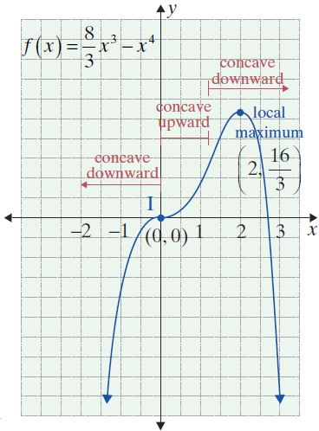
Example 2: Locating Local Extrema (cont.)
So is the other
inflection point. Note as a
check that is between
x = 0 and x = 2, which is already
known.

Slide 20
Second Derivative Test for Local Extrema
NOTES
The Second Derivative Test requires only one number to be checked. The First Derivative Test requires two numbers to be computed. For polynomial functions, the formula for f ′′ is one degree lower than that for f ′, so numbers are easier to calculate. For these reasons, the Second Derivative Test is usually preferred. However, sometimes, as in Example 8, it provides no information, and one must then use the First Derivative Test.

Slide 21
Application: Point of Diminishing Returns
Point of Diminishing Returns
The point of diminishing returns occurs at a point of inflection where the sales curve changes from concave upward to concave downward.

Slide 22
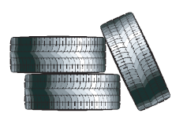
Example 3: Point of Diminishing Returns
Find the point of diminishing returns for the sales function
where x represents thousands of dollars spent on advertising, 0 ≤ x ≤ 80, and S is sales in thousands of dollars for automobile tires.

Slide 23
Example 3: Point of Diminishing Returns (cont.)
Solution:
To find the point at which concavity changes from concave upward to concave downward, we must first find the hypercritical values of x between 0 and 80. Then we determine whether these points are points of inflection.
Find S′(x).
Find S′′(x).

Slide 24
Example 3: Point of Diminishing Returns (cont.)
Note:
Testing shows that
S ′′(x) > 0 for 0 < x < 50
and
S ′′(x) < 0 for 50 < x < 80.
Set S ′′(x) equal to 0 to find the hypercritical values.

Slide 25
Example 3: Point of Diminishing Returns (cont.)
Concavity changes from upward on the left side of S(50) to downward on the other, signifying it is a point of diminishing returns.
Thus the point of diminishing returns is at (50, S(50)) = (50, 5100). At the point of diminishing returns, $50,000 is spent on advertising, and sales in tires are $5,100,000.

