Slide 1
Section 12.4
Curve Sketching: Rational Functions

Slide 2
Objectives
Find vertical, horizontal, and oblique asymptotes of a rational function.
Sketch the graph of a given rational function.

Slide 3
Rational Functions
Rational Function
A rational function is a function of the form
where P(x) and Q(x) are polynomials and Q(x) ≠ 0.

Slide 4
Rational Functions
Asymptotes for Rational Functions
1. Vertical asymptotes are of the form x = a and occur where the denominator is 0 and the numerator is not 0, (that is, Q(a) = 0 and P(a) ≠ 0).
2. Horizontal asymptotes are of the form y = b and occur where

Slide 5
Rational Functions
Asymptotes for Rational Functions (cont.)
3. Oblique asymptotes are of the linear form
y = mx + b and occur when the numerator is one degree larger than the denominator and f(x) can be written as

Slide 6
Rational Functions
Asymptotes for Rational Functions (cont.)
where

Slide 7
Example 1: Locating Vertical and Horizontal Asymptotes
For the function find a. the vertical
asymptotes and b. the horizontal asymptotes.
Solutions:
a. A vertical asymptote occurs when the denominator is 0 (i.e., where x − 5 = 0). Thus the line x = 5 is a vertical asymptote.

Slide 8
Example 1: Locating Vertical and Horizontal Asymptotes (cont.)
b. We find the horizontal asymptotes by finding
Divide both numerator and denominator by x.

Slide 9
Example 1: Locating Vertical and Horizontal Asymptotes (cont.)
The line y = 2 is a horizontal asymptote. Since
we see that also.

Slide 10
Example 2: Locating Vertical and Horizontal Asymptotes
For the function find a. the vertical
asymptotes and b. the horizontal asymptotes.
Solutions:
a. A vertical asymptote occurs when the denominator is 0. Since the denominator, x² + 3, is never 0, there are no vertical asymptotes.

Slide 11
Example 2: Locating Vertical and Horizontal Asymptotes (cont.)
b. We find the horizontal asymptotes by finding
Therefore, the line y = 0 is a horizontal asymptote.

Slide 12
Example 3: Locating Oblique Asymptotes
Find the oblique asymptote for the function
Solution:
Since the numerator is one degree larger than the denominator, we can write f (x) in the following form:

Slide 13
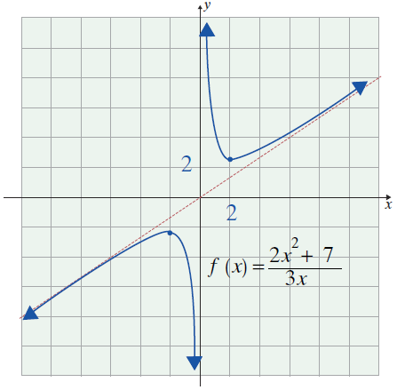
Example 3: Locating Oblique Asymptotes (cont.)
Now we find that
So the remaining term gives
the oblique asymptote:

Slide 14
Example 4: Sketching the Graph of a
Rational Function
Sketch the graph of the rational function
Include any related asymptotes.
Solution: Step 1: Find f ′(x) and f ′′(x).

Slide 15
Example 4: Sketching the Graph of a
Rational Function (cont.)
Steps 2, 3, and 4: Find the critical values, the intervals where f ′(x) > 0 and where f ′(x) < 0, and the local extrema.
The first derivative, is never 0. Note
that f ′ is undefined at x = 2, but x = 2 is not a critical value since 2 is not in the domain of f. Thus there are no critical values of f, and f has no local maxima or local minima.

Slide 16
Example 4: Sketching the Graph of a
Rational Function (cont.)
Also, for all x ≠ 2 and f is
decreasing for all x in its domain.
Steps 5, 6, and 7: Find all hypercritical values, intervals where f ′′(x) > 0 and where f ′′(x) < 0, and points of inflection.

Slide 17
Example 4: Sketching the Graph of a
Rational Function (cont.)
Since and is undefined only for
x = 2, there are no hypercritical values and no points of inflection.
However, if and f is
concave down, and if
then and f is concave up.

Slide 18
Example 4: Sketching the Graph of a
Rational Function (cont.)
Asymptotes:
The line x = 2 is a vertical asymptote because x − 2 is not a factor of the numerator and the value of 2 for x will make the denominator 0.
We now find the horizontal asymptotes by finding

Slide 19
Example 4: Sketching the Graph of a
Rational Function (cont.)
Divide both the numerator and the denominator by the highest power of x present in the function.

Slide 20
Example 4: Sketching the Graph of a
Rational Function (cont.)
Proceeding as before, we can also find that
Therefore, the line y = 1 is a horizontal asymptote.
We also know that this function does not have an oblique asymptote because the degree of the numerator is not one degree higher than the denominator.

Slide 21
Example 4: Sketching the Graph of a
Rational Function (cont.)
Step 8: Sketch the graph.
Interval or Value | Derivative | Nature of Graph
(−∞, 2) or (2, +∞) | f ′(x) < 0 | Decreasing
(−∞, 2) | f ′′(x) < 0 | Concave down
(2, +∞) | f ′′(x) > 0 | Concave up
x = 2 | NA | Vertical asymp.
y = 1 | NA | Horizontal asymp.

Slide 22
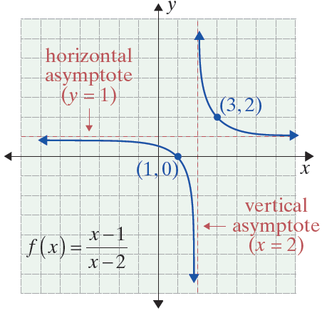
Example 4: Sketching the Graph of a
Rational Function (cont.)

Slide 23
Example 5: Sketching the Graph of a
Rational Function
Sketch the graph of the rational function
Solution:
Here we will first identify the function’s asymptotes. First, it is easy in this case to see by inspection of the formula that x = 0 makes the denominator 0 but not the numerator. Thus x = 0 is a vertical asymptote.

Slide 24
Example 5: Sketching the Graph of a
Rational Function (cont.)
Since we observe is an oblique
asymptote.
Unlike the function in Example 4, this function’s numerator is one degree larger than the denominator, so we know immediately that this function will have an oblique asymptote. Using the above work (equivalent
to division of polynomials), the line is seen to be an oblique asymptote.

Slide 25
Example 5: Sketching the Graph of a
Rational Function (cont.)
Now we will analyze the derivative for x > 0.
We can factor f′(x) even further:

Slide 26
Example 5: Sketching the Graph of a
Rational Function (cont.)
This shows x = 10 and x = −10 are critical values, and we must treat x = 0 as a critical value. The intervals to consider are and
We select a convenient point in each interval and find the slope. We test four points: f ′(−11) = .087,
f ′(−1) = −49.5, f ′(1) = −49.5, and f ′(11) = .087.

Slide 27
Example 5: Sketching the Graph of a
Rational Function (cont.)
For so y is increasing.
For −10 < x < 0, f ′(x) < 0 so y is decreasing. For
0 < x < 10, f ′(x) < 0 so y is decreasing. For x > 10,
f ′(x) > 0 so y is increasing. Note: f (10) = 10, and f (−10) = − 10. The analysis shows (−10, −10) is a local maximum and (10, 10) is a local minimum.
for all x > 0, so f is concave up.

Slide 28
Example 5: Sketching the Graph of a
Rational Function (cont.)
Since f ′(10) = 0 and f ′′(10) > 0, by the Second Derivative Test, we confirm that the point
(10, f (10)) = (10, 10) is a local minimum. Similarly
f ′′(−10) < 0 and (−10, 10) is a local maximum.
Also, because f′′(x) ≠ 0 and there are no points in the domain of f where f ′′(x) is undefined, there are no hypercritical values and no points of inflection.

Slide 29
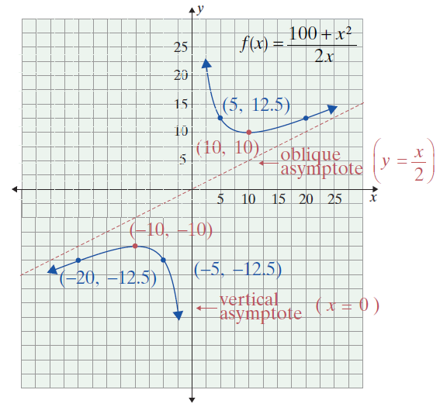
Example 5: Sketching the Graph of a
Rational Function (cont.)

