Slide 1
Section 12.6
Other Applications: Optimization, Distance, and Velocity

Slide 2
Objectives
Use the concepts of maximum and minimum in applications related to geometry and science including the Pythagorean Theorem, volume, area, distance, and velocity.

Slide 3
Example 1: Volume of a Box
A rectangular box with no top is to be made from a rectangular piece of cardboard that is 18 in. long by 12 in. wide. Small squares (all the same size) are to be cut from each corner and the sides folded to form the box. What size should the squares be to give a maximum volume to the box?
Solution:
Let x = length of one side of the square to be cut.

Slide 4
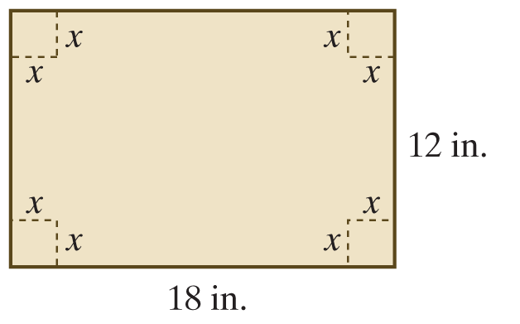
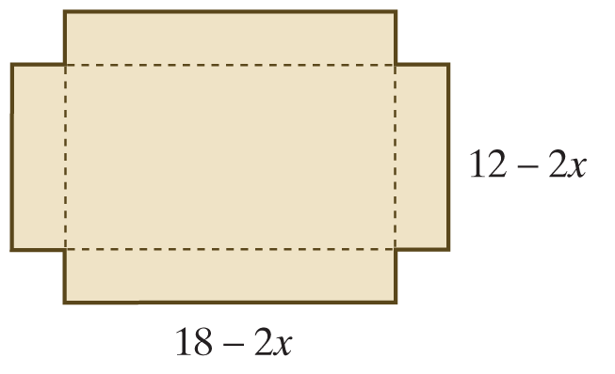
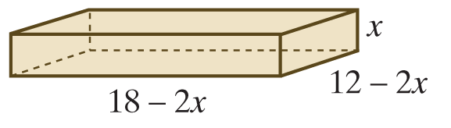
Example 1: Volume of a Box (cont.)
Differentiating V, we obtain

Slide 5
Example 1: Volume of a Box (cont.)
Setting gives

Slide 6
Example 1: Volume of a Box (cont.)
We know that the size of the square cannot be any larger than 6 in. or smaller than 0 in.; that is, x must be in the closed interval [0, 6].

Slide 7
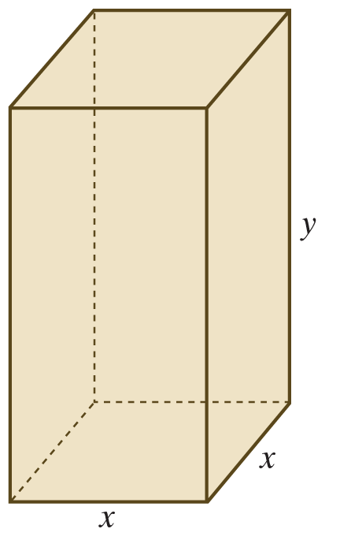
Example 2: Surface Area of a Box
A rectangular box is to be made so that the top and bottom are squares. The volume is to be 250 cm³. Material for the top and bottom costs $2 per square centimeter, but the material for the sides costs only $1 per square centimeter. What dimensions will give a minimum cost for the materials? What is the minimum cost?

Slide 8
Example 2: Surface Area of a Box (cont.)
Solution:
Let x = length of an edge along the square bottom.
Let y = length of a vertical edge.
Note: We are assuming that cost only depends on surface area. The cost, C(x), of the materials is found by multiplying the areas of the faces of the box by $2 and $1 as follows:
Cost of the top, bottom, and 4 sides.

Slide 9
Example 2: Surface Area of a Box (cont.)
Now, using the volume, solve for y and substitute into the cost function.
Solve volume for y.
Substitute y in the equation for C(x).
Rewrite C(x) using exponents.

Slide 10
Example 2: Surface Area of a Box (cont.)
Differentiating C(x), we have
Setting C′(x) = 0 and solving for x gives

Slide 11
Example 2: Surface Area of a Box (cont.)
So
Therefore, the dimensions of the box are 5 cm by 5 cm by 10 cm, and the minimum cost is

Slide 12
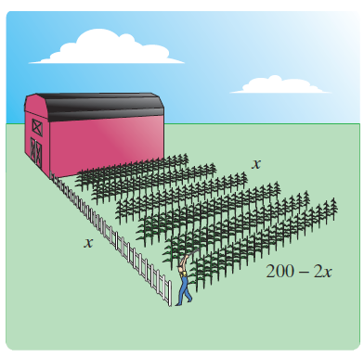
Example 3: Fencing
A farmer wants to enclose a rectangular area next to his barn. If he has 200 feet of fencing to use, what dimensions of the rectangle will maximize the area? What is the maximum area? (Note that the fence is only three sides of the rectangle,
since the barn serves as the fourth
side of the enclosure.)

Slide 13
Example 3: Fencing (cont.)
Solution:
Let x = length of one of the two equal sides of the rectangle.
Then, since there is only 200 feet of fencing available, the length of the third side is 200 − 2x.
The area of the rectangle is to be maximized; so we need a function representing the area:

Slide 14
Example 3: Fencing (cont.)
Then
Setting A′(x) = 0 and solving for x, we have

Slide 15
Example 3: Fencing (cont.)
We apply the Second Derivative Test:
and A is concave down at x = 50. Thus the critical value gives a maximum.
The rectangle should be 50 ft. by 100 ft., and the maximum area is

Slide 16
Example 4: Oil Pipeline
An oil company wants to lay a pipeline from its offshore drilling rig to a storage tank on shore, as illustrated in the figure on the next slide. The rig (point R) is three miles offshore (point A), and the storage tank (point B) is 8 miles down the shoreline. The costs of laying pipe underwater are $800 per mile and along the shoreline are $400 per mile. Point P is the point on shore where the underwater pipe connects with the shoreline pipe. Where should point P be located so as to minimize the cost of laying pipe?

Slide 17
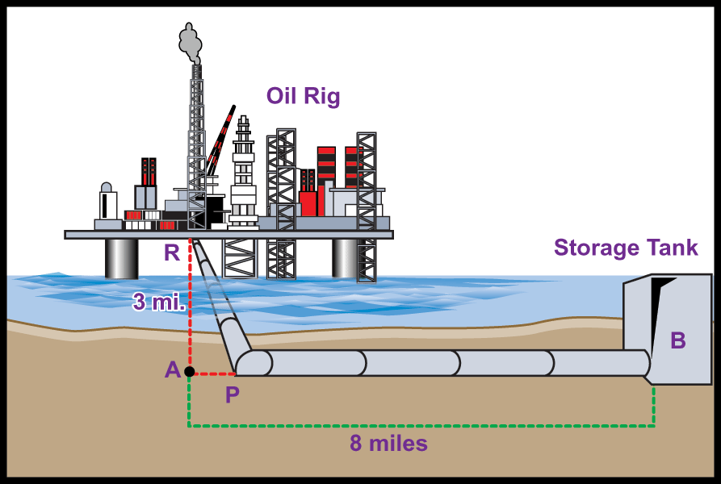
Example 4: Oil Pipeline (cont.)

Slide 18
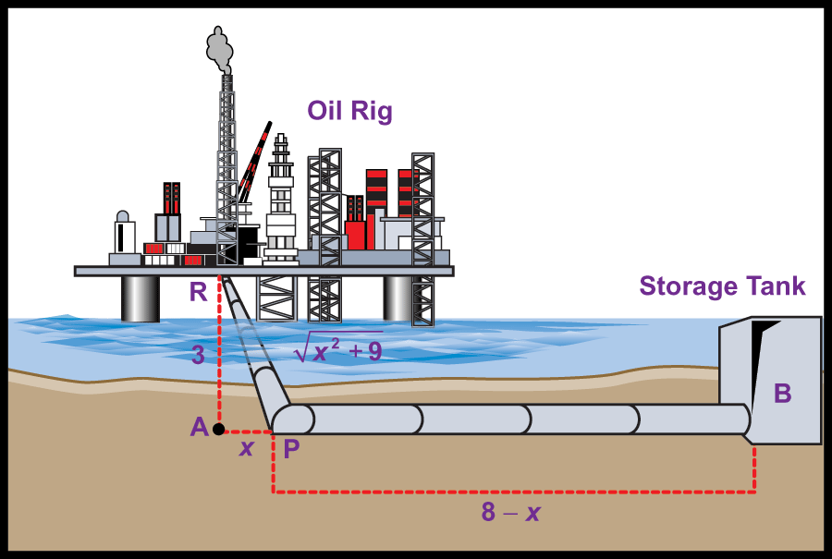
Example 4: Oil Pipeline (cont.)
Solution:
Let x be the distance from A to P.
Since
By the Pythagorean Theorem,
The total cost of laying pipe is

Slide 19
Example 4: Oil Pipeline (cont.)
Differentiating C(x) gives
Setting and solving for x, we have

Slide 20
Example 4: Oil Pipeline (cont.)
Note that is not a reasonable solution because distance cannot be negative. We have assumed x to be in the interval [0, 8].

Slide 21
Example 4: Oil Pipeline (cont.)
Now,
So the minimum cost is incurred if point P is located
miles (approximately 1.732 miles) along the
shoreline from point A (or miles from the storage tank at point B.)

Slide 22
Example 4: Oil Pipeline (cont.)
We should check the endpoints x = 0 and x = 8 to be sure that they do not give an absolute minimum:

Slide 23
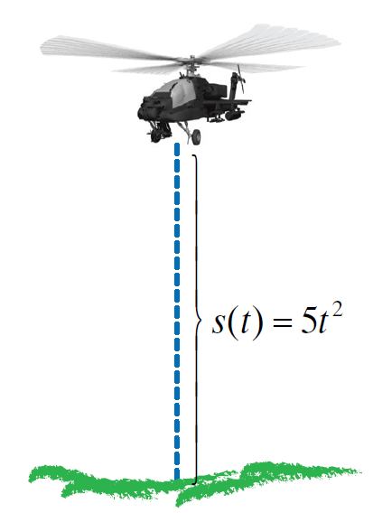
Example 5: Helicopter Lift-Off
Suppose that a helicopter is rising from the ground in such a way that its distance s in feet from the ground is given by s(t) = 5t², where t is time after take off in seconds and 0 ≤ t ≤ 6. How fast is the helicopter rising 3 seconds after takeoff? How high is the helicopter at that time?

Slide 24
Example 5: Helicopter Lift-Off (cont.)
Solution:
Differentiating the distance function with respect to time gives the velocity function:
Three seconds after lift-off, the helicopter is rising at 30 ft./sec.
In 3 seconds the helicopter has risen to an altitude of 45 feet.
Substitute t = 3 into v(t) to find the velocity.
To find the height of the helicopter after 3 seconds, substitute t = 3 into s(t).

Slide 25
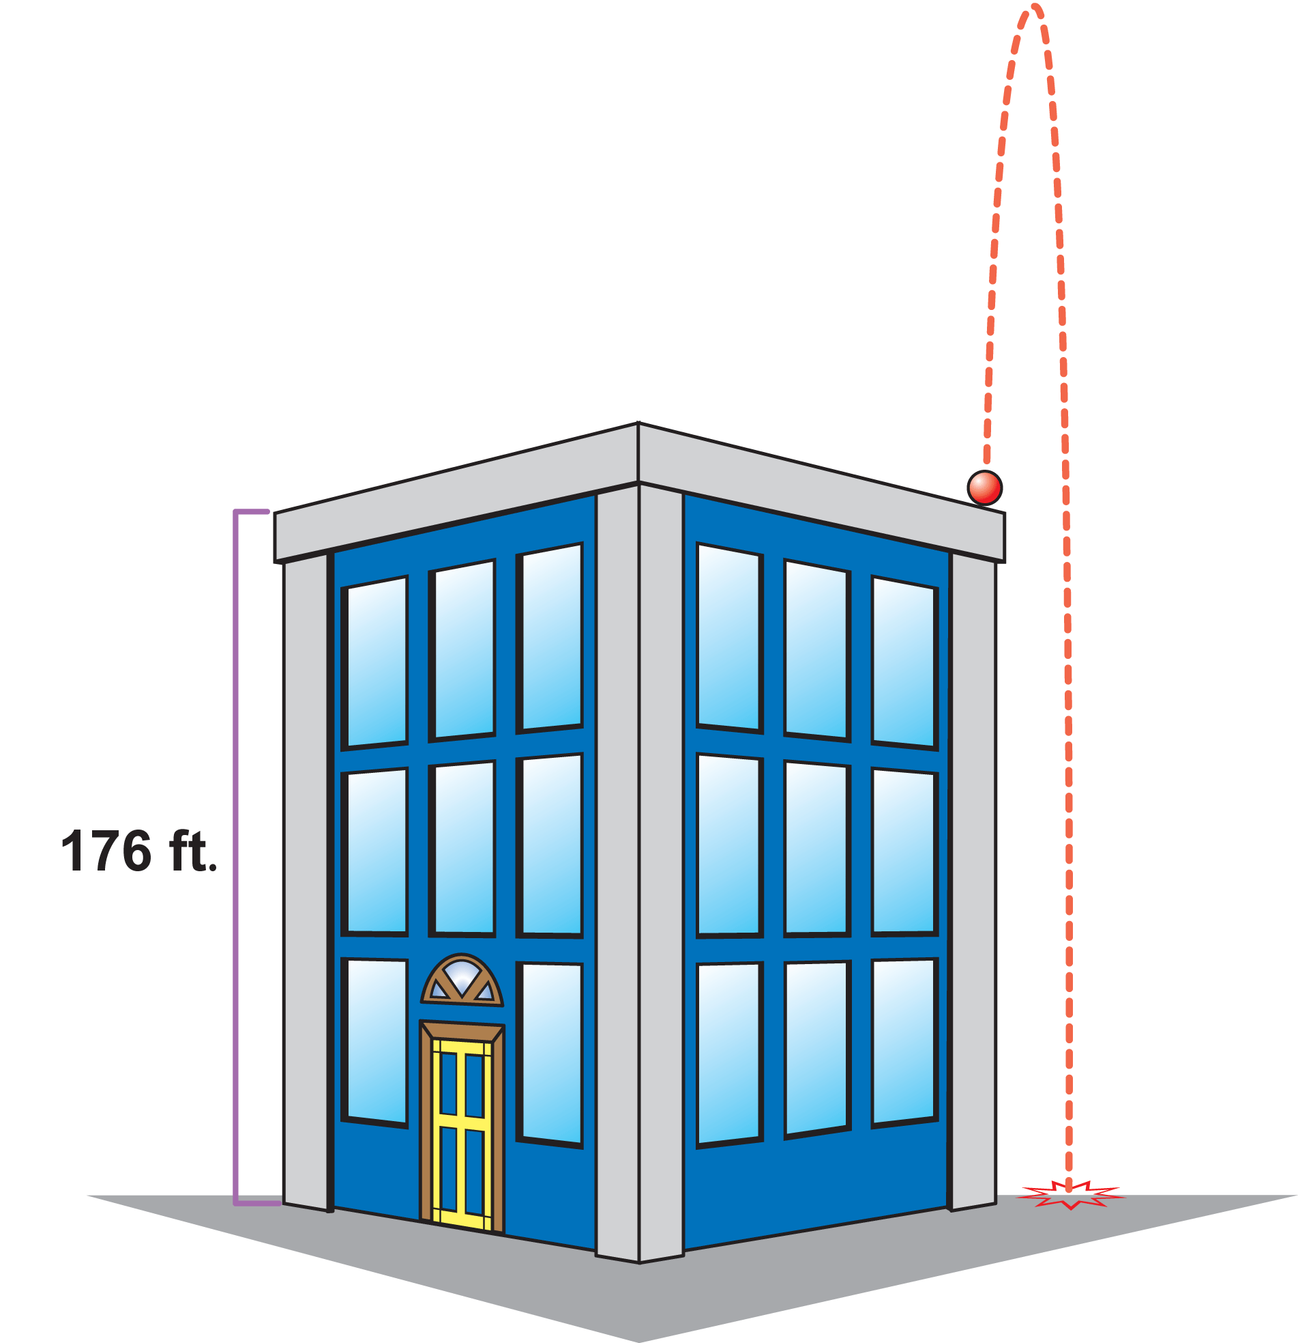
Example 6: Vertical Projectile
A projectile is fired vertically (straight up) from the top corner of the 176-foot tall building. The height of the projectile at time t (in seconds) is given by the function
a. What is the maximum height of the
projectile?
b. When does the projectile hit the
ground?
c. How fast is the projectile moving
when it hits the ground?

Slide 26
Example 6: Vertical Projectile (cont.)
Solutions:
a. The maximum height of the projectile occurs at the point where its velocity is 0.
Differentiate s(t) to determine v(t). Then set v(t) equal to 0 and solve for t.

Slide 27
Example 6: Vertical Projectile (cont.)
Since s′′ = −32 (a constant), the curve s(t) is concave down everywhere. By the Second Derivative Test, the maximum height occurs when t = 5 seconds. Insert this t-value into the s(t) to calculate the maximum height.

Slide 28
Example 6: Vertical Projectile (cont.)
b. The projectile hits the ground when s(t) = 0. (This fact is not related to calculus.)
Thus the projectile hits the ground 11 seconds after it is fired.
Solve s(t) = 0 for t.
Time cannot be negative, so we discard the t = −1.

Slide 29
Example 6: Vertical Projectile (cont.)
c. The projectile’s velocity when it hits the ground is v(11). From part a. we know
The projectile will be falling at a rate of 192 ft./sec when it hits the ground.
The negative sign indicates the projectile is falling.

