Slide 1
Section 13.2
Derivatives of Exponential Functions

Slide 2
Objectives
Differentiate exponential functions.
Use curve sketching techniques to graph exponential functions.

Slide 3
Slopes and Exponential Functions
Derivative of the Exponential Function
If f(x) = e^{x}, then
f ′(x) = e^{x}.

Slide 4
Example 1: Finding the Derivative
Solution:

Slide 5
Example 1: Finding the Derivative (cont.)
Solution:

Slide 6
Slopes and Exponential Functions
Chain Rule for Exponential Functions
If f(x) = e^{g(x)}, then
f ′(x) = e^{g(x)} ⋅ g′(x).

Slide 7
Example 2: Using the Chain Rule
Solution:
Let g(x) = x² + 3x. Then g′(x) = 2x + 3.
Thus

Slide 8
Example 3: Using the Chain Rule
For f(x) = xe^{−x}, find a. f ′(x), b. f ′′(x), and c. the equation of the tangent line to f(x) at the point where x = −1.
Solutions:
By the Product Rule.
Factor out e^{−x}.

Slide 9
Example 3: Using the Chain Rule (cont.)
By the Product Rule applied to f ′(x).
Factor out e^{−x}.

Slide 10
Example 3: Using the Chain Rule (cont.)
c. Since we need the equation at the point (−1, −e).
To determine the slope of the tangent line at the point (−1, −e), we need to find f ′(−1).

Slide 11
Example 3: Using the Chain Rule (cont.)
Using the point-slope formula, the equation of the tangent line is

Slide 12
Example 4: Graphing Exponential Functions
For f(x) = xe^{−x}
a. Find any critical values.
b. Find any hypercritical values.
c. Sketch the graph of the function.

Slide 13
Example 4: Graphing Exponential Functions (cont.)
Solutions:
a. To find critical values, set f ′(x) = 0.
The only critical value is x = 1, since there are no values where f ′(x) is undefined.
We know f ′(x) from Example 3.
e^{−x} is never equal to 0, so we can divide both sides by e^{−x} (that is, cancel e^{−x}).

Slide 14
Example 4: Graphing Exponential Functions (cont.)
b. To find hypercritical values, set f ′′(x) = 0.
The only hypercritical value is x = 2.
We know f ′′(x) from Example 3.

Slide 15
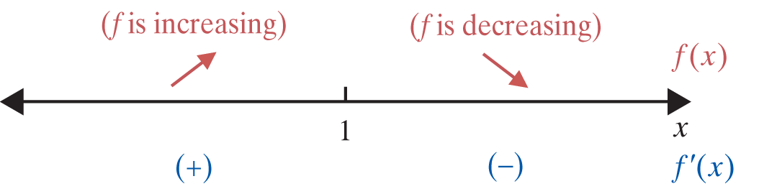
Example 4: Graphing Exponential Functions (cont.)
c. Using the critical value and the hypercritical value found in parts a. and b., we can find the local extrema and the points of inflection.
So there is a local max at (1, e⁻¹).

Slide 16
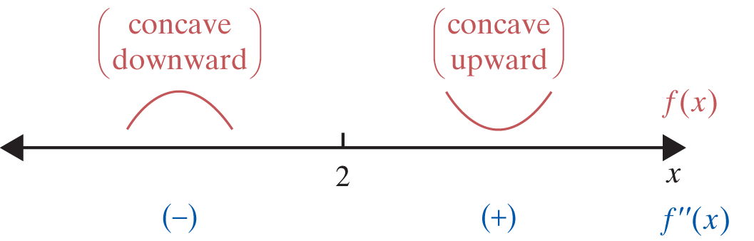
Example 4: Graphing Exponential Functions (cont.)
There is a point of inflection at (2, 2e⁻²).

Slide 17
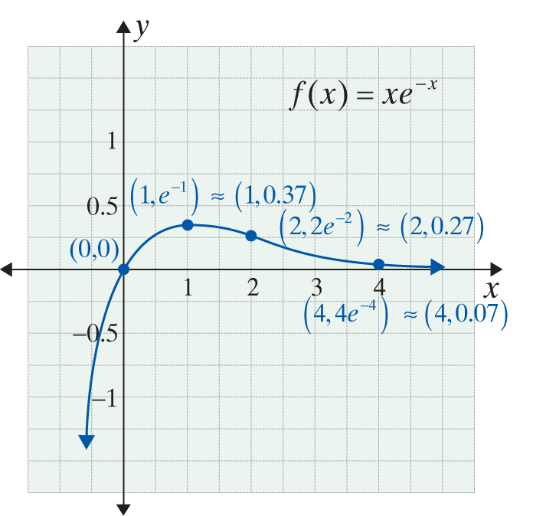
Example 4: Graphing Exponential Functions (cont.)

