Slide 1
Section 13.3
Growth and Decay

Slide 2
Objectives
Solve problems involving growth and decay.

Slide 3
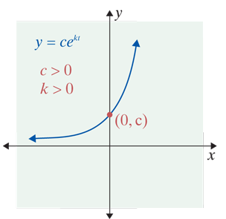
Exponential Growth
Exponential Growth
A function y = f(t) satisfies the equation
if and only if
If k and c are positive, we say that
y grows (or increases) exponentially.
See Figure for a general graph of exponential growth.

Slide 4
Example 1: Population Growth
Suppose that a population of rabbits grows exponentially; that is, the rate of population growth depends on the size of the population. Further, suppose that on Monday at 8 A.M. there are 100 rabbits and that at 8 A.M. on Wednesday there are 130 rabbits.
a. Find an exponential function that represents the rabbit population at time t, where t is measured in days from Monday at 8 A.M.
b. Find the time that the population will be 200 rabbits (double the original 100).

Slide 5
Example 1: Population Growth (cont.)
Solutions:
a. The general form of the function is
When t = 0 (Monday at 8 A.M.), y = 100.
This gives
Substitute the given values into the general form of the function and solve for C.
Substitute C = 100 into the general form of the function.

Slide 6
Example 1: Population Growth (cont.)
Now, when t = 2 (Wednesday at 8 A.M.), y = 130.
Substitute the given values into our formula for y.
Use the definition of natural logarithm.
Therefore, the exponential function is
where t is measured in days from Monday at 8 A.M.

Slide 7
Example 1: Population Growth (cont.)
b. Setting y = 200 and solving for t, we have
which is approximately 3 P.M. on Saturday.

Slide 8
Example 2: Continuous Compounding Interest
Suppose that $2000 is invested in an account that earns 8 percent compounded continuously.
a. What will be the balance in 1 year?
b. When will the original investment be doubled?
Solutions:
a. We know that the growth is exponential because the interest is compounded continuously. Thus
Substitute P = 2000 and r = 0.08 into the formula for continuous compounding interest.

Slide 9
Example 2: Continuous Compounding Interest (cont.)
Substituting t = 1 gives
$2166.57 is the balance at the end of 1 year.

Slide 10
Example 2: Continuous Compounding Interest (cont.)
b. Setting A = 4000 and solving for t, we obtain
The original investment of $2000 will double in approximately 8.7 years.

Slide 11
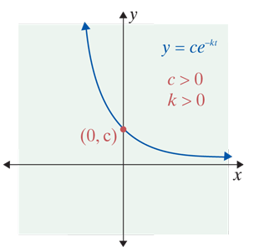
Exponential Decay
Exponential Decline
A function y = f(t) satisfies the equation
if and only if
If k and c are positive, we say that
y declines (or decays) exponentially.
See Figure for a general graph of exponential decline.

Slide 12
Example 3: Carbon-14
The radioactive substance carbon-14 is known to maintain a constant level in living plants and animals. When a plant or animal dies, the level of carbon-14 decays at a rate proportional to the amount present. That is, carbon-14 decays exponentially. For carbon-14, the constant of proportionality is approximately k = 0.000124. Suppose that an animal bone is found at an archeological dig and that it contains 40 percent of its original amount of carbon-14. How old is the bone?

Slide 13
Example 3: Carbon-14 (cont.)
Solution:
Using the function
y = ce^{−0.000124t}
to represent the amount of carbon-14 present, we find that if t = 0, then
y = ce⁰ = c.

Slide 14
Example 3: Carbon-14 (cont.)
That is, c is the amount of carbon-14 present when the animal died. We know that t years after the animal’s death there is 40 percent of the original amount of carbon-14 left. The amount of carbon-14 currently present is thus,
y = 0.40c.

Slide 15
Example 3: Carbon-14 (cont.)
Now, to find the age of the bone t, we substitute
y = 0.40c into our original equation, and solve for t.
The bone is approximately 7400 years old.

Slide 16
Limited Growth
Limited Growth
The mathematical model for limited growth is
where c and k are positive constants.

Slide 17
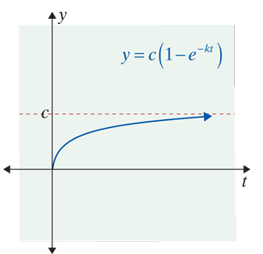
Limited Growth
NOTES
1. As t increases, decreases and approaches 0.
2. As t increases, approaches 1.
3. As t increases, y approaches c,
as shown in the Figure.

Slide 18
Example 4: Limited Growth
Suppose that a man learning to make widgets can make
N = 100(1 − e^{−0.3t})
widgets per week after t weeks on the job.
a. About how many widgets per week can this man produce after 4 weeks on the job?
b. At what rate will his widget-making skills be improving at the end of the 4th week? the 10th week?

Slide 19
Example 4: Limited Growth (cont.)
Solutions:
a. Substitute t = 4 into the formula for N.
He will make approximately 70 widgets per week after 4 weeks on the job.

Slide 20
Example 4: Limited Growth (cont.)
b. To find his rate of learning (or rate of improvement),
we need
Find N′.

Slide 21
Example 4: Limited Growth (cont.)
At t = 4,
At t = 10,
At 4 weeks, his rate of improvement is about 9 widgets per week. By 10 weeks, he is getting closer to the top of his learning curve as his rate of improvement is slowing to 1.5 widgets per week.

Slide 22
Example 5: Half-Life
Suppose that the decay of a particular radioactive isotope is described by the equation
y = 200e^{−0.05t},
where y is the amount of the isotope in grams and t is time in years. Find the half-life of this isotope.
Solution:
When t = 0, we have
y = 200e⁰ = 200.

Slide 23
Example 5: Half-Life (cont.)
Thus, initially, there are 200 grams of the isotope present. We want to find the time it takes for there to be 100 grams left (half of the initial amount of 200 grams).
Therefore, we want to find t in the equation
100 = 200e^{−0.05t}.
We divide both sides of the equation by 200 and then use the definition of natural logarithm:

Slide 24
Example 5: Half-Life (cont.)
Thus
The half-life of the isotope is about 13.86 years.

Slide 25
Logarithmic Differentiation and the General Exponential and Logarithmic Derivatives
General Exponential Derivative
1.
2. Chain Rule:

Slide 26
Logarithmic Differentiation and the General Exponential and Logarithmic Derivatives
General Logarithmic Derivative
1.
2. Chain Rule:

Slide 27
Example 6: Using the Derivatives
Given determine f ′(x).
Solution:
Use the Product Rule.

