Slide 1
Section 13.5
L’Hôpital’s Rule

Slide 2
Objectives
Limits of Indeterminate Forms and
Limits of Other Indeterminate Forms.

Slide 3
Example 1
Determine
Solution
Although we have learned ways to algebraically manipulate fractions of this sort in order to find the limit, l’Hôpital’s Rule makes it strikingly easy.

Slide 4
Theorem: Cauchy’s Mean Value Theorem
Cauchy’s Mean Value Theorem
Suppose that f and g are continuous on [a,b] and differentiable on (a,b), on (a,b), and
Then there is a point such that

Slide 5
Theorem: L’Hôpital’s Rule
L’Hôpital’s Rule
Suppose f and g are differentiable at all points of an open interval I containing c, and that for all
x ∈ I except possibly at x = c. Suppose further that either
or

Slide 6
Theorem: L’Hôpital’s Rule
L’Hôpital’s Rule (cont.)
Then
assuming the limit on the right is a real number or ∞ or −∞.
Further, the rule is true for one‑sided limits at c and for limits at infinity; that is, x → c can be replaced with
x → c⁺, x → c⁻, x → −∞, or x → ∞, assuming always that the limit on the right is a real number or ∞ or −∞.

Slide 7
Theorem: L’Hôpital’s Rule
Proof
We will prove only the case in which
and we will prove that the claim is true as x → c⁻; the corresponding result for x → c⁺ is nearly identical, and the two one‑sided limits together prove the theorem.
Suppose that x ∈ I is a number lying to the left of c. Then and we can apply Cauchy’s MVT to the interval [x,c].

Slide 8
Theorem: L’Hôpital’s Rule
Proof (cont.)
Thus, there is a point such that
∼
∼
∼

Slide 9
Theorem: L’Hôpital’s Rule
Proof (cont.)
As we let x → c⁻, as well since c always lies between x and c. Hence,
∼
∼
∼
∼

Slide 10
Example 2
Determine
Solution
First, note that l’Hôpital’s Rule is indeed applicable: this limit at infinity is of indeterminate form So we evaluate the limit as follows.

Slide 11
Example 3
Determine where a > 0 is a constant.
Solution
The limit is of indeterminate form so we proceed using l’Hôpital’s Rule.

Slide 12
Caution
Caution
L’Hôpital’s Rule says the limit of a quotient of two functions is equal to the limit of the quotient of their derivatives—don’t mistakenly apply the Quotient Rule of differentiation! After verifying that the conditions of l’Hôpital’s Rule are satisfied, proceed by differentiating the numerator and denominator individually.

Slide 13
Example 4
Evaluate the following limits.

Slide 14
Example 4 (cont.)
Solution
a. The limit is of indeterminate form so we can apply l’Hôpital’s Rule.

Slide 15
Example 4 (cont.)
b. The limit is of indeterminate form 0/0 and we apply l’Hôpital’s Rule.
If we mistakenly continued to apply the rule, we would have obtained
which is incorrect.

Slide 16
Example 5
Determine
Solution
We say that a limit of a product fg is of indeterminate form 0 ⋅ ∞ if one of the functions approaches 0 and the other approaches ∞ or −∞. The limit, if it exists, depends on which function dominates—the product could tend toward 0, could grow unbounded, or could approach some nonzero real number if the two functions balance one another just right.

Slide 17
Example 5 (cont.)
We can apply l’Hôpital’s Rule if we can rewrite the product as a quotient in either the indeterminate form
or That is, we rewrite fg as either
whichever is easier to work with.

Slide 18
Example 5 (cont.)
In this example,

Slide 19
Example 6
Determine
Solution
A limit of a difference f − g is of indeterminate form
∞ − ∞ if f → ∞ and g → ∞. Again, such limits are usually not trivial: if f dominates, the difference will tend to ∞; and if g dominates, the difference will tend to −∞; but it is also possible for the two to balance out and result in a finite limit.

Slide 20
Example 6 (cont.)
To use l’Hôpital’s Rule, we need to rewrite the difference as a quotient. In this case, we can do so by combining the two fractions using a common denominator; in other such problems, rationalization or factoring out a common factor may be helpful.

Slide 21
Example 6 (cont.)
Apply l’Hôpital’s Rule once.
Simplify the fraction.
Apply l’Hôpital’s Rule again.

Slide 22
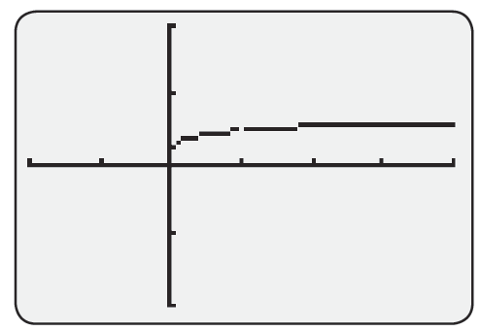
Example 6 (cont.)
Figure visually confirms the limit we found.

Slide 23
Example 7
Determine
Solution
Note that the base of the expression goes to 1 and the exponent goes to ∞ as x → 0⁺. We let

Slide 24
Example 7 (cont.)
The limit of this last expression is of the form and we can apply l’Hôpital’s Rule.
Since
Hence,

Slide 25
Example 8
Determine
Solution
Both the base and the exponent approach 0. Letting
y = x^{x}, we arrive at
a limit of indeterminate form

Slide 26
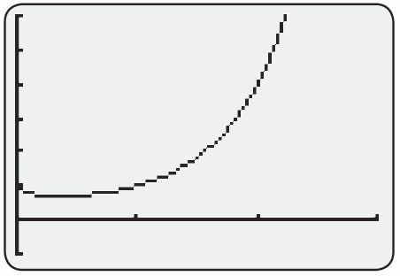
Example 8 (cont.)
So,
and hence x^{x} → e⁰ = 1 as x → 0⁺
(don’t forget this last step!).
Y = x^{x} on [0, 3] by [−1, 6]

Slide 27
Example 9
Determine
Solution
The base has a limit of ∞ and the exponent has a limit of 0. We proceed as in the last two examples.

Slide 28
Example 9 (cont.)
Applying l’Hôpital’s Rule,
and therefore

