Slide 1
Section 13.6
Differentials

Slide 2
Objectives
Find the differential of a function.
Use differentials to approximate changes in volume, revenue, and other real-life applications.

Slide 3
Differentials
Differential
If y = f(x) is a function and y′ = f′(x) exists, then the differential dy is defined as
dy = f′(x) ⋅ dx .

Slide 4
Example 1: Finding Differentials
a. Find dy for y = x².
Solution:
Find the derivative of y.
Substitute f′(x) = 2x into the definition of differential.

Slide 5
Example 1: Finding Differentials (cont.)
b. Find du for
Solution:
The differential du is found in the same way as dy,
So
Find the derivative of u.

Slide 6
Example 1: Finding Differentials (cont.)
c. Find dv if
Solution:
So
Find the derivative of v.

Slide 7
Example 2: Using Differentials
For find a. Δy, b. dy, and c. Δy − dy.
Solutions:

Slide 8
Example 2: Using Differentials (cont.)
Find the derivative of y.
Substitute f ′(x) = 2x into the definition of differential.
Substitute in x = 9 and dx = 0.1.
Substitute the values found in parts a. and b. into the equation and solve.

Slide 9
Example 3: Estimating Square Roots
Using differentials, estimate
Solution:
Here we let
We have chosen x = 16 because 16 is the closest square number to 15. This gives 15 = 16 + Δx, which leads to Δx = −1.

Slide 10
Example 3: Estimating Square Roots (cont.)
So
Rewrite f(x) using exponents.
Find the derivative of f(x).
Substitute f ′(x) into the definition of differential.
Find dy for x = 16: substitute x = 16 and Δx = −1.

Slide 11
Example 3: Estimating Square Roots (cont.)
This means that
Your calculator will give

Slide 12
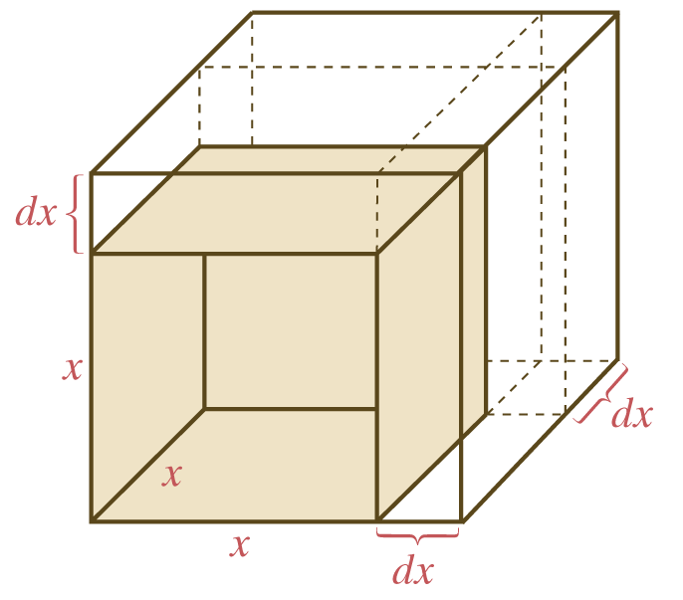
Example 4: Volume
The volume of a cube with edge x is given by V = x³. Using differentials, approximate the change in V if x is
a. Changed from 5 cm to 5.01 cm.
b. Changed from 5 cm to 4.99 cm.

Slide 13
Example 4: Volume (cont.)
Solutions:
If x = 5 and dx = 0.01, then
Substitute in x = 5 (original length of an edge) and dx = 0.01 (the change in length).

Slide 14
Example 4: Volume (cont.)
b. Using x = 5 and dx = −0.01,
Note that with a calculator, we can find the volume of each cube:
So our values of dV = ± 0.75 (calculated in parts a. and b.) are very close to the actual changes in volume.

Slide 15

Example 5: Change in Revenue
Suppose that a company makes and sells x tennis rackets per week, and the corresponding revenue function (in hundreds of dollars) is
where x is between 0 and 600. Use dR to estimate the approximate change in revenue if production is
a. Increased from 150 to 160 rackets.
b. Increased from 480 to 490 rackets.

Slide 16
Example 5: Change in Revenue (cont.)
Solutions:

Slide 17
Example 5: Change in Revenue (cont.)
Let x = 150 and Δx = dx = 160 − 150 = 10.
Then
The change in revenue is approximately 100 hundred dollars (or $10,000).

Slide 18
Example 5: Change in Revenue (cont.)
b. Let x = 480 and Δx = dx = 490 − 480 = 10.
Then
The change in revenue is negative 120 hundred dollars, or a loss of $12,000. In this case, the revenue is actually decreasing at a high level of production and sales because the corresponding price of rackets has been lowered to maintain sales.

