Slide 1
Section 14.3
Area and Riemann Sums

Slide 2
Objectives
Use Riemann sums to estimate the area under a curve.

Slide 3
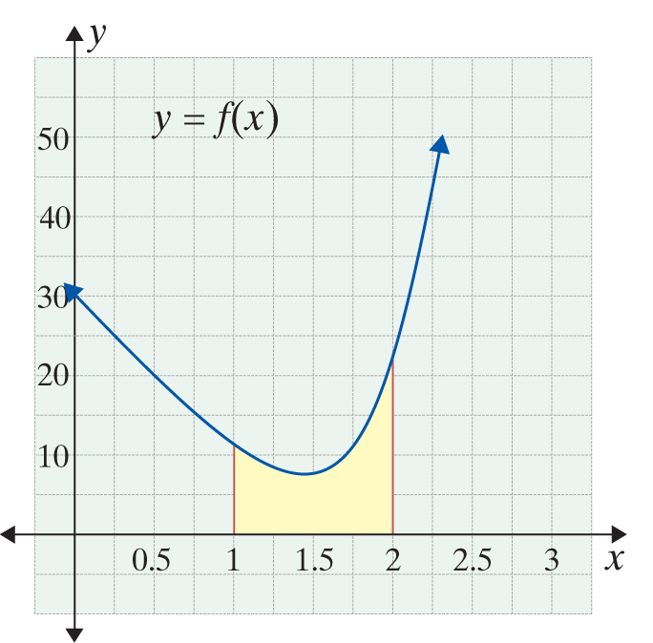
Example 1: Using the Fundamental Theorem of Calculus
Use the Fundamental Theorem of Calculus to determine the area under the graph of
and over the x-axis interval [1, 2].
Solution:
First, we must find the
antiderivative, F(x).

Slide 4
Example 1: Using the Fundamental Theorem of Calculus (cont.)
Using the antiderivative, solve for F(b) − F(a).
Use a = 1 and b = 2.
The area is 10.5 square units.

Slide 5
Riemann Sums
General Form of a Riemann Sum
The general form of a Riemann sum for a function
y = f(x) continuous on [a, b] is
Where n is the number of subintervals of
[a, b] and each of the numbers represents one x-value from each subinterval.

Slide 6
Example 2: Riemann Sum
Use a Riemann sum to estimate the area between
and the x-axis on the interval [a, b] = [1, 5]
with n = 4.
Solution:
In this example we use the midpoint of each subinterval for the values of
First, we find Δx by substituting the given values a = 1, b = 5, and
n = 4.

Slide 7
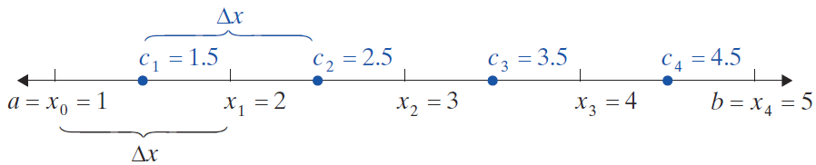
Example 2: Riemann Sum (cont.)
Substitute the appropriate values into the general form of the Riemann sum.

Slide 8
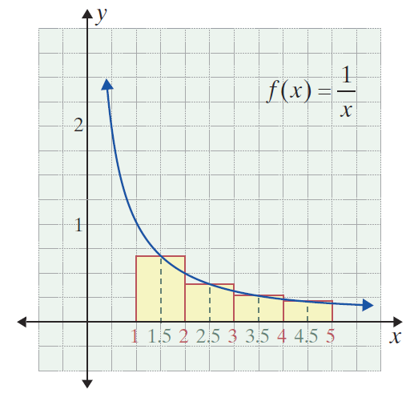
Example 2: Riemann Sum (cont.)

Slide 9
Example 3: Riemann Sum
Use a Riemann sum to estimate the area between
and the x-axis on the interval [a, b] = [−1, 2] with n = 6.
Solution:
In this example we use the left endpoint of each subinterval for the values of
First, we find Δx by substituting the given values a = −1, b = 2, and n = 6.

Slide 10
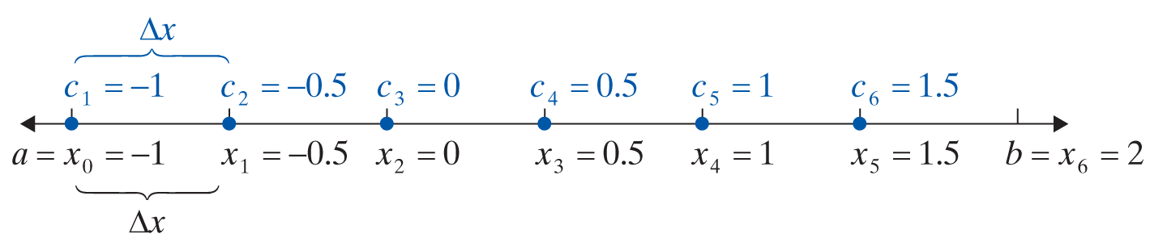
Example 3: Riemann Sum (cont.)
Substitute the appropriate values into the general form of the Riemann sum.

Slide 11
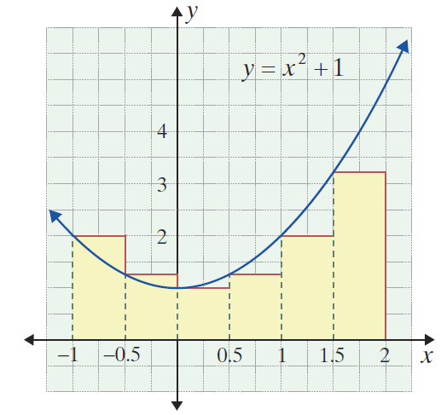
Example 3: Riemann Sum (cont.)

Slide 12
Riemann Sums
Notes
Programmable graphing calculators (like the TI-84 Plus) will calculate various types of Riemann sums directly using a menu. We do not include such problems in this text.

