Slide 1
Section 15.4
Numerical Integration

Slide 2
Objectives
The Trapezoidal Rule.
Simpson’s Rule.

Slide 3
Definition: Trapezoidal Rule
Trapezoidal Rule
An approximation of using the Trapezoidal Rule is the sum
where and x_{i} = a + iΔx for i = 0, 1, …, n.

Slide 4
Example 1
Use the Trapezoidal Rule to approximate with n = 10, and compare the result to the exact value of this integral.
Solution
Given that a = 1, b = 2, and n = 10, we note that and for i from 0 to 10.

Slide 5
Example 1 (cont.)
Using integration by parts, we know that so
So
approximately 0.1% of the exact value.

Slide 6
Example 2
A hygrometer at a weather station records the following percent humidity measurements at the top of the hour from midnight to noon one day.
Use the Trapezoidal Rule to find the approximate average percent humidity over this 12-hour period.
Time | Humidity (%) | Time | Humidity (%)
12 a.m. | 55 | 7 a.m. | 70
1 a.m. | 57 | 8 a.m. | 62
2 a.m. | 60 | 9 a.m. | 50
3 a.m. | 65 | 10 a.m. | 48
4 a.m. | 72 | 11 a.m. | 48
5 a.m. | 75 | 12 p.m. | 47
6 a.m. | 74

Slide 7
Example 2 (cont.)
Solution
Taking this approach to finding the average humidity, we are implicitly making the assumption that humidity h is a continuous function of time—under this
assumption, we know that exists, even if we
don’t actually know a formula for h. Assumptions like this are reasonable, because physical attributes like humidity don’t typically exhibit abrupt discontinuous changes.

Slide 8
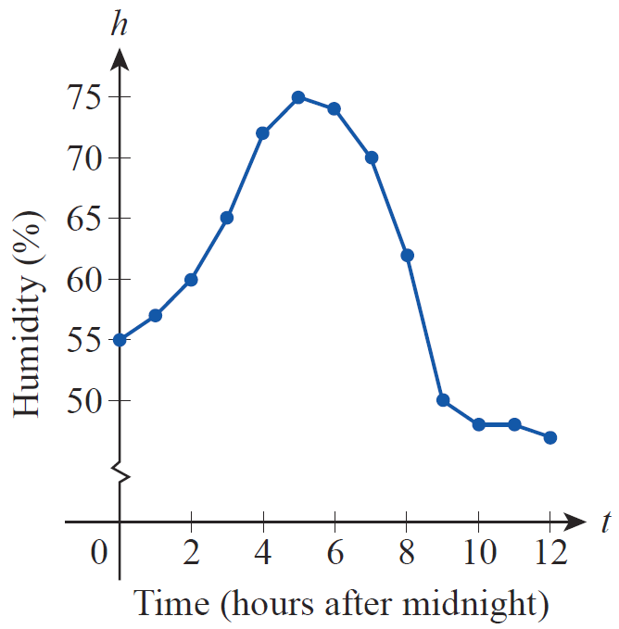
Example 2 (cont.)
If we simply plot the 13 data points we have and connect them with straight lines, the result is the graph.
Humidity Measurements

Slide 9
Example 2 (cont.)
Note that the data indicate sharper changes in humidity over some one-hour periods than others. Using our formula for the average value of a function over an interval we have
Since we don’t have a formula for h, we use the Trapezoidal Rule with Δt = 1 hour.

Slide 10
Example 2 (cont.)
Compare this to the less sophisticated approach of simply taking the average of the 13 data points, which gives us an answer of approximately 60.2% humidity. The difference comes from the fact that a simple average does not take into account differing rates of change of the humidity over the interval.

Slide 11
Theorem: Error Estimate for the Trapezoidal Rule
Error Estimate for the Trapezoidal Rule
If f″ is continuous on [a, b] and M is an upper bound for |f′′ (x)|, then the error E_{T} between the exact value
of and the Trapezoidal Rule approximation T_{n}
satisfies
where n is the number of subintervals in the partition.

Slide 12
Example 3
Determine a number of subintervals that will guarantee
an approximation of to within an error of
0.01 using the Trapezoidal Rule.
Solution
Although an antiderivative of cannot be expressed in terms of elementary functions, its second derivative is easy enough to determine:

Slide 13
Example 3 (cont.)
Since sine and cosine are always bounded by 1 in magnitude, we have the following:

Slide 14
Example 3 (cont.)
Any upper bound M of |f″ (x)| on the interval will work, and M = 48 is a convenient number larger than 2 + 4π ². We can now ensure |E_{T}|< 0.01 by solving the inequality
for n.

Slide 15
Example 3 (cont.)
So n = 112 subintervals will provide an approximation of the integral safely within an error of 0.01.

Slide 16
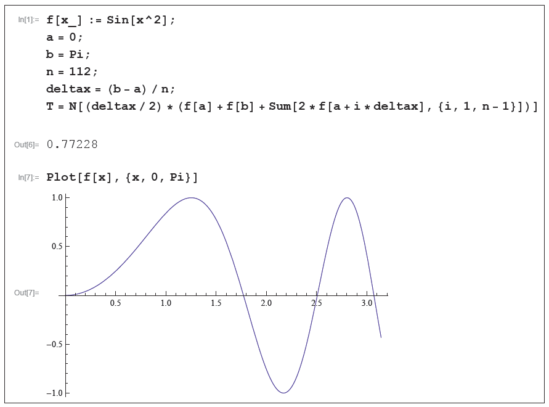
Technology Note
Referring back to Example 3, a computer algebra system like Mathematica can be used to calculate the approximation T₁₁₂ = 0.77228 with commands such as the ones shown in Figure.
Using the Trapezoidal Rule in Mathematica

Slide 17
Theorem: Simpson’s Rule
Simpson’s Rule
An approximation of using Simpson’s Rule is the sum
where n is even, and x_{i} = a + iΔx for i = 0, …, n. (Note the pattern of the coefficients: 1, 4, 2, 4, 2, …, 2, 4, 1.)

Slide 18
Example 4
Use Simpson’s Rule to approximate with n = 10.
Solution
As in Example 1, a = 1, b = 2, and for i from 0 to 10.
This is a considerable improvement over the Trapezoidal Rule approximation, and only differs in the 6th decimal place from the exact answer.

Slide 19
Theorem: Error Estimate for Simpson’s Rule
Error Estimate for Simpson’s Rule
If f⁽⁴⁾ is continuous on [a, b] and M is an upper bound for |f ⁽⁴⁾ (x)|, then the error E_{S} between the exact value
of and the Simpson’s Rule approximation S_{n}
satisfies
where n is the number of subintervals in the partition.

Slide 20
Example 5
Use Simpson’s Rule with n = 4 to approximate the
nonelementary integral and estimate the error
in the approximation.
Solution
With a = 0, b = 1, and n = 4, we have and x_{i} = i/4 for i = 0, …, 4.

Slide 21
Example 5 (cont.)
The fourth derivative of is and for we know
so the error estimate E_{S} satisfies

Slide 22
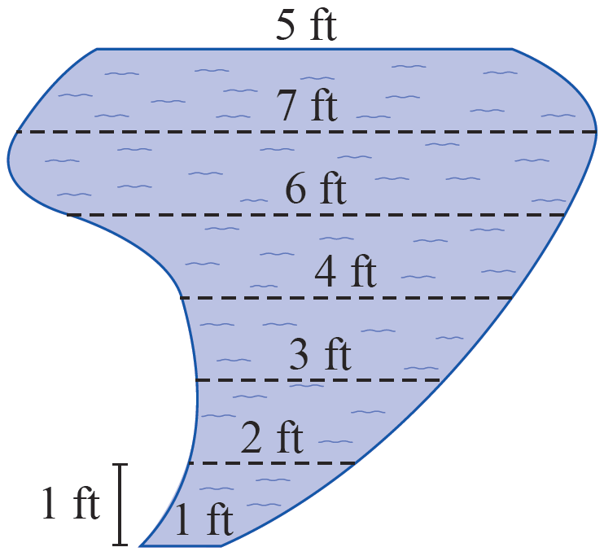
Example 6
A landscape designer has planned a free-form garden pond with the shape shown in Figure and needs to estimate its volume in cubic feet. The pond will have a uniform depth of 2 feet. At 1-foot intervals, the distances across the pond are to be as indicated in the diagram. Use Simpson’s Rule to estimate the volume of the pond.
Garden Pond

Slide 23
Example 6 (cont.)
Solution
To use Simpson’s Rule, we let Δx = 1 and take the distances as shown to be the values of a function. Note that n = 6.
So the estimated volume of the pond is this surface
area times the depth, or

