Slide 1
Section 15.6
Volume

Slide 2
Objectives
Find the volume of a solid of revolution.

Slide 3
Solid of Revolution
Volume of a Solid of Revolution
If y = f(x) is a nonnegative continuous function on the interval [a, b], then the volume of the solid formed by revolving the region bounded by the graph of the function and the x-axis (a ≤ x ≤ b) about the x-axis is given by

Slide 4
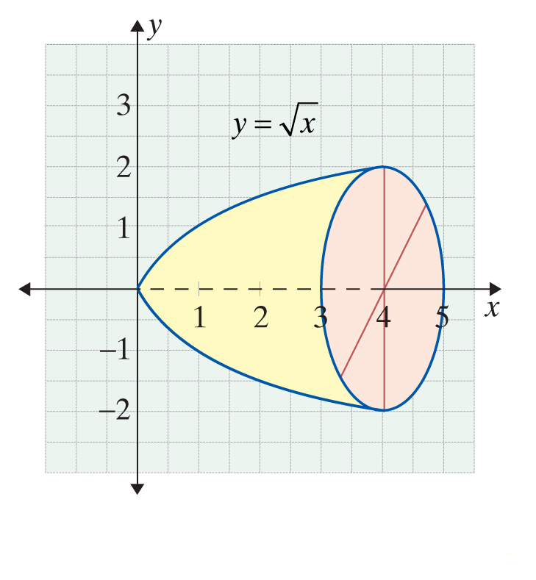
Example 1: Finding the Volume of a Solid of Revolution
Find the volume of the solid of revolution generated by
revolving the region under the curve from x = 0 to x = 4 about the axis.
Solution:
The volume is 8π cubic units.

Slide 5
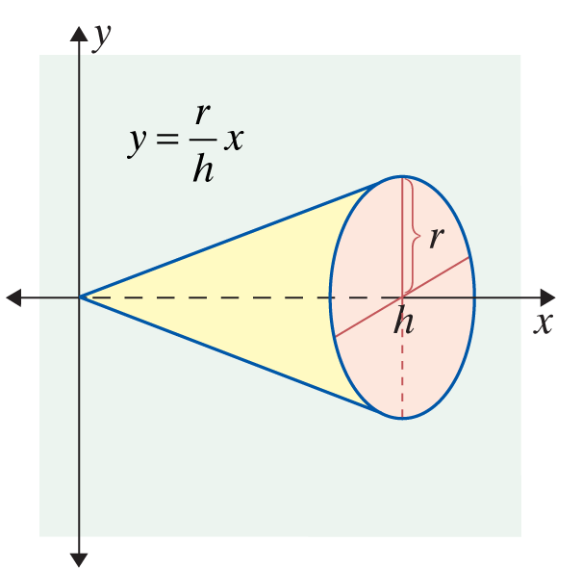
Example 2: Finding the Volume of a Solid of Revolution
If the region under the line from x = 0 to x = h is
revolved about the x-axis, a circular cone is formed. Find the volume of this cone.
Solution:

Slide 6
Example 2: Finding the Volume of a Solid of Revolution (cont.)
Thus the volume is given by the standard formula

Slide 7
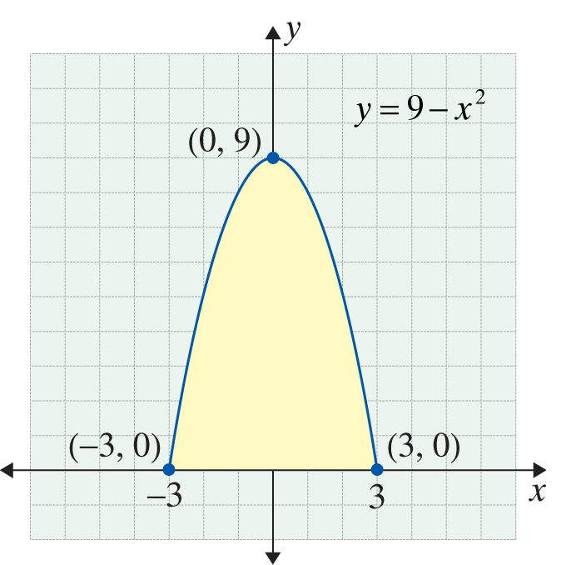
Example 3: Finding the Volume of a Solid of Revolution
The region bounded by the parabola y = 9 − x² and the x-axis is revolved about the x-axis. Find the volume of the solid of revolution that is generated.
Solution:
Set y = 0 to find the points where
the parabola intersects the x-axis.

Slide 8
Example 3: Finding the Volume of a Solid of Revolution (cont.)

Slide 9
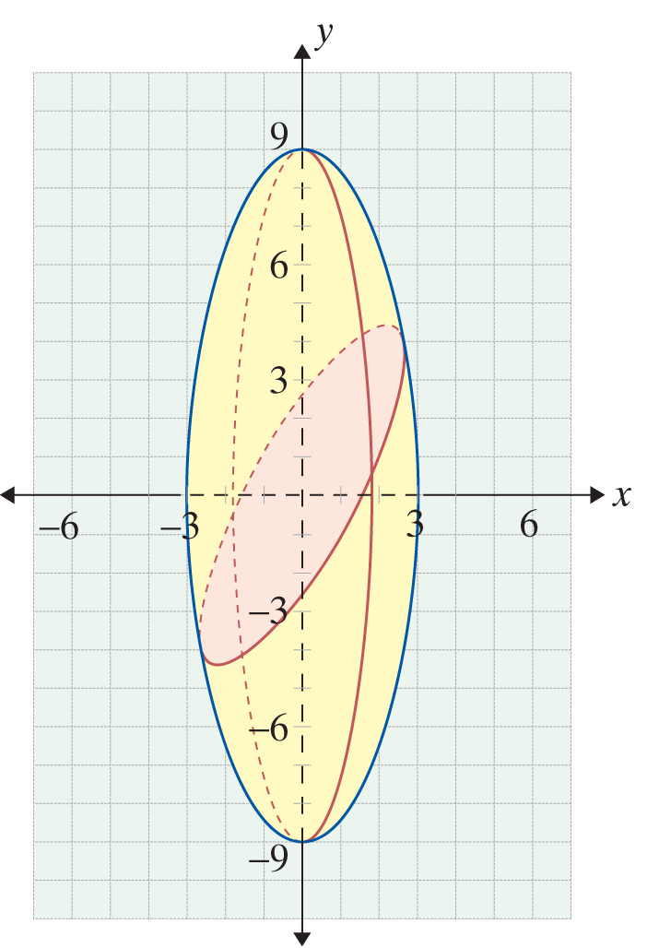
Example 3: Finding the Volume of a Solid of Revolution (cont.)

