Slide 1
Section 16.1
Functions of Several Variables

Slide 2
Objectives
Evaluate values for functions of two or more variables.
Graph a function of two variables in a 3D coordinate system.

Slide 3
Functions of Several Variables
Domain and Range of f(x, y)
If D is a set of ordered pairs of real numbers and for each ordered pair (x, y) in D there corresponds a unique real number f(x, y), then f is called a function of x and y. The set D is the domain of the function. The set of all the values of f(x, y) is called the range of the function.

Slide 4
Example 1: Evaluating f(x, y)
For find the following:
Solutions:
Substitute x = 2 and y = 3.
Substitute x = 2 and
Substitute x = 0 and y = 0.

Slide 5
Example 2: Evaluating f(x, y)
For
a. find the domain and b. find f(0, 1).
Solutions:
a. For to be defined, we must have x ≥ 0.
For lny to be defined, we must have y > 0.
So, the domain is
Substitute x = 0 and y = 1.

Slide 6
Example 3: Evaluating Revenue Influenced by Two Variables
A pharmacy sells two brands of aspirin. Brand A sells for $1.25 per bottle and Brand B sells for $1.50 per bottle.
a. What is the revenue function for aspirin?
b. What is the revenue for aspirin if 100 bottles of Brand A and 150 bottles of Brand B are sold?

Slide 7
Example 3: Evaluating Revenue Influenced by Two Variables (cont.)
Solutions:
a. Let x = the number of bottles of Brand A sold, and y = the number of bottles of Brand B sold.
Then the revenue function is
b.

Slide 8
Example 4: Characteristics of a Box
Suppose that a box has a square base and an open top.
a. Write a function of two variables that represents the volume of the box.
b. Write a function of two variables that represents the surface area of the box.
c. Determine the surface area if x = 4 and y = 5.

Slide 9
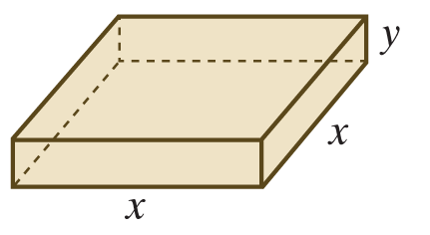
Example 4: Characteristics of a Box (cont.)
Solutions:
Since the base is square, the length and width of the box are equal.
Let x = length of the box,
x = width of the box, and
y = height of the box.

Slide 10
Example 4: Characteristics of a Box (cont.)
a. The formula for the volume of a rectangular solid is V = l ⋅ w ⋅ h, where l = length, w = width, and h = height. Thus, the function that represents the volume of this box is

Slide 11
Example 4: Characteristics of a Box (cont.)
b. The surface area consists of the sum of the areas of the bottom surface, the front and back faces, and the left and the right faces. For this box, we have
x² = area of bottom surface and
xy = area of each of the other four faces.
Thus, the total surface area is represented by the function

Slide 12
Example 4: Characteristics of a Box (cont.)
c. Evaluate this function in two variables at x = 4 and y = 5. Then

Slide 13
Example 5: Using the Cobb-Douglas Production Formula
Suppose that the function represents the number of units produced by a company with x units of labor and y units of capital.
a. How many units of a product will be manufactured if 300 units of labor and 50 units of capital are used?
b. How many units will be produced if twice the number of units of labor and capital are used?
Solutions:
a.
Fractional units are not counted.

Slide 14
Example 5: Using the Cobb-Douglas Production Formula (cont.)
b. If the number of units of labor and capital are both doubled, then
x = 2 ⋅ 300 = 600 and y = 2 ⋅ 50 = 100.
So
Thus, we see that production is doubled if both labor and capital are doubled.
Substitute x = 600 and y = 100.

Slide 15
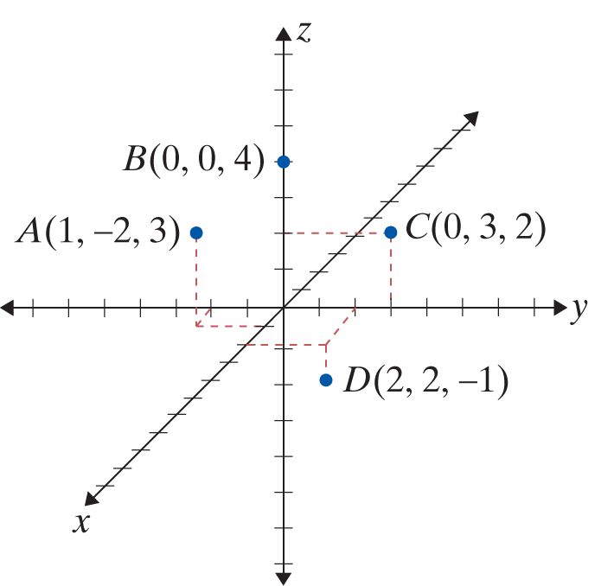
Example 6: Graphing 3D Points
Draw a three-dimensional coordinate system; then graph and label the following points:
A(1, −2, 3), B(0, 0, 4), C(0, 3, 2), and D(2, 2, −1).
Solution:

Slide 16
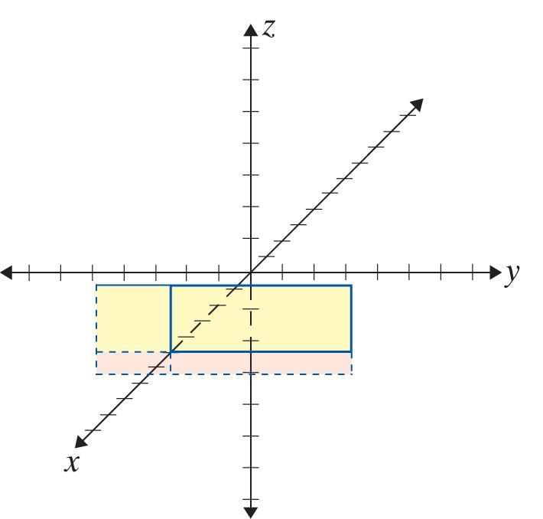
Example 7: Graphing 3D Planes
Set up a three-dimensional coordinate system to graph each of the following planes:
a. x = 5 b. y = −2.
Solutions:
a.
Note: x = 5 is a plane parallel to the yz-plane.

Slide 17
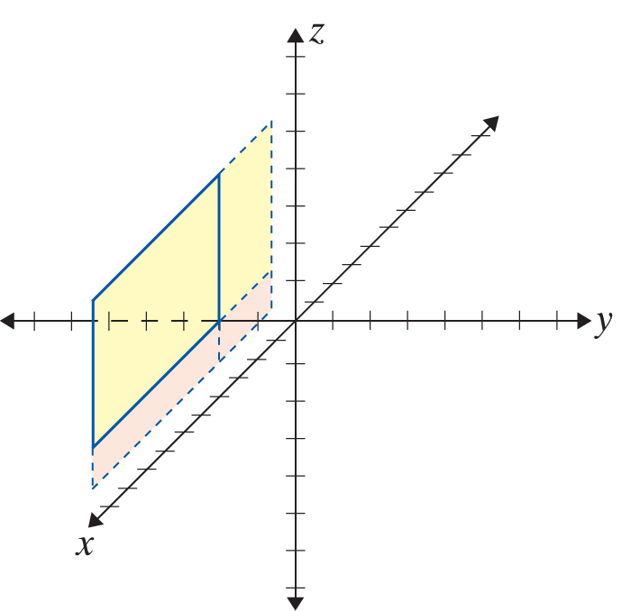
Example 7: Graphing 3D Planes (cont.)
b.
Note: y = −2 is a plane parallel to the xz-plane.
In each graph, the contrasting color corresponds to negative z-values.
Note: In each case, only a portion of the plane is graphed. You might have chosen to sketch a different portion. For your sketch to have a proper perspective, the lines that are shown should be drawn parallel to the coordinate axes.

