Slide 1
Section 16.4
Lagrange Multipliers

Slide 2
Objectives
Apply the method of Lagrange multipliers to solve constrained optimization problems.

Slide 3
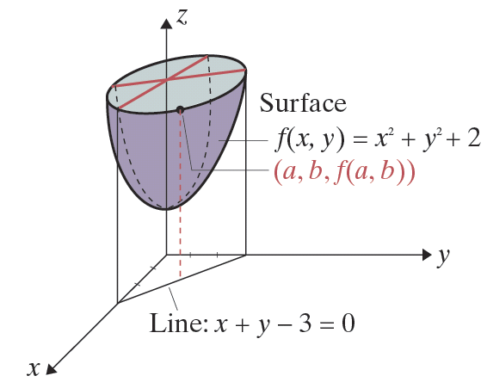
Lagrange Multipliers
Figure 8.4.1

Slide 4
Lagrange Multipliers
The Method of Lagrange Multipliers
To maximize or minimize a function z = f(x, y) subject to the constraint g(x, y) = 0,
Step 1: Form the Lagrange function
Step 2: Find each of the partial derivatives F_{x}, F_{y}, and F_{λ}, provided all partials exist.

Slide 5
Lagrange Multipliers
The Method of Lagrange Multipliers (cont.)
Step 3: Solve the system of three equations

Slide 6
Lagrange Multipliers
The Method of Lagrange Multipliers (cont.)
Step 4: If f has a local maximum or local minimum subject to the constraint g(x, y) = 0, then the corresponding x and y values will be found among the solutions to the system in Step 3.

Slide 7
Example 1: Applying the Method of Lagrange Multipliers
Use the method of Lagrange multipliers to find the minimum value of the function with the constraint x + y − 3 = 0.
Solution:
Step 1: Form the Lagrange function.

Slide 8
Example 1: Applying the Method of Lagrange Multipliers (cont.)
Step 2: Find each of the partial derivatives.
Note: The constraint function g(x, y) will always be equal to F_{λ} because it is treated as a constant coefficient of λ in the Lagrange function.

Slide 9
Example 1: Applying the Method of Lagrange Multipliers (cont.)
Step 3: Solve the following system of equations by isolating λ in equations (1) and (2) and solving the resulting equations.

Slide 10
Example 1: Applying the Method of Lagrange Multipliers (cont.)
Thus −2x = −2y and x = y. Substituting y for x in equation (3) gives
Since x = y, we have y = 1.5.

Slide 11
Example 1: Applying the Method of Lagrange Multipliers (cont.)
Step 4: From the graph in Figure 8.4.1, we can see that
is a minimum. In order to verify this result algebraically, we choose the point (1.4, 1.6), which is close to (1.5, 1.5) and satisfies the constraint x + y − 3 = 0, and find that f(1.4, 1.6) = 6.52 > 6.50. The D-Test can also be used to verify this.

Slide 12
Example 2: Applying the Method of Lagrange Multipliers
Use the method of Lagrange multipliers to find the maximum value of the function f(x, y) = xy under the restriction where x > 0 and y > 0.
Solution:
Step 1: Form the Lagrange function.
Step 2: Find each of the partial derivatives.

Slide 13
Example 2: Applying the Method of Lagrange Multipliers (cont.)
Step 3: Solve the following system of equations by isolating λ in equations (1) and (2) and solving the resulting equations.

Slide 14
Example 2: Applying the Method of Lagrange Multipliers (cont.)
We have which gives and
Substituting x² for y² in equation (3), we have

Slide 15
Example 2: Applying the Method of Lagrange Multipliers (cont.)
Since and y = ±10. Thus there are four points that satisfy the system: (10, 10), (10, −10), (−10, 10), and (−10, −10). However, among these points, only the point (10, 10) satisfies the additional conditions x > 0 and y > 0.

Slide 16
Example 2: Applying the Method of Lagrange Multipliers (cont.)
Step 4: f(10, 10) = (10)(10) = 100 is a maximum for
f(x, y) = xy under the given constraints. As a check that 100 is indeed a maximum, we find that
Note: Points close to (10, 10) have irrational coordinates and we have chosen 9.88 and 10.12 as rounded off values that nearly satisfy the constraints.

Slide 17
Example 3: Optimization Using the Cobb−Douglas Production Formula
Suppose that the Cobb-Douglas Production Formula for a particular product is where x represents units of labor at a cost of $200 per unit and y represents units of capital at a cost of $300 per unit. If the company’s budget allows $120,000 for labor and capital, then the constraint is represented by the equation 200x + 300y = 120,000. Find the maximum level of production for this product.

Slide 18
Example 3: Optimization Using the Cobb−Douglas Production Formula (cont.)
Solution:
Step 1: Form the Lagrange function.
Step 2: Find each of the partial derivatives.

Slide 19
Example 3: Optimization Using the Cobb−Douglas Production Formula (cont.)
Step 3: Solve the following system of equations by
isolating λ in equations (1) and (2) and solving the resulting equations.
From equations (1) and (2) we have

Slide 20
Example 3: Optimization Using the Cobb−Douglas Production Formula (cont.)
Multiply both sides of the equation by
Substitute for y in the partial derivative F_{λ}.

Slide 21
Example 3: Optimization Using the Cobb−Douglas Production Formula (cont.)

Slide 22
Example 3: Optimization Using the Cobb−Douglas Production Formula (cont.)
Step 4: To maximize production, the company should invest 360 units of labor and 160 units of capital. This investment will result in a production level of approximately
(The student should verify that 26,029 is indeed a maximum.)

