Slide 1
Section 2.3
Forms of Linear Equations

Slide 2
The Slope of a Line
The Slope of a Line
Let L stand for a given line in the Cartesian plane, and
let (x₁, y₁) and (x₂, y₂) be the coordinates of any two distinct points on L. The slope of the line L is the
ratio which can be described in words as
“change in y over change in x” or “rise over run.”

Slide 3
The Slope of a Line
Caution
It doesn’t matter how you assign the labels (x₁, y₁) and (x₂, y₂) to the two points you are using to calculate slope, but it is important that you are consistent as you apply the formula. You cannot change the order in which you are subtracting as you determine the numerator and denominator in the slope formula.

Slide 4
Example 1: Calculating the Slope of a Line
Determine the slopes of the lines passing through the following pairs of points in ℝ².

Slide 5
Example 1: Calculating the Slope of a Line (cont.)
Solutions:
The final answer tells us that the line through the two points rises 14 units for every run of 3 units horizontally.

Slide 6
Example 1: Calculating the Slope of a Line (cont.)
These two points have the same y-coordinate and thus lie on a horizontal line.

Slide 7
The Slope of a Line
Slopes of Horizontal and Vertical Lines
Horizontal lines, which can be written in the form y = c, have a slope of 0.
Vertical lines, which can be written in the form x = c, have an undefined slope.

Slide 8
Example 2: Calculating the Slope of a Line
Determine the slopes of the lines defined by the following equations.
Solutions:
a. First, we find two points on the line by calculating the intercepts.

Slide 9
Example 2: Calculating the Slope of a Line (cont.)
Recall that the x-intercept is found by setting y equal to 0 and solving for x, and vice versa for the y-intercept.
Once we have two points, we apply the slope formula.

Slide 10
Example 2: Calculating the Slope of a Line (cont.)
In this example, we have found the x-intercept. We do not have to find both intercepts; the point (1, 1) is clearly on the line and is simple to use in calculation.

Slide 11
Example 2: Calculating the Slope of a Line (cont.)
c. The equation is of the form x = c, and is a vertical line. Therefore, the slope is undefined.
d. This equation is of the form y = c, and is a horizontal line. Therefore, it has a slope of 0.

Slide 12
Slope-Intercept Form of a Line
Slope-Intercept Form of a Line
If the equation of a nonvertical line in x and y is solved for y, the result is an equation in slope-intercept form:
y = mx + b.
The constant m is the slope of the line, and the y-intercept of the line is (0, b). If the variable x does not appear in the equation, the slope is 0 and the equation is simply of the form y = b and is a horizontal line.

Slide 13
Example 3: Slope-Intercept Form of a Line
Use the slope-intercept form of the line to graph the equation 4x − 3y = 6.
Solution:
Solving the equation for y puts it in slope-intercept form. Once we have done this, we know that the line has a
slope of and crosses the y-axis at −2.

Slide 14
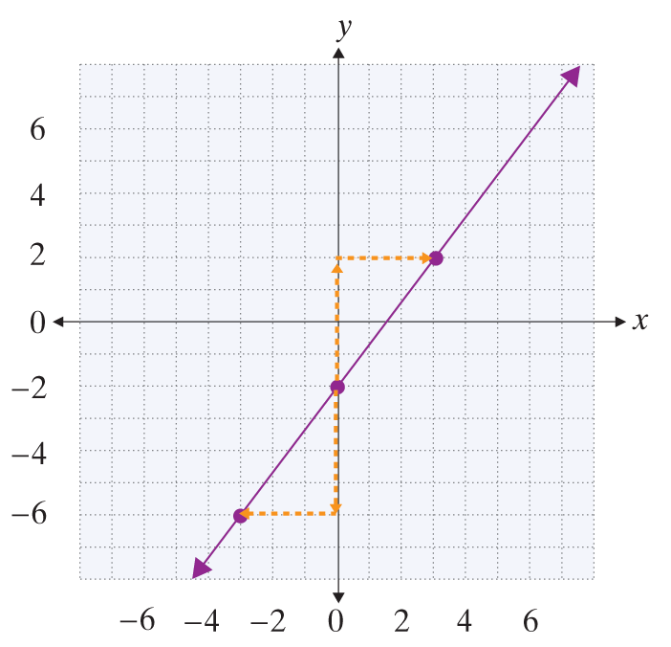
Example 3: Slope-Intercept Form of a Line (cont.)
Immediately, we can plot the y-intercept.
A second point can now be found by using the fact that slope is “rise over run.” This means a second point must lie 4 units to up and 3 units to the right, i.e. at (3, 2).
Alternatively, we could locate a second point by moving down 4 units and moving to the left 3 units.

Slide 15
Example 4: Slope-Intercept Form of a Line
Find the equation of the line that passes through the
point (0, 3) and has a slope of Then graph the line.
Solution:
First, we write the equation of this line in slope-intercept form. We are given the y-intercept of (0, 3)
and the slope of
We can immediately write down the equation since the only information we need is the y-intercept and the slope.

Slide 16
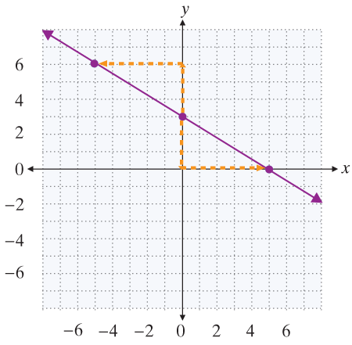
Example 4: Slope-Intercept Form of a Line (cont.)
We first plot the y-intercept, then move down 3 units and to the right 5 units to find a second point.
Or, we could have plotted a second point by moving up 3 units and to the left 5 units. Both methods make
use of the fact that the slope is

Slide 17
Point-Slope Form of a Line
Point-Slope Form of a Line
The point-slope form of the equation for the line
passing through the point (x₁, y₁) with slope m is
Note that m, x₁, and y₁ are all constants, while x and y are variables. Note also that since the line, by definition, has slope m, vertical lines cannot be described in this form.

Slide 18
Example 5: Point-Slope Form of a Line
Find the equation, in slope-intercept form, of the line that passes through the point (−2, 5) with slope 3.
Solution:
Since we are given the slope of the line and a point on the line, we can substitute directly into the point-slope form, then solve for y to obtain the slope-intercept form.

Slide 19
Example 5: Point-Slope Form of a Line (cont.)

Slide 20
Example 6: Point-Slope Form of a Line
Find the equation, in slope-intercept form, of the line that passes through the two points (−3, −2) and (1, 6).
Solution:
We already have a point (actually, two) on the line, but we still need the slope to use the point-slope form. We can calculate this using the two points and the slope formula.

Slide 21
Example 6: Point-Slope Form of a Line (cont.)
Now we can substitute into the point-slope form, then solve for y to obtain the desired slope-intercept equation.
Note that no matter which point we substitute into the point-slope form, the resulting slope-intercept equation is the same.

