Slide 1
Section 2.4
Parallel and Perpendicular Lines

Slide 2
Slopes of Parallel Lines
Definition
Two nonvertical lines with slopes m₁ and m₂ are parallel if and only if m₁ = m₂. Also, two vertical lines (with undefined slopes) are always parallel to each other.

Slide 3

Example 1: Finding Equations of Parallel Lines
Find equations for two lines parallel to each of the given lines.
$y=−\frac{2}{3}x+4$
$10x−2y=14$

Slide 4
Note
When given a line in standard form, it is usually easier to find its slope by rewriting it in slope-intercept form than to find two points on the line and calculate the slope directly.

Slide 5
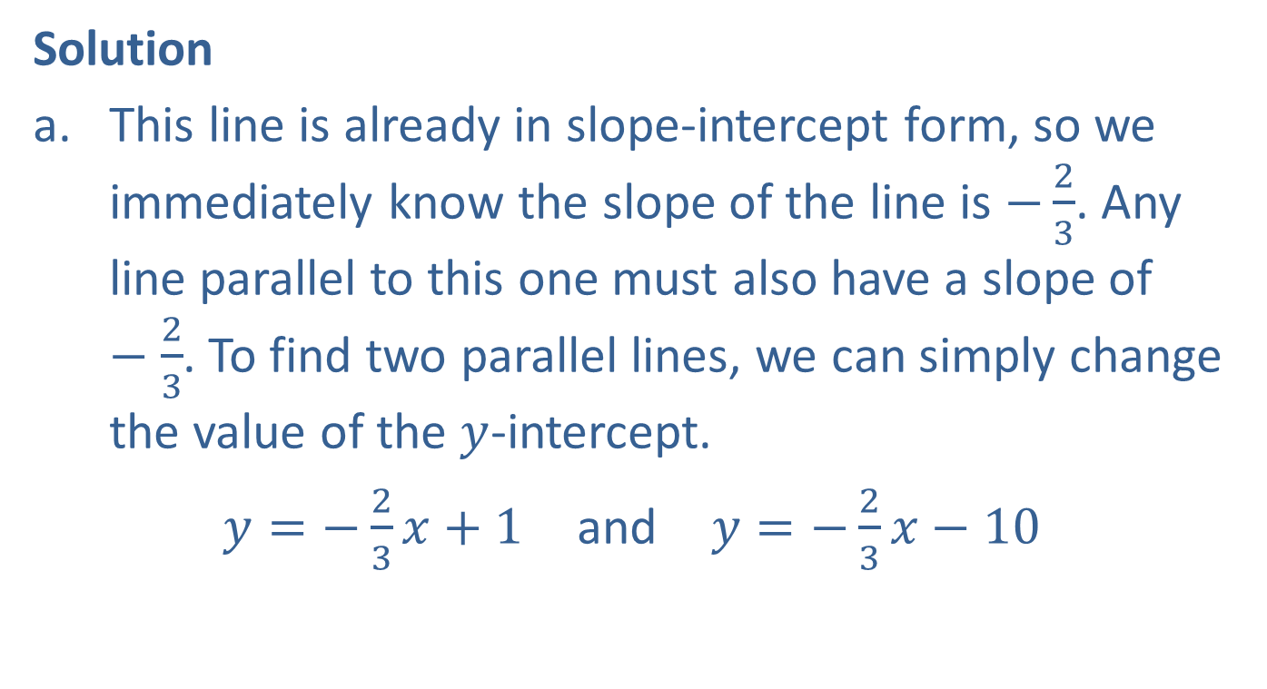
Example 1: Finding Equations of Parallel Lines (cont.)
Solution
This line is already in slope-intercept form, so we immediately know the slope of the line is $−\frac{2}{3}$. Any line parallel to this one must also have a slope of $−\frac{2}{3}$. To find two parallel lines, we can simply change the value of the $y$-intercept.
$y=−\frac{2}{3}x+1$ and $y=−\frac{2}{3}x−10$

Slide 6
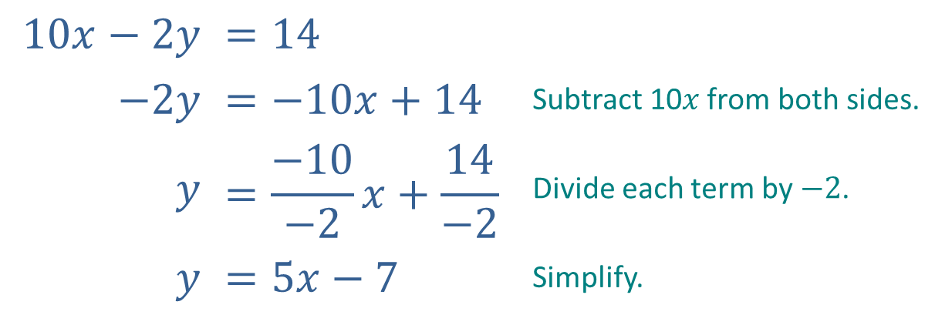
Example 1: Finding Equations of Parallel Lines (cont.)
This line is in standard form. Our first step is to rewrite it in slope-intercept form.
$$10x−2y$$ | $$=14$$
$$−2y$$ | $$=−10x+14$$ | Subtract 10$x$ from both sides.
$$y$$ | $$=\frac{−10}{−2}x+\frac{14}{−2}$$ | Divide each term by $−2$.
$$y$$ | $$=5x−7$$ | Simplify.

Slide 7

Example 1: Finding Equations of Parallel Lines (cont.)
Again, once the line is in slope-intercept form, we can change the $y$-intercept to find two lines parallel to the original line.
$y=5x$ and $y=5x+8$

Slide 8
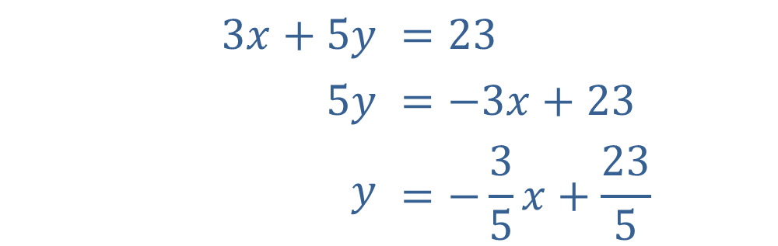
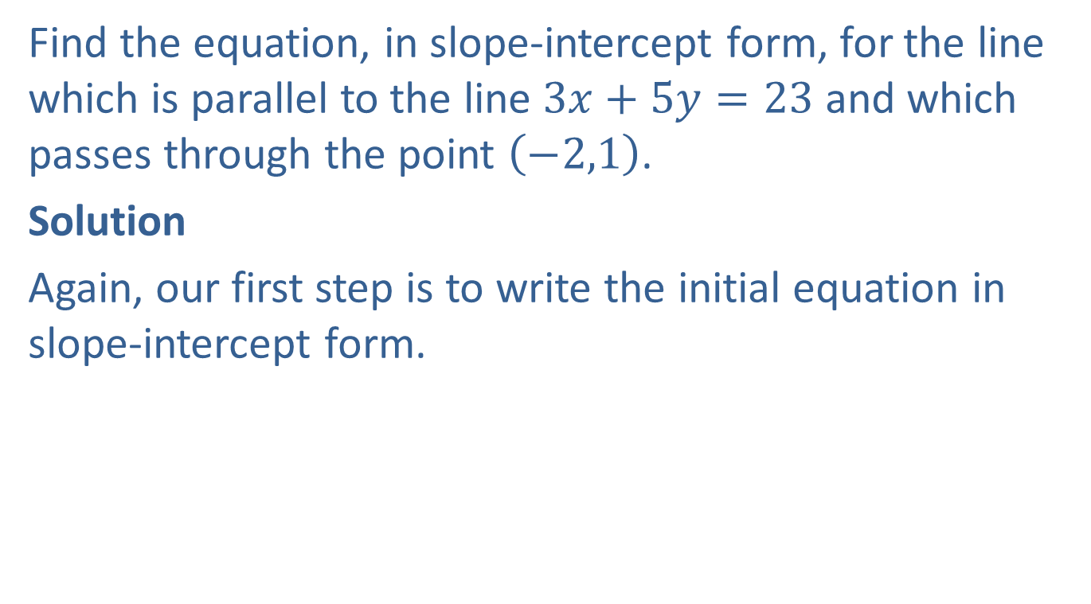
Example 2: Finding Equations of Parallel Lines
Find the equation, in slope-intercept form, for the line which is parallel to the line $3x+5y=23$ and which passes through the point $\left(−2,1\right)$.
Solution
Again, our first step is to write the initial equation in slope-intercept form.
$$3x+5y$$ | $$=23$$
$$5y$$ | $$=−3x+23$$
$$y$$ | $$=−\frac{3}{5}x+\frac{23}{5}$$

Slide 9

Example 2: Finding Equations of Parallel Lines (cont.)
This tells us that the slope of the line whose equation we seek is $−\frac{3}{5}$. We also know that the line is to pass through $\left(−2,1\right)$, so we can use the point-slope form to obtain the desired equation.

Slide 10
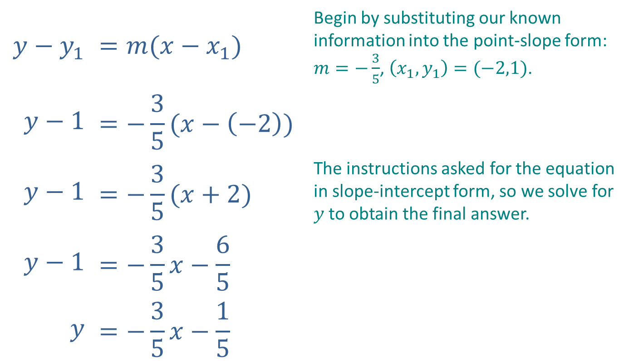
Example 2: Finding Equations of Parallel Lines (cont.)
$$y−y_{1}$$ | $$=m(x−x_{1})$$ | Begin by substituting our known information into the point-slope form: $m=−\frac{3}{5}$, $\left(x_{1}, y_{1}\right)=(−2,1)$.
$$y−1$$ | $$=−\frac{3}{5}(x−\left(−2\right))$$
$$y−1$$ | $$=−\frac{3}{5}(x+2)$$ | The instructions asked for the equation in slope-intercept form, so we solve for $y$ to obtain the final answer.
$$y−1$$ | $$=−\frac{3}{5}x−\frac{6}{5}$$
$$y$$ | $$=−\frac{3}{5}x−\frac{1}{5}$$

Slide 11
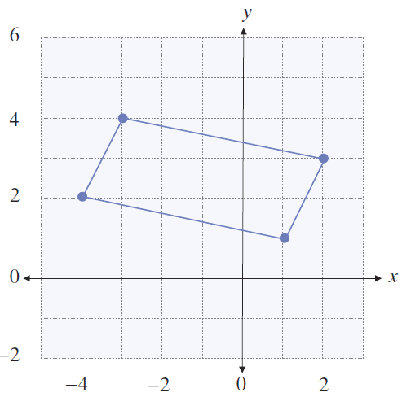
Example 3: Identifying a Quadrilateral
Determine if the graphed quadrilateral (four-sided figure) is a parallelogram (a quadrilateral in which both pairs of opposite sides are parallel).

Slide 12
Example 3: Identifying a Quadrilateral (cont.)
Solution
The four vertices are plotted, and the sides of the quadrilateral are drawn in the given graph. The figure is a parallelogram if the left and right sides are parallel and the top and bottom sides are parallel.

Slide 13
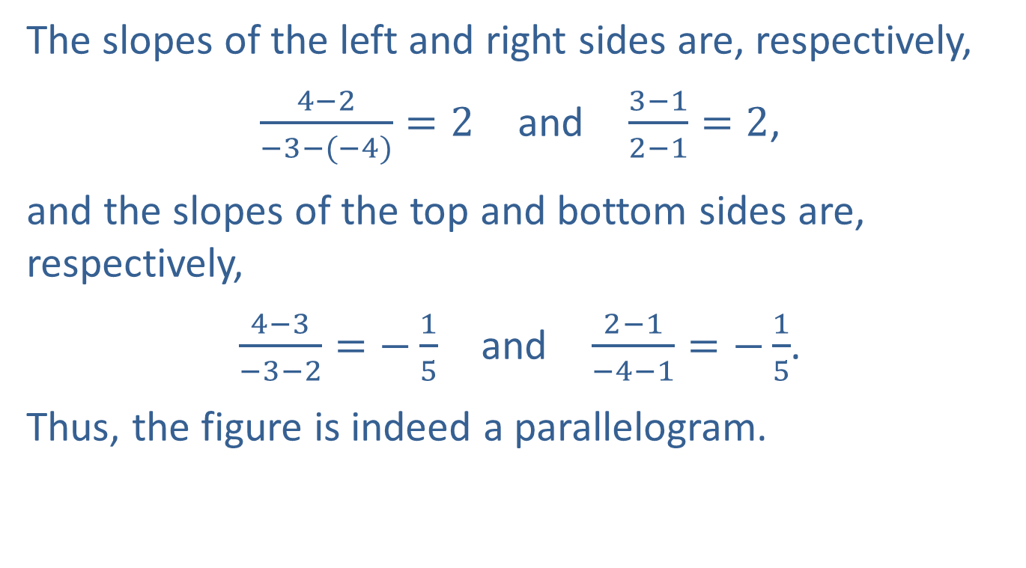
Example 3: Identifying a Quadrilateral (cont.)
The slopes of the left and right sides are, respectively,
$\frac{4−2}{−3−(−4)}=2$ and $\frac{3−1}{2−1}=2$,
and the slopes of the top and bottom sides are, respectively,
$\frac{4−3}{−3−2}=−\frac{1}{5}$ and $\frac{2−1}{−4−1}=−\frac{1}{5}$.
Thus, the figure is indeed a parallelogram.

Slide 14
Slopes of Perpendicular Lines
Definition
Suppose m₁ and m₂ represent the slopes of two lines, neither of which is vertical. The two lines are
perpendicular if and only if (equivalently,
and ). If one of two perpendicular lines is vertical, the other is horizontal, and the slopes are, respectively, undefined and zero.

Slide 15
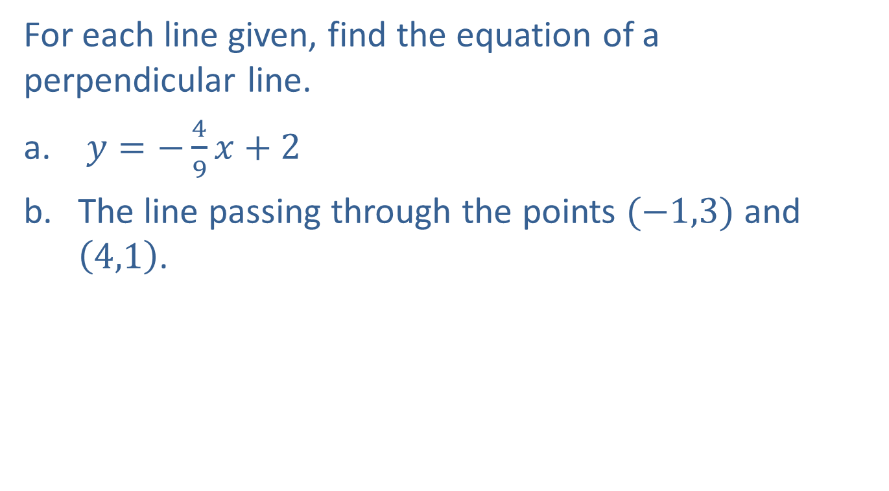
Example 4: Finding Equations of Perpendicular Lines
For each line given, find the equation of a perpendicular line.
$y=−\frac{4}{9}x+2$
The line passing through the points $(−1,3)$ and $\left(4,1\right)$.

Slide 16
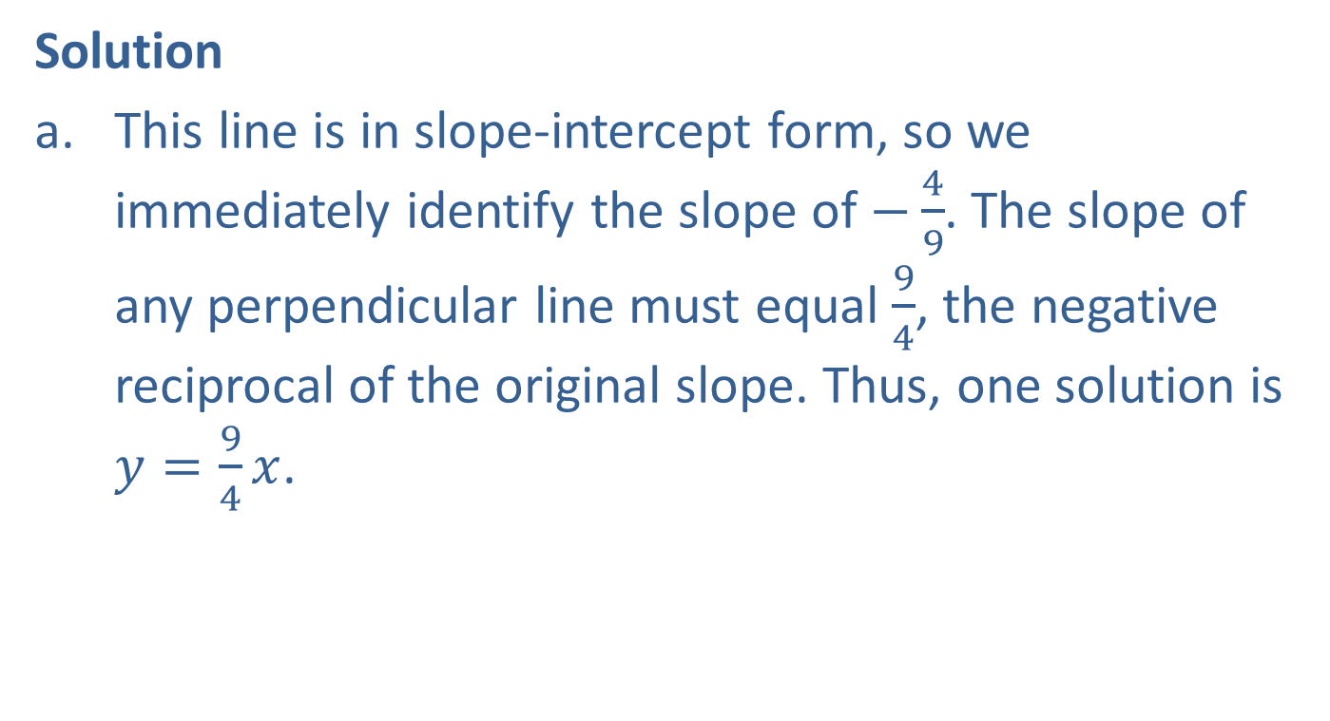
Example 4: Finding Equations of Perpendicular Lines (cont.)
Solution
This line is in slope-intercept form, so we immediately identify the slope of $−\frac{4}{9}$. The slope of any perpendicular line must equal $\frac{9}{4}$, the negative reciprocal of the original slope. Thus, one solution is $y=\frac{9}{4}x$.

Slide 17
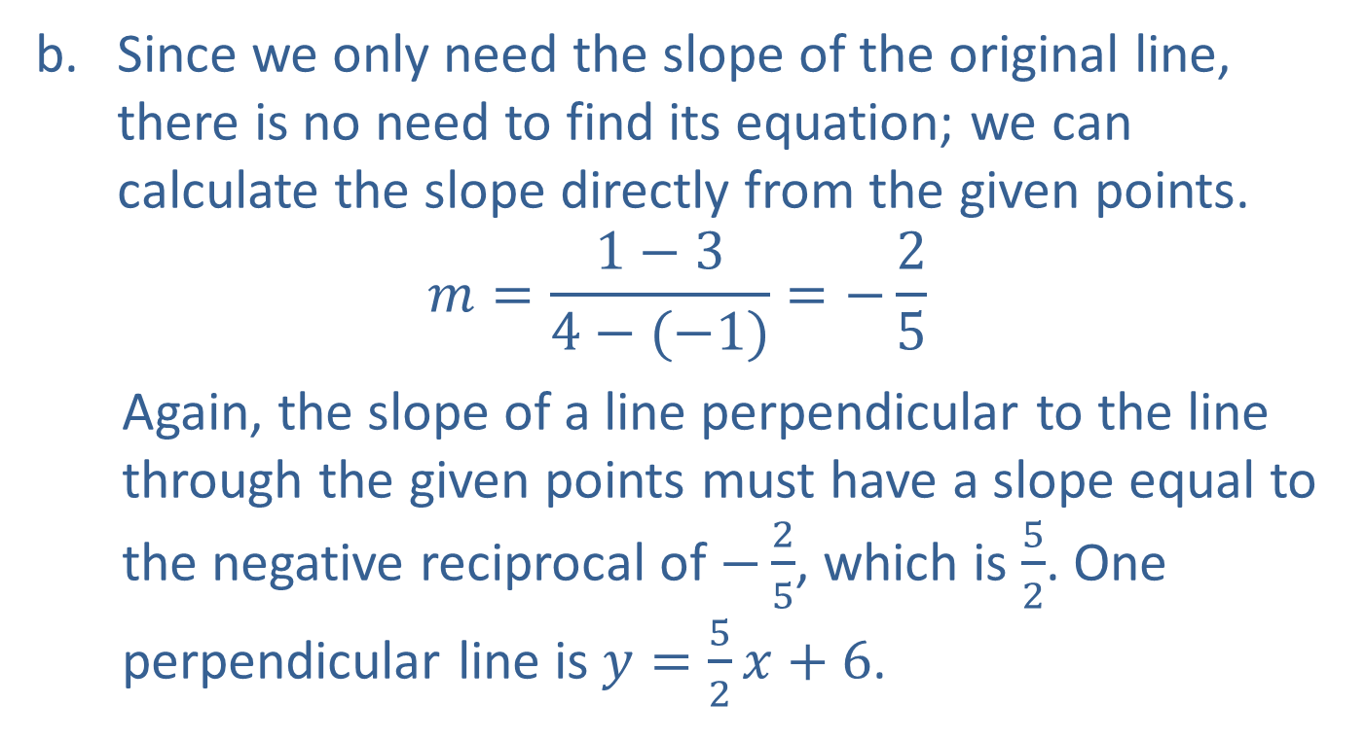
Example 4: Finding Equations of Perpendicular Lines (cont.)
Since we only need the slope of the original line, there is no need to find its equation; we can calculate the slope directly from the given points.
$$m=\frac{1−3}{4−(−1)}=−\frac{2}{5}$$
Again, the slope of a line perpendicular to the line through the given points must have a slope equal to the negative reciprocal of $−\frac{2}{5}$, which is $\frac{5}{2}$. One perpendicular line is $y=\frac{5}{2}x+6$.

Slide 18
Example 5: Finding Equations of Perpendicular Lines
Find the equation, in standard form, of the line that passes through the point (−3, 13), and that is perpendicular to the line y = −7.

Slide 19
Note
Remember that if you encounter a horizontal or vertical line, you cannot use the slope formulas to find a perpendicular line.

Slide 20
Example 5: Finding Equations of Perpendicular Lines (cont.)
Solution
The line y = −7 is a horizontal line, and hence any line perpendicular to it must be a vertical line, having the form x = c. Since the perpendicular line must pass through the point (−3, 13), the desired solution is x = −3.

Slide 21
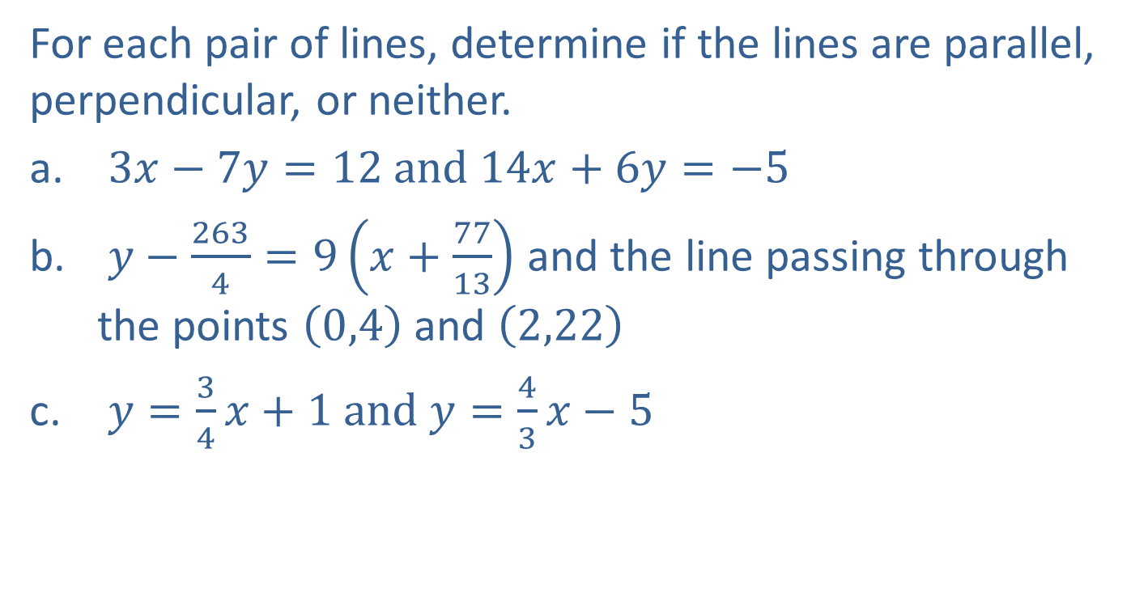
Example 6: Identifying Parallel and Perpendicular Lines
For each pair of lines, determine if the lines are parallel, perpendicular, or neither.
$3x−7y=12 and 14x+6y=−5$
$y−\frac{263}{4}=9\left(x+\frac{77}{13}\right)$ and the line passing through the points $\left(0,4\right)$ and $\left(2,22\right)$
$y=\frac{3}{4}x+1 and y=\frac{4}{3}x−5$

Slide 22
Note
A pair of lines cannot be both parallel and perpendicular.

Slide 23
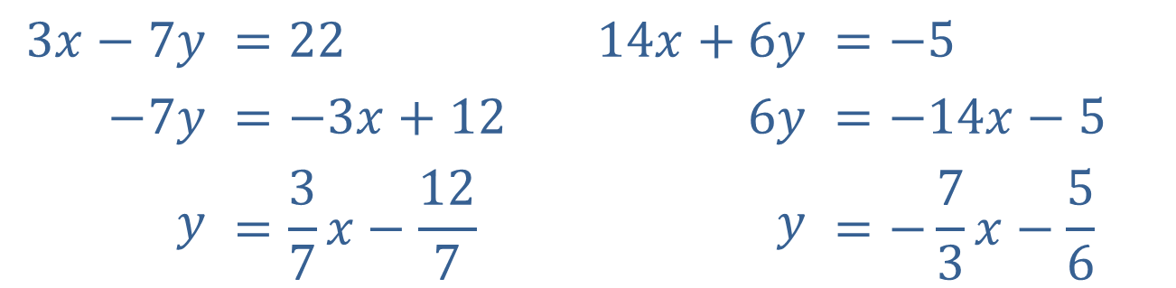
Example 6: Identifying Parallel and Perpendicular Lines (cont.)
Solution
Both equations are in standard form, so our first step is to rewrite them in slope-intercept form to identify the slopes.
$$3x−7y$$ | $$=22$$ |  | $$14x+6y$$ | $$=−5$$
$$−7y$$ | $$=−3x+12$$ |  | $$6y$$ | $$=−14x−5$$
$$y$$ | $$=\frac{3}{7}x−\frac{12}{7}$$ |  | $$y$$ | $$=−\frac{7}{3}x−\frac{5}{6}$$

Slide 24
Example 6: Identifying Parallel and Perpendicular Lines (cont.)
Are the lines parallel?
No, the slopes are not equal.
Are the lines perpendicular?
Yes, the slopes are negative reciprocals of each other.
Thus, the lines are perpendicular.

Slide 25
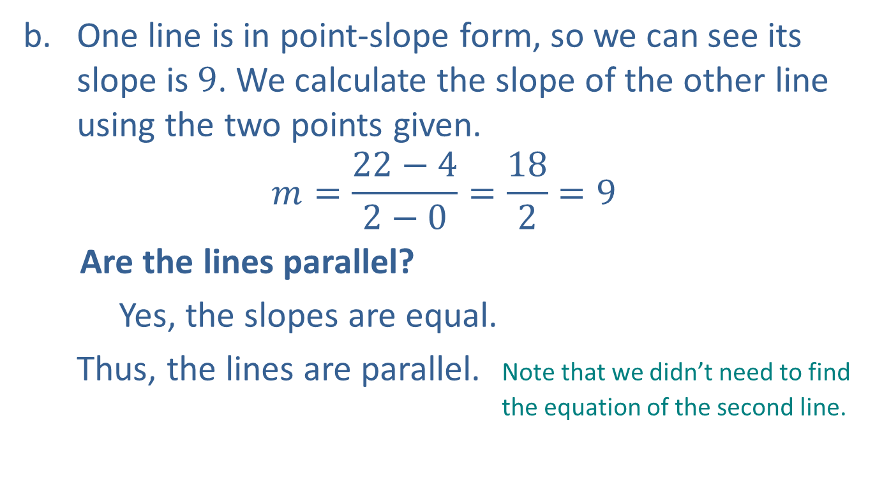
Example 6: Identifying Parallel and Perpendicular Lines (cont.)
One line is in point-slope form, so we can see its slope is $9$. We calculate the slope of the other line using the two points given.
$$m=\frac{22−4}{2−0}=\frac{18}{2}=9$$
Are the lines parallel?
Yes, the slopes are equal.
Thus, the lines are parallel. Note that we didn’t need to find the equation of the second line.

Slide 26
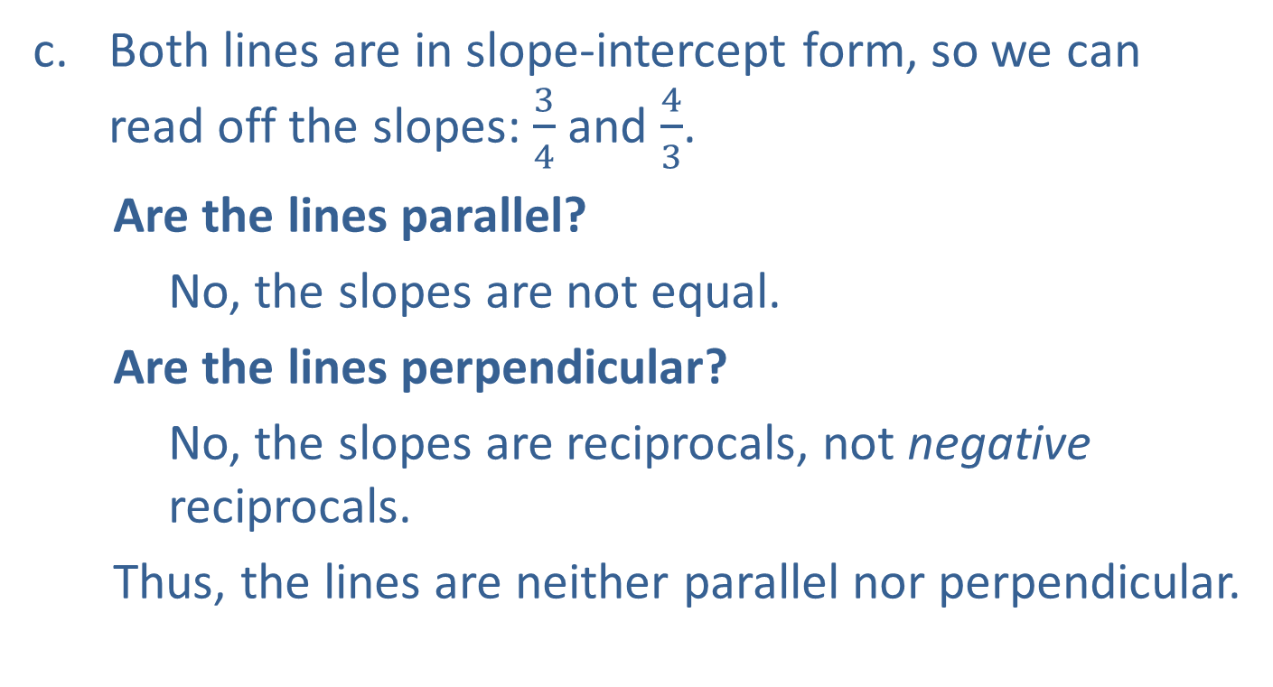
Example 6: Identifying Parallel and Perpendicular Lines (cont.)
Both lines are in slope-intercept form, so we can read off the slopes: $\frac{3}{4}$ and $\frac{4}{3}$.
Are the lines parallel?
No, the slopes are not equal.
Are the lines perpendicular?
No, the slopes are reciprocals, not negative reciprocals.
Thus, the lines are neither parallel nor perpendicular.

