Slide 1
Section 3.1
Introduction to Functions

Slide 2
Definition of a Function
Function, Domain, and Range
Let D and R be two sets of real numbers. A function f is a rule that matches each number x in D with exactly one number y (or f(x)) in R. D is called the domain of f, and R is called the range of f.
Note: In a function, there is only one y-value (or f(x) value) for each value of x.

Slide 3
Example 1: Function Evaluation
For the familiar function f (x) = x², evaluate the following.
a. f (3)
Solution:
b. f (5)
Solution:
c. f (−2)
Solution:
f (3)
= 3²
= 9
Read “f of 3.”
3 is substituted for x.
f (5)
= 5²
= 25
5 is substituted for x.
f (−2)
= (−2)²
= 4
−2 is substituted for x.

Slide 4
Example 2: Function Evaluation
For evaluate the following.
a. f (2)
Solution:
b. f (a)
Solution:

Slide 5
Example 2: Function Evaluation (cont.)
c. f (a + 1)
Solution:
Substitute a + 1 for x.
Expanding and combining like terms, we have:

Slide 6
Example 2: Function Evaluation (cont.)
d. f (a) + 1
Solution:
Add 1 to f (a).

Slide 7
Definition of a Function
CAUTION!
As illustrated in Examples 2c and 2d,

Slide 8
Example 3: Function Evaluation
For evaluate the following.
a. F (5) − F (2)
Solution:
We want the difference between the two functional values F (5) and F (2).

Slide 9
Example 3: Function Evaluation (cont.)
b. F (x + h)
Solution:
Substitute x + h for x.

Slide 10
Example 3: Function Evaluation (cont.)
c. F (x + h) − F (x)
Solution:
Find the difference between F(x + h) and F(x).

Slide 11

Example 4: Piecewise Function
A real estate broker charges a commission of 6% on sales valued up to $300,000. For sales valued at more than $300,000, the commission is $6000 plus 4% of the sale price.
a. Represent the commission earned as a function R.
Solution:

Slide 12
Example 4: Piecewise Function (cont.)
b. Find R(200,000).
Solution:
R(200,000)
c. Find R(500,000).
Solution:
R(500,000)
= 0.06(200,000)
= $12,000
Use R(x) = 0.06x since 200,000 ≤ 300,000.
= 0.04(500,000) + 6000
= 20,000 + 6000
= $26,000
Use R(x) = 0.04x+6000 since 500,000 > 300,000.

Slide 13
Example 5: Domain
Find the domain of the following functions.
Solution:
Since no denominator can be 0, x – 2 ≠ 0. Thus the domain consists of all real numbers but 2. We indicate this by writing x ≠ 2.

Slide 14
Example 5: Domain (cont.)
Solution:
Since we are only interested in real numbers, x − 2 must be nonnegative. Thus the domain is indicated by x − 2 ≥ 0 or x ≥ 2.

Slide 15
Vertical Line Test
If any vertical line intersects a graph at more than one point, then the graph does not represent a function.

Slide 16
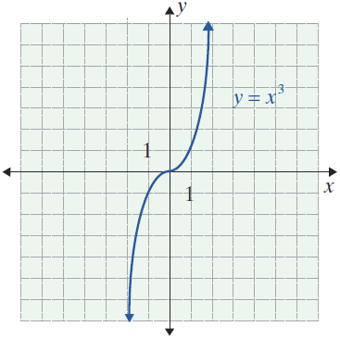
Example 6 : Vertical Line Test
Use the vertical line test to determine whether or not each of the following graphs is a function.
a.

Slide 17
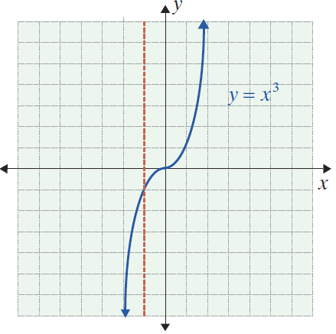
Example 6 : Vertical Line Test (cont.)
Solution:
The equation y = x³ represents a function (which can also be written as f (x) = x³ ). No vertical line can intersect the graph in more than one point.

Slide 18
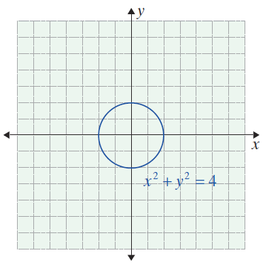
Example 6 : Vertical Line Test (cont.)
b.

Slide 19
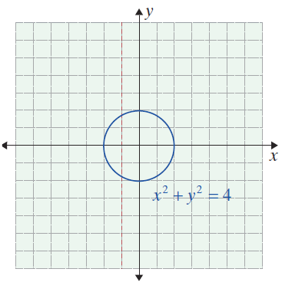
Example 6 : Vertical Line Test (cont.)
Solution:
The graph of x² + y² = 4 is a circle. The graph shows that the equation does not represent a function. Vertical lines can be drawn that intersect the graph in more than one point.

