Slide 1
Section 3.3
Linear and Quadratic Functions

Slide 2
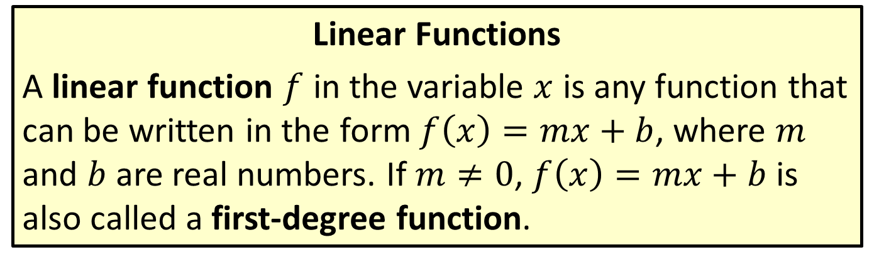
Linear Functions and Their Graphs
Linear Functions
A linear function $f$ in the variable $x$ is any function that can be written in the form $f\left(x\right)=mx+b$, where $m$ and $b$ are real numbers. If $m≠0$, $f\left(x\right)=mx+b$ is also called a first-degree function.

Slide 3

Example 1: Graphing Linear Functions
Graph the following linear functions.
​$f\left(x\right)=3x+2$
​$g\left(x\right)=3$

Slide 4
Note:
A function cannot represent a vertical line (since it fails the vertical line test). Vertical lines can represent the graphs of equations, but not functions.

Slide 5
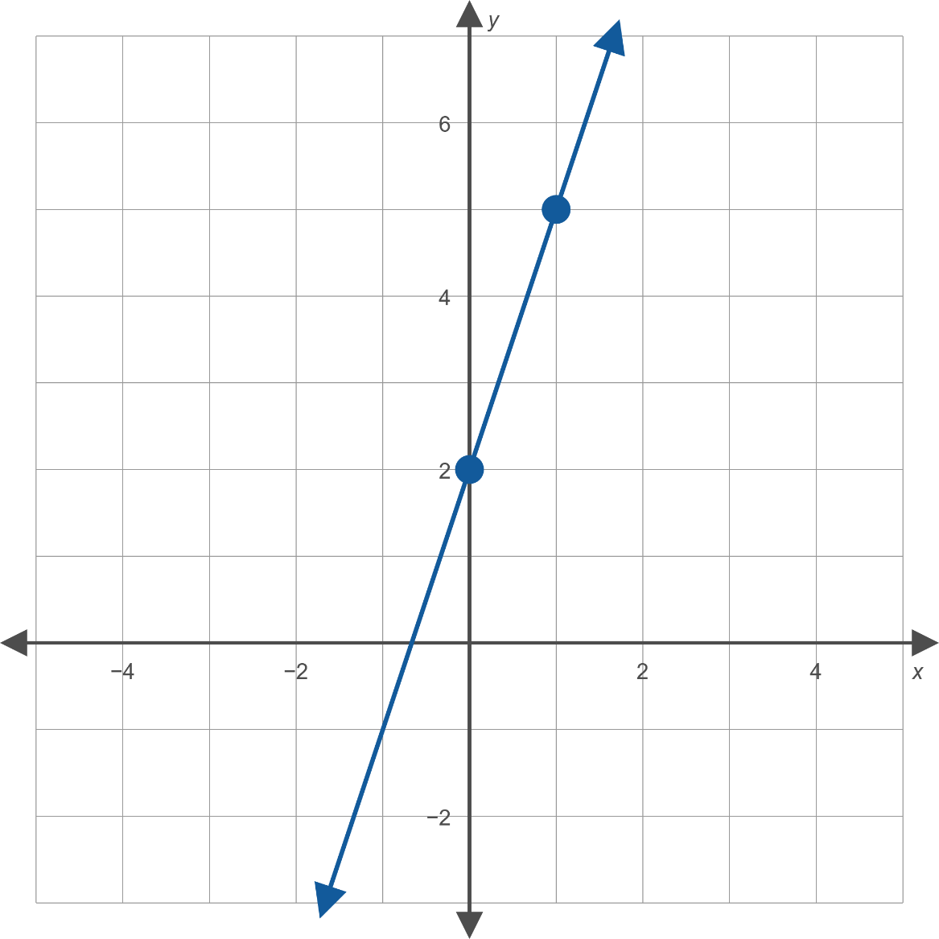

Example 1: Graphing Linear Functions (cont.)
​The function $f$ is a line with a slope of 3 and a $y$-intercept of 2. To graph the function, plot the ordered pair $\left(0\text{, }2\right)$ and locate another point on the line by moving up 3 units and over to the right 1 unit, giving the ordered pair $\left(1\text{, }5\right)$. Once these two points have been plotted, connecting them with a straight line completes the process.

Slide 6
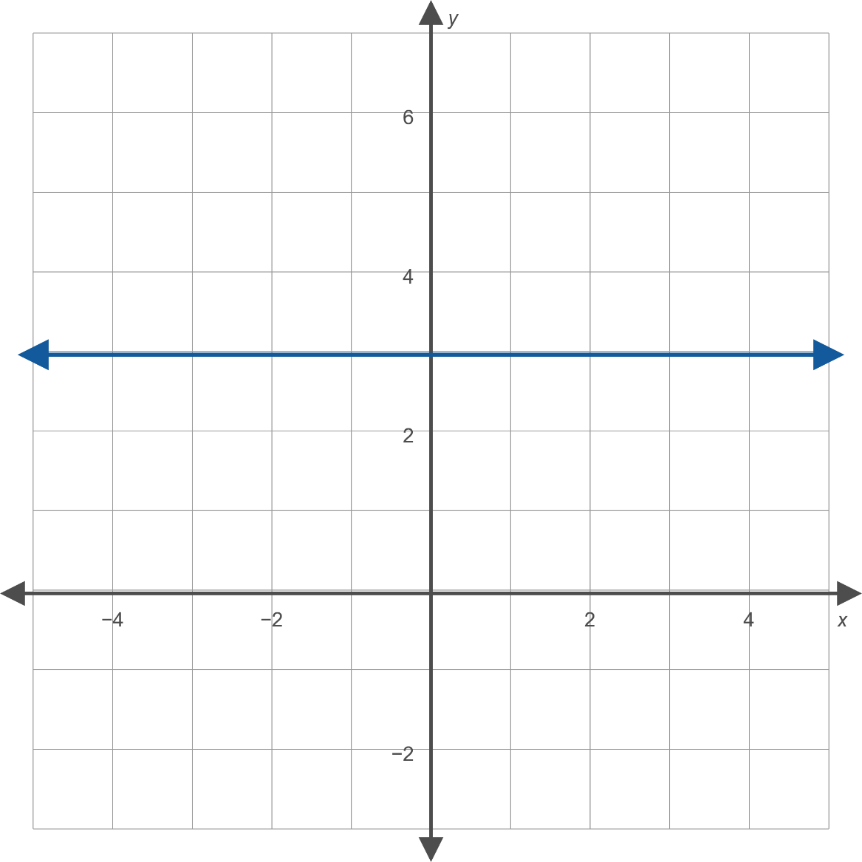

Example 1: Graphing Linear Functions (cont.)
​The graph of the function $g$ is a straight line with a slope of 0 and a $y$-intercept of 3. A linear function with a slope of 0 is also called a constant function, as it turns any input into one fixed constant—in this case the number 3. The graph of a constant function is always a horizontal line.

Slide 7
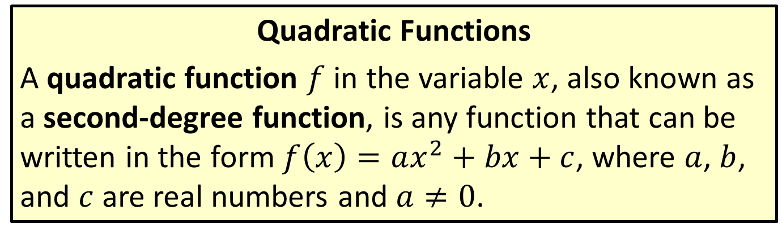
Quadratic Functions and Their Graphs
Quadratic Functions
A quadratic function $f$ in the variable $x$, also known as a second-degree function, is any function that can be written in the form $f\left(x\right)=ax^{2}+bx+c$, where $a$, $b$, and $c$ are real numbers and $a≠0$.

Slide 8
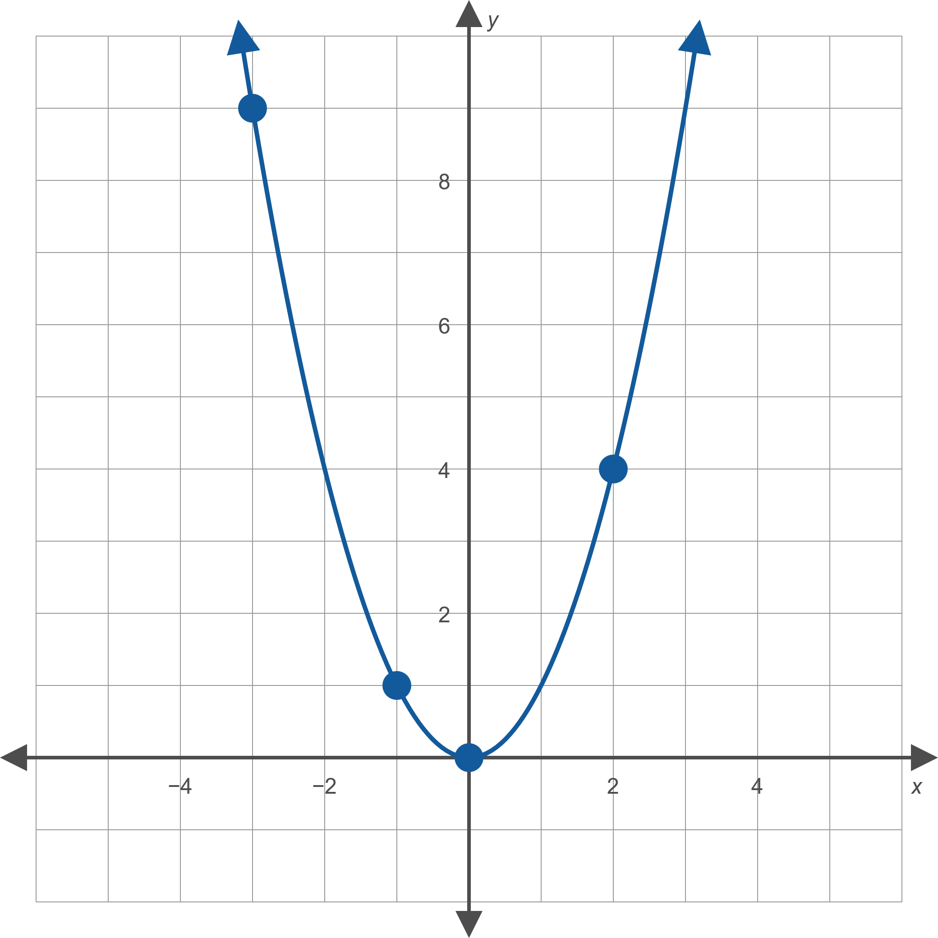

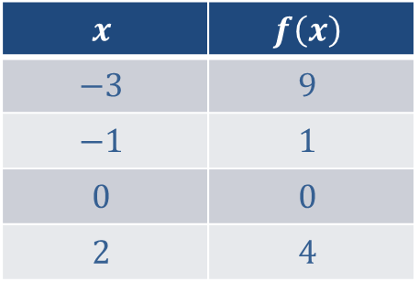
Figure 2: Graph of $f\left(x\right)=x^{2}$
$$x$$ | $$f\left(x\right)$$
$$−3$$ | $$9$$
$$−1$$ | $$1$$
$$0$$ | $$0$$
$$2$$ | $$4$$

Slide 9
Quadratic Functions and Their Graphs
Vertex and Axis of a Parabola
Figure 2 demonstrates two key characteristics of parabolas:
There is one point, known as the vertex, where the graph "changes direction." Scanning the graph from left to right, it is the point where the graph stops going down and begins to go up (if the parabola opens upward) or stops going up and begins to go down (if the parabola opens downward).
Every parabola is symmetric with respect to its axis, a line passing through the vertex dividing the parabola into two halves that are mirror images of each other. This line is also called the axis of symmetry.

Slide 10
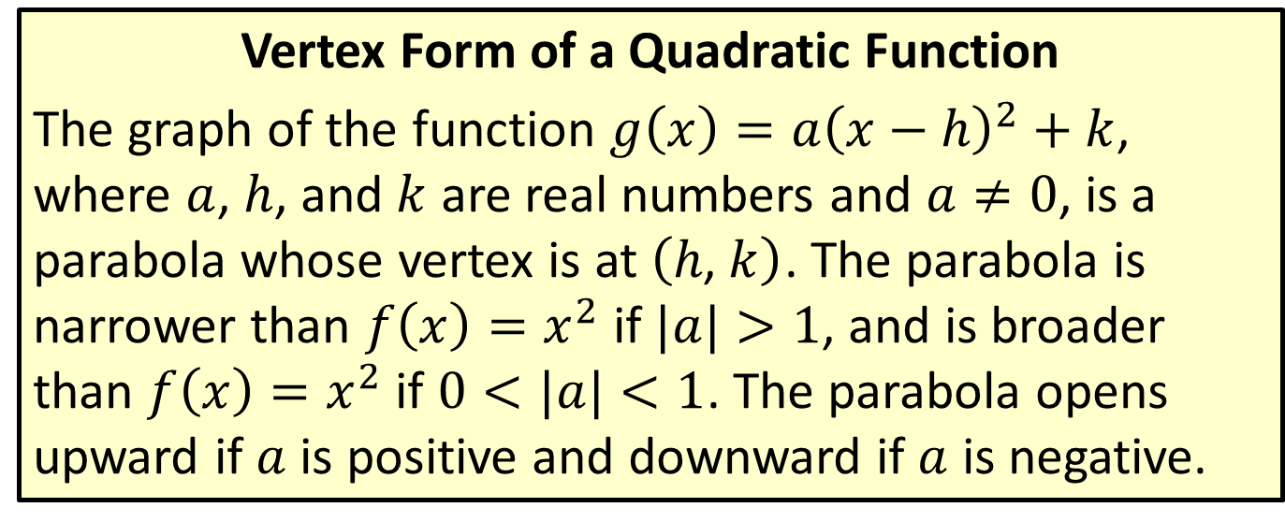
Quadratic Functions and Their Graphs
Vertex Form of a Quadratic Function
The graph of the function $g\left(x\right)=a{\left(x−h\right)}^{2}+k$, where $a$, $h$, and $k$ are real numbers and $a≠0$, is a parabola whose vertex is at $\left(h\text{, }k\right)$. The parabola is narrower than $f\left(x\right)=x^{2}$ if $|a|>1$, and is broader than $f\left(x\right)=x^{2}$ if $0<|a|<1$. The parabola opens upward if $a$ is positive and downward if $a$ is negative.

Slide 11

Example 2: Graphing Quadratic Functions
Sketch the graph of the function
$f\left(x\right)=−x^{2}−2x+3$.
Locate the vertex and the $x$-intercepts.

Slide 12
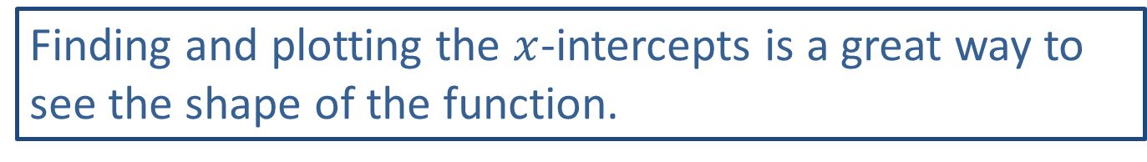
Note:
Finding and plotting the $x$-intercepts is a great way to see the shape of the function.

Slide 13
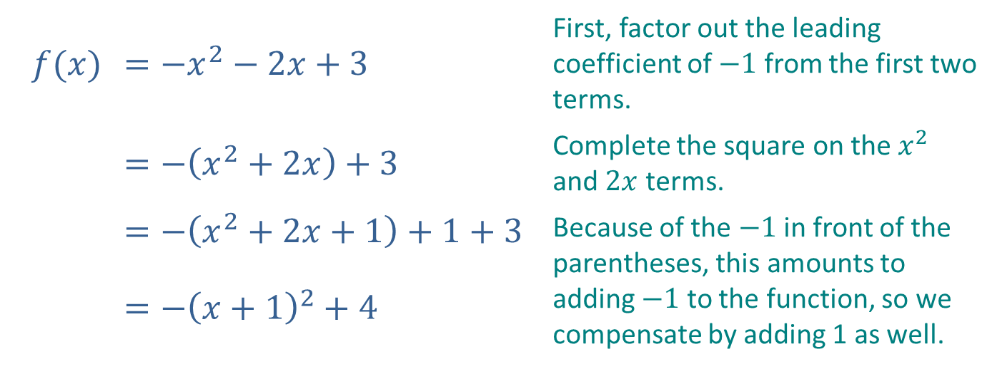
Example 2: Graphing Quadratic Functions (cont.)
Solution
First, identify the vertex of the function by completing the square as follows.
$$f(x)$$ | $$=−x^{2}−2x+3$$ | First, factor out the leading coefficient of $−1$ from the first two terms.
 | $$=−\left(x^{2}+2x\right)+3$$ | Complete the square on the $x^{2}$ and $2x$ terms.
 | $$=−\left(x^{2}+2x+1\right)+1+3$$ | Because of the $−1$ in front of the parentheses, this amounts to adding $−1$ to the function, so we compensate by adding 1 as well.
 | $$=−{\left(x+1\right)}^{2}+4$$ | Because of the $−1$ in front of the parentheses, this amounts to adding $−1$ to the function, so we compensate by adding 1 as well.

Slide 14
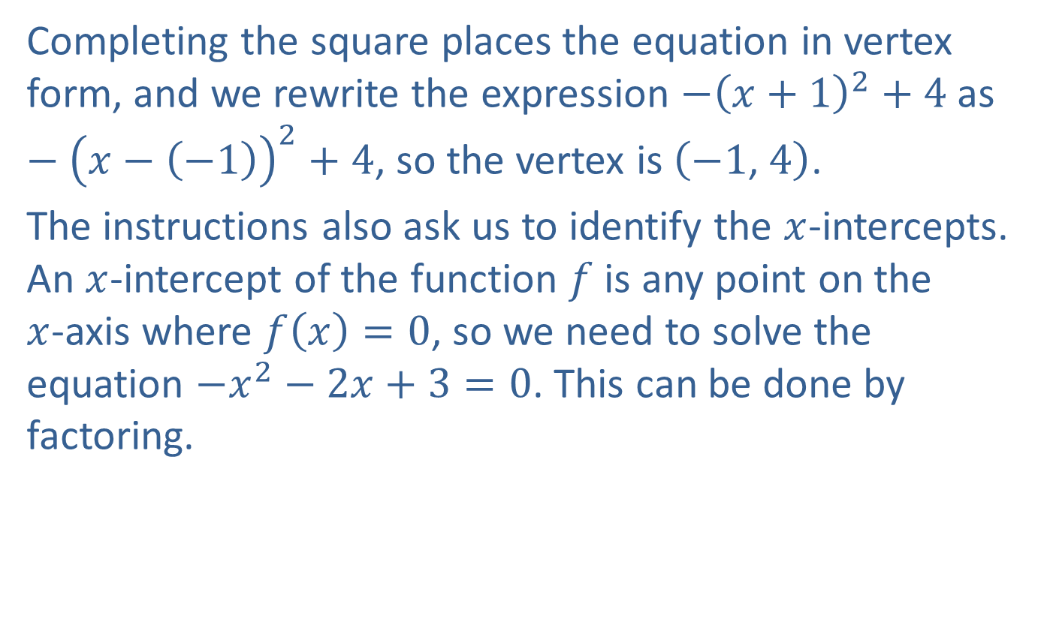
Example 2: Graphing Quadratic Functions (cont.)
Completing the square places the equation in vertex form, and we rewrite the expression $−{\left(x+1\right)}^{2}+4$ as $−{\left(x−\left(−1\right)\right)}^{2}+4$, so the vertex is $\left(−1\text{, }4\right)$.
The instructions also ask us to identify the $x$-intercepts. An $x$-intercept of the function $f$ is any point on the $x$-axis where $f\left(x\right)=0$, so we need to solve the equation $−x^{2}−2x+3=0$. This can be done by factoring.

Slide 15
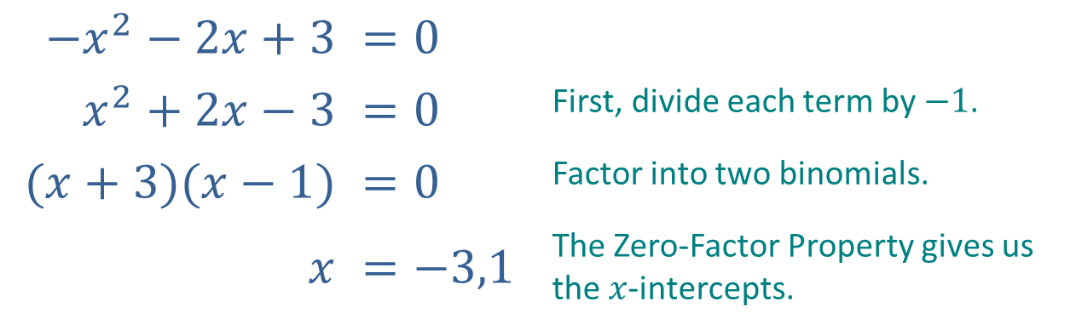

Example 2: Graphing Quadratic Functions (cont.)
Therefore, the $x$-intercepts are located at $\left(−3\text{, }0\right)$ and $\left(1\text{, }0\right)$.
$$−x^{2}−2x+3$$ | $$=0$$
$$x^{2}+2x−3$$ | $$=0$$ | First, divide each term by $−1$.
$$(x+3)(x−1)$$ | $$=0$$ | Factor into two binomials.
$$x$$ | $$=−3,1$$ | The Zero-Factor Property gives us the $x$-intercepts.

Slide 16
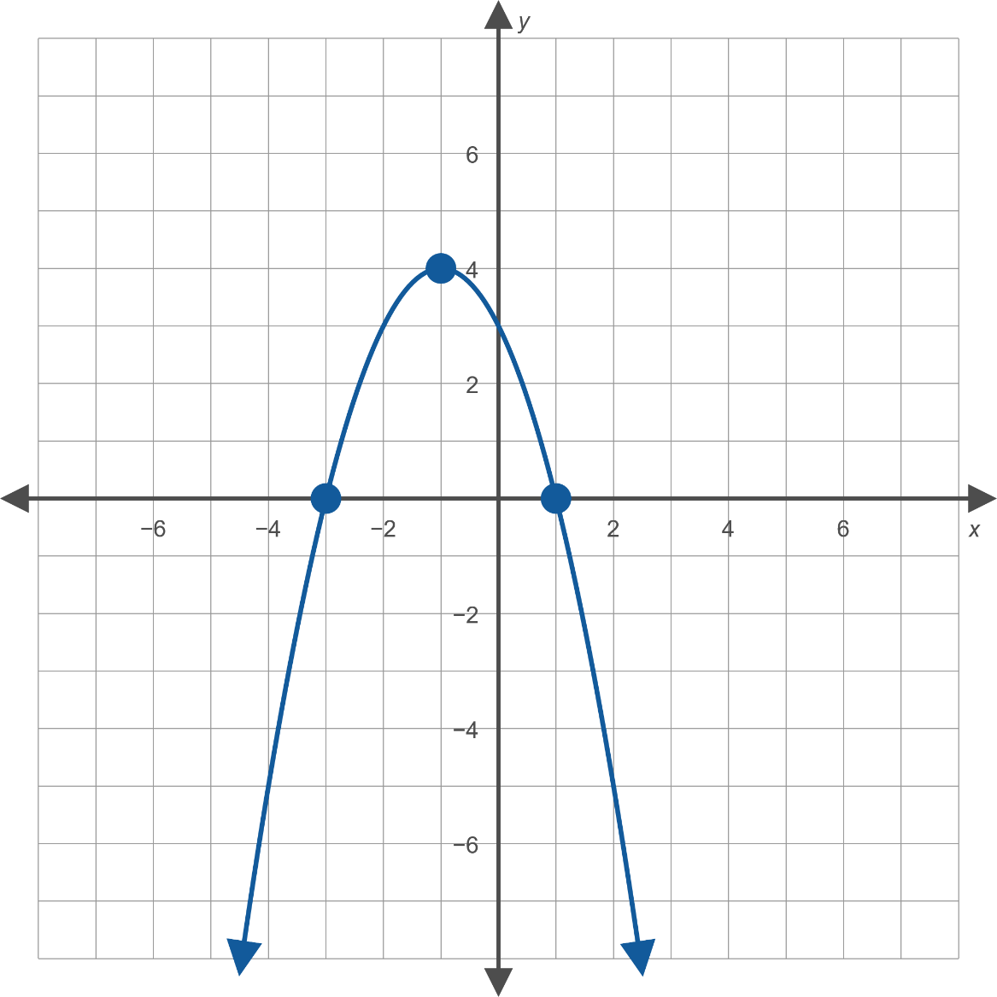
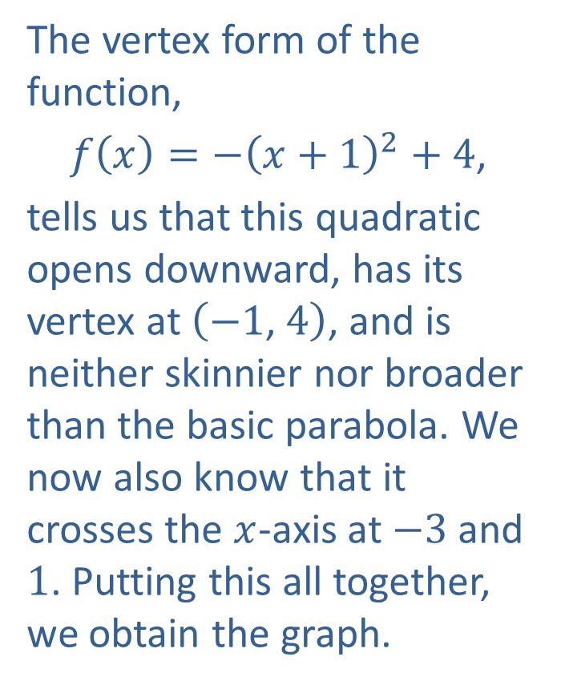
Example 2: Graphing Quadratic Functions (cont.)
The vertex form of the function,
$f\left(x\right)=−{\left(x+1\right)}^{2}+4$,
tells us that this quadratic opens downward, has its vertex at $\left(−1\text{, }4\right)$, and is neither skinnier nor broader than the basic parabola. We now also know that it crosses the $x$-axis at $−3$ and 1. Putting this all together, we obtain the graph.

Slide 17
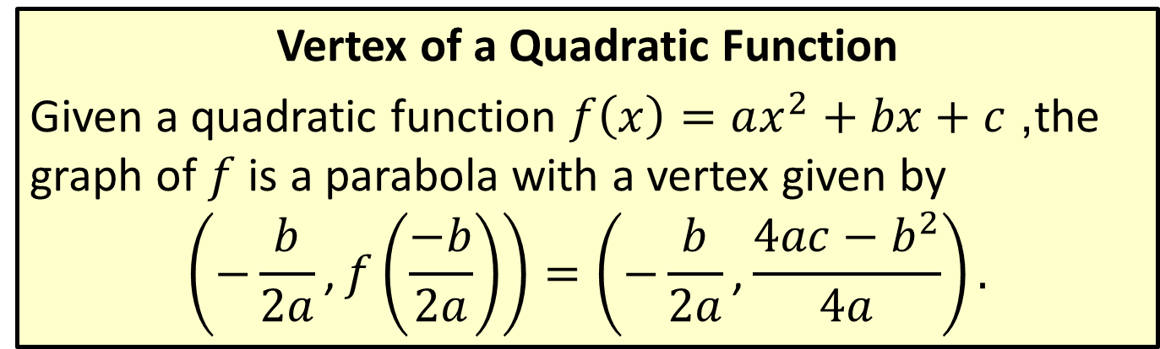
Quadratic Functions and Their Graphs
Vertex of a Quadratic Function
Given a quadratic function $f\left(x\right)=ax^{2}+bx+c$, the graph of $f$ is a parabola with a vertex given by
$$\left(−\frac{b}{2a}\text{,}f\left(\frac{−b}{2a}\right)\right)=\left(−\frac{b}{2a}\text{,}\frac{4ac−b^{2}}{4a}\right).$$

Slide 18

Example 3: Using the Vertex Formula
Find the vertex of the following quadratic functions using the vertex formula.
​$f\left(x\right)=x^{2}−4x+8$
​$g\left(x\right)=3x^{2}+5x−1$

Slide 19
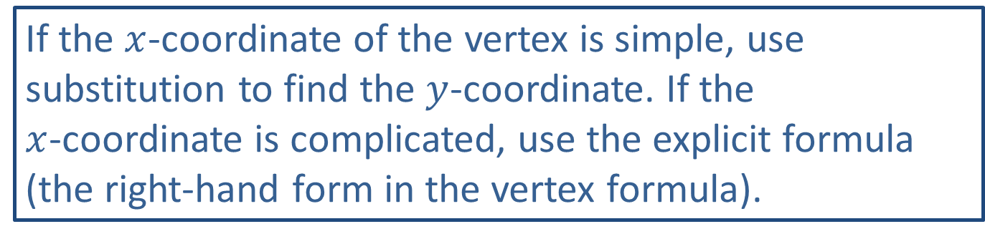
Note:
If the $x$-coordinate of the vertex is simple, use substitution to find the $y$-coordinate. If the $x$-coordinate is complicated, use the explicit formula (the right-hand form in the vertex formula).

Slide 20
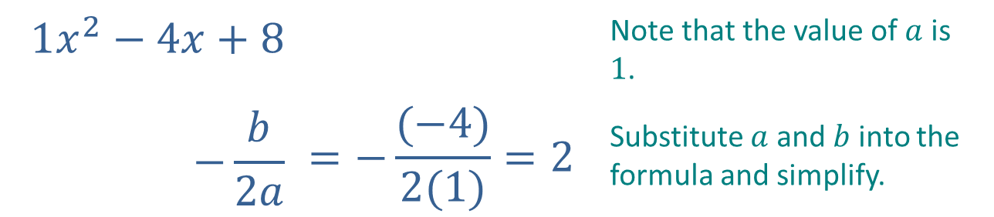

Example 3: Using the Vertex Formula (cont.)
Solution
​Begin by using the formula to find the $x$-coordinate of the vertex.
​
$$1x^{2}−4x+8$$ |  | Note that the value of $a$ is $1$.
$$−\frac{b}{2a}$$ | $$=−\frac{(−4)}{2(1)}=2$$ | Substitute $a$ and $b$ into the formula and simplify.

Slide 21
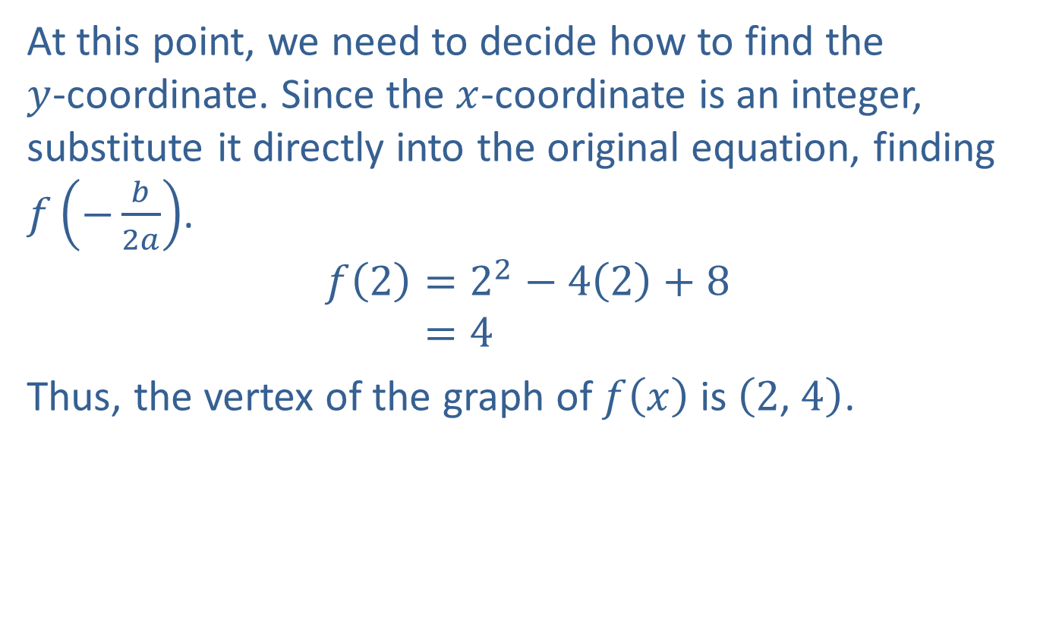
Example 3: Using the Vertex Formula (cont.)
​At this point, we need to decide how to find the $y$-coordinate. Since the $x$-coordinate is an integer, substitute it directly into the original equation, finding $f⁡\left(−\frac{b}{2a}\right)$.
𝑓2=22−42+8𝑓⁡2=4
​Thus, the vertex of the graph of $f⁡\left(x\right)$ is $\left(2\text{, }4\right)$.

Slide 22
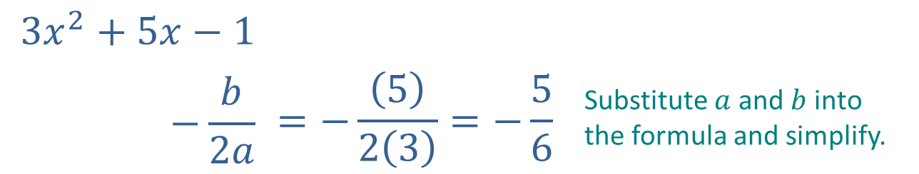

Example 3: Using the Vertex Formula (cont.)
​Again, begin by finding the $x$-coordinate of the vertex.
​
$$3x^{2}+5x−1$$
$$−\frac{b}{2a}$$ | $$=−\frac{\left(5\right)}{2\left(3\right)}=−\frac{5}{6}$$ | Substitute $a$ and $b$ into the formula and simplify.

Slide 23
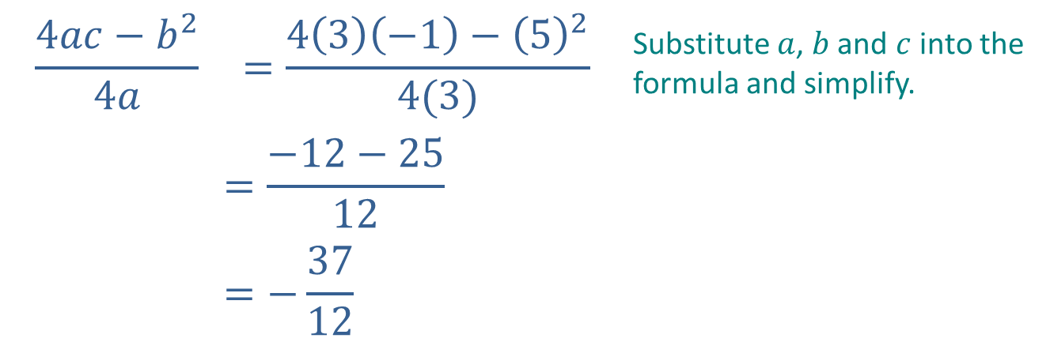

Example 3: Using the Vertex Formula (cont.)
​Here, the $x$-coordinate is a fraction, so substituting it into the original equation leads to messy calculations. Instead, use the explicit formula to find the $y$-coordinate.
​Thus, the vertex of the graph of $g⁡\left(x\right)$ is $\left(−\frac{5}{6}\text{,}−\frac{37}{12}\right)$.
$$\frac{4ac−b^{2}}{4a}$$ | $$=\frac{4\left(3\right)\left(−1\right)−{\left(5\right)}^{2}}{4(3)}$$ | Substitute $a$, $b$ and $c$ into the formula and simplify.
 | $$=\frac{−12−25}{12}$$
 | $$=−\frac{37}{12}$$

