Slide 1
Section 3.4
Applications of Quadratic Functions

Slide 2
Example 1: Fencing a Garden
A farmer plans to use 100 feet of spare fencing material to form a rectangular garden plot against the side of a long barn, using the barn as one side of the plot. How should he split up the fencing among the other three sides in order to maximize the area of the garden plot?

Slide 3
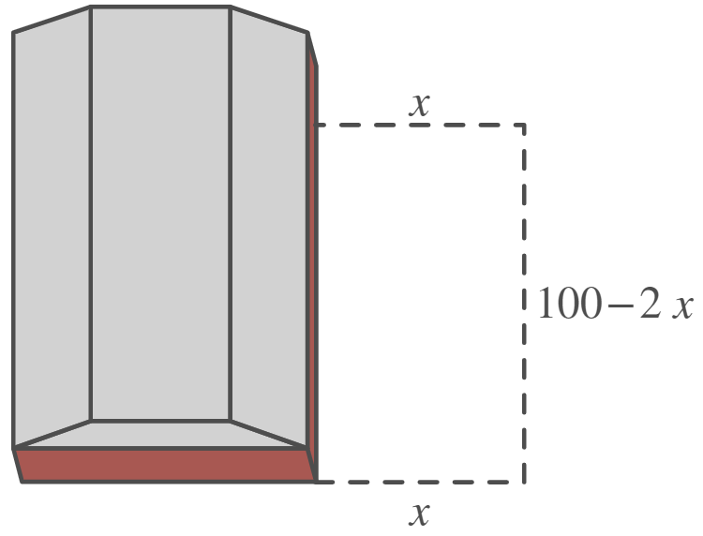
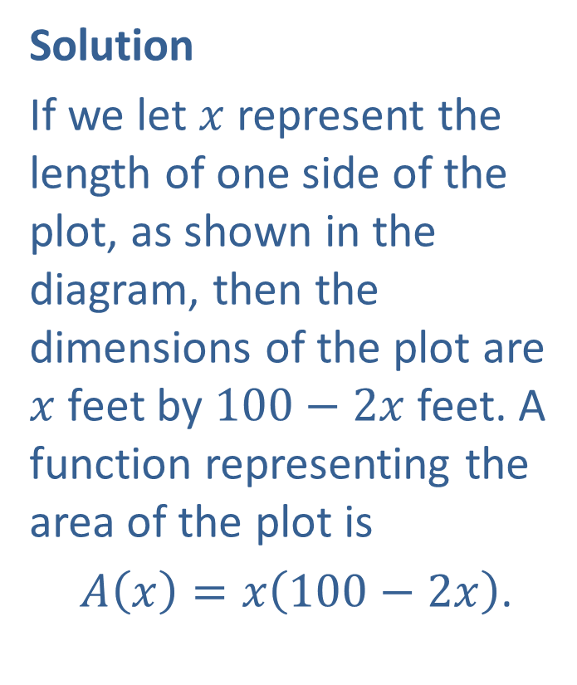
Example 1: Fencing a Garden (cont.)
Solution
If we let $x$ represent the length of one side of the plot, as shown in the diagram, then the dimensions of the plot are $x$ feet by $100−2x$ feet. A function representing the area of the plot is
$A\left(x\right)=x\left(100−2x\right)$.

Slide 4
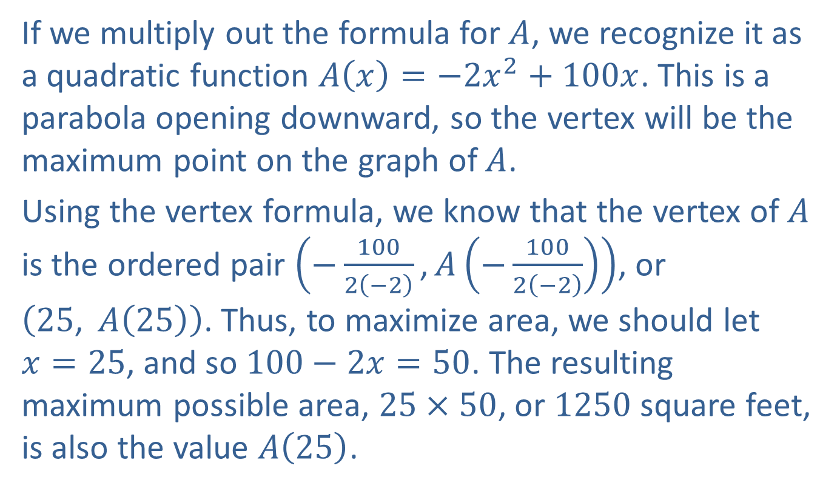
Example 1: Fencing a Garden (cont.)
If we multiply out the formula for $A$, we recognize it as a quadratic function $A\left(x\right)=−2x^{2}+100x$. This is a parabola opening downward, so the vertex will be the maximum point on the graph of $A$.
Using the vertex formula, we know that the vertex of $A$ is the ordered pair $\left(−\frac{100}{2\left(−2\right)}\text{,}A\left(−\frac{100}{2\left(−2\right)}\right)\right)$, or $\left(25\text{, }A\left(25\right)\right)$. Thus, to maximize area, we should let $x=25$, and so $100−2x=50$. The resulting maximum possible area, $25×50$, or 1250 square feet, is also the value $A⁡\left(25\right)$.

