Slide 1
Section 3.5
Other Common Functions

Slide 2


Example 1: Functions of the Form $ax$^{n}
Sketch the graphs of the following functions.
​$f\left(x\right)=\frac{x^{4}}{5}$
​$g\left(x\right)=−x^{3}$

Slide 3
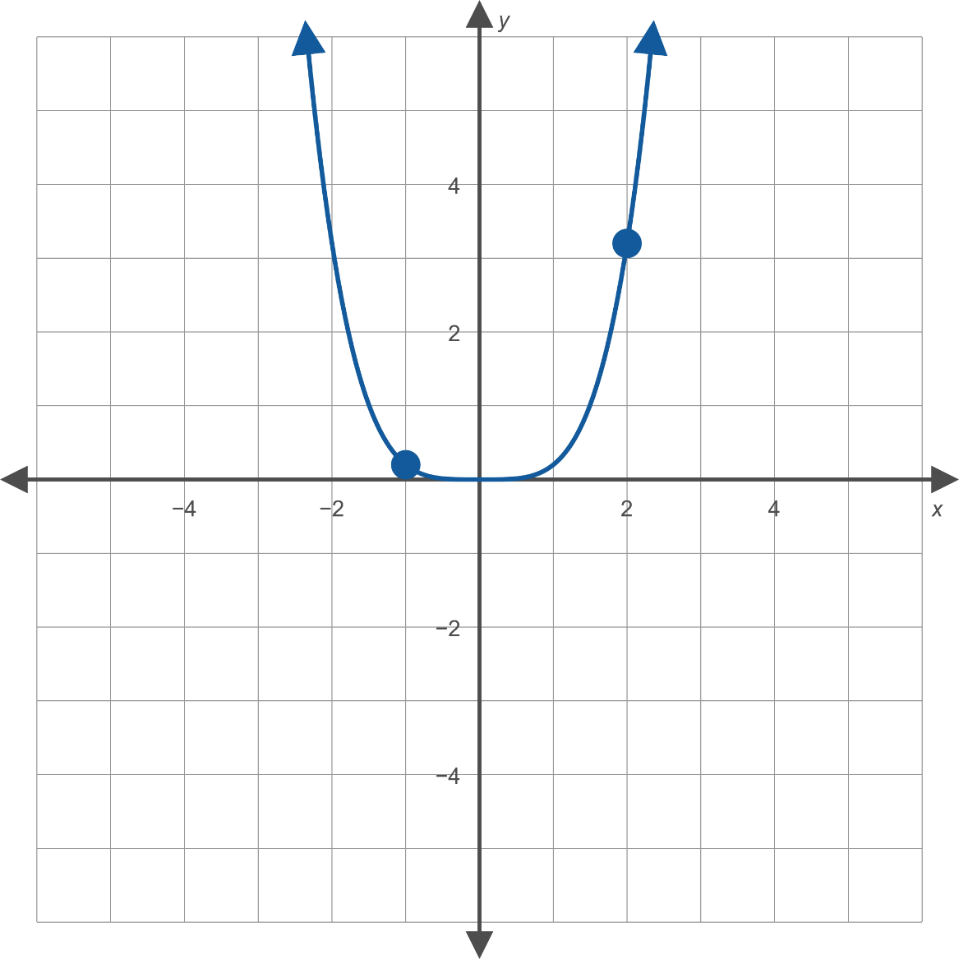
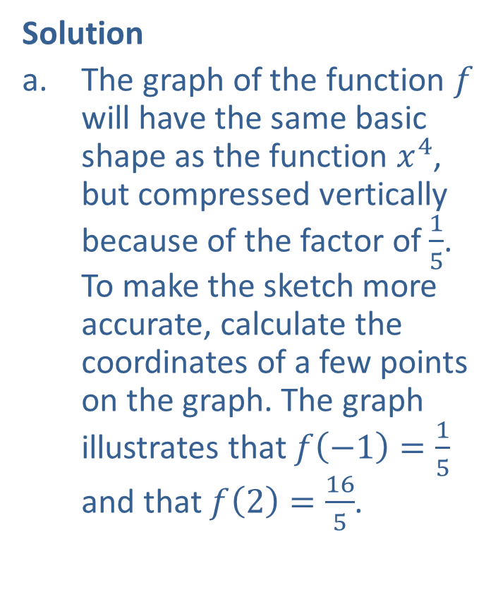

Example 1: Functions of the Form $ax$^{n} (cont.)
Solution
​The graph of the function $f$ will have the same basic shape as the function $x^{4}$, but compressed vertically because of the factor of $\frac{1}{5}$. To make the sketch more accurate, calculate the coordinates of a few points on the graph. The graph illustrates that $f\left(−1\right)=\frac{1}{5}$ and that $f\left(2\right)=\frac{16}{5}$.
​

Slide 4
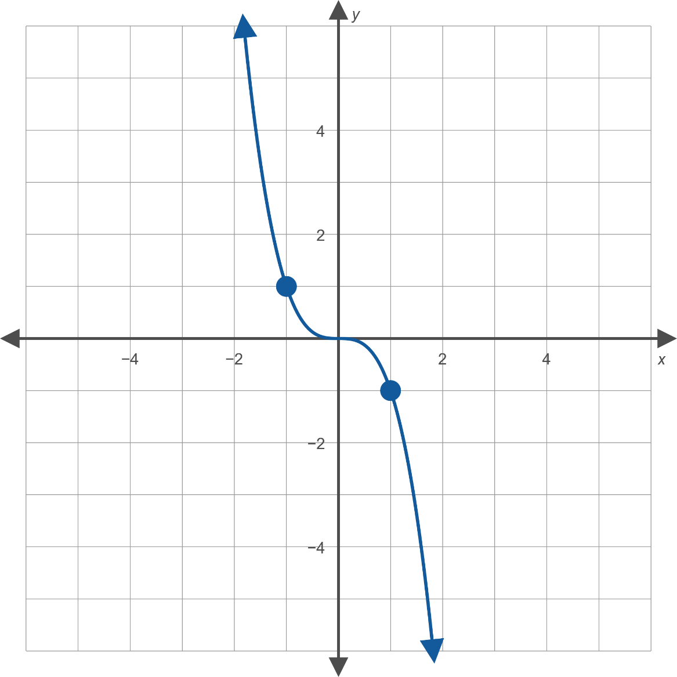
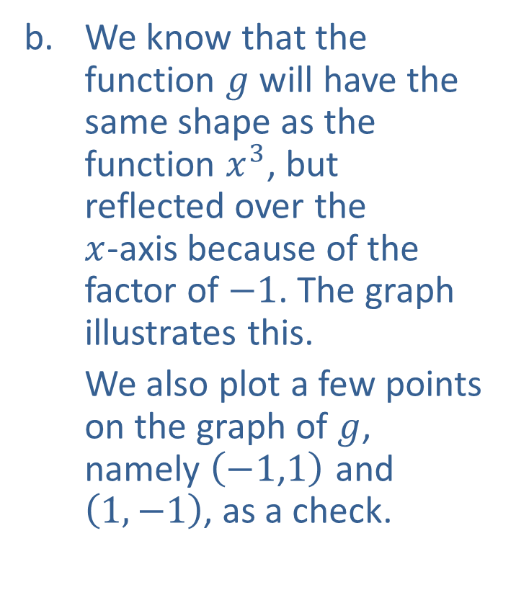

Example 1: Functions of the Form $ax$^{n} (cont.)
​We know that the function $g$ will have the same shape as the function $x^{3}$, but reflected over the
$x$-axis because of the factor of $−1$. The graph illustrates this.
​We also plot a few points on the graph of $g$, namely $\left(−1\text{,}1\right)$ and $\left(1,−1\right)$, as a check.
​

Slide 5


Example 2: Functions of the Form $\frac{a}{x^{n}}$
Sketch the graph of the function $f\left(x\right)=−\frac{1}{4x}$.

Slide 6
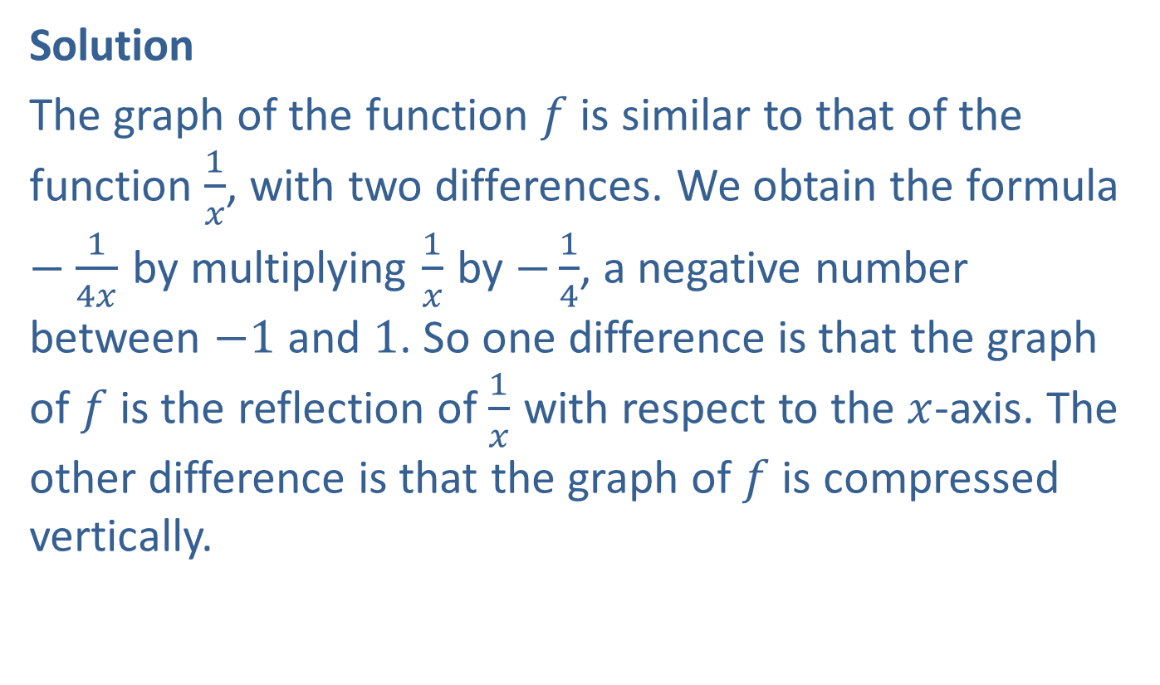
Example 2: Functions of the Form $\frac{a}{x^{n}}$
Solution
The graph of the function $f$ is similar to that of the function $\frac{1}{x}$, with two differences. We obtain the formula $−\frac{1}{4x}$ by multiplying $\frac{1}{x}$ by $−\frac{1}{4}$, a negative number between $−1$ and 1. So one difference is that the graph of $f$ is the reflection of $\frac{1}{x}$ with respect to the $x$-axis. The other difference is that the graph of $f$ is compressed vertically.

Slide 7
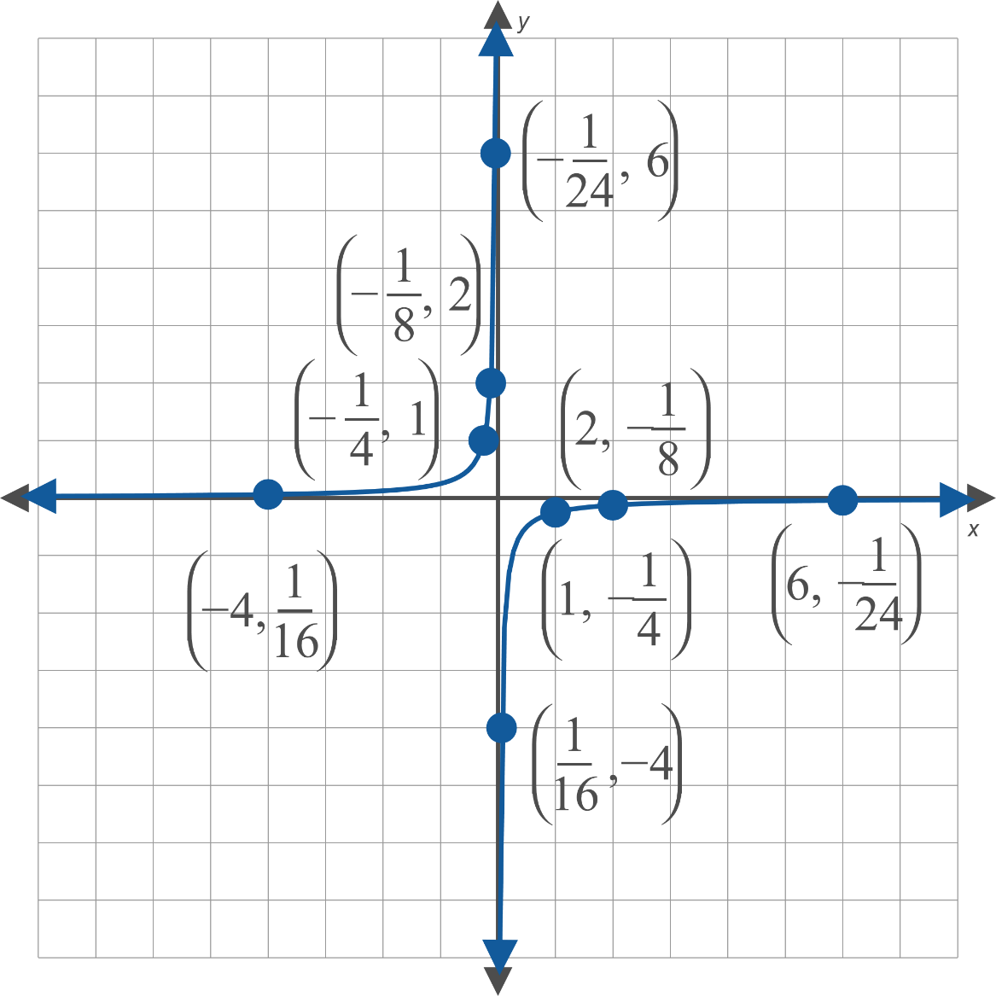
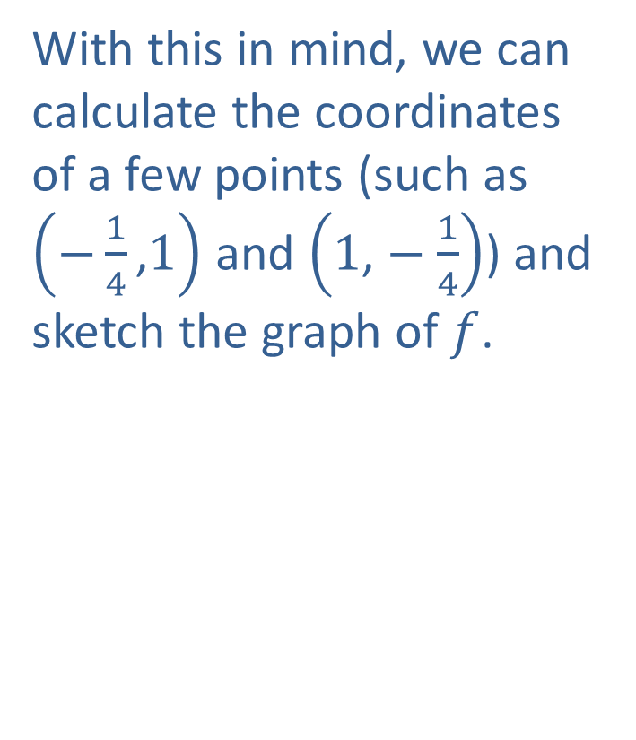

Example 2: Functions of the Form $\frac{a}{x^{n}}$ (cont.)
With this in mind, we can calculate the coordinates of a few points (such as $\left(−\frac{1}{4}\text{,}1\right)$ and $\left(1\text{,}−\frac{1}{4}\right)$) and sketch the graph of $f$.

Slide 8

Example 3: The Absolute Value Function
Sketch the graph of the function $f\left(x\right)=−2|x|$.

Slide 9
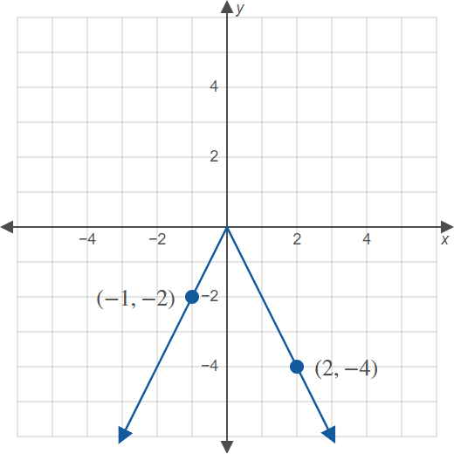
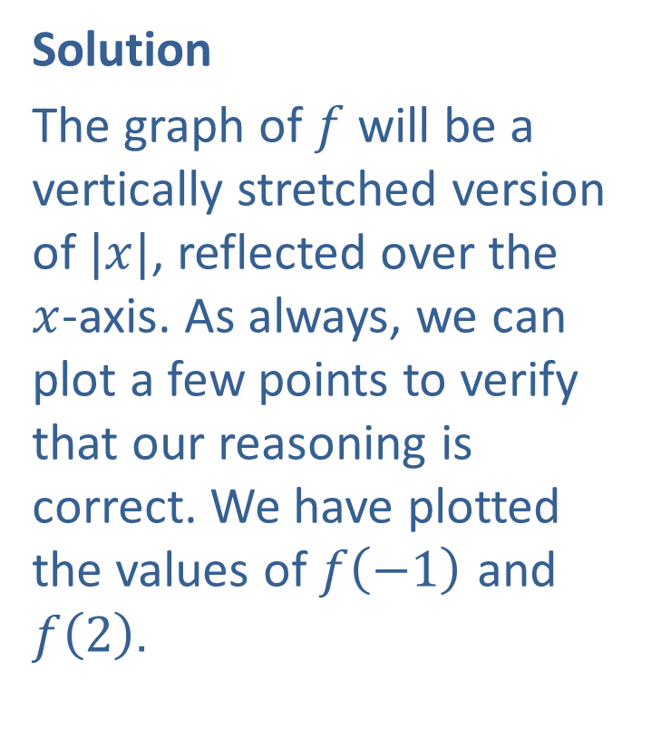
Example 3: The Absolute Value Function
Solution
The graph of $f$ will be a vertically stretched version of $|x|$, reflected over the $x$-axis. As always, we can plot a few points to verify that our reasoning is correct. We have plotted the values of $f⁡\left(−1\right)$ and $f⁡\left(2\right)$.

Slide 10
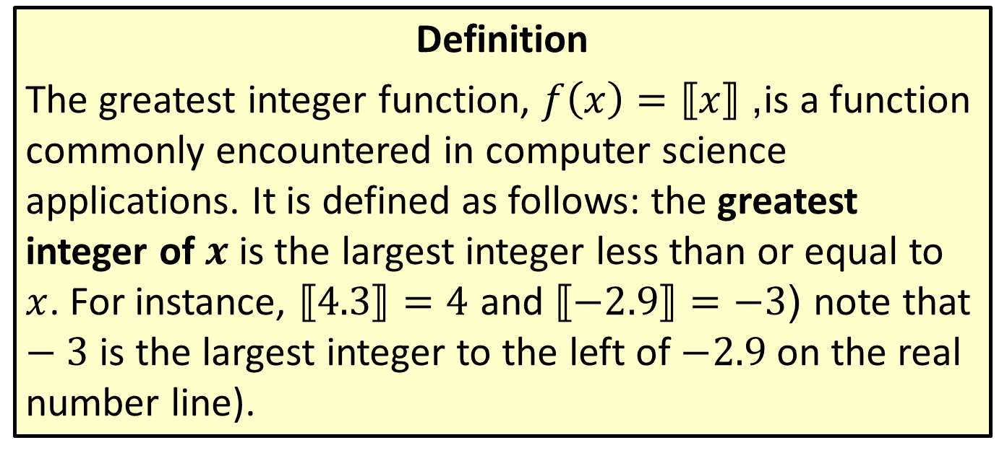
The Greatest Integer Function
Definition
The greatest integer function, $f\left(x\right)=⟦x⟧$, is a function commonly encountered in computer science applications. It is defined as follows: the greatest integer of $x$ is the largest integer less than or equal to $x$. For instance, $⟦4.3⟧=4$ and $⟦−2.9⟧=−3$ (note that $−3$ is the largest integer to the left of $−2.9$ on the real number line).

Slide 11
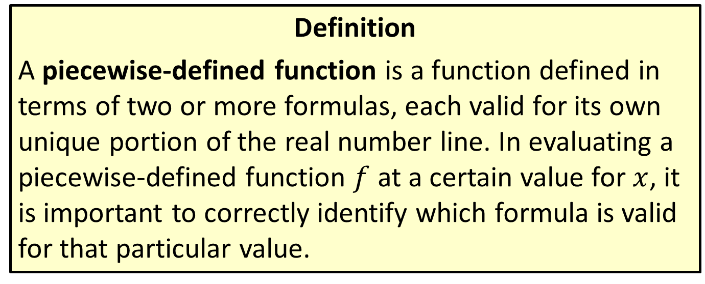
Piecewise-Defined Functions
Definition
A piecewise-defined function is a function defined in terms of two or more formulas, each valid for its own unique portion of the real number line. In evaluating a piecewise-defined function $f$ at a certain value for $x$, it is important to correctly identify which formula is valid for that particular value.

Slide 12

Example 4: Piecewise-Defined Function
Sketch the graph of the following function.
$$f\left(x\right)=\left\{\begin{matrix}−2x−2 & \text{if} x≤−1 \\ x^{2} & \text{if} x>−1\end{matrix}\right.$$

Slide 13
Note:
Always pay close attention to the boundary points of each interval. Remember that only one rule applies at each point.

Slide 14
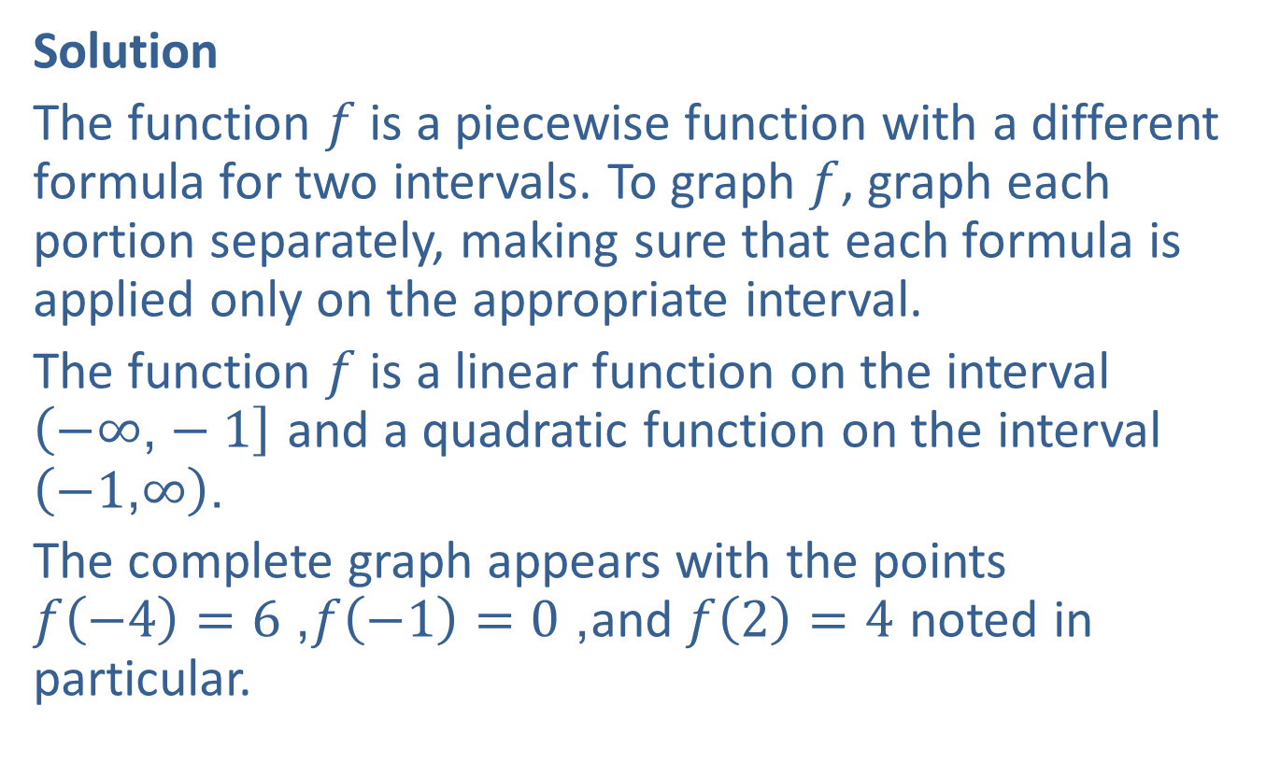
Example 4: Piecewise-Defined Function (cont.)
Solution
The function $f$ is a piecewise function with a different formula for two intervals. To graph $f$, graph each portion separately, making sure that each formula is applied only on the appropriate interval.
The function $f$ is a linear function on the interval
$\left(−∞\text{,}−1\right]$ and a quadratic function on the interval $\left(−1\text{,}∞\right)$.
The complete graph appears with the points
$f\left(−4\right)=6$, $f\left(−1\right)=0$, and $f\left(2\right)=4$ noted in particular.

Slide 15
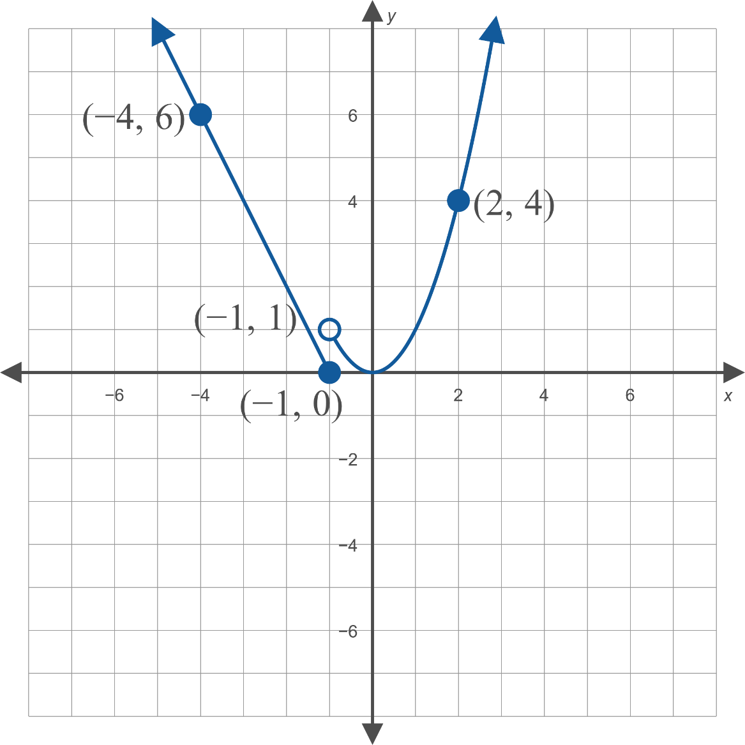
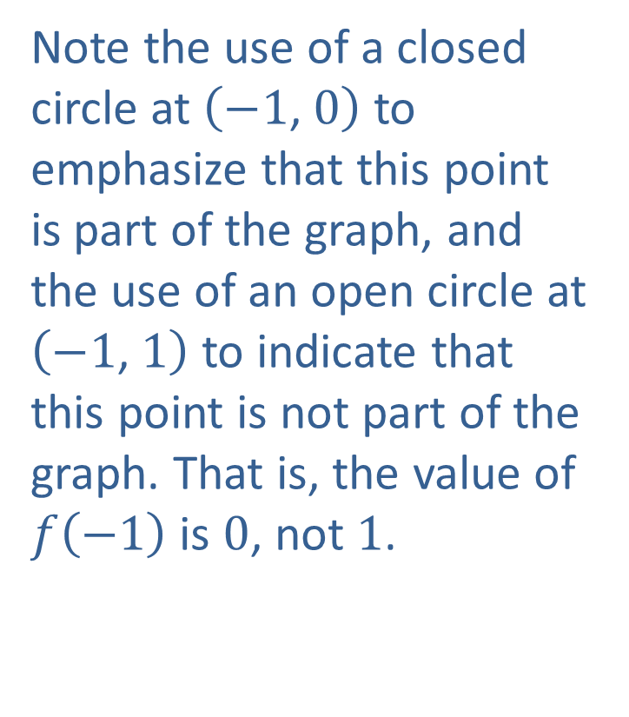
Example 4: Piecewise-Defined Function (cont.)
Note the use of a closed circle at $\left(−1\text{, }0\right)$ to emphasize that this point is part of the graph, and the use of an open circle at $\left(−1\text{, }1\right)$ to indicate that this point is not part of the graph. That is, the value of $f⁡\left(−1\right)$ is 0, not 1.

