Slide 1
Section 3.6
Transformations of Functions

Slide 2
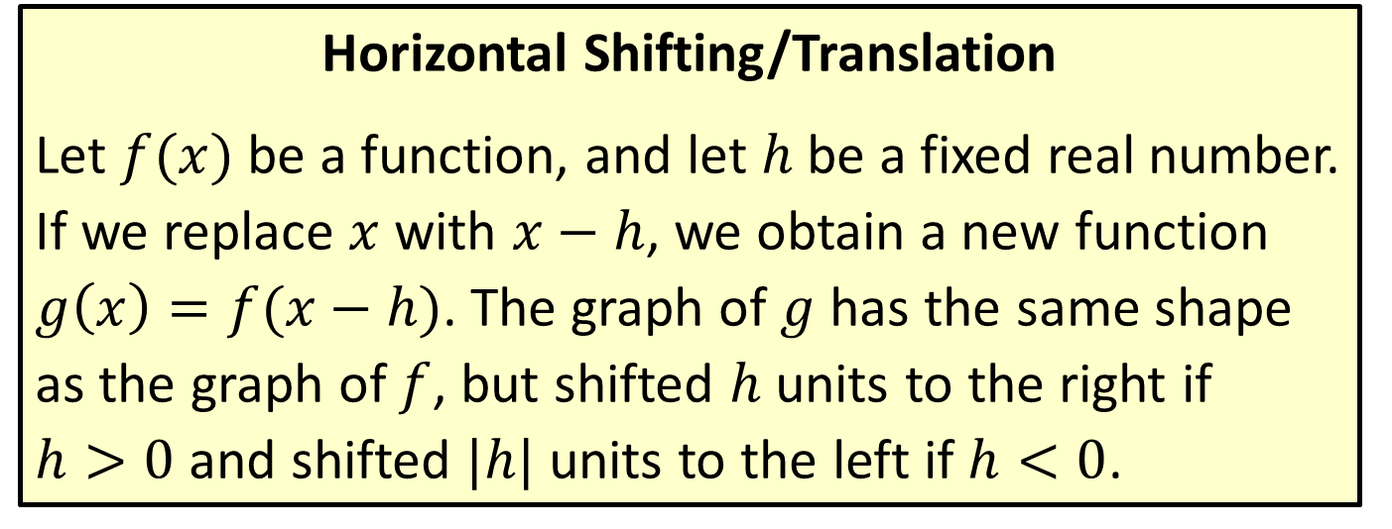
Shifting, Reflecting, and Stretching Graphs
Horizontal Shifting/Translation
Let $f(x)$ be a function, and let $h$ be a fixed real number. If we replace $x$ with $x−h$, we obtain a new function $g\left(x\right)=f(x−h)$. The graph of $g$ has the same shape as the graph of $f$, but shifted $h$ units to the right if $h>0$ and shifted $|h|$ units to the left if $h<0$.

Slide 3

Example 1: Horizontal Shifting/Translation
Sketch the graphs of the following functions.
$f\left(x\right)={\left(x+2\right)}^{3}$
$g\left(x\right)=\left|x−4\right|$

Slide 4
Note
Begin by identifying the underlying function that is being shifted.

Slide 5
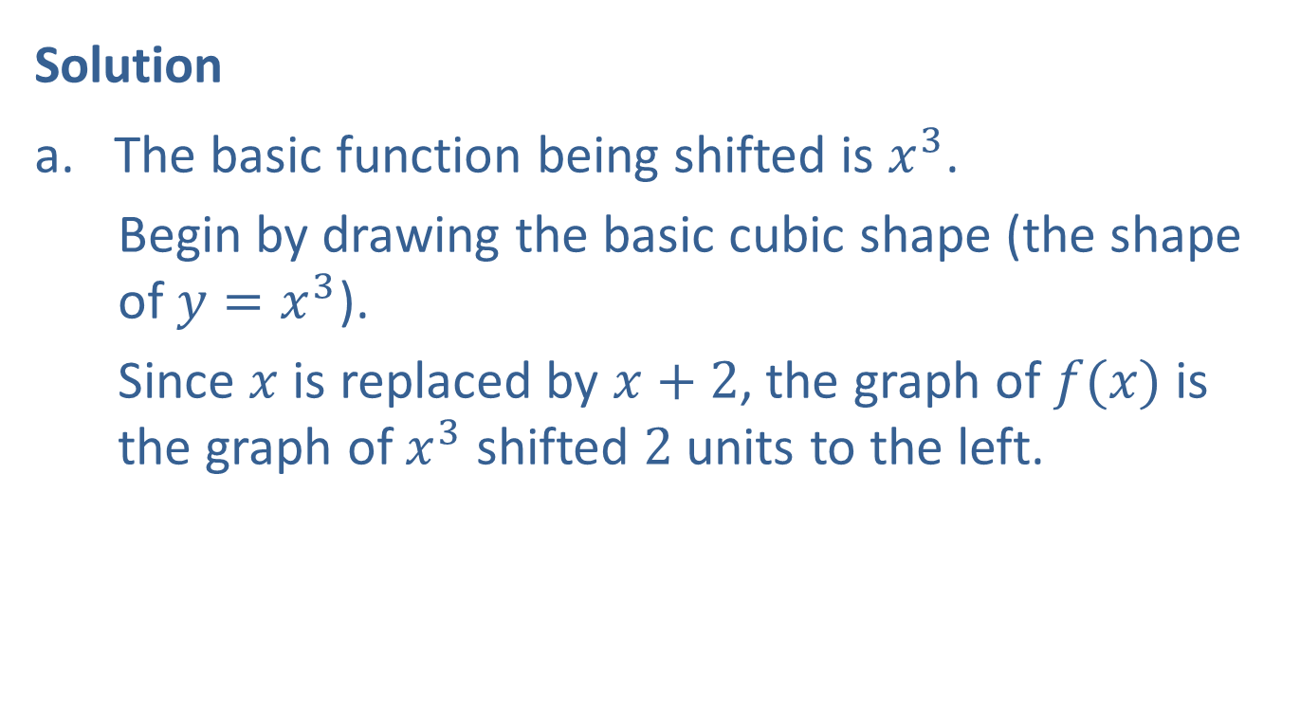
Example 1: Horizontal Shifting/Translation (cont.)
Solution
The basic function being shifted is $x^{3}$.
Begin by drawing the basic cubic shape (the shape of $y=x^{3}$).
Since $x$ is replaced by $x+2$, the graph of $f(x)$ is the graph of $x^{3}$ shifted $2$ units to the left.

Slide 6
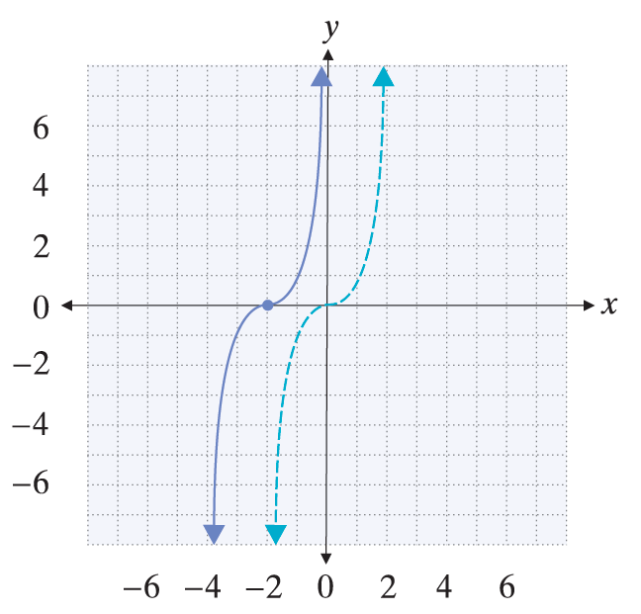

Example 1: Horizontal Shifting/Translation (cont.)
Note, for example, that $\left(−2,0\right)$ is one point on the graph.

Slide 7

Example 1: Horizontal Shifting/Translation (cont.)
The basic function being shifted is $\left|x\right|$.
Start by graphing the basic absolute value function.
The graph of $g\left(x\right)=\left|x−4\right|$ has the same shape, but shifted $4$ units to the right.

Slide 8
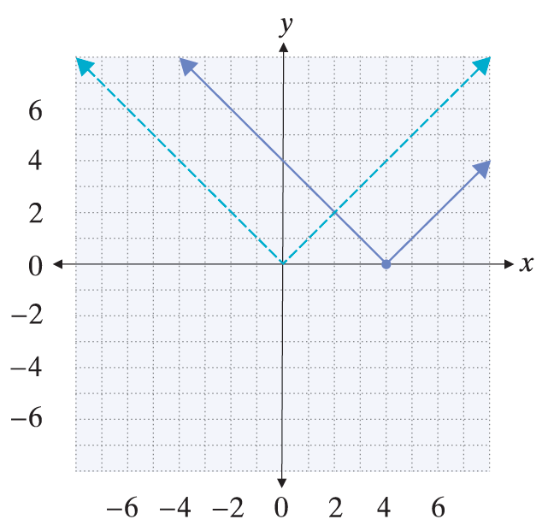

Example 1: Horizontal Shifting/Translation (cont.)
Note, for example, that $\left(4,0\right)$ lies on the graph of $g$.

Slide 9
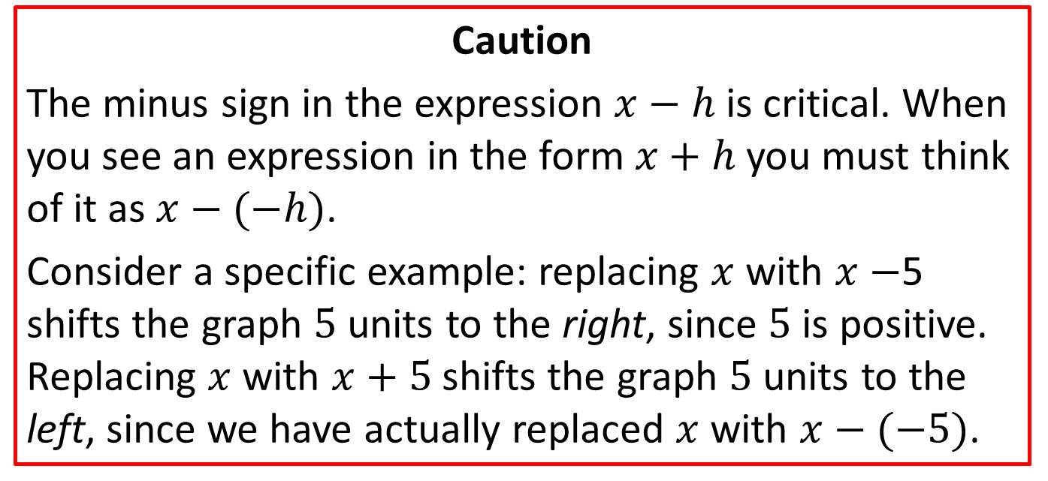
Shifting, Reflecting, and Stretching Graphs
Caution
The minus sign in the expression $x−h$ is critical. When you see an expression in the form $x+h$ you must think of it as $x−(−h)$.
Consider a specific example: replacing $x$ with $x−$5 shifts the graph $5$ units to the right, since $5$ is positive. Replacing $x$ with $x+5$ shifts the graph $5$ units to the left, since we have actually replaced $x$ with $x−(−5)$.

Slide 10
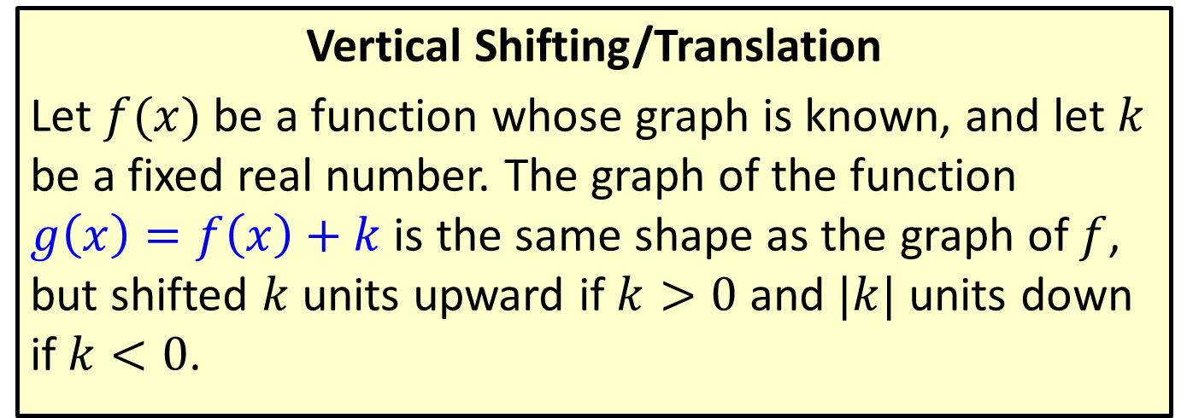
Shifting, Reflecting, and Stretching Graphs
Vertical Shifting/Translation
Let $f(x)$ be a function whose graph is known, and let $k$ be a fixed real number. The graph of the function $g\left(x\right)=f\left(x\right)+k$ is the same shape as the graph of $f$, but shifted $k$ units upward if $k>0$ and $|k|$ units down if $k<0$.

Slide 11

Example 2: Vertical Shifting/Translation
Sketch the graphs of the following functions.
$f\left(x\right)=\frac{1}{x}+3$
$g\left(x\right)=\sqrt[3]{x}−2$

Slide 12
Note
As before, begin by identifying the basic function being shifted.

Slide 13
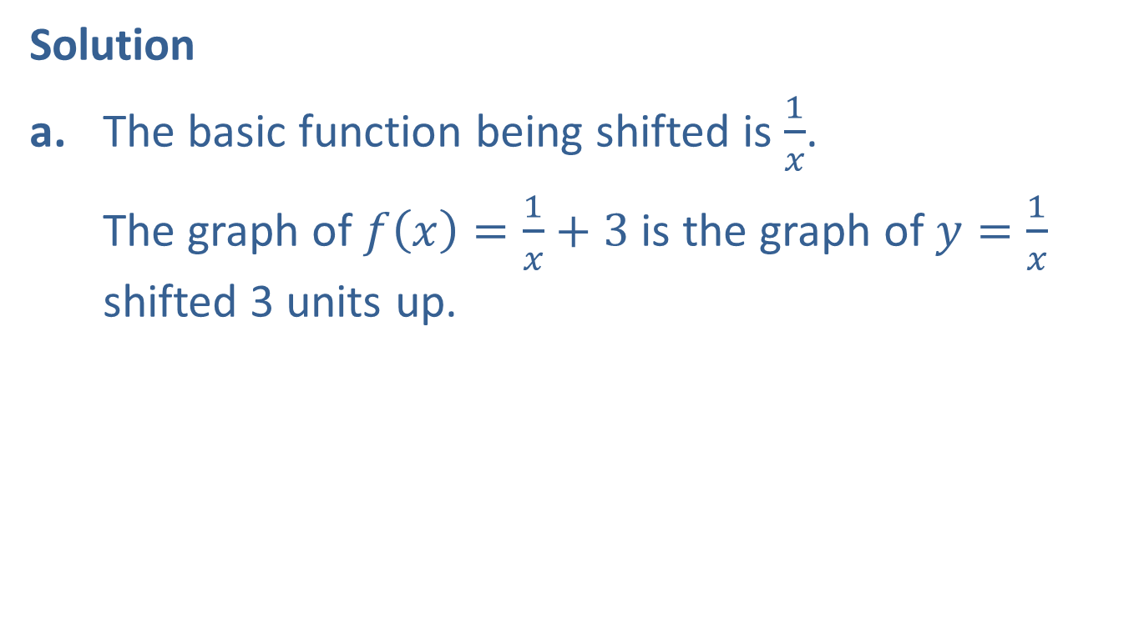
Example 2: Vertical Shifting/Translation (cont.)
Solution
a. The basic function being shifted is $\frac{1}{x}$.
The graph of $f\left(x\right)=\frac{1}{x}+3$ is the graph of $y=\frac{1}{x}$ shifted 3 units up.

Slide 14
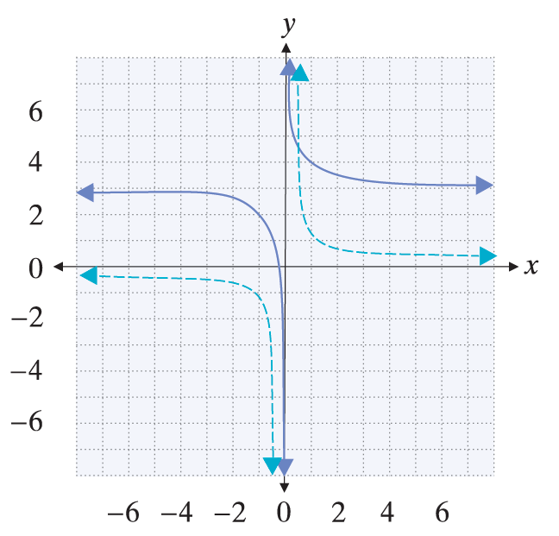

Example 2: Vertical Shifting/Translation (cont.)
Note that this doesn't change the domain.
However, the range is affected; the range of $f$ is $\left(−∞,3\right)∪\left(3,∞\right).$

Slide 15
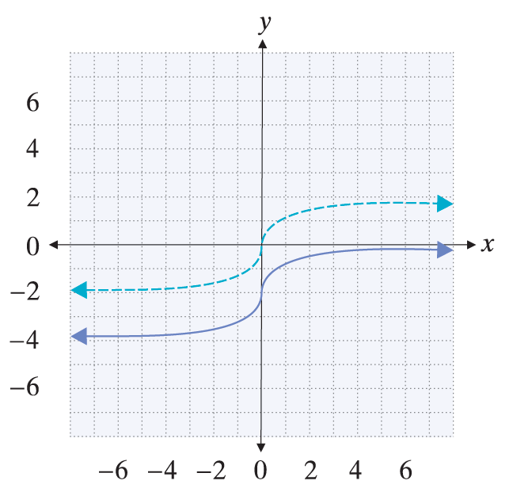
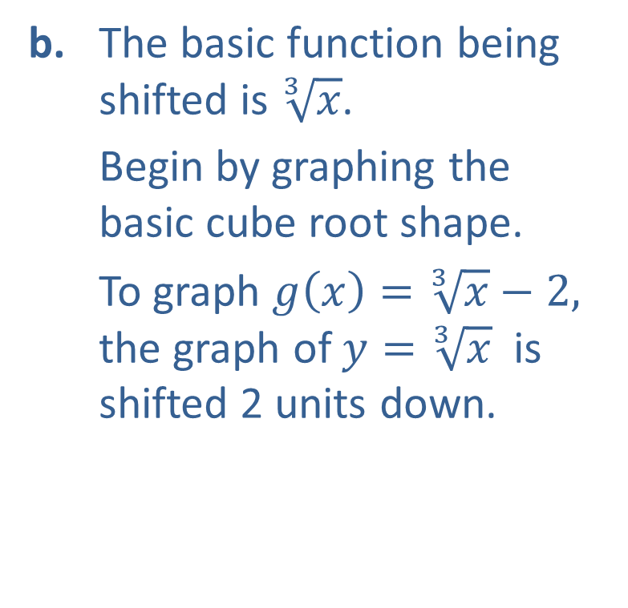
Example 2: Vertical Shifting/Translation (cont.)
b. The basic function being shifted is $\sqrt[3]{x}$.
Begin by graphing the basic cube root shape.
To graph $g\left(x\right)=\sqrt[3]{x}−2,$ the graph of $y=\sqrt[3]{x}$ is shifted 2 units down.

Slide 16

Example 3: Horizontal and Vertical Shifting
Sketch the graph of the function $f\left(x\right)=\sqrt{x+4}+1$.

Slide 17
Note
In this case, it doesn't matter which shift we apply first. However, when functions get more complicated, it is usually best to apply horizontal shifts before vertical shifts.

Slide 18
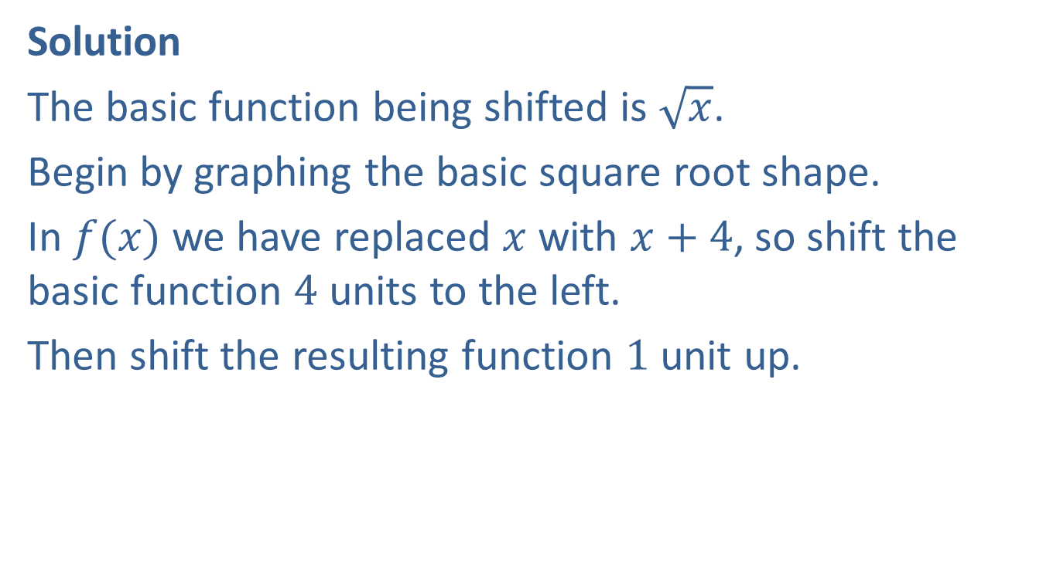
Example 3: Horizontal and Vertical Shifting (cont.)
Solution
The basic function being shifted is $\sqrt{x}$.
Begin by graphing the basic square root shape.
In $f(x)$ we have replaced $x$ with $x+4$, so shift the basic function $4$ units to the left.
Then shift the resulting function $1$ unit up.

Slide 19
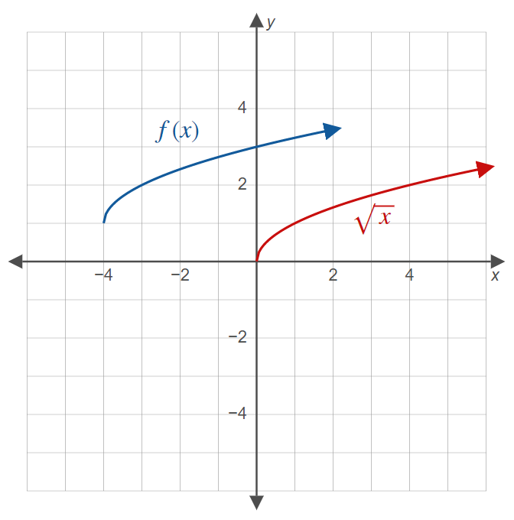
Example 3: Horizontal and Vertical Shifting (cont.)

Slide 20
Shifting, Reflecting, and Stretching Graphs
Reflecting with Respect to the Axes
Let f(x) be a function.
1. The graph of the function g(x)= −f(x) is the reflection of the graph of f with respect to the x-axis.
2. The graph of the function g(x) = f(−x) is the reflection of the graph of f with respect to the
y-axis.
In other words, a function is reflected with respect to the x-axis by multiplying the entire function by −1, and it is reflected with respect to the y-axis by replacing x with −x.

Slide 21

Example 4: Reflecting with Respect to the Axes
Sketch the graphs of the following functions.
$f\left(x\right)=−x^{2}$
$g\left(x\right)=\sqrt{−x}$

Slide 22
Note
We state that a function is reflected with respect to particular axis. Visually, this means the function is reflected over (across) that axis.

Slide 23
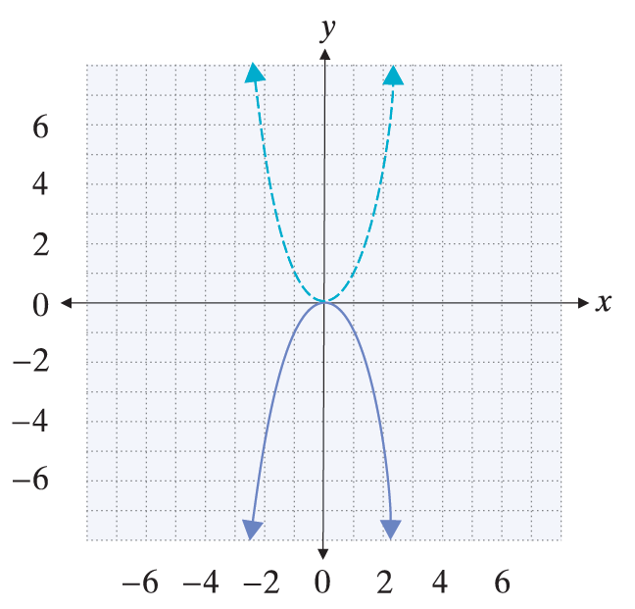
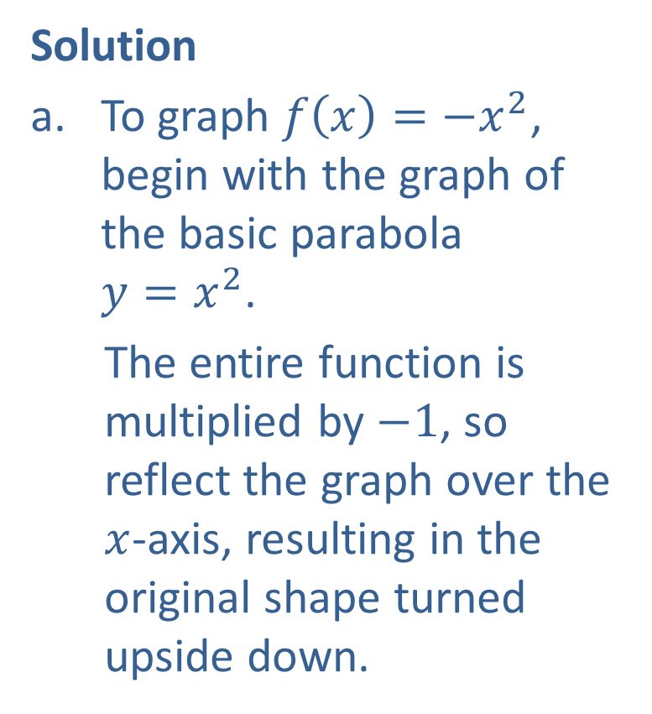
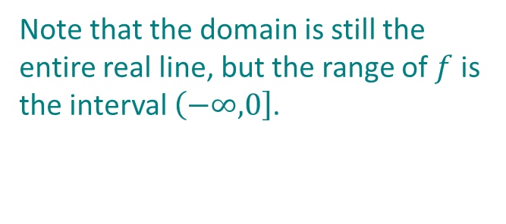
Example 4: Reflecting with Respect to the Axes (cont.)
Solution
To graph $f\left(x\right)={−x}^{2}$, begin with the graph of the basic parabola $y=x^{2}$.
The entire function is multiplied by $−1$, so reflect the graph over the $x$-axis, resulting in the original shape turned upside down.
Note that the domain is still the entire real line, but the range of $f$ is the interval $\left(−∞,\right.\left.0\right]$.

Slide 24
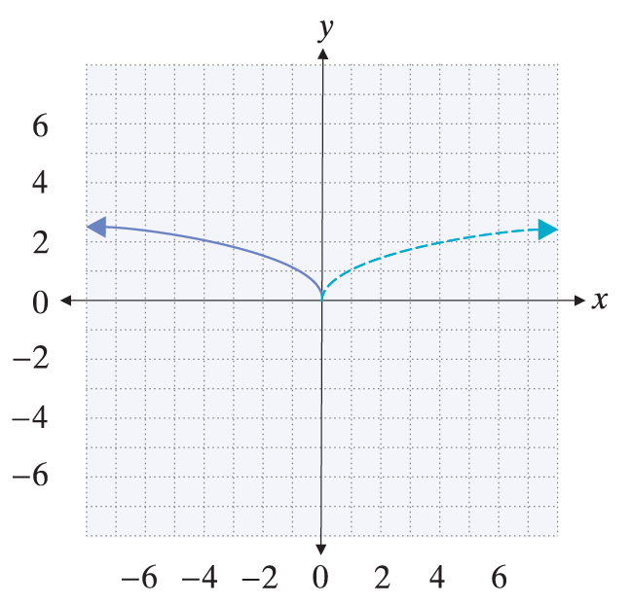
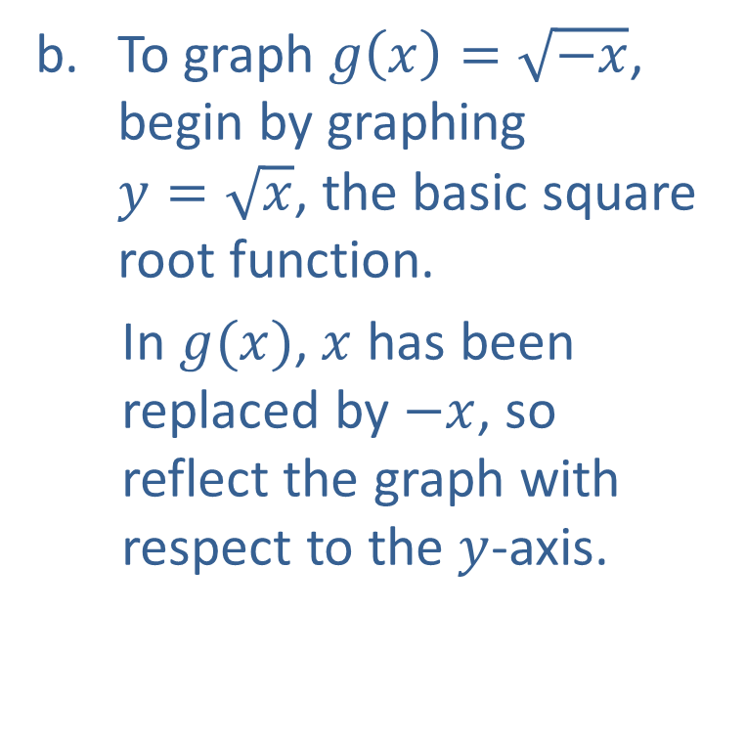
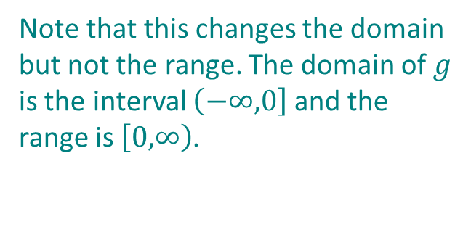
Example 4: Reflecting with Respect to the Axes (cont.)
To graph $g\left(x\right)=\sqrt{−x}$, begin by graphing $y=\sqrt{x}$, the basic square root function.
In $g(x)$, $x$ has been replaced by $−x$, so reflect the graph with respect to the $y$-axis.
Note that this changes the domain but not the range. The domain of $g$ is the interval $\left(−∞,\right.\left.0\right]$ and the range is $\left[0,\right.\left.∞\right)$.

Slide 25
Shifting, Reflecting, and Stretching Graphs
Vertical Stretching and Compressing
Let f(x) be a function and let a be a positive real number.
The graph of the function g(x)= a f(x) is stretched vertically compared to the graph of f by a factor of a if a > 1.
2. The graph of the function g(x)= a f(x) is compressed vertically compared to the graph of f by a factor of a if 0 < a < 1.

Slide 26

Example 5: Vertical Stretching and Compressing
Sketch the graphs of the following functions.
$f\left(x\right)=\frac{\sqrt{x}}{10}$
$g\left(x\right)=5\left|x\right|$

Slide 27
Note
When graphing stretched or compressed functions, it may help to plot a few points of the new function.

Slide 28
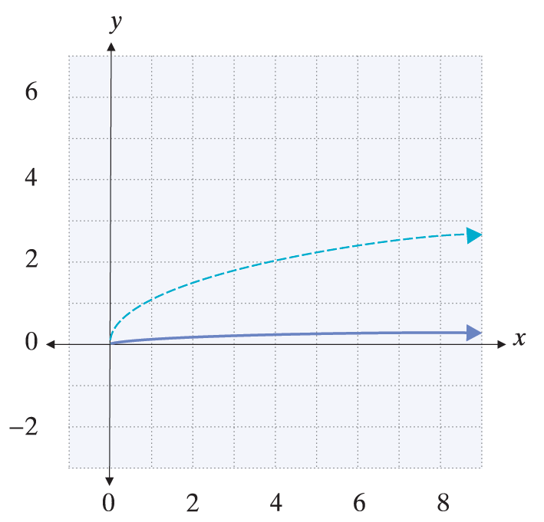
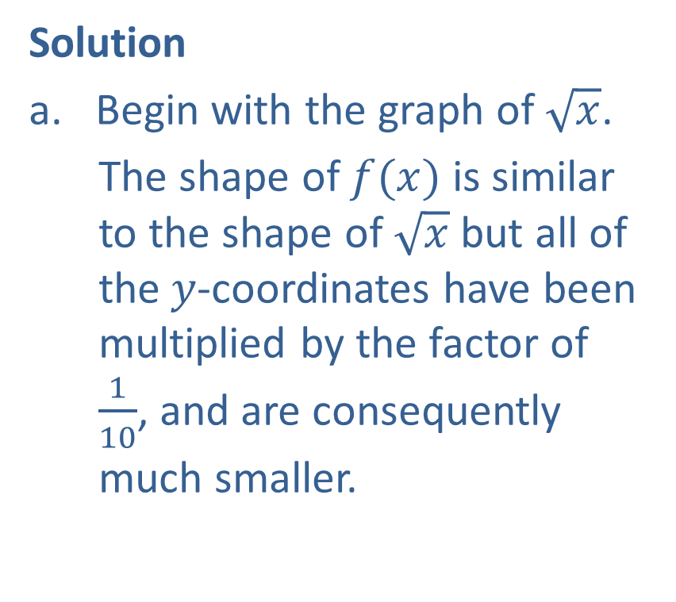
Example 5: Vertical Stretching and Compressing (cont.)
Solution
Begin with the graph of $\sqrt{x}$.
The shape of $f(x)$ is similar to the shape of $\sqrt{x}$ but all of the$y$-coordinates have been multiplied by the factor of $\frac{1}{10}$, and are consequently much smaller.

Slide 29
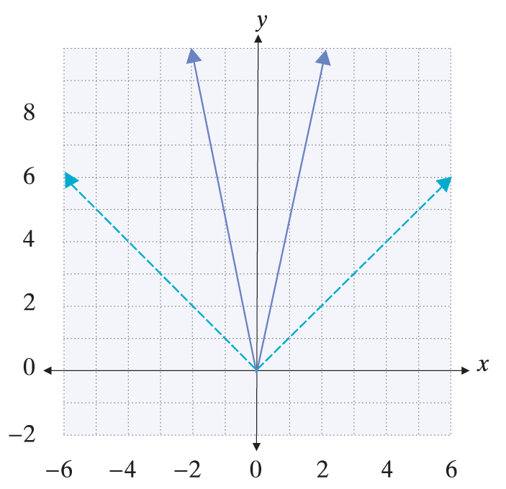
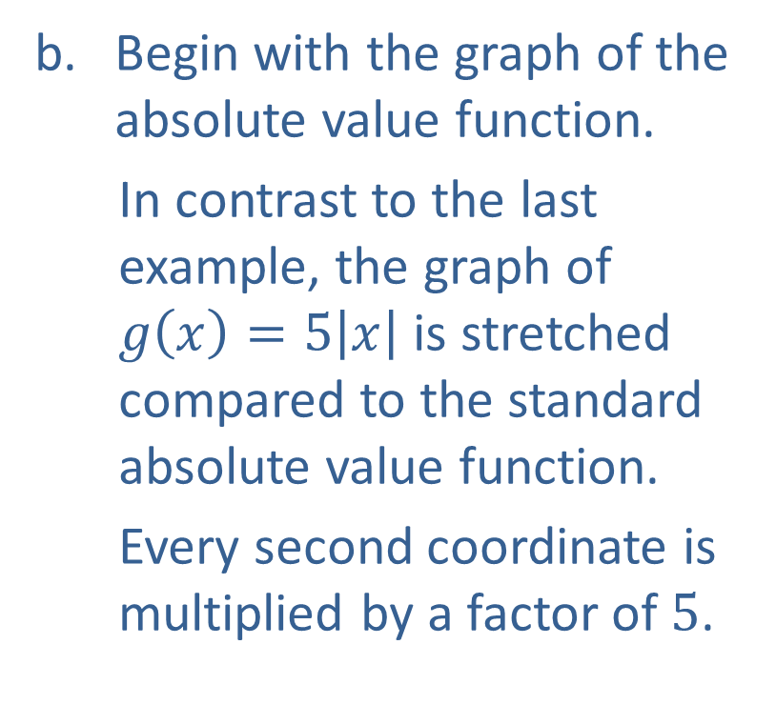
Example 5: Vertical Stretching and Compressing (cont.)
Begin with the graph of the absolute value function.
In contrast to the last example, the graph of $g\left(x\right)=5\left|x\right|$ is stretched compared to the standard absolute value function.
Every second coordinate is multiplied by a factor of $5$.

Slide 30
Shifting, Reflecting, and Stretching Graphs
Order of Transformations
If a function g has been obtained from a simpler function f through a number of transformations, g can usually be understood by looking for transformations in the following order.
1. Horizontal shifts
2. Stretching and compressing
3. Reflections
4. Vertical shifts

Slide 31
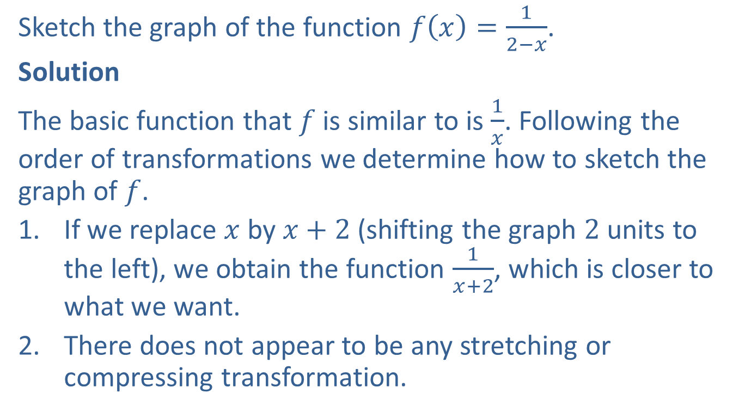
Example 6: Order of Transformations
Sketch the graph of the function $f\left(x\right)=\frac{1}{2−x}$.
Solution
The basic function that $f$ is similar to is $\frac{1}{x}$. Following the order of transformations we determine how to sketch the graph of $f$.
If we replace $x$ by $x+2$ (shifting the graph $2$ units to the left), we obtain the function $\frac{1}{x+2}$, which is closer to what we want.
There does not appear to be any stretching or compressing transformation.

Slide 32
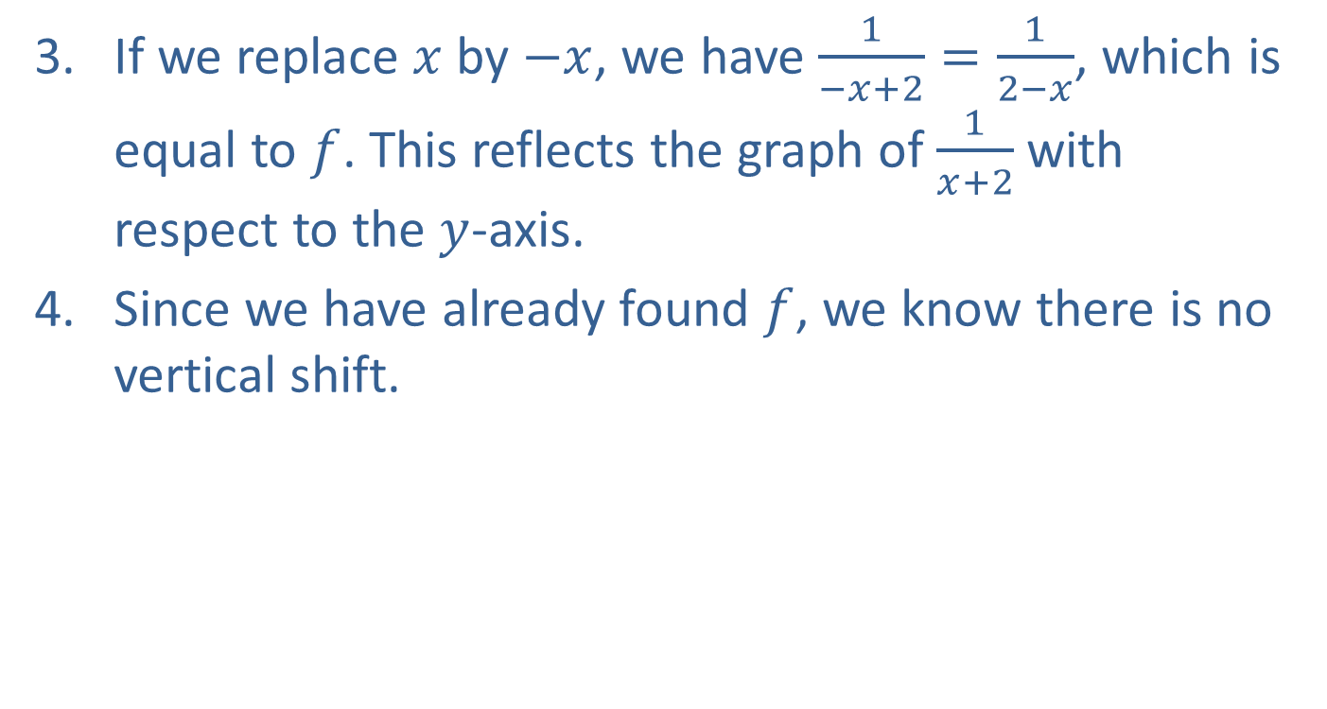
Example 6: Order of Transformations (cont.)
If we replace $x$ by $−x$, we have $\frac{1}{−x+2}=\frac{1}{2−x}$, which is equal to $f$. This reflects the graph of $\frac{1}{x+2}$ with respect to the $y$-axis.
Since we have already found $f$, we know there is no vertical shift.

Slide 33
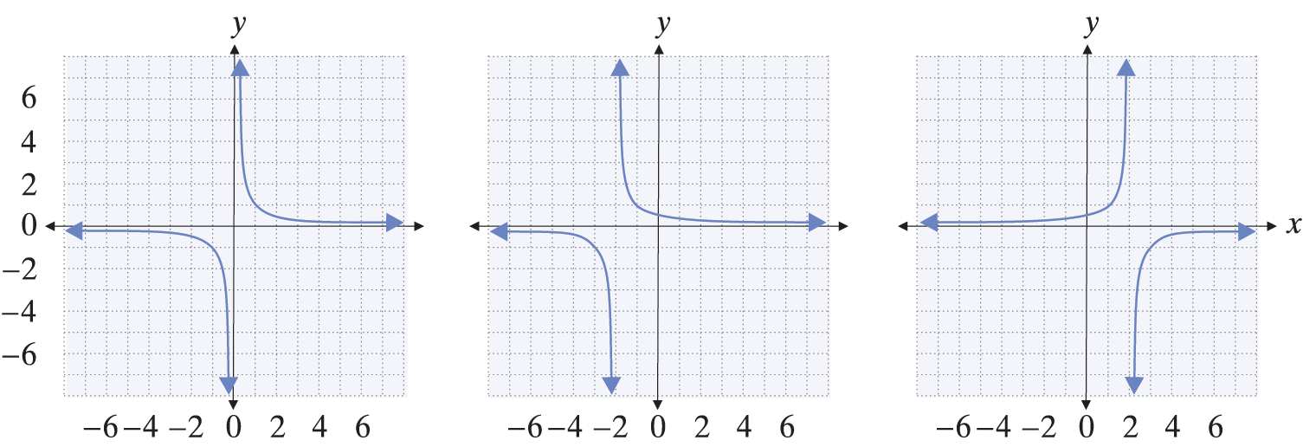

Example 6: Order of Transformations (cont.)
The entire sequence of transformations is shown below, ending with the graph of $f$.

Slide 34
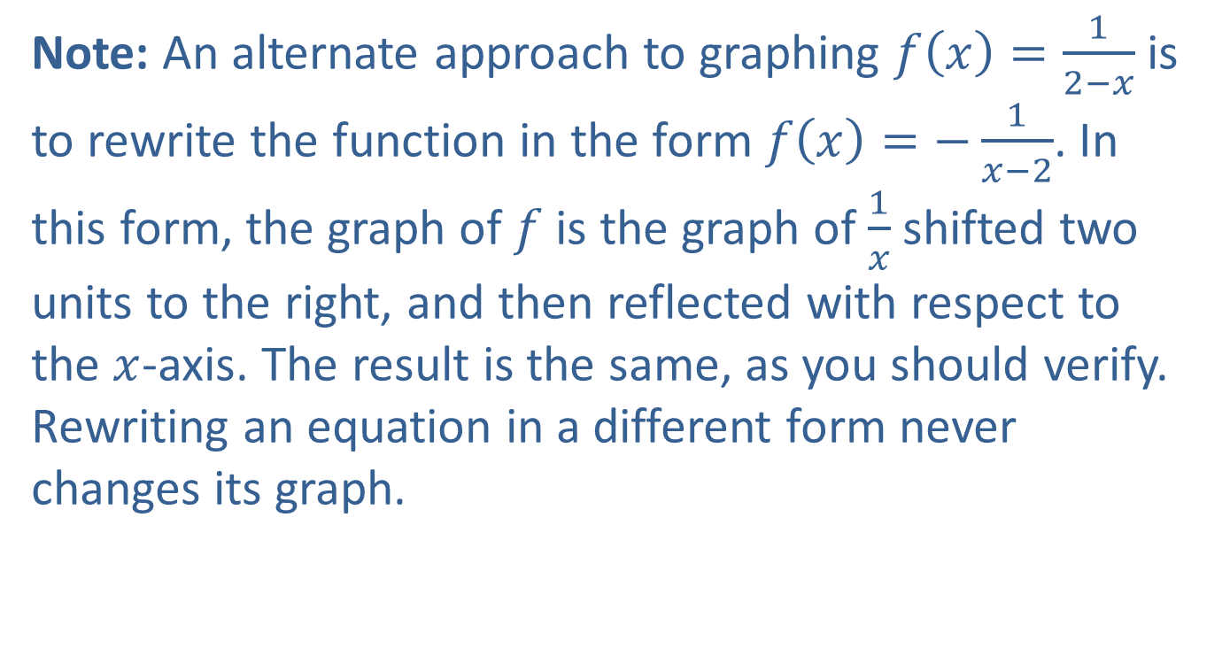
Example 6: Order of Transformations (cont.)
Note: An alternate approach to graphing $f\left(x\right)=\frac{1}{2−x}$ is to rewrite the function in the form $f\left(x\right)=−\frac{1}{x−2}$. In this form, the graph of $f$ is the graph of $\frac{1}{x}$ shifted two units to the right, and then reflected with respect to the $x$-axis. The result is the same, as you should verify. Rewriting an equation in a different form never changes its graph.

Slide 35
Symmetry of Functions and Equations
y-Axis Symmetry
The graph of a function f has y-axis symmetry, or is symmetric with respect to the y-axis, if f(−x) = f(x) for all x in the domain of f. Such functions are called even functions.

Slide 36
Symmetry of Functions and Equations
Origin Symmetry
The graph of a function f has origin symmetry, or is symmetric with respect to the origin, if f(−x) = −f(x) for all x in the domain of f. Such functions are called odd functions.

Slide 37
Symmetry of Functions and Equations
Symmetry of Equations
We say that an equation in x and y is symmetric with respect to
1. the y-axis if replacing x with −x results in an equivalent equation;
2. the x-axis if replacing y with −y results in an equivalent equation;
3. the origin if replacing x with −x and y with −y results in an equivalent equation.

Slide 38
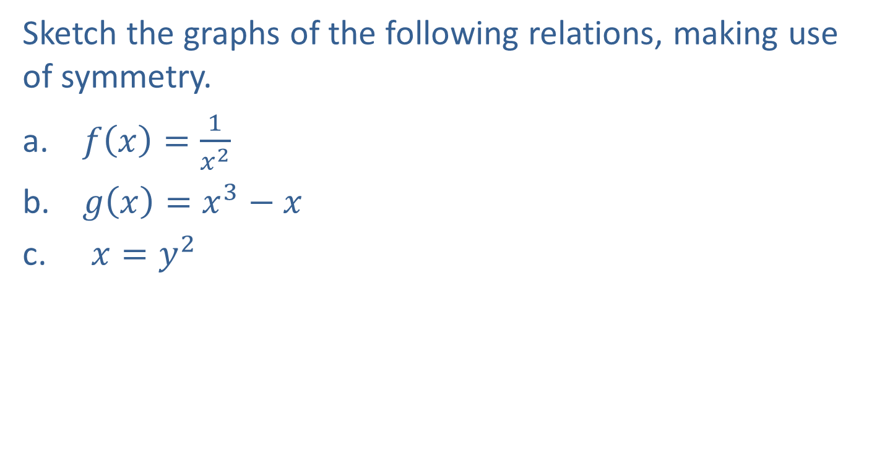
Example 7: Symmetry of Equations
Sketch the graphs of the following relations, making use of symmetry.
$f\left(x\right)=\frac{1}{x^{2}}$
$g\left(x\right)=x^{3}−x$
$x=y^{2}$

Slide 39
Note
If you don't know where to begin when sketching a graph, plotting points often helps you understand the basic shape.

Slide 40
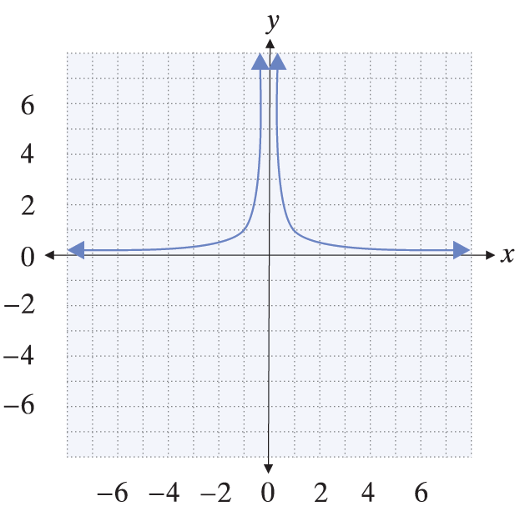
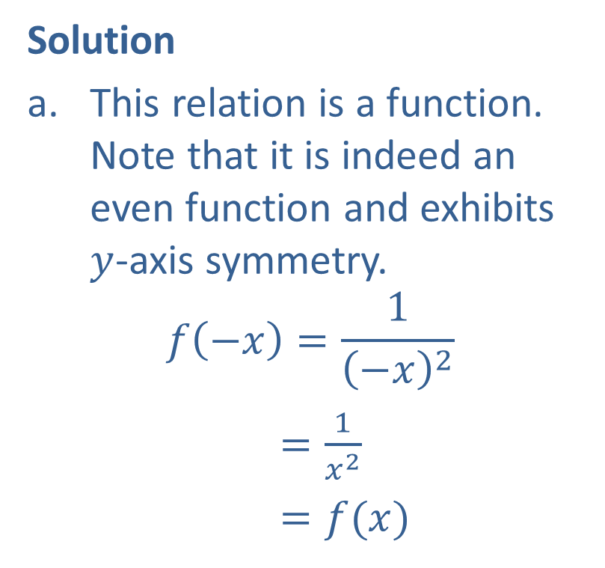
Example 7: Symmetry of Equations (cont.)
Solution
This relation is a function. Note that it is indeed an even function and exhibits $y$-axis symmetry.
$$f\left(−x\right)=\frac{1}{{\left(−x\right)}^{2}}$$
$=\frac{1}{x^{2}}$
$=f(x)$

Slide 41

Example 7: Symmetry of Equations (cont.)
While we do not yet have the tools to graph general polynomial functions, we can obtain a good sketch of $g\left(x\right)=x^{3}−x$.
First, $g$ is odd: $g\left(−x\right)=−g(x)$ (verify this).

Slide 42
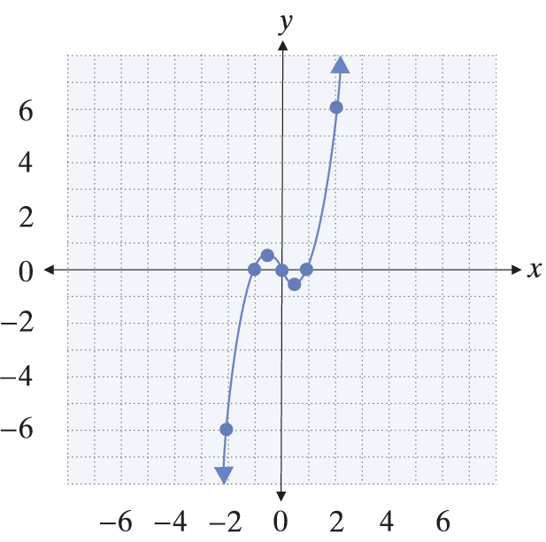
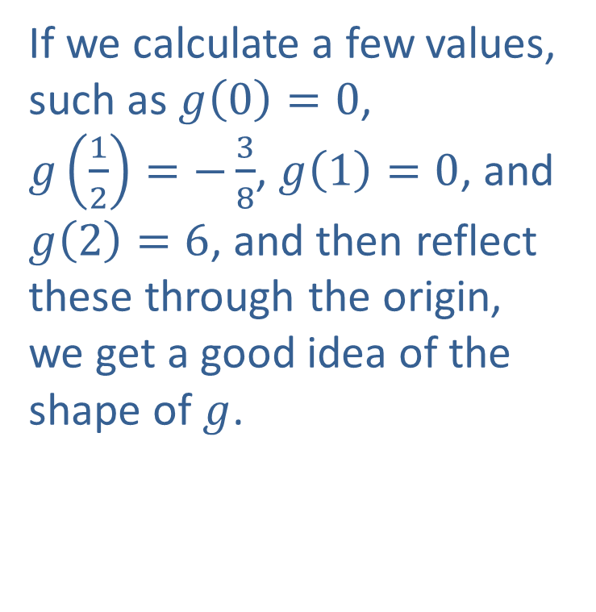
Example 7: Symmetry of Equations (cont.)
If we calculate a few values, such as $g\left(0\right)=0$, $g\left(\frac{1}{2}\right)=−\frac{3}{8}$, $g\left(1\right)=0$, and $g\left(2\right)=6$, and then reflect these through the origin, we get a good idea of the shape of $g$.

Slide 43
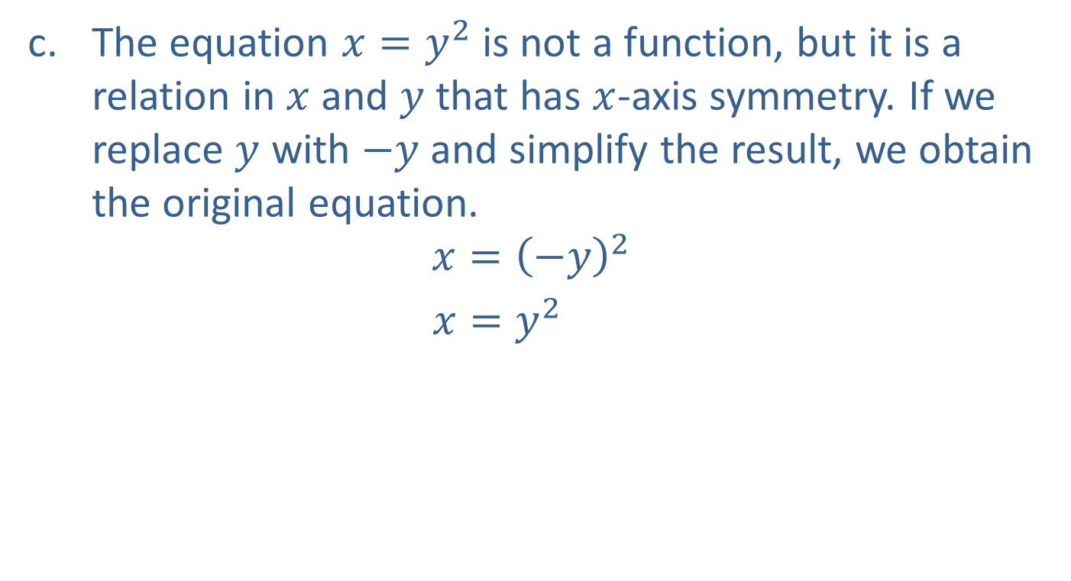
Example 7: Symmetry of Equations (cont.)
The equation $x=y^{2}$ is not a function, but it is a relation in $x$ and $y$ that has $x$-axis symmetry. If we replace $y$ with $−y$ and simplify the result, we obtain the original equation.
$$x={\left(−y\right)}^{2}$$
$x=y^{2}$

Slide 44
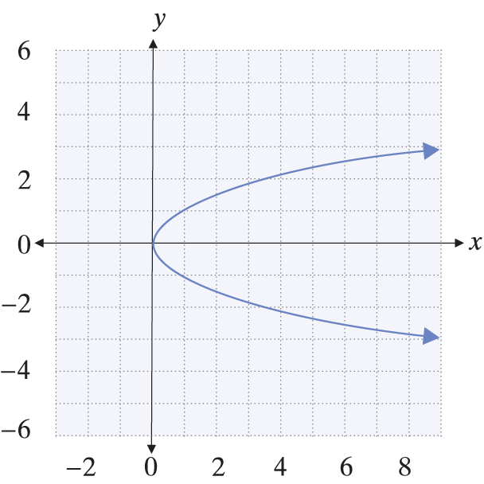
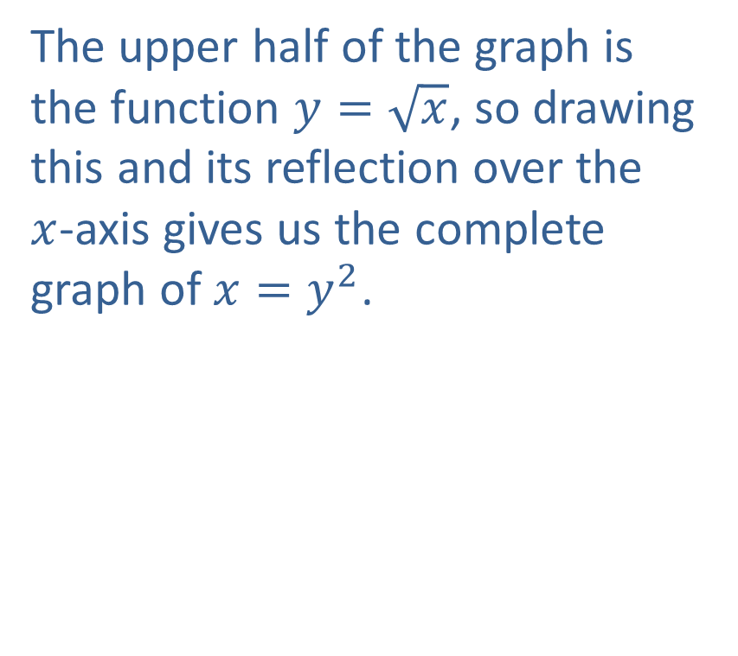
Example 7: Symmetry of Equations (cont.)
The upper half of the graph is the function $y=\sqrt{x}$, so drawing this and its reflection over the $x$-axis gives us the complete graph of $x=y^{2}$.

Slide 45
Intervals of Monotonicity
Increasing, Decreasing, and Constant
We say that a function f is
1. increasing on an interval if, for any x₁ and x₂ in the interval with x₁ < x₂, it is the case that f(x₁) < f(x₂);
2. decreasing on an interval if, for any x₁ and x₂ in the interval with x₁ < x₂, it is the case that f(x₁) > f(x₂);
3. constant on an interval if, for any x₁ and x₂ in the interval, it is the case that f(x₁) = f(x₂).

Slide 46
Example 8: Determining Intervals of Monotonicity
Determine the open intervals of monotonicity of the function

Slide 47
Example 8: Determining Intervals of Monotonicity (cont.)
Solution
We know that the graph of f is the basic parabola shifted 2 units to the right and 1 unit down, as shown on the following page.

Slide 48
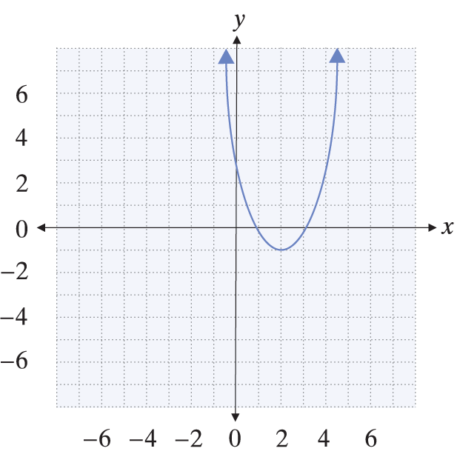
Example 8: Determining Intervals of Monotonicity (cont.)

Slide 49
Example 8: Determining Intervals of Monotonicity (cont.)
From the graph, we can see that f is decreasing on the interval and increasing on the interval Remember that these are intervals of the x-axis: if x₁ and x₂ are any two points in the interval , with
x₁ < x₂, then f(x₁) > f(x₂). In other words, f is falling on this interval as we scan the graph from left to right. On the other hand, f is rising on the interval as we scan the graph from left to right.

Slide 50
Example 9: Modeling the Water Level of a River
The water level of a certain river varied over the course of a year as follows. In January, the level was 13 feet. From that level, the water increased linearly to a level of 18 feet in May. The water remained constant at that level until July, at which point it began to decrease linearly to a final level of 11 feet in December. Graph the water level as a function of time and determine the intervals of monotonicity.

Slide 51
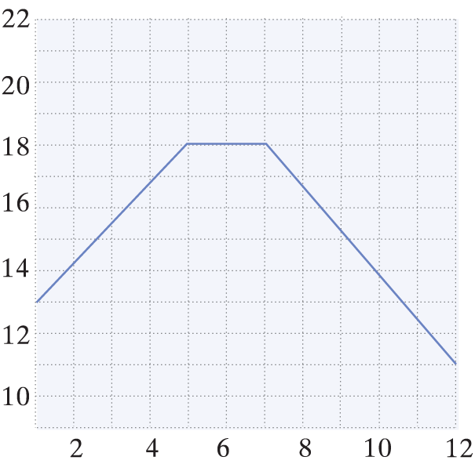
Example 9: Modeling the Water Level of a River (cont.)
Solution:
If we let 1 to 12 represent January through December, the intervals of monotonicity are as follows:
increasing on (1, 5),
constant on (5, 7),
and decreasing on (7, 12).
The graph of the water level as
a function of the month is shown
to the right.

