Slide 1
Section 3.7
Polynomial Functions

Slide 2
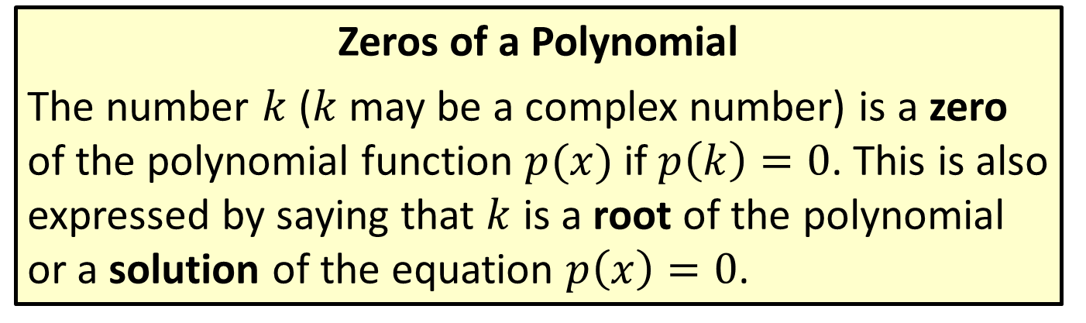
Zeros of Polynomials and Solutions of Polynomial Equations
Zeros of a Polynomial
The number $k$ ($k$ may be a complex number) is a zero of the polynomial function $p(x)$ if $p\left(k\right)=0$. This is also expressed by saying that $k$ is a root of the polynomial or a solution of the equation $p\left(x\right)=0$.

Slide 3
Zeros of Polynomials and Solutions of Polynomial Equations
Polynomial Equations
A polynomial equation in one variable, say the variable x, is an equation that can be written in the form , where n is a nonnegative integer, are constants. Assuming a_{n} ≠ 0, we say such an equation is of degree n and call a_{n} the leading coefficient.

Slide 4
Example 1: Solutions of Polynomial Equations
Verify that the given values of x solve the corresponding polynomial equations.

Slide 5
Note:
When verifying a zero, there is no need to rewrite the equation in the form of the definition.

Slide 6
Example 1: Solutions of Polynomial Equations (cont.)
Solution
a.
Substitute x = 4 throughout the equation.
Simplify both sides.
This is a true statement, so 4 is a solution.

Slide 7

Example 1: Solutions of Polynomial Equations (cont.)
b.
Substitute $x=1+2i$ in the equation.
Expand both sides.
Simplify, using the fact that $i^{2}=−1$.
This is a true statement, so $1+2i$ is a solution.

Slide 8
Example 1: Solutions of Polynomial Equations (cont.)
c.
Substitute 0 for x in the equation.
After simplifying, we arrive at a true statement. Thus, 0 is a solution to the polynomial equation.

Slide 9
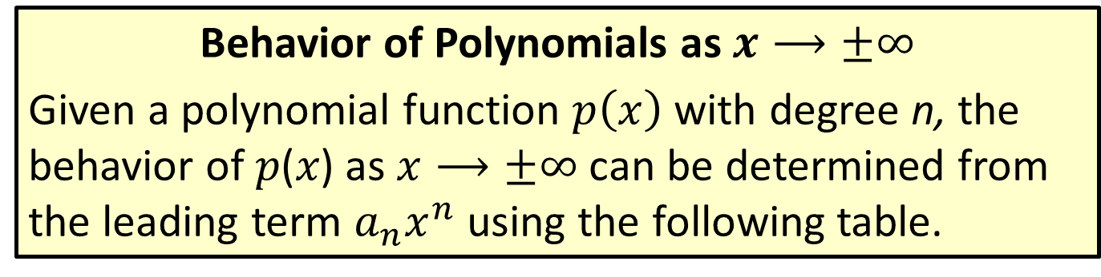
Graphing Factored Polynomials
Behavior of Polynomials as $x⟶±∞$
Given a polynomial function $p\left(x\right)$ with degree n, the behavior of 𝑝(𝑥) as $x⟶±∞$ can be determined from the leading term $a_{n}x^{n}$ using the following table.

Slide 10
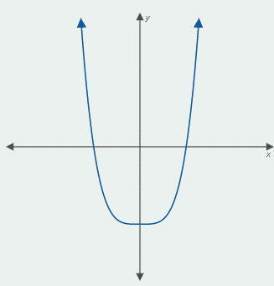
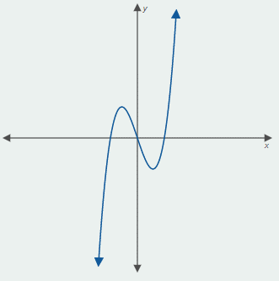
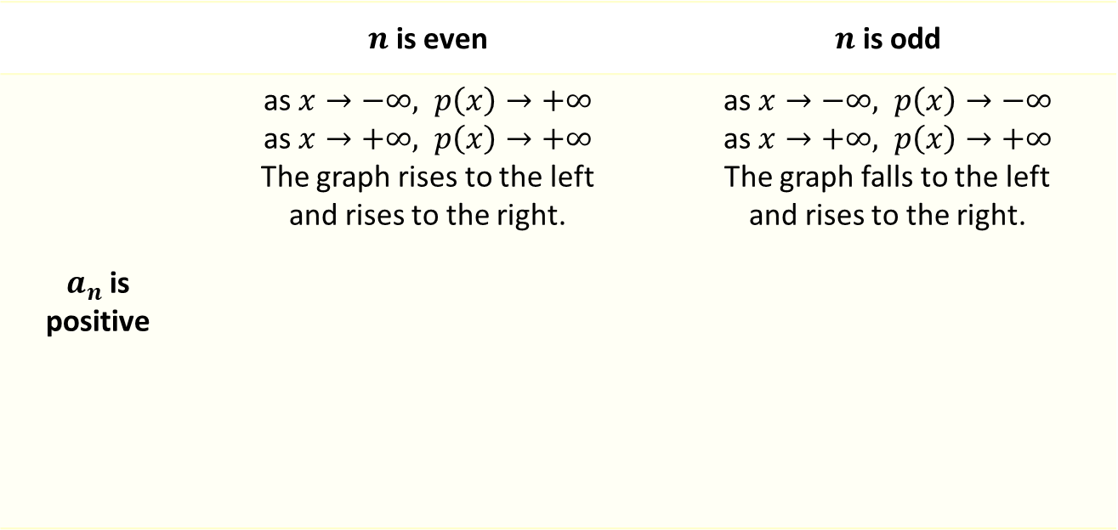

Graphing Factored Polynomials
Behavior of Polynomials as $x⟶±∞$ (cont.)
 | $n$ is even | $n$ is odd
$a_{n}$ is positive | as $x→−∞, p\left(x\right)→+∞$ as $x→+∞, p\left(x\right)→+∞$ The graph rises to the left and rises to the right. | as $x→−∞, p\left(x\right)→−∞$ as $x→+∞, p\left(x\right)→+∞$ The graph falls to the left and rises to the right.

Slide 11
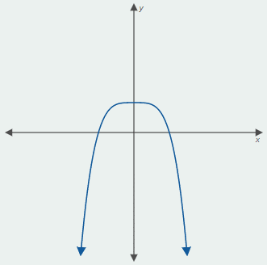
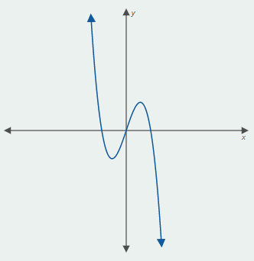
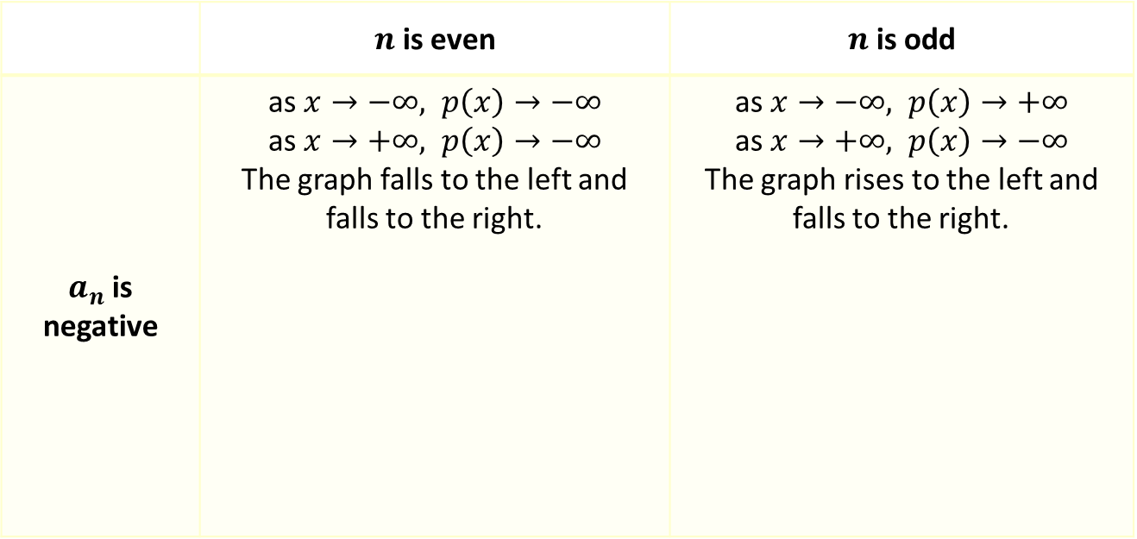
Graphing Factored Polynomials
Behavior of Polynomials as $x⟶±∞$ (cont.)
 | $n$ is even | $n$ is odd
$a_{n}$ is negative | as $x→−∞, p\left(x\right)→−∞$ as $x→+∞, p\left(x\right)→−∞$ The graph falls to the left and falls to the right. | as $x→−∞, p\left(x\right)→+∞$ as $x→+∞, p\left(x\right)→−∞$ The graph rises to the left and falls to the right.

Slide 12

Example 2: Graphing Polynomial Functions
Sketch the graphs of the following polynomial functions, paying particular attention to the x‐intercept(s), the y‐intercept, and the behavior as $x→±∞$.

Slide 13
Note:
As always, plotting additional points will help in sketching an accurate graph.

Slide 14
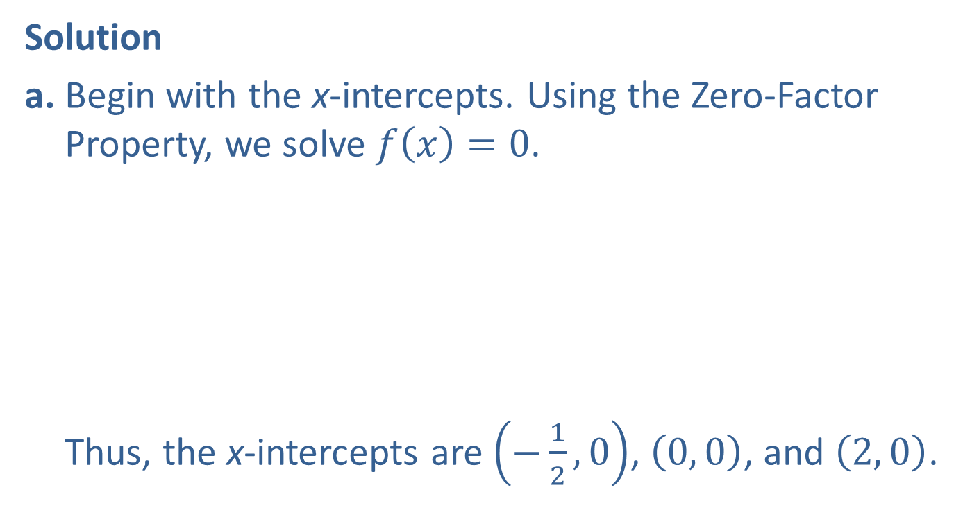
Example 2: Graphing Polynomial Functions (cont.)
Solution
a. Begin with the x-intercepts. Using the Zero-Factor Property, we solve $f\left(x\right)=0$.
Thus, the x-intercepts are $\left(−\frac{1}{2}, 0\right)$, $\left(0, 0\right)$, and $\left(2, 0\right)$.

Slide 15
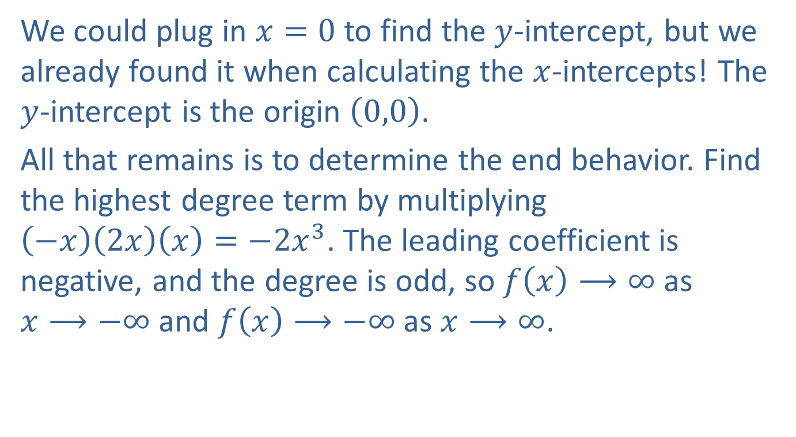
Example 2: Graphing Polynomial Functions (cont.)
We could plug in $x=0$ to find the $y$-intercept, but we already found it when calculating the $x$-intercepts! The $y$-intercept is the origin $\left(0,0\right)$.
All that remains is to determine the end behavior. Find the highest degree term by multiplying $\left(−x\right)\left(2x\right)\left(x\right)=−2x^{3}$. The leading coefficient is negative, and the degree is odd, so $f\left(x\right)⟶∞$ as $x⟶−∞$ and $f\left(x\right)⟶−∞$ as $x⟶∞$.

Slide 16
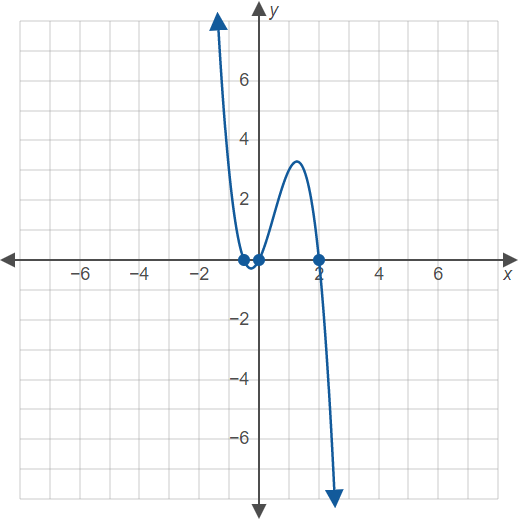
Example 2: Graphing Polynomial Functions (cont.)
Putting all this together, we obtain the following graph.

Slide 17
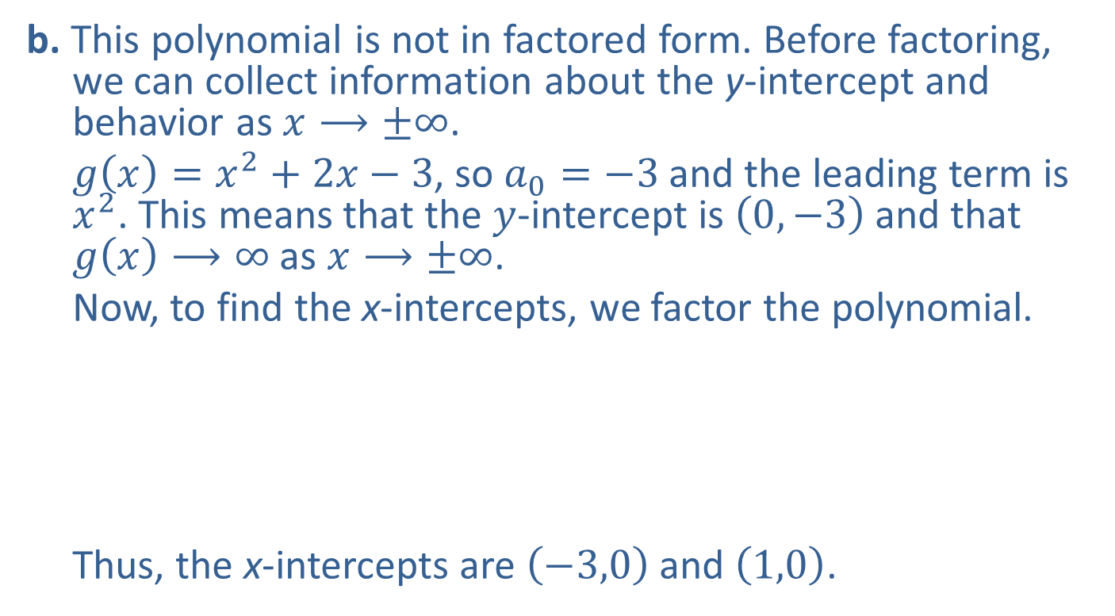
Example 2: Graphing Polynomial Functions (cont.)
b. This polynomial is not in factored form. Before factoring, we can collect information about the y-intercept and behavior as $x⟶±∞$.
$g\left(x\right)=x^{2}+2x−3$, so $a_{0}=−3$ and the leading term is $x^{2}$. This means that the $y$-intercept is $\left(0,−3\right)$ and that $g\left(x\right)⟶∞$ as $x⟶±∞$.
Now, to find the x-intercepts, we factor the polynomial.
Thus, the x-intercepts are $\left(−3,0\right)$ and $\left(1,0\right)$.

Slide 18
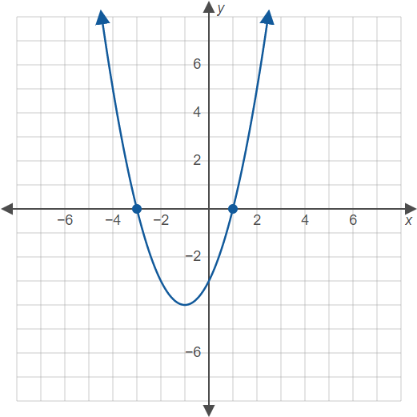
Example 2: Graphing Polynomial Functions (cont.)

Slide 19

Example 2: Graphing Polynomial Functions (cont.)
c. As with the previous example, we determine the $y$-intercept and end behavior before factoring. $h\left(x\right)=x^{4}−1$, so $a_{0}=−1$ and the leading term is $x^{4}$. This tells us that the y-intercept is $\left(0,−1\right)$ and that $h\left(x\right)⟶∞$ as $x⟶±∞$.

Slide 20

Example 2: Graphing Polynomial Functions (cont.)
Once again, we factor the polynomial to calculate the x-intercepts.
A difference of squares.
Another difference of squares.
Only the real solutions lead to $x$-intercepts. Here, the $x$-intercepts are $\left(−1,0\right)$ and $\left(1,0\right)$.

Slide 21
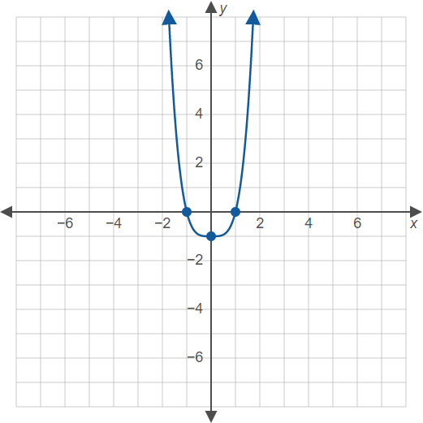
Example 2: Graphing Polynomial Functions (cont.)

Slide 22
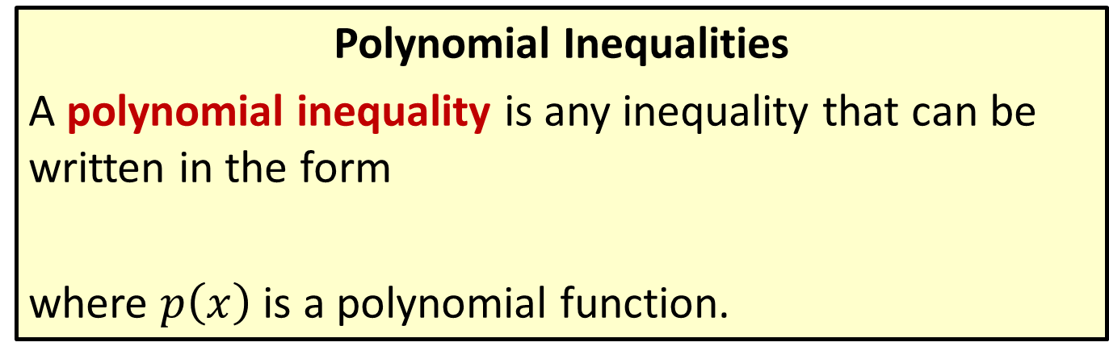
Solving Polynomial Inequalities
Polynomial Inequalities
A polynomial inequality is any inequality that can be written in the form
where $p\left(x\right)$ is a polynomial function.

Slide 23
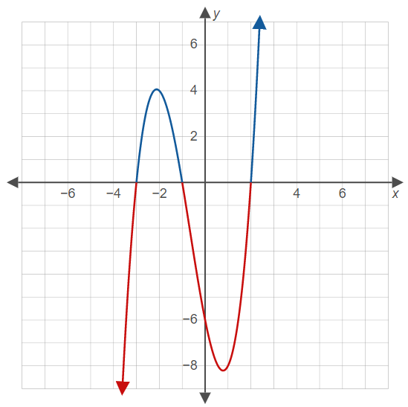
Example 3: Solving Polynomial Inequalities Using a Graph
Solve the polynomial inequalities, given the graph of

Slide 24
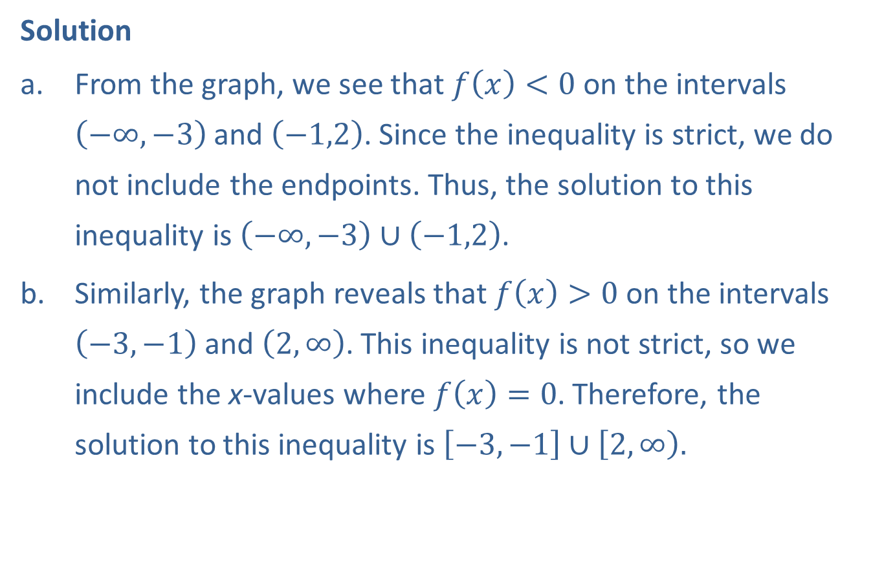
Example 3: Solving Polynomial Inequalities Using a Graph (cont.)
Solution
From the graph, we see that $f\left(x\right)<0$ on the intervals $\left(−∞,−3\right)$and $\left(−1,2\right)$. Since the inequality is strict, we do not include the endpoints. Thus, the solution to this inequality is $\left(−∞,−3\right)∪\left(−1,2\right)$.
Similarly, the graph reveals that $f\left(x\right)>0$ on the intervals $\left(−3,−1\right)$and $\left(2,∞\right)$. This inequality is not strict, so we include the x-values where $f\left(x\right)=0$. Therefore, the solution to this inequality is $\left[−3,−1\right]∪\left[2\right.,\left.∞\right).$

Slide 25
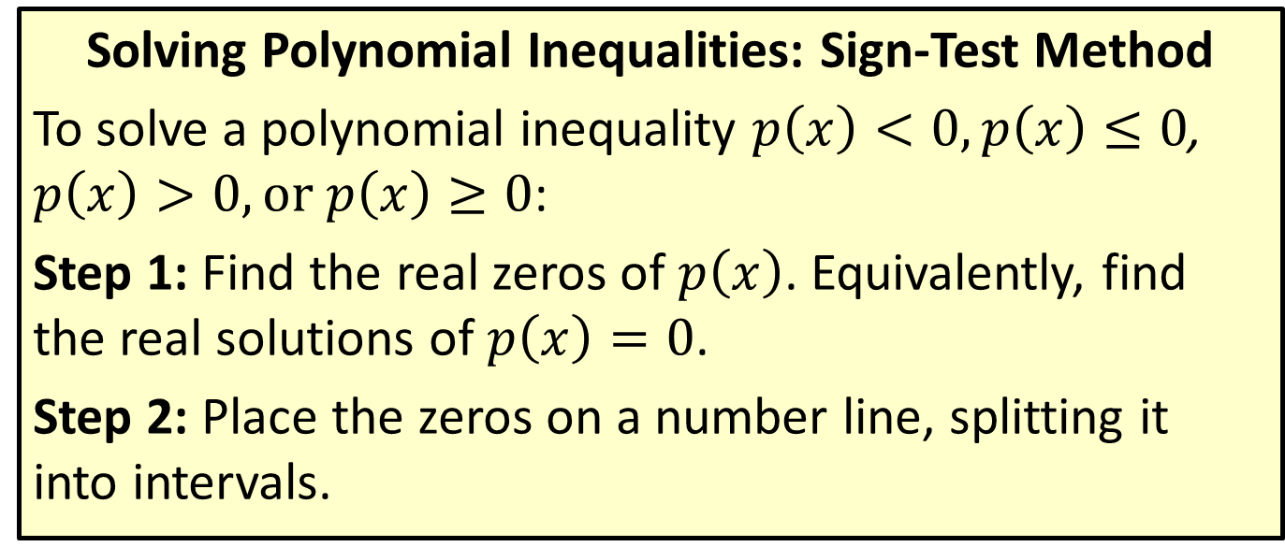
Solving Polynomial Inequalities
Solving Polynomial Inequalities: Sign-Test Method
To solve a polynomial inequality $p\left(x\right)<0,p\left(x\right)≤0$, $p\left(x\right)>0, or p\left(x\right)≥0$:
Step 1: Find the real zeros of $p\left(x\right)$. Equivalently, find the real solutions of $p\left(x\right)=0$.
Step 2: Place the zeros on a number line, splitting it into intervals.

Slide 26
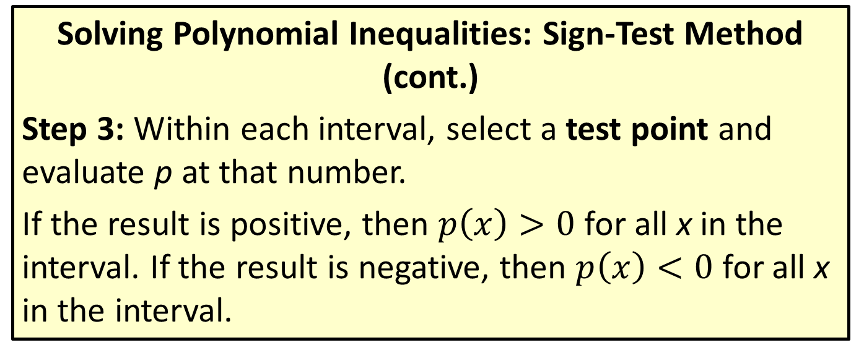
Solving Polynomial Inequalities
Solving Polynomial Inequalities: Sign-Test Method (cont.)
Step 3: Within each interval, select a test point and evaluate p at that number.
If the result is positive, then $p\left(x\right)>0$ for all x in the interval. If the result is negative, then $p\left(x\right)<0$ for all x in the interval.

Slide 27
Solving Polynomial Inequalities
Solving Polynomial Inequalities: Sign-Test Method (cont.)
Step 4: Write the solution set, consisting of all of the intervals that satisfy the given inequality.
If the inequality is not strict (uses ≤ or ≥), then the zeros are included in the solution set as well.

Slide 28
Example 4: Solving Polynomial Inequalities: Sign-Test Method
Solve the polynomial inequality

Slide 29
Note:
When choosing test points, integers (especially 0) are usually easiest to work with.

Slide 30

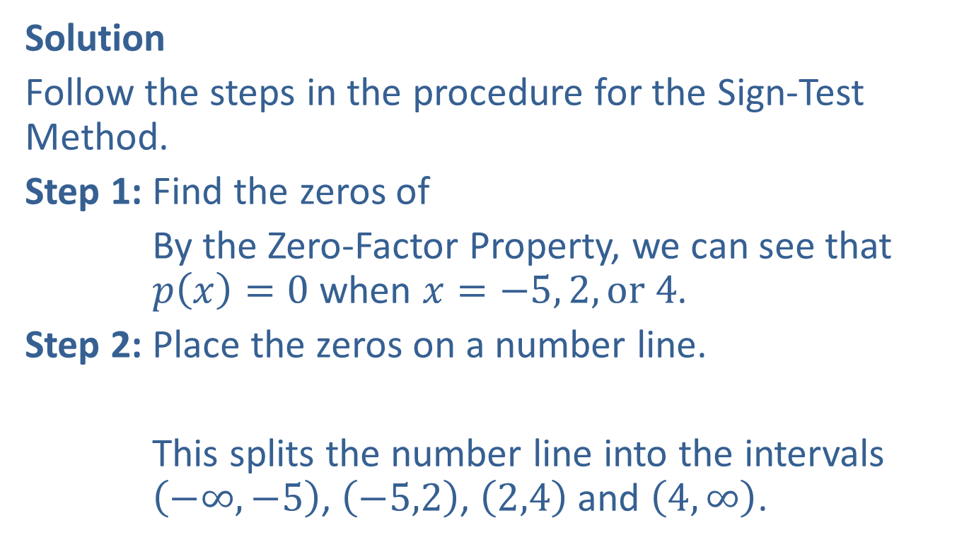
Example 4: Solving Polynomial Inequalities: Sign-Test Method (cont.)
Solution
Follow the steps in the procedure for the Sign-Test Method.
Step 1: Find the zeros of
By the Zero-Factor Property, we can see that $p\left(x\right)=0$ when $x=−5, 2, or 4$.
Step 2: Place the zeros on a number line.
This splits the number line into the intervals $\left(−∞,−5\right)$, $\left(−5,2\right)$, $\left(2,4\right)$ and $\left(4,∞\right)$.

Slide 31
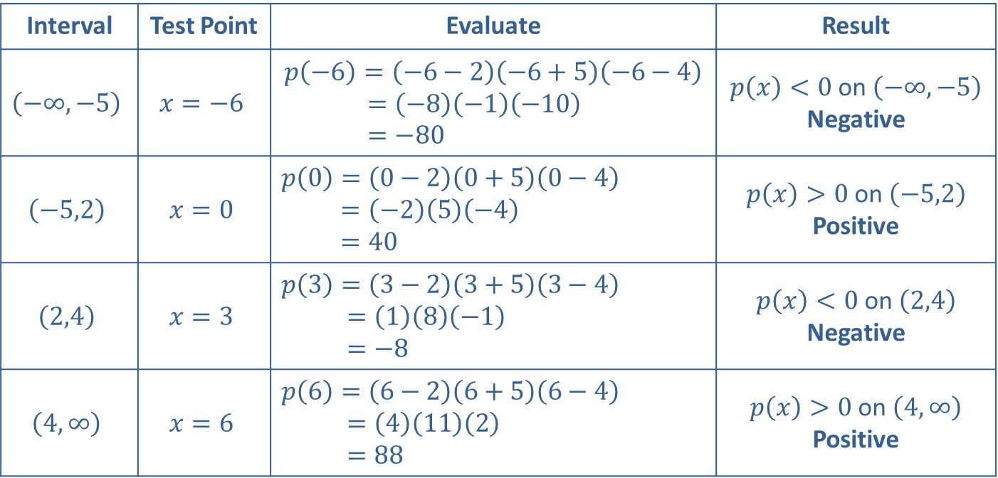
Example 4: Solving Polynomial Inequalities: Sign-Test Method (cont.)
Step 3: Evaluate p(x) for a test point in each interval.
Interval | Test Point | Evaluate | Result
$$\left(−∞,−5\right)$$ | $$x=−6$$ | $$p\left(−6\right)=\left(−6−2\right)\left(−6+5\right)\left(−6−4\right) \\ =\left(−8\right)\left(−1\right)\left(−10\right) \\ =−80$$ | $p\left(x\right)<0$ on $\left(−∞,−5\right)$ Negative
$$\left(−5,2\right)$$ | $$x=0$$ | $$p\left(0\right)=\left(0−2\right)\left(0+5\right)\left(0−4\right)$$ $$=\left(−2\right)\left(5\right)\left(−4\right)$$ $$=40$$ | $p\left(x\right)>0$ on $\left(−5,2\right)$ Positive
$$\left(2,4\right)$$ | $$x=3$$ | $$p\left(3\right)=\left(3−2\right)\left(3+5\right)\left(3−4\right)$$ $$=\left(1\right)\left(8\right)\left(−1\right)$$ $$=−8$$ | $p\left(x\right)<0$ on $\left(2,4\right)$ Negative
$$\left(4,∞\right)$$ | $$x=6$$ | $$p\left(6\right)=\left(6−2\right)\left(6+5\right)\left(6−4\right)$$ $$=\left(4\right)\left(11\right)\left(2\right)$$ $$=88$$ | $p\left(x\right)>0$ on $\left(4,∞\right)$ Positive

Slide 32
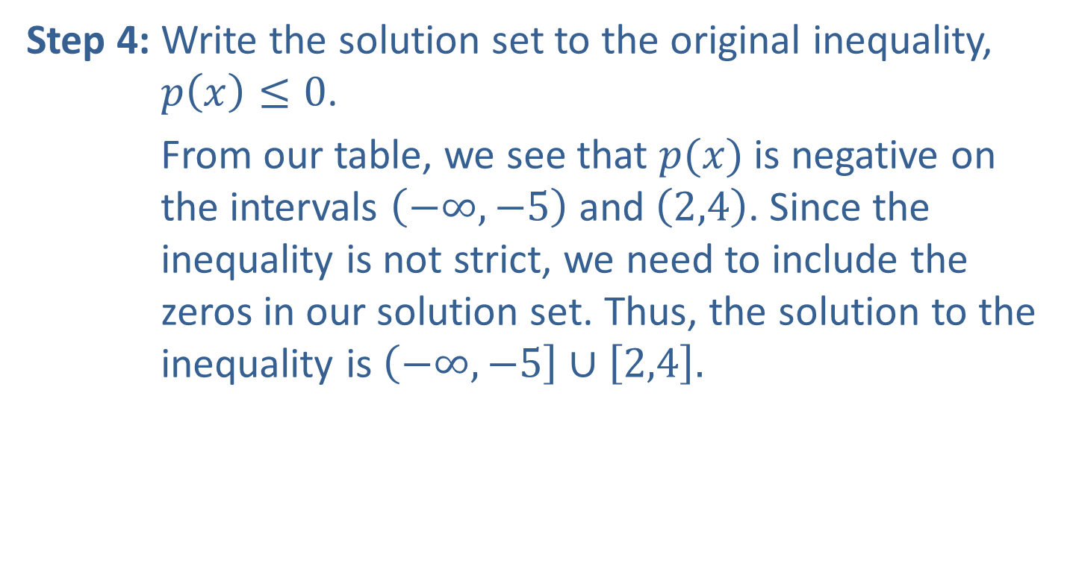
Example 4: Solving Polynomial Inequalities: Sign-Test Method (cont.)
Step 4: Write the solution set to the original inequality, $p\left(x\right)≤0$.
From our table, we see that $p(x)$ is negative on the intervals $\left(−∞,−5\right)$ and $\left(2,4\right)$. Since the inequality is not strict, we need to include the zeros in our solution set. Thus, the solution to the inequality is $\left(−∞\right.,\left.−5\right]∪\left[2,4\right].$

