Slide 1
Section 3.8
Rational Functions

Slide 2
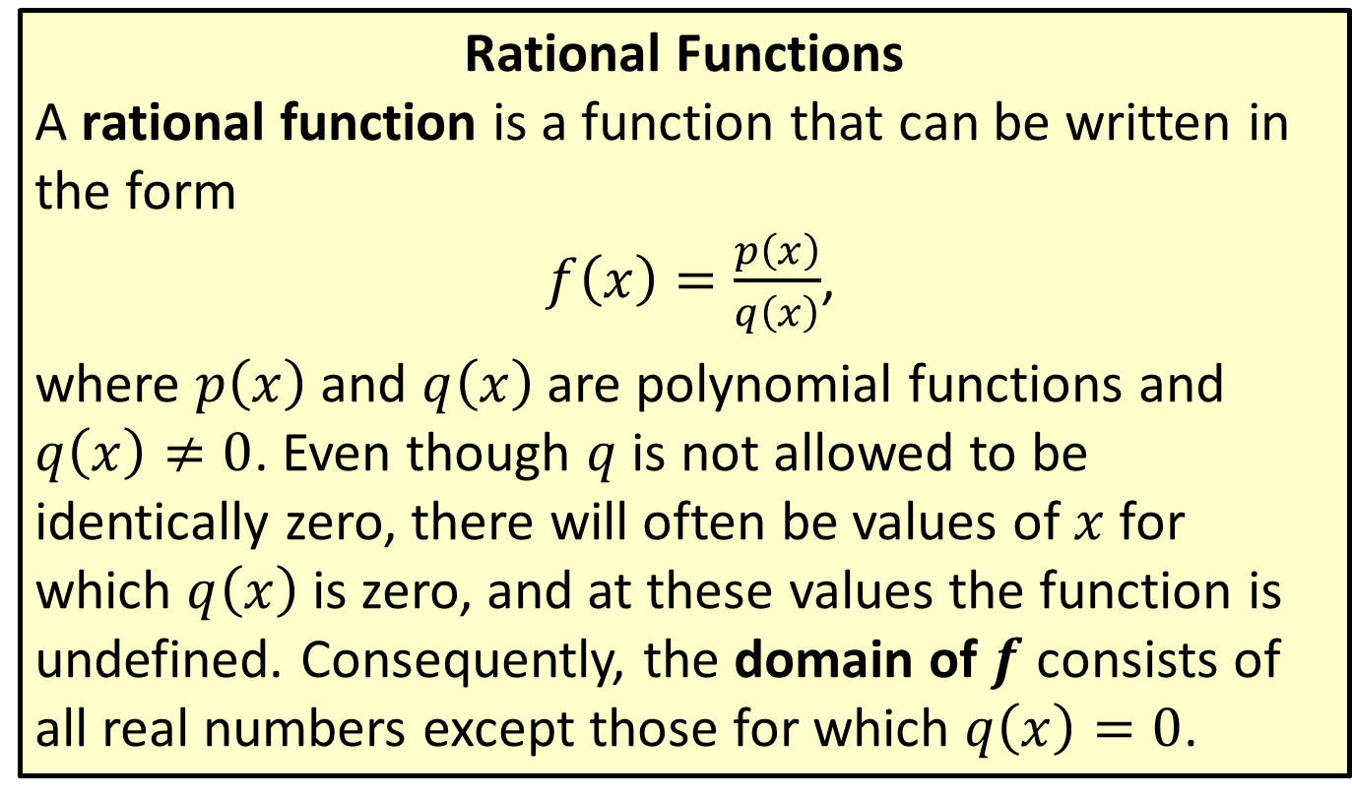
Definitions and Useful Notation
Rational Functions
A rational function is a function that can be written in the form
$f⁡\left(x\right)=\frac{p\left(x\right)}{q\left(x\right)}$,
where $p⁡\left(x\right)$ and $q⁡\left(x\right)$ are polynomial functions and $q⁡\left(x\right)≠0$. Even though $q$ is not allowed to be identically zero, there will often be values of $x$ for which $q⁡\left(x\right)$ is zero, and at these values the function is undefined. Consequently, the domain of $f$ consists of all real numbers except those for which $q⁡\left(x\right)=0$.

Slide 3
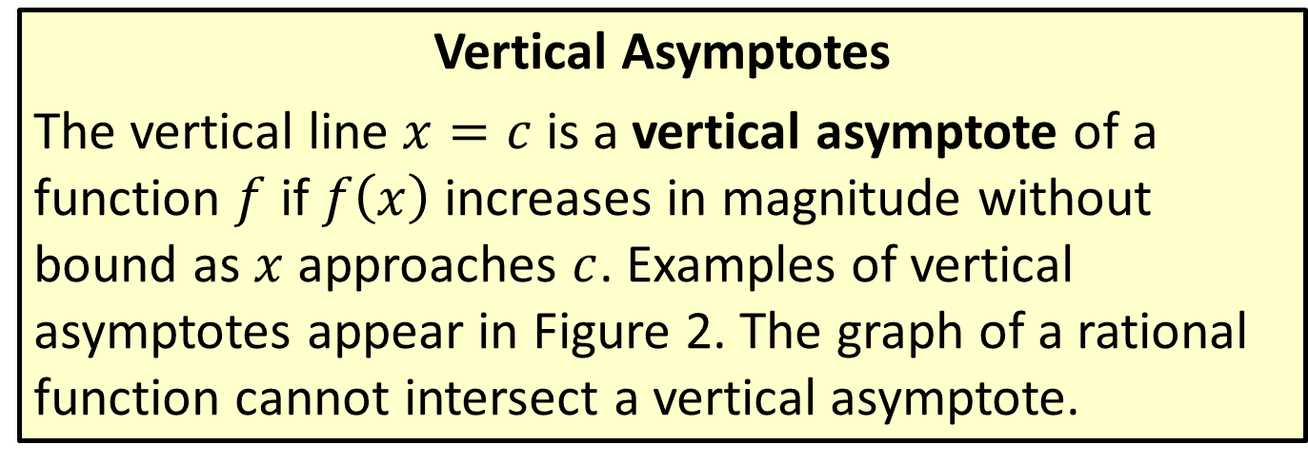
Definitions and Useful Notation
Vertical Asymptotes
The vertical line $x=c$ is a vertical asymptote of a function $f$ if $f⁡\left(x\right)$ increases in magnitude without bound as $x$ approaches $c$. Examples of vertical asymptotes appear in Figure 2. The graph of a rational function cannot intersect a vertical asymptote.

Slide 4
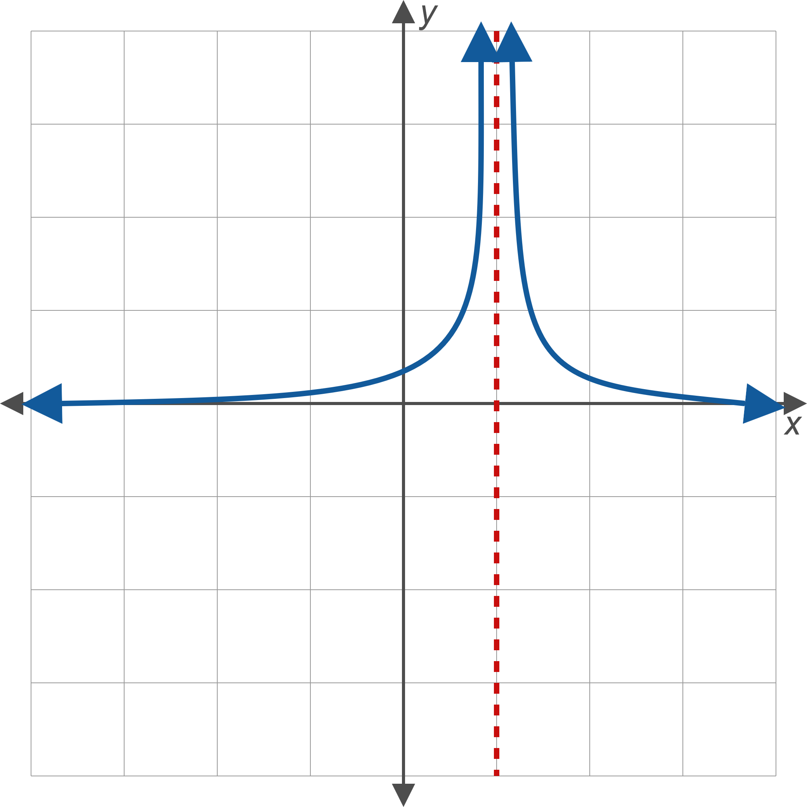
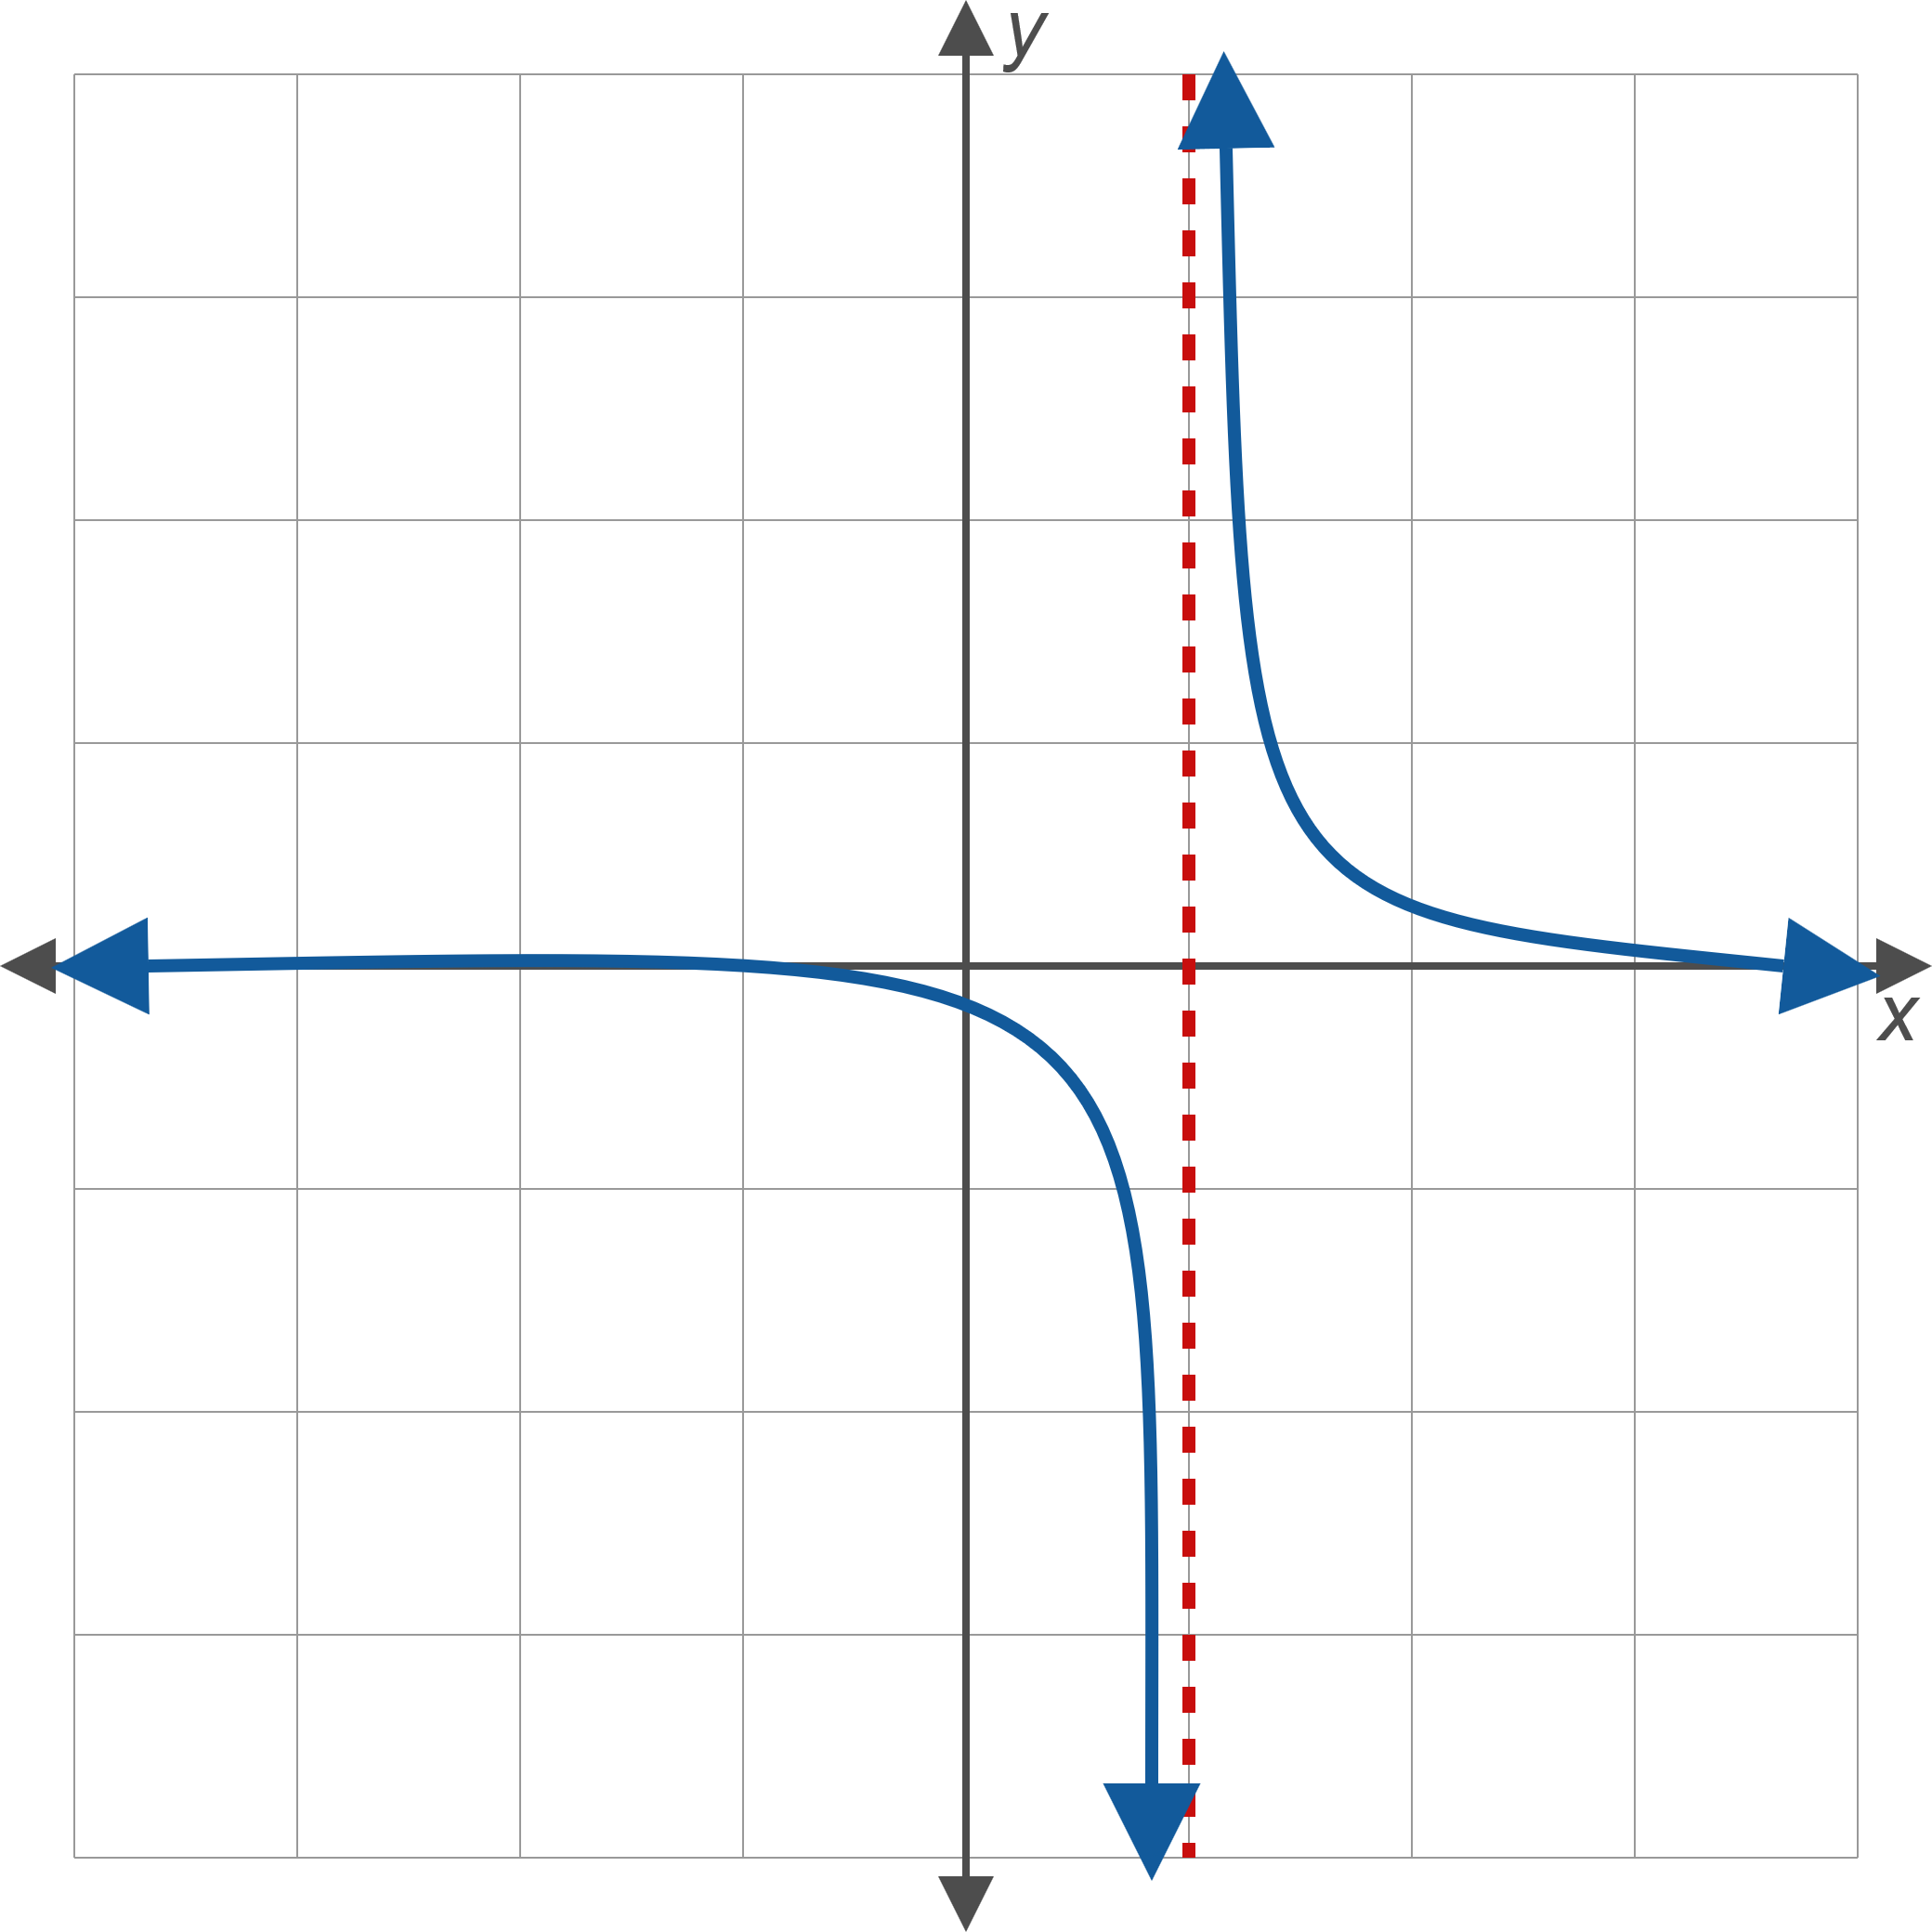
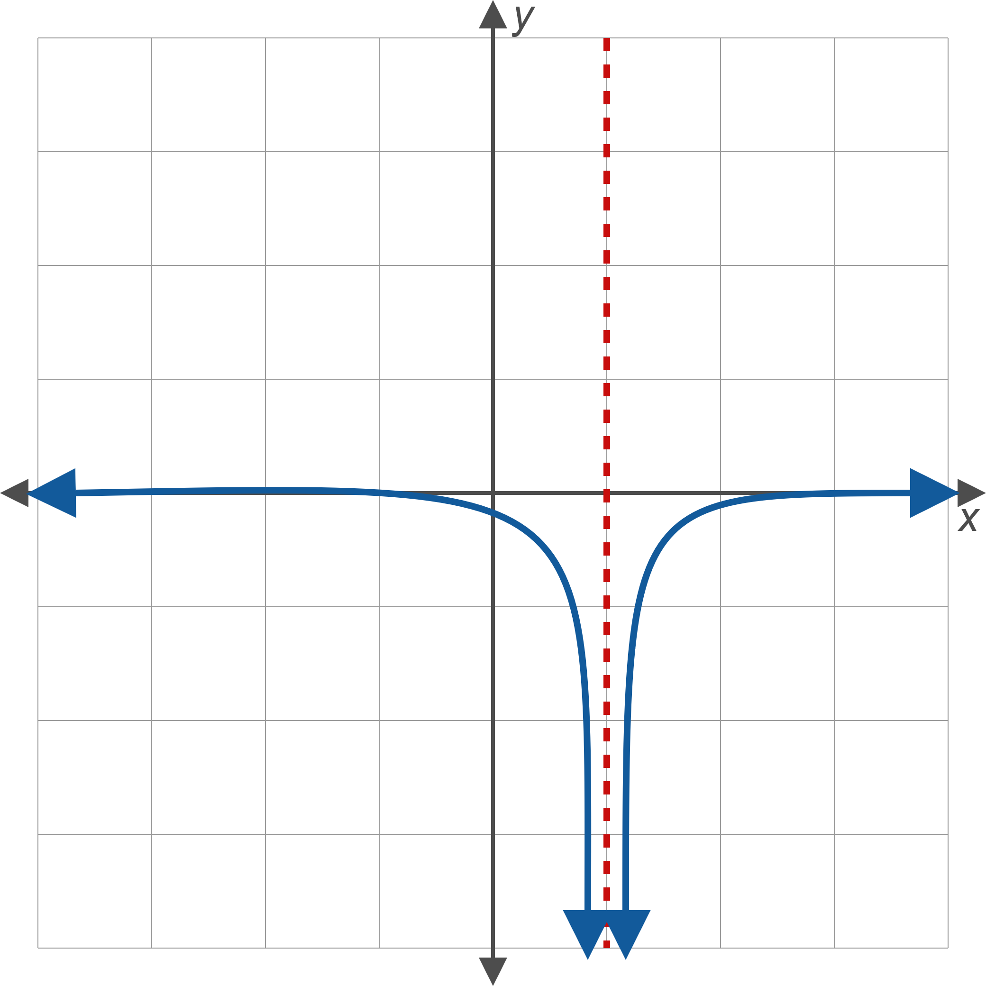
Figure 2: Vertical Asymptotes

Slide 5
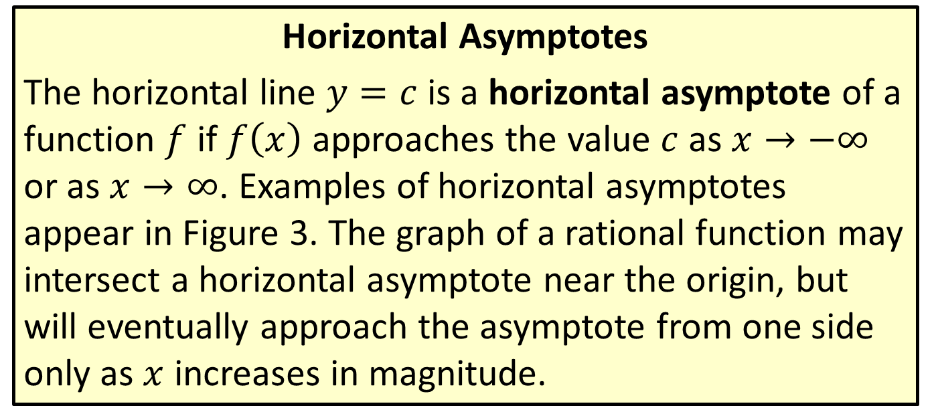
Definitions and Useful Notation
Horizontal Asymptotes
The horizontal line $y=c$ is a horizontal asymptote of a function $f$ if $f⁡\left(x\right)$ approaches the value $c$ as $x→−∞$ or as $x→∞$. Examples of horizontal asymptotes appear in Figure 3. The graph of a rational function may intersect a horizontal asymptote near the origin, but will eventually approach the asymptote from one side only as $x$ increases in magnitude.

Slide 6
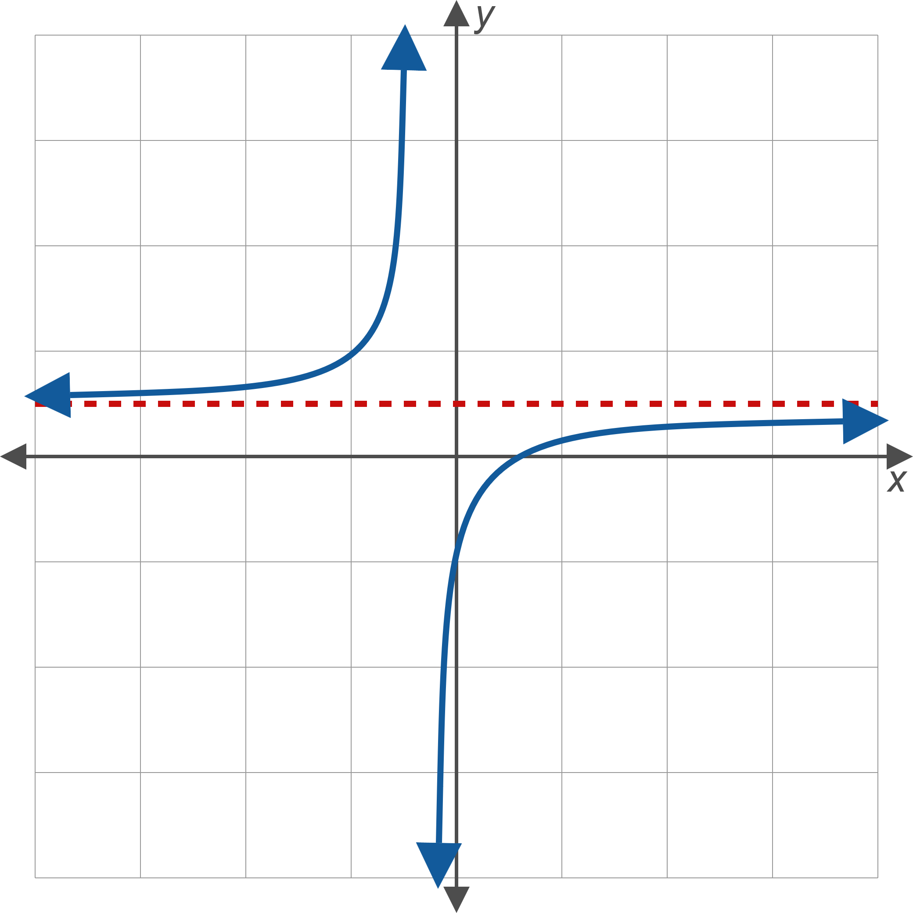
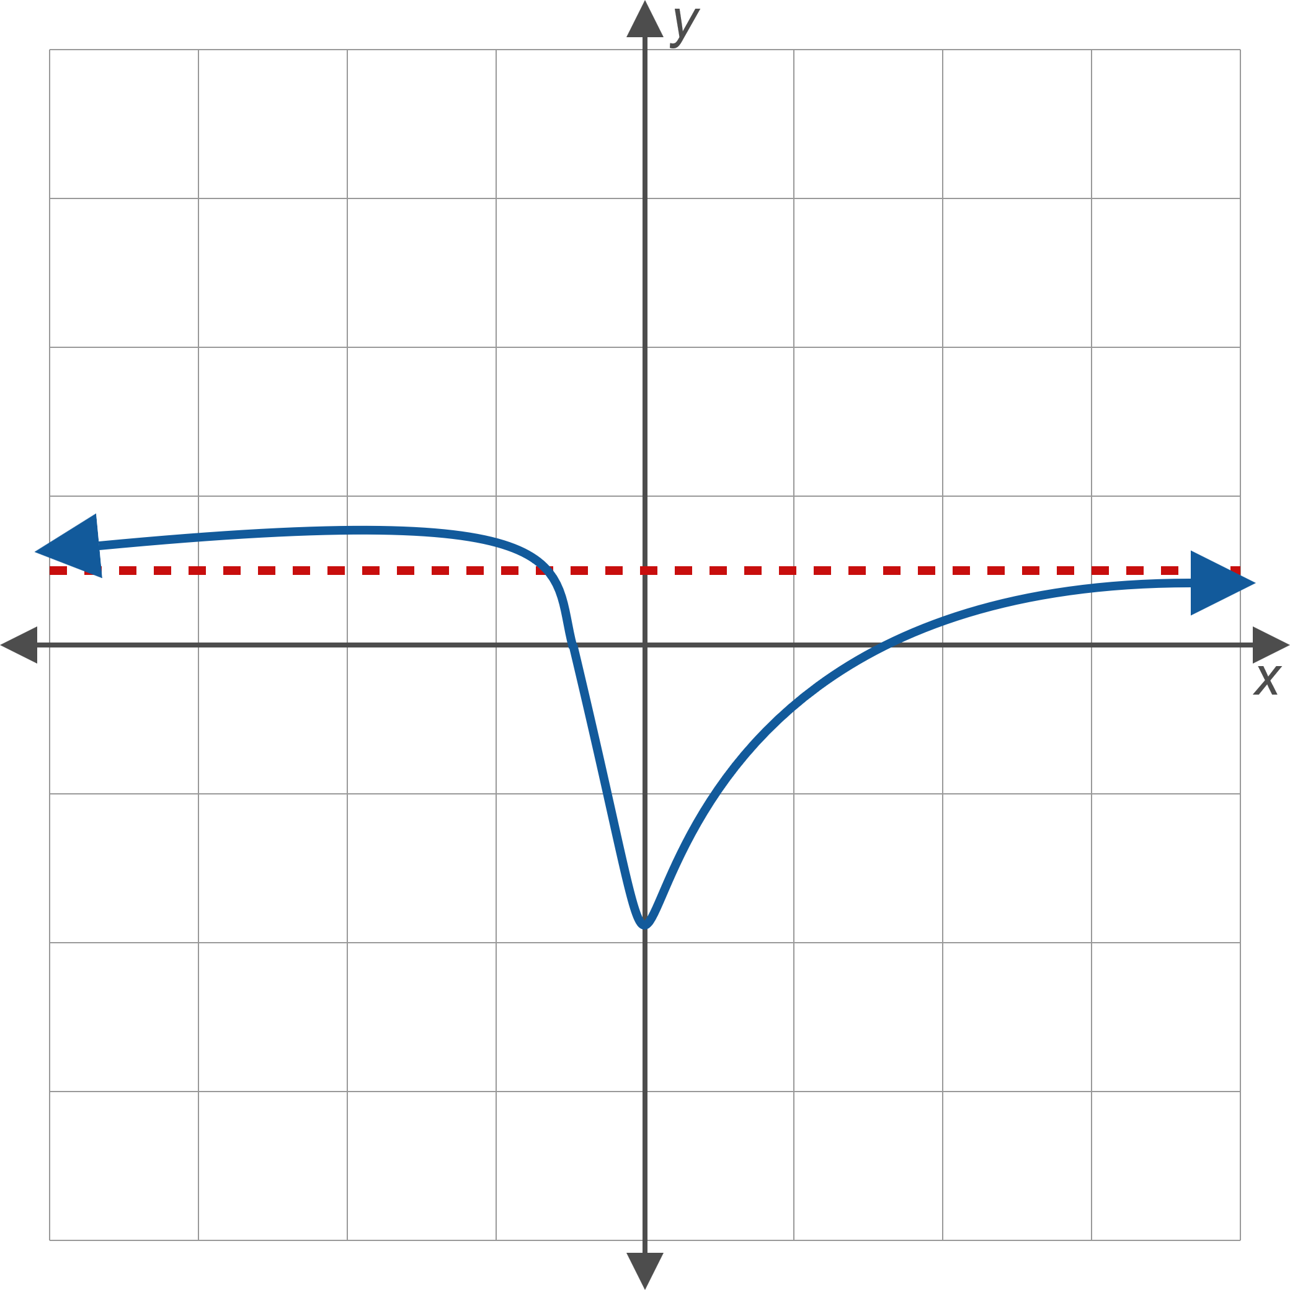
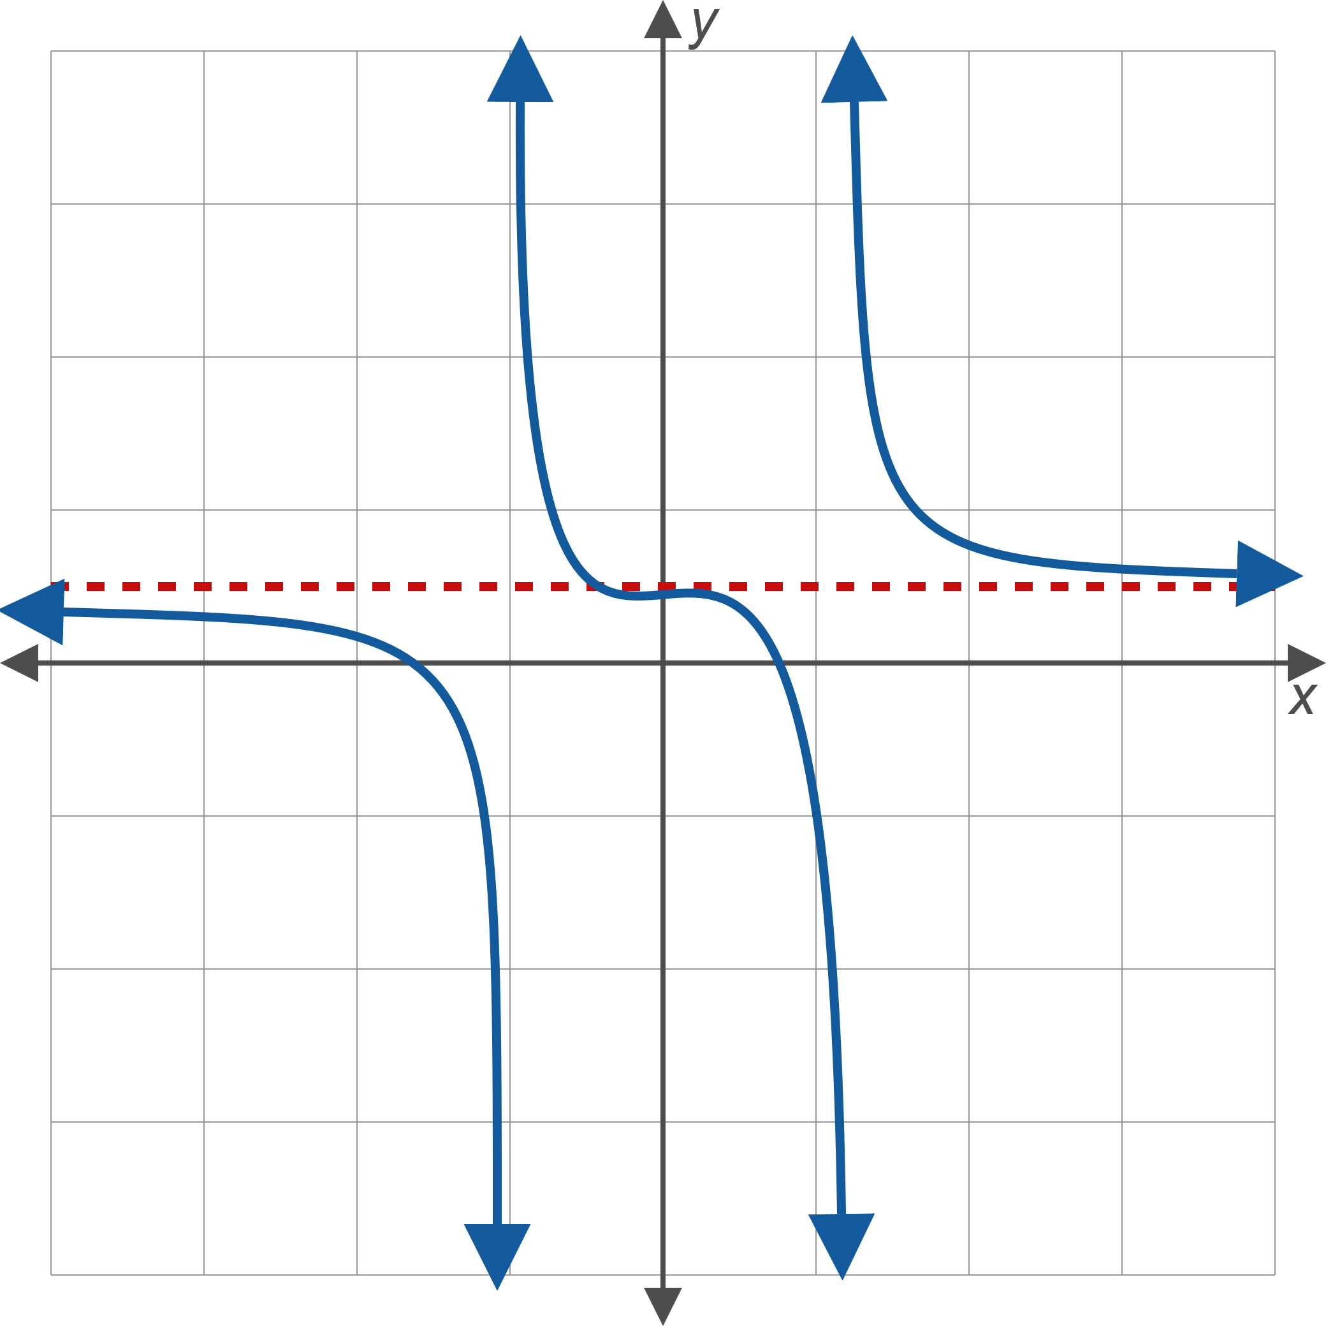
Figure 3: Horizontal Asymptotes

Slide 7
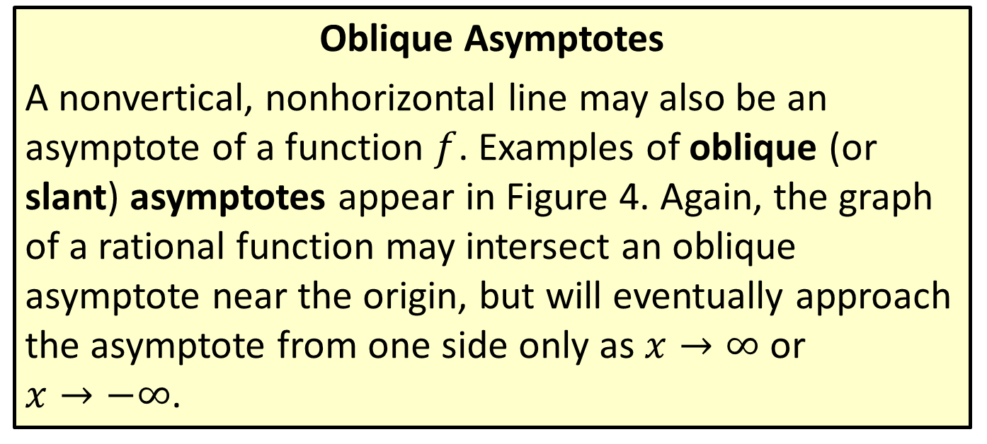
Definitions and Useful Notation
Oblique Asymptotes
A nonvertical, nonhorizontal line may also be an asymptote of a function $f$. Examples of oblique (or slant) asymptotes appear in Figure 4. Again, the graph of a rational function may intersect an oblique asymptote near the origin, but will eventually approach the asymptote from one side only as $x→∞$ or $x→−∞$.

Slide 8
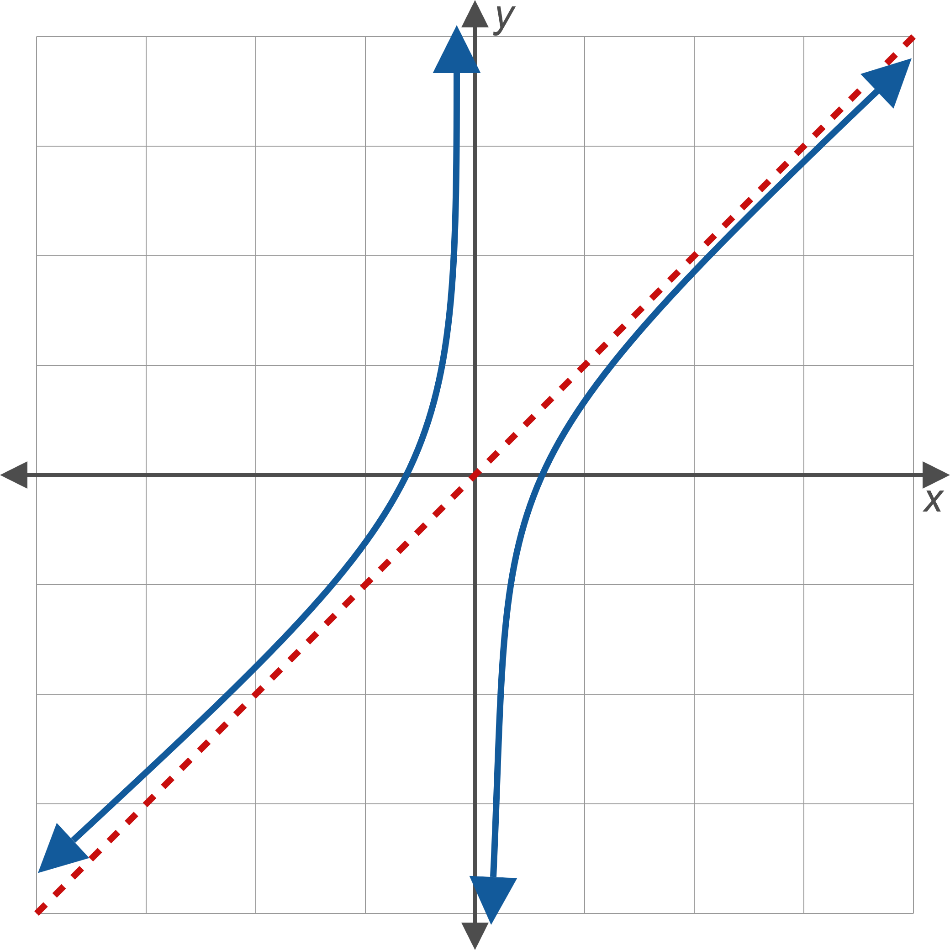
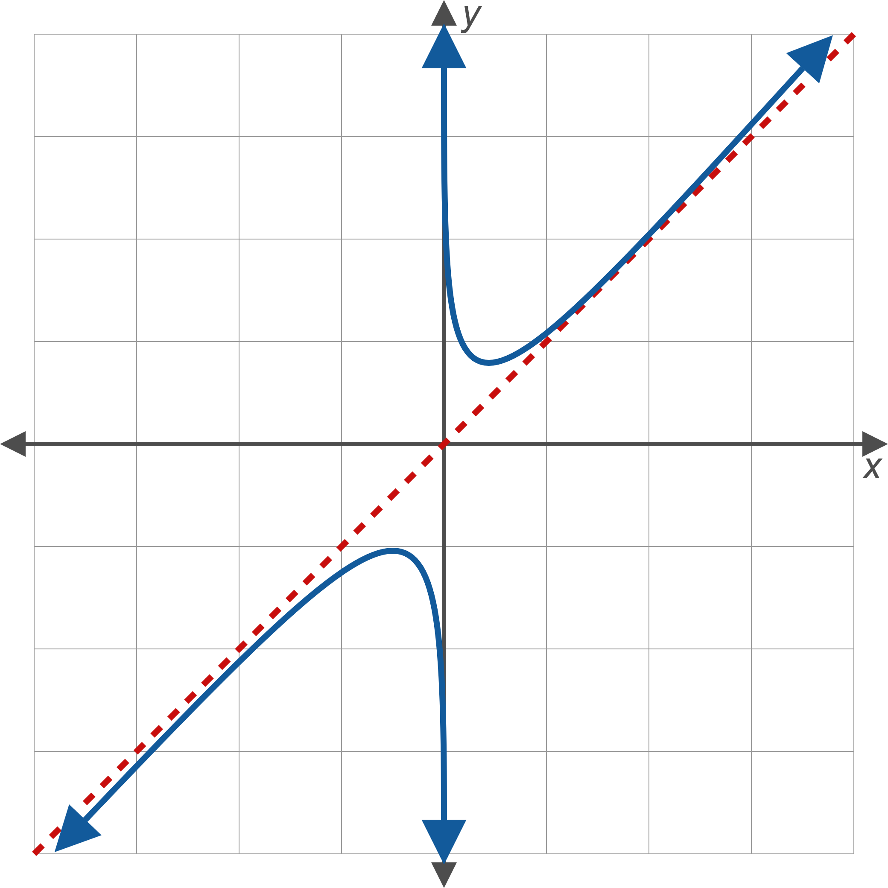
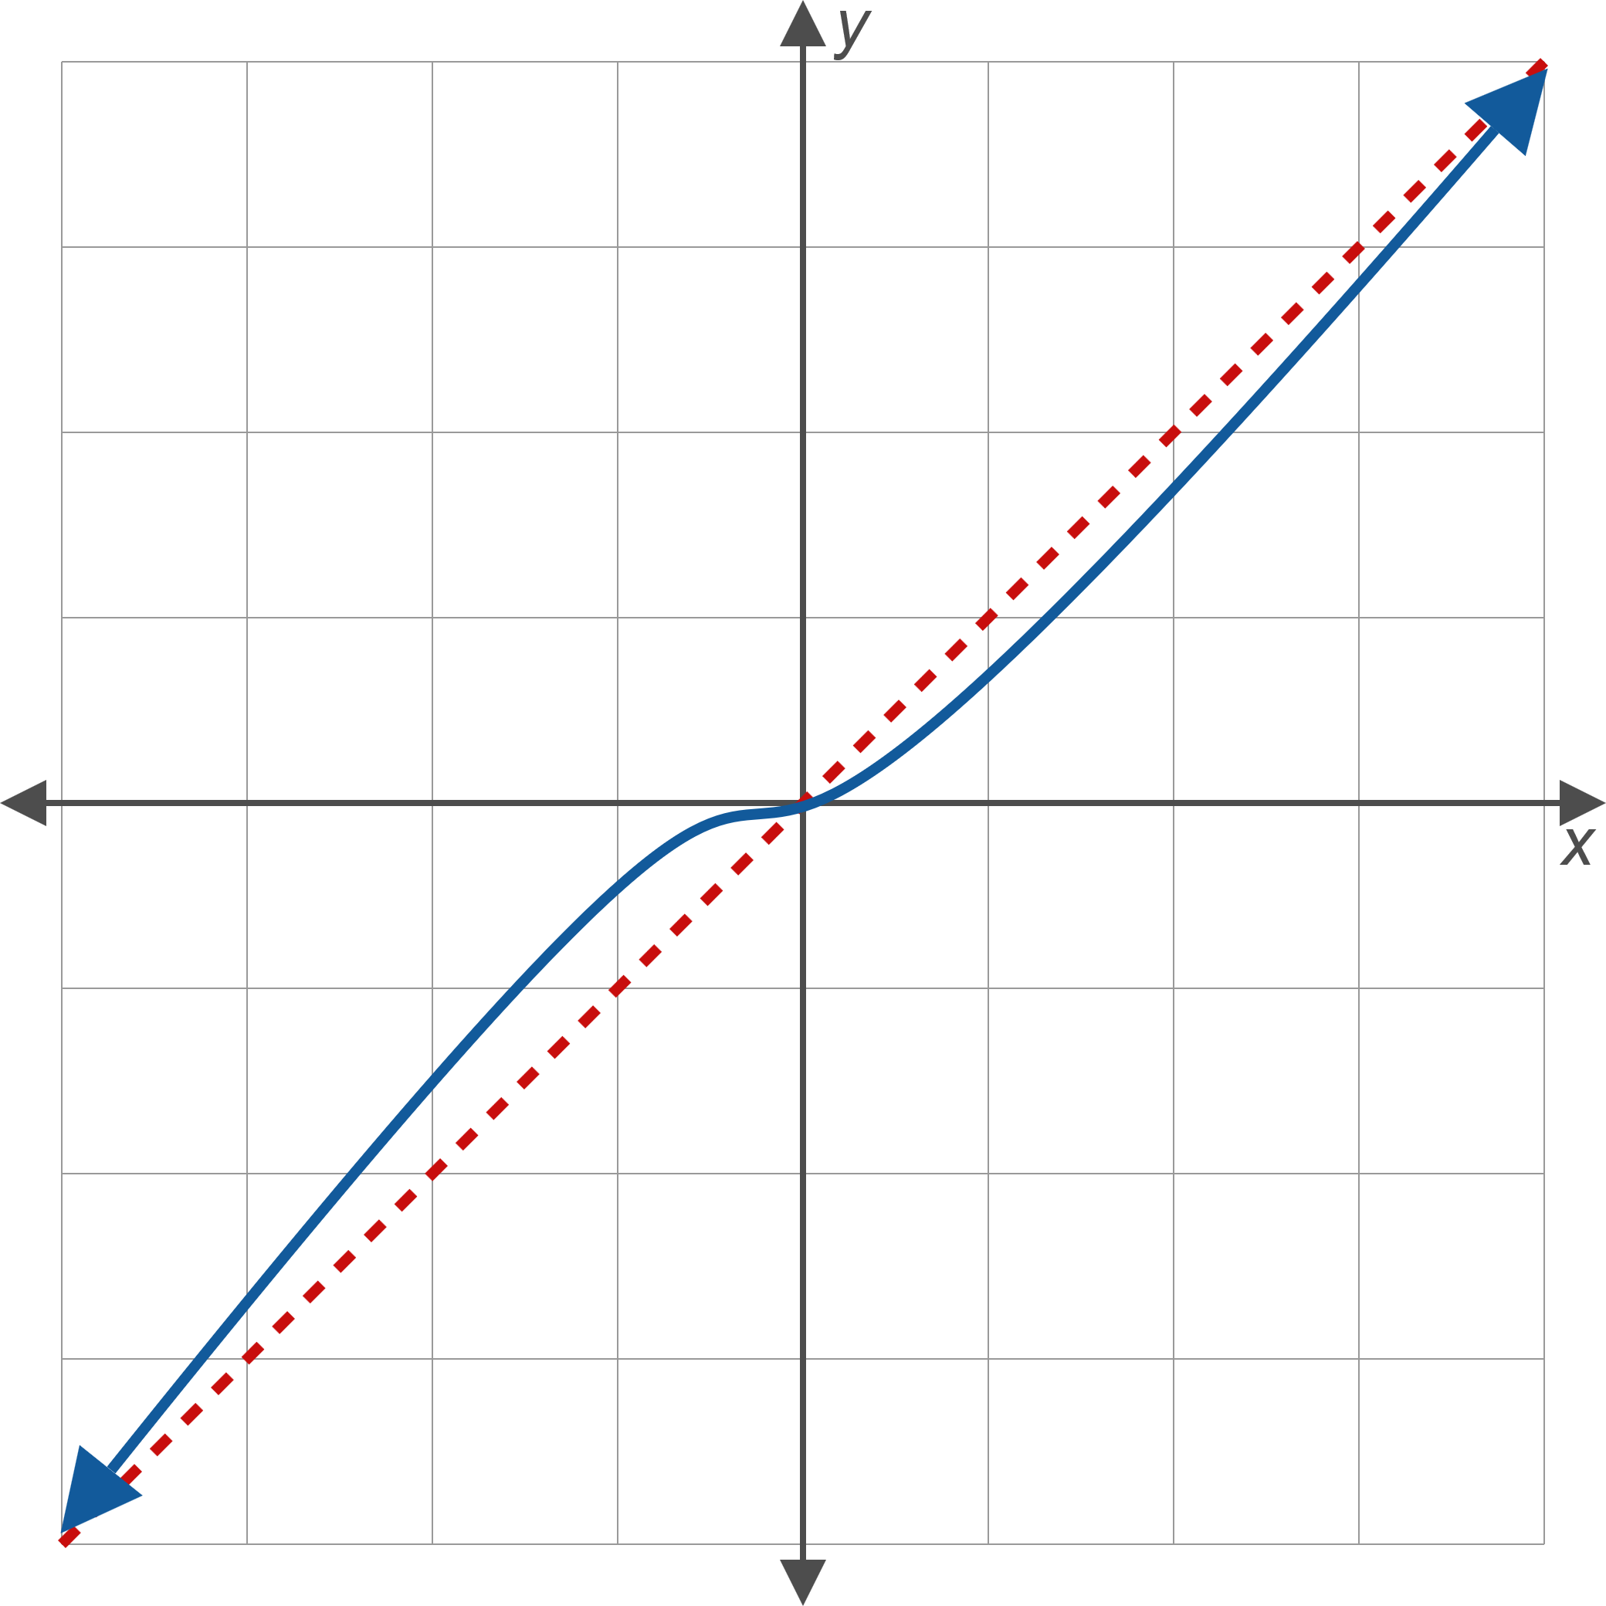
Figure 4: Oblique Asymptotes

Slide 9
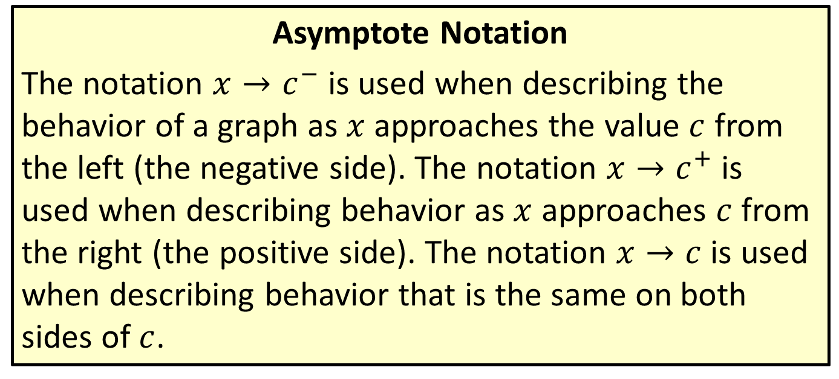
Definitions and Useful Notation
Asymptote Notation
The notation $x→c^{−}$ is used when describing the behavior of a graph as $x$ approaches the value $c$ from the left (the negative side). The notation $x→c^{+}$ is used when describing behavior as $x$ approaches $c$ from the right (the positive side). The notation $x→c$ is used when describing behavior that is the same on both sides of $c$.

Slide 10
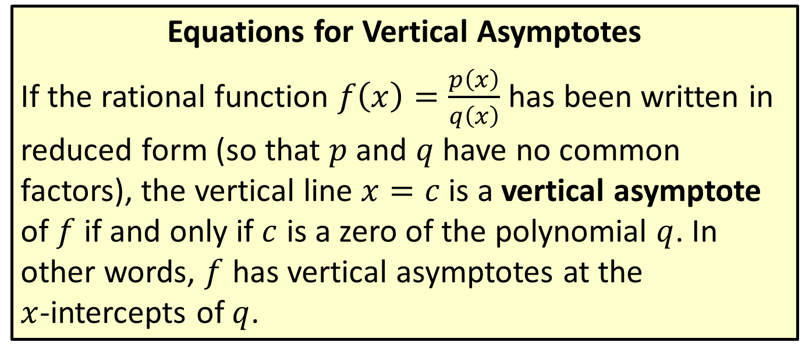
Vertical Asymptotes
Equations for Vertical Asymptotes
If the rational function $f⁡\left(x\right)=\frac{p\left(x\right)}{q\left(x\right)}$ has been written in reduced form (so that $p$ and $q$ have no common factors), the vertical line $x=c$ is a vertical asymptote of $f$ if and only if $c$ is a zero of the polynomial $q$. In other words, $f$ has vertical asymptotes at the $x$-intercepts of $q$.

Slide 11
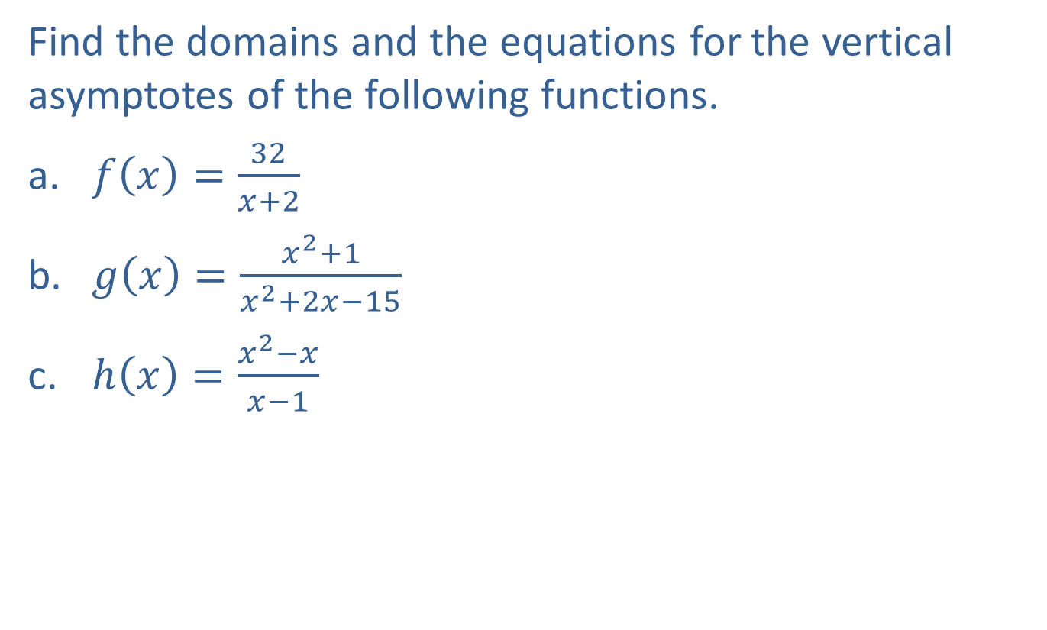
Example 1: Vertical Asymptotes
Find the domains and the equations for the vertical asymptotes of the following functions.
​$f\left(x\right)=\frac{32}{x+2}$
​$g\left(x\right)=\frac{x^{2}+1}{x^{2}+2x−15}$
​$h\left(x\right)=\frac{x^{2}−x}{x−1}$

Slide 12
Note:
We must always find the domain before canceling common factors. Even if a zero is removed from the denominator when finding the reduced form, that value is not part of the domain.

Slide 13
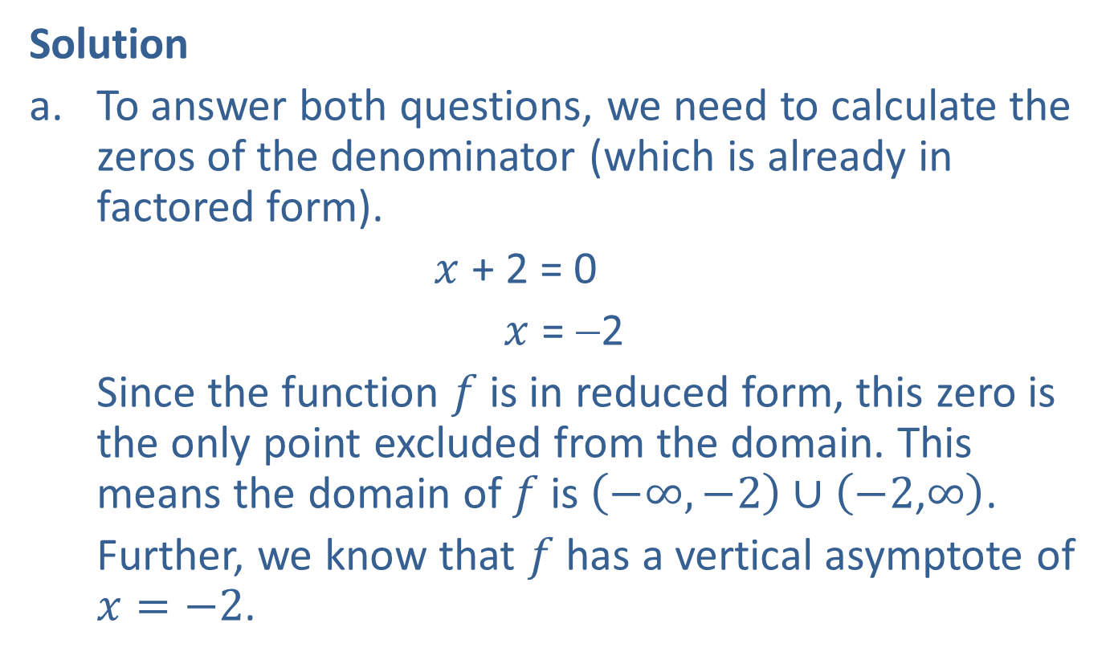
Example 1: Vertical Asymptotes (cont.)
Solution
​To answer both questions, we need to calculate the zeros of the denominator (which is already in factored form).
$x$ + 2 = 0
​ $x$ = −2
​Since the function $f$ is in reduced form, this zero is the only point excluded from the domain. This means the domain of $f$ is $\left(−∞,−2\right)∪\left(−2\text{,}∞\right)$.
Further, we know that $f$ has a vertical asymptote of $x=−2$.

Slide 14
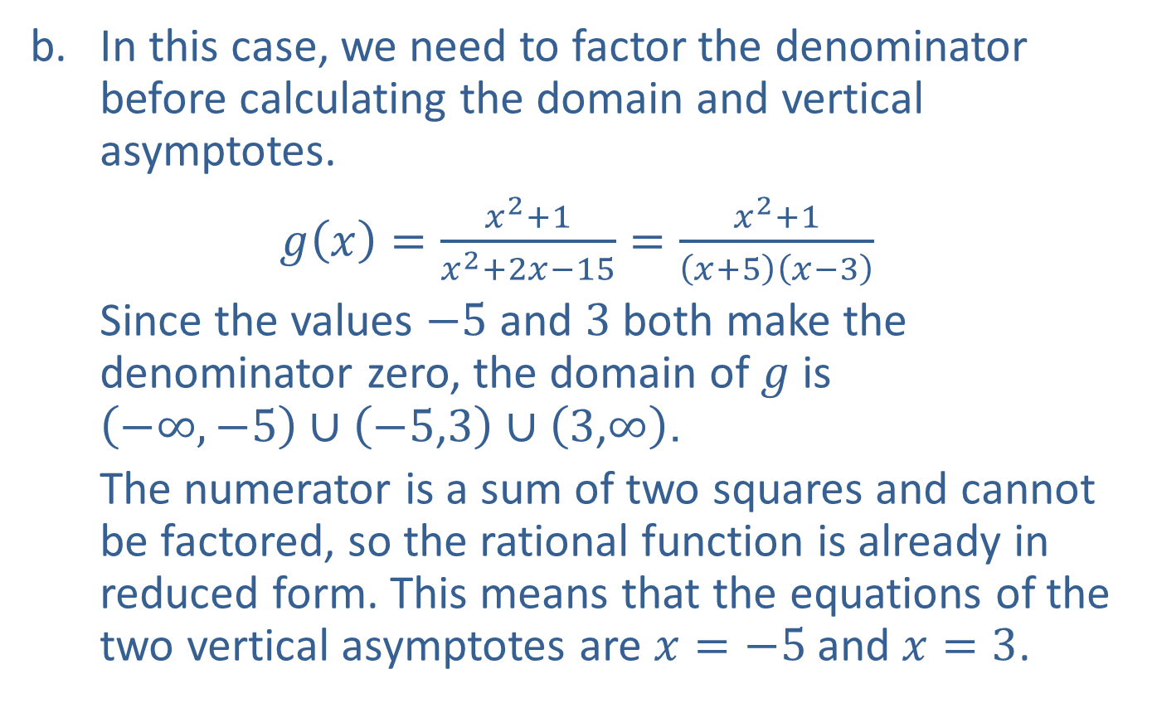
Example 1: Vertical Asymptotes (cont.)
​In this case, we need to factor the denominator before calculating the domain and vertical asymptotes.
​$g\left(x\right)=\frac{x^{2}+1}{x^{2}+2x−15}=\frac{x^{2}+1}{\left(x+5\right)\left(x−3\right)}$
​Since the values $−5$ and 3 both make the denominator zero, the domain of $g$ is $\left(−∞,−5\right)∪\left(−5\text{,}3\right)∪\left(3\text{,}∞\right)$.
​The numerator is a sum of two squares and cannot be factored, so the rational function is already in reduced form. This means that the equations of the two vertical asymptotes are $x=−5$ and $x=3$.

Slide 15
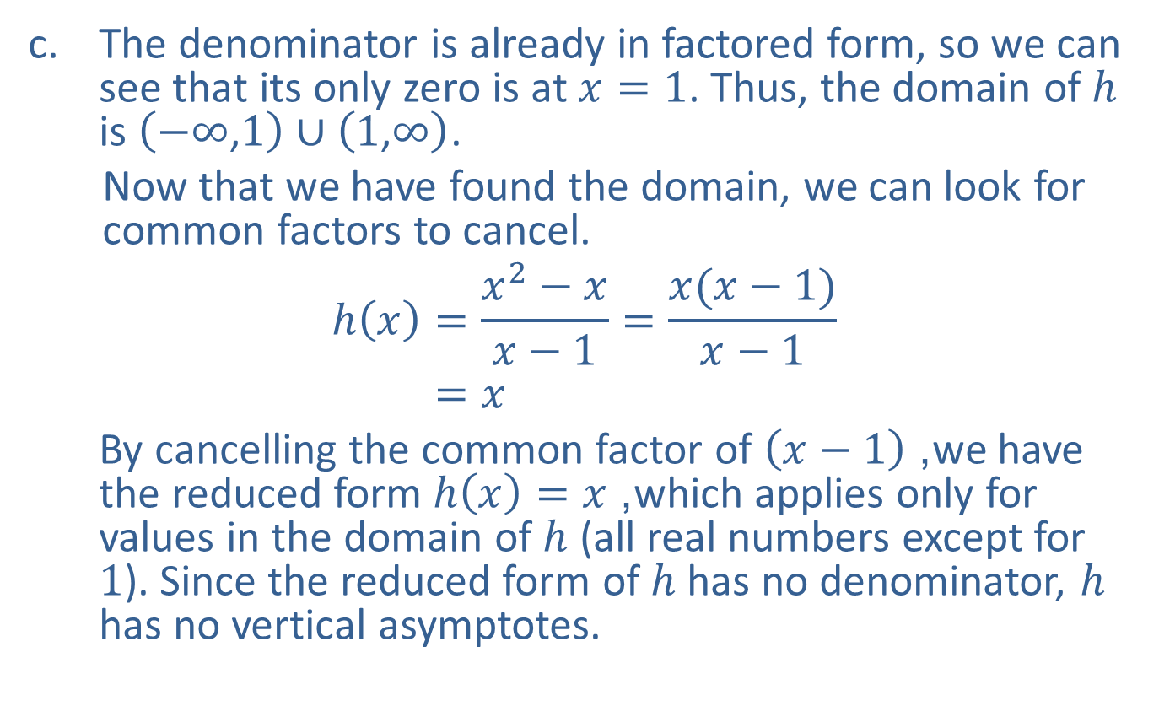
Example 1: Vertical Asymptotes (cont.)
​The denominator is already in factored form, so we can see that its only zero is at $x=1$. Thus, the domain of $h$ is $\left(−∞\text{,}1\right)∪\left(1\text{,}∞\right)$.
​Now that we have found the domain, we can look for common factors to cancel.
h𝑥=𝑥2−𝑥𝑥−1=𝑥(𝑥−1)𝑥−1h⁡𝑥=𝑥
​By cancelling the common factor of $\left(x−1\right)$, we have the reduced form $h\left(x\right)=x$, which applies only for values in the domain of $h$ (all real numbers except for 1). Since the reduced form of $h$ has no denominator, $h$ has no vertical asymptotes.

Slide 16
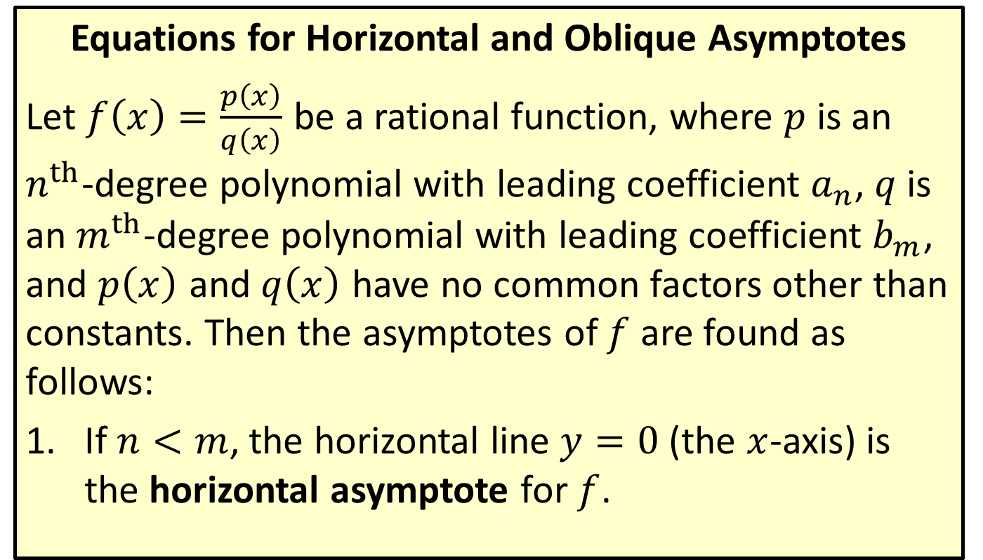
Horizontal and Oblique Asymptotes
Equations for Horizontal and Oblique Asymptotes
Let $f⁡\left(x\right)=\frac{p\left(x\right)}{q\left(x\right)}$ be a rational function, where $p$ is an $n^{th}$-degree polynomial with leading coefficient $a_{n}$, $q$ is an $m^{th}$-degree polynomial with leading coefficient $b_{m}$, and $p⁡\left(x\right)$ and $q⁡\left(x\right)$ have no common factors other than constants. Then the asymptotes of $f$ are found as follows:
​If $n<m$, the horizontal line $y=0$ (the $x$-axis) is the horizontal asymptote for $f$.

Slide 17
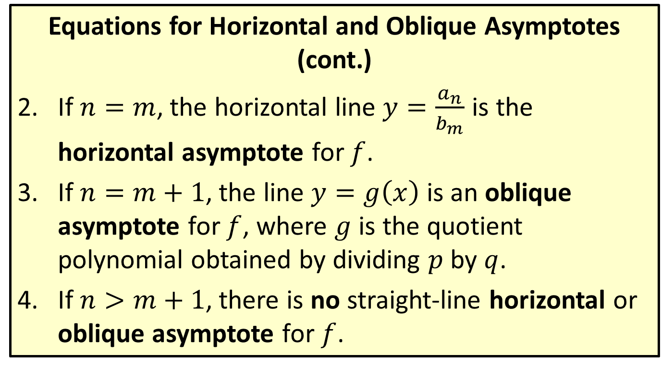
Horizontal and Oblique Asymptotes
Equations for Horizontal and Oblique Asymptotes (cont.)
​If $n=m$, the horizontal line $y=\frac{a_{n}}{b_{m}}$ is the horizontal asymptote for $f$.
​If $n=m+1$, the line $y=g\left(x\right)$ is an oblique asymptote for $f$, where $g$ is the quotient polynomial obtained by dividing $p$ by $q$.
​If $n>m+1$, there is no straight-line horizontal or oblique asymptote for $f$.

Slide 18
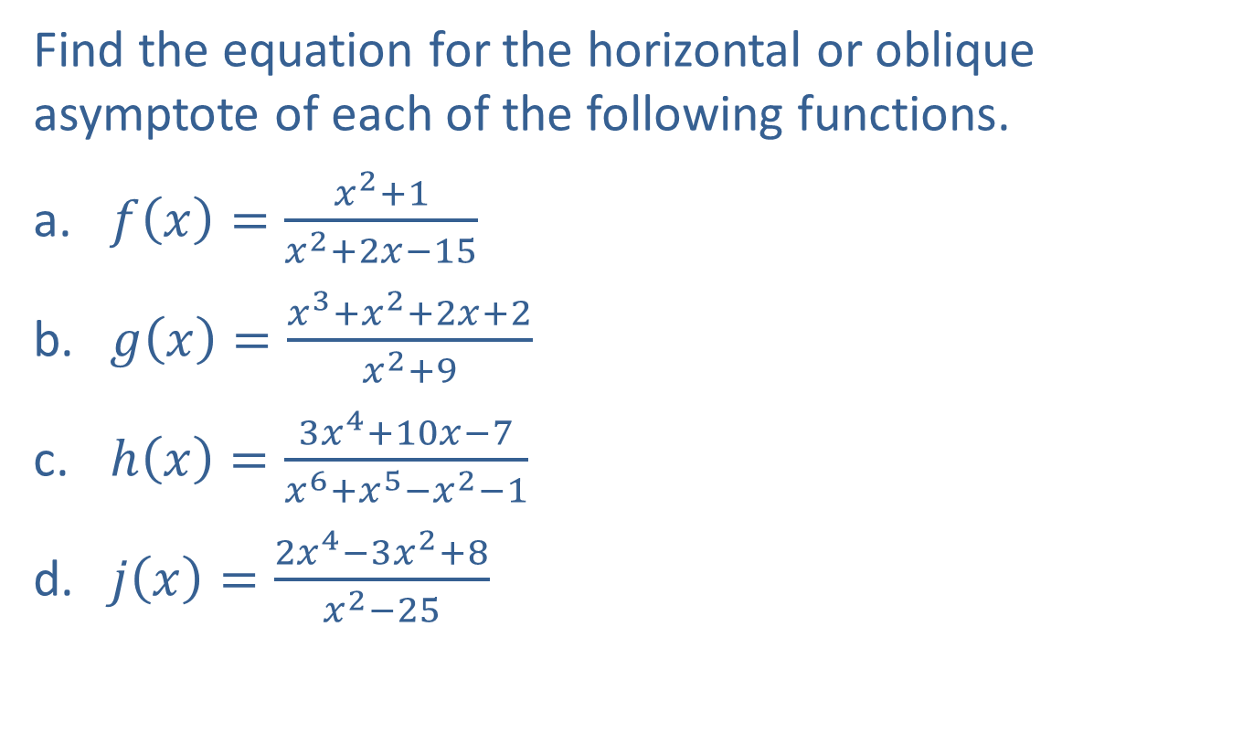
Example 2: Horizontal and Oblique Asymptotes
Find the equation for the horizontal or oblique asymptote of each of the following functions.
​$f⁡\left(x\right)=\frac{x^{2}+1}{x^{2}+2x−15}$
​$g⁡\left(x\right)=\frac{x^{3}+x^{2}+2x+2}{x^{2}+9}$
​$h⁡\left(x\right)=\frac{3x^{4}+10x−7}{x^{6}+x^{5}−x^{2}−1}$
​$j⁡\left(x\right)=\frac{2x^{4}−3x^{2}+8}{x^{2}−25}$

Slide 19
Note:
Always begin by comparing the degrees of the numerator and the denominator.

Slide 20

Example 2: Horizontal and Oblique Asymptotes (cont.)
Solution
​First, note that the degrees of the numerator and denominator of $f$ are both equal to two. This means that the line $y=\frac{a_{2}}{b_{2}}=1$ is the horizontal asymptote of $f$.

Slide 21
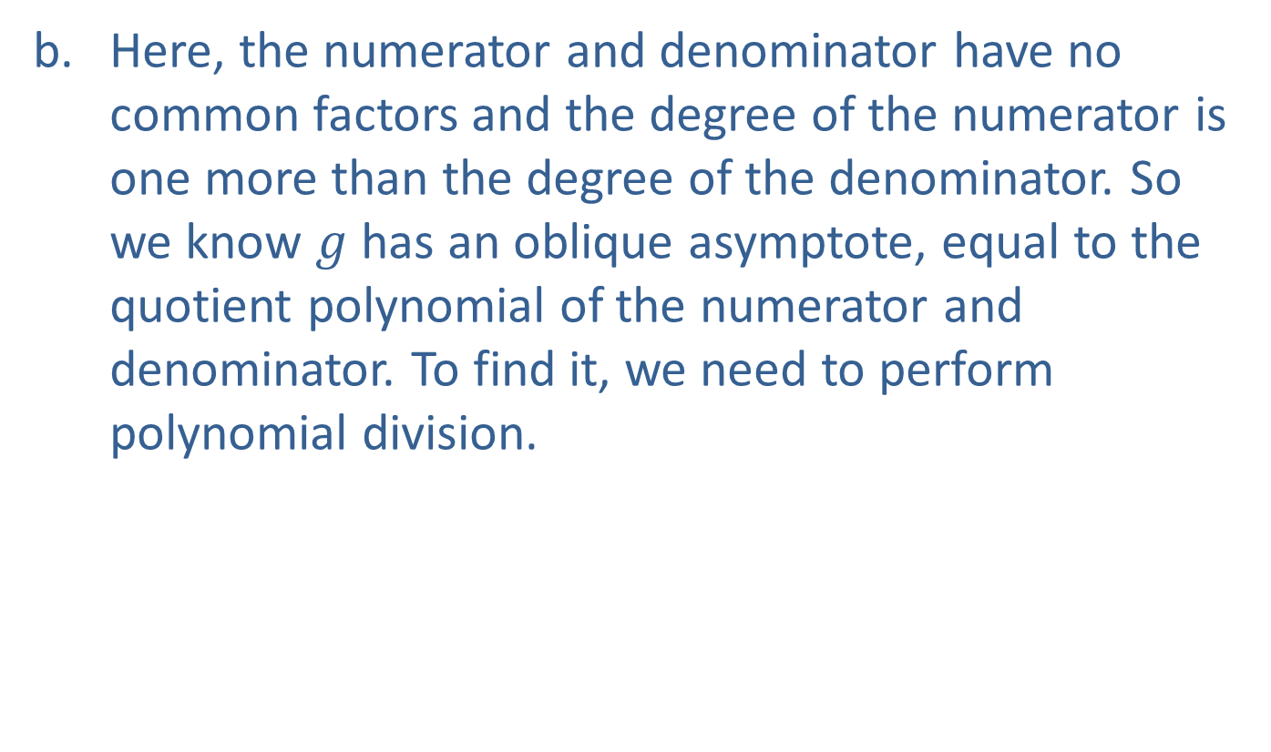
Example 2: Horizontal and Oblique Asymptotes (cont.)
​Here, the numerator and denominator have no common factors and the degree of the numerator is one more than the degree of the denominator. So we know $g$ has an oblique asymptote, equal to the quotient polynomial of the numerator and denominator. To find it, we need to perform polynomial division.

Slide 22

Example 2: Horizontal and Oblique Asymptotes (cont.)
​
This tells us that $g⁡\left(x\right)=x+1+\frac{−7x−7}{x^{2}+9}$, ​but we only need the quotient, $x+1$, to find that the equation for the oblique asymptote is $y=x+1$.

Slide 23
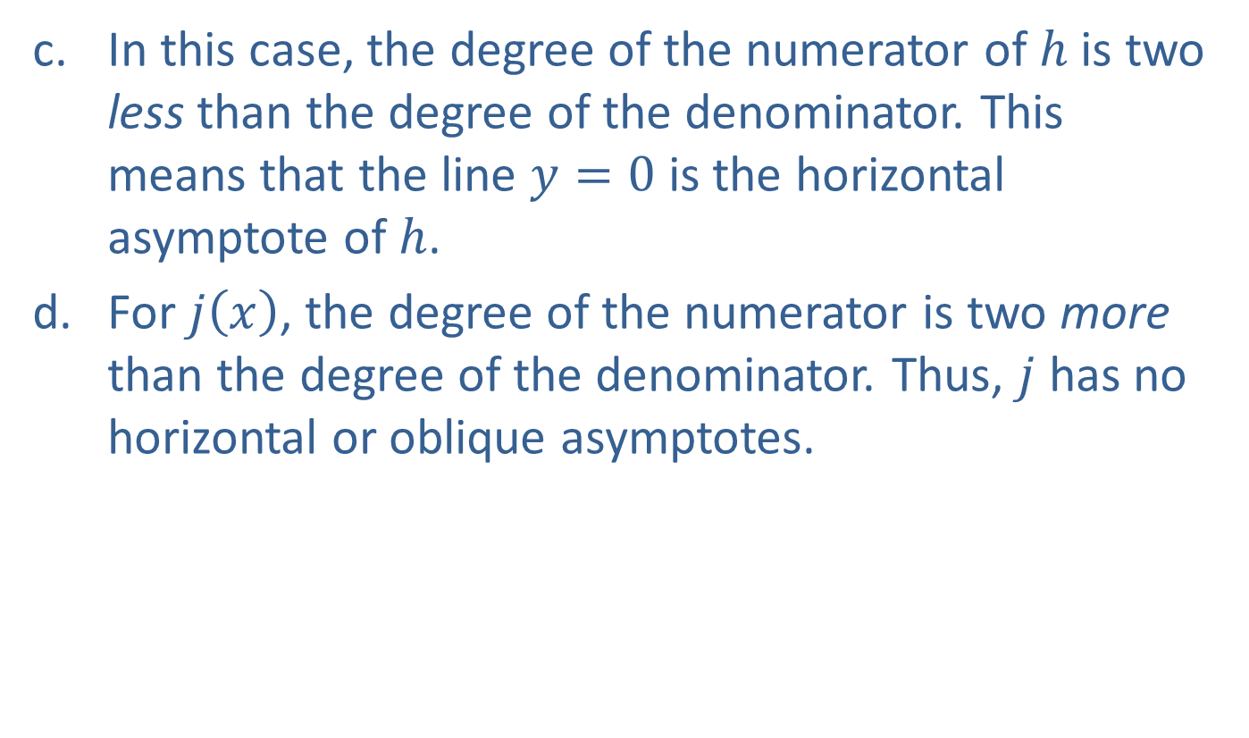
Example 2: Horizontal and Oblique Asymptotes (cont.)
​In this case, the degree of the numerator of $h$ is two less than the degree of the denominator. This means that the line $y=0$ is the horizontal asymptote of $h$.
​For $j⁡\left(x\right)$, the degree of the numerator is two more than the degree of the denominator. Thus, $j$ has no horizontal or oblique asymptotes.

Slide 24

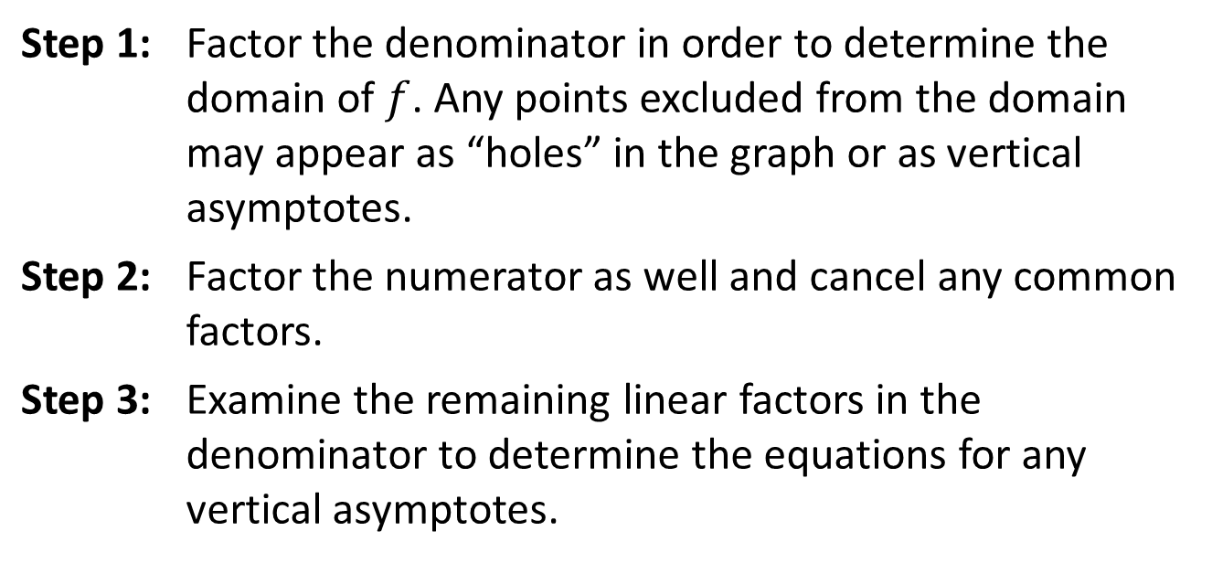
Graphing Rational Functions
Procedure
Given a rational function $f$,
Step 1: | Factor the denominator in order to determine the domain of $f$. Any points excluded from the domain may appear as “holes” in the graph or as vertical asymptotes.
Step 2: | Factor the numerator as well and cancel any common factors.
Step 3: | Examine the remaining linear factors in the denominator to determine the equations for any vertical asymptotes.

Slide 25
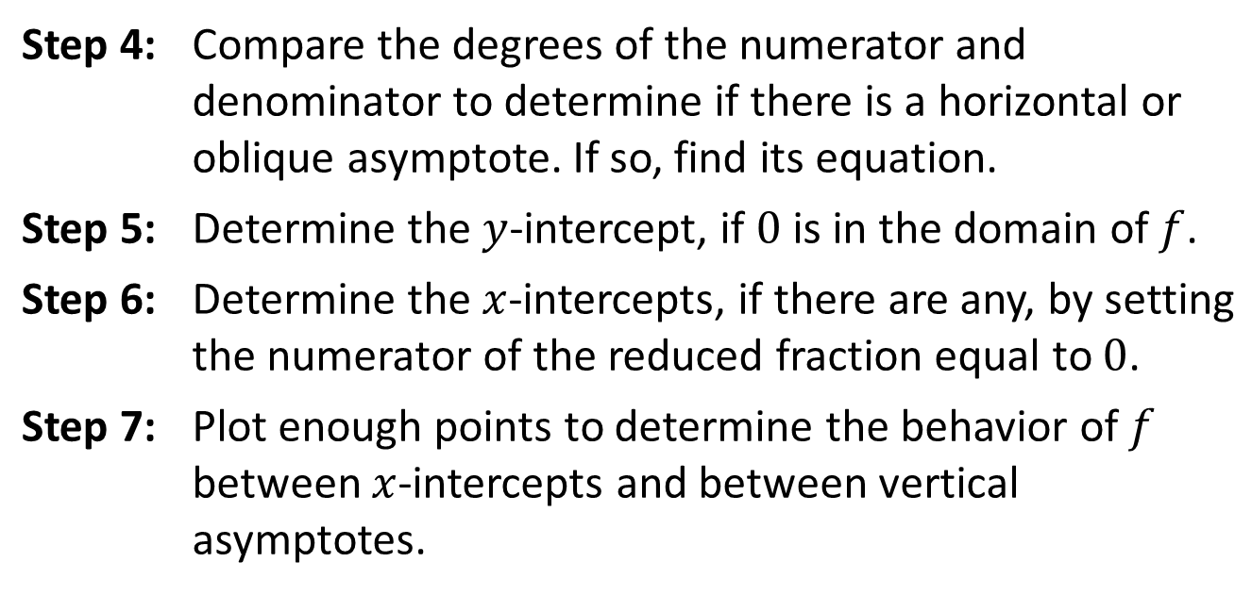
Graphing Rational Functions
Procedure (cont.)
Step 4: | Compare the degrees of the numerator and denominator to determine if there is a horizontal or oblique asymptote. If so, find its equation.
Step 5: | Determine the $y$-intercept, if 0 is in the domain of $f$.
Step 6: | Determine the $x$-intercepts, if there are any, by setting the numerator of the reduced fraction equal to 0.
Step 7: | Plot enough points to determine the behavior of $f$ between $x$-intercepts and between vertical asymptotes.

Slide 26

Example 3: Graphing Rational Functions
Sketch the graphs of the following rational functions.
​$f\left(x\right)=\frac{x^{2}−x}{x−1}$
​$g\left(x\right)=\frac{x^{2}+1}{x^{2}+2x−15}$
​$h\left(x\right)=\frac{x^{3}+x^{2}+2x+2}{x^{2}+9}$

Slide 27
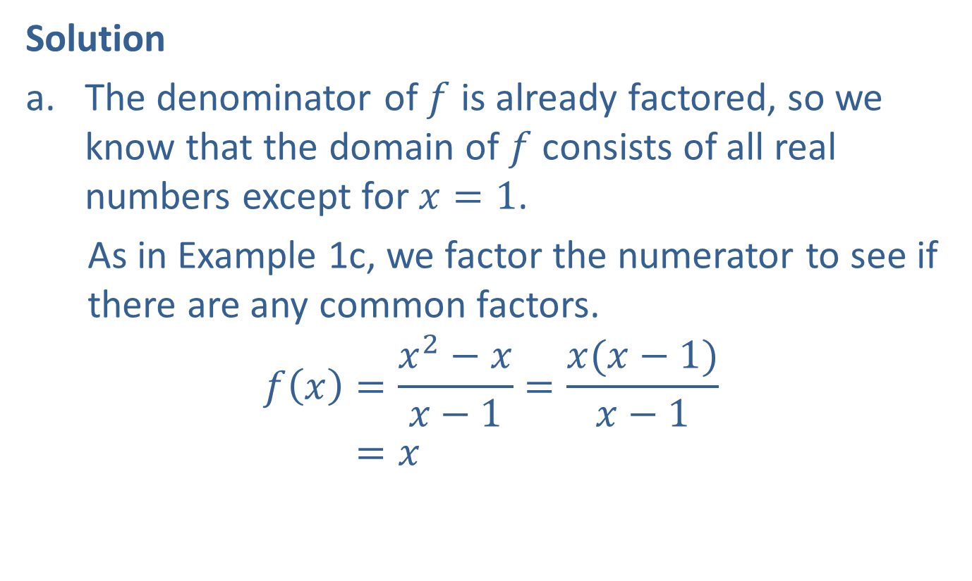
Example 3: Graphing Rational Functions (cont.)
Solution
​The denominator of $f$ is already factored, so we know that the domain of $f$ consists of all real numbers except for $x=1$.
​As in Example 1c, we factor the numerator to see if there are any common factors.
𝑓𝑥=𝑥2−𝑥𝑥−1=𝑥(𝑥−1)𝑥−1𝑓⁡𝑥=𝑥
​

Slide 28
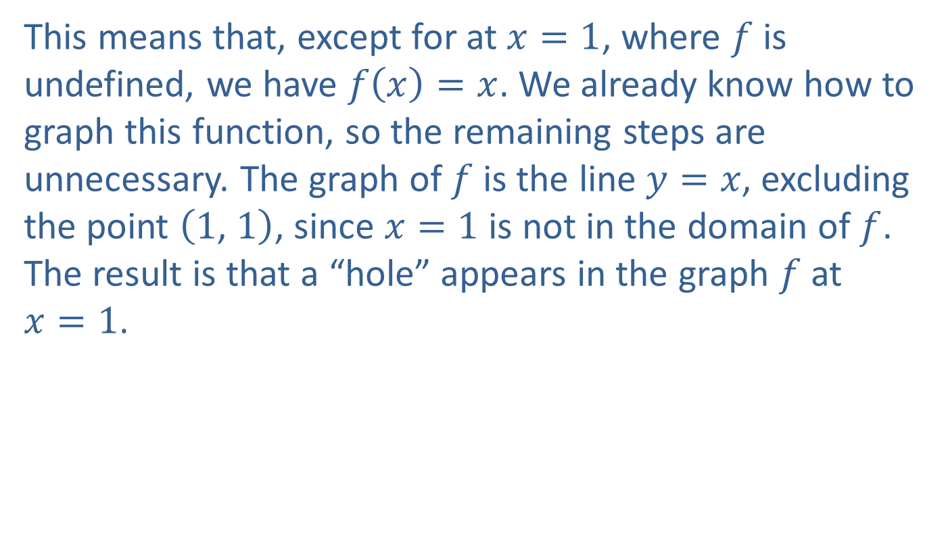
Example 3: Graphing Rational Functions (cont.)
​This means that, except for at $x=1$, where $f$ is undefined, we have $f\left(x\right)=x$. We already know how to graph this function, so the remaining steps are unnecessary. The graph of $f$ is the line $y=x$, excluding the point $\left(1\text{, }1\right)$, since $x=1$ is not in the domain of $f$. The result is that a “hole” appears in the graph $f$ at $x=1$.

Slide 29
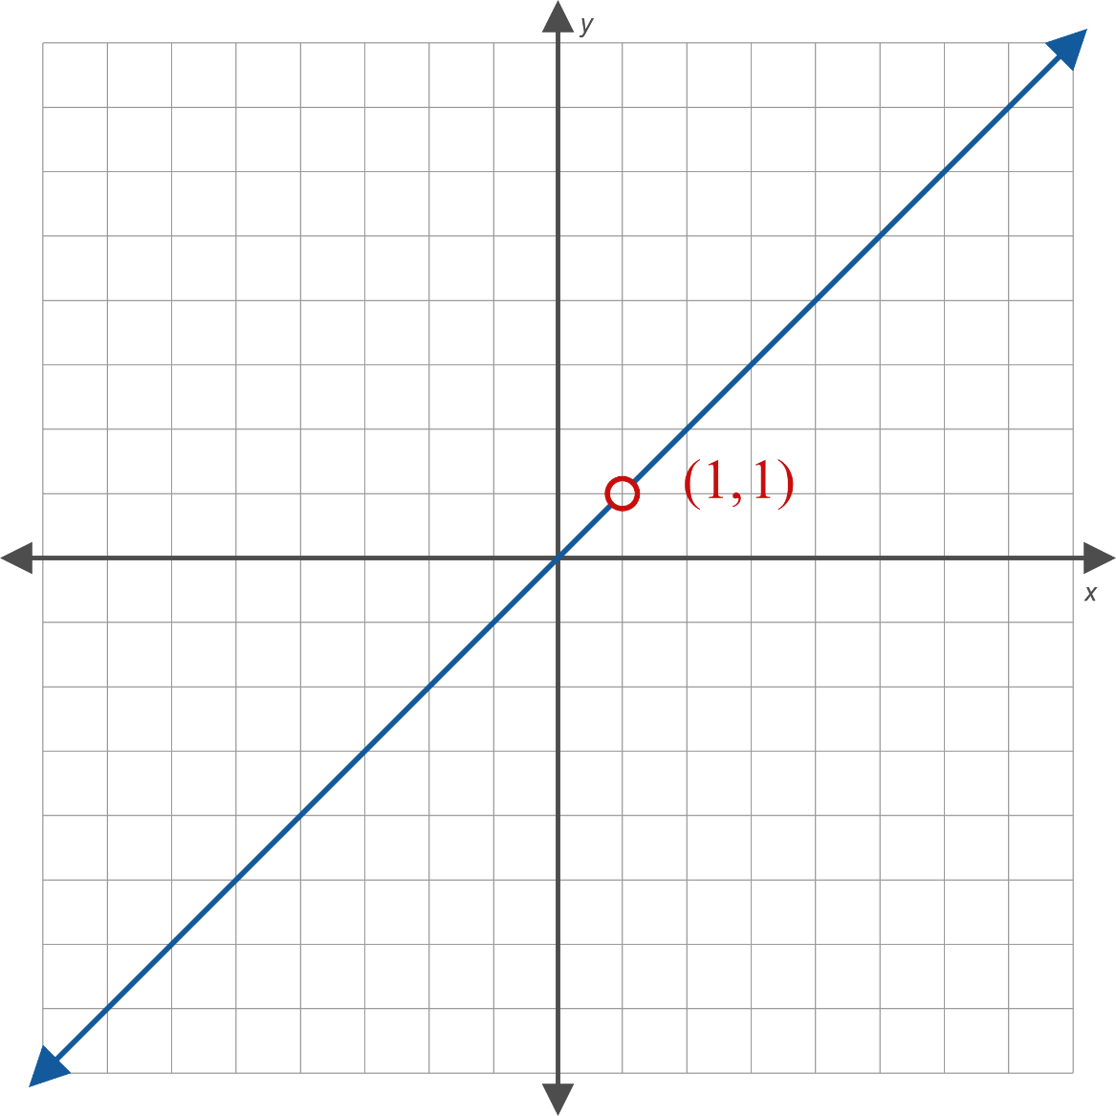
Example 3: Graphing Rational Functions (cont.)

Slide 30
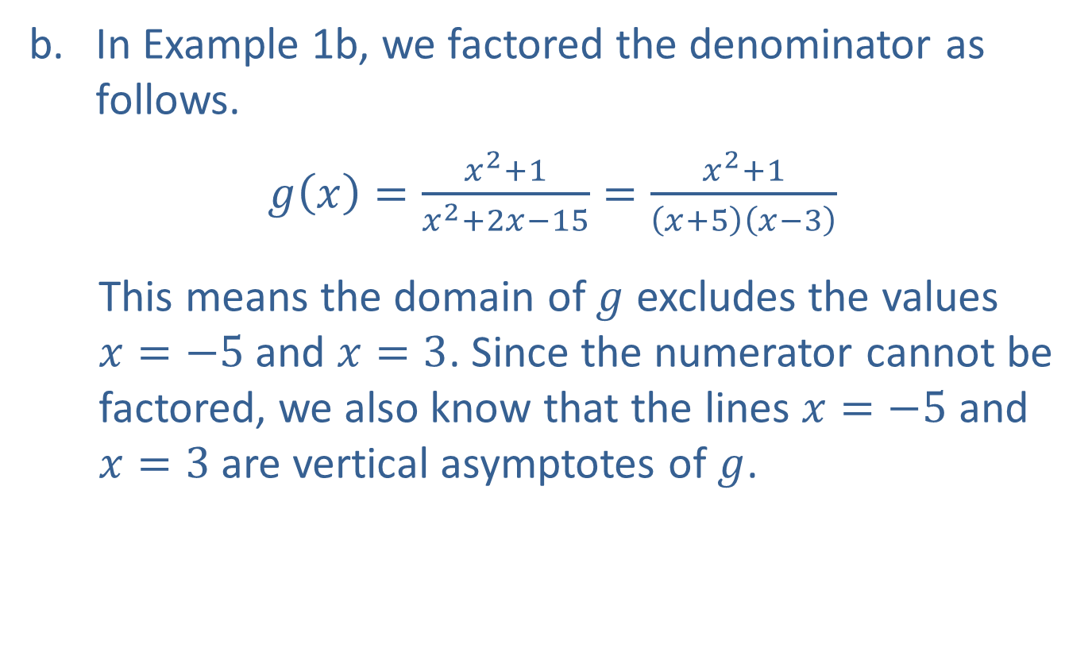
Example 3: Graphing Rational Functions (cont.)
​In Example 1b, we factored the denominator as follows.
​$g\left(x\right)=\frac{x^{2}+1}{x^{2}+2x−15}=\frac{x^{2}+1}{\left(x+5\right)\left(x−3\right)}$
​This means the domain of $g$ excludes the values $x=−5$ and $x=3$. Since the numerator cannot be factored, we also know that the lines $x=−5$ and $x=3$ are vertical asymptotes of $g$.
​

Slide 31

Example 3: Graphing Rational Functions (cont.)
​Next, we look at the degrees of the numerator and denominator. As we saw in Example 2a, the degrees are the same, so the line $y=1$ is the horizontal asymptote. Plotting the asymptotes provides us a framework for graphing $g⁡\left(x\right)$.

Slide 32
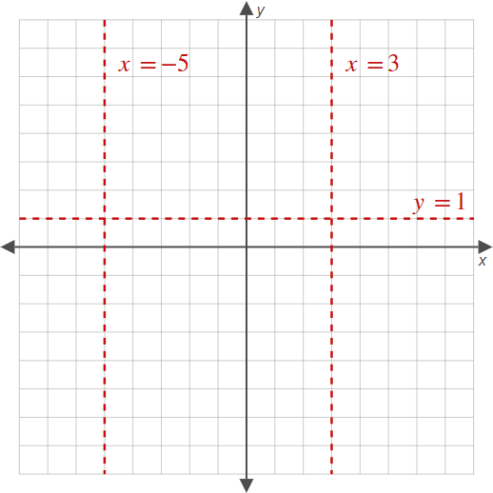
Example 3: Graphing Rational Functions (cont.)

Slide 33
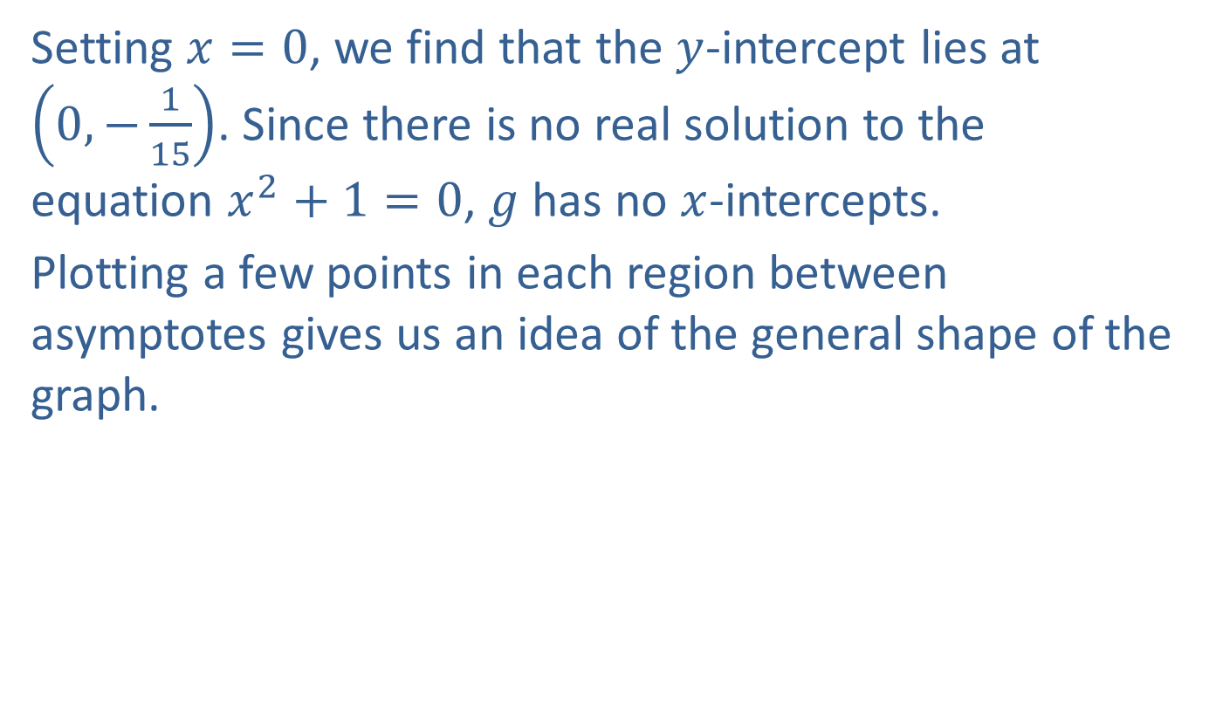
Example 3: Graphing Rational Functions (cont.)
​Setting $x=0$, we find that the $y$-intercept lies at $\left(0,−\frac{1}{15}\right)$. Since there is no real solution to the equation $x^{2}+1=0$, $g$ has no $x$-intercepts.
​Plotting a few points in each region between asymptotes gives us an idea of the general shape of the graph.
​

Slide 34
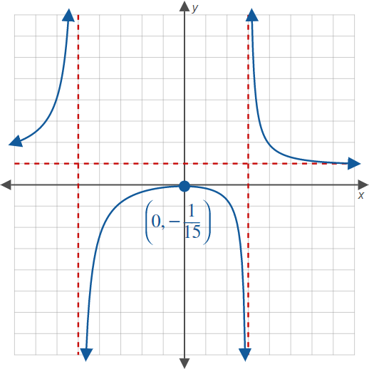
Example 3: Graphing Rational Functions (cont.)

Slide 35
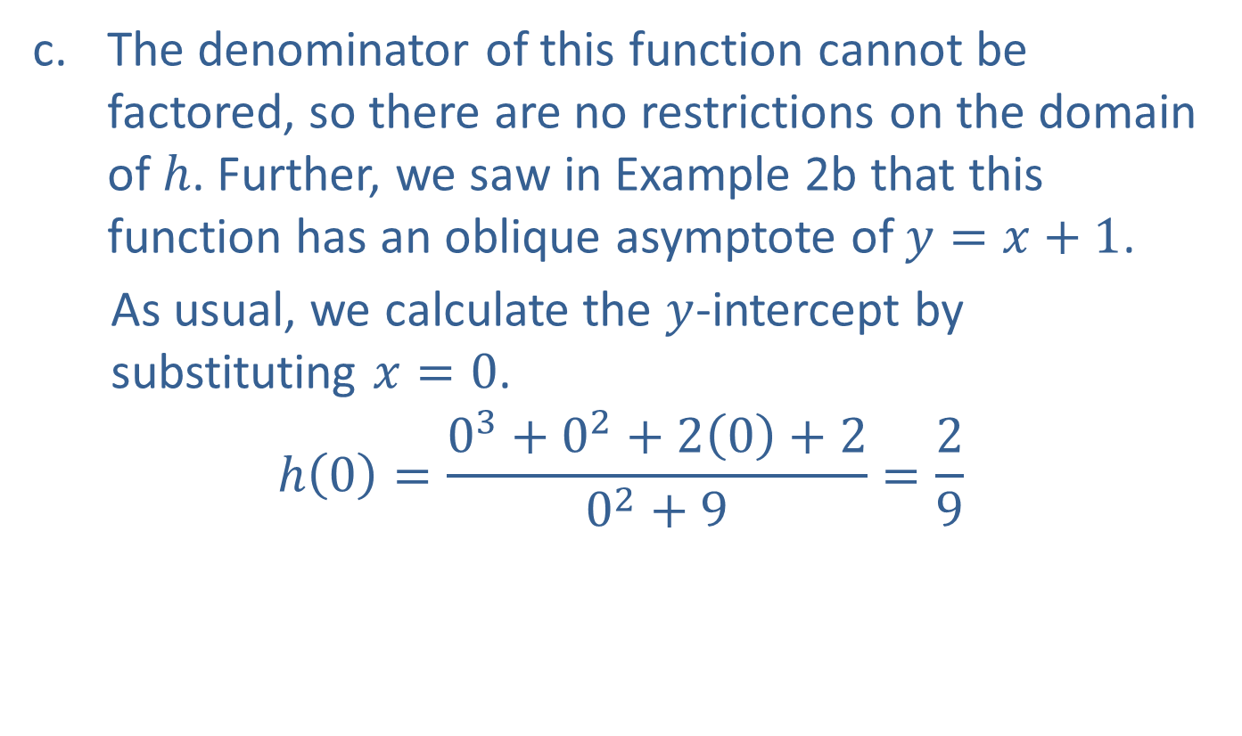
Example 3: Graphing Rational Functions (cont.)
​The denominator of this function cannot be factored, so there are no restrictions on the domain of $h$. Further, we saw in Example 2b that this function has an oblique asymptote of $y=x+1$.
​As usual, we calculate the $y$-intercept by substituting $x=0$.
$$h\left(0\right)=\frac{0^{3}+0^{2}+2\left(0\right)+2}{0^{2}+9}=\frac{2}{9}$$
​

Slide 36
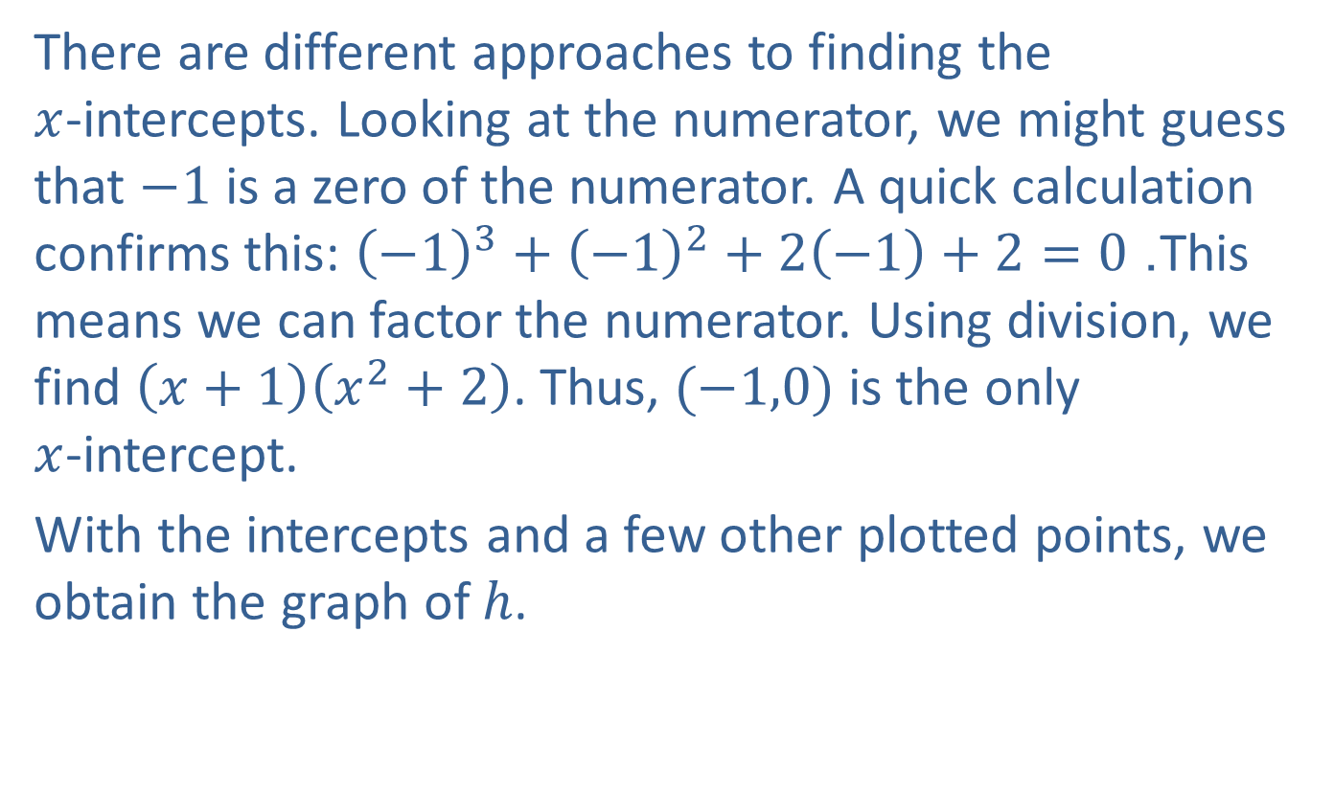
Example 3: Graphing Rational Functions (cont.)
There are different approaches to finding the $x$-intercepts. Looking at the numerator, we might guess that $−1$ is a zero of the numerator. A quick calculation confirms this: ${\left(−1\right)}^{3}+{\left(−1\right)}^{2}+2\left(−1\right)+2=0$. This means we can factor the numerator. Using division, we find $\left(x+1\right)\left(x^{2}+2\right)$. Thus, $(−1,0)$ is the only $x$-intercept.
​With the intercepts and a few other plotted points, we obtain the graph of $h$.

Slide 37
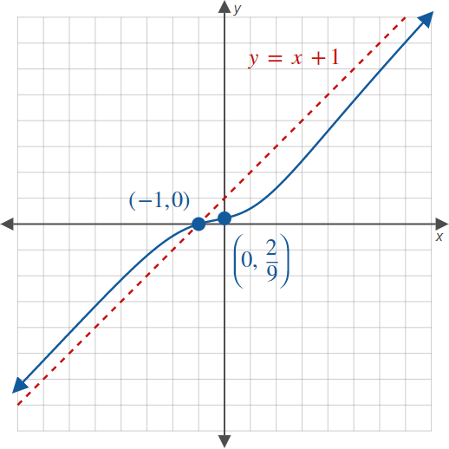
Example 3: Graphing Rational Functions (cont.)

