Slide 1
Section 3.9
Rational Inequalities

Slide 2
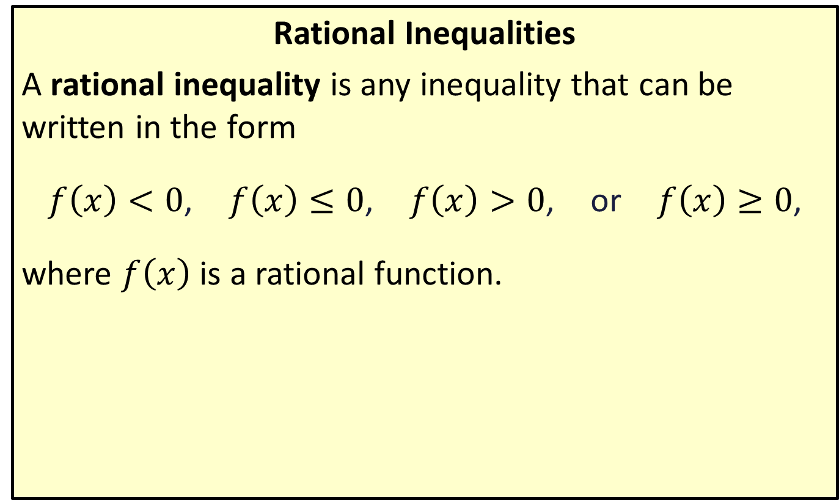
Solving Rational Inequalities
Rational Inequalities
A rational inequality is any inequality that can be written in the form
$f⁡\left(x\right)<0$, $f⁡\left(x\right)≤0$, $f⁡\left(x\right)>0$, or $f⁡\left(x\right)≥0$,
where $f⁡\left(x\right)$ is a rational function.

Slide 3
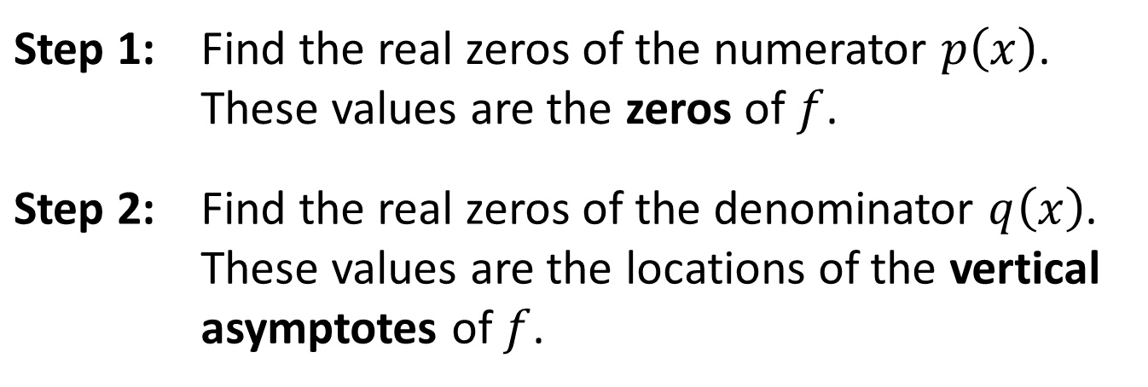

Solving Rational Inequalities: Sign-Test Method
To solve a rational inequality $f\left(x\right)<0$, $f\left(x\right)≤0$,
$f\left(x\right)>0$, or $f\left(x\right)≥0$, where the rational function
$f\left(x\right)=\frac{p\left(x\right)}{q\left(x\right)}$ is in reduced form, perform the following steps.
Step 1: | Find the real zeros of the numerator $p⁡\left(x\right)$. These values are the zeros of $f$.
Step 2: | Find the real zeros of the denominator $q⁡\left(x\right)$. These values are the locations of the vertical asymptotes of $f$.

Slide 4
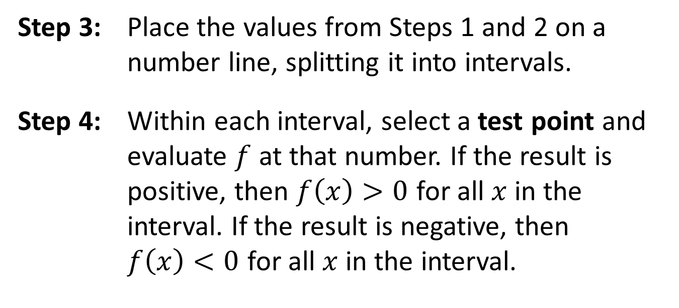
Solving Rational Inequalities: Sign-Test Method (cont.)
Step 3: | Place the values from Steps 1 and 2 on a number line, splitting it into intervals.
Step 4: | Within each interval, select a test point and evaluate $f$ at that number. If the result is positive, then $f\left(x\right)>0$ for all $x$ in the interval. If the result is negative, then $f\left(x\right)<0$ for all $x$ in the interval.

Slide 5
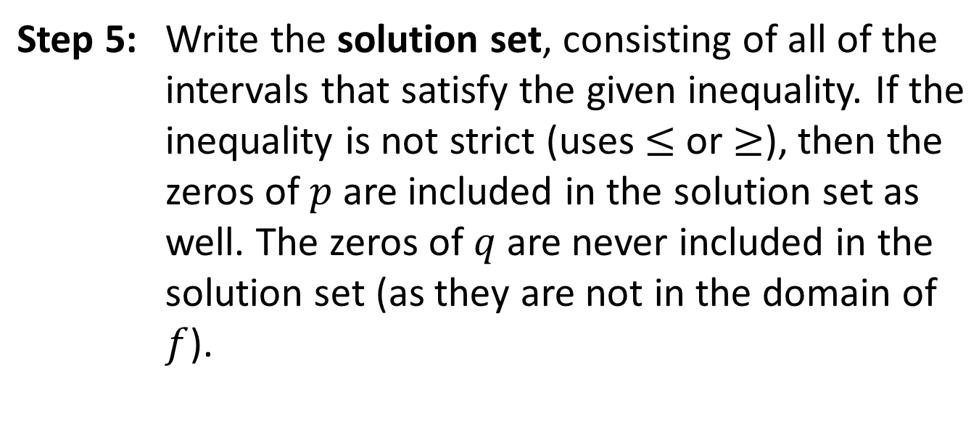
Solving Rational Inequalities: Sign-Test Method (cont.)
Step 5: | Write the solution set, consisting of all of the intervals that satisfy the given inequality. If the inequality is not strict (uses $≤$ or $≥$), then the zeros of $p$ are included in the solution set as well. The zeros of $q$ are never included in the solution set (as they are not in the domain of $f$).

Slide 6

Example 1: Solving Rational Inequalities
Solve the rational inequality $\frac{x^{2}+1}{x^{2}+2x−15}>0$.

Slide 7
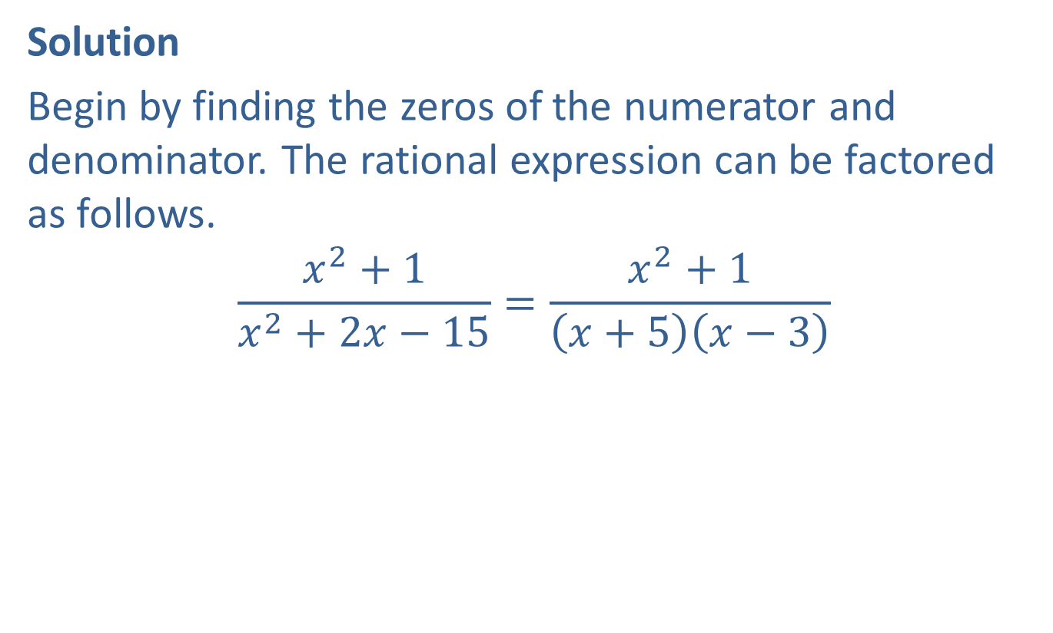
Example 1: Solving Rational Inequalities (cont.)
Solution
Begin by finding the zeros of the numerator and denominator. The rational expression can be factored as follows.
$$\frac{x^{2}+1}{x^{2}+2x−15}=\frac{x^{2}+1}{\left(x+5\right)\left(x−3\right)}$$

Slide 8
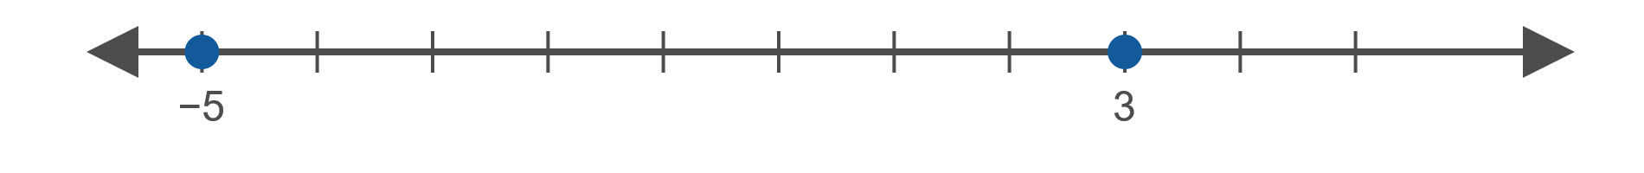

Example 1: Solving Rational Inequalities (cont.)
Thus, we can see that the numerator has no zeros, while the denominator has zeros at $x=−5$ and $x=3$.
Therefore, we place the values $−5$ and 3 on a number line.

Slide 9

Example 1: Solving Rational Inequalities (cont.)
This splits the number line into the intervals $(−∞,−5)$, $(−5,3)$, $(3,∞)$. We then evaluate $f⁡\left(x\right)$ for a test point in each interval.

Slide 10
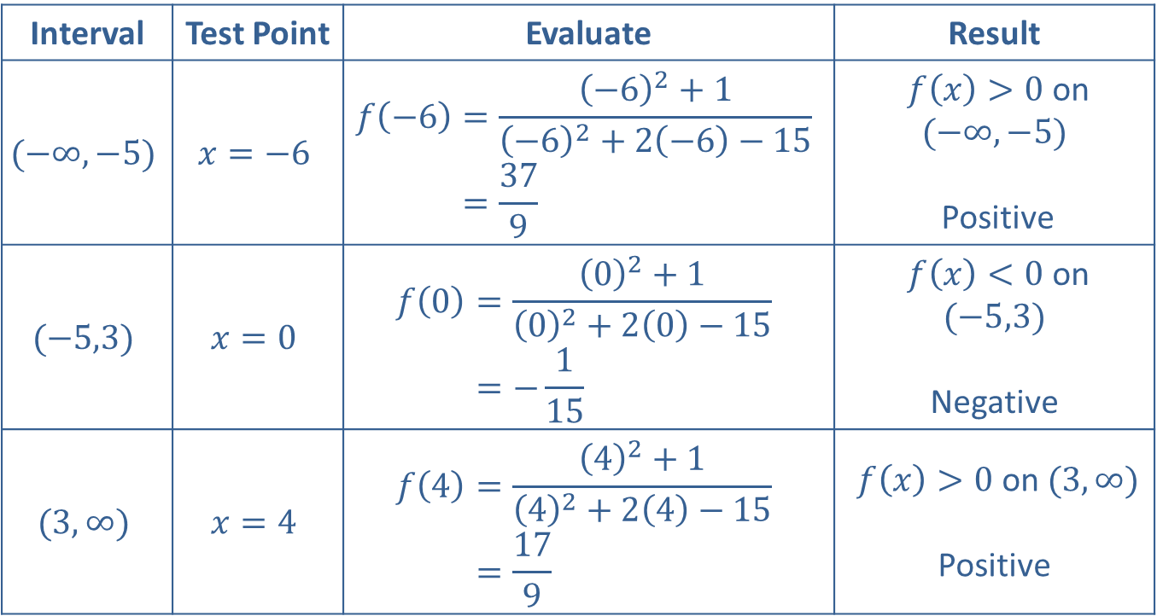
Example 1: Solving Rational Inequalities (cont.)
Interval | Test Point | Evaluate | Result
$$(−∞,−5)$$ | $$x=−6$$ | 𝑓−6=−62+1−62+2−6−15𝑓⁡−6=379 | $f\left(x\right)>0$ on $(−∞,−5)$ Positive
$$(−5,3)$$ | $$x=0$$ | 𝑓0=02+102+20−15𝑓⁡0=−115 | $f⁡\left(x\right)<0$ on $(−5,3)$ Negative
$$(3,∞)$$ | $$x=4$$ | 𝑓4=42+142+24−15𝑓⁡4=179 | $f\left(x\right)>0$ on $(3,∞)$ Positive

Slide 11

Example 1: Solving Rational Inequalities (cont.)
Then, the solution to the inequality consists of those intervals where $f\left(x\right)>0$, which is the set
$\left(−∞,−5\right)∪\left(3,∞\right)$.

Slide 12
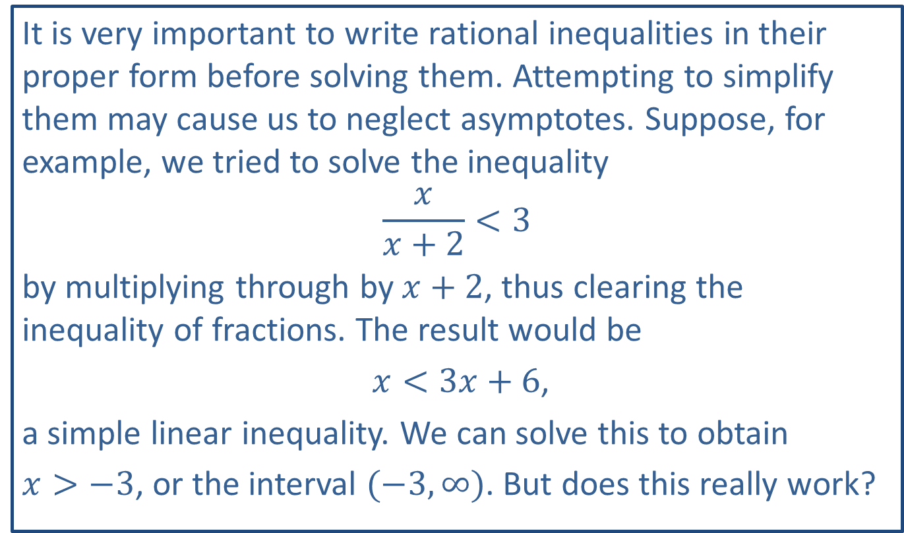
CAUTION!
It is very important to write rational inequalities in their proper form before solving them. Attempting to simplify them may cause us to neglect asymptotes. Suppose, for example, we tried to solve the inequality
$$\frac{x}{x+2}<3$$
by multiplying through by $x+2$, thus clearing the inequality of fractions. The result would be
$x<3x+6$,
a simple linear inequality. We can solve this to obtain
$x>−3$, or the interval $(−3,∞)$. But does this really work?

Slide 13
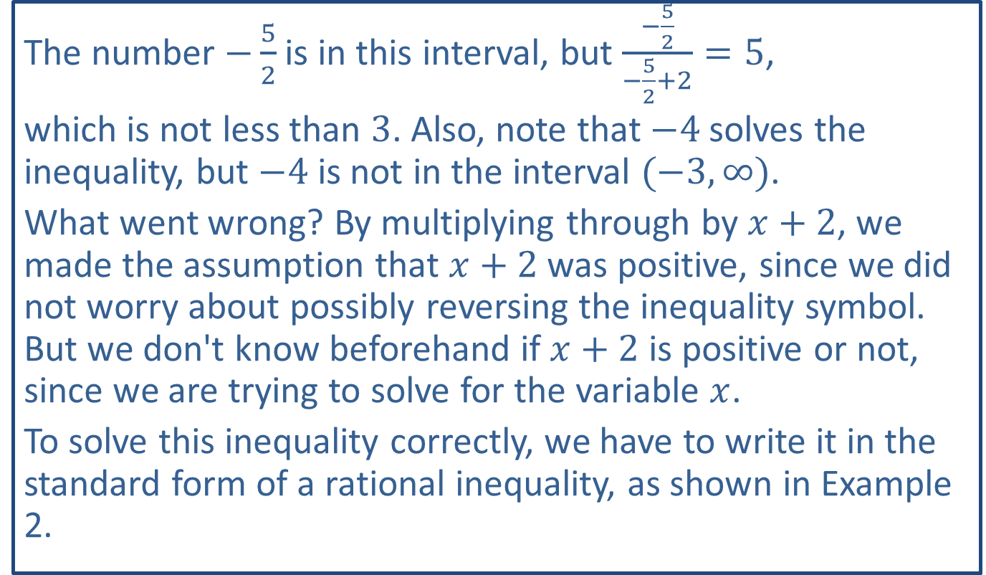
CAUTION! (cont.)
The number $−\frac{5}{2}$ is in this interval, but $\frac{−\frac{5}{2}}{−\frac{5}{2}+2}=5$,
which is not less than 3. Also, note that $−4$ solves the inequality, but $−4$ is not in the interval $(−3,∞)$.
What went wrong? By multiplying through by $x+2$, we made the assumption that $x+2$ was positive, since we did not worry about possibly reversing the inequality symbol. But we don't know beforehand if $x+2$ is positive or not, since we are trying to solve for the variable $x$.
To solve this inequality correctly, we have to write it in the standard form of a rational inequality, as shown in Example 2.

Slide 14

Example 2: Solving Rational Inequalities
Solve the rational inequalities $\frac{x}{x+2}<3$ and $\frac{x}{x+2}≤3$.

Slide 15
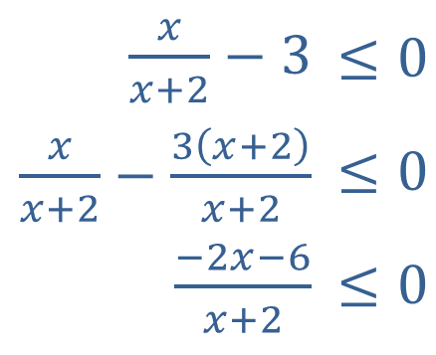
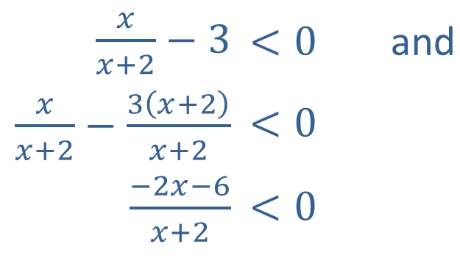
Example 2: Solving Rational Inequalities (cont.)
Solution
Most of the work can be done for both inequalities at the same time.
We begin by subtracting 3 from both sides and then write the left-hand side as a single rational function.
​$\frac{x}{x+2}−3$ | ​$<0$ | and
​$\frac{x}{x+2}−\frac{3\left(x+2\right)}{x+2}$ | ​$<0$
​$\frac{−2x−6}{x+2}$ | ​$<0$
​$\frac{x}{x+2}−3$ | ​$≤0$
​$\frac{x}{x+2}−\frac{3\left(x+2\right)}{x+2}$ | ​$≤0$
​$\frac{−2x−6}{x+2}$ | ​$≤0$

Slide 16
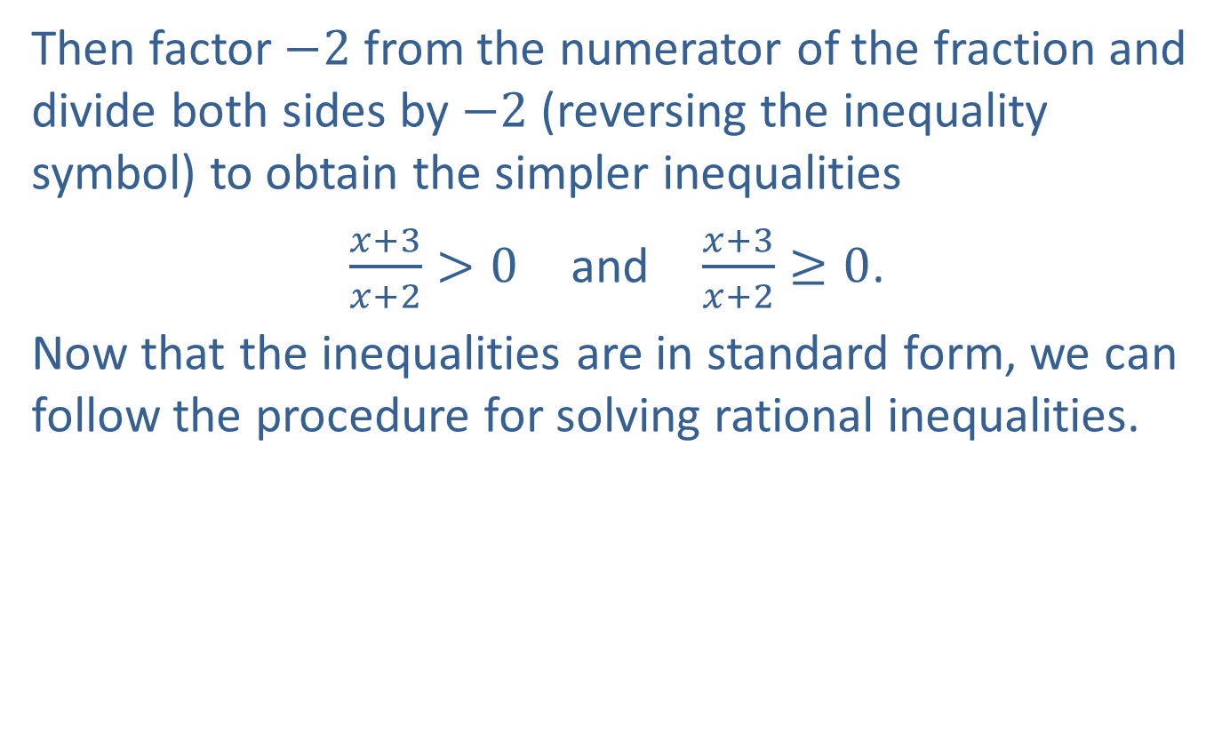
Example 2: Solving Rational Inequalities (cont.)
Then factor $−2$ from the numerator of the fraction and divide both sides by $−2$ (reversing the inequality symbol) to obtain the simpler inequalities
$\frac{x+3}{x+2}>0$ and $\frac{x+3}{x+2}≥0$.
Now that the inequalities are in standard form, we can follow the procedure for solving rational inequalities.

Slide 17
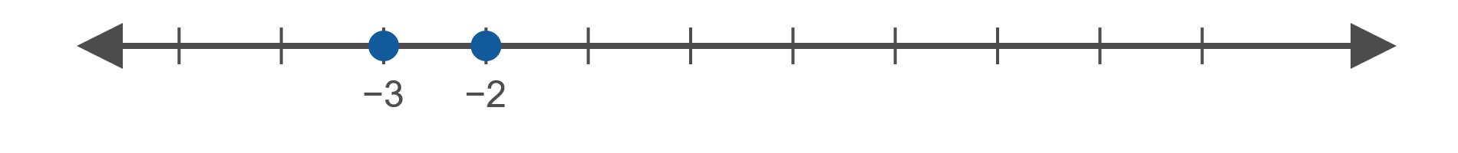


Example 2: Solving Rational Inequalities (cont.)
The zeros of the numerator and denominator are $−3$ and $−2$, respectively. Placing these values on a number line,
we have the intervals $(−∞,−3)$, $(−3,−2)$, and $(−2,∞)$.

Slide 18
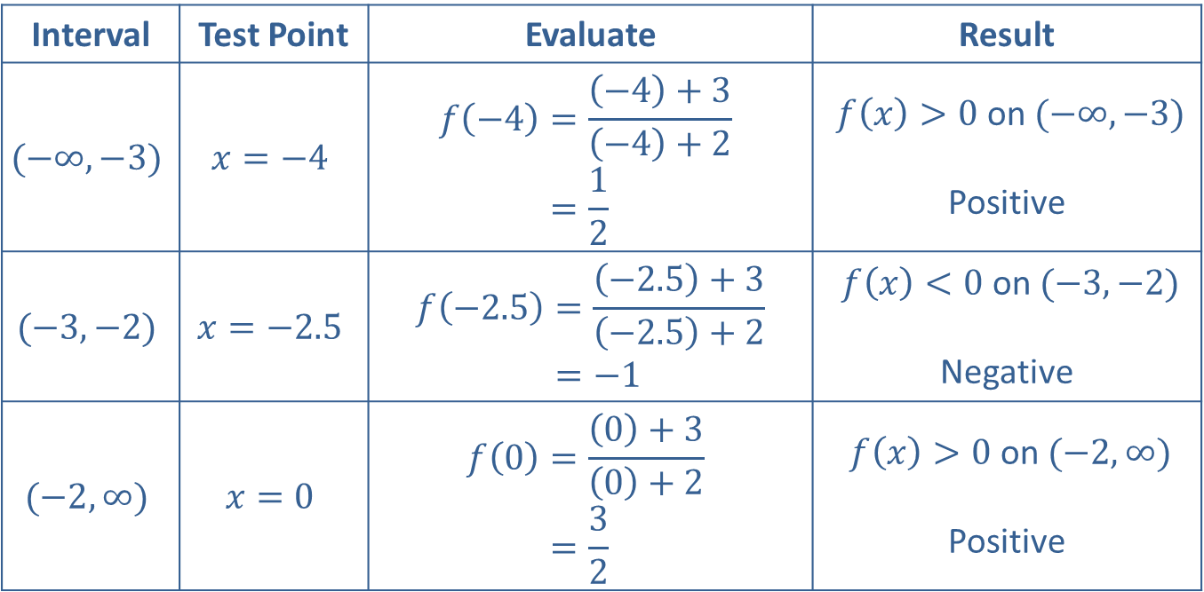
Example 2: Solving Rational Inequalities (cont.)
Interval | Test Point | Evaluate | Result
$$(−∞,−3)$$ | $$x=−4$$ | 𝑓−4=−4+3−4+2𝑓⁡−4=12 | $f⁡\left(x\right)>0$ on $(−∞,−3)$ Positive
$$(−3,−2)$$ | $$x=−2.5$$ | 𝑓−2.5=−2.5+3−2.5+2𝑓⁡−2.5=−1 | $f⁡\left(x\right)<0$ on $(−3,−2)$ Negative
$$(−2,∞)$$ | $$x=0$$ | 𝑓0=0+30+2𝑓⁡0=32 | $f⁡\left(x\right)>0$ on $(−2,∞)$ Positive

Slide 19
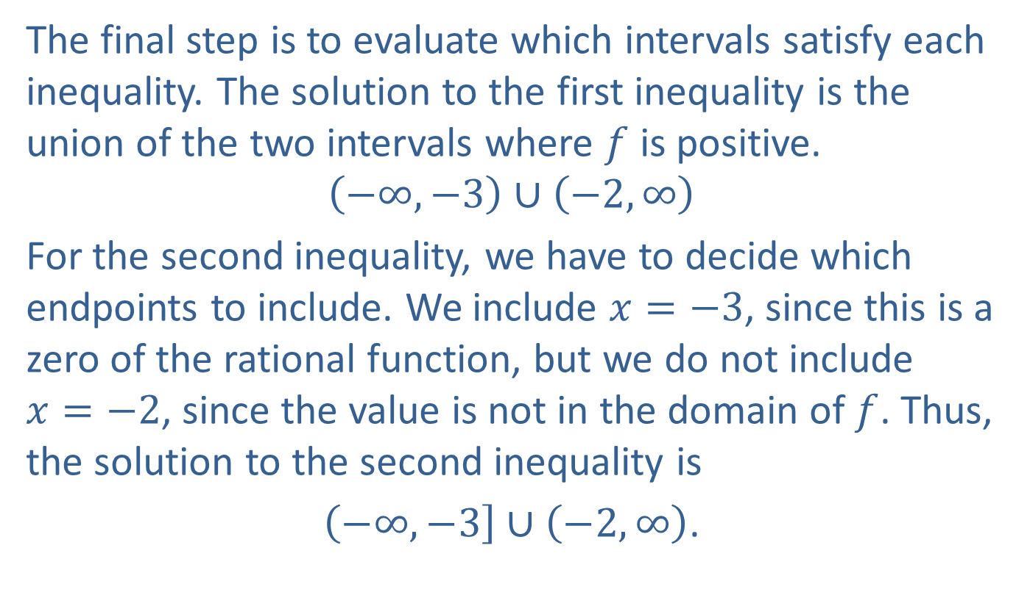
Example 2: Solving Rational Inequalities (cont.)
The final step is to evaluate which intervals satisfy each inequality. The solution to the first inequality is the union of the two intervals where $f$ is positive.
$$\left(−∞,−3\right)∪\left(−2,∞\right)$$
For the second inequality, we have to decide which endpoints to include. We include $x=−3$, since this is a zero of the rational function, but we do not include
$x=−2$, since the value is not in the domain of $f$. Thus, the solution to the second inequality is
$\left(−∞,−3\right]∪\left(−2,∞\right)$.

