Slide 1
Section 4.1
Exponential Functions and
Their Graphs

Slide 2
Definition and Classification of
Exponential Functions
Exponential Functions
Let a be a fixed, positive real number not equal to 1. The exponential function with base a is the function

Slide 3
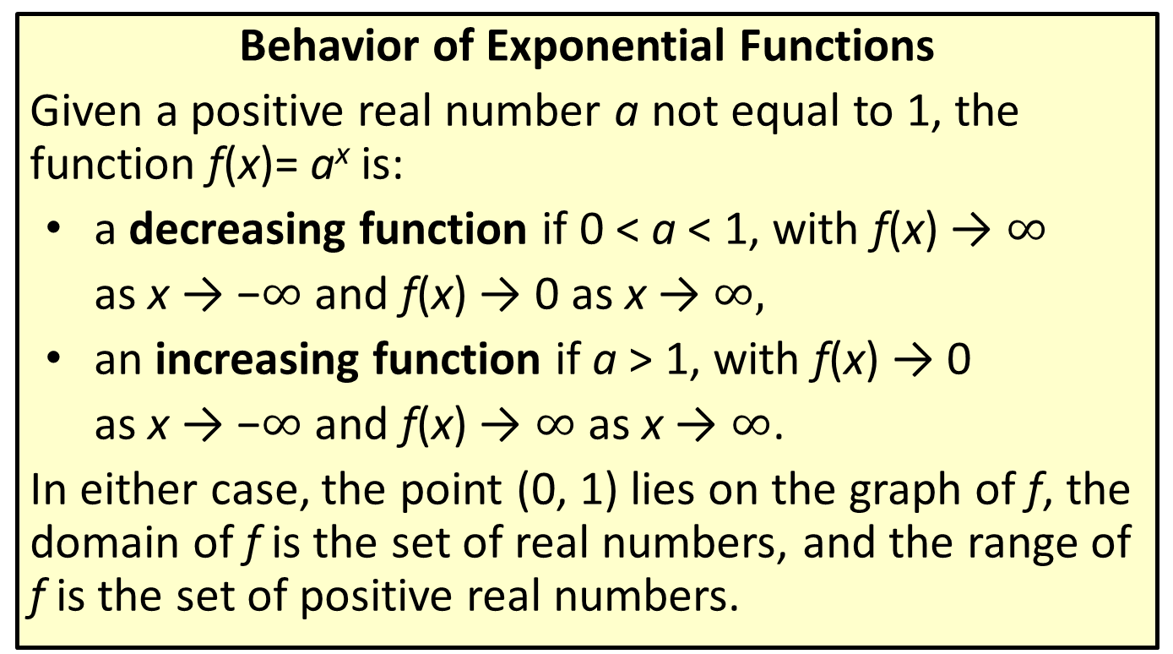
Definition and Classification of
Exponential Functions
Behavior of Exponential Functions
Given a positive real number a not equal to 1, the function f(x)= a^{x} is:
a decreasing function if 0 < a < 1, with f(x) → $∞$
as x → −$∞$ and f(x) → 0 as x → $∞,$
an increasing function if a > 1, with f(x) → 0
as x → −$∞$ and f(x) → $∞$ as x → $∞$.
In either case, the point (0, 1) lies on the graph of f, the domain of f is the set of real numbers, and the range of f is the set of positive real numbers.

Slide 4
Example 1: Graphing Exponential Functions
Sketch the graphs of the following exponential functions.

Slide 5

Example 1: Graphing Exponential Functions (cont.)
Note
Plugging in $x=−1$, $x=0,$and $x=1$ will produce a good idea of the shape of the graph.

Slide 6
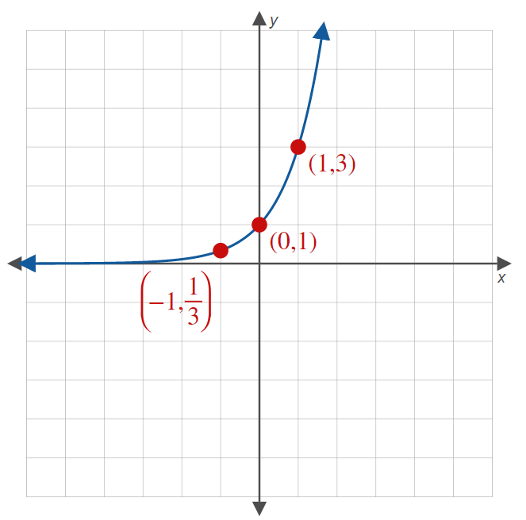
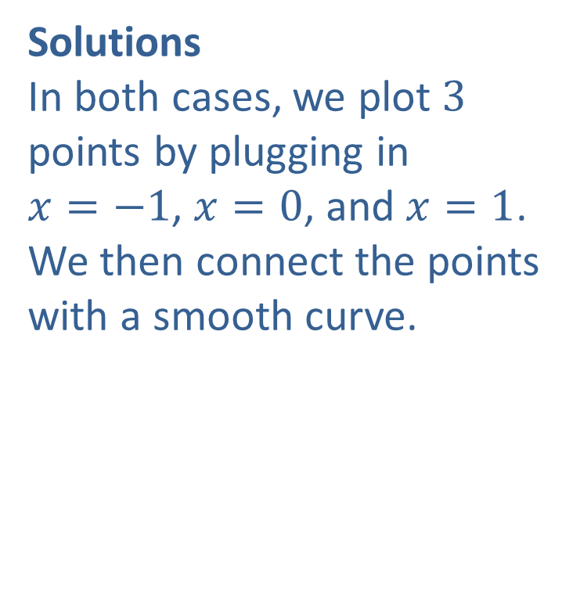
Example 1: Graphing Exponential Functions (cont.)
Solutions
In both cases, we plot $3$ points by plugging in
$x=−1$, $x=0$, and $x=1$. We then connect the points with a smooth curve.
a.

Slide 7
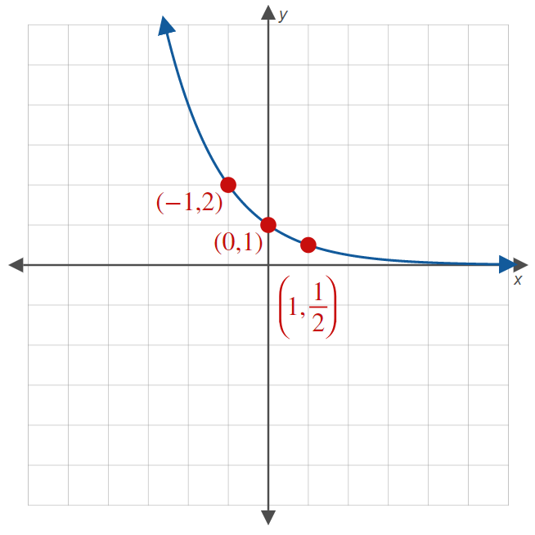
Example 1: Graphing Exponential Functions (cont.)
b.

Slide 8

Example 2: Graphing Exponential Functions
Sketch the graph of each of the following functions.
$f\left(x\right)={\left(\frac{1}{2}\right)}^{x+3}$
$g\left(x\right)={−3}^{x}+1$
$h\left(x\right)=2^{−x}$

Slide 9
Example 2: Graphing Exponential Functions (cont.)
Note
For each example, first graph the base function, then apply any transformations.

Slide 10
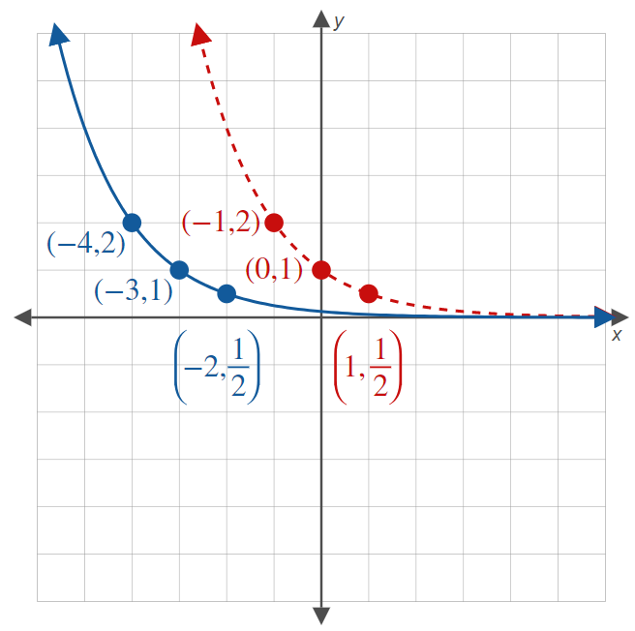
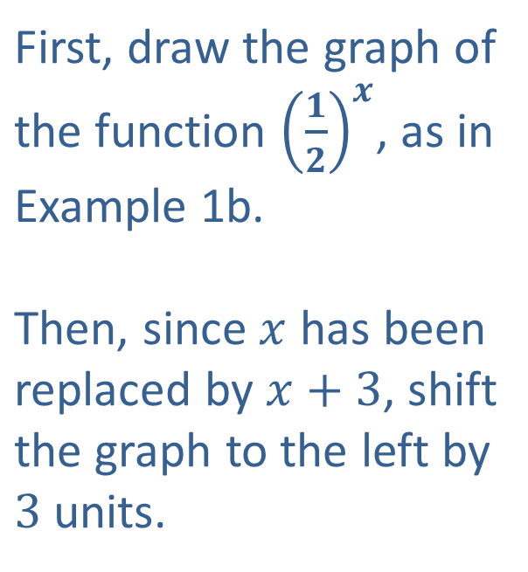
Example 2: Graphing Exponential Functions (cont.)
Solutions
a.
First, draw the graph of the function ${\left(\frac{1}{2}\right)}^{x}$, as in Example 1b. Then, since $x$ has been replaced by $x+3$, shift the graph to the left by $3$ units.

Slide 11
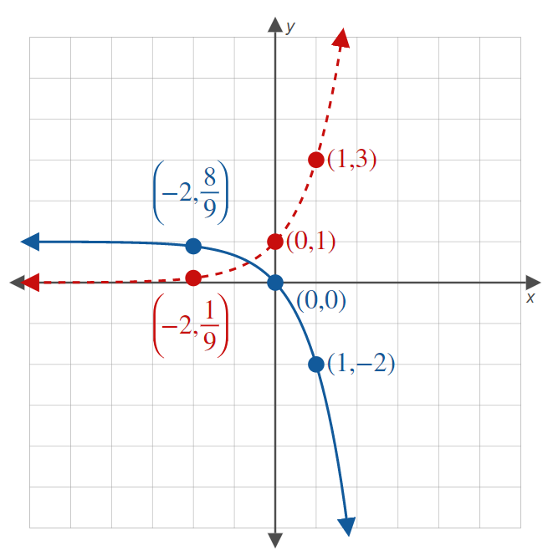
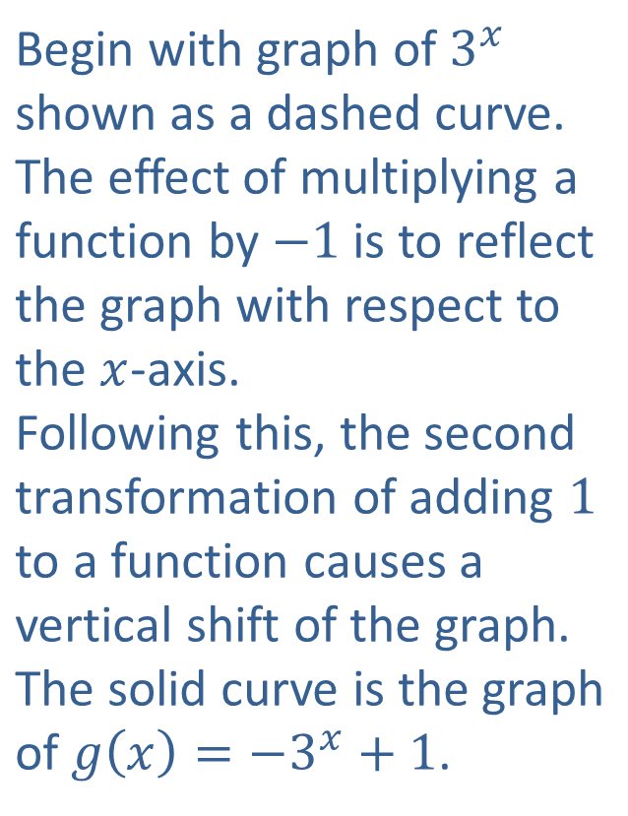
Example 2: Graphing Exponential Functions (cont.)
Begin with graph of $3^{x}$ shown as a dashed curve. The effect of multiplying a function by $−1$ is to reflect the graph with respect to the $x$-axis. Following this, the second transformation of adding $1$ to a function causes a vertical shift of the graph. The solid curve is the graph of $g\left(x\right)=−3^{x}+1$.
b.

Slide 12
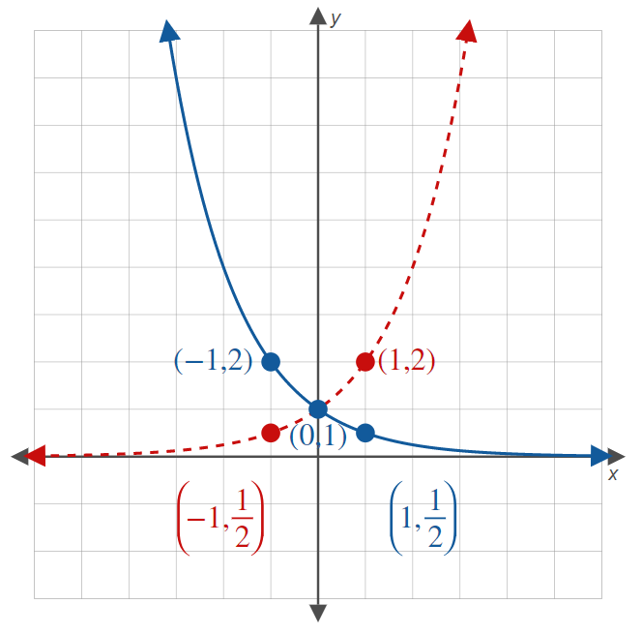
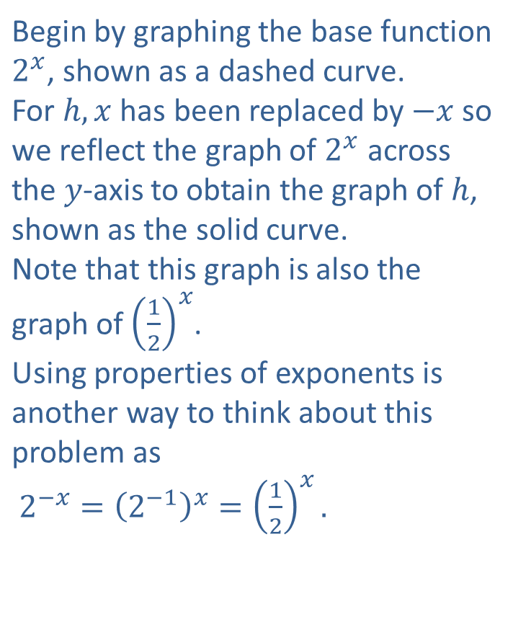
Example 2: Graphing Exponential Functions (cont.)
Begin by graphing the base function $2^{x}$, shown as a dashed curve. For $h,x$ has been replaced by $−x$ so we reflect the graph of $2^{x}$ across the $y$-axis to obtain the graph of $h$, shown as the solid curve. Note that this graph is also the graph of ${\left(\frac{1}{2}\right)}^{x}$. Using properties of exponents is another way to think about this problem as $2^{−x}={\left(2^{−1}\right)}^{x}={\left(\frac{1}{2}\right)}^{x}.$
c.

Slide 13
Solving Elementary Exponential Equations
To solve an elementary exponential equation, complete the following steps.
Step 1: Isolate the exponential. Move the exponential containing x to one side of the equation and any constants or other variables in the expression to the other side. Simplify, if necessary.

Slide 14
Solving Elementary Exponential Equations (cont.)
Step 2: Find a base that can be used to rewrite both sides of the equation.
Step 3: Equate the powers, and solve the resulting equation.

Slide 15
Example 3: Solving Elementary Exponential Equations
Solve the following exponential equations.

Slide 16
Example 3: Solving Elementary Exponential Equations (cont.)
Note
As always, it is good practice to check your solution in the original equation.

Slide 17
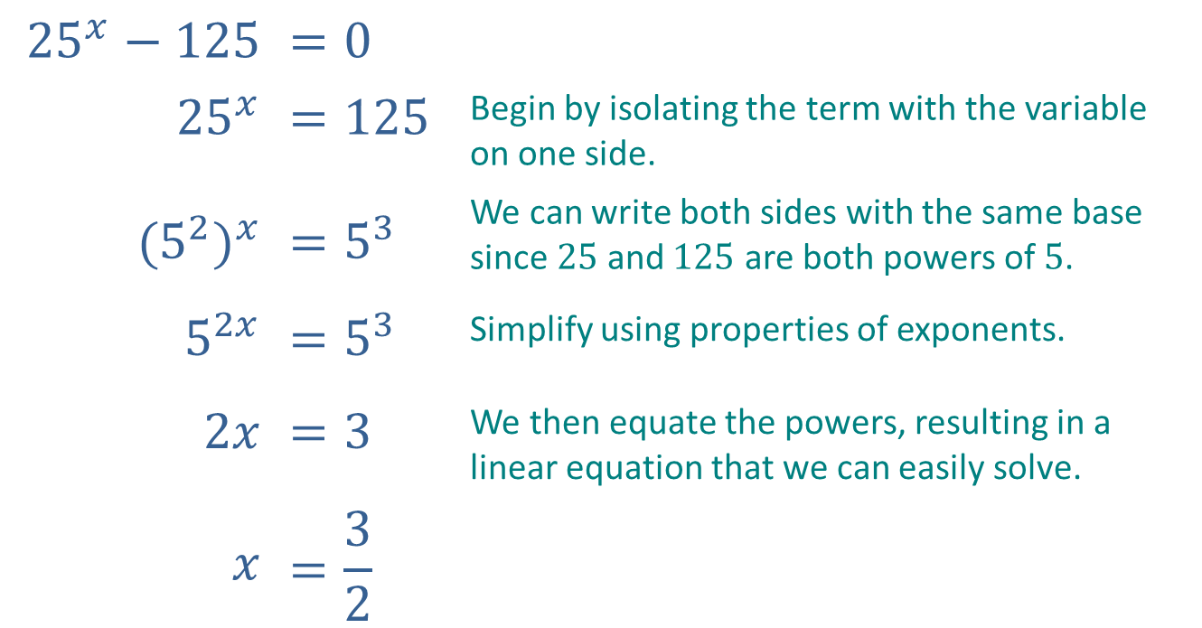
Example 3: Solving Elementary Exponential Equations (cont.)
Solutions
a.
$${25}^{x}−125$$ | $$=0$$
$${25}^{x}$$ | $$=125$$ | Begin by isolating the term with the variable on one side.
$${(5^{2})}^{x}$$ | $$=5^{3}$$ | We can write both sides with the same base since $25$ and $125$ are both powers of $5$.
$$5^{2x}$$ | $$=5^{3}$$ | Simplify using properties of exponents.
$$2x$$ | $$=3$$ | We then equate the powers, resulting in a linear equation that we can easily solve.
$$x$$ | $$=\frac{3}{2}$$

Slide 18
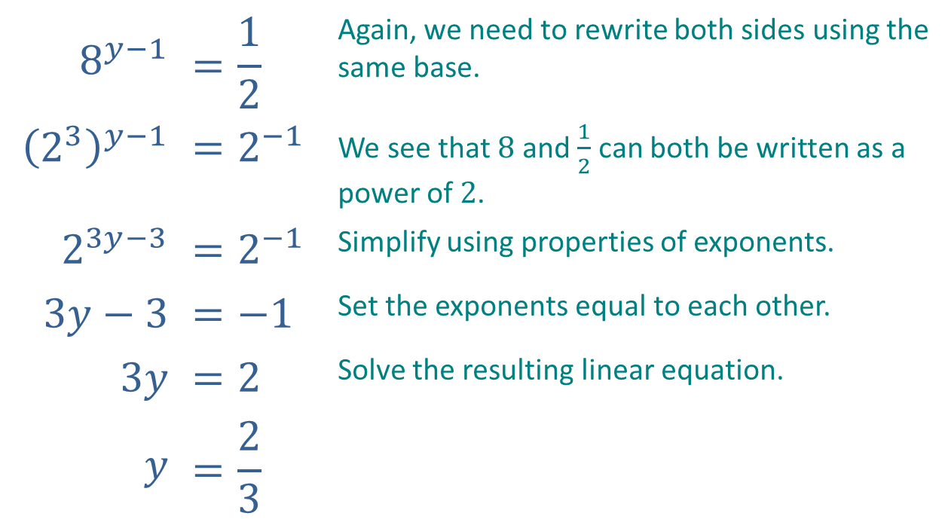
Example 3: Solving Elementary Exponential Equations (cont.)
$$8^{y−1}$$ | $$=\frac{1}{2}$$ | Again, we need to rewrite both sides using the same base.
$${\left(2^{3}\right)}^{y−1}$$ | $$=2^{−1}$$ | We see that $8$ and $\frac{1}{2}$ can both be written as a power of $2$.
$$2^{3y−3}$$ | $$=2^{−1}$$ | Simplify using properties of exponents.
$$3y−3$$ | $$=−1$$ | Set the exponents equal to each other.
$$3y$$ | $$=2$$ | Solve the resulting linear equation.
$$y$$ | $$=\frac{2}{3}$$
b.

Slide 19
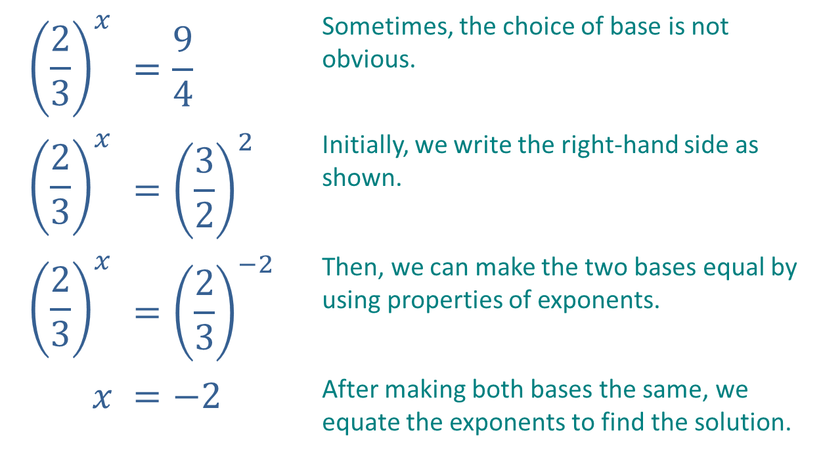
Example 3: Solving Elementary Exponential Equations (cont.)
$${\left(\frac{2}{3}\right)}^{x}$$ | $$=\frac{9}{4}$$ | Sometimes, the choice of base is not obvious.
$${\left(\frac{2}{3}\right)}^{x}$$ | $$={\left(\frac{3}{2}\right)}^{2}$$ | Initially, we write the right-hand side as shown.
$${\left(\frac{2}{3}\right)}^{x}$$ | $$={\left(\frac{2}{3}\right)}^{−2}$$ | Then, we can make the two bases equal by using properties of exponents.
$$x$$ | $$=−2$$ | After making both bases the same, we equate the exponents to find the solution.
c.

