Slide 1
Section 4.2
Applications of Exponential Functions

Slide 2
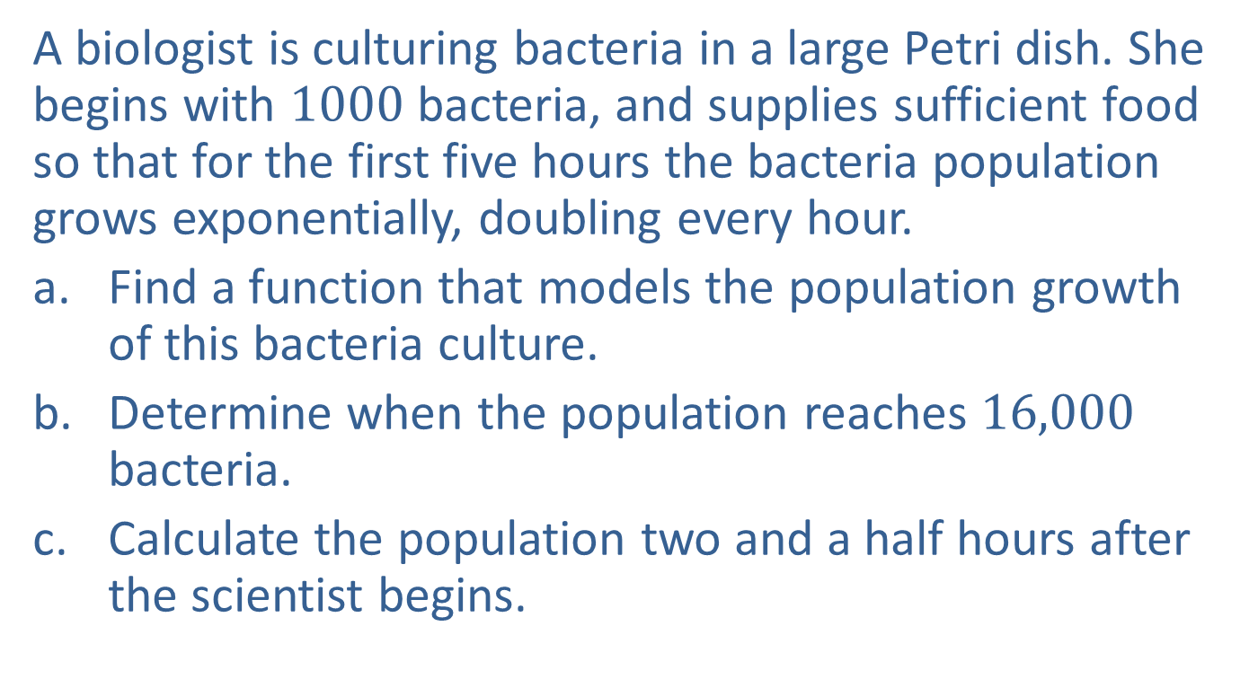
Example 1: Population Growth
A biologist is culturing bacteria in a large Petri dish. She begins with $1000$ bacteria, and supplies sufficient food so that for the first five hours the bacteria population grows exponentially, doubling every hour.
Find a function that models the population growth of this bacteria culture.
Determine when the population reaches $16,000$ bacteria.
Calculate the population two and a half hours after the scientist begins.

Slide 3
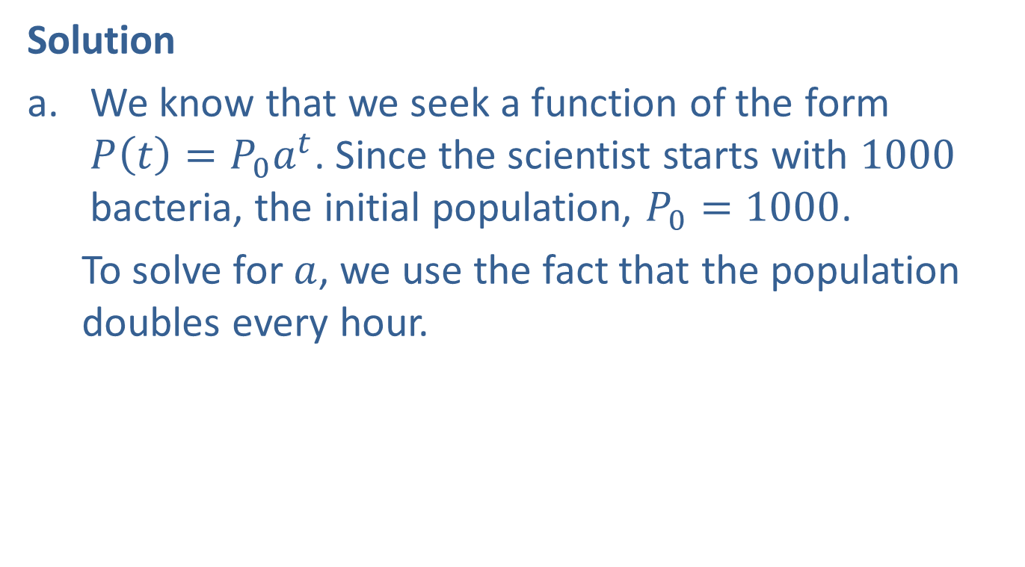
Example 1: Population Growth (cont.)
Solution
We know that we seek a function of the form $P\left(t\right)=P_{0}a^{t}$. Since the scientist starts with $1000$ bacteria, the initial population, $P_{0}=1000$.
To solve for $a$, we use the fact that the population doubles every hour.

Slide 4
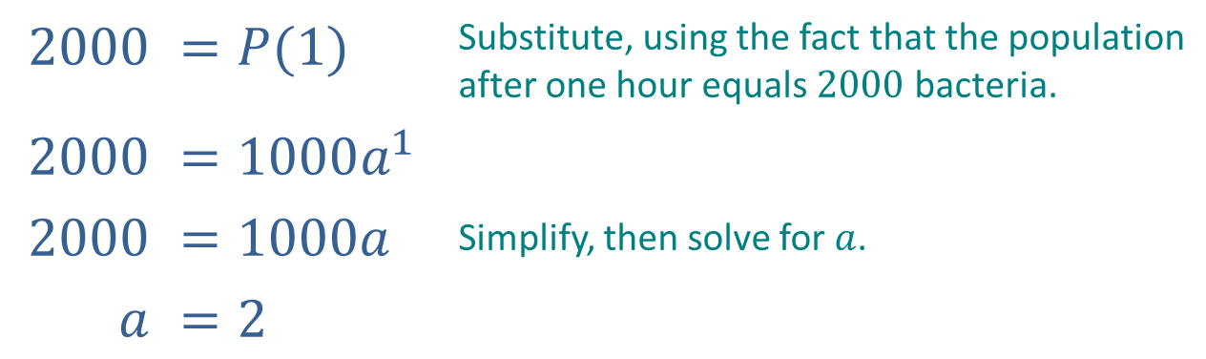

Example 1: Population Growth (cont.)
Thus, a function which models the population growth of the bacteria culture is $P\left(t\right)=1000{\left(2\right)}^{t}$, where $t$ is measured in hours.
$$2000$$ | $$=P(1)$$ | Substitute, using the fact that the population after one hour equals $2000$ bacteria.
$$2000$$ | $$=1000a^{1}$$
$$2000$$ | $$=1000a$$ | Simplify, then solve for $a$.
$$a$$ | $$=2$$

Slide 5
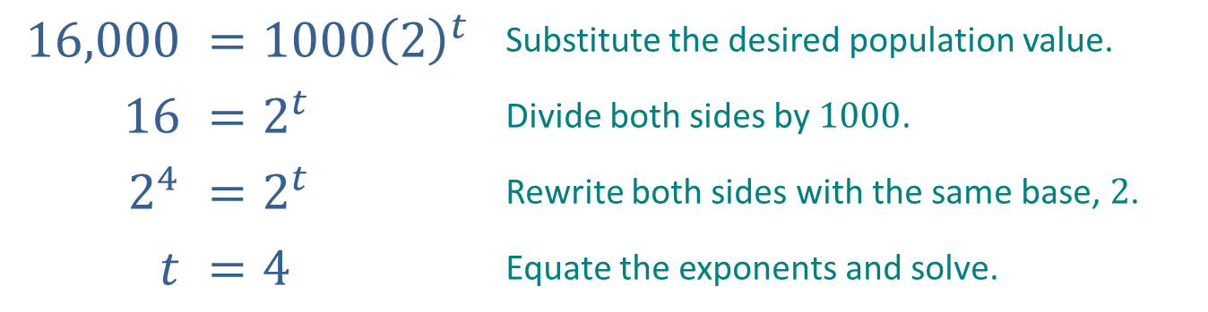

Example 1: Population Growth (cont.)
We wish to find the time $t$ for which $P\left(t\right)=16,000$.
Thus, the bacteria culture reaches a population of $16,000$ in $4$ hours.
$$16,000$$ | $$=1000{\left(2\right)}^{t}$$ | Substitute the desired population value.
$$16$$ | $$=2^{t}$$ | Divide both sides by $1000$.
$$2^{4}$$ | $=2^{t}$ | Rewrite both sides with the same base, $2$.
$$t$$ | $$=4$$ | Equate the exponents and solve.

Slide 6
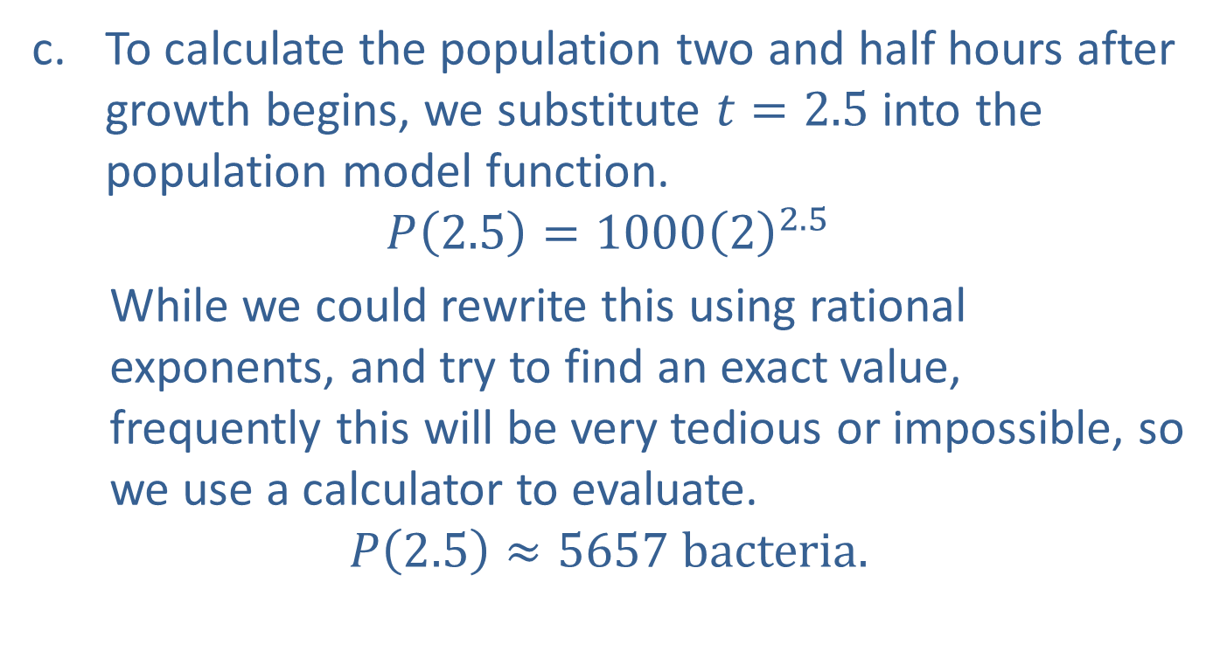
Example 1: Population Growth (cont.)
To calculate the population two and half hours after growth begins, we substitute $t=2.5$ into the population model function.
$$P\left(2.5\right)=1000{\left(2\right)}^{2.5}$$
While we could rewrite this using rational exponents, and try to find an exact value, frequently this will be very tedious or impossible, so we use a calculator to evaluate.
$$P\left(2.5\right)≈5657 bacteria.$$

Slide 7
Example 2: Radioactive Decay
Determine the base a so that the function A(t) = A₀a^{t} accurately describes the decay of carbon-14 as a function of t years.

Slide 8
Example 2: Radioactive Decay (cont.)
Solution
Note that A(0) = A₀a⁰ = A₀, so A₀ represents the amount of carbon-14 at time t = 0. Since we are seeking a general formula, we don’t know what A₀ is specifically; that is, the value of A₀ will vary depending on the details of the situation. But we can still determine the base constant a.

Slide 9
Example 2: Radioactive Decay (cont.)
What we know is that half of the original amount of carbon-14 decays over a period of 5730 years, so A(5730) will be half of A₀. This gives us the following equation.
To solve this for a, we can first divide both sides by A₀; the fact that A₀ then cancels from the equation just emphasizes that its exact value is irrelevant for the task at hand. Now we have the following equation.

Slide 10
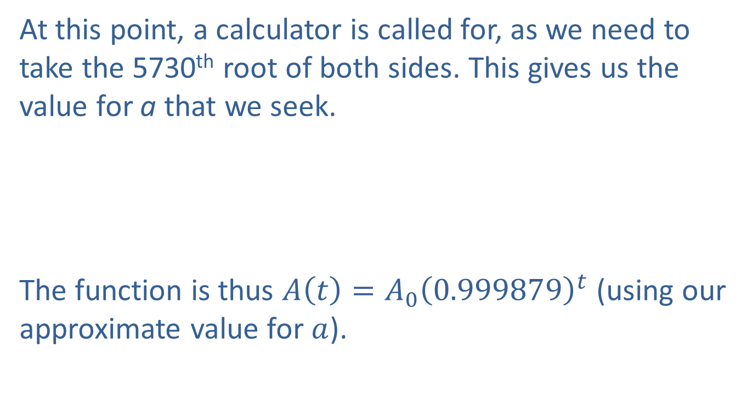
Example 2: Radioactive Decay (cont.)
At this point, a calculator is called for, as we need to take the 5730th root of both sides. This gives us the value for a that we seek.
The function is thus $A\left(t\right)=A_{0}{\left(0.999879\right)}^{t}$ (using our approximate value for $a$).

Slide 11
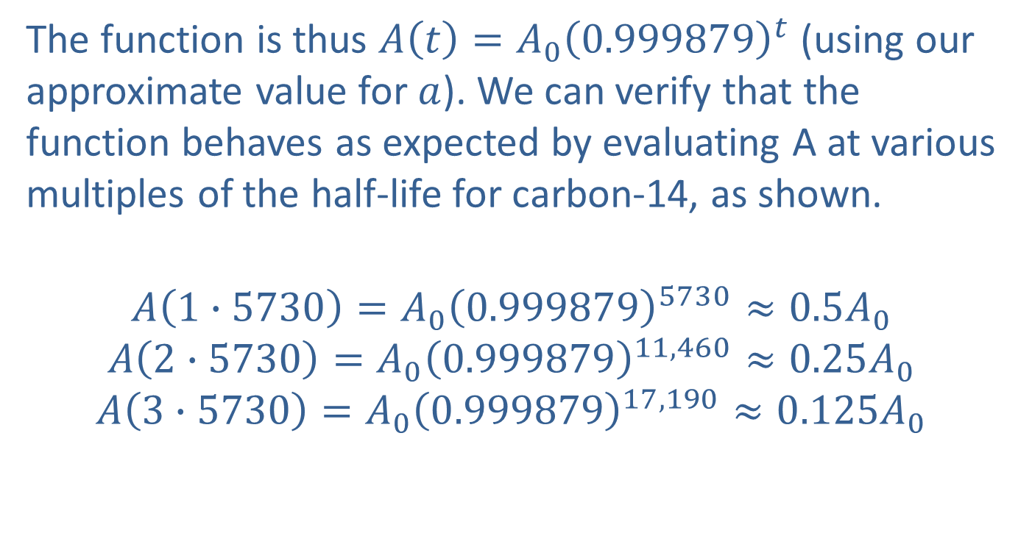
Example 2: Radioactive Decay (cont.)
The function is thus $A\left(t\right)=A_{0}{\left(0.999879\right)}^{t}$ (using our approximate value for $a$). We can verify that the function behaves as expected by evaluating A at various multiples of the half-life for carbon-14, as shown.
$$A\left(1∙5730\right)=A_{0}{\left(0.999879\right)}^{5730}≈0.5A_{0}$$
$$A\left(2∙5730\right)=A_{0}{\left(0.999879\right)}^{11,460}≈0.25A_{0}$$
$$A\left(3∙5730\right)=A_{0}{\left(0.999879\right)}^{17,190}≈0.125A_{0}$$

Slide 12
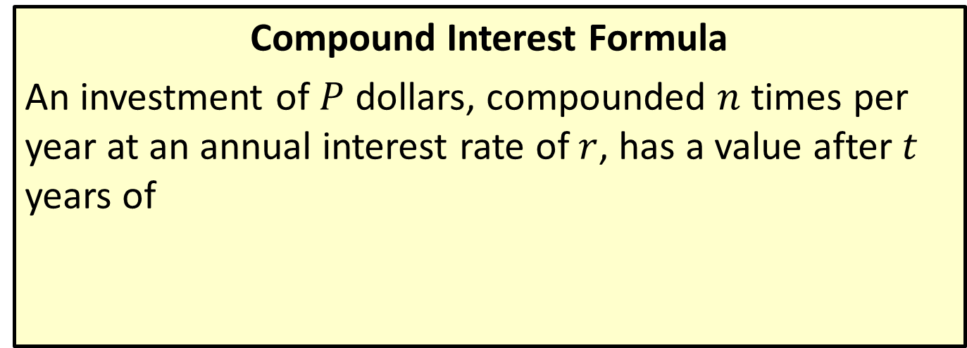
Compound Interest and the Number e
Compound Interest Formula
An investment of $P$ dollars, compounded $n$ times per year at an annual interest rate of $r$, has a value after $t$ years of

Slide 13
Example 3: Compound Interest Formula
Sandy invests $10,000 in a savings account earning 4.5% annual interest compounded quarterly. What is the value of her investment after three and a half years?

Slide 14
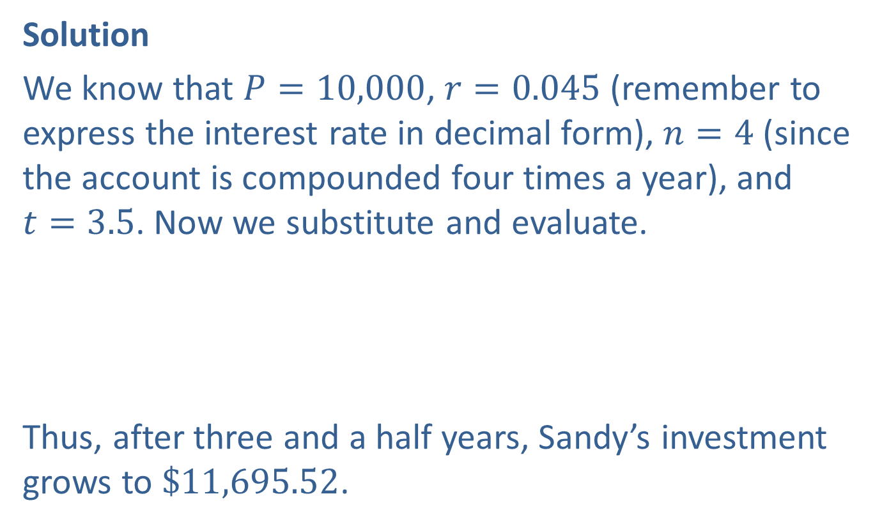
Example 3: Compound Interest Formula
Solution
We know that $P=10,000$, $r=0.045$ (remember to express the interest rate in decimal form), $n=4$ (since the account is compounded four times a year), and
$t=3.5$. Now we substitute and evaluate.
Thus, after three and a half years, Sandy’s investment grows to $\$11,695.52$.

Slide 15
Example 4: Compound Interest Formula
Nine months after depositing $520.00 in a monthly compounded savings account, Frank checks his balance and finds the account has $528.84. Being the forgetful type, he can’t remember what the annual interest rate for his account is, and sees the bank is advertising a rate of 2.5% for new accounts. Should he close out his existing account and open a new one?

Slide 16
Example 4: Compound Interest Formula (cont.)
Solution
As in Example 3, we will begin by identifying the known quantities in the compound interest formula: P = 520,
n = 12 (12 compoundings per year), and t = 0.75 (nine months is three-quarters of a year).
Further, the amount in the account, A, at this time is $528.84. This gives us the equation
to solve for r, the annual interest rate.

Slide 17
Example 4: Compound Interest Formula (cont.)
Simplify the exponent.
Divide both sides by 520.
Take the ninth root of both sides.
Simplify to solve for r.

Slide 18
Example 4: Compound Interest Formula (cont.)
Thus Frank’s current savings account is paying an annual interest rate of 2.25%, so he would gain a slight advantage by switching to a new account.

Slide 19
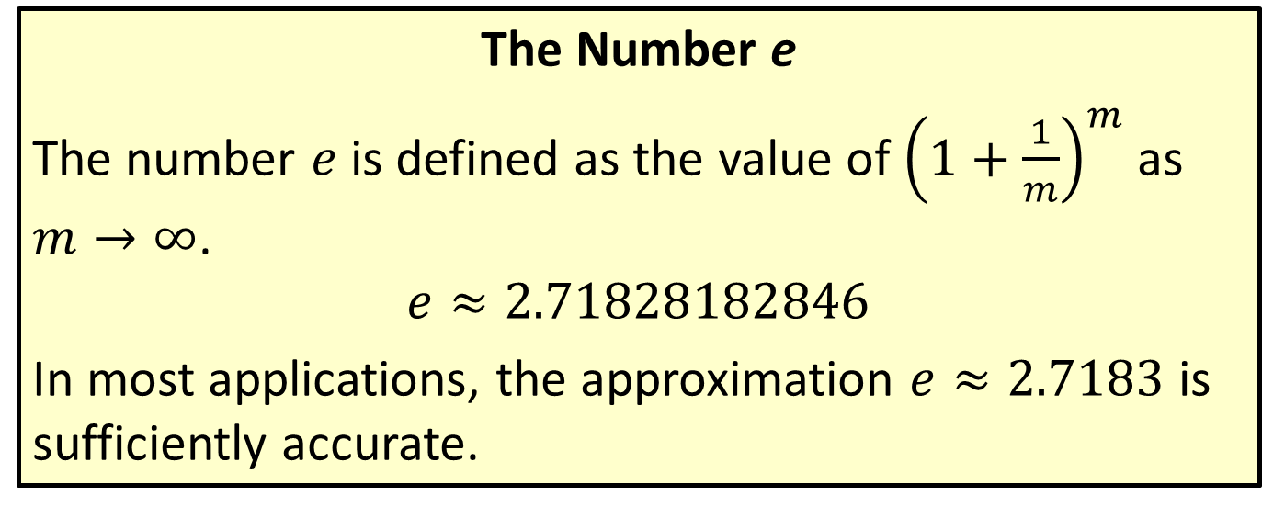
Compound Interest and the Number e
The Number e
The number $e$ is defined as the value of ${\left(1+\frac{1}{m}\right)}^{m}$ as $m→∞$.
$$e≈2.71828182846$$
In most applications, the approximation $e≈2.7183$ is sufficiently accurate.

Slide 20
Compound Interest and the Number e
Continuous Compounding Formula
An investment of P dollars, compounded continuously at an annual interest rate of r, has a value after t years of

Slide 21
Example 5: Continuous Compounding Formula
If Sandy (last seen in Example 3) has the option of investing her $10,000 in a continuously compounded account earning 4.5% annual interest, what will be the value of her account in three and a half years?

Slide 22
Example 5: Continuous Compounding Formula (cont.)
Solution
Again, the solution boils down to substituting the correct values and evaluating the result. Here,
P = 10,000, r = 0.045, and t = 3.5.
This account earns $10.29 more than the quarterly compounded account in Example 3.

