Slide 1
Section 4.3
Logarithmic Functions and
Their Graphs

Slide 2
Definition of Logarithmic Functions
Solvable | Not Easily Solvable Yet
We can solve the equation 2^{x} = 8 by writing 8 as 2³ and equating exponents. This is an example of an elementary exponential equation we learned to solve in an earlier section. | We cannot solve the equation 2^{x} = 9 in the same way, although this equation is only slightly different. All we can say at the moment is that x must be a bit larger than 3.

Slide 3
Definition of Logarithmic Functions
Solvable | Not easily solvable yet
If we know A, P, n, and t, we can solve the compound interest equation for the annual interest rate r. | If we know A, P, and t, it is not so easy to solve the continuously compounded interest equation for the annual interest rate r.

Slide 4
Definition of Logarithmic Functions
Logarithmic Functions
Let a be a fixed positive real number not equal to 1. The logarithmic function with base a is defined to be the inverse of the exponential function with base a, and is denoted log_{a}x.
In symbols, if f(x) = a^{x}, then f ⁻¹(x) = log_{a}x.

Slide 5
Definition of Logarithmic Functions
Logarithmic Functions (cont.)
In equation form, the definition of logarithm means that the equations
x = a^{y} and y = log_{a}x
are equivalent. Note that a is the base in both equations: either the base of the exponential function or the base of the logarithmic function.

Slide 6
Example 1: Exponential and Logarithmic Equations
Use the definition of logarithmic functions to rewrite the following exponential equations as logarithmic equations.

Slide 7
Example 1: Exponential and Logarithmic Equations (cont.)
Then rewrite the following logarithmic equations as exponential equations.

Slide 8
Example 1: Exponential and Logarithmic Equations (cont.)
Solution
Note that in each case, the base of the exponential equation is the base of the logarithmic equation.

Slide 9
Example 1: Exponential and Logarithmic Equations (cont.)

Slide 10
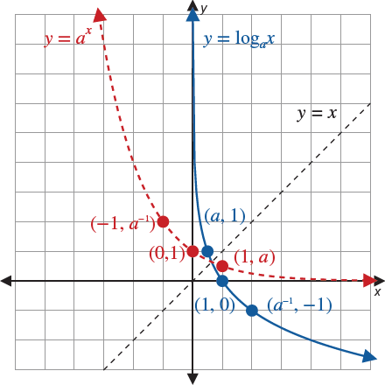
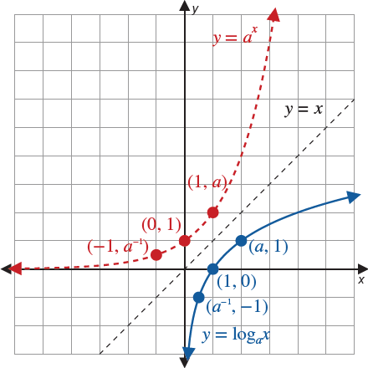
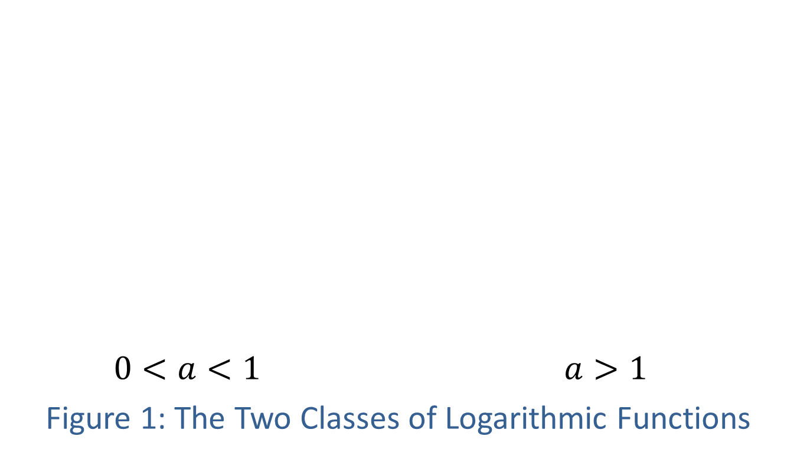
Graphing Logarithmic Functions
$0<a<1$ $a>1$
Figure 1: The Two Classes of Logarithmic Functions

Slide 11
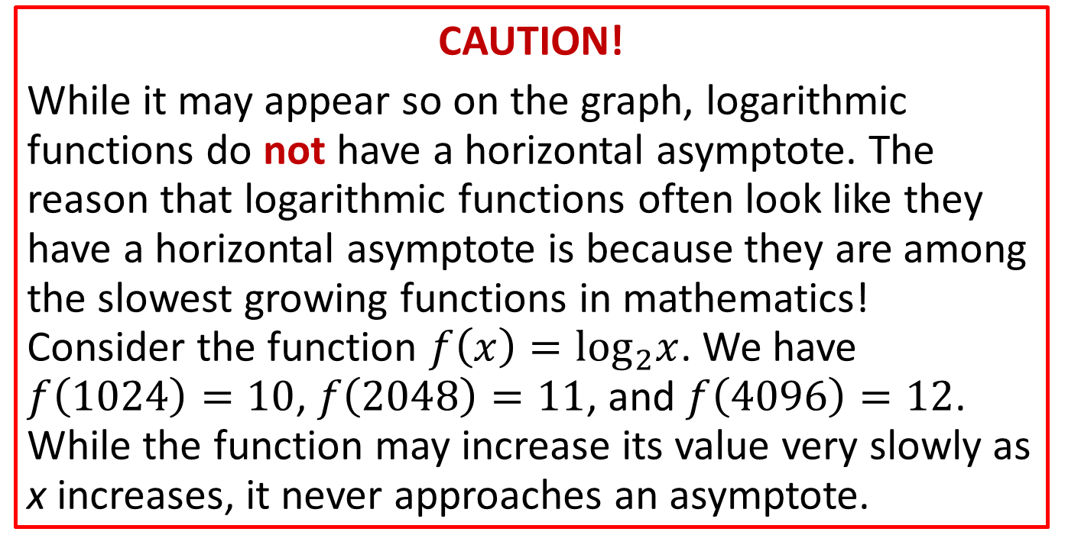
Graphing Logarithmic Functions
CAUTION!
While it may appear so on the graph, logarithmic functions do not have a horizontal asymptote. The reason that logarithmic functions often look like they have a horizontal asymptote is because they are among the slowest growing functions in mathematics! Consider the function $f\left(x\right)=\log_{2}x$. We have $f\left(1024\right)=10$, $f\left(2048\right)=11$, and $f\left(4096\right)=12$. While the function may increase its value very slowly as x increases, it never approaches an asymptote.

Slide 12
Example 2: Graphing Logarithmic Functions
Sketch the graphs of the following functions.

Slide 13
Note
Once again, plotting a few key points will provide a good idea of the shape of the function.

Slide 14
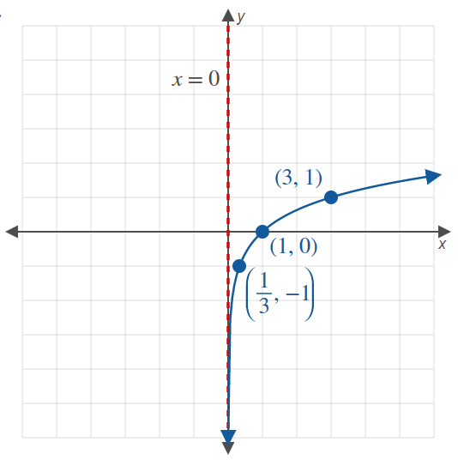
Example 2: Graphing Logarithmic Functions (cont.)
Solution
a.

Slide 15
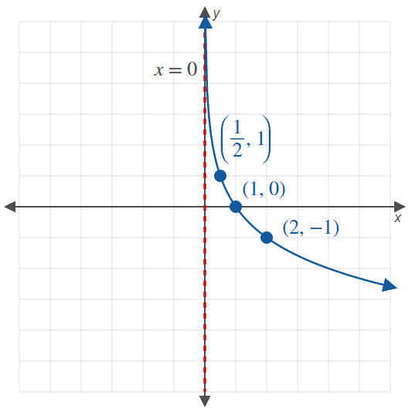
Example 2: Graphing Logarithmic Functions (cont.)
b.

Slide 16
Example 3: Graphing Logarithmic Functions
Sketch the graphs of the following functions.

Slide 17
Note
Begin by graphing the base function, then apply any transformations.

Slide 18
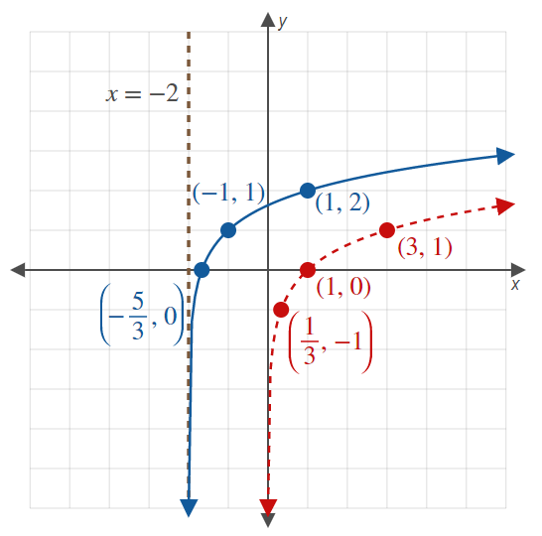

Example 3: Graphing Logarithmic Functions (cont.)
Solution
a.
Begin by graphing the base function, which is $\log_{3}x$. This is shown as a dashed curve.
Since $x$ has been replaced by $x+2$, we shift the graph 2 units to the left.
To find the graph of f, we shift the result up 1 unit, since 1 has been added to the function. This graph is the solid curve.
Note that the asymptote has also shifted to the left.

Slide 19
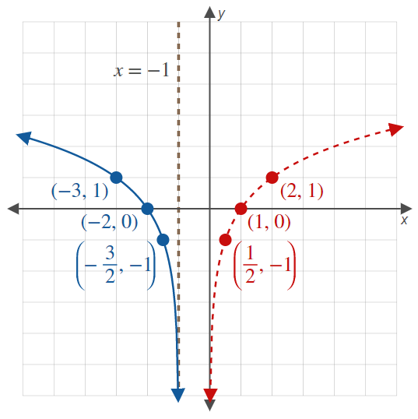

Example 3: Graphing Logarithmic Functions (cont.)
b.
The basic shape of the graph of g is the same as the shape of ${y=log}_{2}x$, the dashed curve.
To obtain g from $\log_{2}x$, the variable $x$ is replaced with $x−1$, which shifts the graph 1 unit to the right, and then $x$ is replaced by $−x$, which reflects the graph with respect to the $y$-axis.

Slide 20
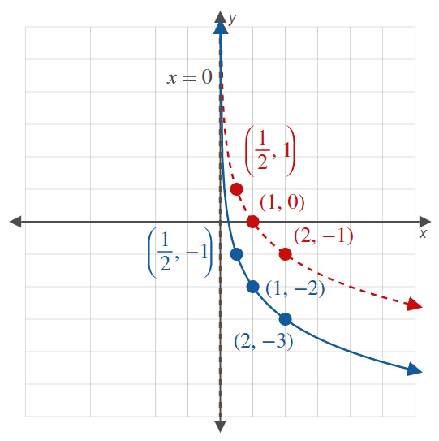
Example 3: Graphing Logarithmic Functions (cont.)
c.
We begin with the dashed curve, which is the graph of
We then shift the graph 2 units down to obtain the graph of the function h.

Slide 21
Example 4: Logarithmic Expressions
Evaluate the following logarithmic expressions.

Slide 22
Note
We write each of the equivalent exponential equations as a reference.

Slide 23

Example 4: Logarithmic Expressions (cont.)
Solution
Rewrite 25 as a power of 5.
Rewrite 2 as a power of $\frac{1}{2}$.
Rewrite the radical as a rational exponent.

Slide 24

Example 4: Logarithmic Expressions (cont.)
Rewrite 4 as a power of 16.
Rewrite $\frac{1}{100}$ as a power of 10.

Slide 25
Example 5: Solving Logarithmic Equations
Solve the following equations involving logarithms.

Slide 26
Example 5: Solving Logarithmic Equations (cont.)
Solution
Convert the equation to exponential form.
Simplify the exponent, then solve for x.

Slide 27
Example 5: Solving Logarithmic Equations (cont.)
This time, we convert from the exponential form to the logarithmic form.
We can equate the bases, just like we equate the exponents in an elementary exponential equation.

Slide 28
Example 5: Solving Logarithmic Equations (cont.)
Rewrite the equation in exponential form.
Rewrite 8 as a power of 2.
Simplify using properties of exponents.
Set the exponents equal to each other, then solve.

Slide 29
Common and Natural Logarithms
Definition
The function log₁₀ x is called the common logarithm, and is usually written log x.
The function log_{e} x is called the natural logarithm, and is usually written ln x.

Slide 30
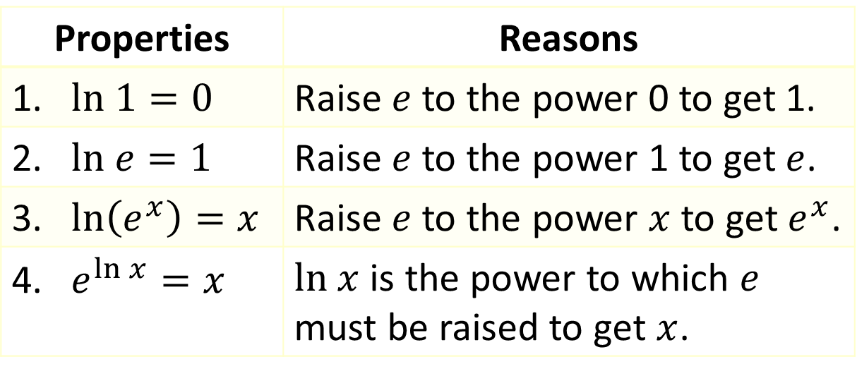

Common and Natural Logarithms
Properties of Natural Logarithms
$$ln x=y \text{⇔} e^{y}=x$$
Properties | Reasons
1. $ln 1=0$ | Raise $e$ to the power 0 to get 1.
2. $ln e=1$ | Raise $e$ to the power 1 to get $e$.
3. $ln\left(e^{x}\right)=x$ | Raise $e$ to the power $x$ to get $e^{x}$.
4. $e^{ln x}=x$ | $ln x$ is the power to which $e$ must be raised to get $x$.

Slide 31
Example 6: Evaluating Logarithmic Expressions
Evaluate the following logarithmic expressions.

Slide 32
Example 6: Evaluating Logarithmic Expressions (cont.)
Solution
No calculator is necessary for this problem, just an application of an elementary property of logarithms.
Again, no calculator is required.

Slide 33
Example 6: Evaluating Logarithmic Expressions (cont.)
This time, a calculator is needed, and only an approximate answer can be given. Be sure to use the correct logarithm.
Again, we must use a calculator, though we can say beforehand that the answer should be only slightly larger than 1, as
log 10 = 1 and 10.5 is only slightly larger than 10.

