Slide 1
Section 4.4
Applications of Logarithmic Functions

Slide 2
Example 1: Continuously Compounded Interest
Anne reads an ad in the paper for a new bank in town. The bank is advertising “continuously compounded savings accounts” in an attempt to attract customers, but fails to mention the annual interest rate. Curious, she goes to the bank and is told by an account agent that if she were to invest $10,000 in an account, her money would grow to $10,202.01 in one year’s time. But, strangely, the agent also refuses to divulge the yearly interest rate. What rate is the bank offering?

Slide 3
Example 1: Continuously Compounded Interest (cont.)
Solution
We need to solve the equation A = Pe^{rt} for r, given that A = 10,202.01, P = 10,000, and t = 1.
Note that we use the natural logarithm since the base of the exponential function is e. While we must use a calculator, we can now solve the equation for r.
Substitute the given values.
Divide both sides by 10,000.
Convert to logarithmic form.
Evaluate using a calculator.

Slide 4
Example 2: Solving Exponential Equations
Solve the equation 2^{x} = 9.
Solution
We convert the equation to logarithmic form to obtain the solution x = log₂ 9. Unfortunately, this answer still doesn’t tell us anything about x in decimal form, other than that it is bound to be slightly more than 3. Further, we can’t use a calculator to evaluate log₂ 9 since the base is neither 10 nor e.

Slide 5
Properties of Logarithms
Properties of Logarithms
Let a (the logarithmic base) be a positive real number not equal to 1, let x and y be positive real numbers, and let r be any real number.
1. (“the log of a product is the sum of the logs”)
2. (“the log of a quotient is
the difference of the logs”)

Slide 6
Properties of Logarithms
Properties of Logarithms (cont.)
3. (“the log of something raised to a power is the power times the log”)

Slide 7
Properties of Logarithms
CAUTION!
Errors in working with logarithms often arise from incorrect recall of the logarithmic properties. The following list highlights some common mistakes.

Slide 8
Properties of Logarithms
Incorrect Statements | Correct Statements

Slide 9
Example 3: Expanding Logarithmic Expressions
Use the properties of logarithms to expand the following expressions as much as possible (that is, decompose the expressions into sums or differences of the simplest possible terms).

Slide 10
Note
As long as the base is the same for each term, its value does not affect the use of the properties.

Slide 11
Example 3: Expanding Logarithmic Expressions (cont.)
Solution
Use the first property to rewrite the expression as three terms.
We can evaluate the first term and rewrite the second and third terms using the third property.

Slide 12
Example 3: Expanding Logarithmic Expressions (cont.)
Rewrite the radical as an exponent.
Bring the exponent in front of the logarithm using the third property. Expand the expression using the first two properties.
Apply the third property to the terms that result.

Slide 13
Example 3: Expanding Logarithmic Expressions (cont.)
Recall that if a base is not explicitly written, it is assumed to be 10. It is appropriate to either evaluate log(2.7) or leave it in exact form. Use the context of the problem to decide which form is more convenient.
Expand using the first and second properties.
Evaluate the first two terms and use the third property on the last term.

Slide 14
Example 4: Condensing Logarithmic Expressions
Use the properties of logarithms to condense the following expressions as much as possible (that is, rewrite each expression as a sum or difference of as few logarithms as possible).

Slide 15
Note
Often, there will be multiple orders in which we can apply the properties to find the final result.

Slide 16
Example 4: Condensing Logarithmic Expressions (cont.)
Solution
Use the third property to make the coefficients appear as exponents.
Evaluate the exponents.
Combine terms using the first property.

Slide 17
Example 4: Condensing Logarithmic Expressions (cont.)
Rewrite each term to have a coefficient of 1 or −1 using the third property.
We can then combine the terms using the second property.
The final answer can be written in several different ways, two of which are shown.

Slide 18
Example 4: Condensing Logarithmic Expressions (cont.)
Rewrite the coefficient as an exponent, then combine terms.

Slide 19
The Change of Base Formula
Change of Base Formula
Let a and b both be positive real numbers, neither of them equal to 1, and let x be a positive real number. Then

Slide 20
Example 5: Change of Base Formula
Evaluate the following logarithmic expressions, using the base of your choice.

Slide 21
Note
Both the common and natural logarithms work in solving these problems.

Slide 22
Example 5: Change of Base Formula (cont.)
Solution
Apply the change of base formula.
Evaluate using a calculator.
Apply the change of base formula. This time we use the common logarithm.
Since the base of the logarithm is a fraction, we should expect a negative answer.

Slide 23
Example 5: Change of Base Formula (cont.)
Although a base of is not often encountered, the original expression is legitimate, and the change of base formula allows us to evaluate it.

Slide 24
The pH Scale
In chemistry, the concentration of hydronium ions in a solution determines its acidity. Since concentrations are small numbers that vary over many orders of magnitude, it is convenient to express acidity in terms of the pH scale, as follows.
The pH of a solution is defined to be −log[H₃O⁺], where [H₃O⁺] is the concentration of hydronium ions in units of moles/liter. Solutions with a pH less than 7 are said to be acidic, while those with a pH greater than 7 are basic.

Slide 25
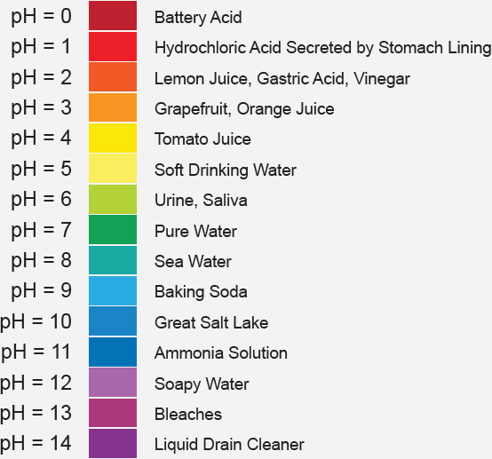
The pH Scale
Figure 1: pH of Common Substances

Slide 26
Example 6: The pH Scale
If a sample of orange juice is determined to have a [H₃O⁺] concentration of 1.58 × 10⁻⁴ moles / liter, what is its pH?

Slide 27
Example 6: The pH Scale (cont.)
Solution
Applying the formula pH = −log[H₃O⁺], we can find the pH of the sample as follows.
After doing this calculation, the reason for the minus sign in the formula is more apparent. By multiplying the log of the concentration by −1, the pH of a solution is necessarily positive, and convenient for comparative purposes.

Slide 28
The Richter Scale
Definition
Earthquake intensity is measured on the Richter scale (named for the American seismologist Charles Richter, 1900−1985). In the original formula that follows, I₀ is the intensity of a just-discernible earthquake, I is the intensity of an earthquake being analyzed, and R is its ranking on the Richter scale.

Slide 29
The Richter Scale
Definition (cont.)
By this measure, earthquakes range from a classification of minor (R < 4), to light (4 ≤ R < 5), to moderate (5 ≤ R < 6), to strong (6 ≤ R < 7), to major (7 ≤ R < 8), to great (8 ≤ R).

Slide 30
The Richter Scale
The base 10 logarithm means that every increase of 1 unit on the Richter scale corresponds to an increase by a factor of 10 in the intensity. This is a characteristic of all logarithmic scales. Also, note that a barely discernible earthquake has a rank of 0, since log 1 = 0.

Slide 31
Example 7: The Richter Scale
The January 2001 earthquake in the state of Gujarat in India was 7,940,000 times as intense as a 0-level earthquake. What was the Richter ranking of this devastating event?

Slide 32
Example 7: The Richter Scale (cont.)
Solution
If we let I denote the intensity of the Gujarat earthquake, then I = 7,940,000l₀, so
The Gujarat earthquake thus fell in the category of strong on the Richter scale.

Slide 33
The Decibel Scale
Definition
In the decibel scale, I₀ is the intensity of a just-discernible sound, I is the intensity of the sound being analyzed, and D is its decibel level.

Slide 34
The Decibel Scale
Definition (cont.)
Decibel levels range from 0 for a barely discernible sound, to 60 for the level of normal conversation, to 80 for heavy traffic, to 120 for a loud rock concert, and finally (as far as humans are concerned) to around 160, at which point the eardrum is likely to rupture.

Slide 35
Example 8: The Decibel Scale
Given that I₀ = 10⁻¹² watts /meter², what is the decibel level of a jet airliner’s engines at a distance of 45 meters, for which the sound intensity is 50 watts /meter²?

Slide 36
Example 8: The Decibel Scale (cont.)
Solution
In other words, the sound level would probably not be literally earsplitting, but it would be very painful.

