Slide 1
Section 5.4
Borrowing Money

Slide 2
Objectives
Calculate credit card payments.
Calculate interest paid on a loan.
Calculate monthly payments.
Calculate the total amount paid on a loan.
Calculate time needed to pay off debt.

Slide 3
Borrowing Money
Good financial habits, such as creating a budget and saving for the future, are key to staying financially healthy. However, even with the best budgeting skills, sometimes we must borrow money in order to make larger purchases, such as a car or house, or bridge the gap when emergencies arise.

Slide 4
Grace Period
Grace Period
A grace period is a period of time in which no interest accrues on a debt.

Slide 5
Minimum Payment
Minimum Payment
The minimum payment is the minimum amount the lender requires you to pay each month. This amount is typically equal to a percentage of the total balance.

Slide 6
Number of Fixed Payments Required to Pay Off Credit Card Debt
Number of Fixed Payments Required to Pay Off Credit Card Debt
The number of fixed payments R required to pay off a credit card debt is calculated with the formula

Slide 7
Number of Fixed Payments Required to Pay Off Credit Card Debt
Number of Fixed Payments Required to Pay Off Credit Card Debt (cont.)
where n is the number of payments made per year for a loan of amount A, with interest rate r and monthly payment PMT.

Slide 8
Example 1: Paying Off Credit Card Debt with a Fixed Payment
Assume you want to buy a new computer that costs $2200 using a credit card that has an APR of 19.99%.
a. How long will it take you to pay off the computer if you make regular monthly payments of $40?
b. How much will you pay in the long run for the computer if you make monthly payments of $40?
c. How long will it take you to pay off the computer if you make regular monthly payments of $80?
d. How much will you pay in the long run for the computer if you make monthly payments of $80?

Slide 9
Example 1: Paying Off Credit Card Debt with a Fixed Payment (cont.)
Solution
a. We wish to find the number of fixed payments required to pay off a credit card debt. We are told that the debt is A = 2200 and the APR = 19.99%, so r = 0.1999. The monthly payment is PMT = 40 and n = 12. Substituting these values into the formula, we have the following.

Slide 10
Example 1: Paying Off Credit Card Debt with a Fixed Payment (cont.)
Therefore, it will take approximately 150 monthly payments, or years, to payoff the debt.

Slide 11
Example 1: Paying Off Credit Card Debt with a Fixed Payment (cont.)
b. If we make 150 payments at $40 each, then over years we will have paid a total of
150 ⋅ $40 = $6000.
As you might imagine, the computer would be considerably out of date in 1 years, and you paid nearly triple the original price of the computer. This is not a wise method for purchasing a computer.

Slide 12
Example 1: Paying Off Credit Card Debt with a Fixed Payment (cont.)
c. This time, we will double the monthly fixed payment so the PMT = 80. The remaining variables stay the same; that is, A = 2200, r = 0.1999, and n = 12. Using the formula, we have the following.
Therefore, it will take approximately 37 monthly payments, or just over three years, to pay off the debt.

Slide 13
Example 1: Paying Off Credit Card Debt with a Fixed Payment (cont.)
d. If we make 37 payments at $80 each, then over three years we will have paid a total of
37 ⋅ $80 = $2960.
This is a much more reasonable method for purchasing the computer. Although the computer still might be outdated in three years, it will probably still be functionally acceptable.

Slide 14
Fixed Installment Loans
Fixed Installment Loans
Fixed installment loans have a fixed interest rate and are paid off with monthly payments over a specified amount of time.

Slide 15
Down Payment
Down Payment
A down payment is a cash payment made up front towards the total purchase price of the goods or service.

Slide 16
Monthly Payment Formula for Fixed Installment Loans
Monthly Payment Formula for Fixed Installment Loans
The amount of a monthly payment (PMT) on a fixed installment loan is calculated with the formula
where P is the principal amount of money borrowed, r is the APR, n is the number of payments per year, and t is the number of years of the loan.

Slide 17
Example 2: Purchasing a New Car
Kelly wishes to purchase a new car. The car she has chosen has a price of $34,000, including taxes and fees. She chooses to make a down payment of 20% of the price and wants to finance the remainder. If Kelly has acquired an APR of 3.99% for a 72-month loan, what is the amount of her monthly payment?

Slide 18
Example 2: Purchasing a New Car (cont.)
Solution
First we need to know the amount of the down payment Kelly will pay up front. We can find 20% of $34,000 by multiplying the two together. Remember to change the percentage to a decimal in order to multiply.
down payment = 0.20 ⋅ $34000 = $6800

Slide 19
Example 2: Purchasing a New Car (cont.)
Therefore, Kelly will need to finance the remainder, found by subtracting the down payment from the original price of the car.
principal to finance = $34,000 − $6800 = $27,200
Now we have that Kelly will borrow P = 27,200 for t = 6 years with an APR of 3.99%, so r = 0.0399. Substituting into the formula for fixed installment loans, we can calculate what Kelly’s monthly payment will be.

Slide 20
Example 2: Purchasing a New Car (cont.)
So Kelly’s monthly payment for her new car would be $425.43.

Slide 21
Skill Check #1
Skill Check #1
Jeff wants to buy a new truck that costs $48,000. After a down payment of $10,000 he finances $38,000. If Jeff has an APR of 5% for a 48-month loan, what is Jeff’s monthly payment?
Answer: $875.11

Slide 22
Example 3: Determining Best New Car Incentive
Dean gets to choose from one of the new car incentives when he purchases his car next week. He can either choose 0.9% APR financing for 60 months or $1500 cash back with a 3.75% APR over 48 months. Compare the two incentives that Dean has to choose from if the new car he wishes to buy is $27,465 and he has saved a down payment of $5000.

Slide 23
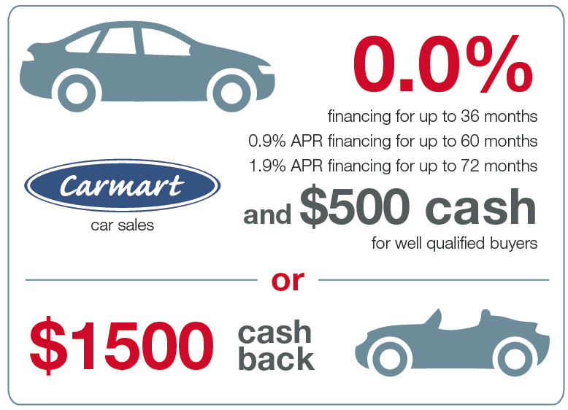
Example 3: Determining Best New Car Incentive (cont.)

Slide 24
Example 3: Determining Best New Car Incentive (cont.)
Solution
Let Option A be the 0.9% APR financing for 60 months and Option B will be $1500 cash back with a 3.75% APR over 48 months.
Option A: For this option, the principal to be financed is
principal to be financed = $27,465 − $5000 = $22,465.

Slide 25
Example 3: Determining Best New Car Incentive (cont.)
In addition, r = 0.009 and t = 60 ÷ 12 = 5. The payments each month are calculated as follows.

Slide 26
Example 3: Determining Best New Car Incentive (cont.)
Dean would have a monthly payment of $383.04 for 60 months with Option A. His total cost for the car would be
$383.04 ⋅ 60 + $5,000 = $27,982.40.
Option B: For this option the APR is considerably more at 3.75%, but Dean can use the $1500 cash back to add to his down payment so that he has less to finance. Therefore, he will only need to finance
$27,465 − $5000 − $1500 = $20,965.

Slide 27
Example 3: Determining Best New Car Incentive (cont.)
For this option r = 0.0375 and the length of time is now t = 48 ÷ 12 = 4. So the payments each month will be the following.

Slide 28
Example 3: Determining Best New Car Incentive (cont.)
Therefore, Dean’s payments for Option B will be $471.03 for 48 months. His total cost for the car would be
$471.03 ⋅ 48 + $5,000 = $27,609.44.
Now that the calculations for both options have been done, you can see that Dean will pay less overall if he uses Option B. Note that the difference is about $400 between the two options. There are other factors that might sway Dean’s decision.

Slide 29
Example 3: Determining Best New Car Incentive (cont.)
First, Option B only saves him money if he is disciplined and puts the cash back that he received towards the purchase of the car. However, the car is completely paid off an entire year earlier with this option. Dean will also need to consider which monthly payment option he can afford. Option A has the lower monthly payment. Now that Dean understands the outcomes of total cost based on length of the loan and interest rate, he can use his knowledge of budgeting and financial decision-making to choose the best option for his financial situation.

Slide 30
Example 4: Calculating Monthly Mortgage Payments
William and Helen are preparing to buy a new home in the Midwestern United States. They have saved $21,300 for a down payment. The total price of the house is $131,800, including taxes and fees. Find their monthly mortgage payment if the fixed interest rate is 3.52% for a 30-year loan.

Slide 31
Example 4: Calculating Monthly Mortgage Payments (cont.)
Solution
Since William and Helen have a down payment, we can subtract that from the purchase price to find the amount they will need to finance to buy the home.
principal amount to finance = $131,800 − $21,300
= $110,500
We are told that the APR = 3.52%, so r = 0.0352 and t = 30 years. Using the payment formula for fixed installment loans we can calculate their monthly mortgage payment.

Slide 32
Example 4: Calculating Monthly Mortgage Payments (cont.)
Therefore, William and Helen will have a monthly mortgage of $497.43.

Slide 33
Maximum Purchase Price Formula
Maximum Purchase Price Formula
The maximum purchase price for a house can be found by
where PMT is the monthly mortgage payment you wish to make, r is the APR, n is the number of payments per year, and t is the number of years of the loan.

Slide 34
Example 5: How Much House Can You Afford?
Suppose you have recently graduated from college and want to purchase a house. Your take-home pay is $3220 per month and you wish to stay within the recommended guidelines for mortgage amounts by
only spending of your take-home pay on a house
payment. You have $15,300 saved for a down payment. With your good credit and the down payment you can get an APR from your bank of 3.37% compounded monthly.

Slide 35
Example 5: How Much House Can You Afford? (cont.)
a. What is the total cost of a house you could afford with a 15-year mortgage?
b. What is the most that you could afford with a traditional 30-year mortgage instead of a 15-year?
Solution
a. The first thing to do is to calculate the size of the monthly mortgage payment you are willing to spend. Since you have $3220 per month in take-home pay, multiply this by 25% to find your maximum monthly payment.
advised monthly payment = $3220 ⋅ 0.25 = $805

Slide 36
Example 5: How Much House Can You Afford? (cont.)
We know that r = 0.0337 and that because this is a 15-year mortgage, n = 12 and t = 15. Substituting these values in the formula, we have the following.

Slide 37
Example 5: How Much House Can You Afford? (cont.)
So, you could afford a 15-year mortgage of approximately $113,617.82.
Remember that the amount of down payment you have available will add to the maximum amount you can spend on a house. Therefore, with a 15-year mortgage you can afford to buy a house with a maximum price of
$113,617.82 + $15,300 = $128,917.82.

Slide 38
Example 5: How Much House Can You Afford? (cont.)
b. For a 30-year mortgage, the only thing that changes is t. Now t = 30. The monthly payment you can afford stays the same, as well as the interest rate and n. Therefore, we have the following.

Slide 39
Example 5: How Much House Can You Afford? (cont.)
By this calculation, you should be able to afford a house that costs approximately $182,200 plus your down payment.
With the down payment added in, your total purchase price with a 30-year mortgage could be as much as
$182,200 + $15,300 = $197,500.

Slide 40
Example 5: How Much House Can You Afford? (cont.)
This amount is considerably more than the 15-year mortgage, but remember that you will incur much more interest over the 30 years as well. In addition, we assumed that you could get the same interest rates for both time periods, but in reality, the 30-year mortgage would probably have a higher interest rate as well.

Slide 41
Good Financial Habits
Make a budget.
Control impulse spending.
Have an emergency fund.
Be a smart consumer.
Monitor your accounts and pay your bills on time.
Ask questions.

