Slide 1
Section 6.1
Solving Systems of Linear Equations by Substitution and Elimination

Slide 2
Solutions to Linear Systems of Equations
Definition
• A linear system of equations with no solution is called inconsistent.
• A linear system of equations that has at least one solution is called consistent.
Any linear system with more than one solution must have an infinite number of solutions and is called dependent.

Slide 3
Example 1: Solving a System of Equations by Substitution
Use the method of substitution to solve the system

Slide 4
Note
Solving for a variable with a coefficient of 1 will make the process of substitution a bit easier.

Slide 5
Example 1: Solving a System of Equations by Substitution (cont.)
Solution
Either equation can be solved for either variable, and the choice doesn’t affect the final answer. We will solve the second equation for x, and then substitute the result in the first equation in the variable y. Once we have solved for y, we can substitute the value of y into either the original equation to find x.

Slide 6
Example 1: Solving a System of Equations by Substitution (cont.)
We then substitute our answer for y into the original second equation.
Thus, the solution to the system of equations is (2,3).

Slide 7
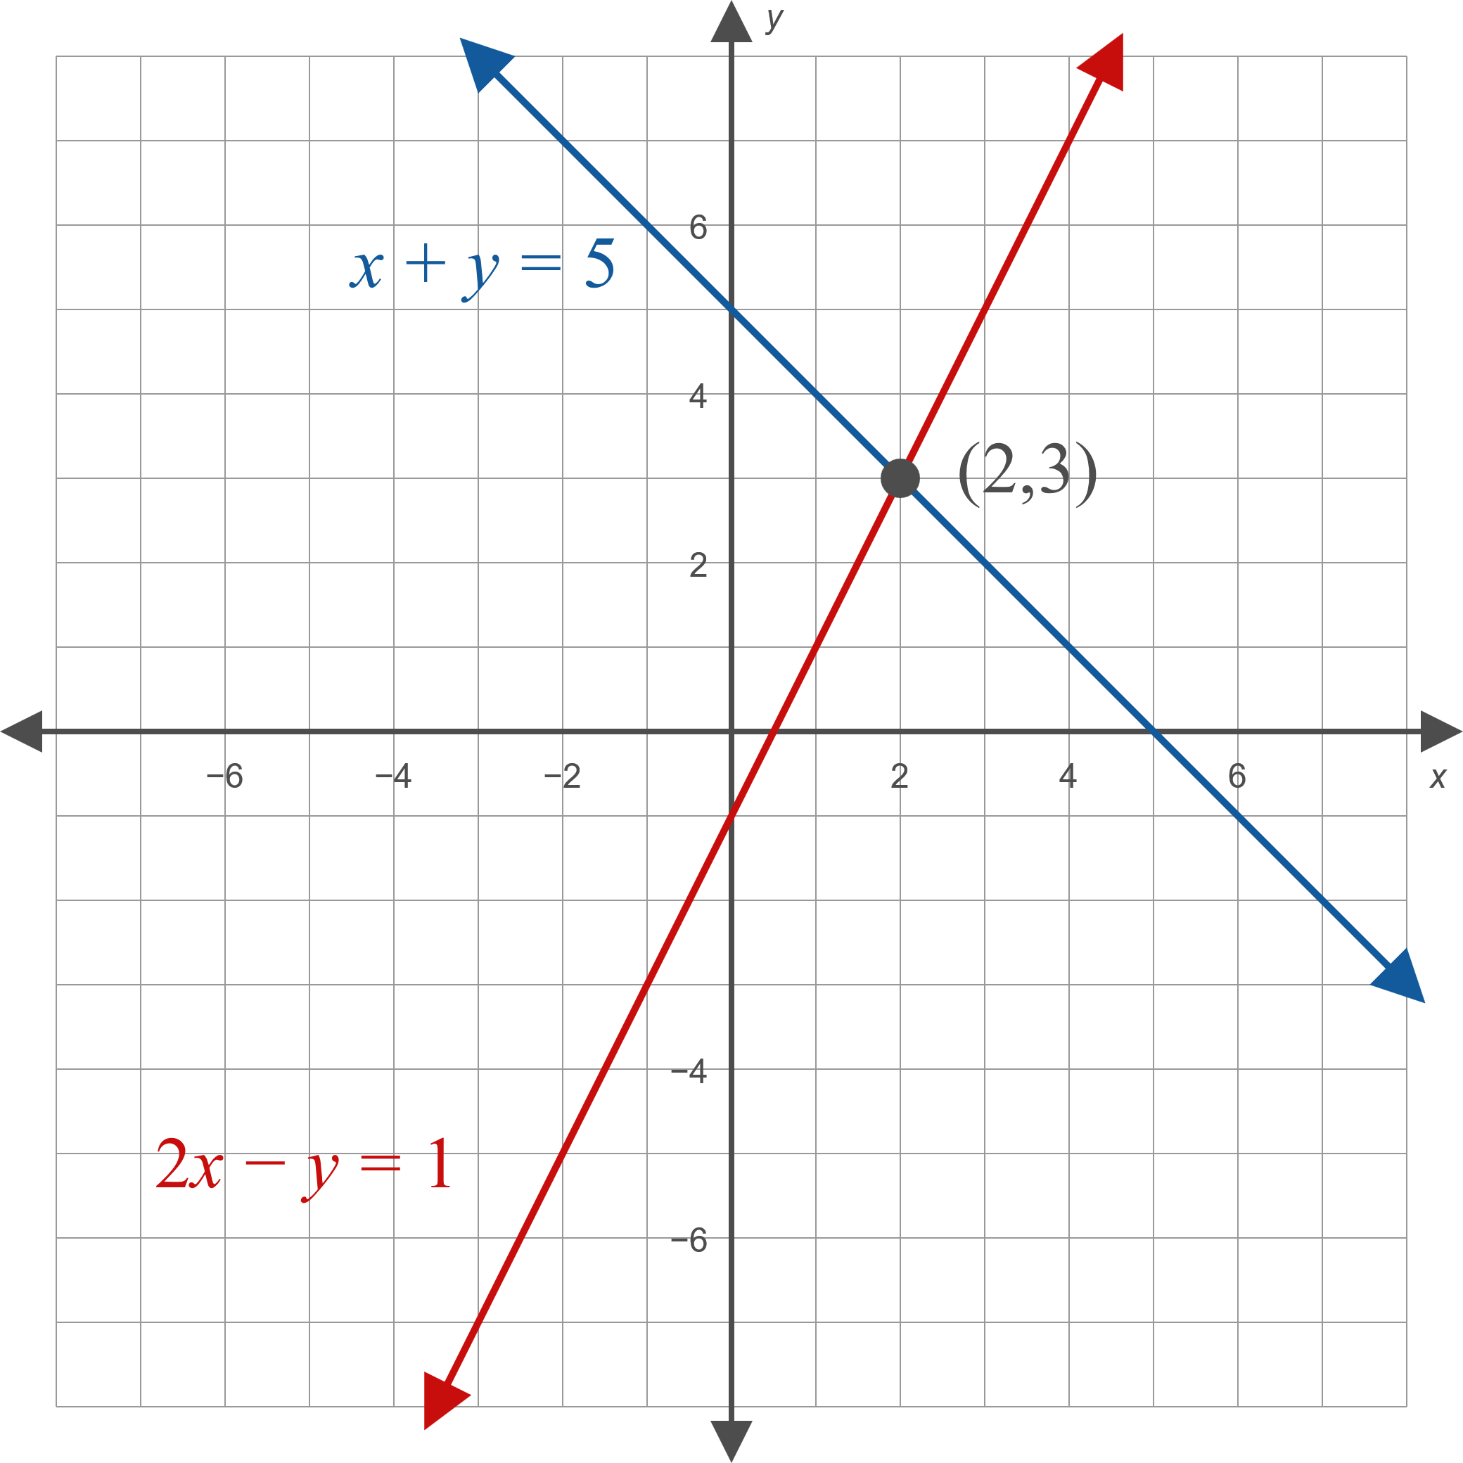
Example 1: Solving a System of Equations by Substitution (cont.)
Note how the graph corresponds to the system and the ordered pair solution that we have found.

Slide 8
Example 2: Solving a System of Equations by Substitution
Use the method of substitution to solve the system

Slide 9
Example 2: Solving a System of Equations by Substitution (cont.)
Solution

Slide 10
Example 2: Solving a System of Equations by Substitution (cont.)
The resulting equation is always true. This means that for any value of y, letting x = 3y − 3 results in an ordered pair (x, y) = (3y − 3, y) that solves both equations. Since there are an infinite number of solutions, the system is dependent.
Graphically, this means the graphs of the two equations are exactly the same. In fact, the first equation is simply a rearranged multiple of the second equation.

Slide 11
Example 2: Solving a System of Equations by Substitution (cont.)
Algebraically, we can describe the solution set as
. If we had solved either equation for y instead of x, we would have obtained the alternative
but equivalent solution
ℝ
ℝ

Slide 12
Example 3: Solving a System of Equations by Elimination
Use the method of elimination to solve the system

Slide 13
Example 3: Solving a System of Equations by Elimination (cont.)
Solution
The coefficient of y in the second equation in −6, while the coefficient of y in the first equation is 3. This means that if we multiply all the terms in the first equation by 2, the coefficients of y will be negatives of one another, so adding the two equations will eliminate the y variable.
In order to keep track of these steps, we annotate our work with labeled arrows. When we modify the system, we are not changing the solutions, we are just writing an equivalent system that is easier to solve. The ultimate goal is to rewrite the system so that we can “read off” the answer.

Slide 14
Example 3: Solving a System of Equations by Elimination (cont.)
The notation above the arrow indicates that we have modified the system by multiplying each term in equation 1 by the constant 2.

Slide 15
Example 3: Solving a System of Equations by Elimination (cont.)
We can then substitute into either of the original equations to determine y. Here, we substitute in the first equation of the original system.
The ordered pair (−2, 1) is thus the solution of the system. Note that using the second equation gives the same y‐value and is a good way to check our work.

Slide 16
Example 4: Solving a System of Equations by Elimination
Use the method of elimination to solve the system

Slide 17
Example 4: Solving a System of Equations by Elimination (cont.)
Solution
Eliminate the variable x by multiplying both equations by a constant:
Although the intent was to obtain coefficients of x that were negatives of one another, we have achieved the same thing for y.

Slide 18
Example 4: Solving a System of Equations by Elimination (cont.)
When we add the equations, the result is 0 = − 1, a false statement. This means that no ordered pair solves both equations, and the system is inconsistent. Graphically, the two lines defined by the equations are parallel.

Slide 19
Example 5: Solving a System of Equations by Elimination
Solve the system

Slide 20
Example 5: Solving a System of Equations by Elimination (cont.)
Solution
We will follow the same type of approach we used in Example 4. If we add the first equation to the second equation or the third equation, we will eliminate z, resulting in a two equation system in the variables x and y.

Slide 21
EXAMPLE 5: Solving a System of Equations by Elimination (cont.)
Equation 1:
Equation 2:
Equation 1:
Equation 3:

Slide 22
EXAMPLE 5: Solving a System of Equations by Elimination (cont.)
Putting these two equations together, we have the system
We use elimination once more, multiplying the second equation by 4 to eliminate x.

Slide 23
EXAMPLE 5: Solving a System of Equations by Elimination (cont.)
Now that we have solved for y, we can plug this back into one of the equations from the two variable system to solve for x.

Slide 24
EXAMPLE 5: Solving a System of Equations by Elimination (cont.)
Finally, we substitute both x and y into one of the equations from the original system.
Thus, the solution to the system of equations is the ordered triple (−2,3,7).

Slide 25
Example 6: Solving a System of Equations by Elimination
Solve the system

Slide 26
Example 6: Solving a System of Equations by Elimination (cont.)
Solution
In general, a good approach to solving a large system of equations is to try to eliminate a variable and obtain a smaller system.
There are many possible ways to proceed. One option is to use the second equation (or a multiple of it) to eliminate x when we add it to the first and third equations. The result will be a two equation system in the variables y and z.

Slide 27
Example 6: Solving a System of Equations by Elimination (cont.)
Equation 1:
Equation 2:
Equation 2:
Equation 3:

Slide 28
Example 6: Solving a System of Equations by Elimination (cont.)
The two resulting equations are identical, and tell us that y = 8z − 31. We can now use any equation that contains x to determine the relation between x and z. For instance, the third equation in the system tells us that
x = y + 5z − 24,
or

Slide 29
Example 6: Solving a System of Equations by Elimination (cont.)
One description of the solution set is thus
Geometrically, the three planes described by the equations of the system intersect in a line.
ℝ

Slide 30
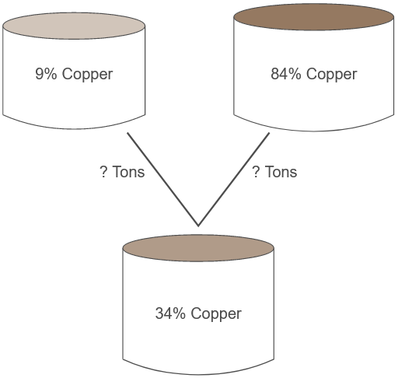
Example 7: Mixing Alloys
A foundry needs to produce 75 tons of an alloy that is 34% copper. It has supplies of 9% copper alloy and 84% copper alloy. How many tons of each must be mixed to obtain the desired result?

Slide 31
Example 7: Mixing Alloys (cont.)
Solution
Let x represent the number of tons of 9% copper alloy needed, and y the number of tons of 84% copper alloy needed. We have two variables, so we will need two equations to find the solution.

Slide 32
Example 7: Mixing Alloys (cont.)
Since we need 75 total tons of alloy, one equation is
x + y = 75. We also know that 9% of the x tons and 84% of the y tons represent the total amount of copper, and this amount must equal 34% of 75 tons. The second equation is thus 0.09x + 0.84y = 0.34(75). This gives us a system that can be solved by elimination:

Slide 33
Example 7: Mixing Alloys (cont.)
Substituting back, we have x + 25 = 75, so x = 50. Thus, 50 tons of 9% alloy and 25 tons of 84% alloy are needed.

Slide 34
Example 8: Determining Ages
If the ages of three girls, Xenia, Yolanda, and Zsa Zsa, are added, the result is 30. The sum of Xenia’s and Yolanda’s ages is Zsa Zsa’s age, while Xenia’s age subtracted from Yolanda’s is half of Zsa Zsa’s age a year ago. How old is each girl?

Slide 35
Example 8: Determining Ages (cont.)
Solution
Let x, y, and z represent Xenia’s, Yolanda’s, and Zsa Zsa’s ages, respectively. The first sentence tells us that
x + y + z = 30, the second sentences tells us that
x + y = z, and that To make work easier, these equations can be rewritten as shown:

Slide 36
Example 8: Determining Ages (cont.)

Slide 37
Example 8: Determining Ages (cont.)
From this, we see that the sum of the first and second equations results in 2x + 2y = 30, or x + y = 15, and the sum of the first and third equations is −x + 3y = 29. The method of elimination is the best choice for solving the new system

Slide 38
Example 8: Determining Ages (cont.)
as the sum of the two equations gives us 4y = 44, or y = 11. With this knowledge, the first of the last two equations tells us x = 4, and then any equation that includes z can be used to determine that z = 15. If this solution is interpreted geometrically, it means that the ordered triple (4, 11, 15) lies on the three planes described by the three equations. In context, it means that Xenia is 4, Yolanda is 11, and Zsa Zsa is 15.

