Slide 1
Section 6.2
Matrix Notation and Gauss-Jordan Elimination

Slide 2
Linear Systems, Matrices, and
Augmented Matrices
Matrices and Matrix Notation
A matrix is a rectangular array of numbers, called elements or entries of the matrix. As the numbers are in a rectangular array, they naturally form rows and columns. It is often important to determine the size of a given matrix; we say that a matrix with m rows and n columns is an m × n matrix (read “m by n”), or of order m × n. By convention, the number of rows is always stated first.

Slide 3
Linear Systems, Matrices, and
Augmented Matrices
Matrices and Matrix Notation (cont.)
This matrix has 3 rows and 4 columns, so it is a 3 × 4 matrix.

Slide 4
Linear Systems, Matrices, and
Augmented Matrices
Matrices and Matrix Notation (cont.)
Matrices are often labeled with capital letters. The same letter in lower-case, with a pair of subscripts attached, is usually used to refer to its individual elements. For instance, if A is a matrix, a_{ij} refers to the element in the i^{th} row and the j^{th} column.
If we call the previous matrix A, then we have a₂₃ = −5 and a₃₂ = −7.

Slide 5
Example 1: Matrices and Matrix Notation
Given the matrix determine:
a. The order of A.
b. The value of a₁₃.
c. The value of a₂₁.

Slide 6
Example 1: Matrices and Matrix Notation (cont.)
Solution
a. A has 2 rows and 3 columns, and is thus a 2 × 3 matrix.
b. The value of the entry in the first row and third column is a₁₃ = 1.
c. The value of the entry in the second row and first column is a₂₁ = 5.

Slide 7
Linear Systems, Matrices, and
Augmented Matrices
Standard Form of a System of Linear Equations
A linear system of equations is in standard form when each equation has been simplified with its variables on the left-hand side and its constant term on the right-hand side. Each equation should have its variable terms listed in the same order.
For example, the system
is written in standard form as

Slide 8
Linear Systems, Matrices, and
Augmented Matrices
Augmented Matrices
Given a linear system of equations written in standard form, the augmented matrix of that system is a matrix consisting of the coefficients of the variables listed in their relative positions with an adjoined column of the constants of the system.

Slide 9
Linear Systems, Matrices, and
Augmented Matrices
Augmented Matrices (cont.)
The matrix of coefficients and the column of constants are customarily separated by a vertical bar.
For example, the augmented matrix for the system
The augmented matrix will have as many rows as there are equations in the system, and one more column than there are variables.

Slide 10
Example 2: Augmented Matrices
Construct the augmented matrix for the linear system

Slide 11
Example 2: Augmented Matrices
Solution
Write each equation in standard form, then read off the coefficients and constants to construct the augmented matrix.
Linear System | Standard Form | Augmented Matrix

Slide 12
Gaussian Elimination and Row Echelon Form
Row Echelon Form
A matrix is in row echelon form if:
1. The first nonzero entry in each row is 1. We call this a leading 1.
2. Every entry below a leading 1 is 0, and each leading 1 appears farther to the right than leading 1’s in the rows above it.
3. All rows consisting entirely of 0’s (if there are any) appear at the bottom.

Slide 13
EXAMPLE 3: Row Echelon Form
Determine if the following matrices are in row echelon form. If not, explain why not.

Slide 14
EXAMPLE 3: Row Echelon Form (cont.)
Solution
a. This matrix fails the first condition, as the first nonzero entry is not always 1.
b. This matrix meets each of the three conditions and is in row echelon form.

Slide 15
EXAMPLE 3: Row Echelon Form (cont.)
c. This matrix fails the second condition, as nonzero values are present beneath a leading 1.

Slide 16
EXAMPLE 3: Row Echelon Form (cont.)
d. This matrix fails the third condition, since there is a row of all zeros that lies above a row with nonzero entries.

Slide 17
Gaussian Elimination and Row Echelon Form
Elementary Row Operations
Let A be an augmented matrix corresponding to a given system of equations. Each of the following operations on A results in the augmented matrix of an equivalent system. In the notation, R_{i} refers to row i of the matrix A.
1. Rows i and j can be interchanged. (Denoted R_{i} ↔ R_{j})
2. Each entry in row i can be multiplied by a nonzero constant c. (Denoted cR_{i})

Slide 18
Gaussian Elimination and Row Echelon Form
Elementary Row Operations (cont.)
3. Row j can be replaced with the sum of itself and a constant multiple of row i. (Denoted cR_{i} + R_{j})
Typically, we write that an operation has been performed by connecting the original matrix to the new matrix with an arrow, writing the type of operation above it. For example, the matrix from Example 3d can be placed in row echelon form as follows.

Slide 19
Gaussian Elimination and Row Echelon Form
Elementary Row Operations (cont.)

Slide 20
EXAMPLE 4: Elementary Row Operations
Perform the indicated elementary row operation.

Slide 21
EXAMPLE 4: Elementary Row Operations (cont.)
Solution
The row operation indicates that we should add −5 times Row 1 to Row 2.

Slide 22
EXAMPLE 4: Elementary Row Operations (cont.)
Note that the first row now begins with 1 and the second row now begins with 0. The row operation has begun to change this matrix towards row echelon form.

Slide 23
Example 5: Gaussian Elimination
Use Gaussian elimination to solve the system

Slide 24
Example 5: Gaussian Elimination (cont.)
Solution
First, we read off the augmented matrix corresponding to this system.

Slide 25
Example 5: Gaussian Elimination (cont.)
Now, we transform it into row echelon form. It is usually easiest to work one column at a time. After getting a leading 1 in the first row, use row operations to obtains 0's below it. Repeat this process with each successive column.

Slide 26
Example 5: Gaussian Elimination (cont.)
Exchange Rows 1 and 2 to make 1 the first entry of the first row.

Slide 27
Example 5: Gaussian Elimination (cont.)
Add 2 times Row 1 to Row 2 to get a 0 as the first entry of Row 2.
Add −3 times Row 1 to Row 3 to get a 0 as the first entry of Row 3.

Slide 28
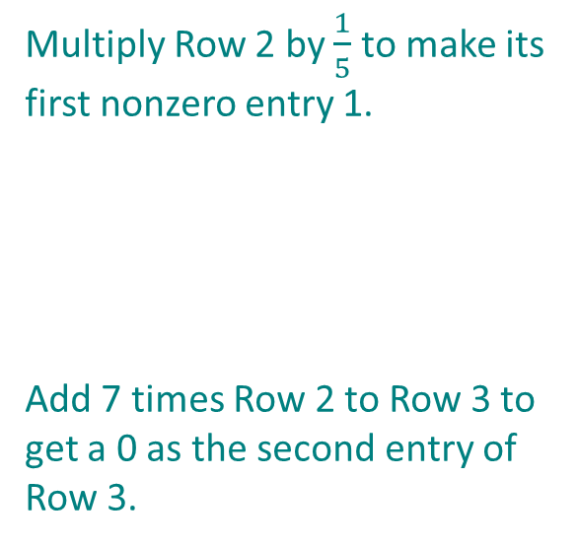
Example 5: Gaussian Elimination (cont.)
Multiply Row 2 by $\frac{1}{5}$ to make its first nonzero entry 1.
Add 7 times Row 2 to Row 3 to get a 0 as the second entry of Row 3.

Slide 29

Example 5: Gaussian Elimination (cont.)
Multiply Row 3 by $−\frac{5}{24}$ to make its first nonzero entry a 1.

Slide 30
Example 5: Gaussian Elimination (cont.)
The third row in the last matrix tells us that z = 1. When we back-substitute this in the second row, we obtain
so y = −3. From the first row, then, we obtain
or x = −1. Thus the ordered triple (−1, −3, 1) solves the system of equations.

Slide 31
Gauss-Jordan Elimination and Reduced Row Echelon Form
Reduced Row Echelon Form
A matrix is said to be in reduced row echelon form if:
1. It is in row echelon form.
2. Each entry above a leading 1 is also 0.

Slide 32
Example 6: Reduced Row Echelon Form
Use Gauss-Jordan elimination to solve the system

Slide 33
Example 6: Reduced Row Echelon Form (cont.)
Solution

Slide 34
Example 6: Reduced Row Echelon Form (cont.)
Note that the row of 0’s at the bottom corresponds to the true statement 0 = 0, indicating that this system has an infinite number of solutions. In order to describe the solution set algebraically, we continue the row operations until the matrix is in reduced row echelon form.

Slide 35
Example 6: Reduced Row Echelon Form (cont.)

Slide 36
Example 6: Reduced Row Echelon Form (cont.)
The last matrix is in reduced row echelon form, as every leading 1 has 0’s both below and above it. The corresponding system of equations is
Thus, we can describe the solution set as
, which is equivalent to
ℝ

