Slide 1
Section 6.6
Leontief Input-Output Analysis

Slide 2
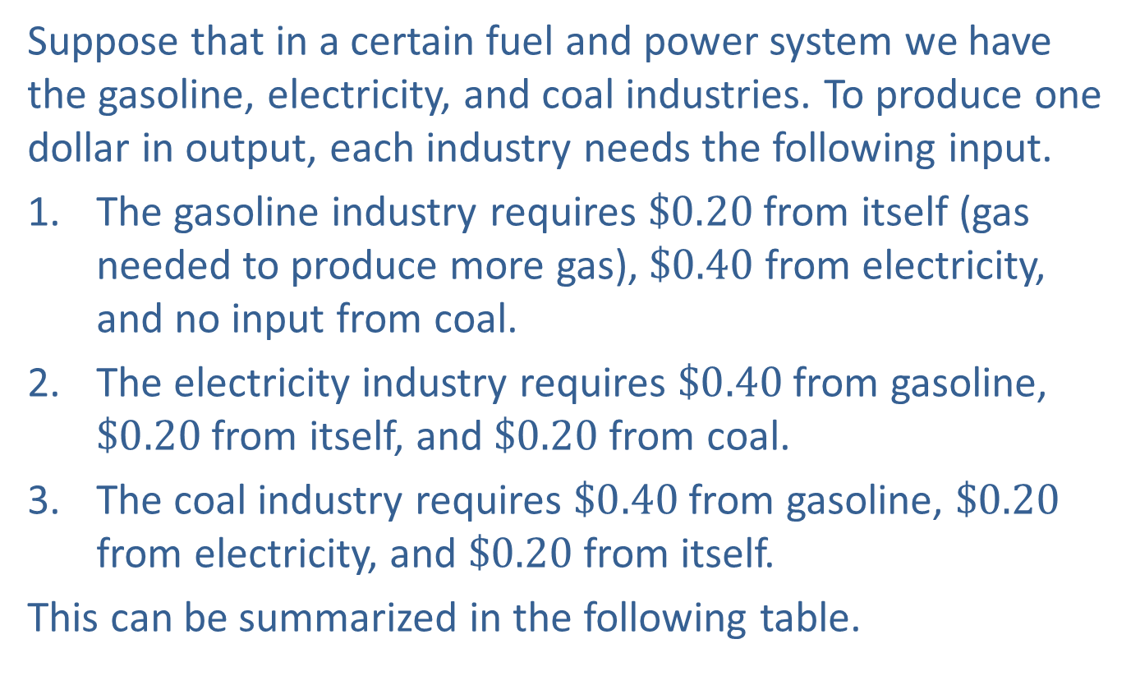
Example 1: Leontief Model
Suppose that in a certain fuel and power system we have the gasoline, electricity, and coal industries. To produce one dollar in output, each industry needs the following input.
​The gasoline industry requires $\$0.20$ from itself (gas needed to produce more gas), $\$0.40$ from electricity, and no input from coal.
​The electricity industry requires $\$0.40$ from gasoline, $\$0.20$ from itself, and $\$0.20$ from coal.
​The coal industry requires $\$0.40$ from gasoline, $\$0.20$ from electricity, and $\$0.20$ from itself.
This can be summarized in the following table.

Slide 3
Example 1: Leontief Model (cont.)
Inputs (Suppliers) | Outputs (Users)
 | Gasoline | Electricity | Coal
Gasoline | 0.20 | 0.40 | 0.40
Electricity | 0.40 | 0.20 | 0.20
Coal | 0.00 | 0.20 | 0.20

Slide 4
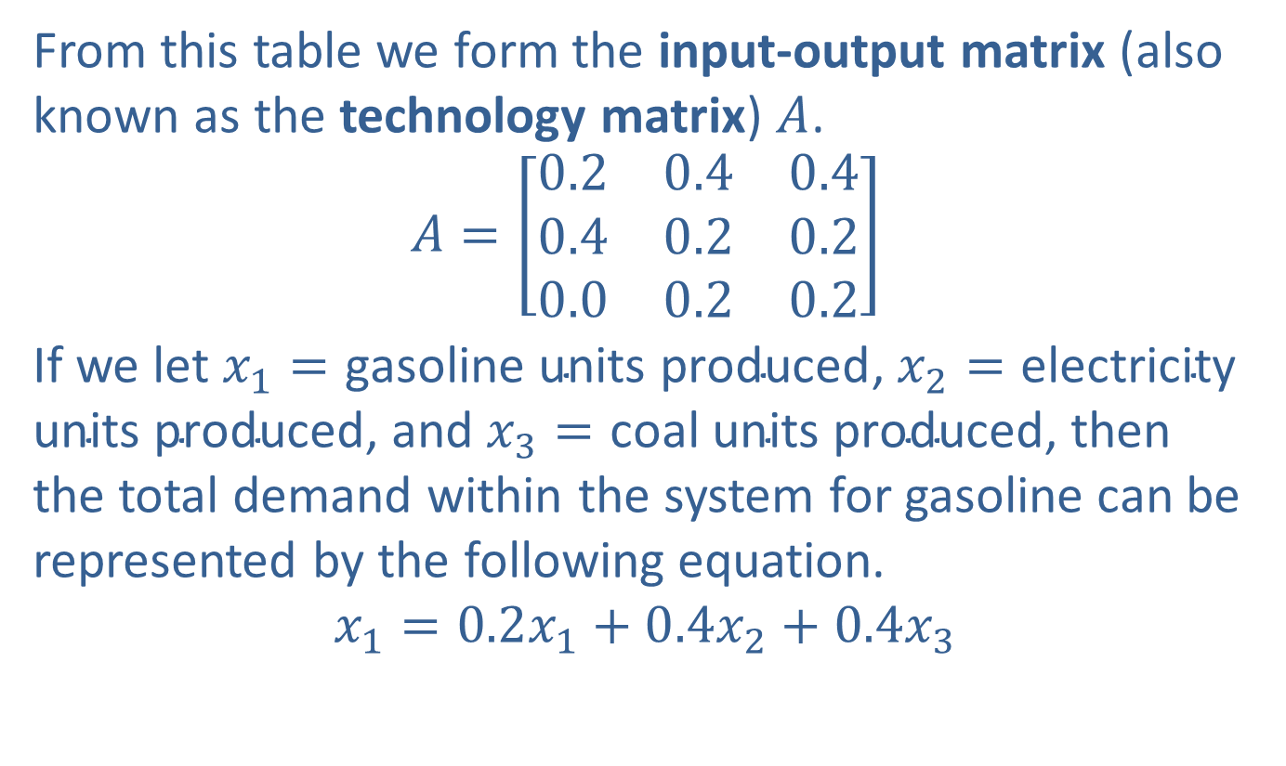
Example 1: Leontief Model (cont.)
From this table we form the input-output matrix (also known as the technology matrix) $A$.
$$A=\left[\begin{matrix}0.2 & 0.4 & 0.4 \\ 0.4 & 0.2 & 0.2 \\ 0.0 & 0.2 & 0.2\end{matrix}\right]$$
If we let $x_{1}=\text{gasoline} \text{units} \text{produced}$, $x_{2}=\text{electricity} \text{units} \text{produced}$, and $x_{3}=\text{coal} \text{units} \text{produced}$, then the total demand within the system for gasoline can be represented by the following equation.
$$x_{1}=0.2x_{1}+0.4x_{2}+0.4x_{3}$$

Slide 5
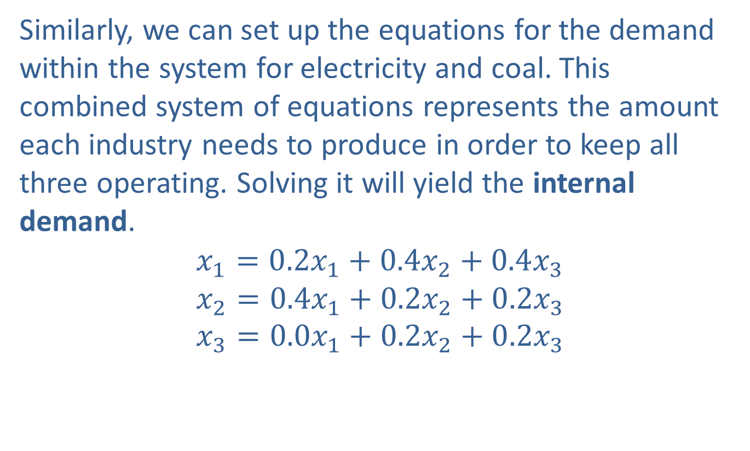
Example 1: Leontief Model (cont.)
Similarly, we can set up the equations for the demand within the system for electricity and coal. This combined system of equations represents the amount each industry needs to produce in order to keep all three operating. Solving it will yield the internal demand.
$$x_{1}=0.2x_{1}+0.4x_{2}+0.4x_{3} \\ x_{2}=0.4x_{1}+0.2x_{2}+0.2x_{3} \\ x_{3}=0.0x_{1}+0.2x_{2}+0.2x_{3}$$

Slide 6
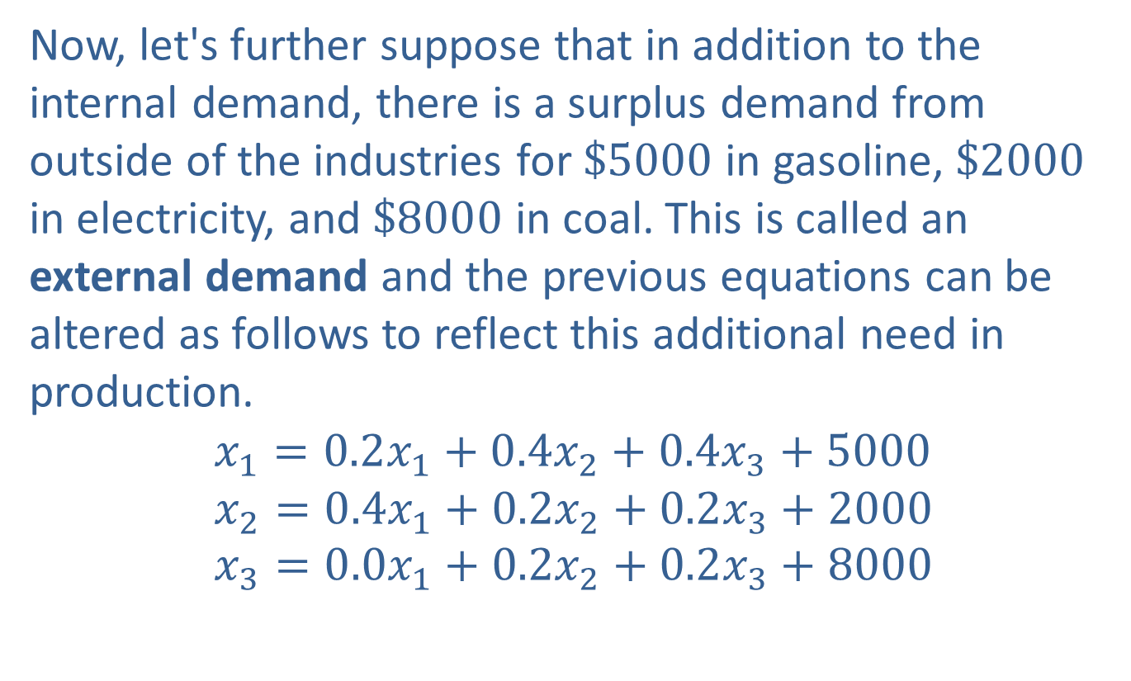
Example 1: Leontief Model (cont.)
Now, let's further suppose that in addition to the internal demand, there is a surplus demand from outside of the industries for $\$5000$ in gasoline, $\$2000$ in electricity, and $\$8000$ in coal. This is called an external demand and the previous equations can be altered as follows to reflect this additional need in production.
$$x_{1}=0.2x_{1}+0.4x_{2}+0.4x_{3}+5000 \\ x_{2}=0.4x_{1}+0.2x_{2}+0.2x_{3}+2000 \\ x_{3}=0.0x_{1}+0.2x_{2}+0.2x_{3}+8000$$

Slide 7
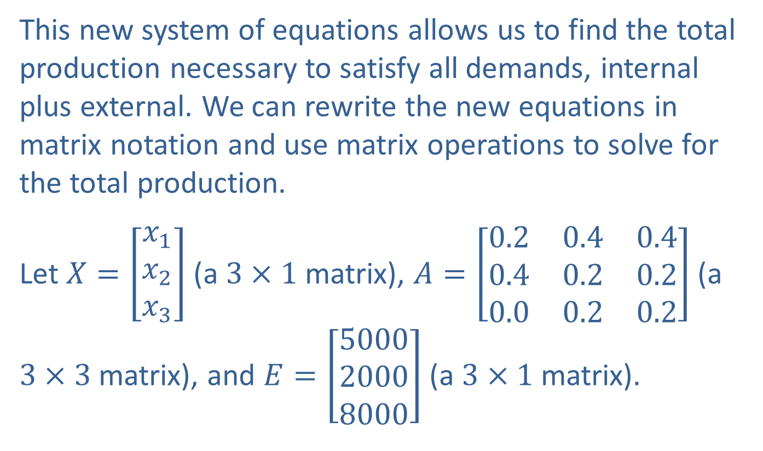
Example 1: Leontief Model (cont.)
This new system of equations allows us to find the total production necessary to satisfy all demands, internal plus external. We can rewrite the new equations in matrix notation and use matrix operations to solve for the total production.
Let $X=\left[\begin{aligned}x_{1} \\ x_{2} \\ x_{3}\end{aligned}\right]$ (a $3×1$ matrix), $A=\left[\begin{matrix}0.2 & 0.4 & 0.4 \\ 0.4 & 0.2 & 0.2 \\ 0.0 & 0.2 & 0.2\end{matrix}\right]$ (a $3×3$ matrix), and $E=\left[\begin{aligned}5000 \\ 2000 \\ 8000\end{aligned}\right]$ (a $3×1$ matrix).

Slide 8
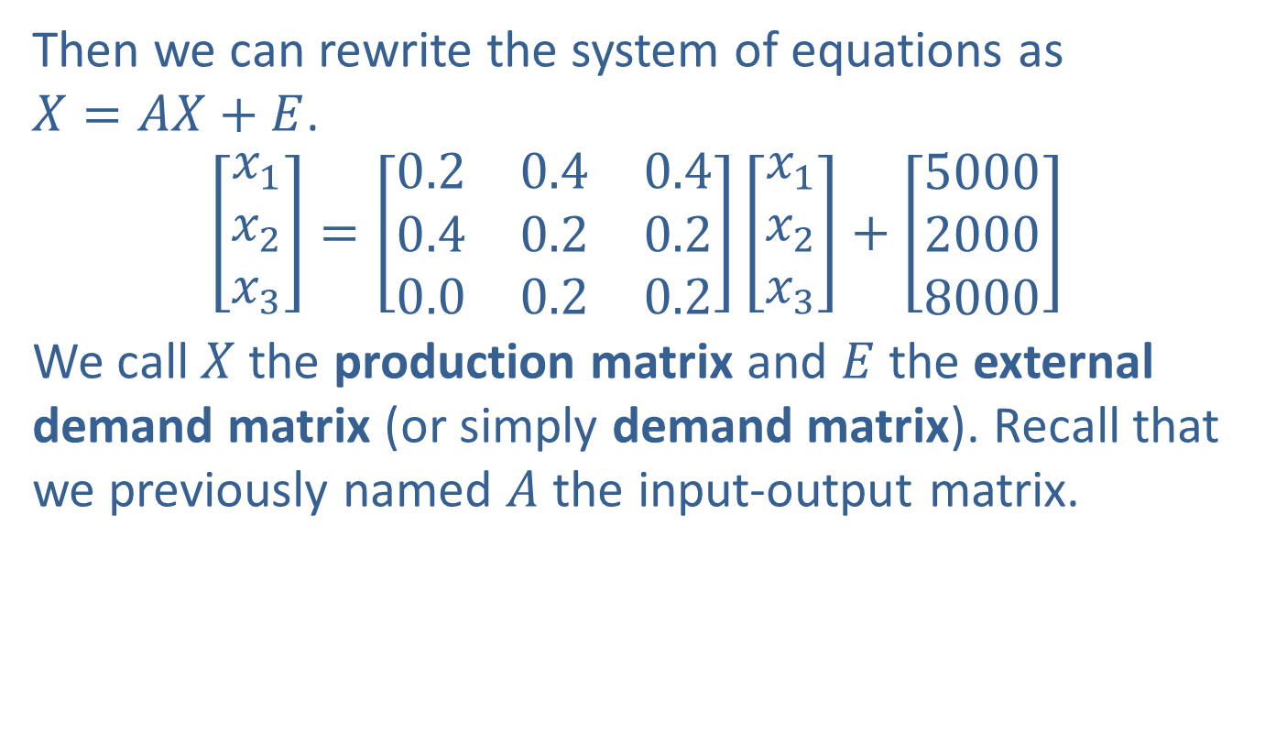
Example 1: Leontief Model (cont.)
Then we can rewrite the system of equations as $X=AX+E$.
$$\left[\begin{aligned}x_{1} \\ x_{2} \\ x_{3}\end{aligned}\right]=\left[\begin{matrix}0.2 & 0.4 & 0.4 \\ 0.4 & 0.2 & 0.2 \\ 0.0 & 0.2 & 0.2\end{matrix}\right]\left[\begin{aligned}x_{1} \\ x_{2} \\ x_{3}\end{aligned}\right]+\left[\begin{aligned}5000 \\ 2000 \\ 8000\end{aligned}\right]$$
We call $X$ the production matrix and $E$ the external demand matrix (or simply demand matrix). Recall that we previously named $A$ the input-output matrix.

Slide 9
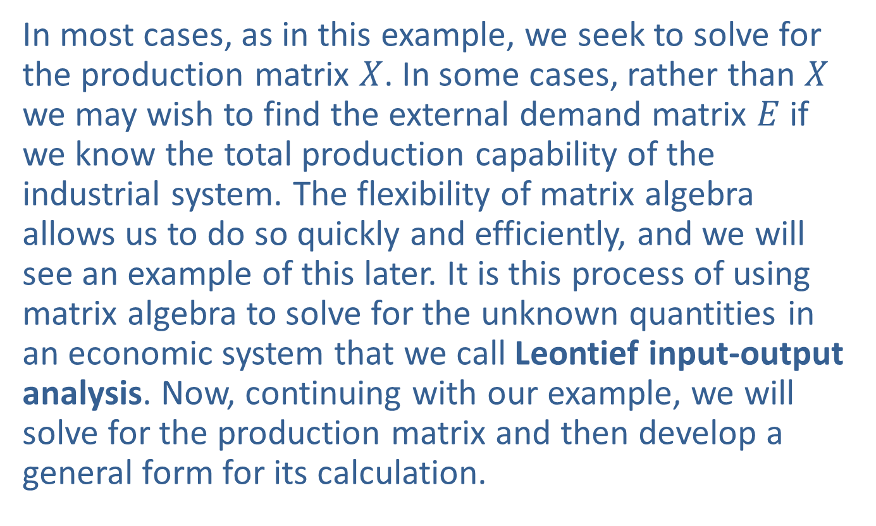
Example 1: Leontief Model (cont.)
In most cases, as in this example, we seek to solve for the production matrix $X$. In some cases, rather than $X$ we may wish to find the external demand matrix $E$ if we know the total production capability of the industrial system. The flexibility of matrix algebra allows us to do so quickly and efficiently, and we will see an example of this later. It is this process of using matrix algebra to solve for the unknown quantities in an economic system that we call Leontief input-output analysis. Now, continuing with our example, we will solve for the production matrix and then develop a general form for its calculation.

Slide 10
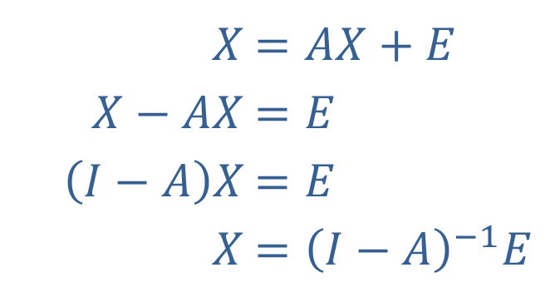

Example 1: Leontief Model (cont.)
Returning to our matrix notation, we solve for $X$ as follows. For this example, $I$ is the $3×3$ identity matrix.
​$X$ | ​$=AX+E$
​$X−AX$ | ​$=E$
​$\left(I−A\right)X$ | ​$=E$
​$X$ | ​$={\left(I−A\right)}^{−1}E$

Slide 11
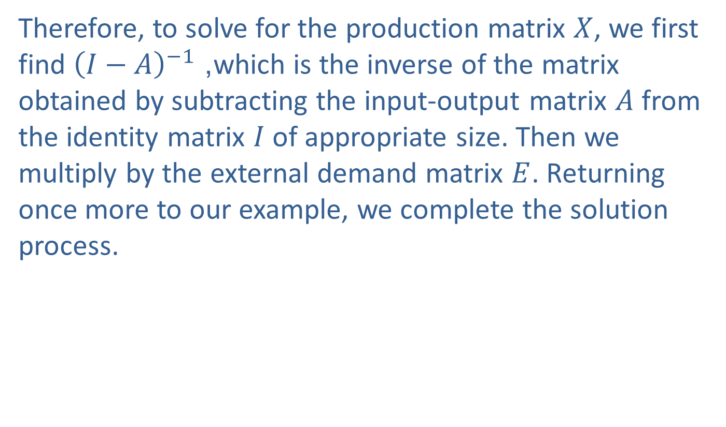
Example 1: Leontief Model (cont.)
Therefore, to solve for the production matrix $X$, we first find ${\left(I−A\right)}^{−1}$, which is the inverse of the matrix obtained by subtracting the input-output matrix $A$ from the identity matrix $I$ of appropriate size. Then we multiply by the external demand matrix $E$. Returning once more to our example, we complete the solution process.

Slide 12
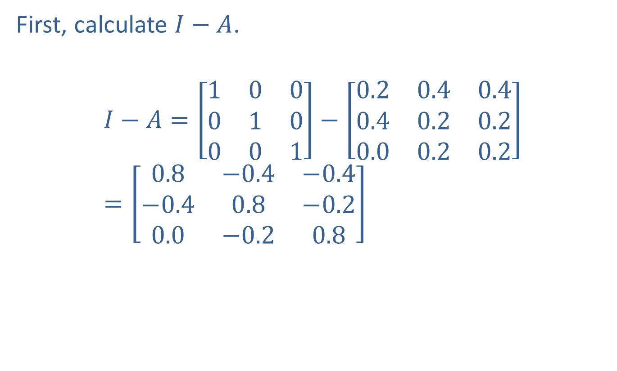
Example 1: Leontief Model (cont.)
First, calculate $I−A$.
$$I−A=\left[\begin{matrix}1 & 0 & 0 \\ 0 & 1 & 0 \\ 0 & 0 & 1\end{matrix}\right]−\left[\begin{matrix}0.2 & 0.4 & 0.4 \\ 0.4 & 0.2 & 0.2 \\ 0.0 & 0.2 & 0.2\end{matrix}\right]=\left[\begin{matrix}0.8 & −0.4 & −0.4 \\ −0.4 & 0.8 & −0.2 \\ 0.0 & −0.2 & 0.8\end{matrix}\right]$$

Slide 13
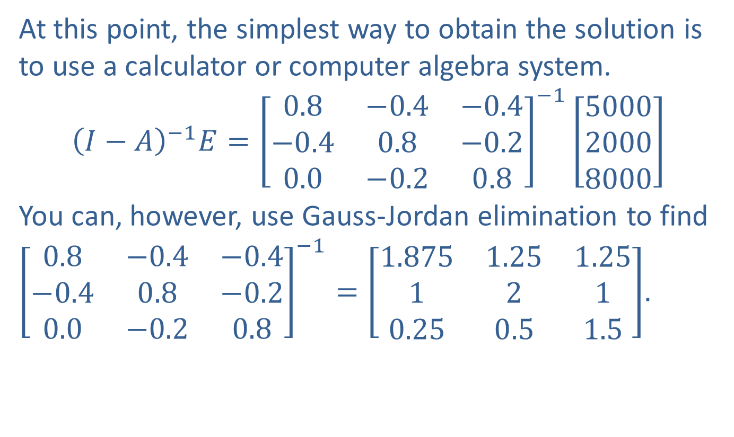
Example 1: Leontief Model (cont.)
At this point, the simplest way to obtain the solution is to use a calculator or computer algebra system.
$${\left(I−A\right)}^{−1}E={\left[\begin{matrix}0.8 & −0.4 & −0.4 \\ −0.4 & 0.8 & −0.2 \\ 0.0 & −0.2 & 0.8\end{matrix}\right]}^{−1}\left[\begin{aligned}5000 \\ 2000 \\ 8000\end{aligned}\right]$$
You can, however, use Gauss-Jordan elimination to find ${\left[\begin{matrix}0.8 & −0.4 & −0.4 \\ −0.4 & 0.8 & −0.2 \\ 0.0 & −0.2 & 0.8\end{matrix}\right]}^{−1}=\left[\begin{matrix}1.875 & 1.25 & 1.25 \\ 1 & 2 & 1 \\ 0.25 & 0.5 & 1.5\end{matrix}\right]$.

Slide 14
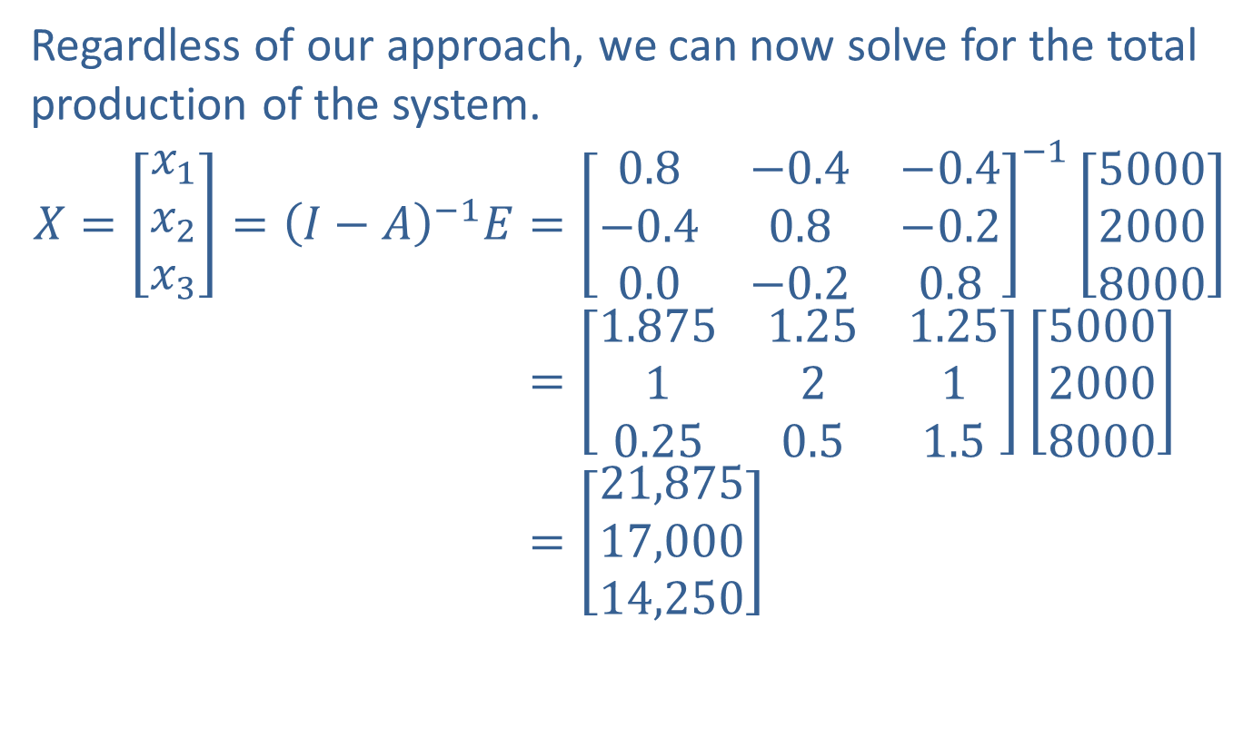
Example 1: Leontief Model (cont.)
Regardless of our approach, we can now solve for the total production of the system.
𝑋=𝑥1𝑥2𝑥3=𝐼−𝐴−1𝐸=0.8−0.4−0.4−0.40.8−0.20.0−0.20.8−1500020008000𝑋=𝑥1𝑥2𝑥3=𝐼−𝐴−1𝐸=1.8751.251.251210.250.51.5500020008000𝑋=𝑥1𝑥2𝑥3=𝐼−𝐴−1𝐸=21,87517,00014,250

Slide 15
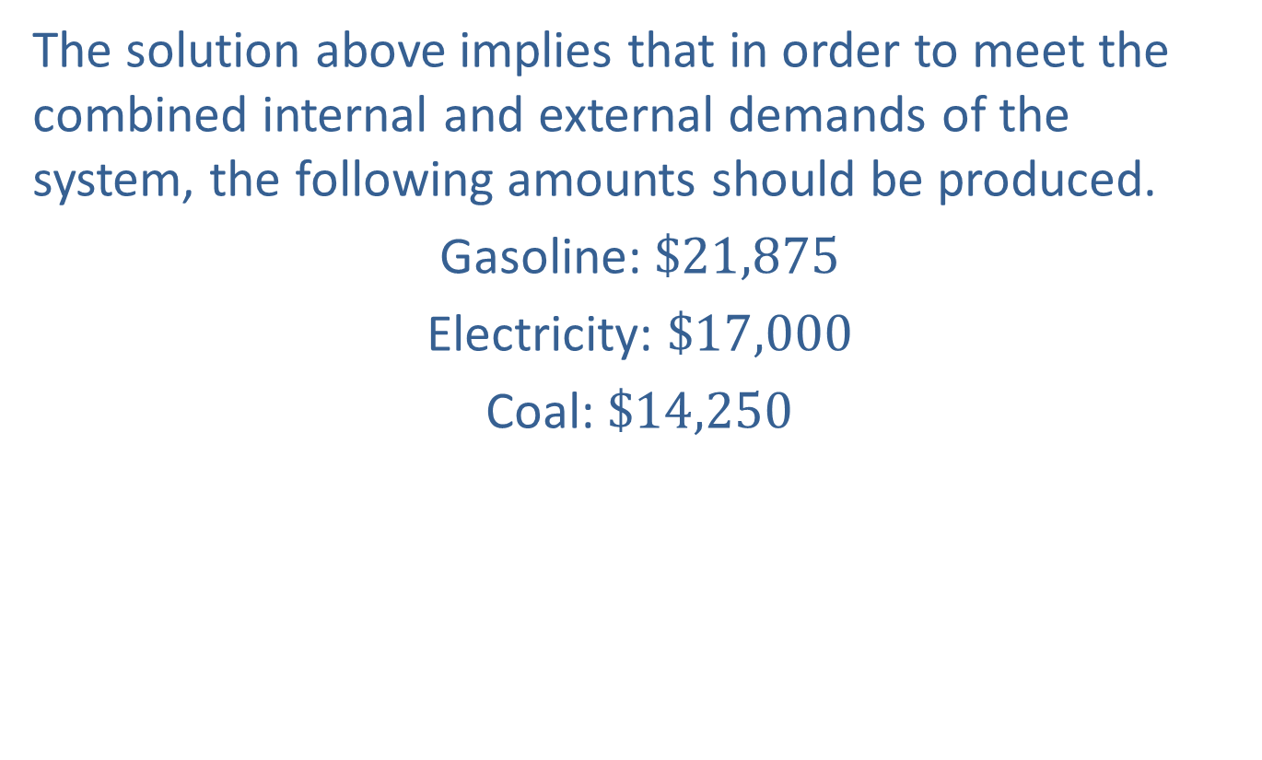
Example 1: Leontief Model (cont.)
The solution above implies that in order to meet the combined internal and external demands of the system, the following amounts should be produced.
Gasoline: $\$21,875$
Electricity: $\$17,000$
Coal: $\$14,250$

Slide 16
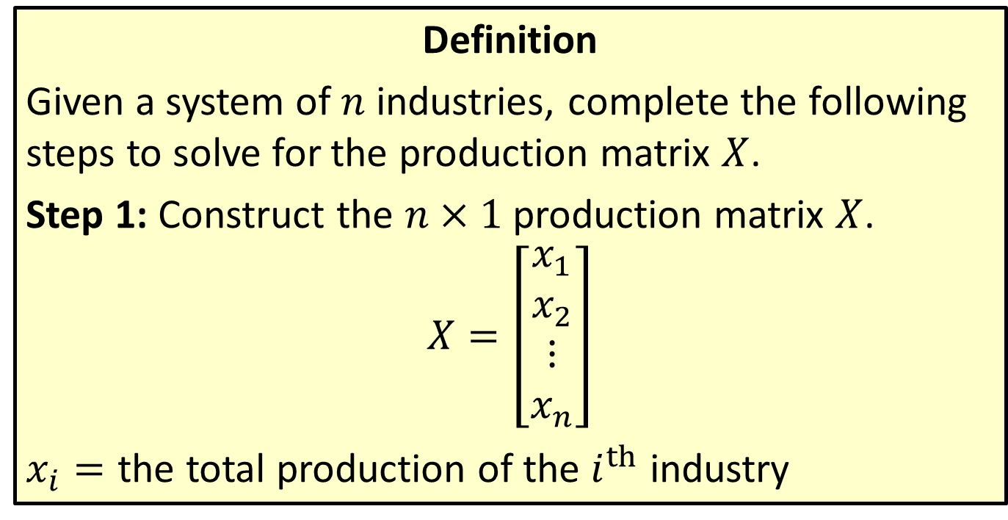
Solving for a Production Matrix
Definition
Given a system of $n$ industries, complete the following steps to solve for the production matrix $X$.
Step 1: Construct the $n×1$ production matrix $X$.
$$X=\left[\begin{aligned}x_{1} \\ x_{2} \\ ⋮ \\ x_{n}\end{aligned}\right]$$
​$x_{i}=$ the total production of the $i^{th}$ industry

Slide 17
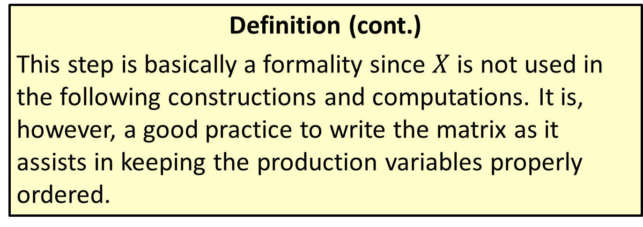
Solving for a Production Matrix
Definition (cont.)
​This step is basically a formality since $X$ is not used in the following constructions and computations. It is, however, a good practice to write the matrix as it assists in keeping the production variables properly ordered.

Slide 18
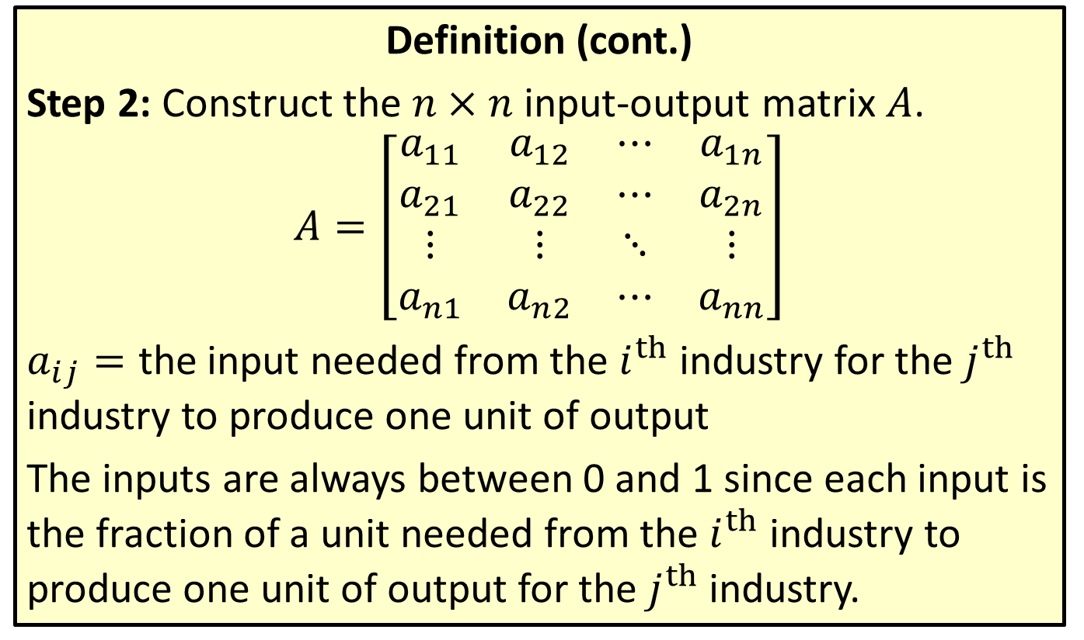
Solving for a Production Matrix (cont.)
Definition (cont.)
Step 2: Construct the $n×n$ input-output matrix $A$.
$$A=\left[\begin{matrix}a_{1⁣1} & a_{1⁣2} & ⋯ & a_{1⁣n} \\ a_{2⁣1} & a_{2⁣2} & ⋯ & a_{2⁣n} \\ ⋮ & ⋮ & ⋱ & ⋮ \\ a_{n⁣1} & a_{n⁣2} & ⋯ & a_{n⁣n}\end{matrix}\right]$$
​$a_{i⁣j}=$ the input needed from the $i^{th}$ industry for the $j^{th}$ industry to produce one unit of output
​The inputs are always between 0 and 1 since each input is the fraction of a unit needed from the $i^{th}$ industry to produce one unit of output for the $j^{th}$ industry.

Slide 19
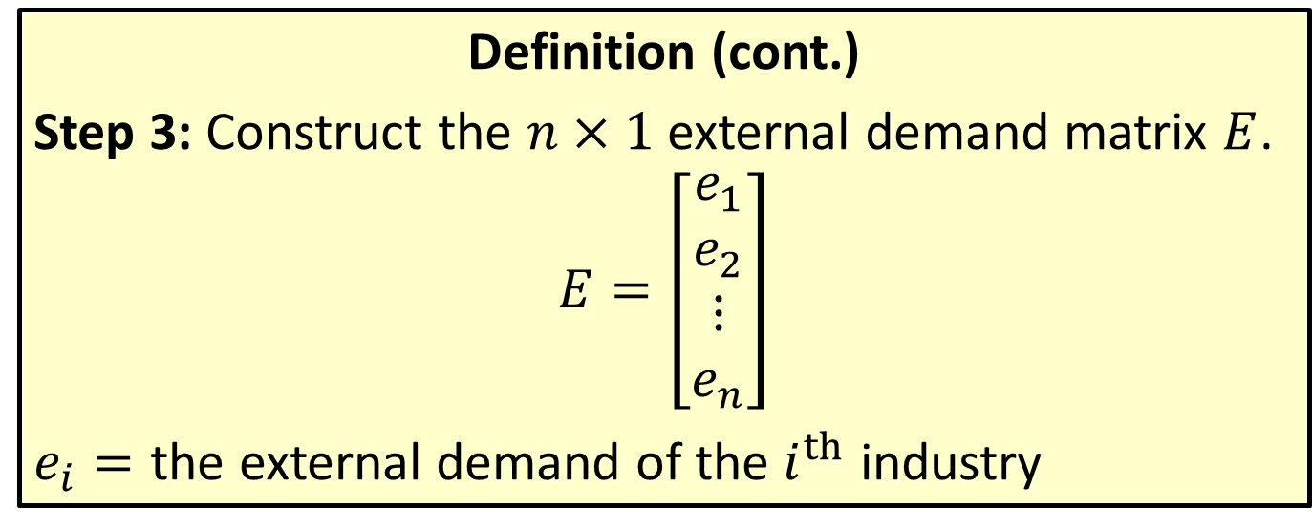
Solving for a Production Matrix (cont.)
Definition (cont.)
Step 3: Construct the $n×1$ external demand matrix $E$.
$$E=\left[\begin{aligned}e_{1} \\ e_{2} \\ ⋮ \\ e_{n}\end{aligned}\right]$$
​$e_{i}=$ the external demand of the $i^{th}$ industry

Slide 20
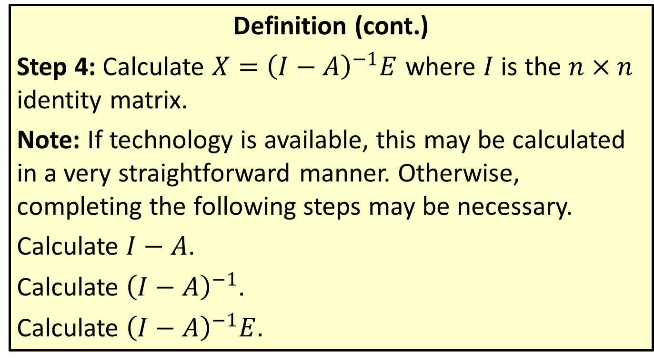
Solving for a Production Matrix (cont.)
Definition (cont.)
Step 4: Calculate $X={\left(I−A\right)}^{−1}E$ where $I$ is the $n×n$ identity matrix.
Note: If technology is available, this may be calculated in a very straightforward manner. Otherwise, completing the following steps may be necessary.
​Calculate $I−A$.
​Calculate ${\left(I−A\right)}^{−1}$.
​Calculate ${\left(I−A\right)}^{−1}E$.

Slide 21
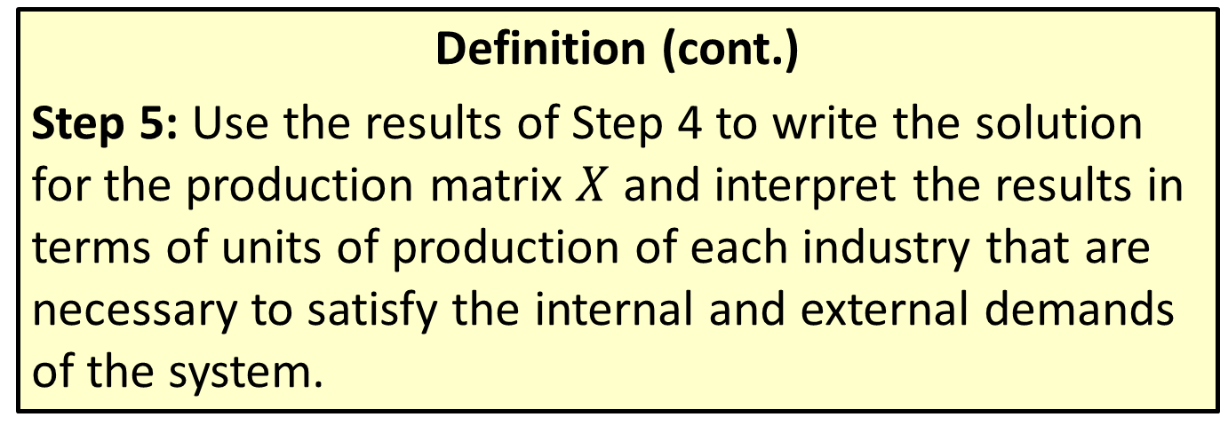
Solving for a Production Matrix (cont.)
Definition (cont.)
Step 5: Use the results of Step 4 to write the solution for the production matrix $X$ and interpret the results in terms of units of production of each industry that are necessary to satisfy the internal and external demands of the system.

Slide 22
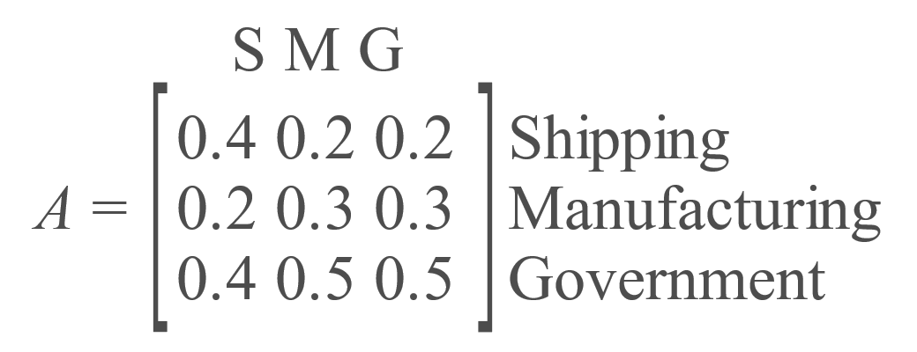

Example 2: Closed Economy
Suppose a closed economy consists of three industries—with $x_{1}$ equal to the value of shipping output, $x_{2}$ equal to the value of manufacturing output, and $x_{3}$ equal to the government budget—and has the following input-output matrix.

Slide 23

Example 2: Closed Economy (cont.)
Find each industry's production (that is, find the shipping output $x_{1}$, manufacturing output $x_{2}$, and government budget $x_{3}$).

Slide 24
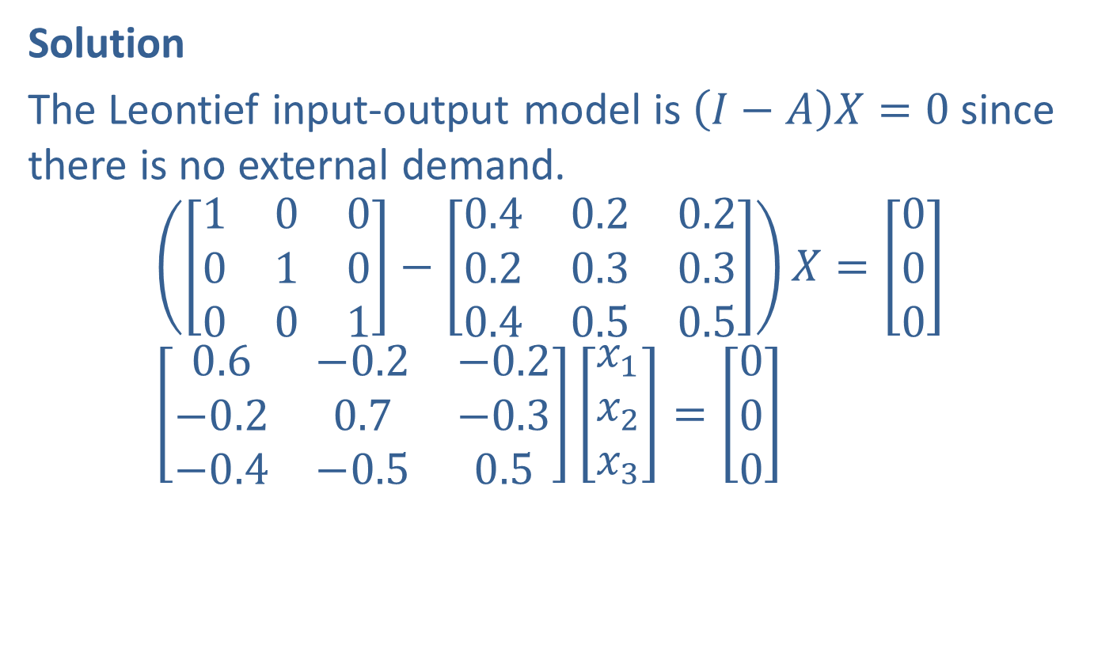
Example 2: Closed Economy (cont.)
Solution
The Leontief input-output model is $\left(I−A\right)X=0$ since there is no external demand.
$$\left(\left[\begin{matrix}1 & 0 & 0 \\ 0 & 1 & 0 \\ 0 & 0 & 1\end{matrix}\right]−\left[\begin{matrix}0.4 & 0.2 & 0.2 \\ 0.2 & 0.3 & 0.3 \\ 0.4 & 0.5 & 0.5\end{matrix}\right]\right)X=\left[\begin{aligned}0 \\ 0 \\ 0\end{aligned}\right] \\ \left[\begin{matrix}0.6 & −0.2 & −0.2 \\ −0.2 & 0.7 & −0.3 \\ −0.4 & −0.5 & 0.5\end{matrix}\right]\left[\begin{aligned}x_{1} \\ x_{2} \\ x_{3}\end{aligned}\right]=\left[\begin{aligned}0 \\ 0 \\ 0\end{aligned}\right]$$

Slide 25
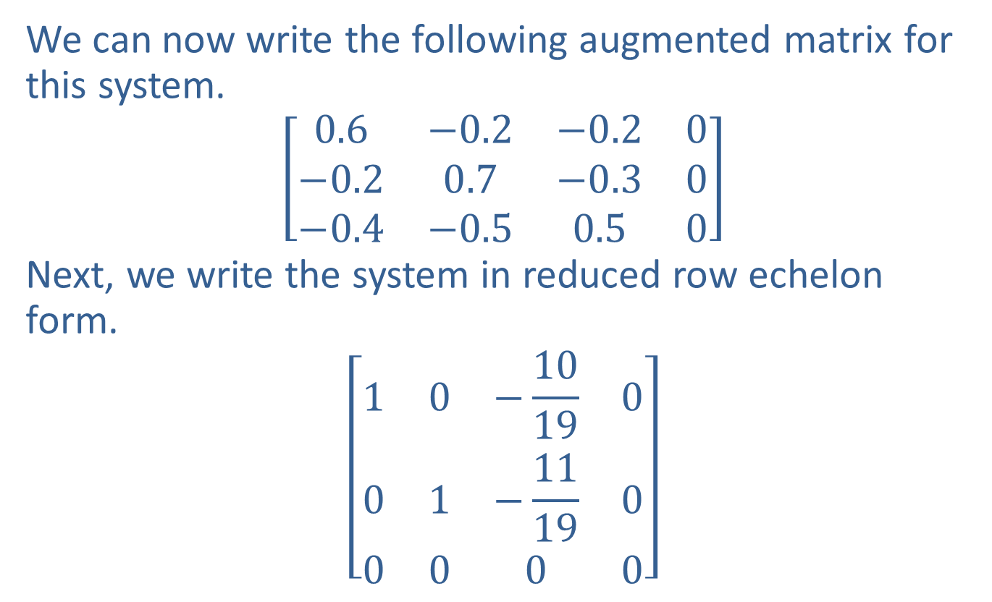
Example 2: Closed Economy (cont.)
We can now write the following augmented matrix for this system.
$$\left[\begin{matrix}0.6 & −0.2 & −0.2 & 0 \\ −0.2 & 0.7 & −0.3 & 0 \\ −0.4 & −0.5 & 0.5 & 0\end{matrix}\right]$$
Next, we write the system in reduced row echelon form.
$$\left[\begin{matrix}1 & 0 & −\frac{10}{19} & 0 \\ 0 & 1 & −\frac{11}{19} & 0 \\ 0 & 0 & 0 & 0\end{matrix}\right]$$

Slide 26
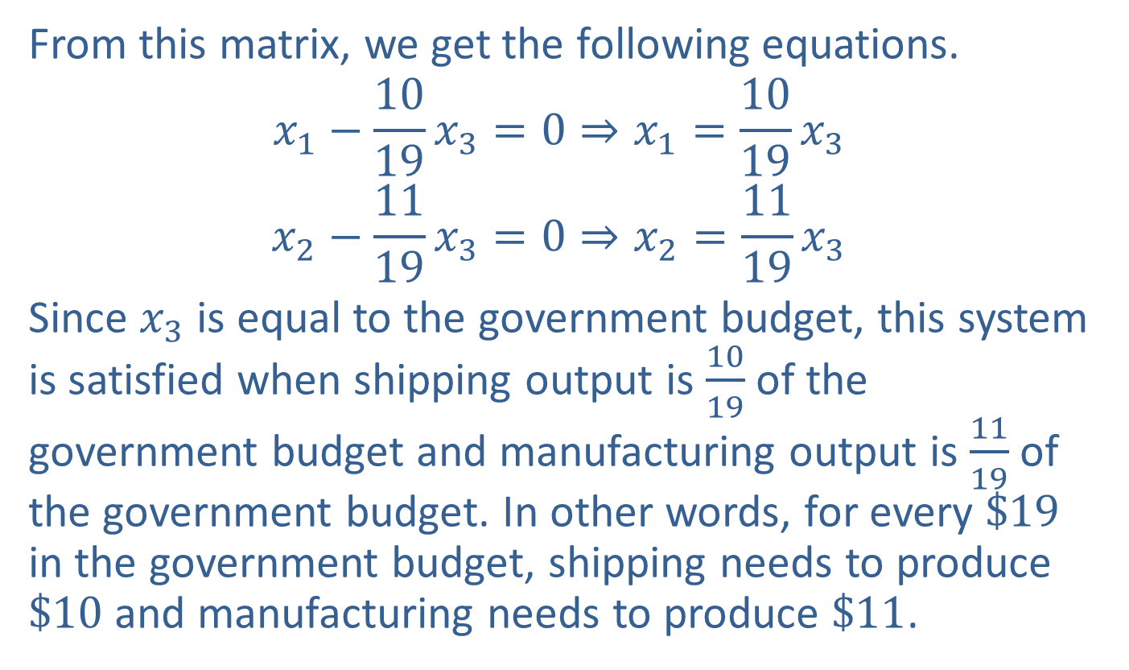
Example 2: Closed Economy (cont.)
From this matrix, we get the following equations.
$$x_{1}−\frac{10}{19}x_{3}=0⇒x_{1}=\frac{10}{19}x_{3}$$
$$x_{2}−\frac{11}{19}x_{3}=0⇒x_{2}=\frac{11}{19}x_{3}$$
Since $x_{3}$ is equal to the government budget, this system is satisfied when shipping output is $\frac{10}{19}$ of the government budget and manufacturing output is $\frac{11}{19}$ of the government budget. In other words, for every $\$19$ in the government budget, shipping needs to produce $\$10$ and manufacturing needs to produce $\$11$.

Slide 27
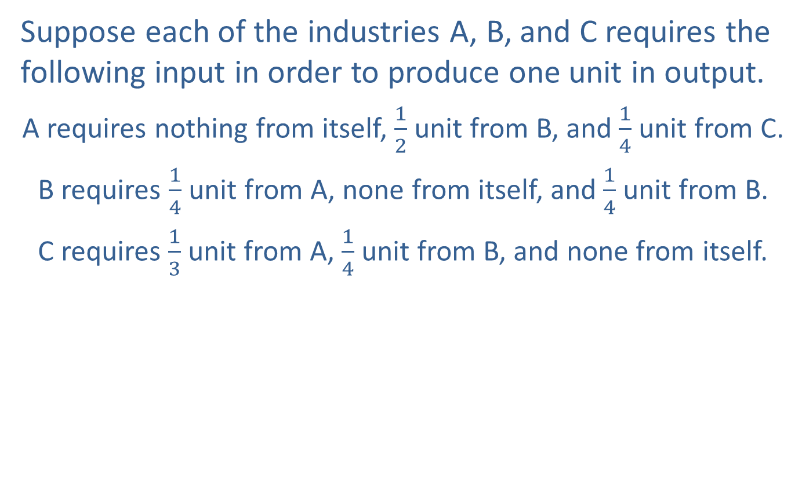
Example 3: External Demand
Suppose each of the industries A, B, and C requires the following input in order to produce one unit in output.
A requires nothing from itself, $\frac{1}{2}$ unit from B, and $\frac{1}{4}$ unit from C.
B requires $\frac{1}{4}$ unit from A, none from itself, and $\frac{1}{4}$ unit from B.
C requires $\frac{1}{3}$ unit from A, $\frac{1}{4}$ unit from B, and none from itself.

Slide 28

Example 3: External Demand (cont.)
So, the input-output matrix $A$ is given as follows.
$$A=\left[\begin{matrix}0 & \frac{1}{4} & \frac{1}{3} \\ \frac{1}{2} & 0 & \frac{1}{4} \\ \frac{1}{4} & \frac{1}{4} & 0\end{matrix}\right]$$

Slide 29
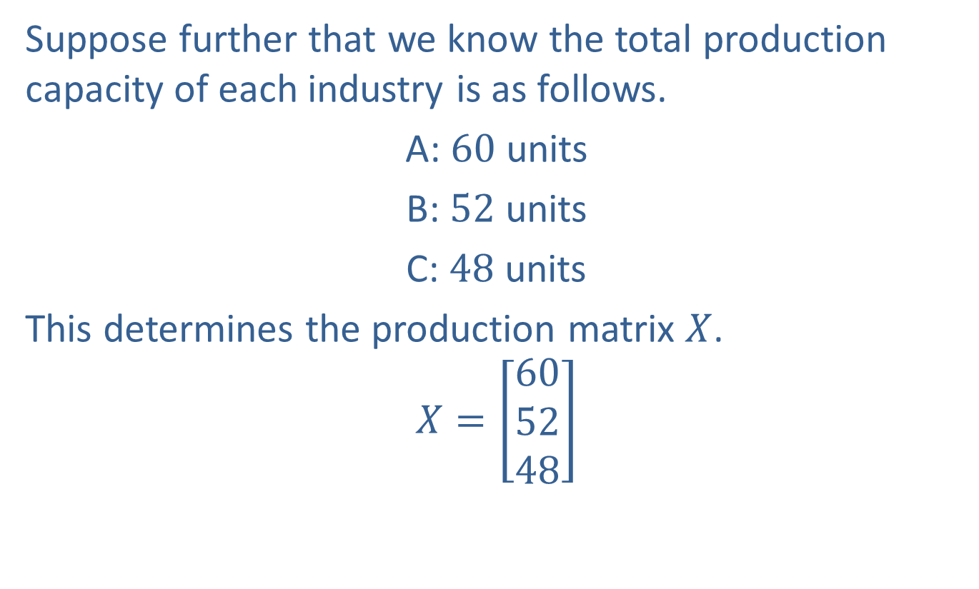
Example 3: External Demand (cont.)
Suppose further that we know the total production capacity of each industry is as follows.
A: 60 units
B: 52 units
C: 48 units
This determines the production matrix $X$.
$$X=\left[\begin{aligned}60 \\ 52 \\ 48\end{aligned}\right]$$

Slide 30
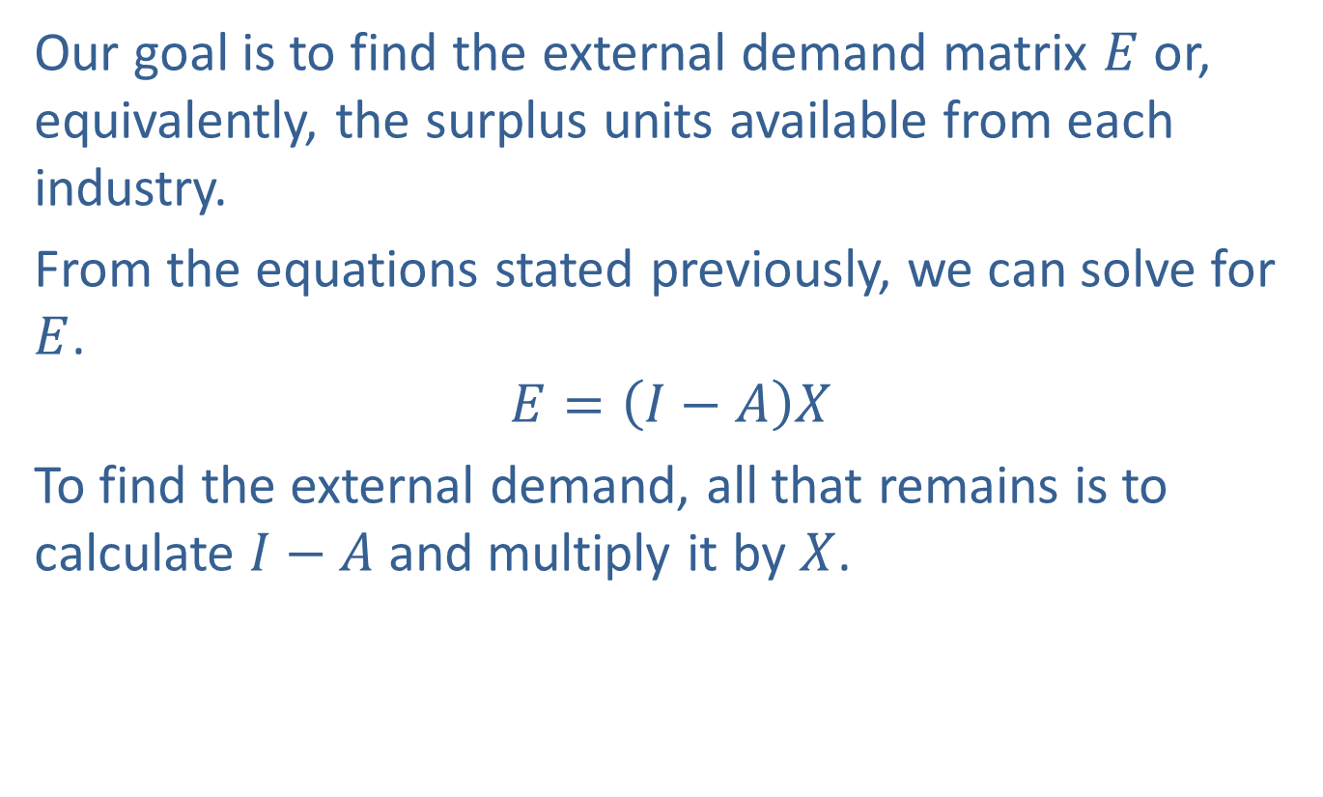
Example 3: External Demand (cont.)
Our goal is to find the external demand matrix $E$ or, equivalently, the surplus units available from each industry.
From the equations stated previously, we can solve for $E$.
$$E=\left(I−A\right)X$$
To find the external demand, all that remains is to calculate $I−A$ and multiply it by $X$.

Slide 31
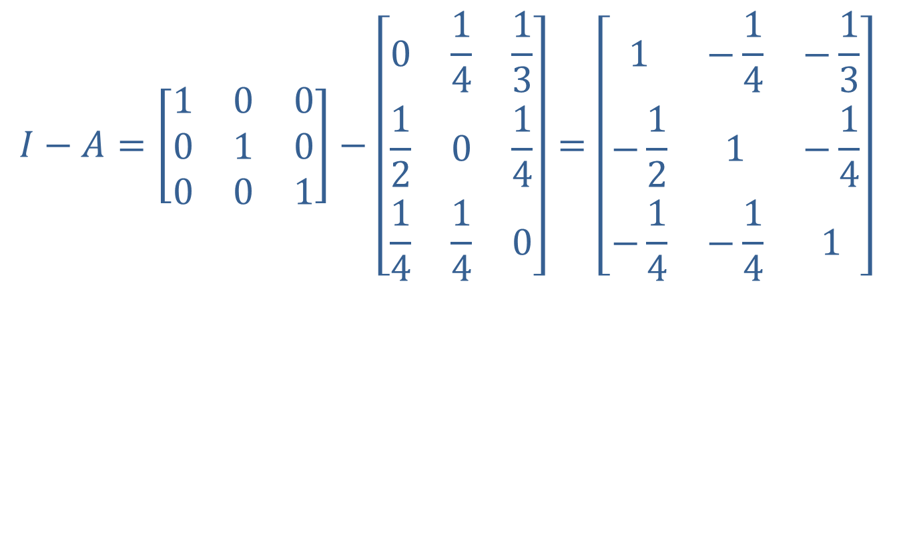
Example 3: External Demand (cont.)
$$I−A=\left[\begin{matrix}1 & 0 & 0 \\ 0 & 1 & 0 \\ 0 & 0 & 1\end{matrix}\right]−\left[\begin{matrix}0 & \frac{1}{4} & \frac{1}{3} \\ \frac{1}{2} & 0 & \frac{1}{4} \\ \frac{1}{4} & \frac{1}{4} & 0\end{matrix}\right]=\left[\begin{matrix}1 & −\frac{1}{4} & −\frac{1}{3} \\ −\frac{1}{2} & 1 & −\frac{1}{4} \\ −\frac{1}{4} & −\frac{1}{4} & 1\end{matrix}\right]$$

Slide 32
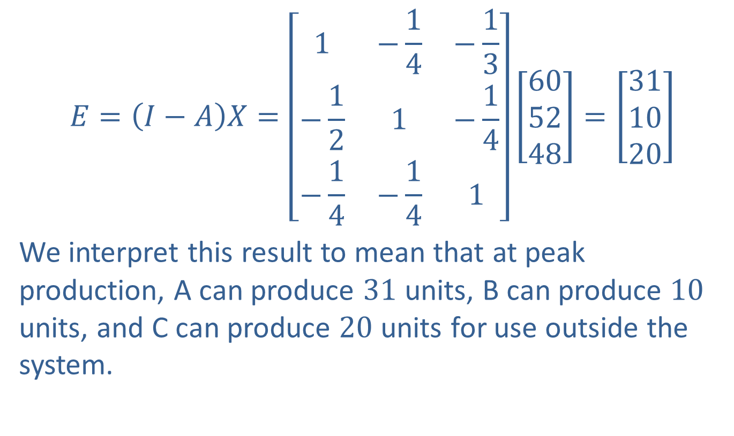
Example 3: External Demand (cont.)
$$E=\left(I−A\right)X=\left[\begin{matrix}1 & −\frac{1}{4} & −\frac{1}{3} \\ −\frac{1}{2} & 1 & −\frac{1}{4} \\ −\frac{1}{4} & −\frac{1}{4} & 1\end{matrix}\right]\left[\begin{aligned}60 \\ 52 \\ 48\end{aligned}\right]=\left[\begin{aligned}31 \\ 10 \\ 20\end{aligned}\right]$$
We interpret this result to mean that at peak production, A can produce 31 units, B can produce 10 units, and C can produce 20 units for use outside the system.

