Slide 1
Section 7.1
Linear Inequalities in Two Variables

Slide 2
Solving Linear Inequalities in Two Variables
Solving Linear Inequalities in Two Variables
Step 1: Graph the line in ℝ² that results from replacing the inequality symbol with =.
Step 2: Make the line solid if the inequality symbol is ≤ or ≥ (non-strict) and dashed if the symbol is < or > (strict). A solid line indicates that points on the line will be included in the eventual solution set while a dashed line indicates that points on the line are to be excluded from the solution set.

Slide 3
Solving Linear Inequalities in Two Variables
Solving Linear Inequalities in Two Variables (cont.)
Step 3: Determine which of the half-planes defined by the boundary line solve the inequality by substituting a test point from one of the two half-planes into the inequality. If the resulting numerical statement is true, all the points in the same half-plane as the test point solve the inequality. Otherwise, the points in the other half-plane solve the inequality. Shade in the half-plane that solves the inequality.

Slide 4

Example 1: Solving Linear Inequalities
Solve the following linear inequalities by graphing their solution sets.
$3x+2y<12$
$x−y≤0$
$x>3$

Slide 5
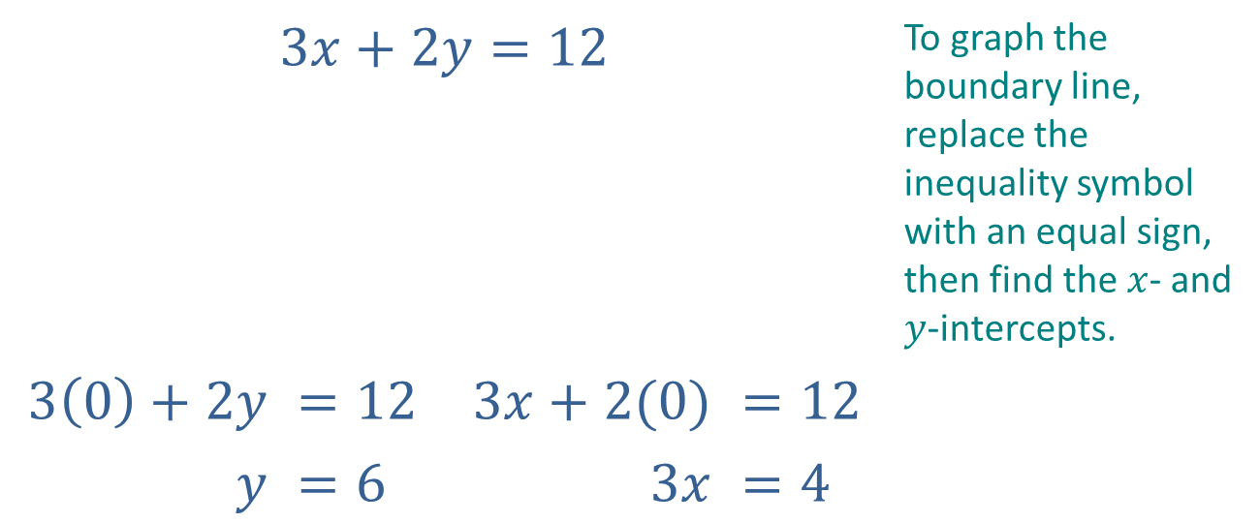
Example 1: Solving Linear Inequalities (cont.)
Solutions
$$3x+2y=12$$ |  |  |  | To graph the boundary line, replace the inequality symbol with an equal sign, then find the $x$- and $y$-intercepts.
$$3\left(0\right)+2y$$ | $$=12$$ | $$3x+2(0)$$ | $$=12$$
$$y$$ | $$=6$$ | $$3x$$ | $$=4$$

Slide 6
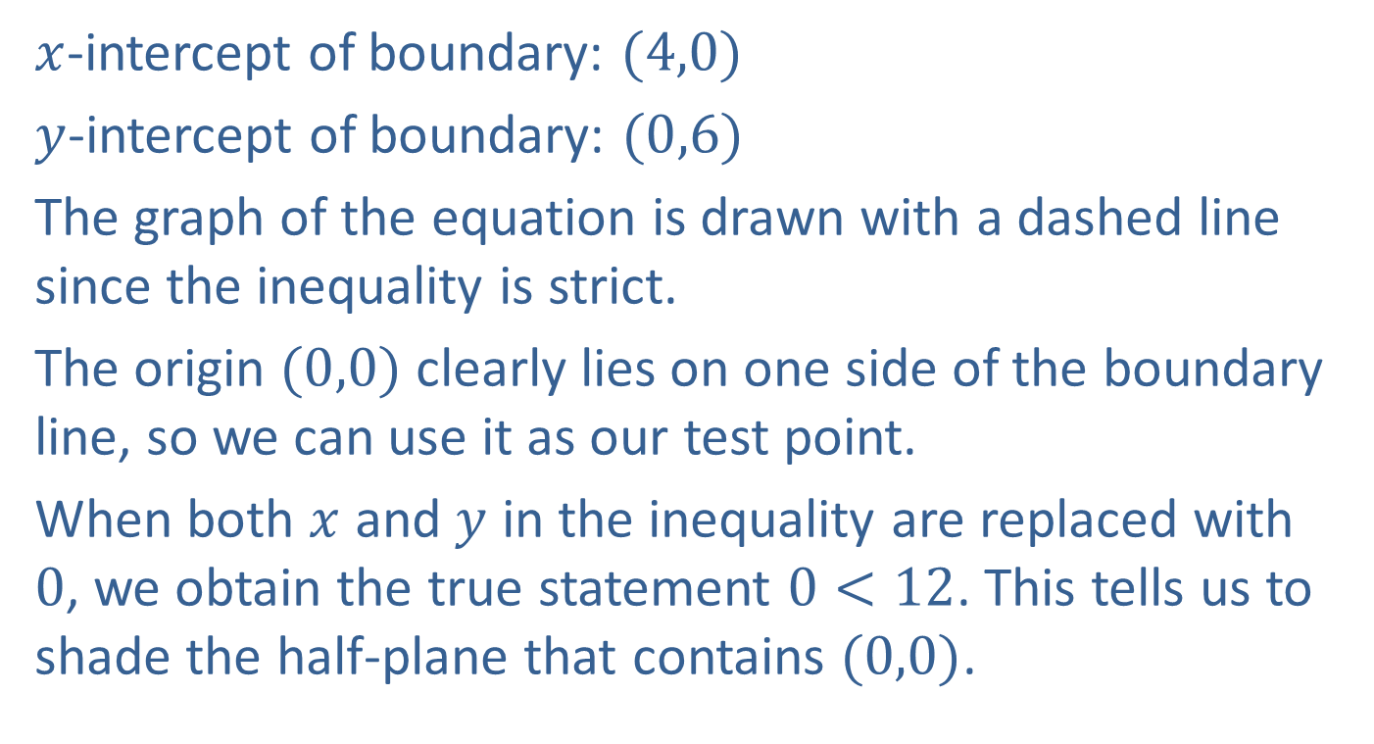
Example 1: Solving Linear Inequalities (cont.)
$x$-intercept of boundary: $(4,0)$
$y$-intercept of boundary: $(0,6)$
The graph of the equation is drawn with a dashed line since the inequality is strict.
The origin $(0,0)$ clearly lies on one side of the boundary line, so we can use it as our test point.
When both $x$ and $y$ in the inequality are replaced with $0$, we obtain the true statement $0<12$. This tells us to shade the half-plane that contains $(0,0)$.

Slide 7
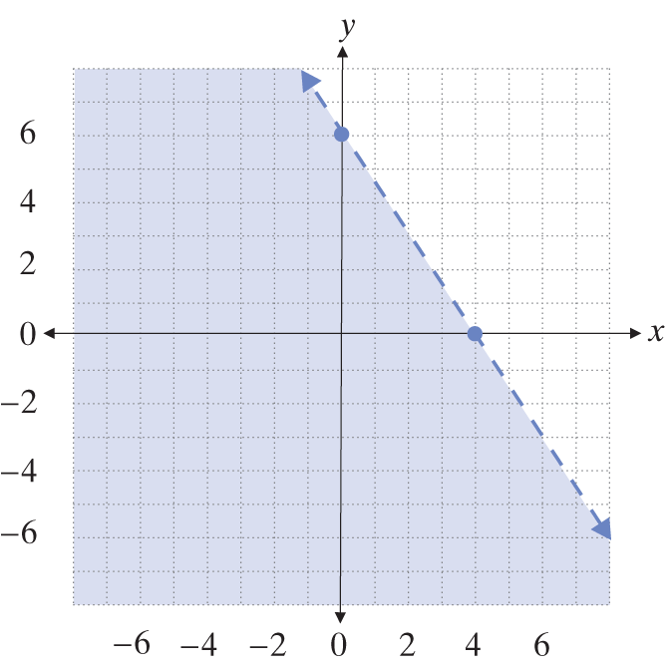
Example 1: Solving Linear Inequalities (cont.)

Slide 8
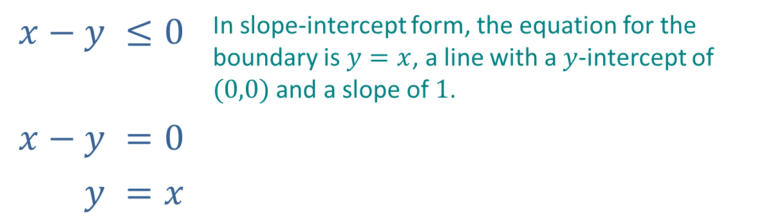
Example 1: Solving Linear Inequalities (cont.)
Graph the boundary with a solid line since the inequality is not strict. Thus, points on the boundary do solve the inequality.
$$x−y$$ | $$≤0$$ | In slope-intercept form, the equation for the boundary is $y=x$, a line with a $y$-intercept of $(0,0)$ and a slope of $1$.
$$x−y$$ | $$=0$$
$$y$$ | $$=x$$

Slide 9
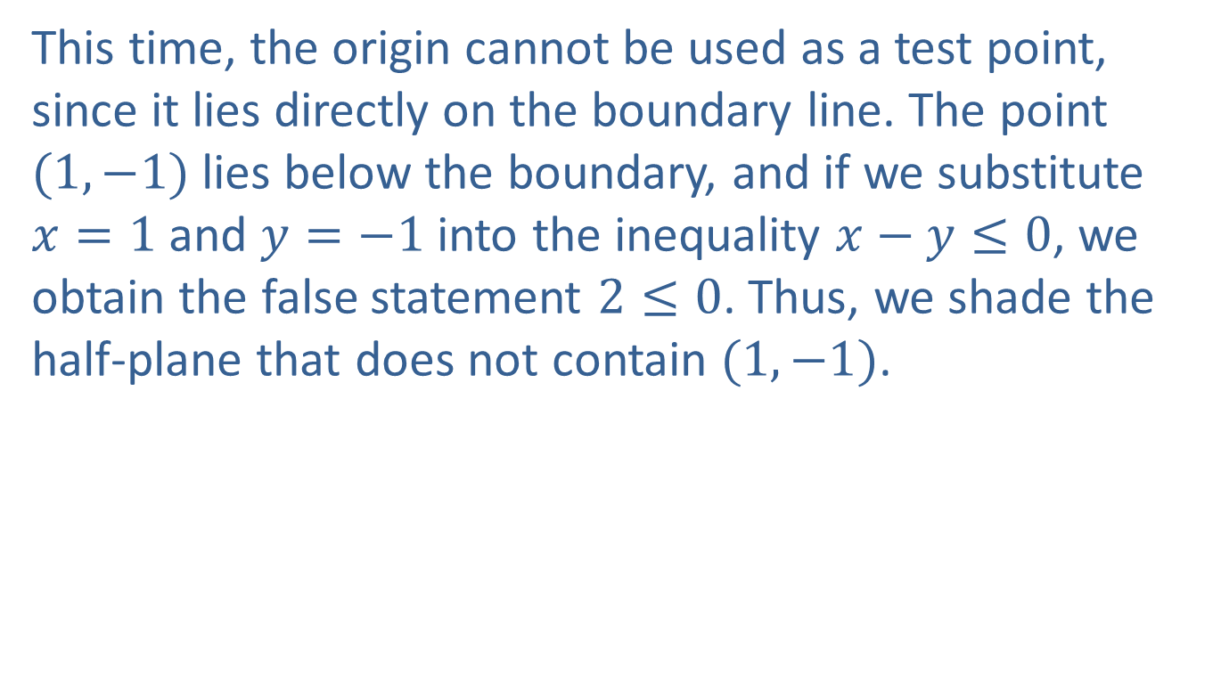
Example 1: Solving Linear Inequalities (cont.)
This time, the origin cannot be used as a test point, since it lies directly on the boundary line. The point $(1,−1)$ lies below the boundary, and if we substitute $x=1$ and $y=−1$ into the inequality $x−y≤0$, we obtain the false statement $2≤0$. Thus, we shade the half-plane that does not contain $(1,−1)$.

Slide 10
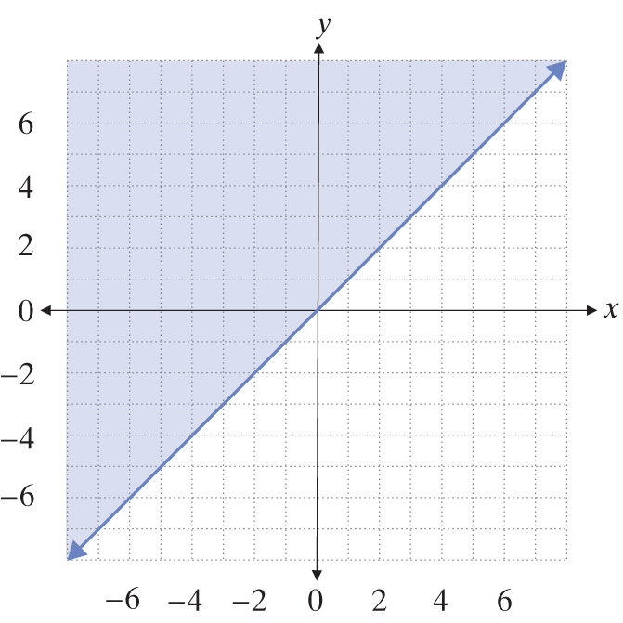
Example 1: Solving Linear Inequalities (cont.)

Slide 11
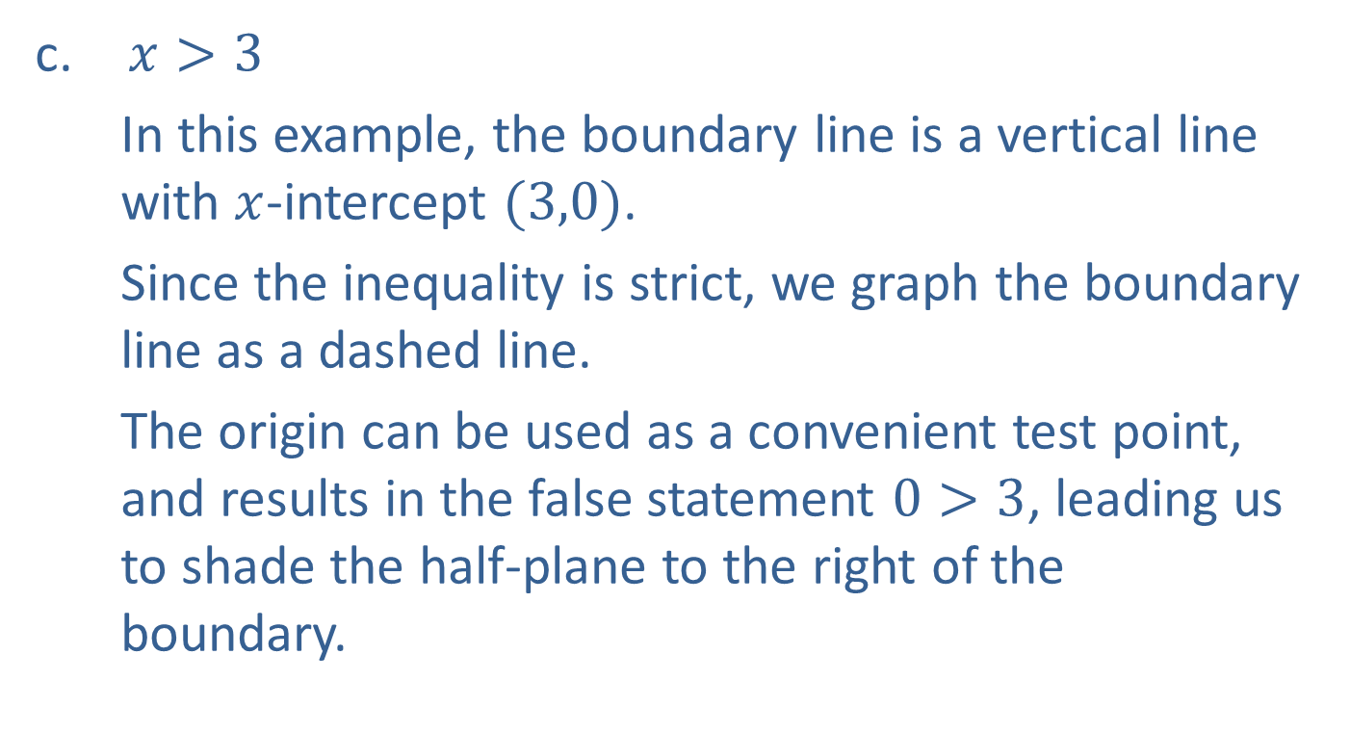
Example 1: Solving Linear Inequalities (cont.)
$x>3$
In this example, the boundary line is a vertical line with $x$-intercept $(3,0)$.
Since the inequality is strict, we graph the boundary line as a dashed line.
The origin can be used as a convenient test point, and results in the false statement $0>3$, leading us to shade the half-plane to the right of the boundary.

Slide 12
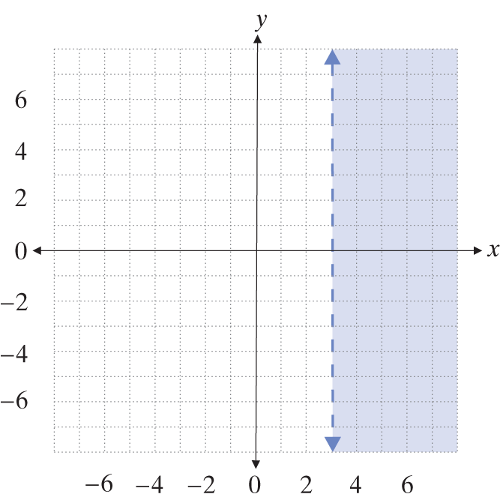
Example 1: Solving Linear Inequalities (cont.)

Slide 13

Example 2: Solving Linear Inequalities
Graph the solution sets that satisfy the following inequalities.
$5x−2y<10 and y≤x$
$x+y<4 or x≥4$

Slide 14
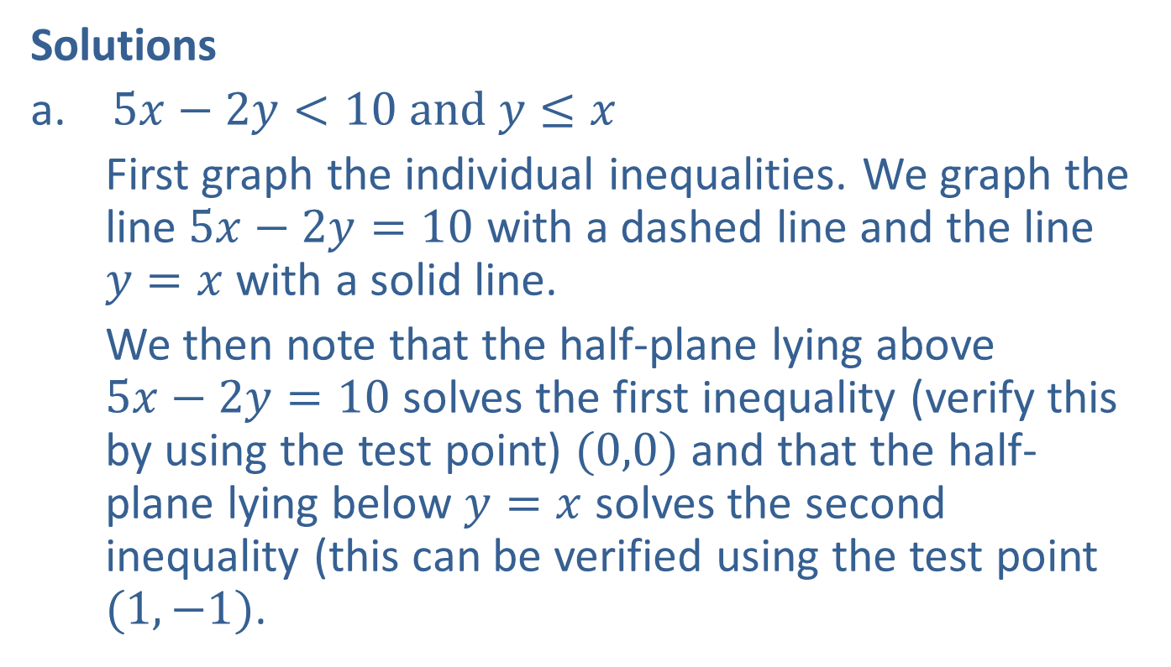
Example 2: Solving Linear Inequalities (cont.)
Solutions
$5x−2y<10 and y≤x$
First graph the individual inequalities. We graph the line $5x−2y=10$ with a dashed line and the line $y=x$ with a solid line.
We then note that the half-plane lying above
$5x−2y=10$ solves the first inequality (verify this by using the test point) $(0,0)$ and that the half-plane lying below $y=x$ solves the second inequality (this can be verified using the test point $(1,−1)$.

Slide 15
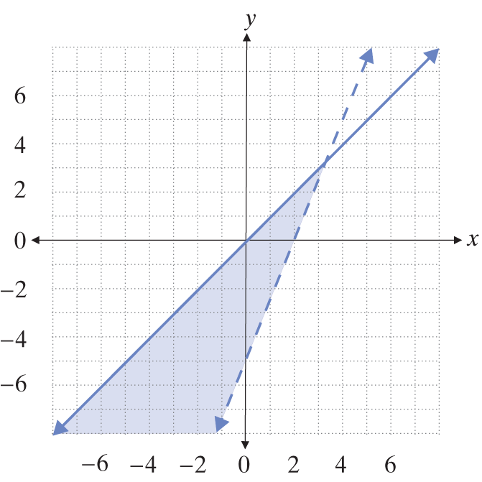
Example 2: Solving Linear Inequalities (cont.)
Since the two inequalities are joined by the word "and", we shade in the intersection of the two half-planes, resulting in the graph below.

Slide 16
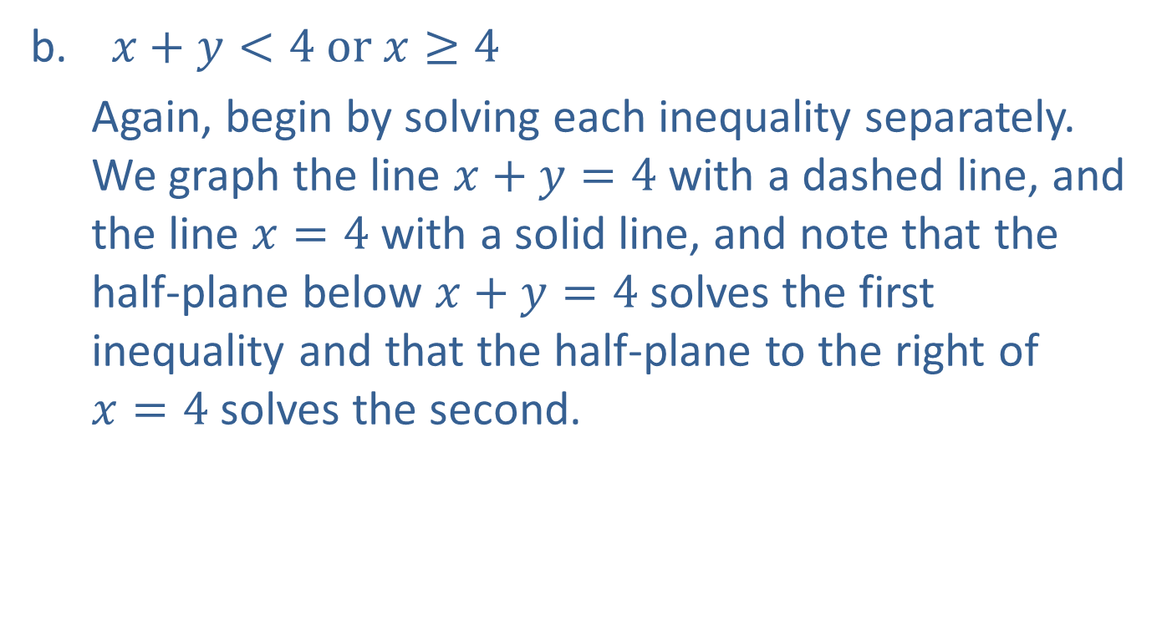
Example 2: Solving Linear Inequalities (cont.)
$x+y<4 or x≥4$
Again, begin by solving each inequality separately. We graph the line $x+y=4$ with a dashed line, and the line $x=4$ with a solid line, and note that the half-plane below $x+y=4$ solves the first inequality and that the half-plane to the right of
$x=4$ solves the second.

Slide 17
Example 2: Solving Linear Inequalities (cont.)
Since the two inequalities are joined by "or", we shade the union of the two half-planes. Note that this results in a larger shaded region than either of the two individual solutions. Any ordered pair in the shaded region will satisfy one or both of the inequalities.

Slide 18
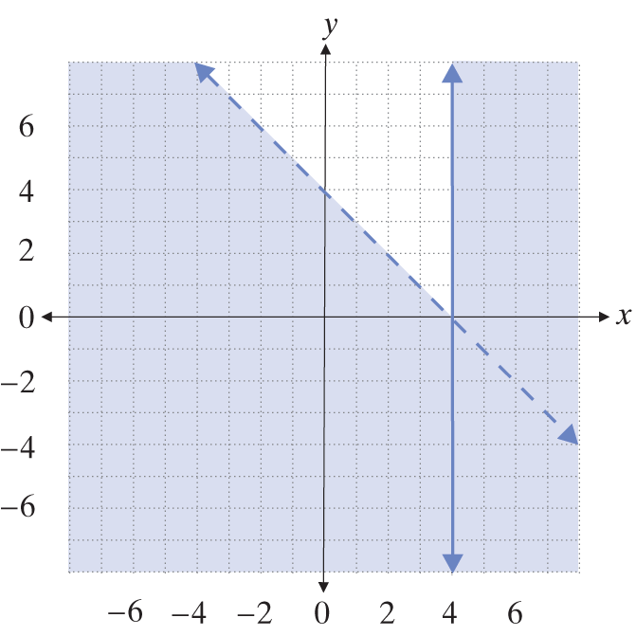
Example 2: Solving Linear Inequalities (cont.)

Slide 19
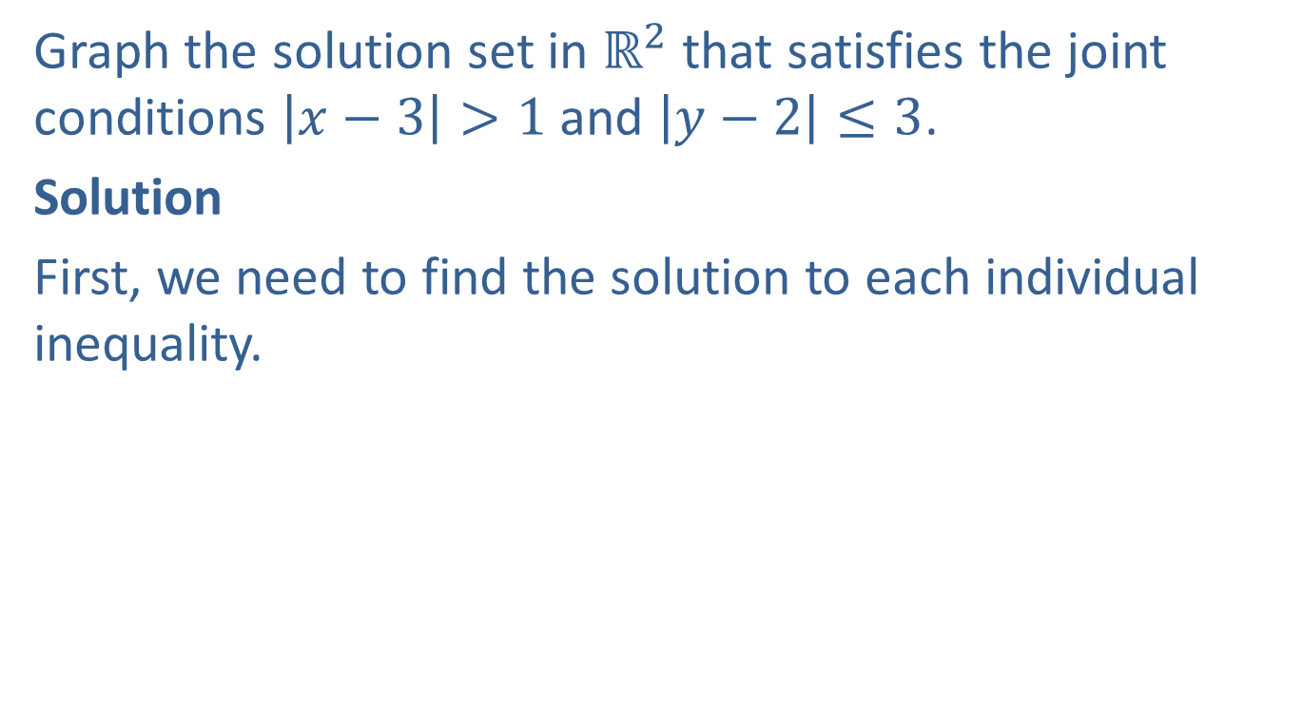
Example 3: Solving Absolute Value Linear Inequalities
Graph the solution set in $ℝ^{2}$ that satisfies the joint conditions $\left|x−3\right|>1$ and $\left|y−2\right|≤3$.
Solution
First, we need to find the solution to each individual inequality.

Slide 20
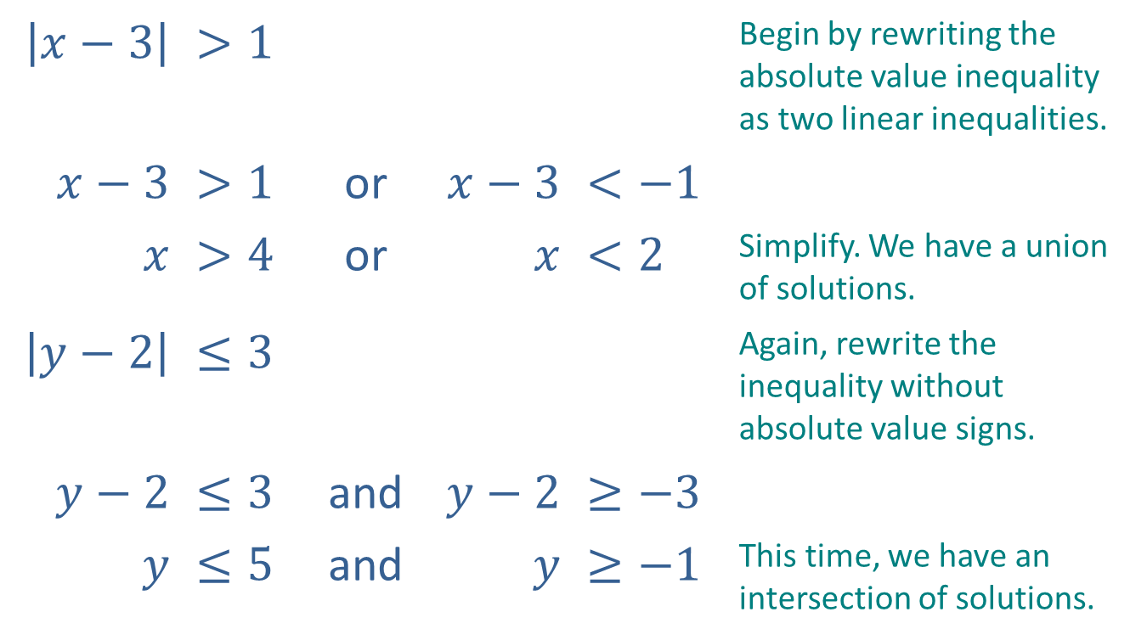
Example 3: Solving Absolute Value Linear Inequalities (cont.)
$$\left|x−3\right|$$ | $$>1$$ |  |  |  | Begin by rewriting the absolute value inequality as two linear inequalities.
$$x−3$$ | $$>1$$ | or | $$x−3$$ | $$<−1$$
$$x$$ | $$>4$$ | or | $$x$$ | $$<2$$ | Simplify. We have a union of solutions.
$$\left|y−2\right|$$ | $$≤3$$ |  |  |  | Again, rewrite the inequality without absolute value signs.
$$y−2$$ | $$≤3$$ | and | $$y−2$$ | $$≥−3$$
$$y$$ | $$≤5$$ | and | $$y$$ | $$≥−1$$ | This time, we have an intersection of solutions.

Slide 21
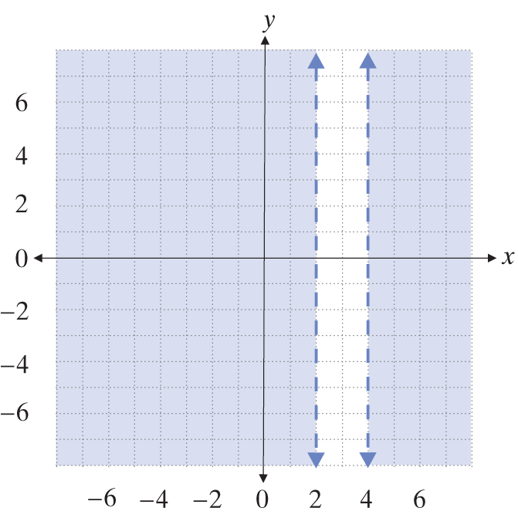
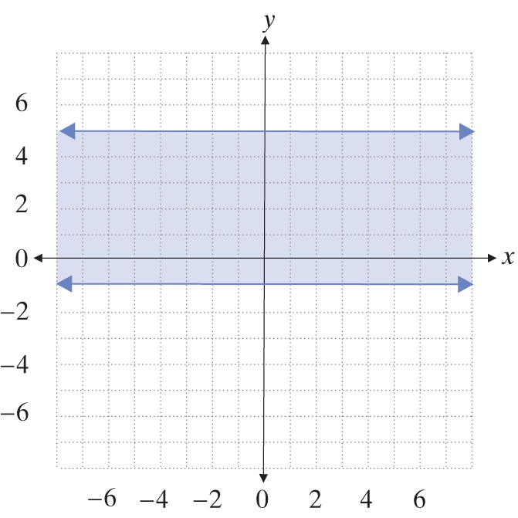

Example 3: Solving Absolute Value Linear Inequalities (cont.)
Now we can graph the solutions to the individual conditions:
$x<2 or x>4$ $y≥−1 and y≤5$

Slide 22
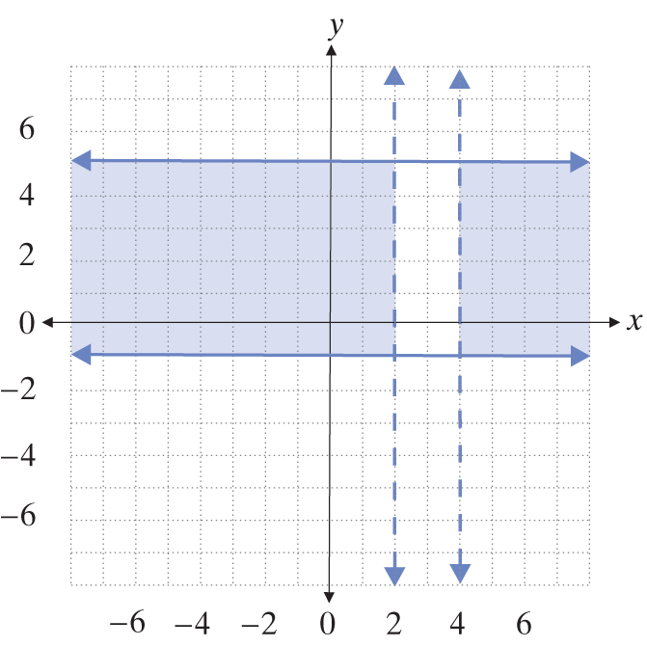

Example 3: Solving Absolute Value Linear Inequalities (cont.)
We now intersect the solution sets to obtain the final answer:
$$\left|x−3\right|>1 and \left|y−2\right|≤3$$

Slide 23
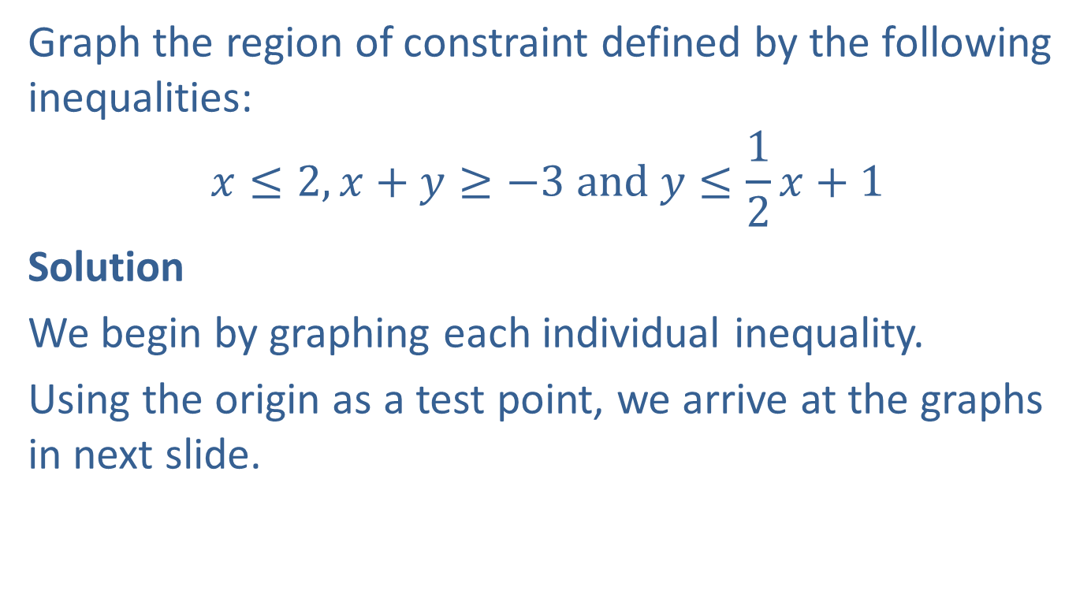
EXAMPLE 4: Graphing Regions of Constraint
Graph the region of constraint defined by the following inequalities:
$$x≤2,x+y≥−3 and y≤\frac{1}{2}x+1$$
Solution
We begin by graphing each individual inequality.
Using the origin as a test point, we arrive at the graphs in next slide.

Slide 24
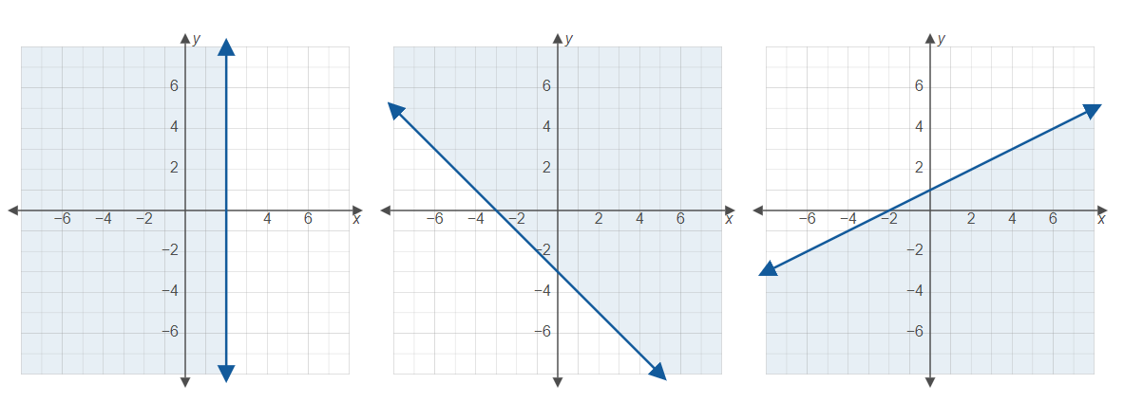
EXAMPLE 4: Graphing Regions of Constraint (cont.)

Slide 25
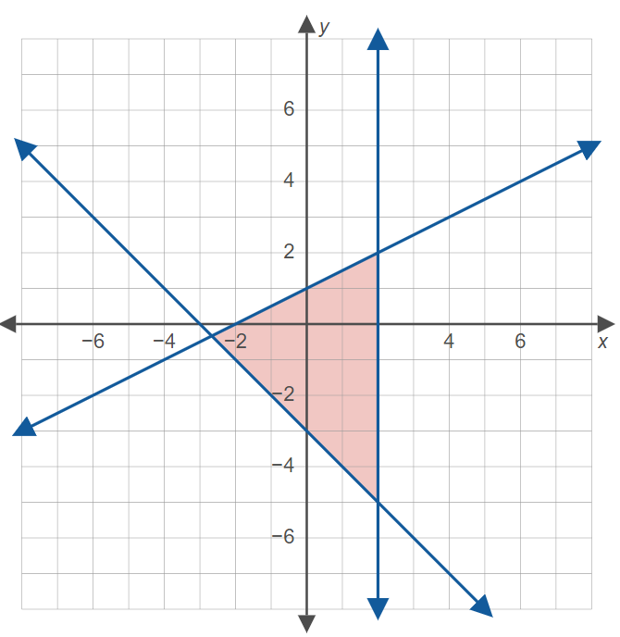
EXAMPLE 4: Graphing Regions of Constraint (cont.)
To obtain the region of constraint, we plot the intersection of the three individual solution sets.

Slide 26
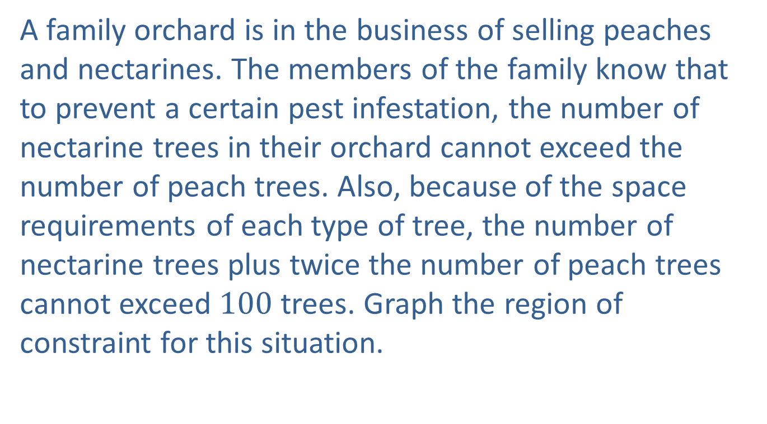
Example 5: Orchard Business
A family orchard is in the business of selling peaches and nectarines. The members of the family know that to prevent a certain pest infestation, the number of nectarine trees in their orchard cannot exceed the number of peach trees. Also, because of the space requirements of each type of tree, the number of nectarine trees plus twice the number of peach trees cannot exceed $100$ trees. Graph the region of constraint for this situation.

Slide 27
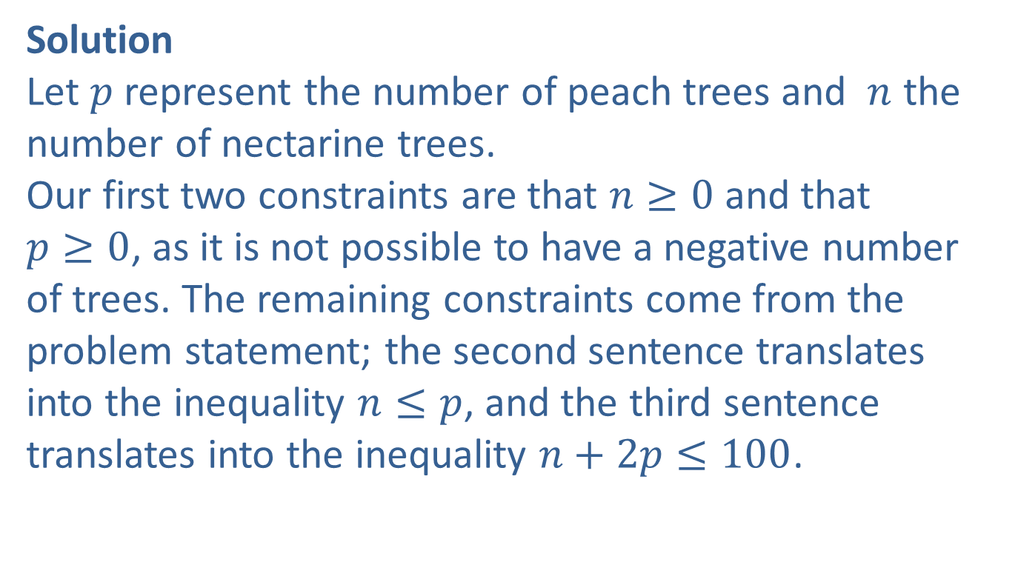
Example 5: Orchard Business (cont.)
Solution
Let $p$ represent the number of peach trees and $n$ the number of nectarine trees.
Our first two constraints are that $n≥0$ and that
$p≥0$, as it is not possible to have a negative number of trees. The remaining constraints come from the problem statement; the second sentence translates into the inequality $n≤p$, and the third sentence translates into the inequality $n+2p≤100$.

Slide 28
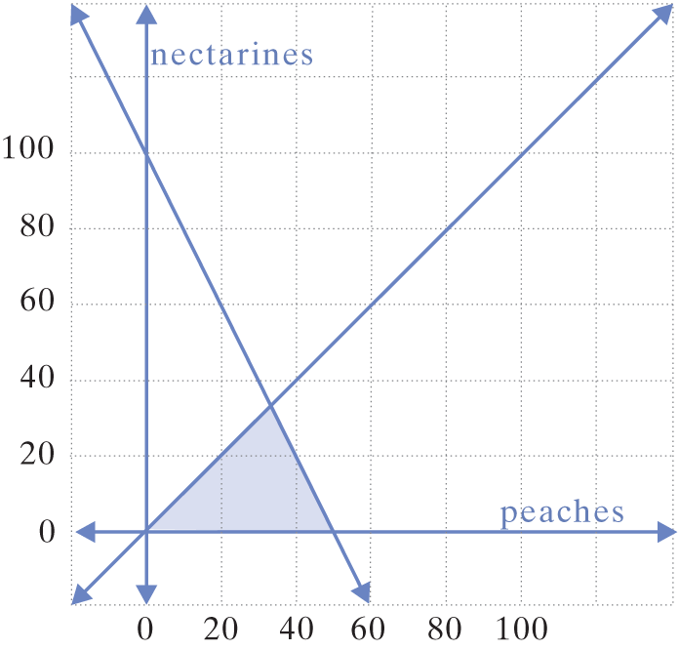
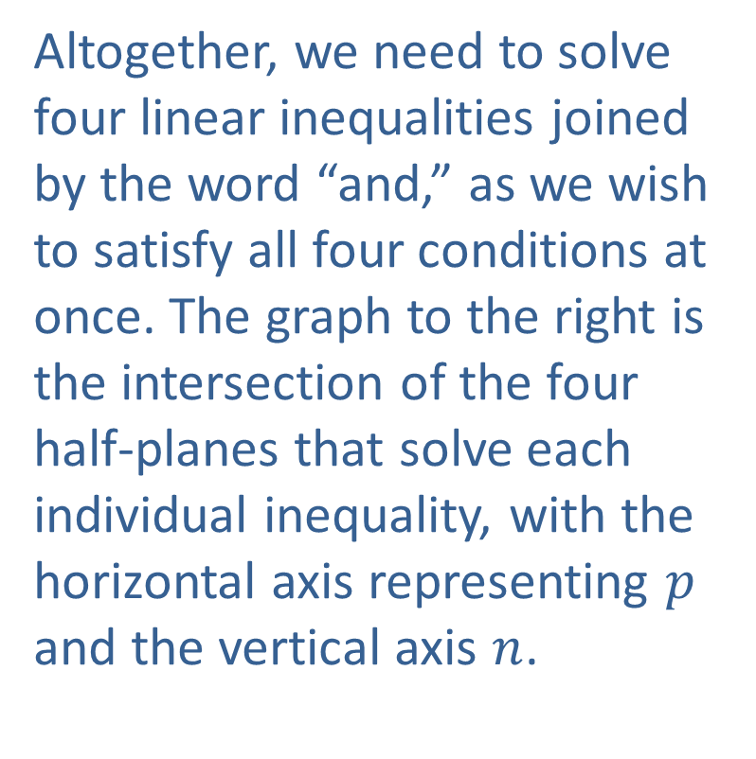
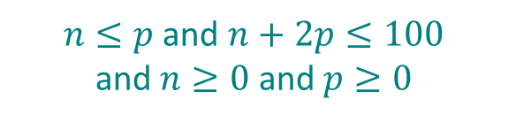
Example 5: Orchard Business (cont.)
Altogether, we need to solve four linear inequalities joined by the word “and,” as we wish to satisfy all four conditions at once. The graph to the right is the intersection of the four half-planes that solve each individual inequality, with the horizontal axis representing $p$ and the vertical axis $n$.
$n≤p$ and $n+2p≤100$
and $n≥0$ and $p≥0$

