Slide 1
Section 7.2
Linear Programming: The Graphical Approach

Slide 2
Objectives
Planar feasible regions.
Linear programming in two variables.

Slide 3
Example 1: Feasible Regions
A family orchard is in the business of selling peaches and nectarines. The owners know that to prevent a certain pest infestation, the number of nectarine trees in the orchard cannot exceed the number of peach trees. Also, because of the space requirements of each type of tree, the number of nectarine trees plus twice the number of peach trees cannot exceed 100 trees. Construct the constraints and graph the feasible region for this situation.

Slide 4
Example 1: Feasible Regions (cont.)
Solution:
Let p be the number of peach trees and n be the number of nectarine trees. The constraints given in the problem can now be written in terms of p and n.
The second sentence tells us that n ≤ p, and the third sentence tells us that n + 2p ≤ 100. Since we can't have a negative number of trees, we also know that n ≥ 0 and p ≥ 0.

Slide 5
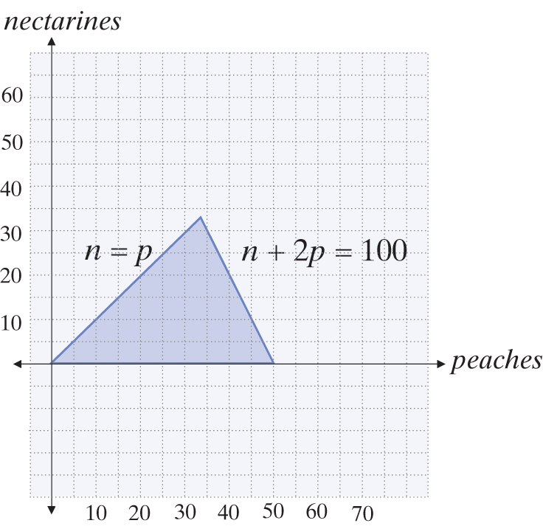
Example 1: Feasible Regions (cont.)
Letting the horizontal axis represent p and the vertical axis represent n, we can graph the feasible region defined by these constraints.

Slide 6
Example 1: Feasible Regions (cont.)
Any point (with integer coordinates) in the shaded feasible region corresponds to a certain number of peach trees and nectarine trees, and all such points meet the stated conditions.

Slide 7
Linear Programming in Two Variables
Linear Programming Method (Two-Variable Case)
Step 1: Identify the variables to be considered in the problem, determine all the constraints on the variables imposed by the problem, and sketch the feasible region described by the constraints.
Step 2: Determine the function that is to be either maximized or minimized. Such a function is called the objective function.

Slide 8
Linear Programming in Two Variables
Linear Programming Method (Two-Variable Case) (cont.)
Step 3: Evaluate the function at each of the vertices of the feasible region and compare the values found. If the feasible region is bounded, the optimum value of the function will occur at a vertex. If the feasible region is unbounded, the optimum value of the function may not exist, but if it does it will occur at a vertex.

Slide 9
Example 2: Linear Programming
Find the maximum and minimum values of
f(x, y) = 3x + 2y subject to the constraints

Slide 10
Example 2: Linear Programming (cont.)
Solution:
The two variables are given to us, as are the constraints; all we must do to complete the first step is sketch the region defined by the constraints. The figure below contains the sketch, with selected boundaries identified by their corresponding equations.
The function to be optimized is also given to us in this problem, so step two is complete. According to the linear programming method, then, the only remaining task is to evaluate the function at the vertices of the feasible region.

Slide 11
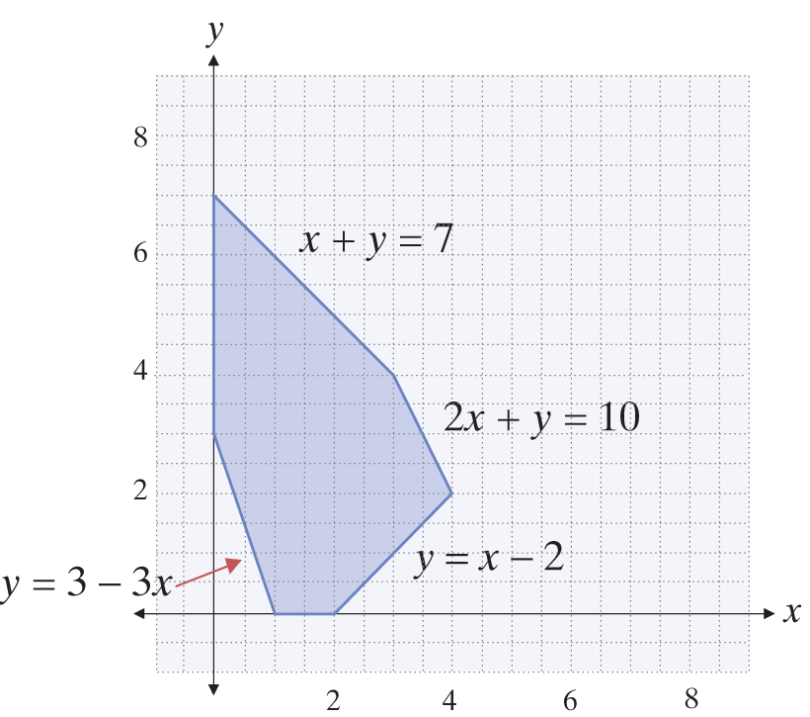
Example 2: Linear Programming (cont.)
Why should we expect the maximum and minimum values of f to occur at vertices, and not in the interior of the region?

Slide 12
Example 2: Linear Programming (cont.)
Another diagram will answer this question. The function f(x, y) will, of course, take on a variety of values at different ordered pairs (x, y). But for any particular value, say k, there will be a line of ordered pairs in the plane such that f(x, y) = k; such lines, for different values of k, will be parallel, as shown here. Two particular values for k are labeled in the diagram, and these values are the minimum and maximum values of f.

Slide 13
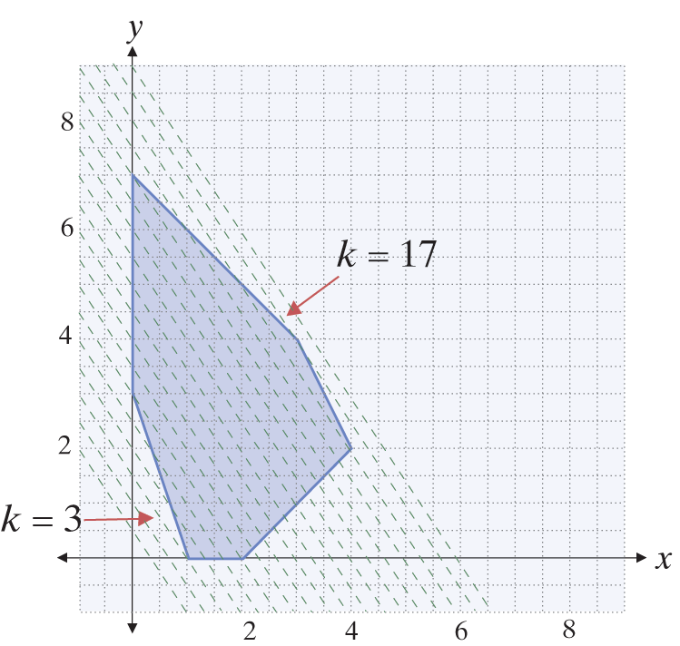
Example 2: Linear Programming (cont.)

Slide 14
Example 2: Linear Programming (cont.)
The extreme values of a linear function over a planar feasible region bounded by straight lines will thus occur where a line of constant value just touches the region, and this will be at a vertex or one of the edges of the region, if the edge is parallel to the line of constant value. In any event, evaluating the function at the vertices of the feasible region will suffice to identify the extreme values.
It is in the third step that the solution methods of this chapter are useful.

Slide 15
Example 2: Linear Programming (cont.)
Each vertex of a feasible region is the intersection of two edges, so the coordinates of each vertex are found by solving a system of two equations. The six vertices of the region in this problem are determined by the following six systems:

Slide 16
Example 2: Linear Programming (cont.)
Solving each of these systems, we find the vertices to be (3, 4), (4, 2), (2, 0), (1, 0), (0, 3), and (0, 7). Substituting each of these ordered pairs into the objective function we find the maximum value of 17 occurs at the vertex (3, 4), and the minimum value of 3 occurs at the vertex (1, 0).

Slide 17
Example 3: Linear Programming
Find the maximum and minimum values of f(x, y) = x + 2y subject to the constraints

Slide 18
Example 3: Linear Programming (cont.)
Solution:
The feasible region defined by the constraints is unbounded; a portion of its sketch appears to the right.
Because the region is unbounded, the function f may not have a maximum or a minimum value over the region. In this case, f has no maximum value. One way to see this is to note that ordered pairs of the form
(x, x) lie in the region for all and
f(x, x) = x + 2x = 3x grows without bound as x increases.

Slide 19
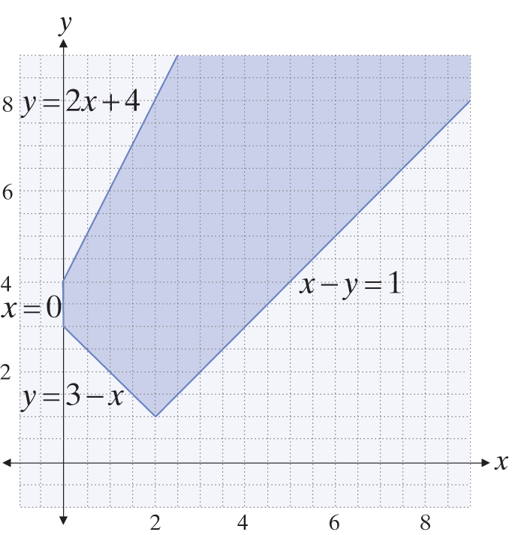
Example 3: Linear Programming (cont.)

Slide 20
Example 3: Linear Programming (cont.)
On the other hand, f does have a minimum value over the feasible region. The three vertices are (0, 4), (0, 3), and (2, 1). Evaluating the function at these points, we obtain f(0, 4) = 8, f(0, 3) = 6, and f(2, 1) = 4, so the minimum value is 4.

Slide 21
Example 4: Linear Programming
A manufacturer makes two models of minidisc players. Model A requires 3 minutes to assemble, 4 minutes to test, and 1 minute to package. Model B requires 4 minutes to assemble, 3 minutes to test, and 6 minutes to package. The manufacturer can allot 7400 minutes total for assembly, 8000 minutes for testing, and 9000 minutes for packaging. Model A generates a profit of $7.00 and model B generates a profit of $8.00. How many of each model should be made in order to maximize profit?

Slide 22
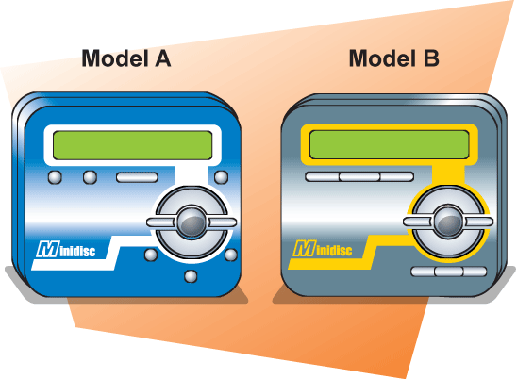
Example 4: Linear Programming (cont.)
Solution:
If we let x denote the number of Model A players made and y the number of Model B players made, the constraint inequalities are

Slide 23
Example 4: Linear Programming (cont.)
The profit function in this situation is f(x, y) = 7x + 8y, and our goal is to maximize this function. The vertices of the feasible region are: (0, 1500), (600, 1400), (1400, 800), (2000, 0), and (0, 0). Of course, manufacturing 0 units of Model A and Model B is not going to be profitable, so we really only need to evaluate f at four vertices:

Slide 24
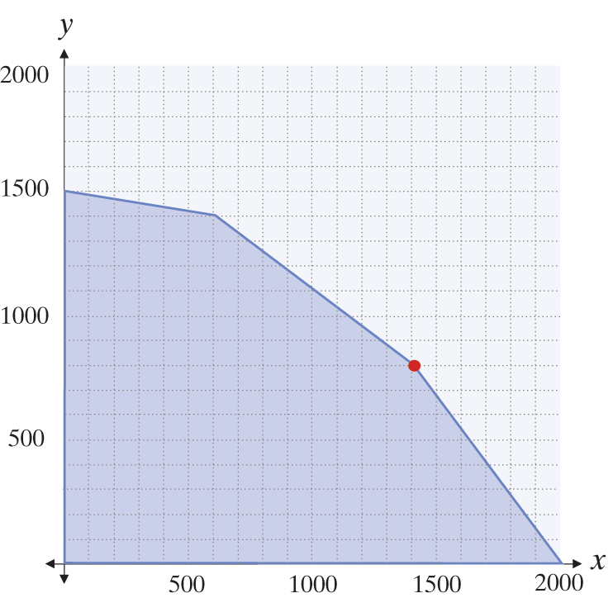
Example 4: Linear Programming (cont.)
f(0, 1500) = 12,000
f(600, 1400) = 15,400
f(1400, 800) = 16,200
f(2000, 0) = 14,000

Slide 25
Example 4: Linear Programming (cont.)
From these calculations, we conclude that the maximum profit is generated from making 1400 units of Model A and 800 units of Model B. The maximum profit would be $16,200.

