Slide 1
Section 7.3
The Simplex Method: Maximization

Slide 2

Example 1: Comparing the Simplex Method to the Graphical Approach
Find the maximum value of $f\left(x,y\right)=5x+8y$ subject to the following constraints.
$$\left\{\begin{aligned}x+8y≤56 \\ 2x+2y≤21\end{aligned}\right.$$

Slide 3

Example 1: Comparing the Simplex Method to the Graphical Approach (cont.)
Solution
The Graphical Approach: The feasible region, shown in the graph below, is in the first quadrant bounded by the lines $x+8y=56$ and $2x+2y=21$.

Slide 4
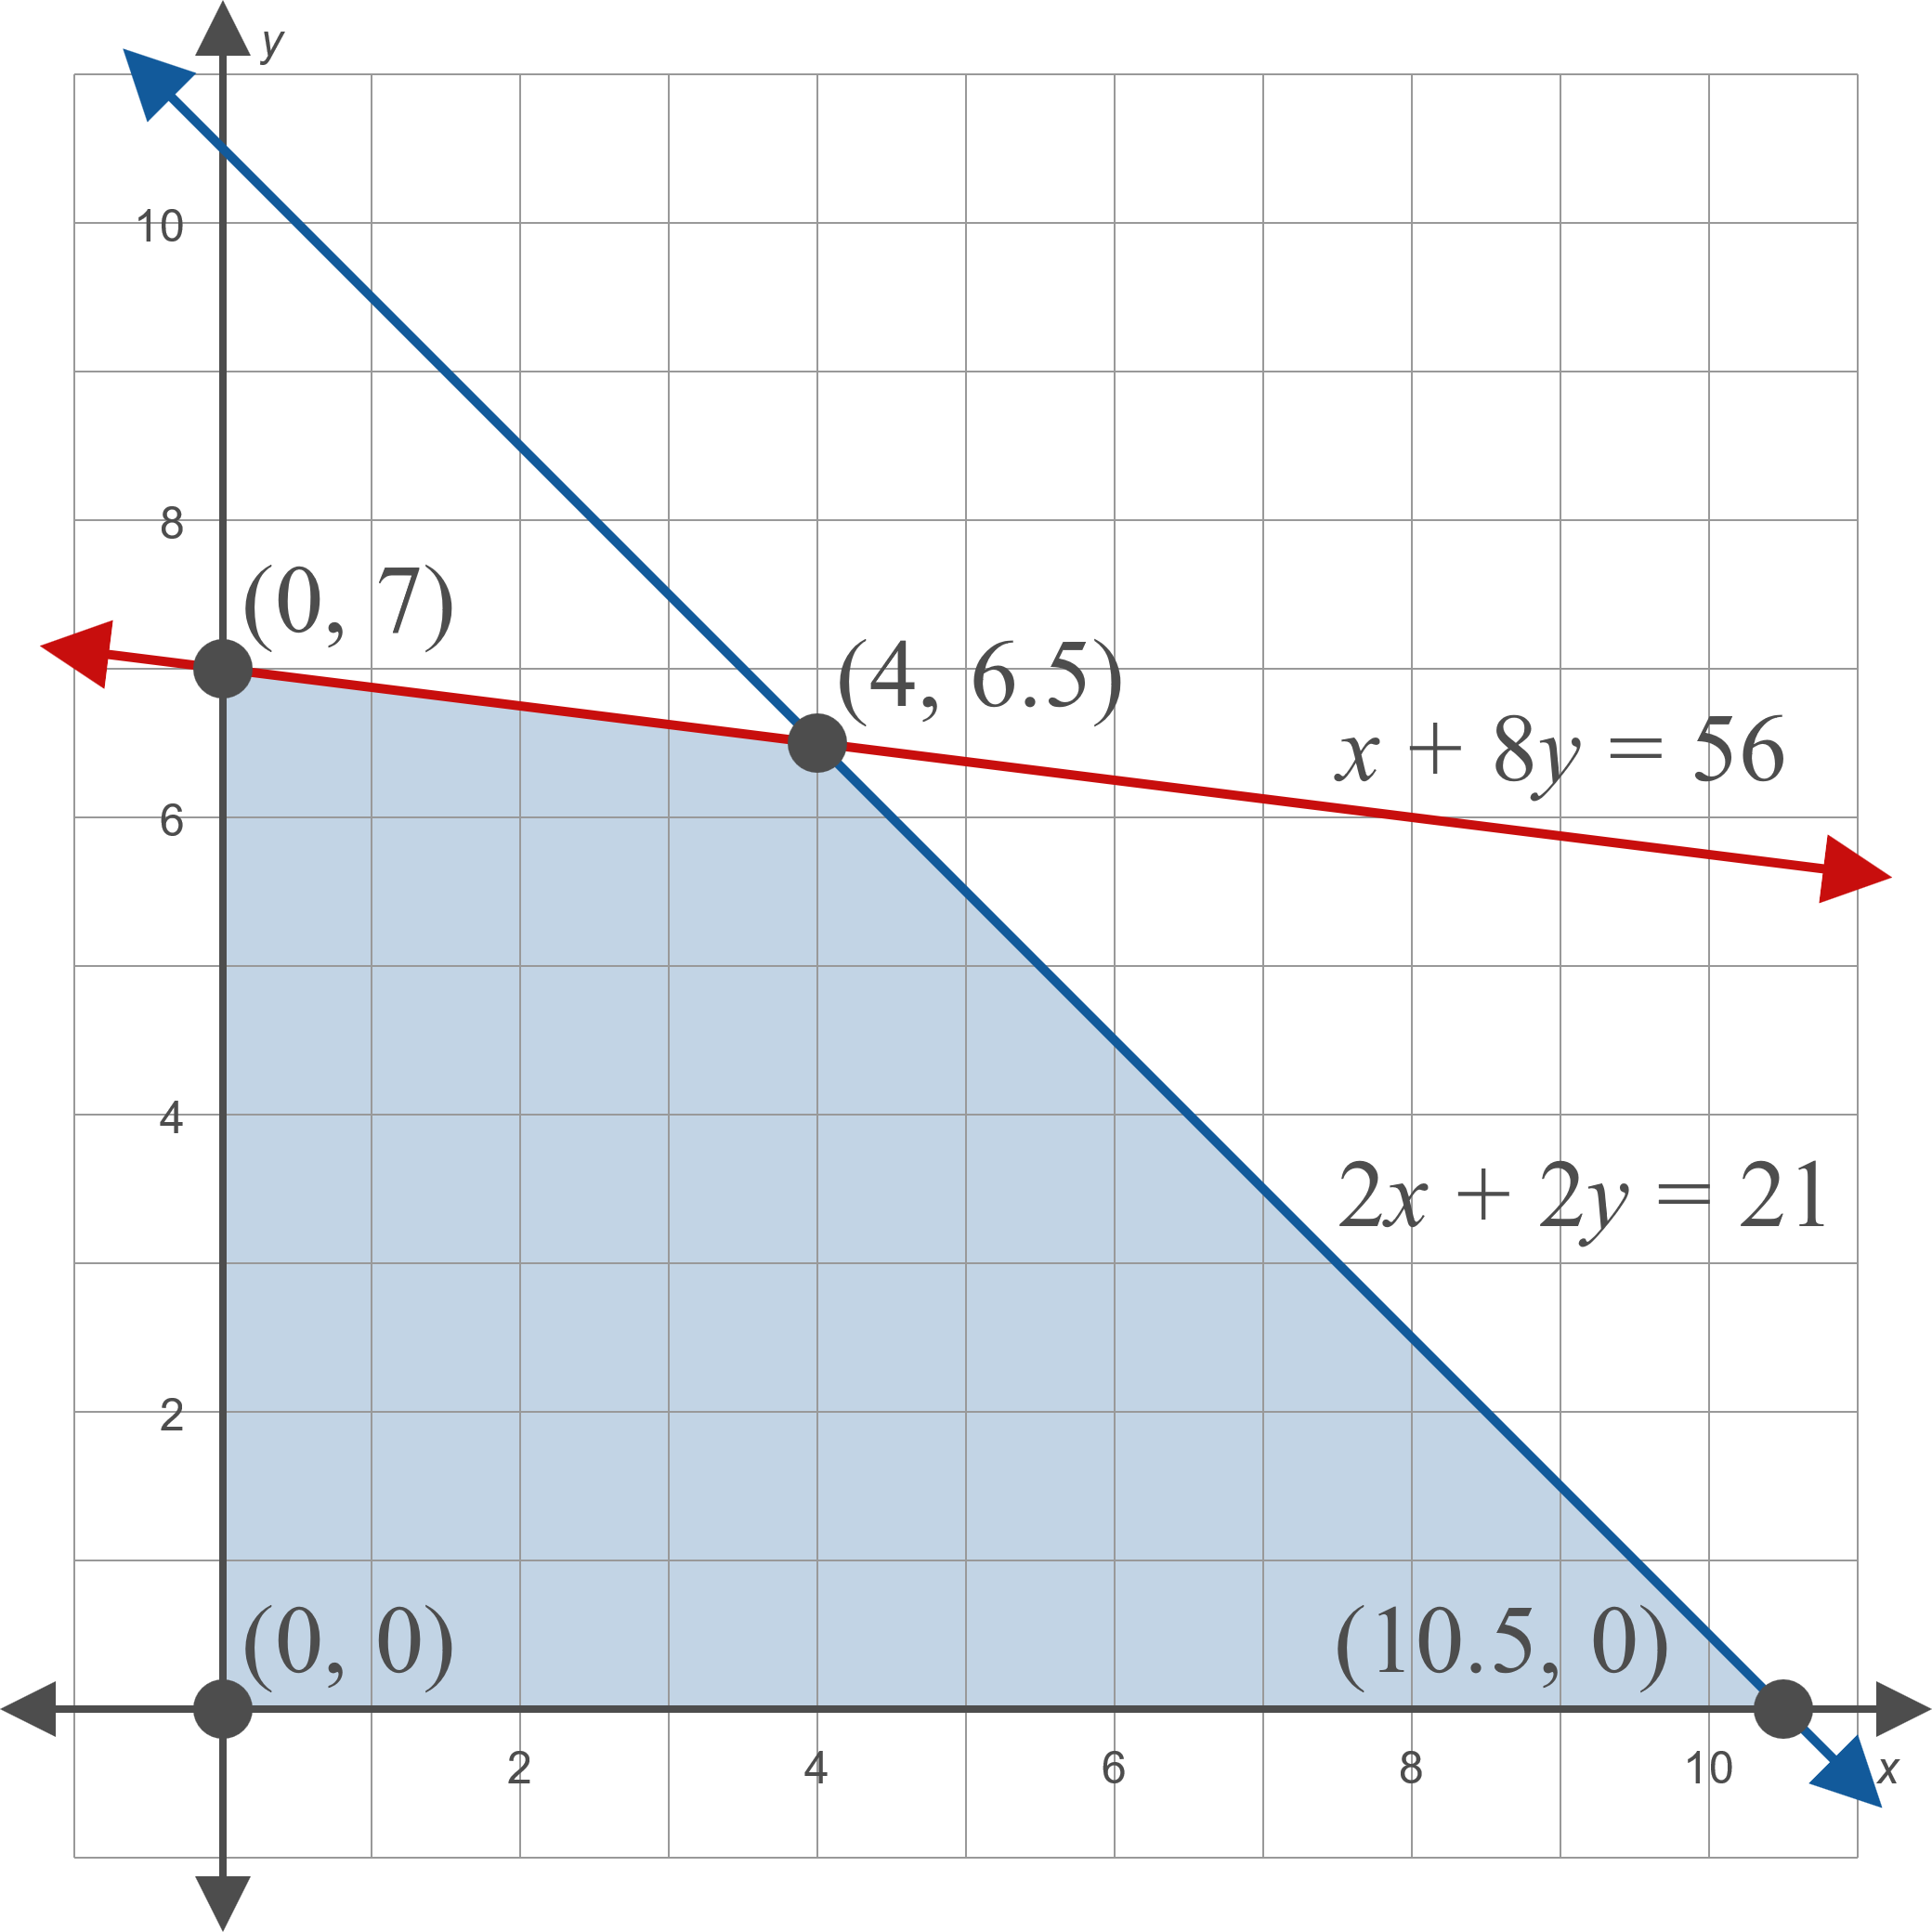
Example 1: Comparing the Simplex Method to the Graphical Approach (cont.)

Slide 5
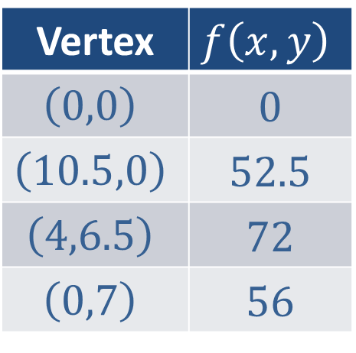

Example 1: Comparing the Simplex Method to the Graphical Approach (cont.)
Now we find the value of $f⁡\left(x,y\right)$ at each vertex.
Therefore, the maximum value of $f$ is 72, and it is attained at $\left(4,6.5\right)$.
Vertex | $$f⁡\left(x,y\right)$$
$$\left(0,0\right)$$ | 0
$$\left(10.5,0\right)$$ | 52.5
$$\left(4,6.5\right)$$ | 72
$$\left(0,7\right)$$ | 56

Slide 6
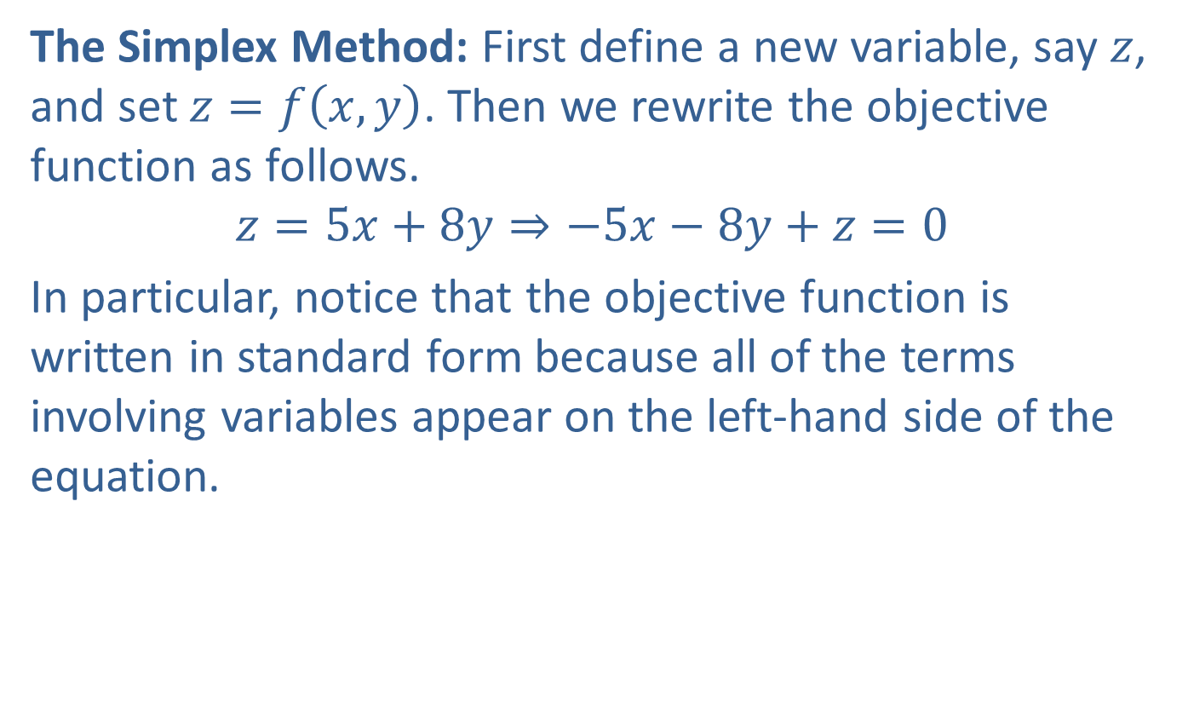
Example 1: Comparing the Simplex Method to the Graphical Approach (cont.)
The Simplex Method: First define a new variable, say $z$, and set $z=f\left(x,y\right)$. Then we rewrite the objective function as follows.
$$z=5x+8y⇒−5x−8y+z=0$$
In particular, notice that the objective function is written in standard form because all of the terms involving variables appear on the left-hand side of the equation.

Slide 7
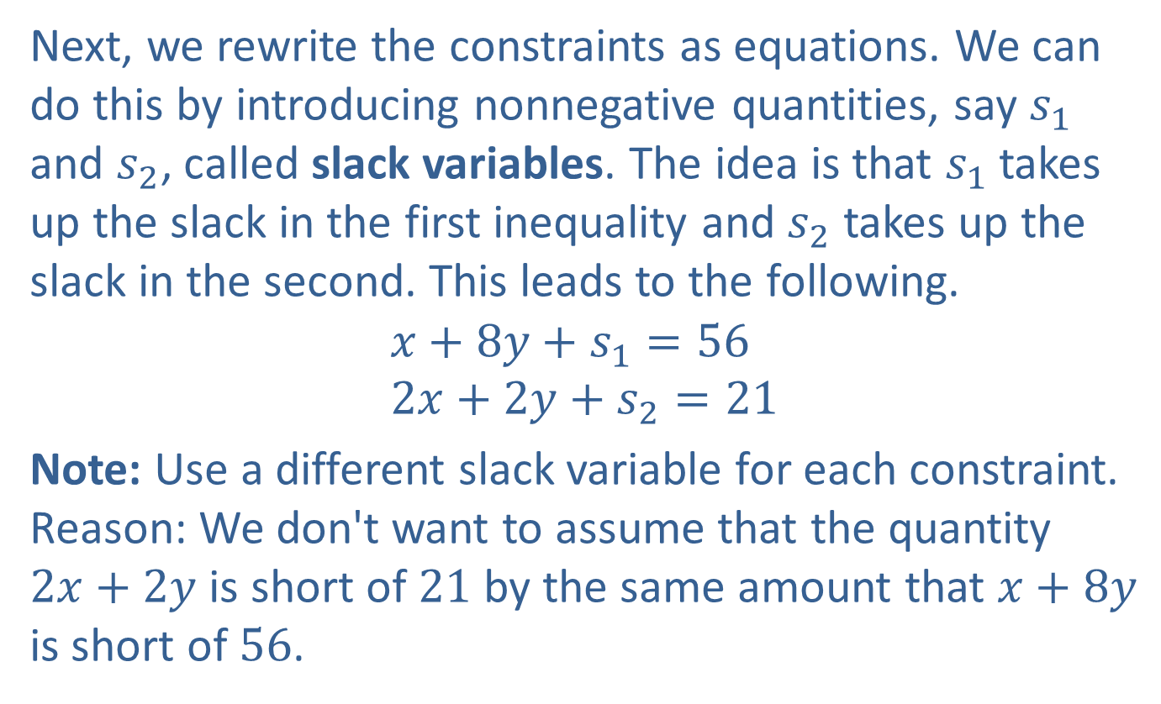
Example 1: Comparing the Simplex Method to the Graphical Approach (cont.)
Next, we rewrite the constraints as equations. We can do this by introducing nonnegative quantities, say $s_{1}$ and $s_{2}$, called slack variables. The idea is that $s_{1}$ takes up the slack in the first inequality and $s_{2}$ takes up the slack in the second. This leads to the following.
$$x+8y+s_{1}=56 \\ 2x+2y+s_{2}=21$$
Note: Use a different slack variable for each constraint. Reason: We don't want to assume that the quantity $2x+2y$ is short of 21 by the same amount that $x+8y$ is short of 56.

Slide 8
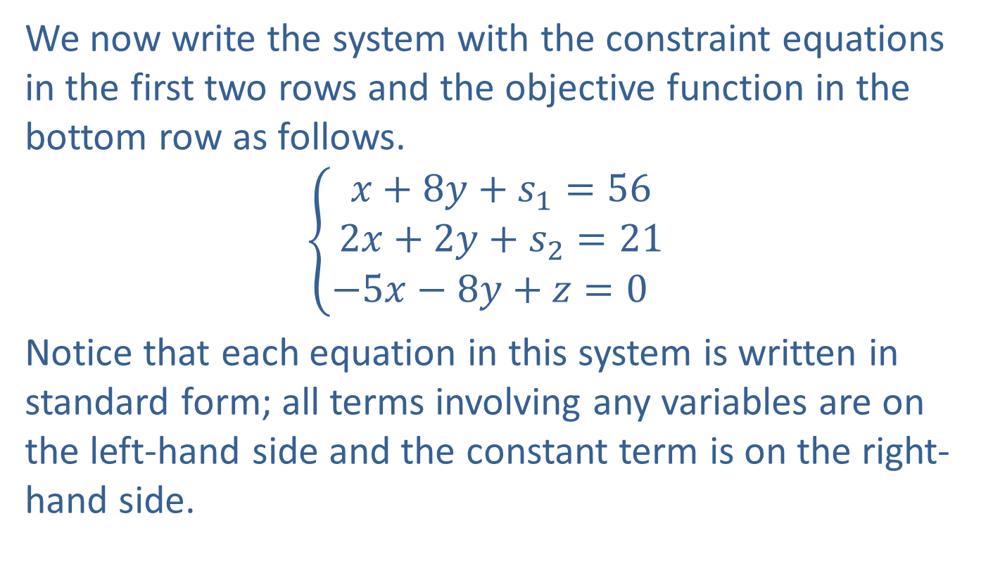
Example 1: Comparing the Simplex Method to the Graphical Approach (cont.)
We now write the system with the constraint equations in the first two rows and the objective function in the bottom row as follows.
𝑥+8𝑦+𝑠1=562𝑥+2𝑦+𝑠2=21−5𝑥−8𝑦+𝑧=00
Notice that each equation in this system is written in standard form; all terms involving any variables are on the left-hand side and the constant term is on the right-hand side.

Slide 9
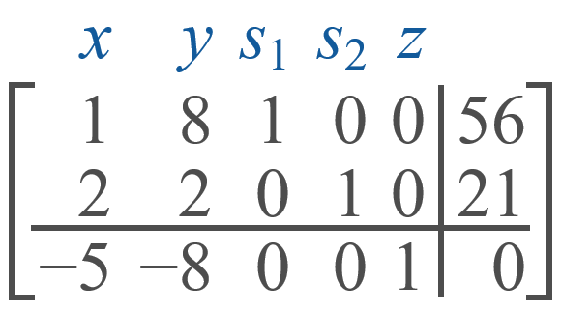
Example 1: Comparing the Simplex Method to the Graphical Approach (cont.)
We then form the augmented matrix corresponding to this system. This is called the initial simplex tableau. In this example, the initial simplex tableau is as follows.

Slide 10
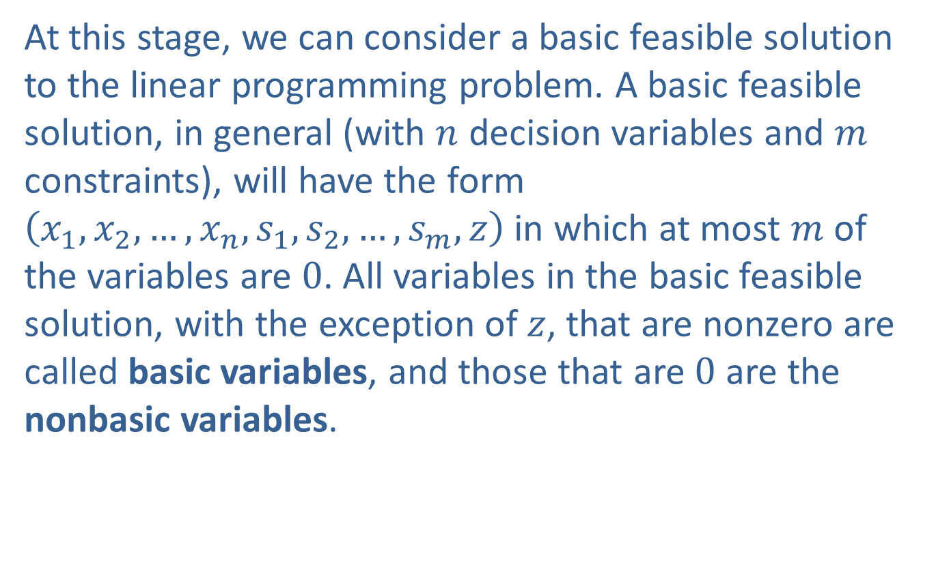
Example 1: Comparing the Simplex Method to the Graphical Approach (cont.)
At this stage, we can consider a basic feasible solution to the linear programming problem. A basic feasible solution, in general (with $n$ decision variables and $m$ constraints), will have the form $\left(x_{1},x_{2},…,x_{n},s_{1},s_{2},…,s_{m},z\right)$ in which at most $m$ of the variables are 0. All variables in the basic feasible solution, with the exception of $z$, that are nonzero are called basic variables, and those that are 0 are the nonbasic variables.

Slide 11
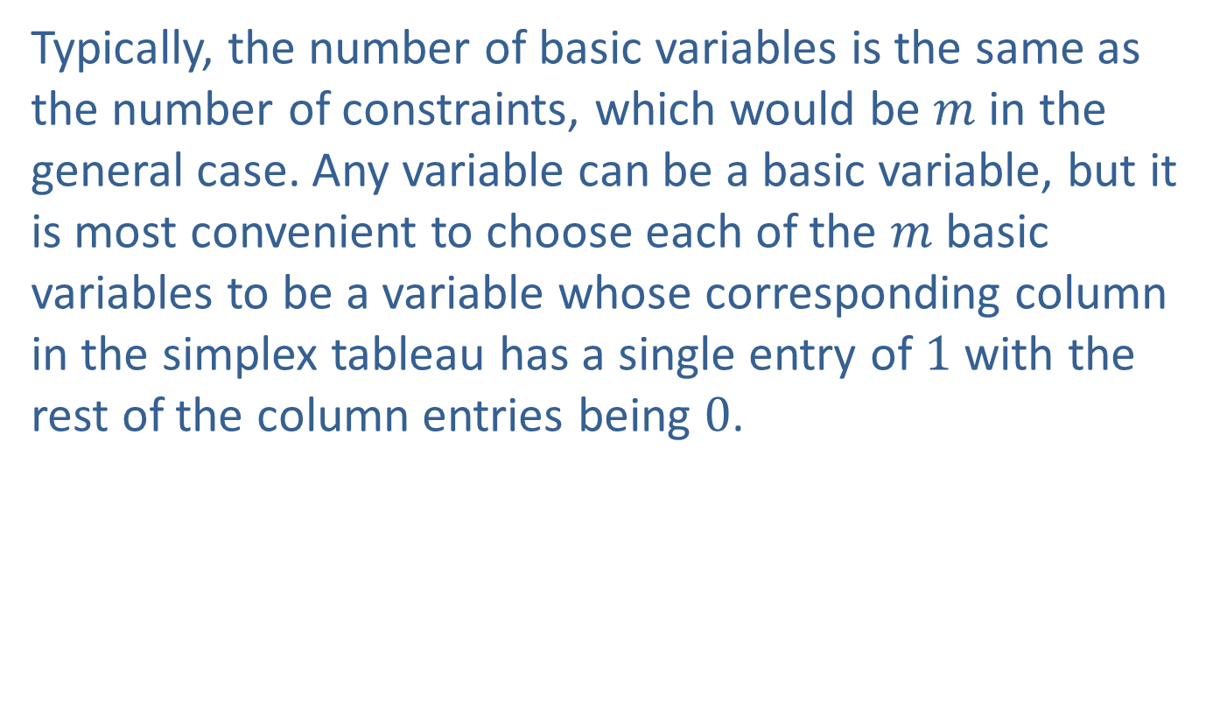
Example 1: Comparing the Simplex Method to the Graphical Approach (cont.)
Typically, the number of basic variables is the same as the number of constraints, which would be $m$ in the general case. Any variable can be a basic variable, but it is most convenient to choose each of the $m$ basic variables to be a variable whose corresponding column in the simplex tableau has a single entry of 1 with the rest of the column entries being 0.

Slide 12
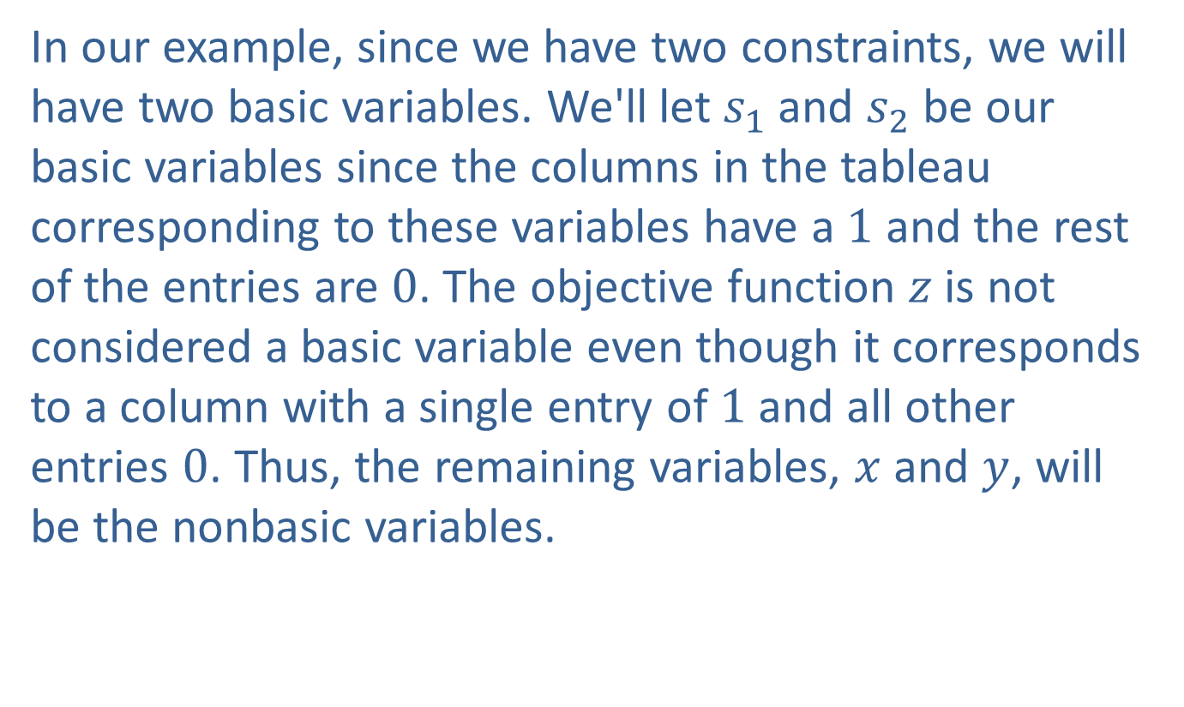
Example 1: Comparing the Simplex Method to the Graphical Approach (cont.)
In our example, since we have two constraints, we will have two basic variables. We'll let $s_{1}$ and $s_{2}$ be our basic variables since the columns in the tableau corresponding to these variables have a 1 and the rest of the entries are 0. The objective function $z$ is not considered a basic variable even though it corresponds to a column with a single entry of 1 and all other entries 0. Thus, the remaining variables, $x$ and $y$, will be the nonbasic variables.

Slide 13
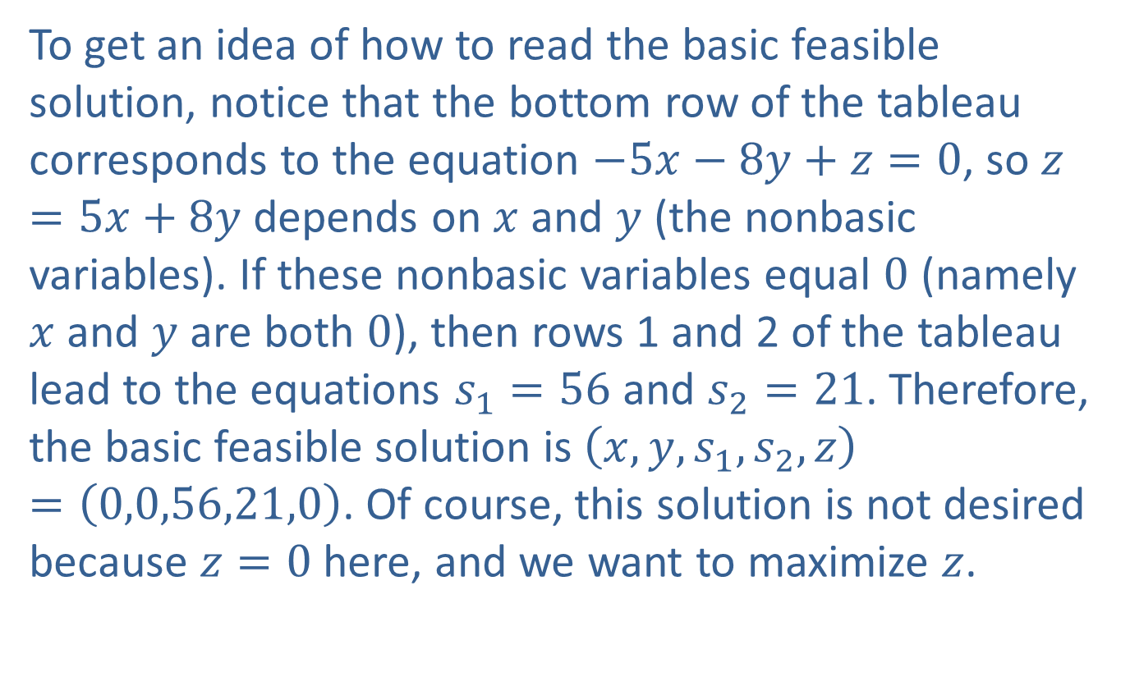
Example 1: Comparing the Simplex Method to the Graphical Approach (cont.)
To get an idea of how to read the basic feasible solution, notice that the bottom row of the tableau corresponds to the equation $−5x−8y+z=0$, so $z=5x+8y$ depends on $x$ and $y$ (the nonbasic variables). If these nonbasic variables equal 0 (namely $x$ and $y$ are both 0), then rows 1 and 2 of the tableau lead to the equations $s_{1}=56$ and $s_{2}=21$. Therefore, the basic feasible solution is $\left(x,y,s_{1},s_{2},z\right)=\left(0,0,56,21,0\right)$. Of course, this solution is not desired because $z=0$ here, and we want to maximize $z$.

Slide 14
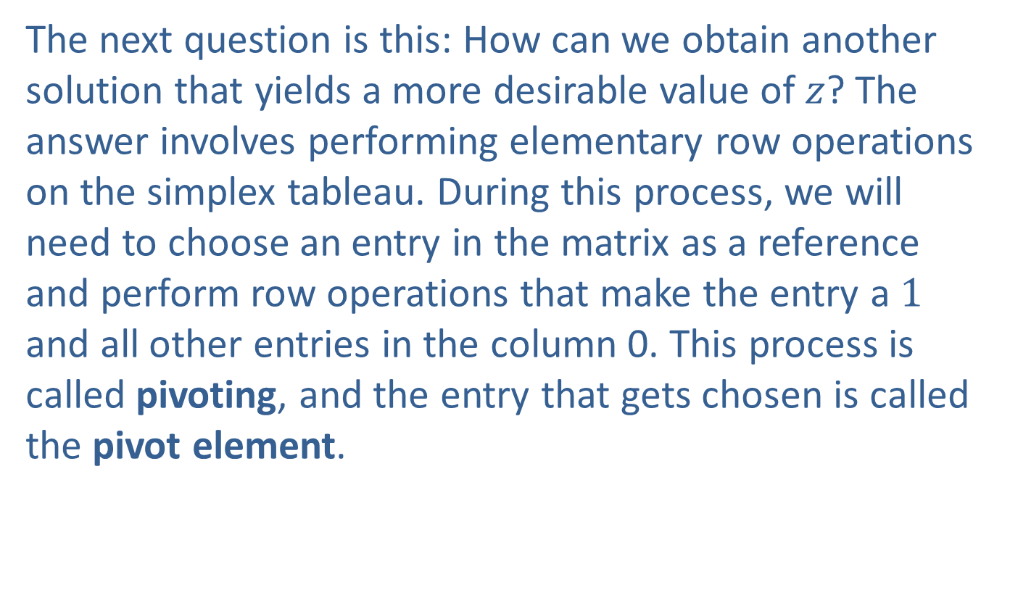
Example 1: Comparing the Simplex Method to the Graphical Approach (cont.)
The next question is this: How can we obtain another solution that yields a more desirable value of $z$? The answer involves performing elementary row operations on the simplex tableau. During this process, we will need to choose an entry in the matrix as a reference and perform row operations that make the entry a 1 and all other entries in the column 0. This process is called pivoting, and the entry that gets chosen is called the pivot element.

Slide 15
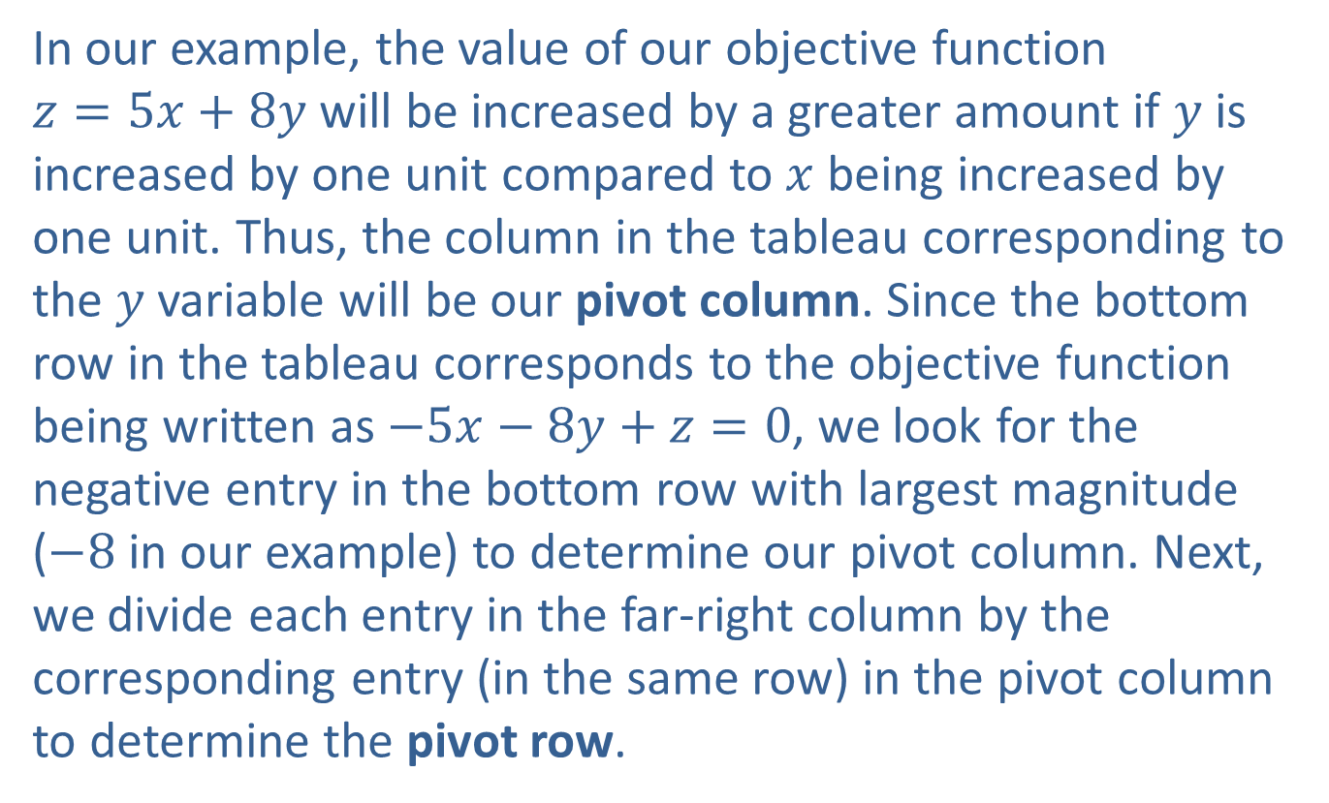
Example 1: Comparing the Simplex Method to the Graphical Approach (cont.)
In our example, the value of our objective function $z=5x+8y$ will be increased by a greater amount if $y$ is increased by one unit compared to $x$ being increased by one unit. Thus, the column in the tableau corresponding to the $y$ variable will be our pivot column. Since the bottom row in the tableau corresponds to the objective function being written as $−5x−8y+z=0$, we look for the negative entry in the bottom row with largest magnitude ($−8$ in our example) to determine our pivot column. Next, we divide each entry in the far-right column by the corresponding entry (in the same row) in the pivot column to determine the pivot row.

Slide 16
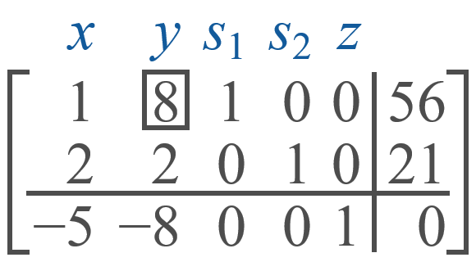
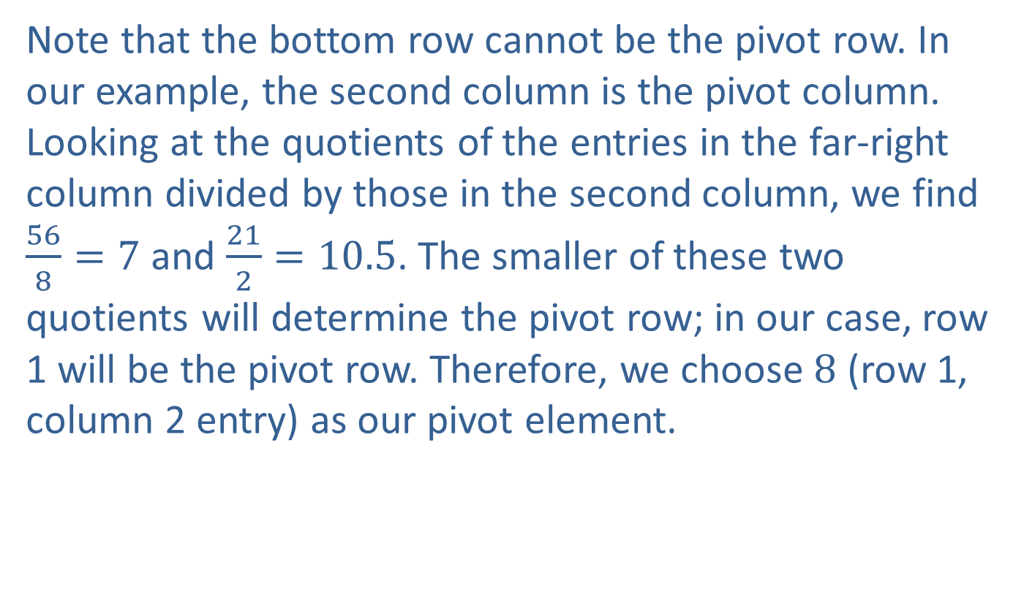
Example 1: Comparing the Simplex Method to the Graphical Approach (cont.)
Note that the bottom row cannot be the pivot row. In our example, the second column is the pivot column. Looking at the quotients of the entries in the far-right column divided by those in the second column, we find $\frac{56}{8}=7$ and $\frac{21}{2}=10.5$. The smaller of these two quotients will determine the pivot row; in our case, row 1 will be the pivot row. Therefore, we choose 8 (row 1, column 2 entry) as our pivot element.

Slide 17
Example 1: Comparing the Simplex Method to the Graphical Approach (cont.)
Next, we illustrate the pivoting process on column 2. Perform elementary row operations using the pivot row so that a 1 appears in the pivot position and all other entries in the pivot column are 0.

Slide 18
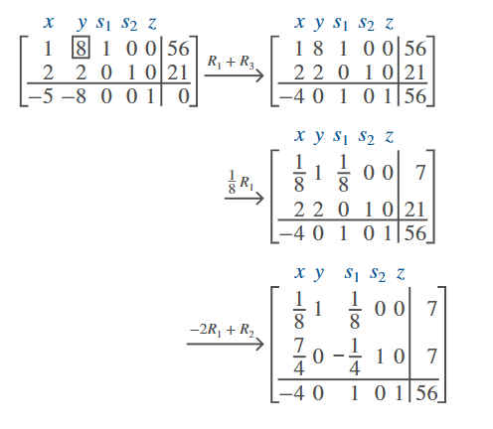
Example 1: Comparing the Simplex Method to the Graphical Approach (cont.)

Slide 19
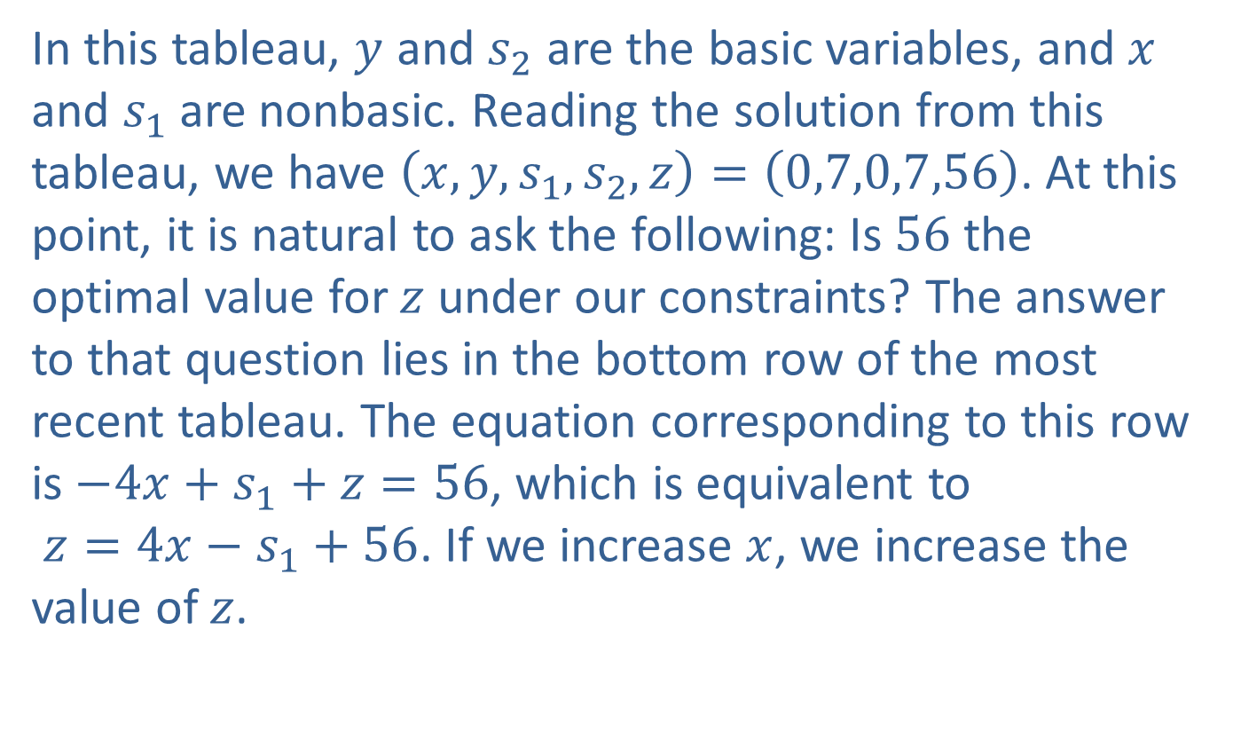
Example 1: Comparing the Simplex Method to the Graphical Approach (cont.)
In this tableau, $y$ and $s_{2}$ are the basic variables, and $x$ and $s_{1}$ are nonbasic. Reading the solution from this tableau, we have $\left(x,y,s_{1},s_{2},z\right)=\left(0,7,0,7,56\right)$. At this point, it is natural to ask the following: Is 56 the optimal value for $z$ under our constraints? The answer to that question lies in the bottom row of the most recent tableau. The equation corresponding to this row is $−4x+s_{1}+z=56$, which is equivalent to $z=4x−s_{1}+56$. If we increase $x$, we increase the value of $z$.

Slide 20
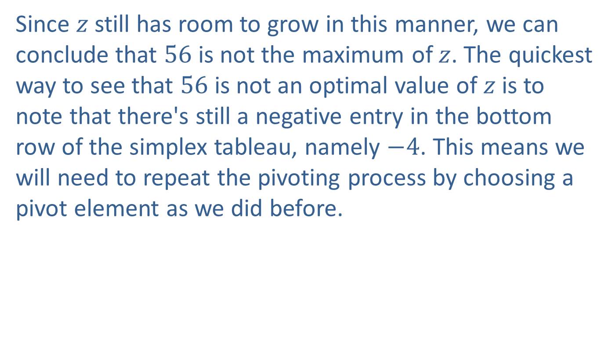
Example 1: Comparing the Simplex Method to the Graphical Approach (cont.)
Since $z$ still has room to grow in this manner, we can conclude that 56 is not the maximum of $z$. The quickest way to see that 56 is not an optimal value of $z$ is to note that there's still a negative entry in the bottom row of the simplex tableau, namely $−4$. This means we will need to repeat the pivoting process by choosing a pivot element as we did before.

Slide 21
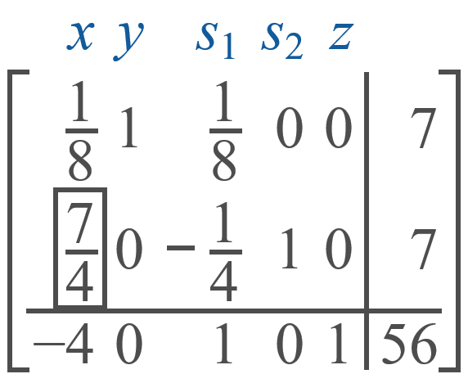
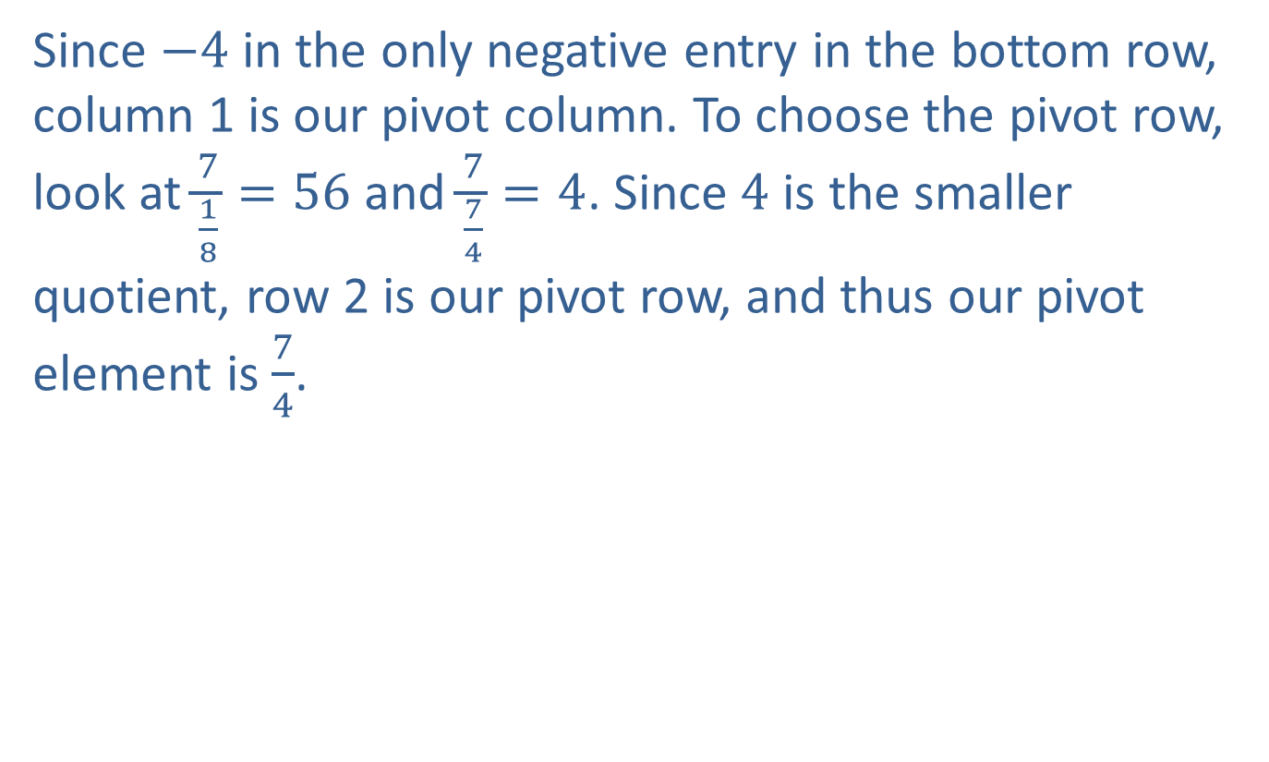
Example 1: Comparing the Simplex Method to the Graphical Approach (cont.)
Since $−4$ in the only negative entry in the bottom row, column 1 is our pivot column. To choose the pivot row, look at $\frac{7}{\frac{1}{8}}=56$ and $\frac{7}{\frac{7}{4}}=4$. Since 4 is the smaller quotient, row 2 is our pivot row, and thus our pivot element is $\frac{7}{4}$.

Slide 22
Example 1: Comparing the Simplex Method to the Graphical Approach (cont.)
We now do the pivoting process on column 1 by performing elementary row operations until a 1 appears in the pivot position and all other entries in the pivot column are 0.

Slide 23
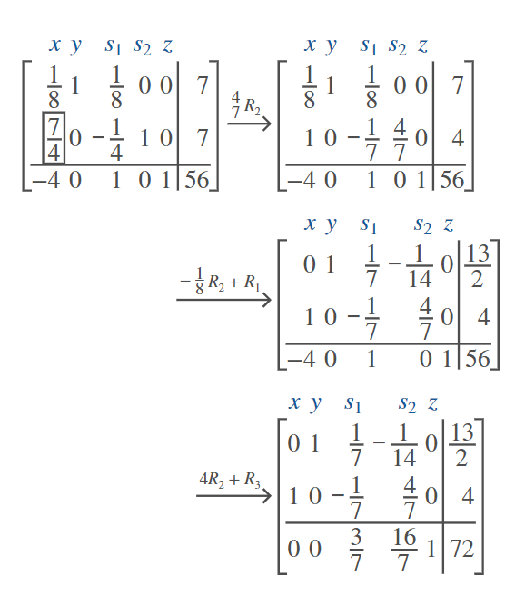
Example 1: Comparing the Simplex Method to the Graphical Approach (cont.)

Slide 24
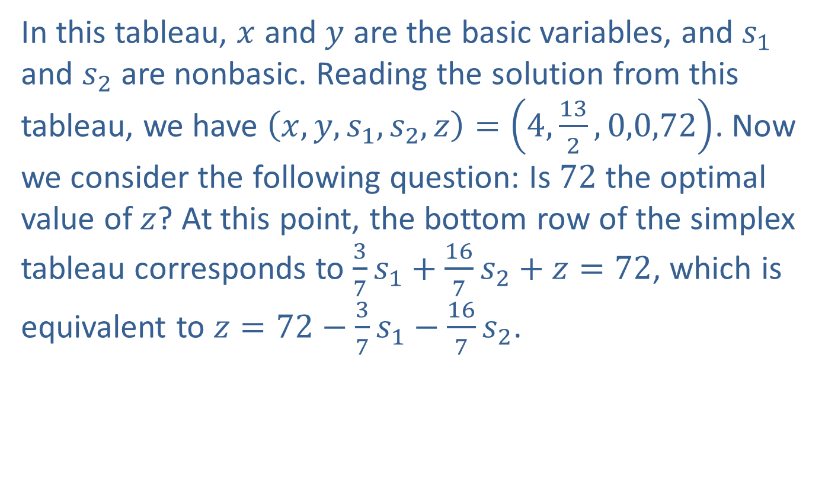
Example 1: Comparing the Simplex Method to the Graphical Approach (cont.)
In this tableau, $x$ and $y$ are the basic variables, and $s_{1}$ and $s_{2}$ are nonbasic. Reading the solution from this tableau, we have $\left(x,y,s_{1},s_{2},z\right)=\left(4,\frac{13}{2},0,0,72\right)$. Now we consider the following question: Is 72 the optimal value of $z$? At this point, the bottom row of the simplex tableau corresponds to $\frac{3}{7}s_{1}+\frac{16}{7}s_{2}+z=72$, which is equivalent to $z=72−\frac{3}{7}s_{1}−\frac{16}{7}s_{2}$.

Slide 25
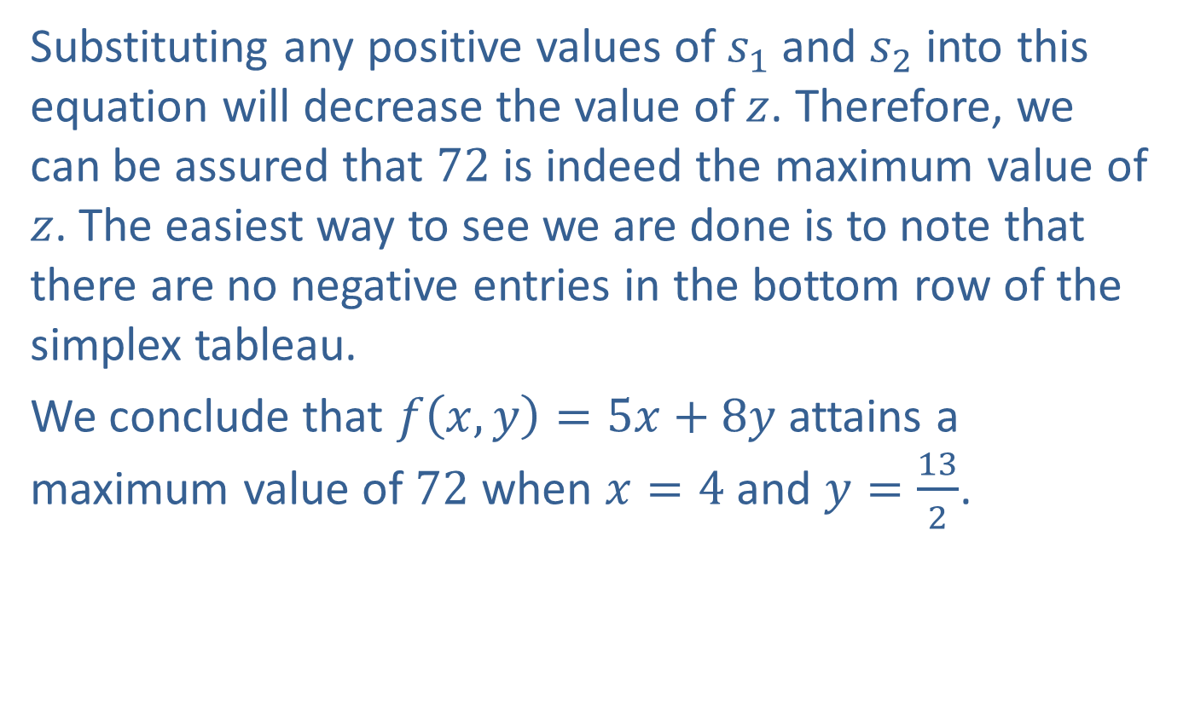
Example 1: Comparing the Simplex Method to the Graphical Approach (cont.)
Substituting any positive values of $s_{1}$ and $s_{2}$ into this equation will decrease the value of $z$. Therefore, we can be assured that 72 is indeed the maximum value of $z$. The easiest way to see we are done is to note that there are no negative entries in the bottom row of the simplex tableau.
We conclude that $f\left(x,y\right)=5x+8y$ attains a maximum value of 72 when $x=4$ and $y=\frac{13}{2}$.

Slide 26
The Simplex Method
Definition
​Rewrite the objective function as an equation in standard form with all variables on the left side and a nonnegative constant on the right side.
​Convert each constraint inequality into an equation with all variables on the left side and a positive constant on the right side by introducing a different slack variable for each constraint.
​Form the system to solve with the constraint equations in the first rows and the objective function in the bottom row.

Slide 27
The Simplex Method (cont.)
​Create the initial simplex tableau by forming the augmented matrix for the system of equations with the objective function in the bottom row.
​Locate the negative entry in the bottom row with largest magnitude to determine the pivot column.
​In each row except for the bottom one, divide the entry in the far-right column by the one in the pivot column. The row with the smallest quotient will be the pivot row.

Slide 28
The Simplex Method (cont.)
​Perform elementary row operations on the simplex tableau to make the pivot element 1 and the remaining entries in the pivot column 0. Always use the pivot row to do any row operations.
​If all entries in the bottom row are nonnegative, stop. If not, repeat steps 5 through 7 until all entries in the bottom row are nonnegative.
​The maximum value of the objective function is in the lower-right corner of the final simplex tableau.

Slide 29
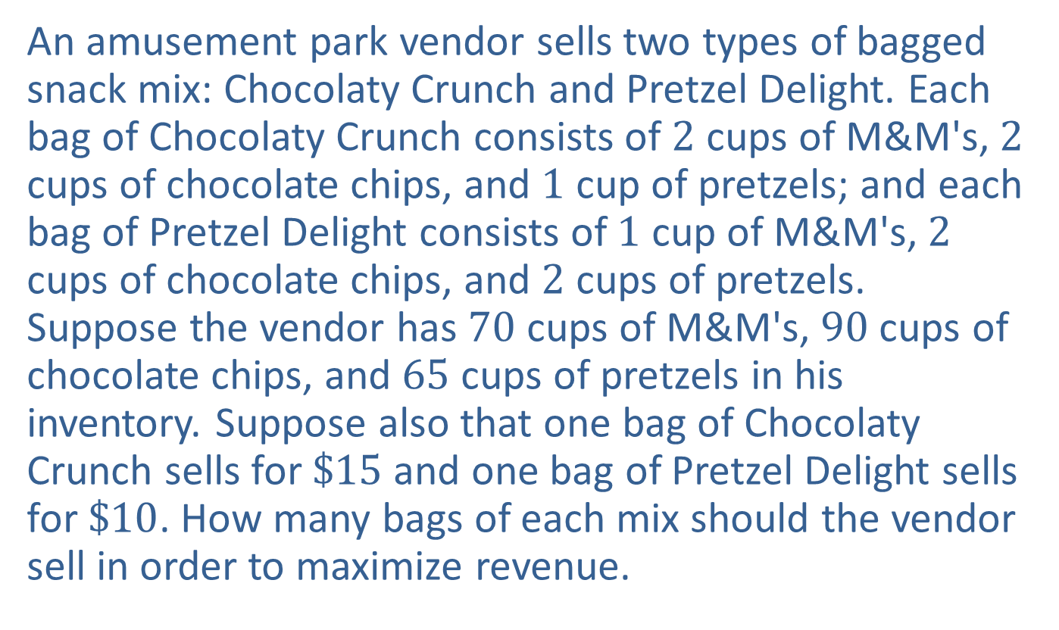
Example 2: An Application of the Simplex Method
An amusement park vendor sells two types of bagged snack mix: Chocolaty Crunch and Pretzel Delight. Each bag of Chocolaty Crunch consists of 2 cups of M&M's, 2 cups of chocolate chips, and 1 cup of pretzels; and each bag of Pretzel Delight consists of 1 cup of M&M's, 2 cups of chocolate chips, and 2 cups of pretzels. Suppose the vendor has 70 cups of M&M's, 90 cups of chocolate chips, and 65 cups of pretzels in his inventory. Suppose also that one bag of Chocolaty Crunch sells for $\$15$ and one bag of Pretzel Delight sells for $\$10$. How many bags of each mix should the vendor sell in order to maximize revenue.

Slide 30
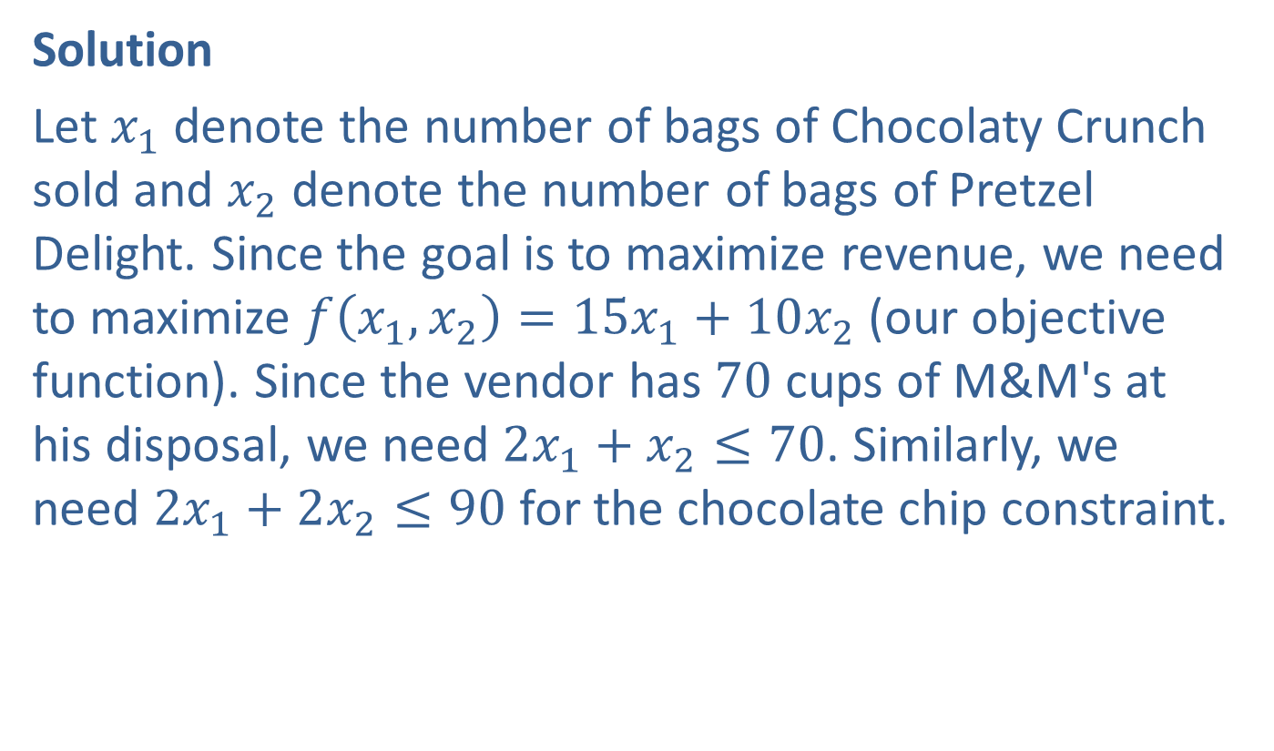
Example 2: An Application of the Simplex Method (cont.)
Solution
Let $x_{1}$ denote the number of bags of Chocolaty Crunch sold and $x_{2}$ denote the number of bags of Pretzel Delight. Since the goal is to maximize revenue, we need to maximize $f⁡\left(x_{1},x_{2}\right)=15x_{1}+10x_{2}$ (our objective function). Since the vendor has 70 cups of M&M's at his disposal, we need $2x_{1}+x_{2}≤70$. Similarly, we need $2x_{1}+2x_{2}≤90$ for the chocolate chip constraint.

Slide 31
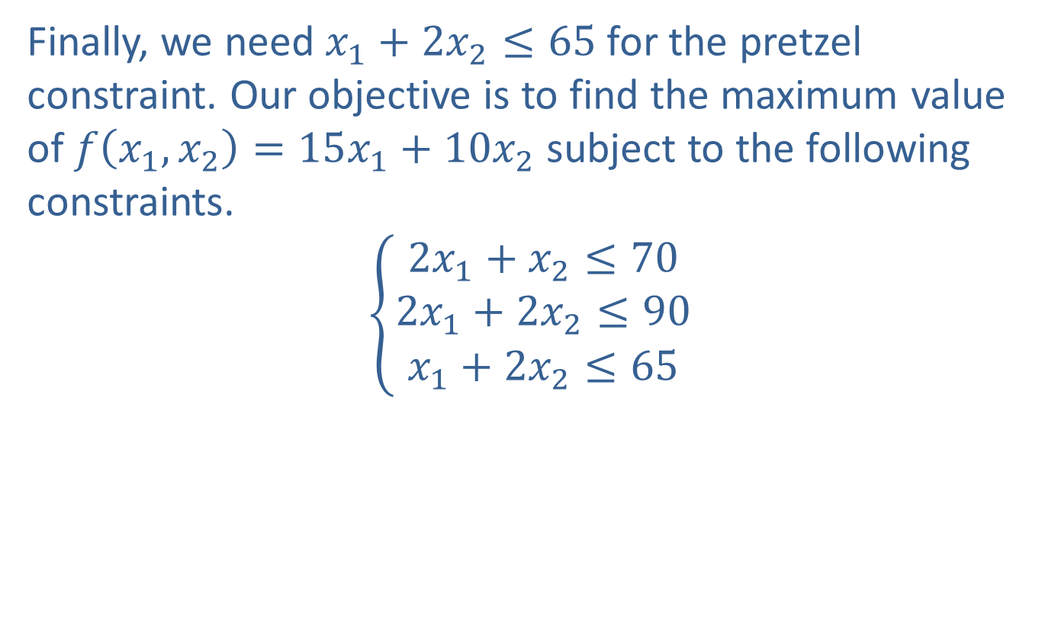
Example 2: An Application of the Simplex Method (cont.)
Finally, we need $x_{1}+2x_{2}≤65$ for the pretzel constraint. Our objective is to find the maximum value of $f⁡\left(x_{1},x_{2}\right)=15x_{1}+10x_{2}$ subject to the following constraints.
$$\left\{\begin{aligned}2x_{1}+x_{2}≤70 \\ 2x_{1}+2x_{2}≤90 \\ x_{1}+2x_{2}≤65\end{aligned}\right.$$

Slide 32
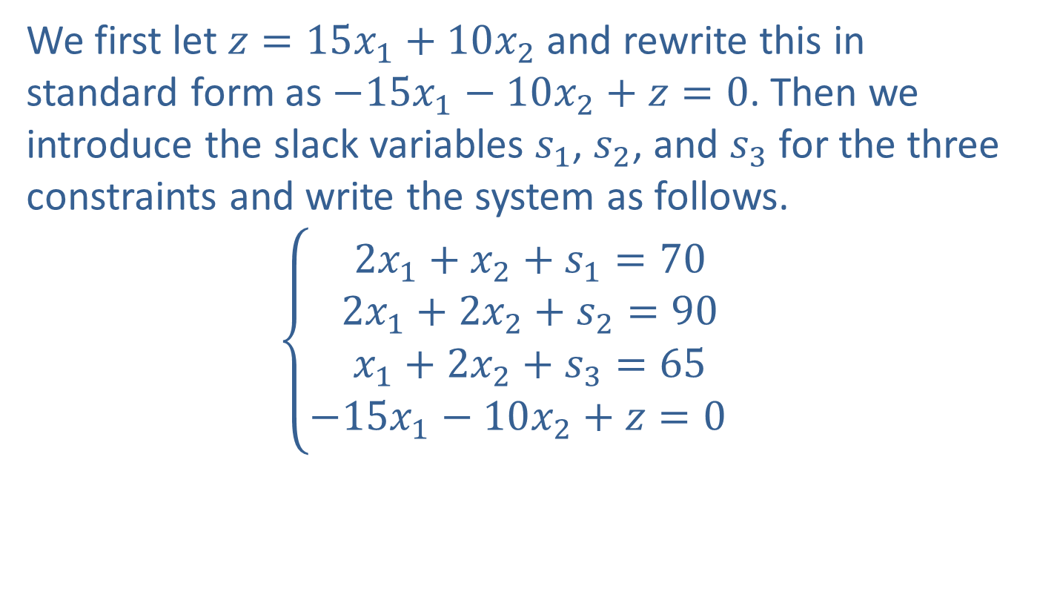
Example 2: An Application of the Simplex Method (cont.)
We first let $z=15x_{1}+10x_{2}$ and rewrite this in standard form as $−15x_{1}−10x_{2}+z=0$. Then we introduce the slack variables $s_{1}$, $s_{2}$, and $s_{3}$ for the three constraints and write the system as follows.
2𝑥1+𝑥2+𝑠1=702𝑥1+2𝑥2+𝑠2=90𝑥1+2𝑥2+𝑠3=65−15𝑥1−10𝑥2+𝑧=00

Slide 33
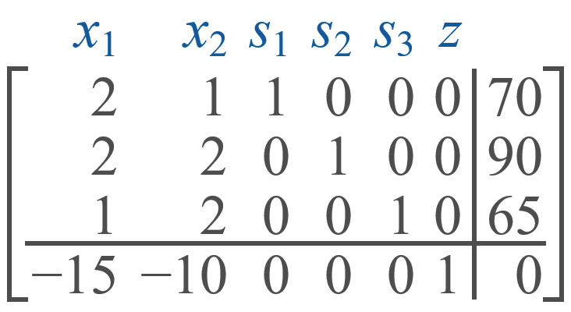
Example 2: An Application of the Simplex Method (cont.)
The initial simplex tableau is as follows.

Slide 34
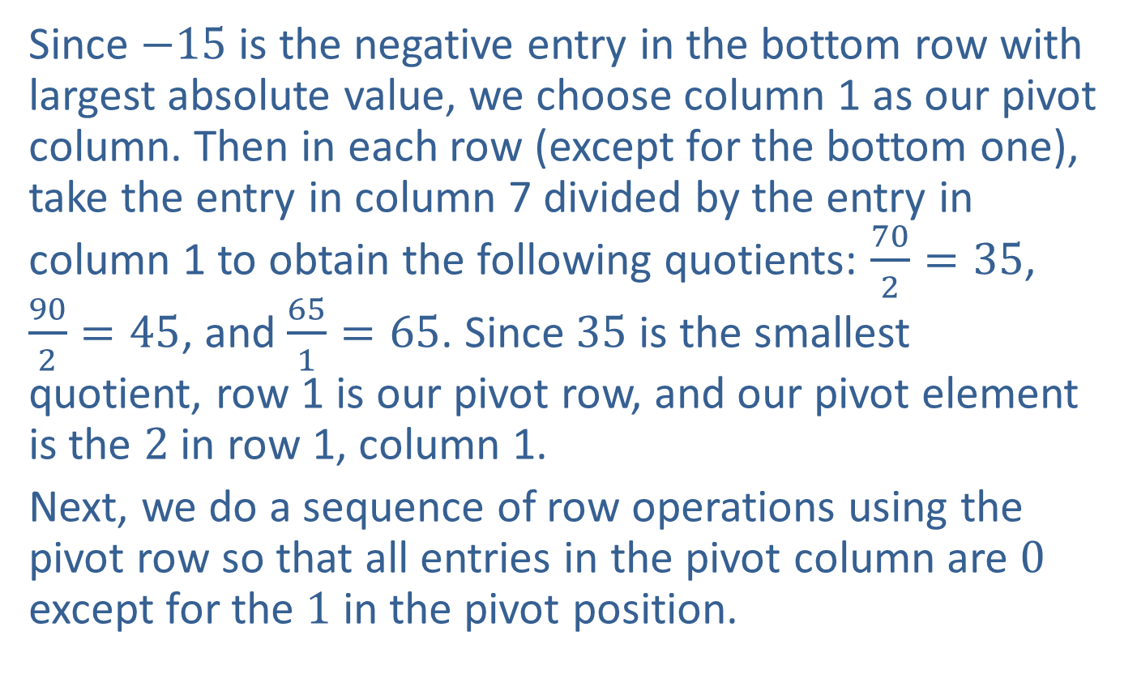
Example 2: An Application of the Simplex Method (cont.)
Since $−15$ is the negative entry in the bottom row with largest absolute value, we choose column 1 as our pivot column. Then in each row (except for the bottom one), take the entry in column 7 divided by the entry in column 1 to obtain the following quotients: $\frac{70}{2}=35$, $\frac{90}{2}=45$, and $\frac{65}{1}=65$. Since 35 is the smallest quotient, row 1 is our pivot row, and our pivot element is the 2 in row 1, column 1.
Next, we do a sequence of row operations using the pivot row so that all entries in the pivot column are 0 except for the 1 in the pivot position.

Slide 35
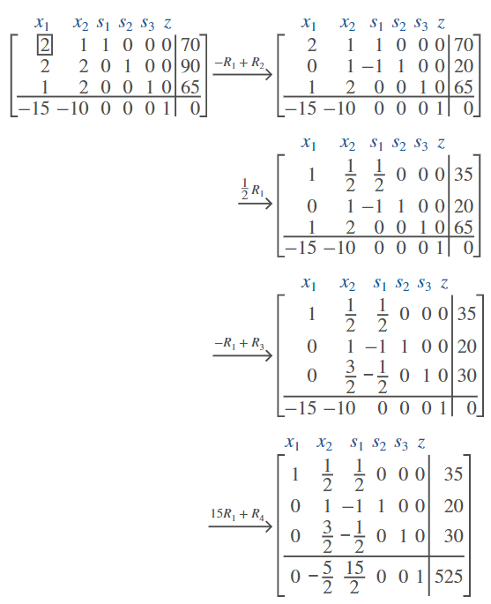
Example 2: An Application of the Simplex Method (cont.)

Slide 36
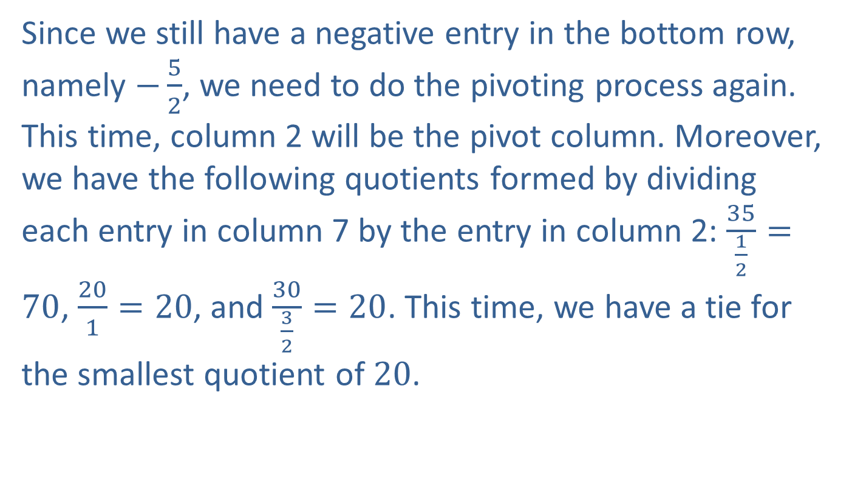
Example 2: An Application of the Simplex Method (cont.)
Since we still have a negative entry in the bottom row, namely $−\frac{5}{2}$, we need to do the pivoting process again. This time, column 2 will be the pivot column. Moreover, we have the following quotients formed by dividing each entry in column 7 by the entry in column 2: $\frac{35}{\frac{1}{2}}=70$, $\frac{20}{1}=20$, and $\frac{30}{\frac{3}{2}}=20$. This time, we have a tie for the smallest quotient of 20.

Slide 37
Example 2: An Application of the Simplex Method (cont.)
We can choose either row 2 or row 3 as our pivot row. Since there's already a 1 in the row 2, column 2 entry, it will be convenient to choose this as our pivot element. Once again, we do a sequence of row operations using the pivot row so that all entries in the pivot column are 0 except for the 1 in the pivot position.

Slide 38
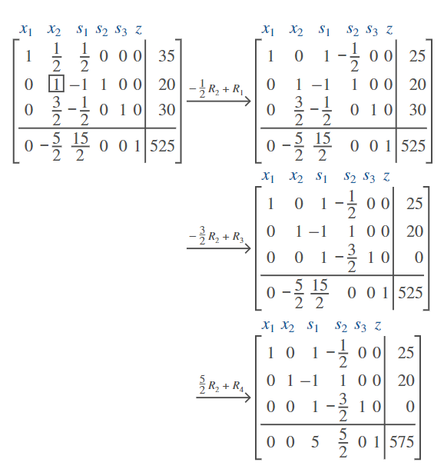
Example 2: An Application of the Simplex Method (cont.)

Slide 39
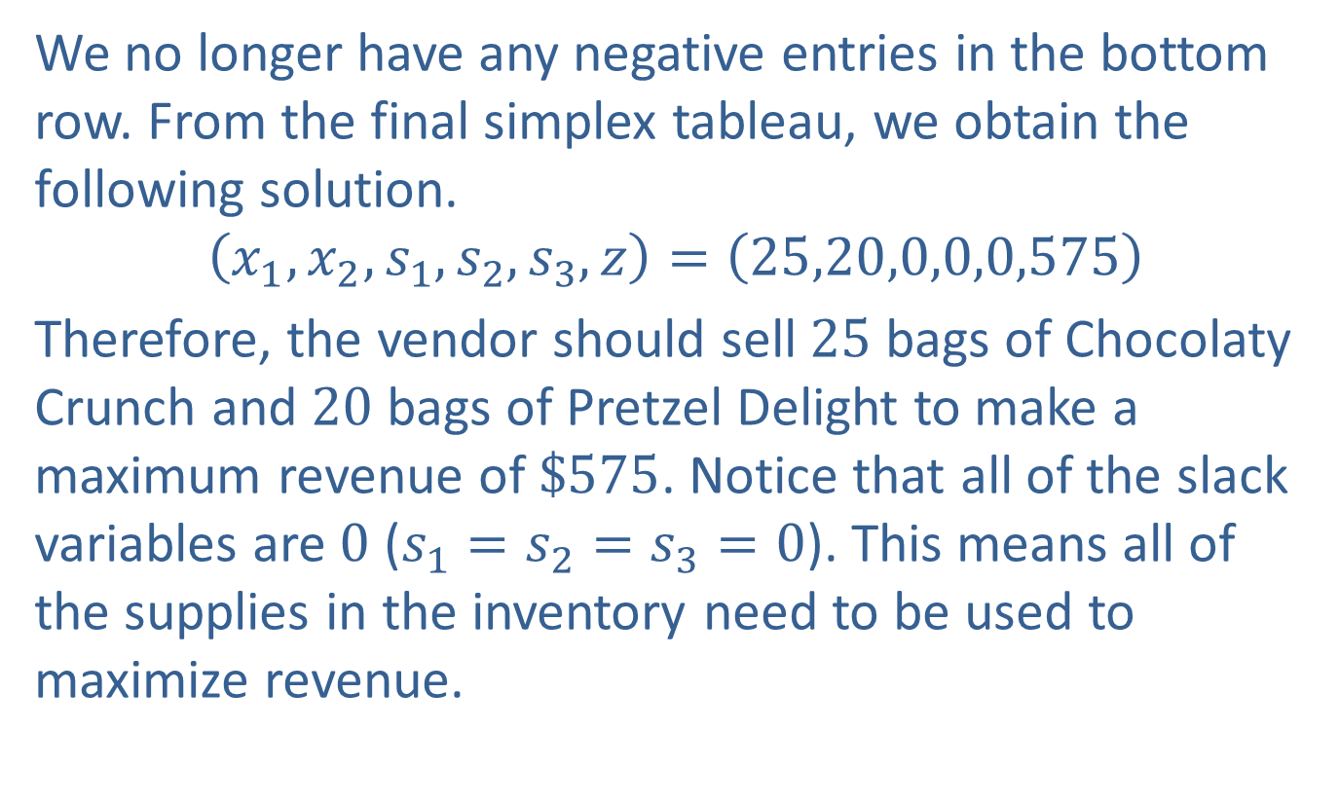
Example 2: An Application of the Simplex Method (cont.)
We no longer have any negative entries in the bottom row. From the final simplex tableau, we obtain the following solution.
$$\left(x_{1},x_{2},s_{1},s_{2},s_{3},z\right)=\left(25,20,0,0,0,575\right)$$
Therefore, the vendor should sell 25 bags of Chocolaty Crunch and 20 bags of Pretzel Delight to make a maximum revenue of $\$575$. Notice that all of the slack variables are 0 ($s_{1}=s_{2}=s_{3}=0$). This means all of the supplies in the inventory need to be used to maximize revenue.

Slide 40
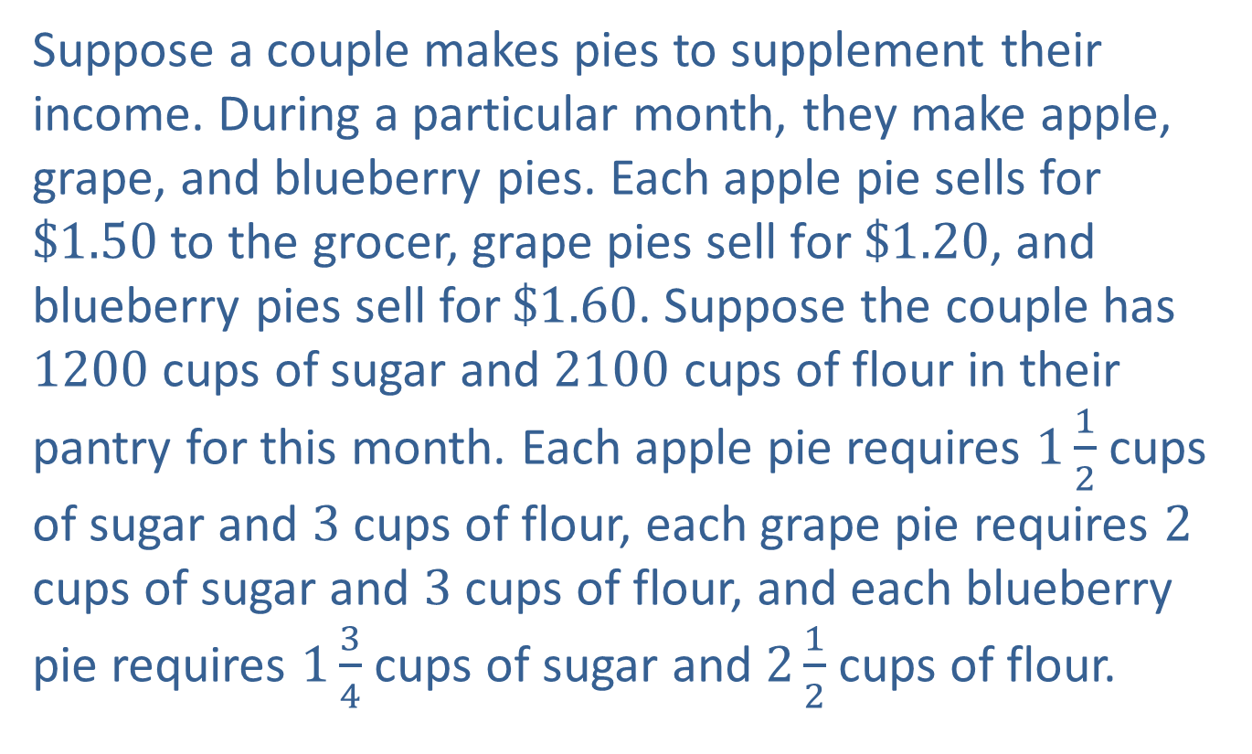
Example 3: An Application of the Simplex Method Involving Three Decision Variables
Suppose a couple makes pies to supplement their income. During a particular month, they make apple, grape, and blueberry pies. Each apple pie sells for $\$1.50$ to the grocer, grape pies sell for $\$1.20$, and blueberry pies sell for $\$1.60$. Suppose the couple has 1200 cups of sugar and 2100 cups of flour in their pantry for this month. Each apple pie requires $1\frac{1}{2}$ cups of sugar and 3 cups of flour, each grape pie requires 2 cups of sugar and 3 cups of flour, and each blueberry pie requires $1\frac{3}{4}$ cups of sugar and $2\frac{1}{2}$ cups of flour.

Slide 41
Example 3: An Application of the Simplex Method Involving Three Decision Variables (cont.)
Working together, the couple takes 6 minutes to make each apple pie, 3 minutes to make each grape pie, and 4 minutes to make each blueberry pie; and they plan to work no more than 62 hours. Determine how many of each kind of pie the couple should produce and sell in order to maximize revenue.

Slide 42
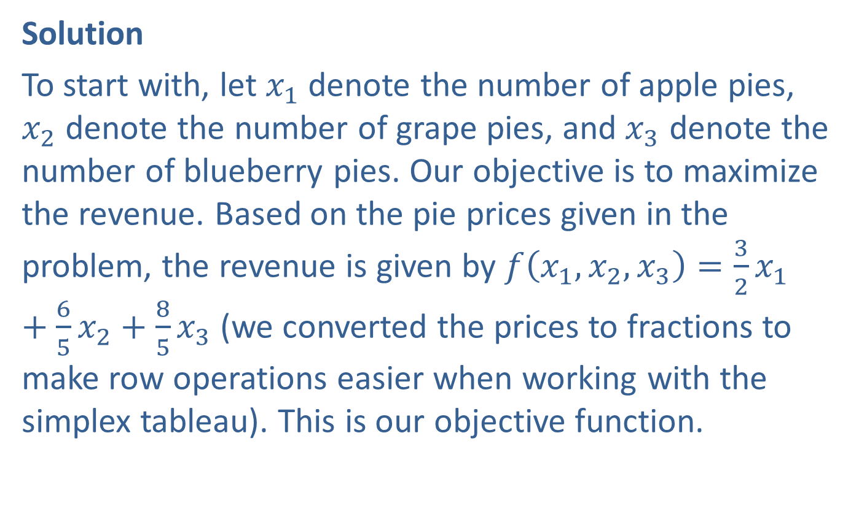
Example 3: An Application of the Simplex Method Involving Three Decision Variables (cont.)
Solution
To start with, let $x_{1}$ denote the number of apple pies, $x_{2}$ denote the number of grape pies, and $x_{3}$ denote the number of blueberry pies. Our objective is to maximize the revenue. Based on the pie prices given in the problem, the revenue is given by $f\left(x_{1},x_{2},x_{3}\right)=\frac{3}{2}x_{1}+\frac{6}{5}x_{2}+\frac{8}{5}x_{3}$ (we converted the prices to fractions to make row operations easier when working with the simplex tableau). This is our objective function.

Slide 43
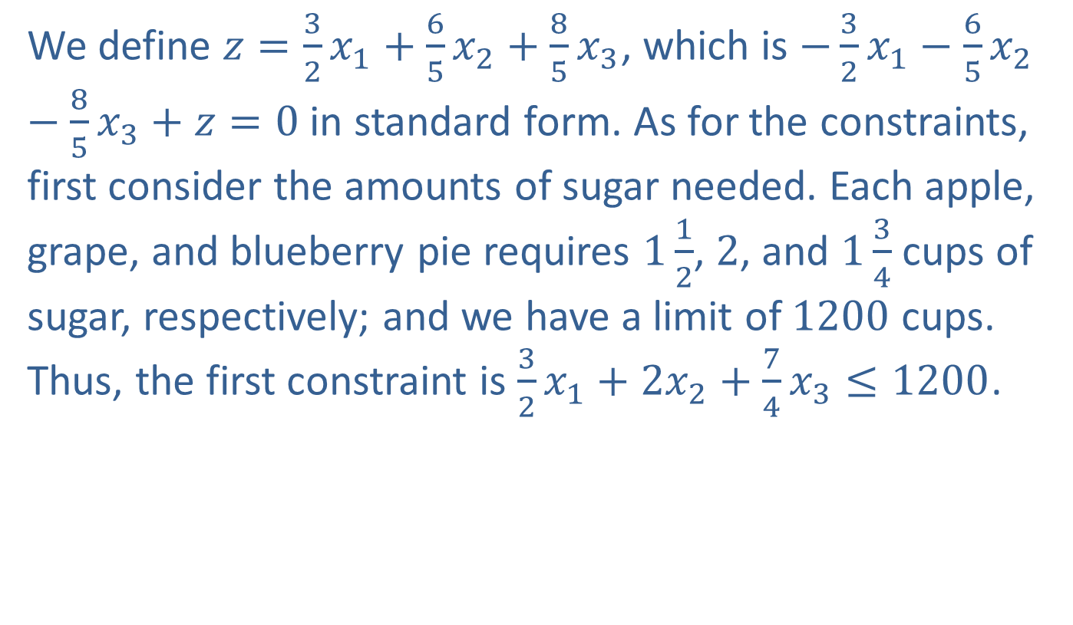
Example 3: An Application of the Simplex Method Involving Three Decision Variables (cont.)
We define $z=\frac{3}{2}x_{1}+\frac{6}{5}x_{2}+\frac{8}{5}x_{3}$, which is $−\frac{3}{2}x_{1}−\frac{6}{5}x_{2}−\frac{8}{5}x_{3}+z=0$ in standard form. As for the constraints, first consider the amounts of sugar needed. Each apple, grape, and blueberry pie requires $1\frac{1}{2}$, 2, and $1\frac{3}{4}$ cups of sugar, respectively; and we have a limit of 1200 cups. Thus, the first constraint is $\frac{3}{2}x_{1}+2x_{2}+\frac{7}{4}x_{3}≤1200$.

Slide 44
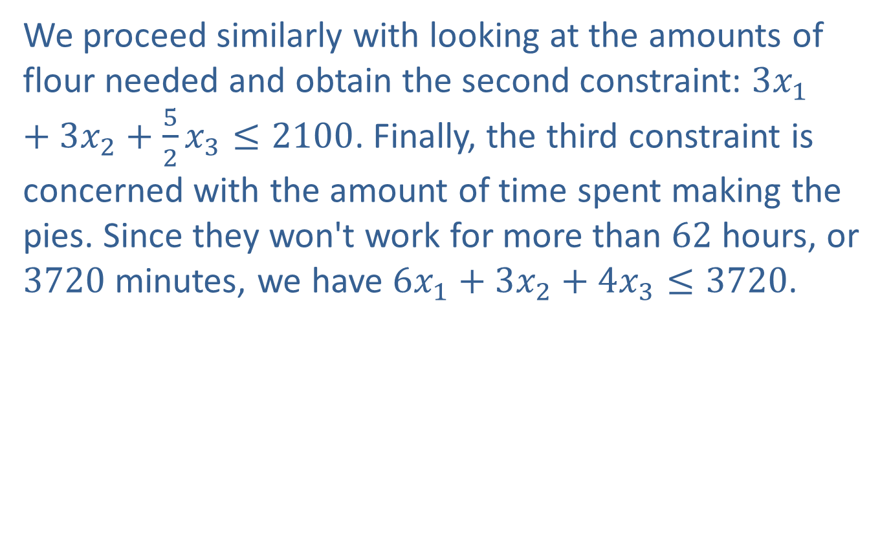
Example 3: An Application of the Simplex Method Involving Three Decision Variables (cont.)
We proceed similarly with looking at the amounts of flour needed and obtain the second constraint: $3x_{1}+3x_{2}+\frac{5}{2}x_{3}≤2100$. Finally, the third constraint is concerned with the amount of time spent making the pies. Since they won't work for more than 62 hours, or 3720 minutes, we have $6x_{1}+3x_{2}+4x_{3}≤3720$.

Slide 45
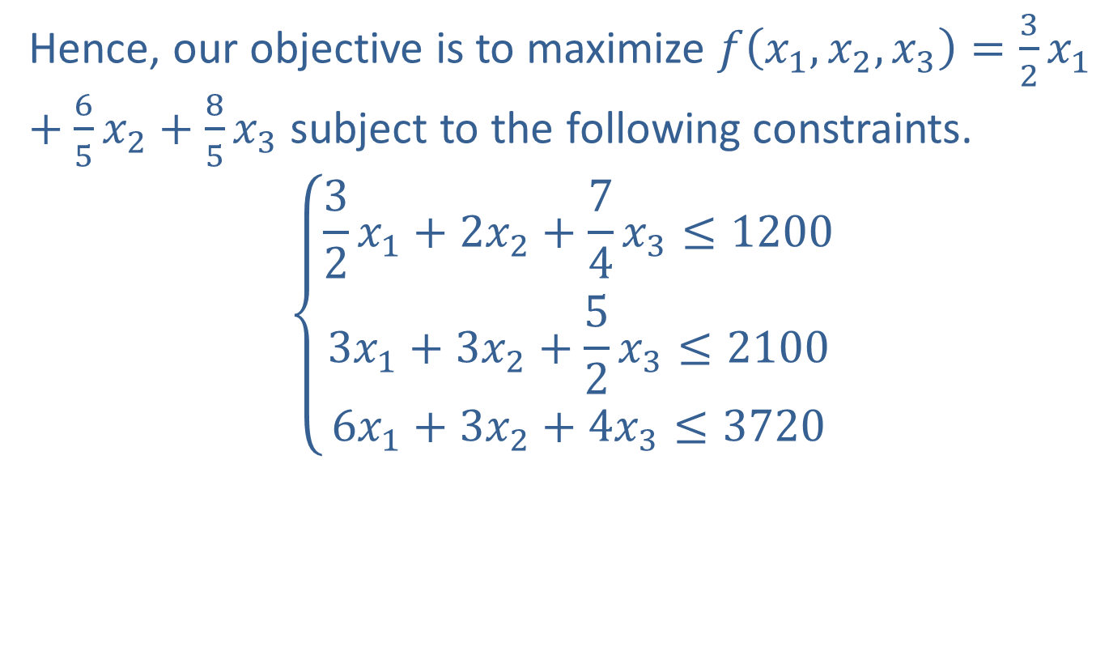
Example 3: An Application of the Simplex Method Involving Three Decision Variables (cont.)
Hence, our objective is to maximize $f\left(x_{1},x_{2},x_{3}\right)=\frac{3}{2}x_{1}+\frac{6}{5}x_{2}+\frac{8}{5}x_{3}$ subject to the following constraints.
$$\left\{\begin{aligned}\frac{3}{2}x_{1}+2x_{2}+\frac{7}{4}x_{3}≤1200 \\ 3x_{1}+3x_{2}+\frac{5}{2}x_{3}≤2100 \\ 6x_{1}+3x_{2}+4x_{3}≤3720\end{aligned}\right.$$

Slide 46
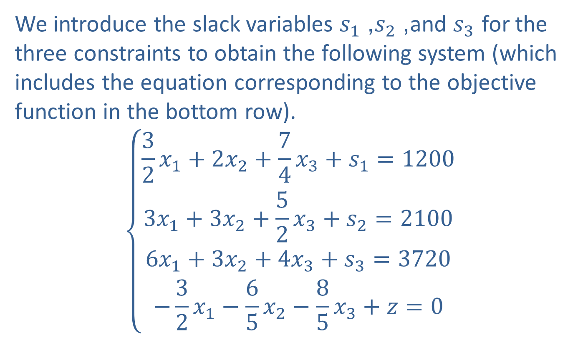
Example 3: An Application of the Simplex Method Involving Three Decision Variables (cont.)
We introduce the slack variables $s_{1}$, $s_{2}$, and $s_{3}$ for the three constraints to obtain the following system (which includes the equation corresponding to the objective function in the bottom row).
$$\left\{\begin{aligned}\frac{3}{2}x_{1}+2x_{2}+\frac{7}{4}x_{3}+s_{1}=1200 \\ 3x_{1}+3x_{2}+\frac{5}{2}x_{3}+s_{2}=2100 \\ 6x_{1}+3x_{2}+4x_{3}+s_{3}=3720 \\ −\frac{3}{2}x_{1}−\frac{6}{5}x_{2}−\frac{8}{5}x_{3}+z=0\end{aligned}\right.$$

Slide 47
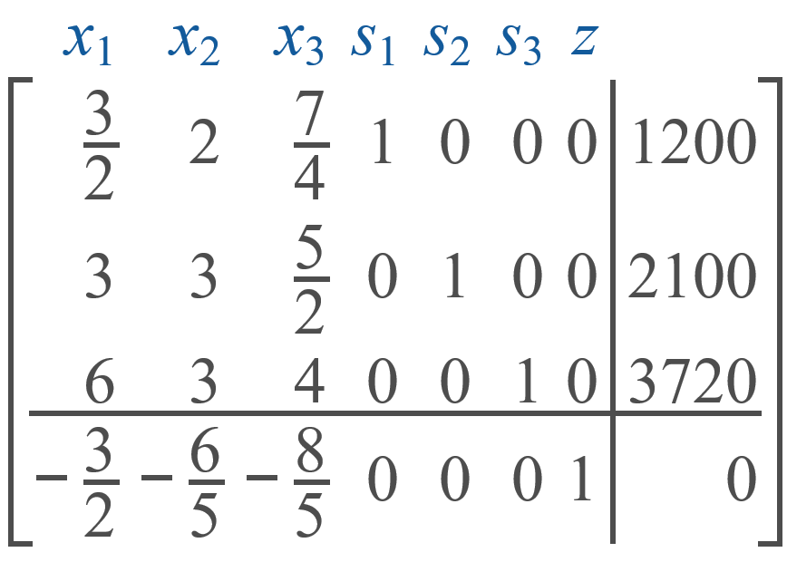
Example 3: An Application of the Simplex Method Involving Three Decision Variables (cont.)
The initial simplex tableau is as follows.

Slide 48
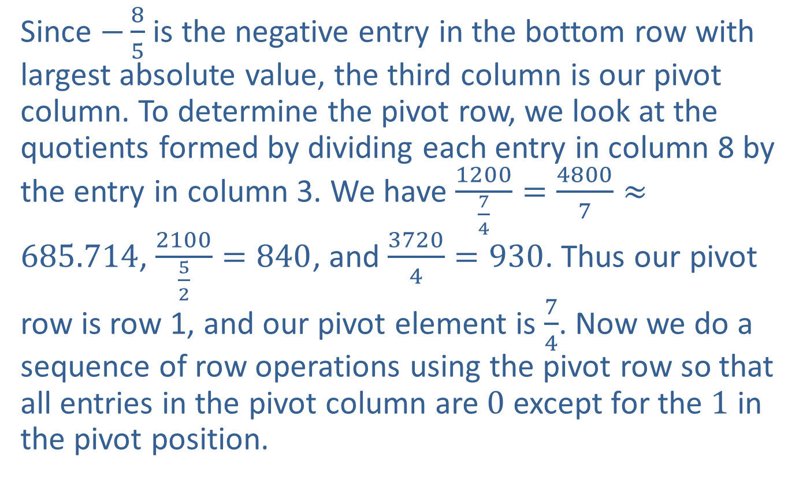
Example 3: An Application of the Simplex Method Involving Three Decision Variables (cont.)
Since $−\frac{8}{5}$ is the negative entry in the bottom row with largest absolute value, the third column is our pivot column. To determine the pivot row, we look at the quotients formed by dividing each entry in column 8 by the entry in column 3. We have $\frac{1200}{\frac{7}{4}}=\frac{4800}{7}≈685.714$, $\frac{2100}{\frac{5}{2}}=840$, and $\frac{3720}{4}=930$. Thus our pivot row is row 1, and our pivot element is $\frac{7}{4}$. Now we do a sequence of row operations using the pivot row so that all entries in the pivot column are 0 except for the 1 in the pivot position.

Slide 49
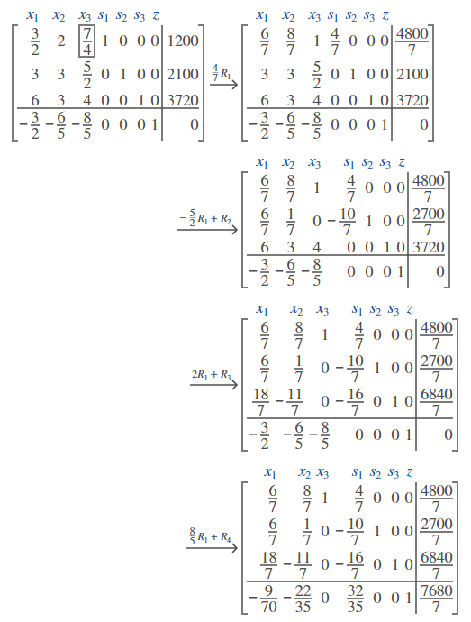
Example 3: An Application of the Simplex Method Involving Three Decision Variables (cont.)

Slide 50
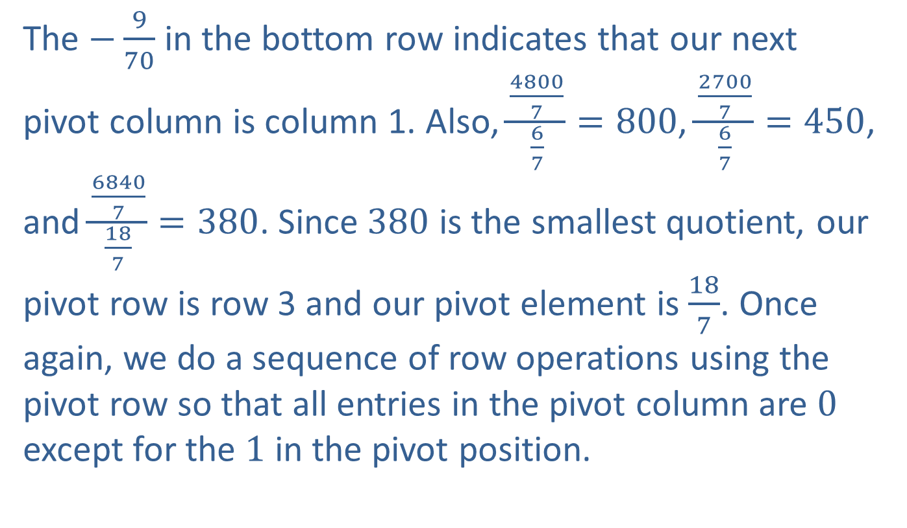
Example 3: An Application of the Simplex Method Involving Three Decision Variables (cont.)
The $−\frac{9}{70}$ in the bottom row indicates that our next pivot column is column 1. Also, $\frac{\frac{4800}{7}}{\frac{6}{7}}=800$, $\frac{\frac{2700}{7}}{\frac{6}{7}}=450$, and $\frac{\frac{6840}{7}}{\frac{18}{7}}=380$. Since 380 is the smallest quotient, our pivot row is row 3 and our pivot element is $\frac{18}{7}$. Once again, we do a sequence of row operations using the pivot row so that all entries in the pivot column are 0 except for the 1 in the pivot position.

Slide 51
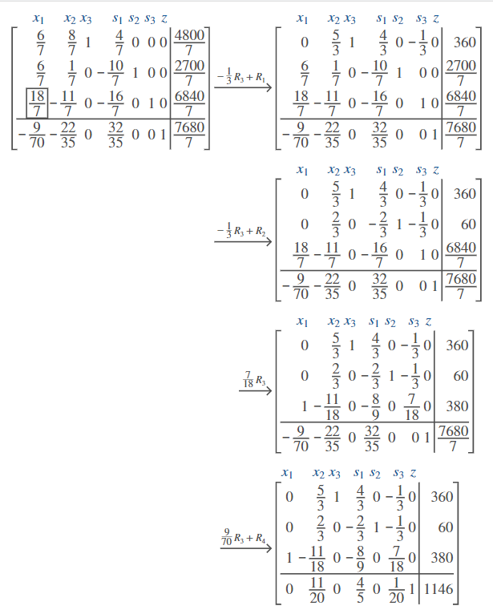
Example 3: An Application of the Simplex Method Involving Three Decision Variables (cont.)

Slide 52
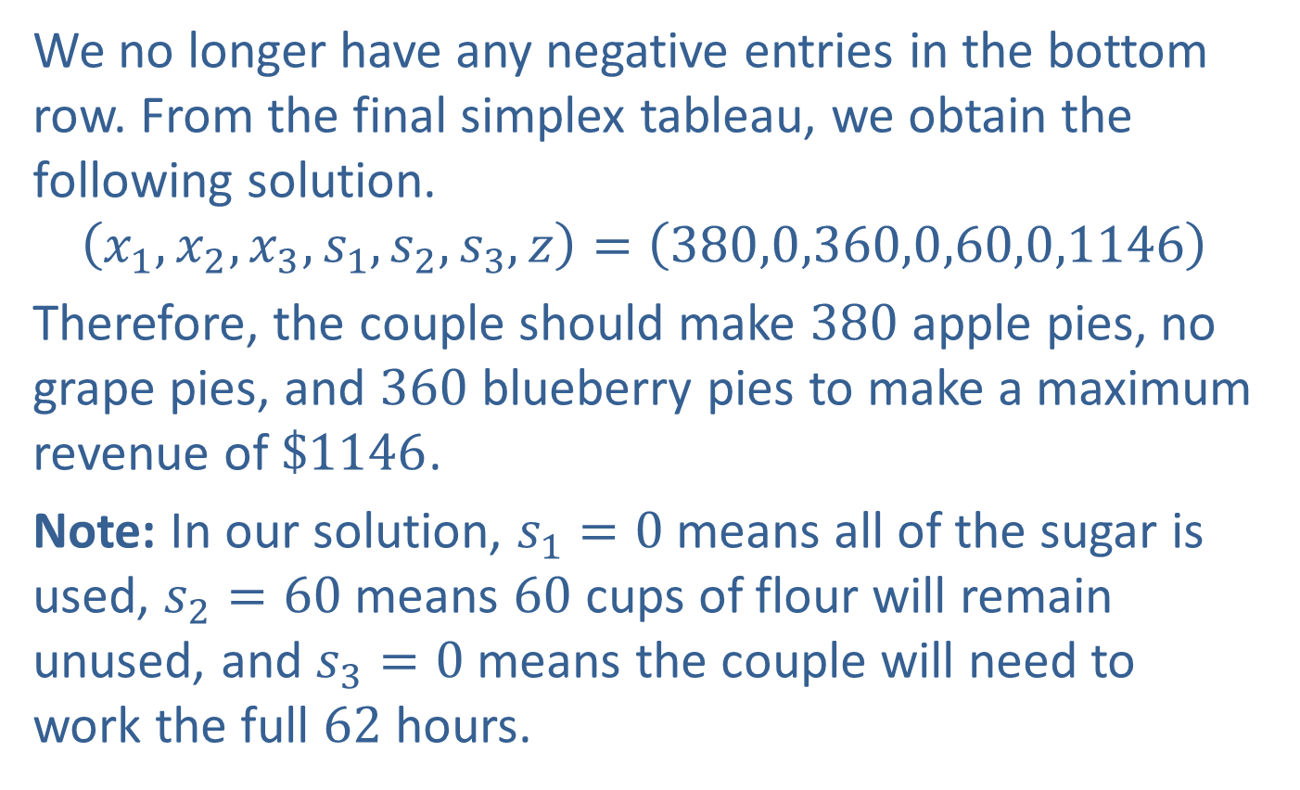
Example 3: An Application of the Simplex Method Involving Three Decision Variables (cont.)
We no longer have any negative entries in the bottom row. From the final simplex tableau, we obtain the following solution.
$$\left(x_{1},x_{2},x_{3},s_{1},s_{2},s_{3},z\right)=\left(380,0,360,0,60,0,1146\right)$$
Therefore, the couple should make 380 apple pies, no grape pies, and 360 blueberry pies to make a maximum revenue of $\$1146$.
Note: In our solution, $s_{1}=0$ means all of the sugar is used, $s_{2}=60$ means 60 cups of flour will remain unused, and $s_{3}=0$ means the couple will need to work the full 62 hours.

Slide 53

Example 4: A Maximization Problem with Multiple Solutions
Use the simplex method to maximize $f\left(x_{1},x_{2}\right)=6x_{1}+8x_{2}$ subject to the following constraints.
$$\left\{\begin{aligned}3x_{1}+4x_{2}≤48 \\ 2x_{1}+5x_{2}≤80\end{aligned}\right.$$

Slide 54
Example 4: A Maximization Problem with Multiple Solutions (cont.)
Solution
Since we only have two decision variables, we will first consider the graphical approach. The feasible region for this problem is in the graph below.

Slide 55
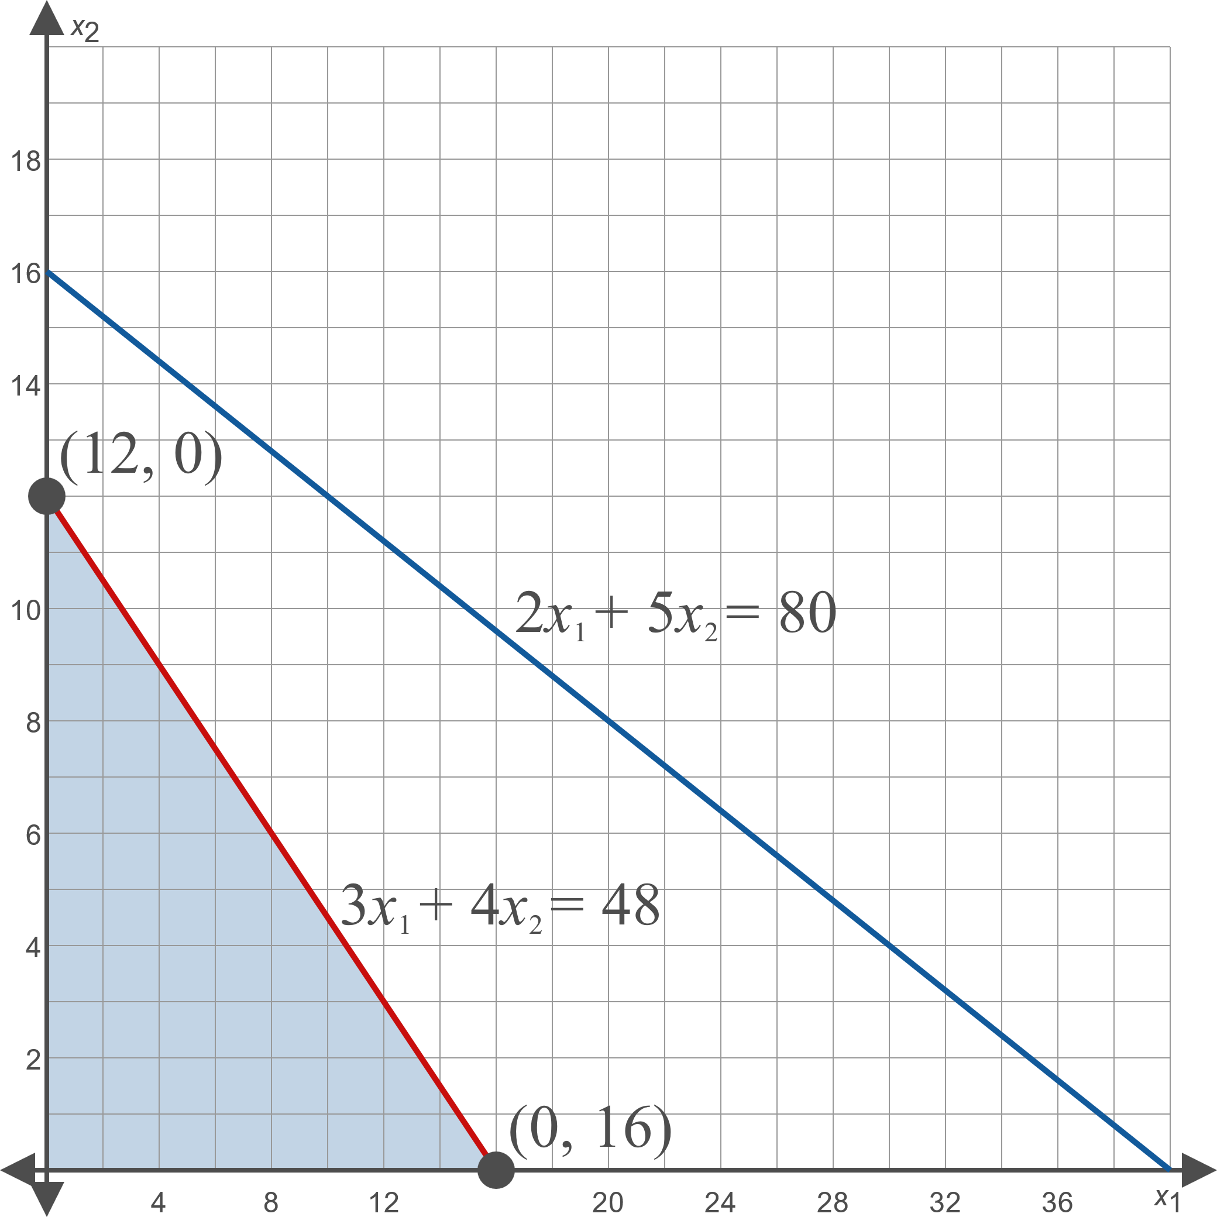
Example 4: A Maximization Problem with Multiple Solutions (cont.)

Slide 56
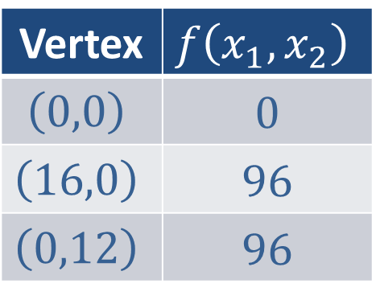

Example 4: A Maximization Problem with Multiple Solutions (cont.)
The value of $f⁡\left(x_{1},x_{2}\right)$ at each vertex is in the following table.
Vertex | $$f⁡\left(x_{1},x_{2}\right)$$
$$\left(0,0\right)$$ | 0
$$\left(16,0\right)$$ | 96
$$\left(0,12\right)$$ | 96

Slide 57

Example 4: A Maximization Problem with Multiple Solutions (cont.)
Therefore, the maximum value of 96 is attained at multiple points. In fact, the maximum value of 96 is attained at all points on the line $3x_{1}+4x_{2}=48$ because for each of these points, $f\left(x_{1},x_{2}\right)=6x_{1}+4x_{2}=2\left(3x_{1}+4x_{2}\right)=2\left(48\right)=96$.
Next, we'll look at what happens when we apply the simplex method. If we set $z=f\left(x_{1},x_{2}\right)$, we obtain the equation $−6x_{1}−8x_{2}+z=0$ in standard form. After introducing the slack variables $s_{1}$ and $s_{2}$, we write the system and obtain the following initial simplex tableau.

Slide 58


Example 4: A Maximization Problem with Multiple Solutions (cont.)
Our pivot column is column 2 since $−8$ is the negative entry in the bottom row with largest absolute value. Moreover, row 1 is our pivot row since $\frac{48}{4}=12$ is smaller than $\frac{80}{5}=16$. We apply the pivoting process in column 2 as follows.

Slide 59

Example 4: A Maximization Problem with Multiple Solutions (cont.)

Slide 60

Example 4: A Maximization Problem with Multiple Solutions (cont.)
Notice that $x_{2}$ and $s_{2}$ are basic variables in this tableau since each of their corresponding columns has a single entry of 1 and all other entries are 0. In addition, $x_{1}$ and $s_{1}$ are nonbasic. In the previous examples, columns corresponding to nonbasic variables have nonzero entries in the bottom row. This example is different because $x_{1}$ is a nonbasic variable but its entry in the bottom row is 0. The bottom row corresponds to the equation $2s_{1}+z=96$, or equivalently $z=96−2s_{1}$. Therefore, increasing $s_{1}$ by any amount will decrease $z$. Thus, the feasible solution of $\left(x_{1},x_{2},s_{1},s_{2},z\right)=\left(0,12,0,20,96\right)$ tells us that $f\left(x_{1},x_{2}\right)=6x_{1}+4x_{2}$ attains a maximum value of 96 at the point $\left(x_{1},x_{2}\right)=\left(0,12\right)$.

Slide 61

Example 4: A Maximization Problem with Multiple Solutions (cont.)
If we continue the pivoting process in column 1, it won't matter which row (either 1 or 2) we choose to determine our pivot position. This is because the bottom entry of the first column is already 0, and thus we don't need to apply any further row operations to change the bottom row. Moreover the bottom row will still correspond to the equation $z=96−2s_{1}$. To see if there are other feasible solutions, we use the row 1, column 1 entry (namely $\frac{3}{4}$) as the pivot element and obtain following simplex tableau.

Slide 62

Example 4: A Maximization Problem with Multiple Solutions (cont.)

Slide 63

Example 4: A Maximization Problem with Multiple Solutions (cont.)
In this simplex tableau, we once again have a nonbasic variable (this time $x_{2}$) whose entry in the bottom row is 0. The feasible solution $\left(x_{1},x_{2},s_{1},s_{2},z\right)=\left(16,0,0,48,96\right)$ tells us that $f\left(x_{1},x_{2}\right)=6x_{1}+4x_{2}$ attains a maximum value of 96 at the point $\left(x_{1},x_{2}\right)=\left(160\right)$. If we were to continue the pivoting process, we may find other points at which the objective function attains a maximum value of 96.

Slide 64

Example 4: A Maximization Problem with Multiple Solutions (cont.)
Thus we conclude that $f\left(x_{1},x_{2}\right)=6x_{1}+4x_{2}$ attains a maximum value of 96 at multiple points. In addition, we observe that when using the simplex method to solve maximization problems with multiple solutions, there is some point in the process where a column corresponding to a nonbasic variable in a simplex tableau has an entry in the bottom row of 0. Furthermore, we can use this column as a pivot column to discover an additional solution.

Slide 65

Example 5: A Maximization Problem with No Solution
Use the simplex method to maximize $f\left(x_{1},x_{2},x_{3}\right)=x_{1}+x_{2}+2x_{3}$ subject to the following constraints.
$$\left\{\begin{aligned}x_{1}−2x_{2}+x_{3}≤2 \\ x_{1}−4x_{2}+2x_{3}≤4\end{aligned}\right.$$

Slide 66


Example 5: A Maximization Problem with No Solution (cont.)
Solution
If we set $z=f\left(x_{1},x_{2},x_{3}\right)$, we obtain the equation $−x_{1}−x_{2}−2x_{3}+z=0$ in standard form. After introducing the slack variables $s_{1}$ and $s_{2}$, we write the system and obtain the following initial simplex tableau.

Slide 67


Example 5: A Maximization Problem with No Solution (cont.)
Our pivot column is column 3 since $−2$ is the negative entry in the bottom row with largest absolute value. Since $\frac{2}{1}=2$ and $\frac{4}{2}=2$, we could choose either row 1 or row 2 to be our pivot row. Since there's a 1 in the row 1, column 3 entry, we'll use that as our pivot element. We then obtain the following simplex tableau.

Slide 68

Example 5: A Maximization Problem with No Solution (cont.)
This time, column 2 has a negative entry in the bottom row. Thus, we choose column 2 to be the pivot column. However, this example is different than previous ones because now there are no positive entries in the second column. Thus, the method we used in earlier examples to identify a pivot row won't work here. What does this mean? First of all, note that the bottom row corresponds to the equation $x_{1}−5x_{2}+2s_{1}+z=4$, or equivalently $z=4−x_{1}+5x_{2}−2s_{1}$. Since increasing $x_{1}$ and $s_{1}$ will decrease $z$ (and because $x_{1}$ and $s_{1}$ are nonbasic variables), $z$ will be optimized if $x_{1}=0$ and $s_{1}=0$.

Slide 69

Example 5: A Maximization Problem with No Solution (cont.)
The second row corresponds to the equation $−x_{1}−2s_{1}+s_{2}=0$, and if we substitute $x_{1}=0$ and $s_{1}=0$ into this equation, we obtain $s_{2}=0$. The first row corresponds to the equation $x_{1}−2x_{2}+x_{3}+s_{1}=2$, and if we substitute $x_{1}=0$ and $s_{1}=0$ into this equation, we obtain $−2x_{2}+x_{3}=2$; or equivalently $x_{3}=2+x_{2}$. Going back to $z=4−x_{1}+5x_{2}−2s_{1}$, we see that increasing $x_{2}$ will increase the value of $z$. However, looking at $x_{3}=2+x_{2}$, we see that increasing $x_{2}$ will increase the value of $x_{3}$.

Slide 70

Example 5: A Maximization Problem with No Solution (cont.)
Therefore, if we increase the size of $x_{2}$ without bound, we will obtain a value of $x_{3}$ that gets infinitely large, and thus $f\left(x_{1},x_{2},x_{3}\right)=x_{1}+x_{2}+2x_{3}$ gets infinitely large.
Therefore, we conclude that $f⁡\left(x_{1},x_{2},x_{3}\right)$ has no maximum value because it is unbounded. In addition, we observe that when using the simplex method to solve maximization problems with no solution, there is some point in the process in which a pivot column in a simplex tableau will have no positive entries.

