Slide 1
Section 7.4
The Simplex Method: Duality and Minimization

Slide 2

Example 1: Minimizing Cost and Duality
Find the minimum value of $f\left(x_{1},x_{2}\right)=5x_{1}+4x_{2}$ subject to the following constraints.
$$\left\{\begin{aligned}10x_{1}+2x_{2}≥15 \\ x_{1}+2x_{2}≥6\end{aligned}\right.$$

Slide 3
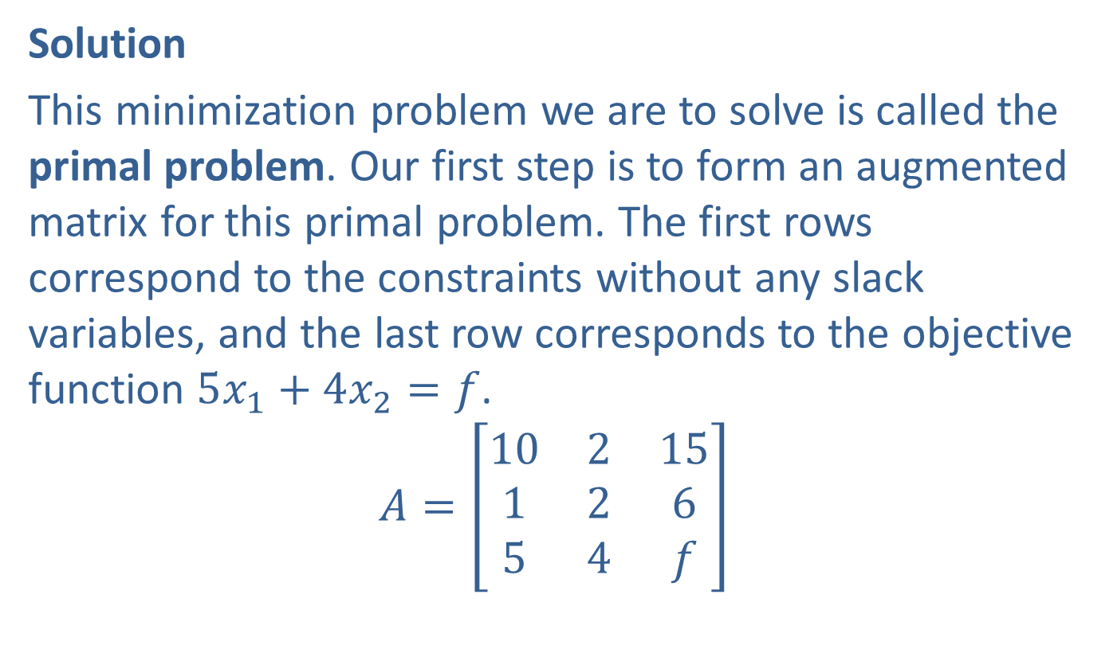
Example 1: Minimizing Cost and Duality (cont.)
Solution
This minimization problem we are to solve is called the primal problem. Our first step is to form an augmented matrix for this primal problem. The first rows correspond to the constraints without any slack variables, and the last row corresponds to the objective function $5x_{1}+4x_{2}=f$.
$$A=\left[\begin{matrix}10 & 2 & 15 \\ 1 & 2 & 6 \\ 5 & 4 & f\end{matrix}\right]$$

Slide 4
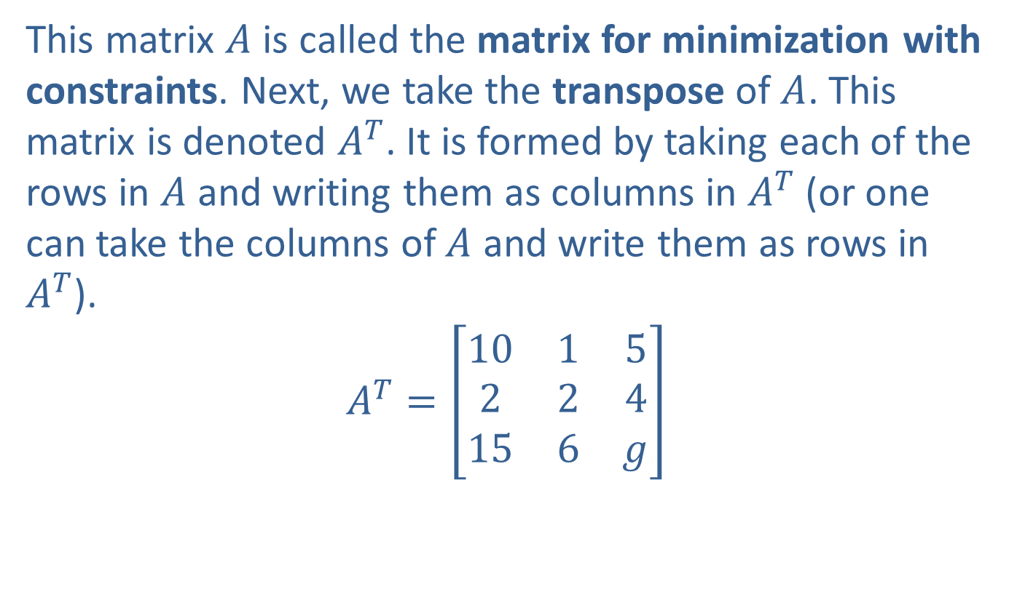
Example 1: Minimizing Cost and Duality (cont.)
This matrix $A$ is called the matrix for minimization with constraints. Next, we take the transpose of $A$. This matrix is denoted $A^{T}$. It is formed by taking each of the rows in $A$ and writing them as columns in $A^{T}$ (or one can take the columns of $A$ and write them as rows in $A^{T}$).
$$A^{T}=\left[\begin{matrix}10 & 1 & 5 \\ 2 & 2 & 4 \\ 15 & 6 & g\end{matrix}\right]$$

Slide 5
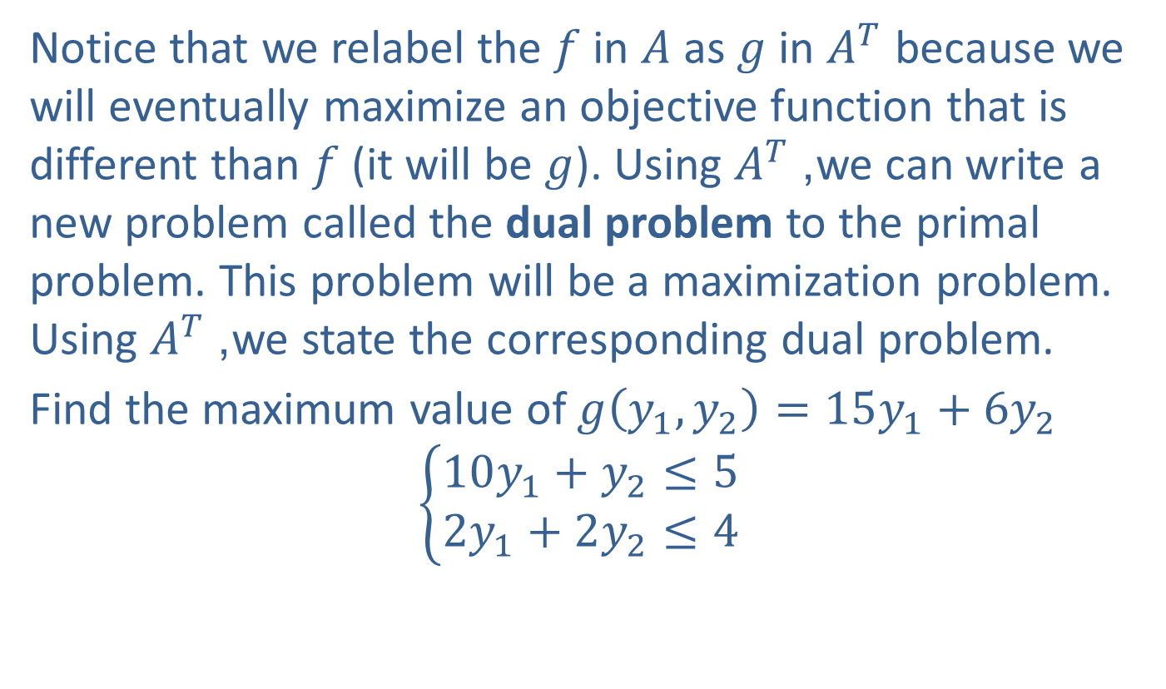
Example 1: Minimizing Cost and Duality (cont.)
Notice that we relabel the $f$ in $A$ as $g$ in $A^{T}$ because we will eventually maximize an objective function that is different than $f$ (it will be $g$). Using $A^{T}$, we can write a new problem called the dual problem to the primal problem. This problem will be a maximization problem. Using $A^{T}$, we state the corresponding dual problem.
Find the maximum value of $g\left(y_{1},y_{2}\right)=15y_{1}+6y_{2}$
$$\left\{\begin{aligned}10y_{1}+y_{2}≤5 \\ 2y_{1}+2y_{2}≤4\end{aligned}\right.$$

Slide 6
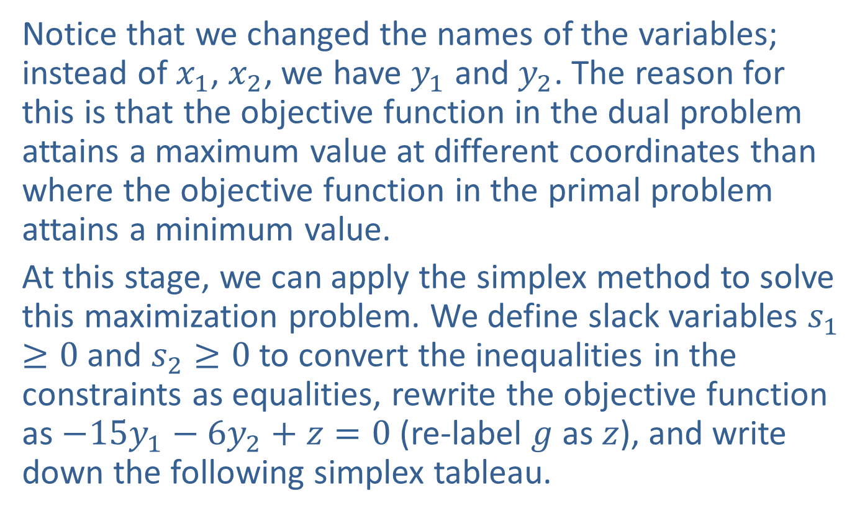
Example 1: Minimizing Cost and Duality (cont.)
Notice that we changed the names of the variables; instead of $x_{1}$, $x_{2}$, we have $y_{1}$ and $y_{2}$. The reason for this is that the objective function in the dual problem attains a maximum value at different coordinates than where the objective function in the primal problem attains a minimum value.
At this stage, we can apply the simplex method to solve this maximization problem. We define slack variables $s_{1}≥0$ and $s_{2}≥0$ to convert the inequalities in the constraints as equalities, rewrite the objective function as $−15y_{1}−6y_{2}+z=0$ (re-label $g$ as $z$), and write down the following simplex tableau.

Slide 7
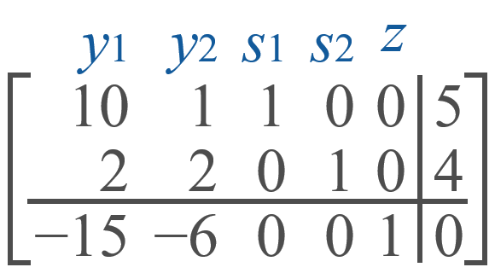
Example 1: Minimizing Cost and Duality (cont.)
Now apply the same methods as employed before in choosing a pivot element and performing row operations to introduce a 1 in the pivot position and 0 elsewhere in the pivot column. We find that 10 in column 1 is the pivot element, and after a few row operations, we arrive at the following tableau.

Slide 8
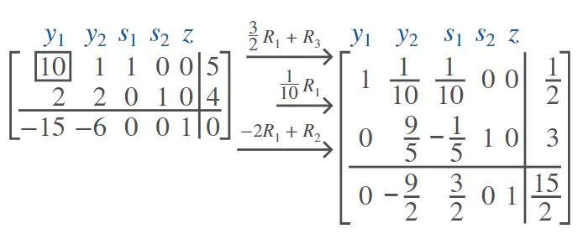
Example 1: Minimizing Cost and Duality (cont.)

Slide 9
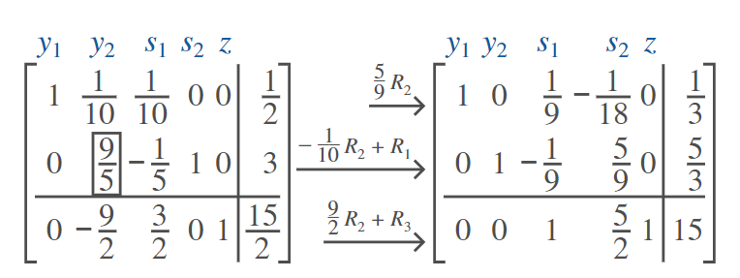

Example 1: Minimizing Cost and Duality (cont.)
Next, $\frac{9}{5}$ in column 2 is the pivot element. After a few more row operations, we obtain the following tableau.

Slide 10
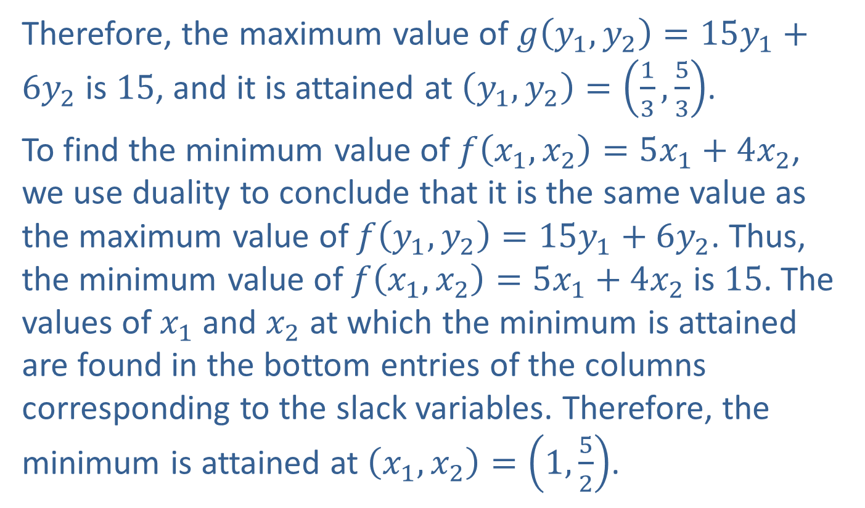
Example 1: Minimizing Cost and Duality (cont.)
Therefore, the maximum value of $g\left(y_{1},y_{2}\right)=15y_{1}+6y_{2}$ is 15, and it is attained at $\left(y_{1},y_{2}\right)=\left(\frac{1}{3},\frac{5}{3}\right)$.
To find the minimum value of $f\left(x_{1},x_{2}\right)=5x_{1}+4x_{2}$, we use duality to conclude that it is the same value as the maximum value of $f\left(y_{1},y_{2}\right)=15y_{1}+6y_{2}$. Thus, the minimum value of $f\left(x_{1},x_{2}\right)=5x_{1}+4x_{2}$ is 15. The values of $x_{1}$ and $x_{2}$ at which the minimum is attained are found in the bottom entries of the columns corresponding to the slack variables. Therefore, the minimum is attained at $\left(x_{1},x_{2}\right)=\left(1,\frac{5}{2}\right)$.

Slide 11
Example 1: Minimizing Cost and Duality (cont.)
Since this example has only 2 decision variables, we can check our result with a graphical approach. The following is a graph of the planar region determined by the constraints.

Slide 12
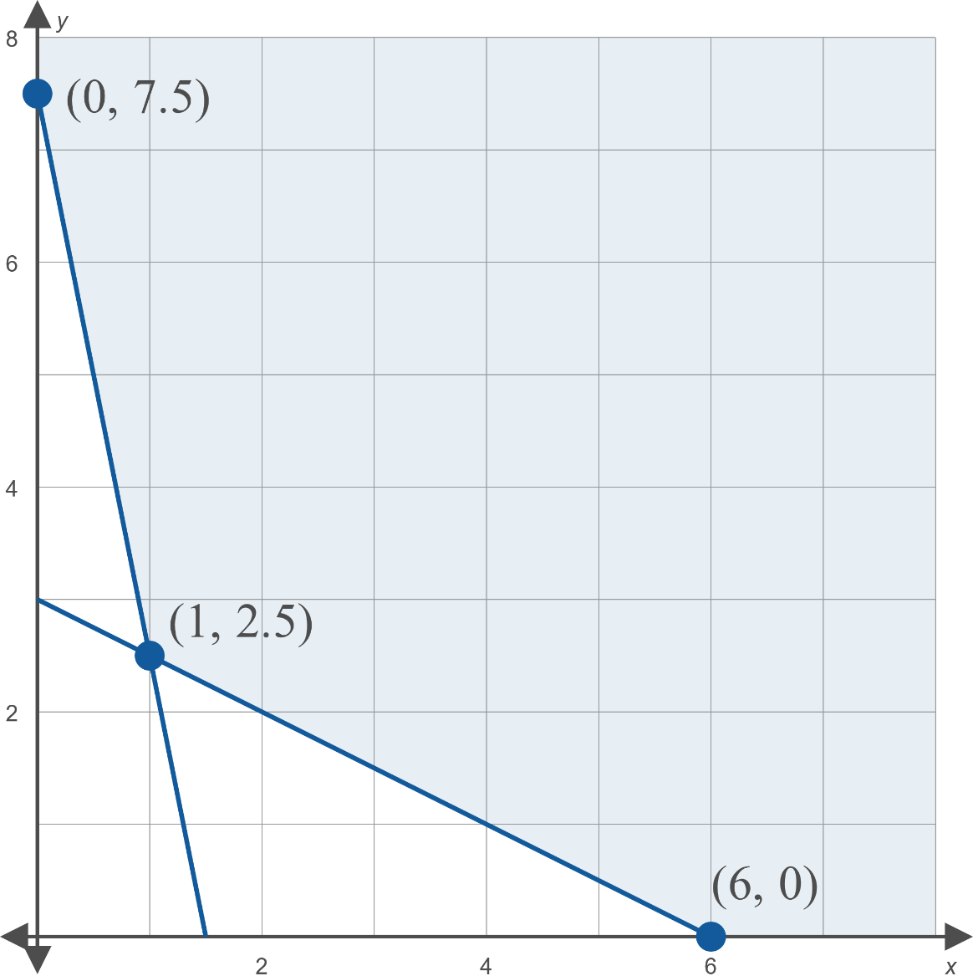
Example 1: Minimizing Cost and Duality (cont.)

Slide 13

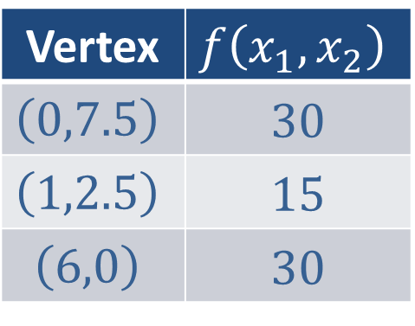
Example 1: Minimizing Cost and Duality (cont.)
Now we find the value of $f⁡\left(x_{1},x_{2}\right)$ at each vertex.
This confirms that the minimum value of $f$ is 15, and it is attained at $\left(1,\frac{5}{2}\right)$.
Vertex | $$f⁡\left(x_{1},x_{2}\right)$$
$$\left(0,7.5\right)$$ | 30
$$\left(1,2.5\right)$$ | 15
$$\left(6,0\right)$$ | 30

Slide 14
Theorem of Duality
Definition
If a minimization problem and its dual maximization problem have a solution, the minimum value of the primal problem is the same as the maximum value of the dual problem. Moreover, when the simplex method is used to solve the dual maximization problem, the coordinates at which the minimum value is attained is given by the bottom entry of the columns corresponding to the slack variables of the maximization problem.

Slide 15
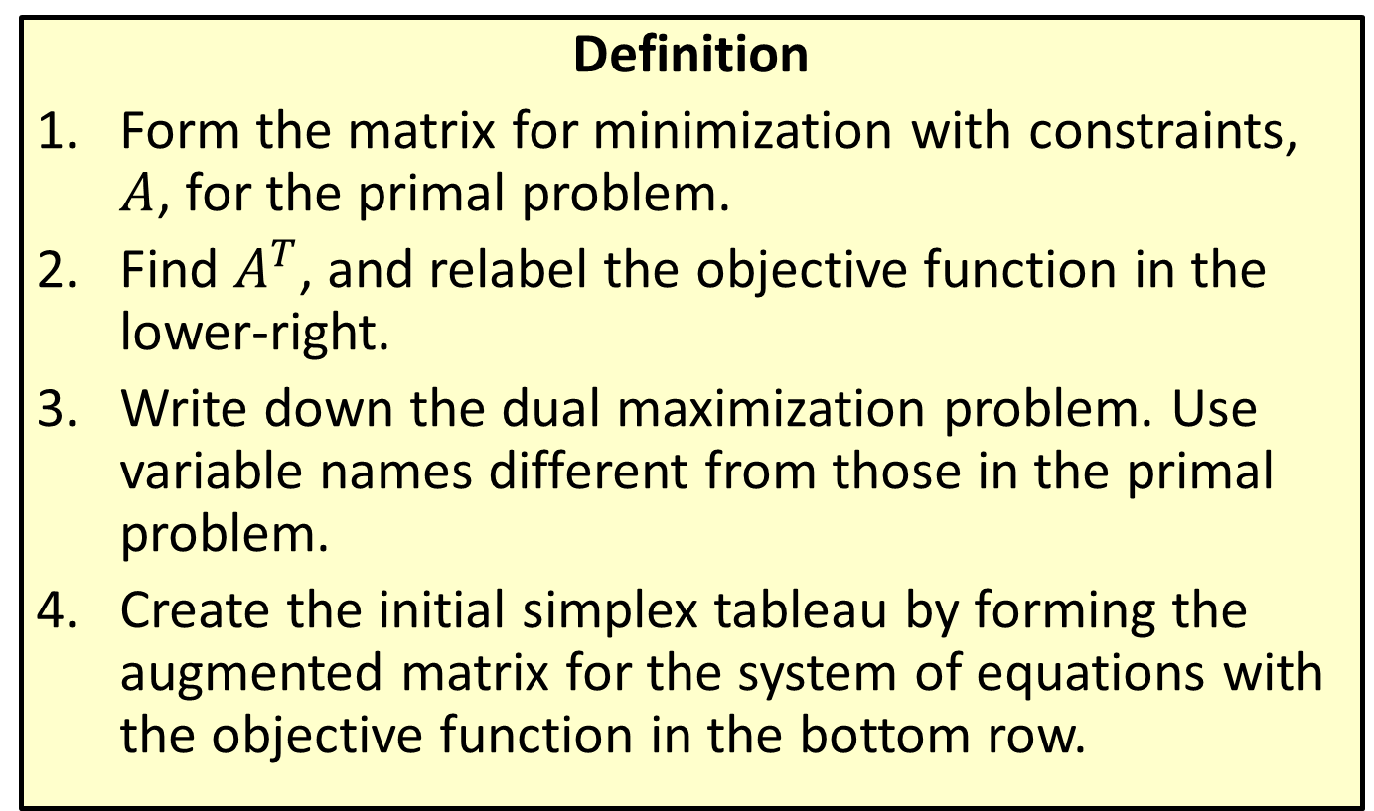
Solving Minimization Problems
Definition
​Form the matrix for minimization with constraints, $A$, for the primal problem.
​Find $A^{T}$, and relabel the objective function in the lower-right.
​Write down the dual maximization problem. Use variable names different from those in the primal problem.
​Create the initial simplex tableau by forming the augmented matrix for the system of equations with the objective function in the bottom row.

Slide 16
Solving Minimization Problems (cont.)
​​Solve the dual maximization problem using the simplex method.
The minimum value of the objective function is in the lower-right corner of the final simplex tableau, and the bottom entry in the columns corresponding to the slack variables give the coordinates at which the minimum is attained.

Slide 17
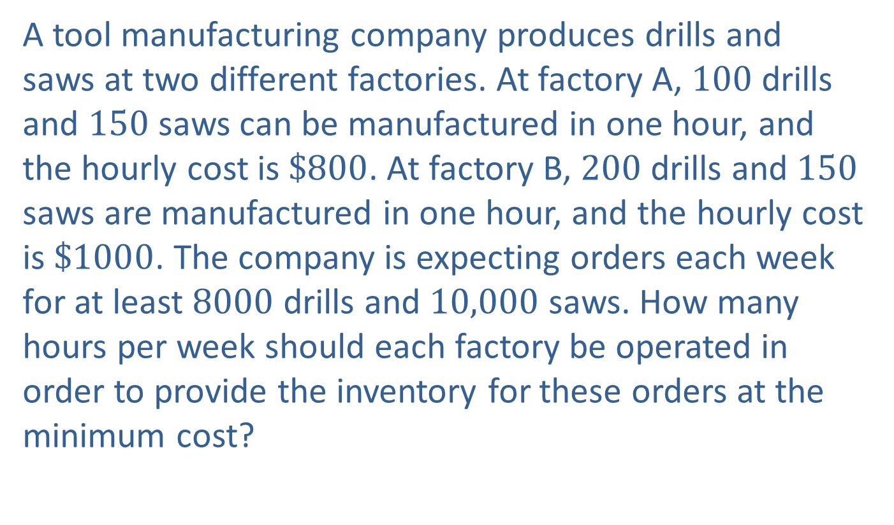
Example 2: Minimizing Cost
A tool manufacturing company produces drills and saws at two different factories. At factory A, 100 drills and 150 saws can be manufactured in one hour, and the hourly cost is $\$800$. At factory B, 200 drills and 150 saws are manufactured in one hour, and the hourly cost is $\$1000$. The company is expecting orders each week for at least 8000 drills and 10,000 saws. How many hours per week should each factory be operated in order to provide the inventory for these orders at the minimum cost?

Slide 18
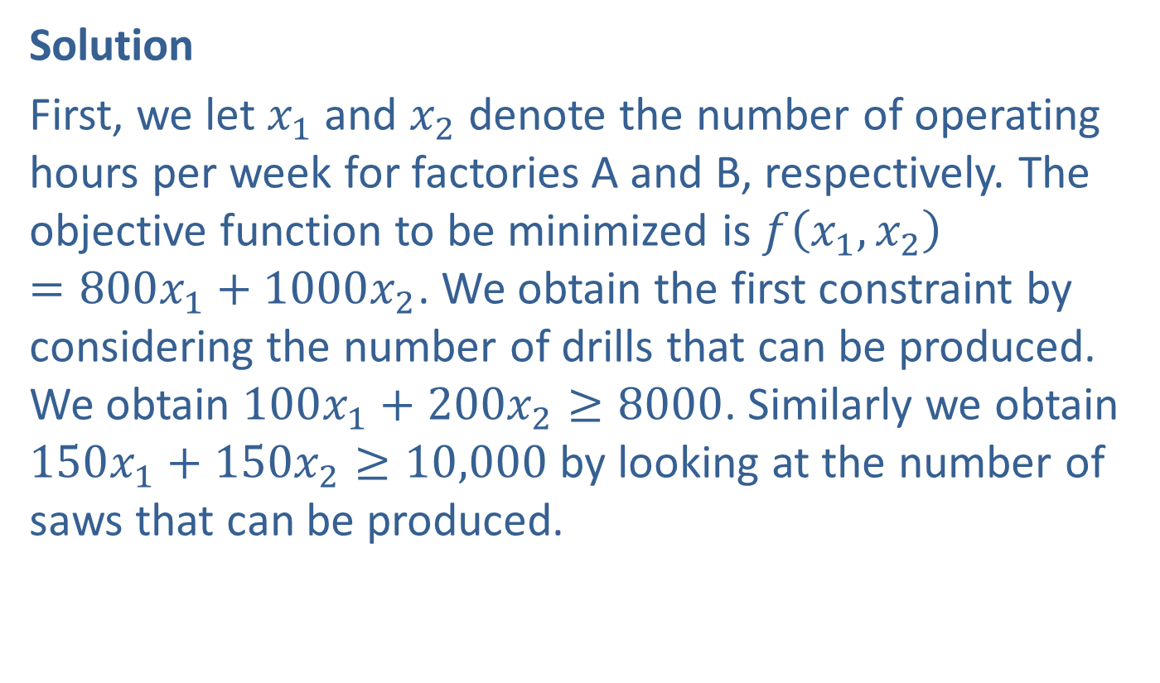
Example 2: Minimizing Cost (cont.)
Solution
First, we let $x_{1}$ and $x_{2}$ denote the number of operating hours per week for factories A and B, respectively. The objective function to be minimized is $f\left(x_{1},x_{2}\right)=800x_{1}+1000x_{2}$. We obtain the first constraint by considering the number of drills that can be produced. We obtain $100x_{1}+200x_{2}≥8000$. Similarly we obtain $150x_{1}+150x_{2}≥10,000$ by looking at the number of saws that can be produced.

Slide 19
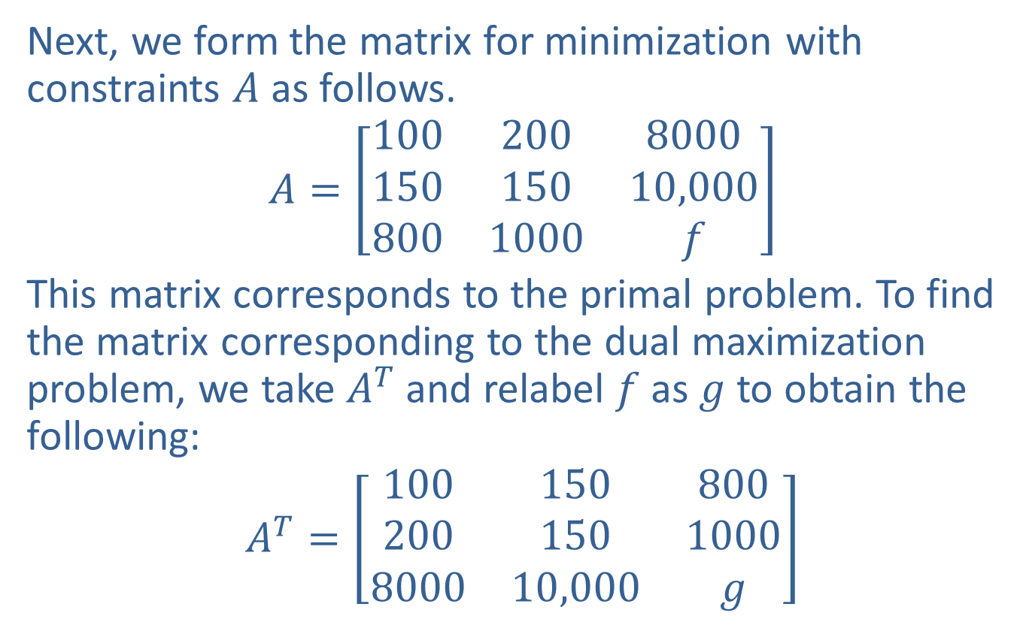
Example 2: Minimizing Cost (cont.)
Next, we form the matrix for minimization with constraints $A$ as follows.
$$A=\left[\begin{matrix}100 & 200 & 8000 \\ 150 & 150 & 10,000 \\ 800 & 1000 & f\end{matrix}\right]$$
This matrix corresponds to the primal problem. To find the matrix corresponding to the dual maximization problem, we take $A^{T}$ and relabel $f$ as $g$ to obtain the following:
$$A^{T}=\left[\begin{matrix}100 & 150 & 800 \\ 200 & 150 & 1000 \\ 8000 & 10,000 & g\end{matrix}\right]$$

Slide 20
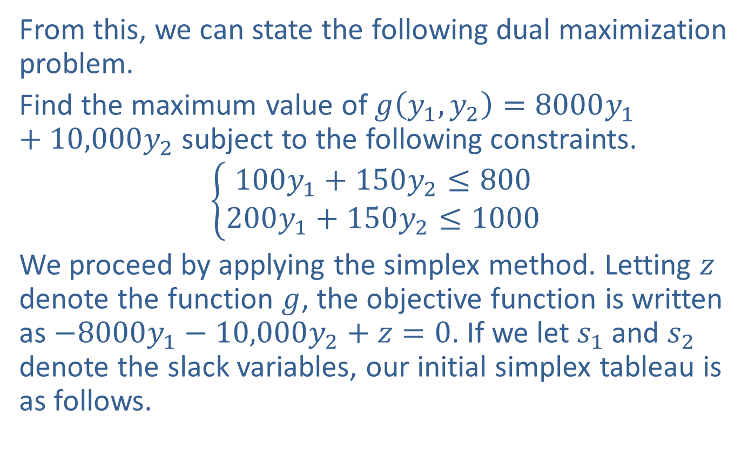
Example 2: Minimizing Cost (cont.)
From this, we can state the following dual maximization problem.
Find the maximum value of $g\left(y_{1},y_{2}\right)=8000y_{1}+10,000y_{2}$ subject to the following constraints.
$$\left\{\begin{aligned}100y_{1}+150y_{2}≤800 \\ 200y_{1}+150y_{2}≤1000\end{aligned}\right.$$
We proceed by applying the simplex method. Letting $z$ denote the function $g$, the objective function is written as $−8000y_{1}−10,000y_{2}+z=0$. If we let $s_{1}$ and $s_{2}$ denote the slack variables, our initial simplex tableau is as follows.

Slide 21
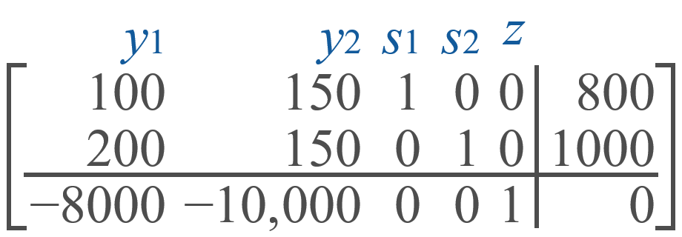
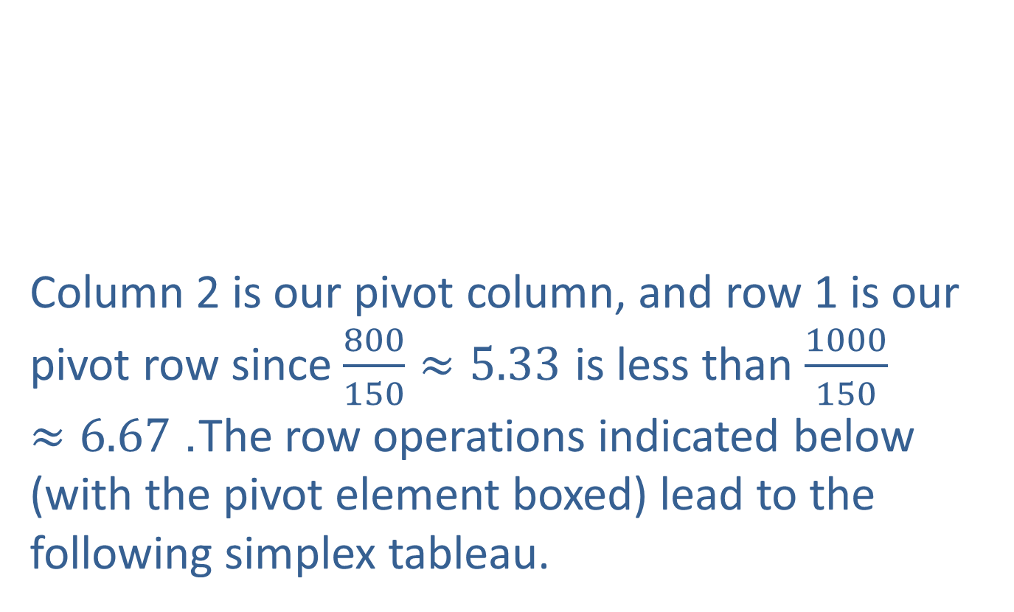
Example 2: Minimizing Cost (cont.)
Column 2 is our pivot column, and row 1 is our pivot row since $\frac{800}{150}≈5.33$ is less than $\frac{1000}{150}≈6.67$. The row operations indicated below (with the pivot element boxed) lead to the following simplex tableau.

Slide 22
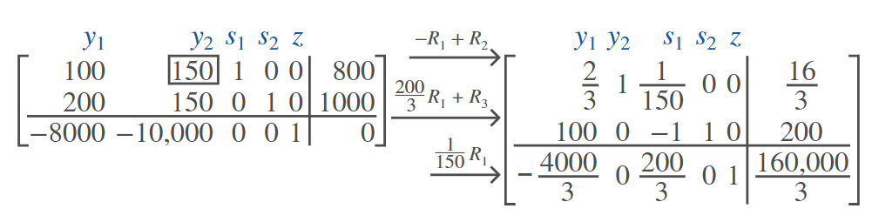
Example 2: Minimizing Cost (cont.)

Slide 23
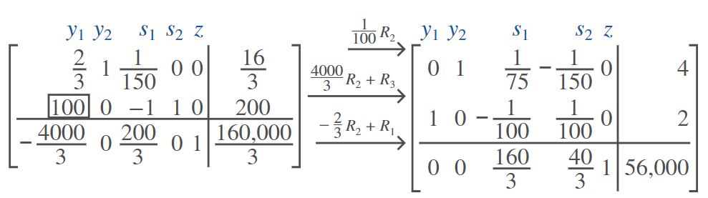

Example 2: Minimizing Cost (cont.)
Column 1 is the next pivot column, and row 2 is the next pivot row since $\frac{200}{100}=2$ is less than $\frac{\frac{16}{3}}{\frac{2}{3}}=8$. A few more row operations lead to the following simplex tableau.

Slide 24
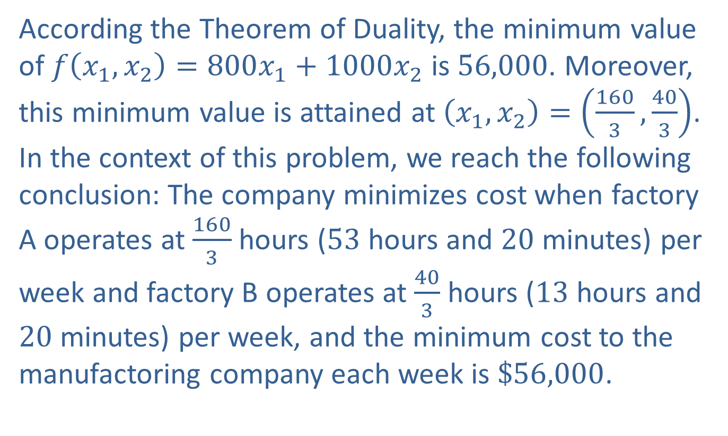
Example 2: Minimizing Cost (cont.)
According the Theorem of Duality, the minimum value of $f\left(x_{1},x_{2}\right)=800x_{1}+1000x_{2}$ is 56,000. Moreover, this minimum value is attained at $\left(x_{1},x_{2}\right)=\left(\frac{160}{3},\frac{40}{3}\right)$. In the context of this problem, we reach the following conclusion: The company minimizes cost when factory A operates at $\frac{160}{3}$ hours (53 hours and 20 minutes) per week and factory B operates at $\frac{40}{3}$ hours (13 hours and 20 minutes) per week, and the minimum cost to the manufactoring company each week is $\$56,000$.

Slide 25
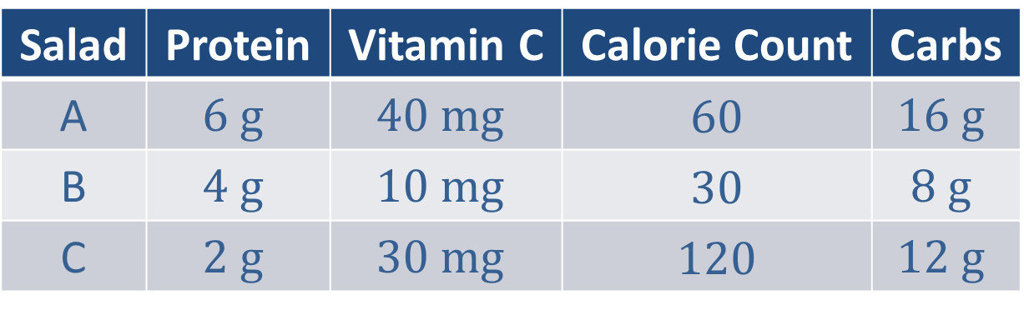
Example 3: Low-Carb Diet
Suppose a salad bar has three different options of salads. The table below gives the protein content (in grams), vitamin C content (in milligrams), calorie count, and carbohydrate content (in grams) in a 2.5-ounce serving of each salad.
Salad | Protein | Vitamin C | Calorie Count | Carbs
A | $$6 g$$ | $$40 mg$$ | 60 | $$16 g$$
B | $$4 g$$ | $$10 mg$$ | 30 | $$8 g$$
C | $$2 g$$ | $$30 mg$$ | 120 | $$12 g$$

Slide 26
Example 3: Low-Carb Diet (cont.)
Suppose that you are on a low-carb diet in which you need a minimum of 12 grams of protein, 70 milligrams of vitamin C, and 240 calories. How many 2.5-ounce servings of each salad should you eat at this salad bar to minimize the carbohydrate content?

Slide 27
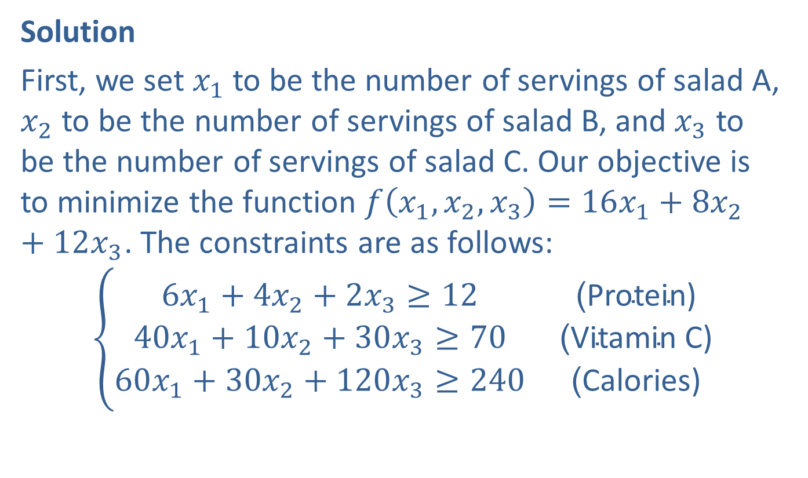
Example 3: Low-Carb Diet (cont.)
Solution
First, we set $x_{1}$ to be the number of servings of salad A, $x_{2}$ to be the number of servings of salad B, and $x_{3}$ to be the number of servings of salad C. Our objective is to minimize the function $f\left(x_{1},x_{2},x_{3}\right)=16x_{1}+8x_{2}+12x_{3}$. The constraints are as follows:
$$\left\{\begin{matrix}6x_{1}+4x_{2}+2x_{3}≥12 & \text{(}\text{Protein}\text{)} \\ 40x_{1}+10x_{2}+30x_{3}≥70 & \text{(}\text{Vitamin} \text{C}\text{)} \\ 60x_{1}+30x_{2}+120x_{3}≥240 & \text{(}\text{Calories}\text{)}\end{matrix}\right.$$

Slide 28
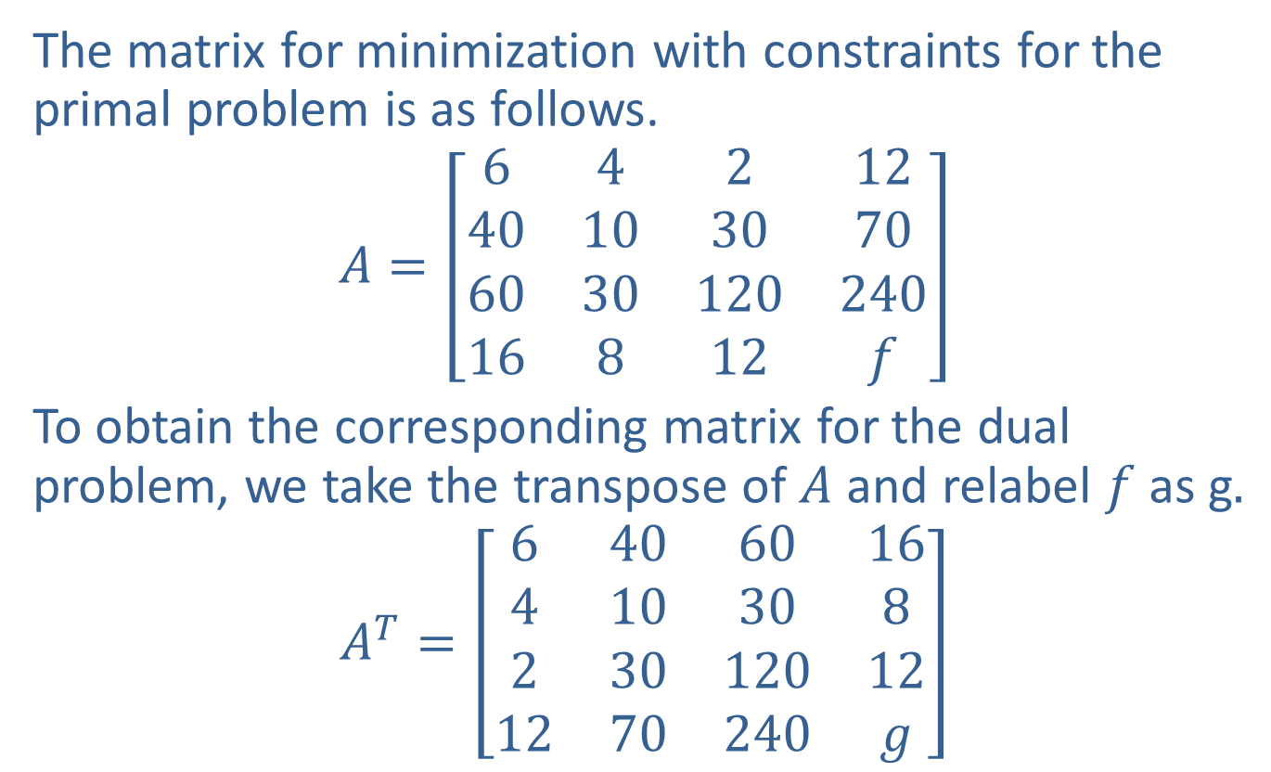
Example 3: Low-Carb Diet (cont.)
The matrix for minimization with constraints for the primal problem is as follows.
$$A=\left[\begin{matrix}6 & 4 & 2 & 12 \\ 40 & 10 & 30 & 70 \\ 60 & 30 & 120 & 240 \\ 16 & 8 & 12 & f\end{matrix}\right]$$
To obtain the corresponding matrix for the dual problem, we take the transpose of $A$ and relabel $f$ as g$.$
$$A^{T}=\left[\begin{matrix}6 & 40 & 60 & 16 \\ 4 & 10 & 30 & 8 \\ 2 & 30 & 120 & 12 \\ 12 & 70 & 240 & g\end{matrix}\right]$$

Slide 29
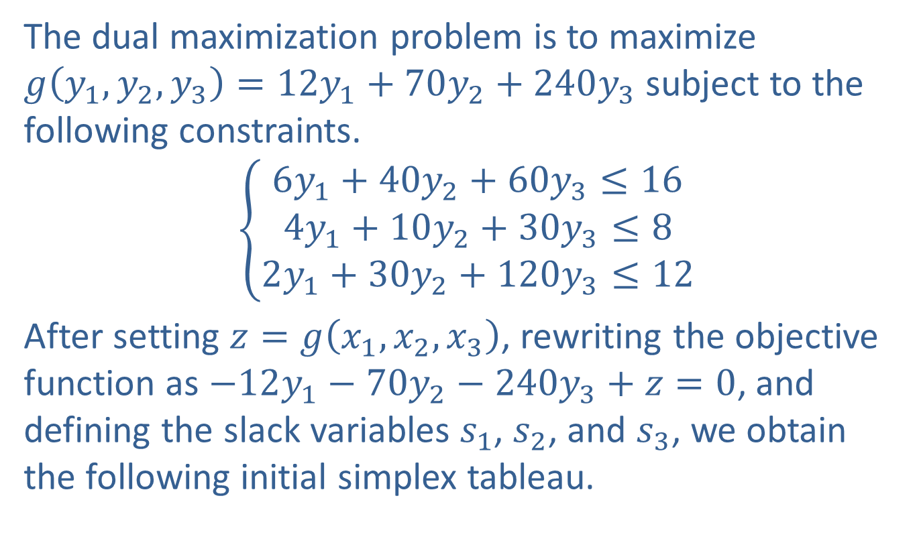
Example 3: Low-Carb Diet (cont.)
The dual maximization problem is to maximize $g\left(y_{1},y_{2},y_{3}\right)=12y_{1}+70y_{2}+240y_{3}$ subject to the following constraints.
$$\left\{\begin{aligned}6y_{1}+40y_{2}+60y_{3}≤16 \\ 4y_{1}+10y_{2}+30y_{3}≤8 \\ 2y_{1}+30y_{2}+120y_{3}≤12\end{aligned}\right.$$
After setting $z=g\left(x_{1},x_{2},x_{3}\right)$, rewriting the objective function as $−12y_{1}−70y_{2}−240y_{3}+z=0$, and defining the slack variables $s_{1}$, $s_{2}$, and $s_{3}$, we obtain the following initial simplex tableau.

Slide 30
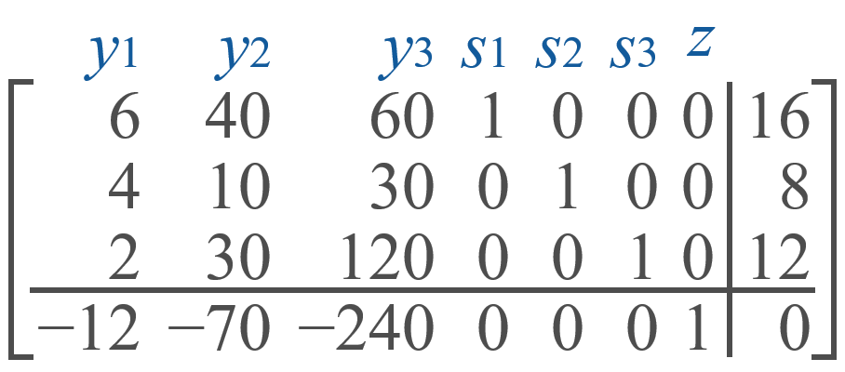
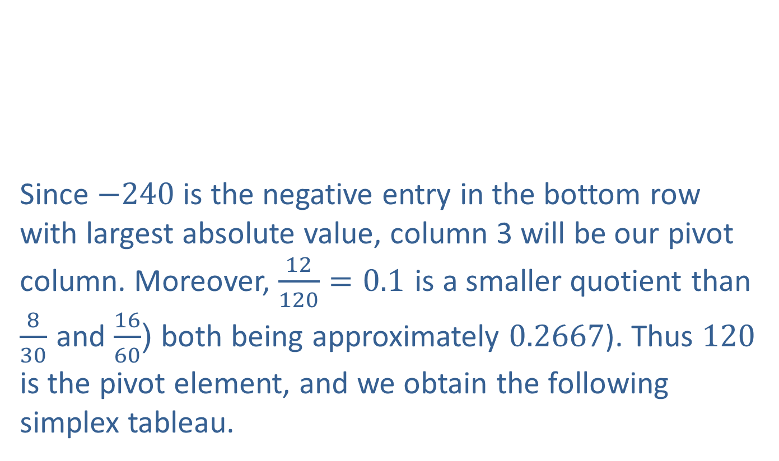
Example 3: Low-Carb Diet (cont.)
Since $−240$ is the negative entry in the bottom row with largest absolute value, column 3 will be our pivot column. Moreover, $\frac{12}{120}=0.1$ is a smaller quotient than $\frac{8}{30}$ and $\frac{16}{60}$ (both being approximately 0.2667). Thus 120 is the pivot element, and we obtain the following simplex tableau.

Slide 31
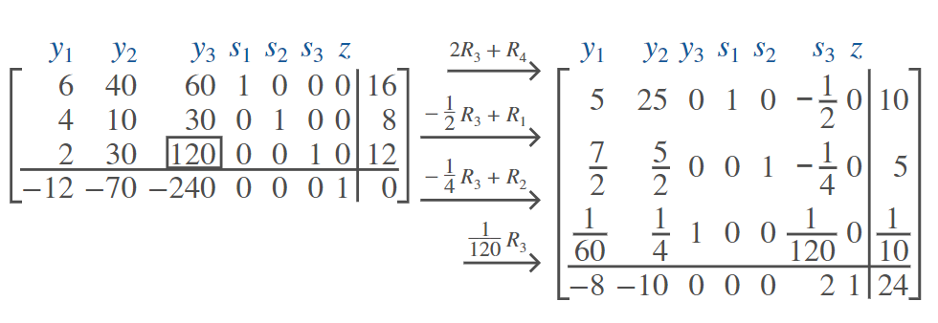
Example 3: Low-Carb Diet (cont.)

Slide 32

Example 3: Low-Carb Diet (cont.)
Column 2 is our next pivot column. We have a tie for the smallest quotients in rows 1 and 3, since $\frac{10}{25}=\frac{\frac{1}{10}}{\frac{1}{4}}=0.4$; if we use 25 as our next pivot element, we obtain the following simplex tableau:

Slide 33
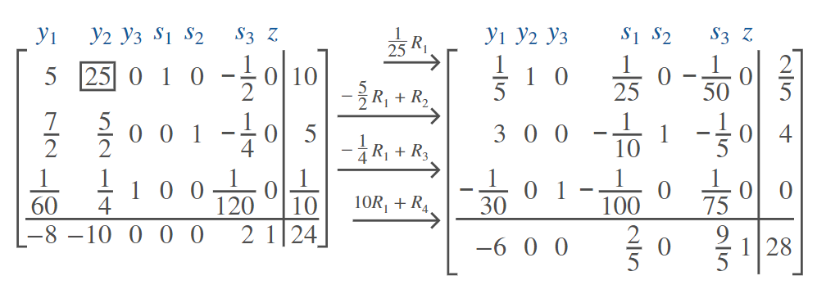
Example 3: Low-Carb Diet (cont.)

Slide 34
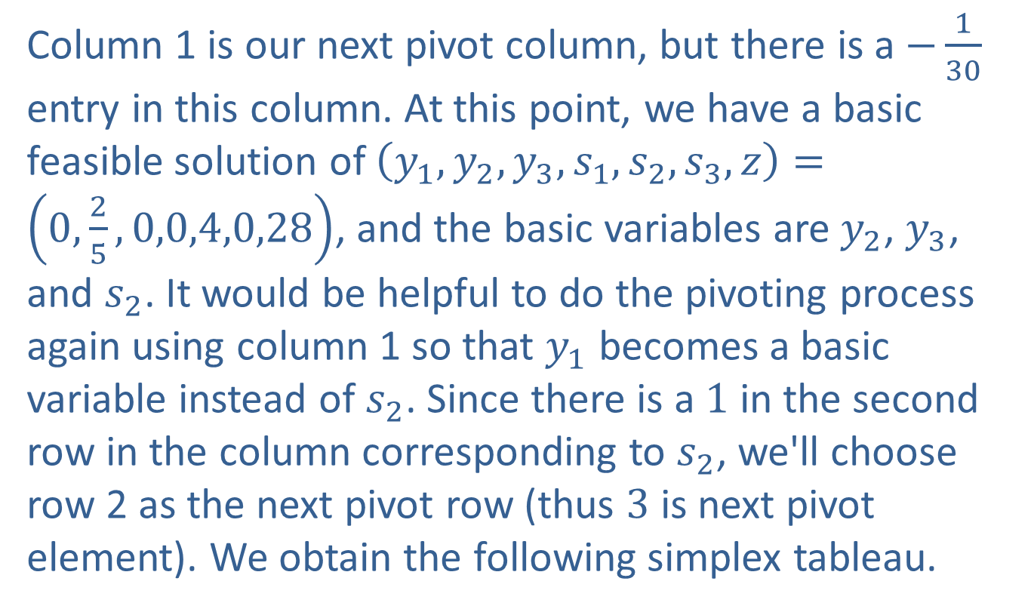
Example 3: Low-Carb Diet (cont.)
Column 1 is our next pivot column, but there is a $−\frac{1}{30}$ entry in this column. At this point, we have a basic feasible solution of $\left(y_{1},y_{2},y_{3},s_{1},s_{2},s_{3},z\right)=\left(0,\frac{2}{5},0,0,4,0,28\right)$, and the basic variables are $y_{2}$, $y_{3}$, and $s_{2}$. It would be helpful to do the pivoting process again using column 1 so that $y_{1}$ becomes a basic variable instead of $s_{2}$. Since there is a 1 in the second row in the column corresponding to $s_{2}$, we'll choose row 2 as the next pivot row (thus 3 is next pivot element). We obtain the following simplex tableau.

Slide 35
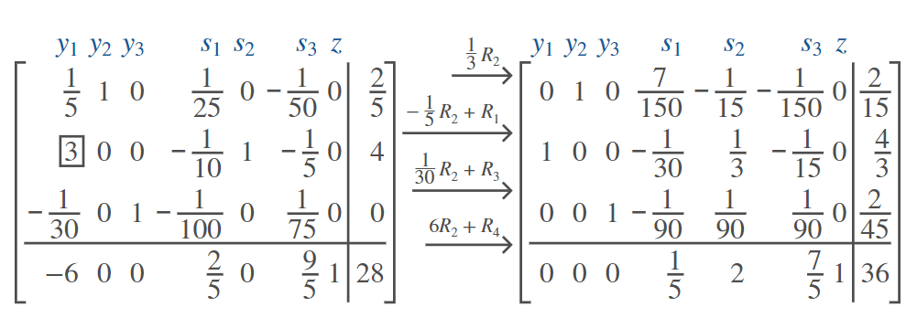
Example 3: Low-Carb Diet (cont.)

Slide 36
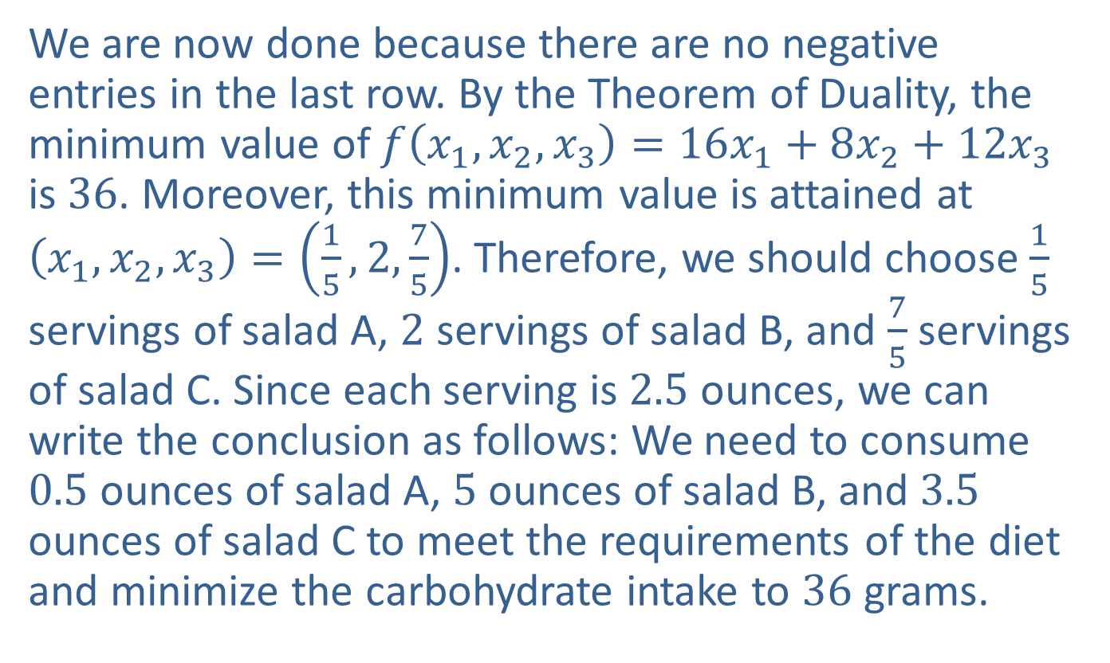
Example 3: Low-Carb Diet (cont.)
We are now done because there are no negative entries in the last row. By the Theorem of Duality, the minimum value of $f⁡\left(x_{1},x_{2},x_{3}\right)=16x_{1}+8x_{2}+12x_{3}$ is 36. Moreover, this minimum value is attained at $\left(x_{1},x_{2},x_{3}\right)=\left(\frac{1}{5},2,\frac{7}{5}\right)$. Therefore, we should choose $\frac{1}{5}$ servings of salad A, 2 servings of salad B, and $\frac{7}{5}$ servings of salad C. Since each serving is 2.5 ounces, we can write the conclusion as follows: We need to consume 0.5 ounces of salad A, 5 ounces of salad B, and 3.5 ounces of salad C to meet the requirements of the diet and minimize the carbohydrate intake to 36 grams.

