Slide 1
Section 7.5
The Simplex Method: Mixed Constraints

Slide 2

Example 1: A Maximization Problem with Mixed Constraints
Maximize the objective function $f\left(x_{1},x_{2}\right)=5x_{1}+7x_{2}$ subject to the following constraints.
$$\left\{\begin{aligned}8x_{1}+4x_{2}≤28 \\ −3x_{1}+2x_{2}≥7\end{aligned}\right.$$

Slide 3
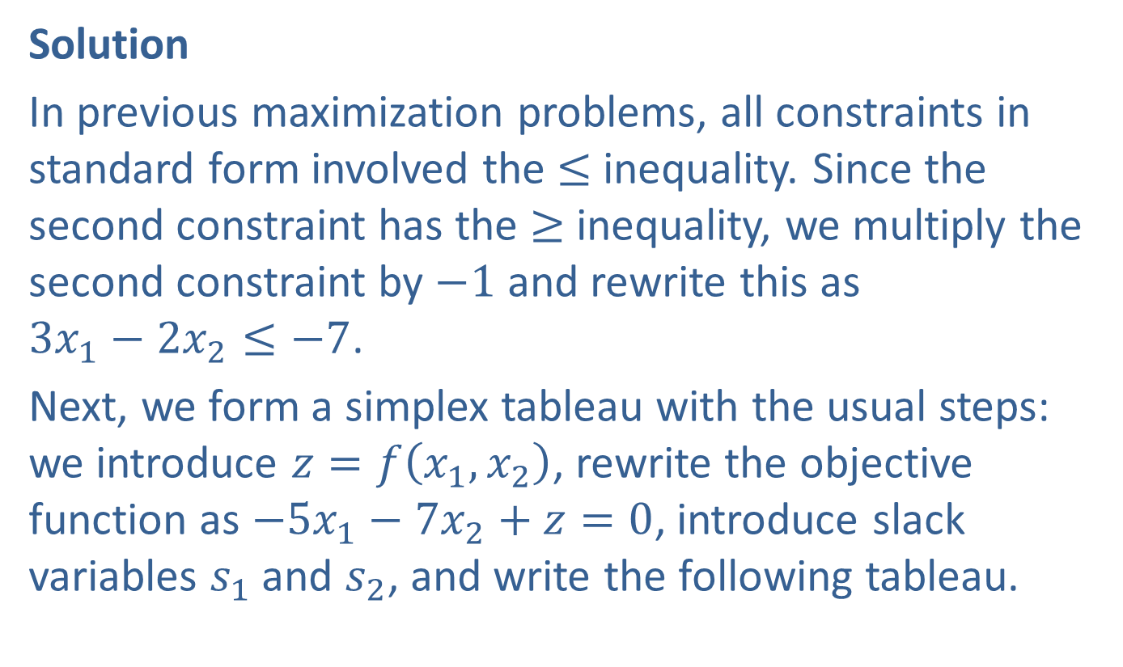
Example 1: A Maximization Problem with Mixed Constraints (cont.)
Solution
In previous maximization problems, all constraints in standard form involved the ≤ inequality. Since the second constraint has the ≥ inequality, we multiply the second constraint by $−1$ and rewrite this as $3x_{1}−2x_{2}≤−7$.
Next, we form a simplex tableau with the usual steps: we introduce $z=f\left(x_{1},x_{2}\right)$, rewrite the objective function as $−5x_{1}−7x_{2}+z=0$, introduce slack variables $s_{1}$ and $s_{2}$, and write the following tableau.

Slide 4
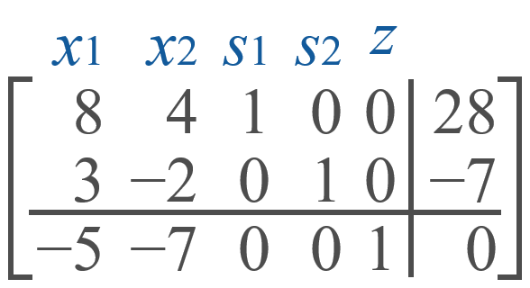

Example 1: A Maximization Problem with Mixed Constraints (cont.)
Note the negative entry $−7$ in the last column above the bottom row. Because of this, we cannot apply the simplex method to this tableau. We will call the above tableau a preliminary simplex tableau because it is in a form such that the simplex method cannot be applied.

Slide 5
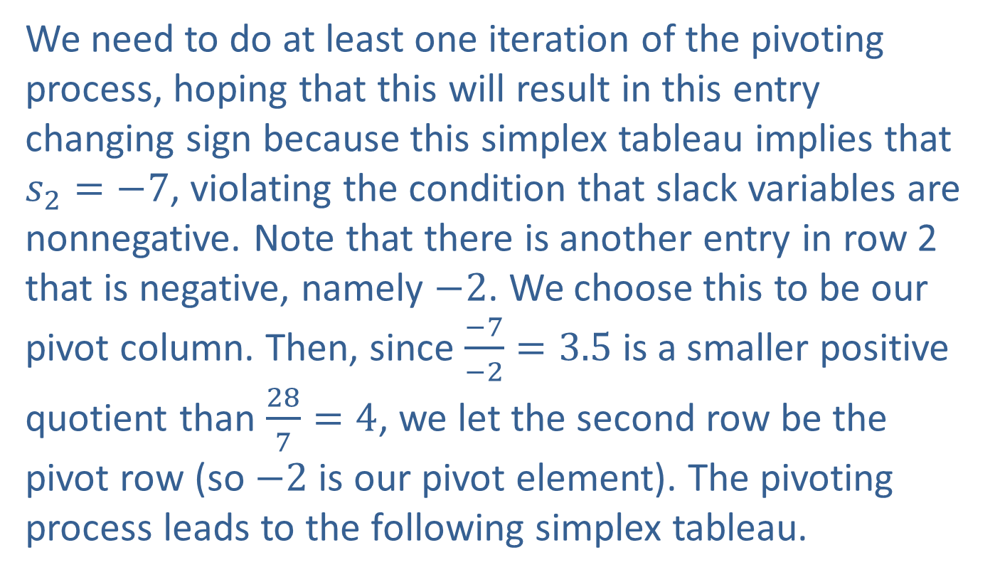
Example 1: A Maximization Problem with Mixed Constraints (cont.)
We need to do at least one iteration of the pivoting process, hoping that this will result in this entry changing sign because this simplex tableau implies that $s_{2}=−7$, violating the condition that slack variables are nonnegative. Note that there is another entry in row 2 that is negative, namely $−2$. We choose this to be our pivot column. Then, since $\frac{−7}{−2}=3.5$ is a smaller positive quotient than $\frac{28}{7}=4$, we let the second row be the pivot row (so $−2$ is our pivot element). The pivoting process leads to the following simplex tableau.

Slide 6
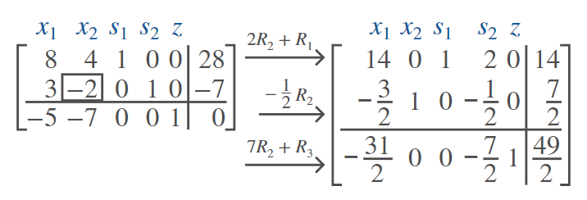
Example 1: A Maximization Problem with Mixed Constraints (cont.)

Slide 7
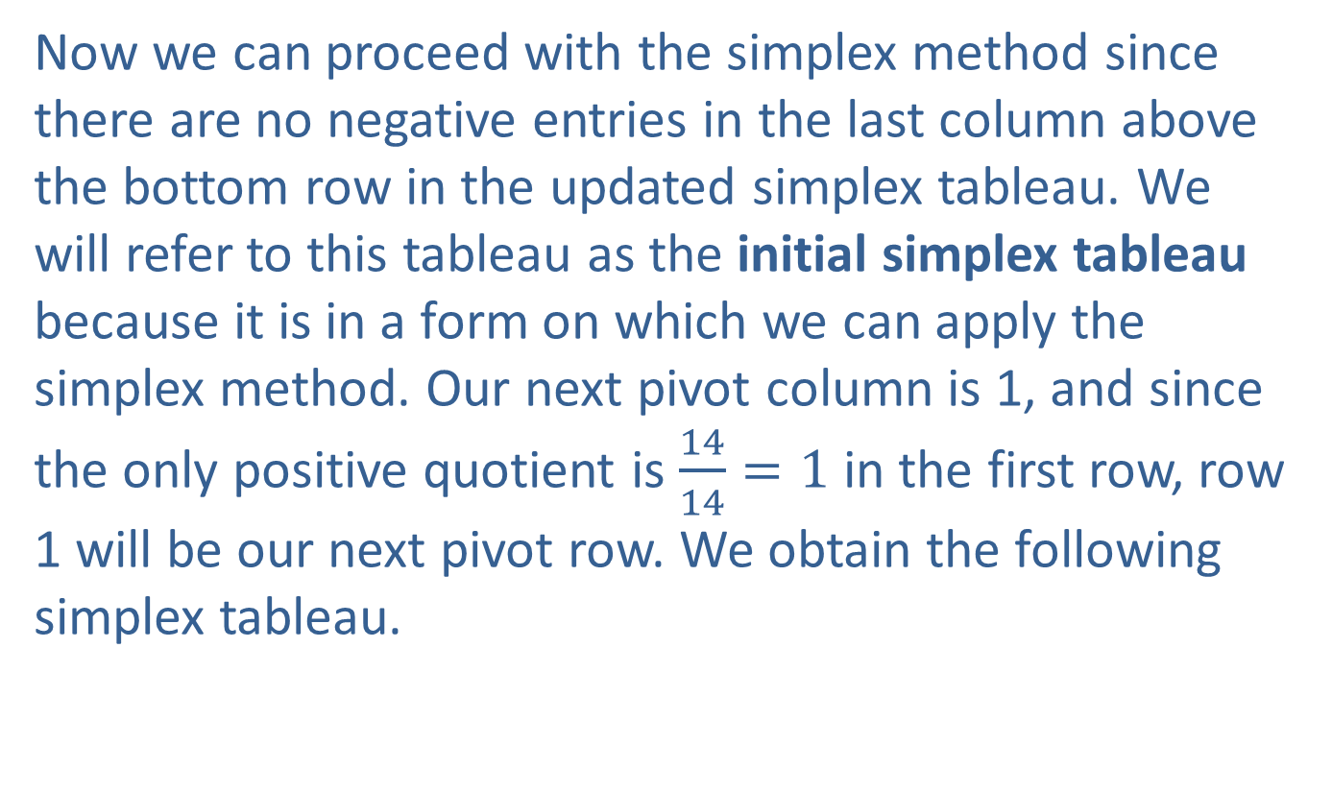
Example 1: A Maximization Problem with Mixed Constraints (cont.)
Now we can proceed with the simplex method since there are no negative entries in the last column above the bottom row in the updated simplex tableau. We will refer to this tableau as the initial simplex tableau because it is in a form on which we can apply the simplex method. Our next pivot column is 1, and since the only positive quotient is $\frac{14}{14}=1$ in the first row, row 1 will be our next pivot row. We obtain the following simplex tableau.

Slide 8
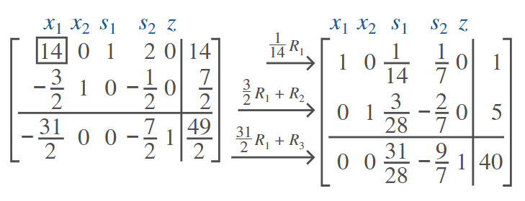
Example 1: A Maximization Problem with Mixed Constraints (cont.)

Slide 9
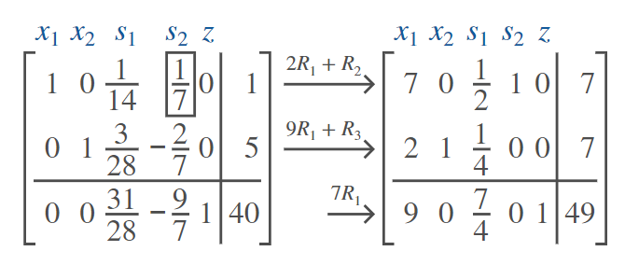

Example 1: A Maximization Problem with Mixed Constraints (cont.)
Column 3 is our next pivot column because of the negative entry in the bottom row, and row 1 is our next pivot row because $\frac{1}{\frac{1}{7}}=7$ is the only positive quotient in the column. We obtain the following simplex tableau.

Slide 10

Example 1: A Maximization Problem with Mixed Constraints (cont.)
We are done since there are no negative entries in the bottom row. Thus, the objective function $f⁡(x_{1},x_{2})=5x_{1}+7x_{2}$ attains a maximum value of 49 at $\left(x_{1},x_{2}\right)=\left(0,7\right)$.

Slide 11

Example 2: A Minimization Problem with Mixed Constraints
Minimize $f\left(x_{1},x_{2}\right)=4x_{1}+3x_{2}$ subject to the following constraints.
$$\left\{\begin{aligned}6x_{1}−5x_{2}≤4 \\ 2x_{1}+5x_{2}≥8\end{aligned}\right.$$

Slide 12
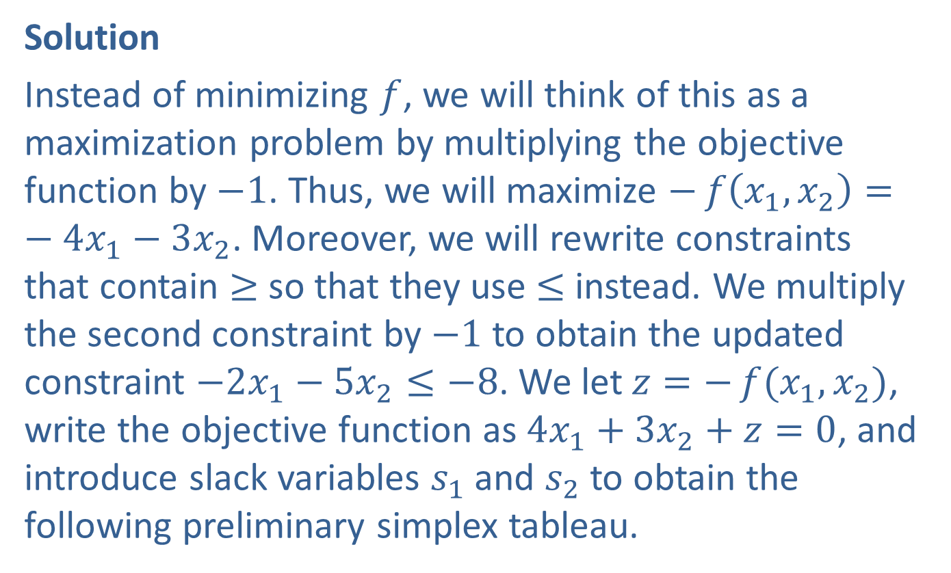
Example 2: A Minimization Problem with Mixed Constraints (cont.)
Solution
Instead of minimizing $f$, we will think of this as a maximization problem by multiplying the objective function by $−1$. Thus, we will maximize $−f\left(x_{1},x_{2}\right)=−4x_{1}−3x_{2}$. Moreover, we will rewrite constraints that contain ≥ so that they use ≤ instead. We multiply the second constraint by $−1$ to obtain the updated constraint $−2x_{1}−5x_{2}≤−8$. We let $z=−f{(x_{1},x_{2})}$, write the objective function as $4x_{1}+3x_{2}+z=0$, and introduce slack variables $s_{1}$ and $s_{2}$ to obtain the following preliminary simplex tableau.

Slide 13
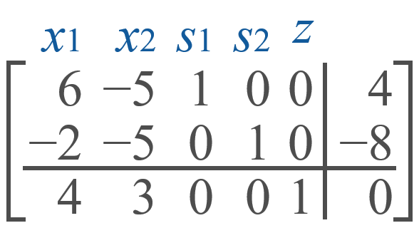
Example 2: A Minimization Problem with Mixed Constraints (cont.)

Slide 14
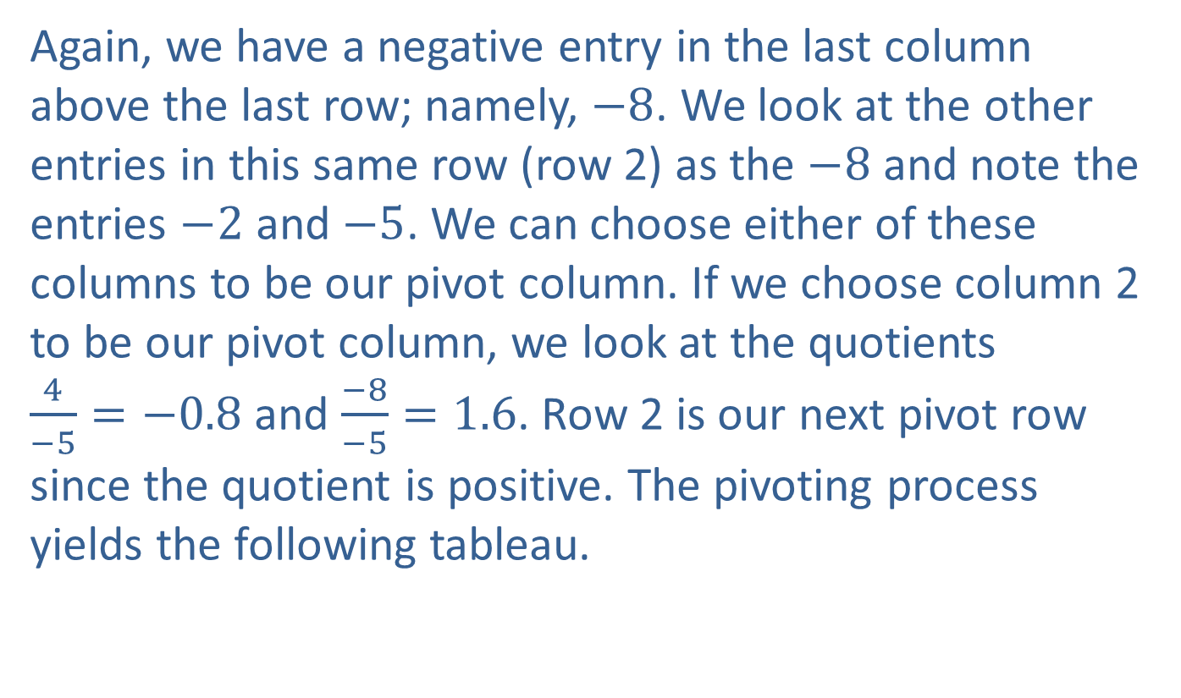
Example 2: A Minimization Problem with Mixed Constraints (cont.)
Again, we have a negative entry in the last column above the last row; namely, $−8$. We look at the other entries in this same row (row 2) as the $−8$ and note the entries $−2$ and $−5$. We can choose either of these columns to be our pivot column. If we choose column 2 to be our pivot column, we look at the quotients $\frac{4}{−5}=−0.8$ and $\frac{−8}{−5}=1.6$. Row 2 is our next pivot row since the quotient is positive. The pivoting process yields the following tableau.

Slide 15
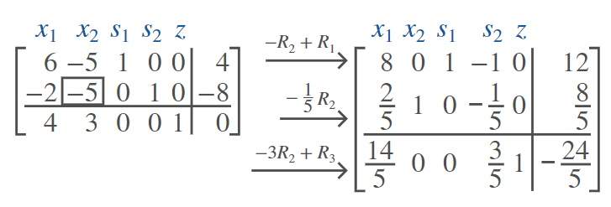
Example 2: A Minimization Problem with Mixed Constraints (cont.)

Slide 16
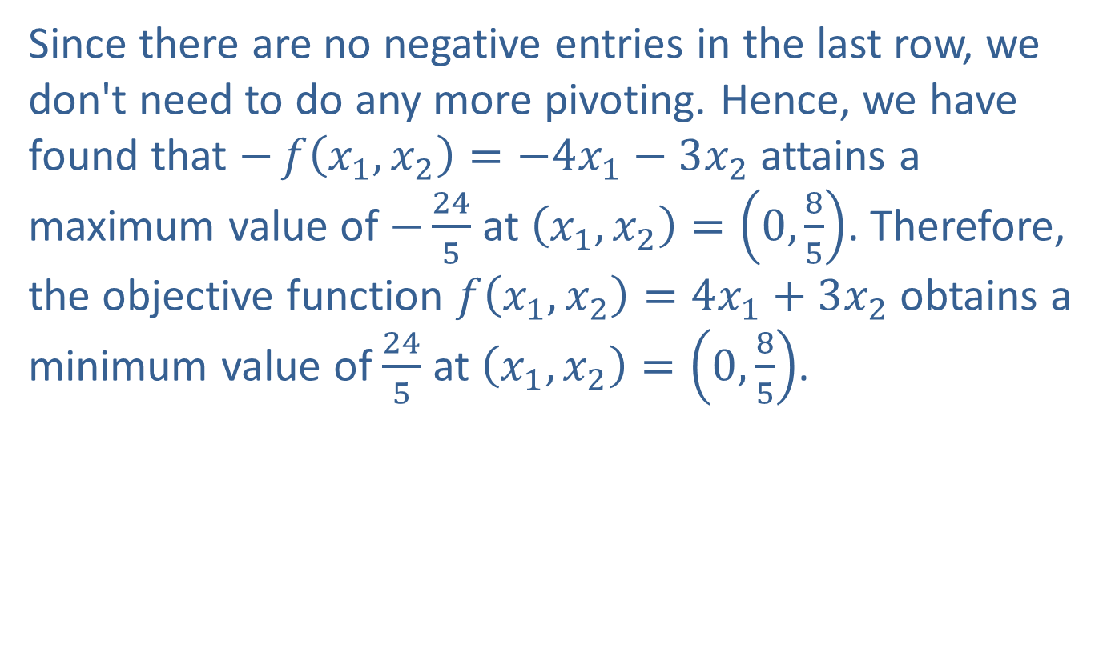
Example 2: A Minimization Problem with Mixed Constraints (cont.)
Since there are no negative entries in the last row, we don't need to do any more pivoting. Hence, we have found that $−f\left(x_{1},x_{2}\right)=−4x_{1}−3x_{2}$ attains a maximum value of $−\frac{24}{5}$ at $\left(x_{1},x_{2}\right)=\left(0,\frac{8}{5}\right)$. Therefore, the objective function $f\left(x_{1},x_{2}\right)=4x_{1}+3x_{2}$ obtains a minimum value of $\frac{24}{5}$ at $\left(x_{1},x_{2}\right)=\left(0,\frac{8}{5}\right)$.

Slide 17
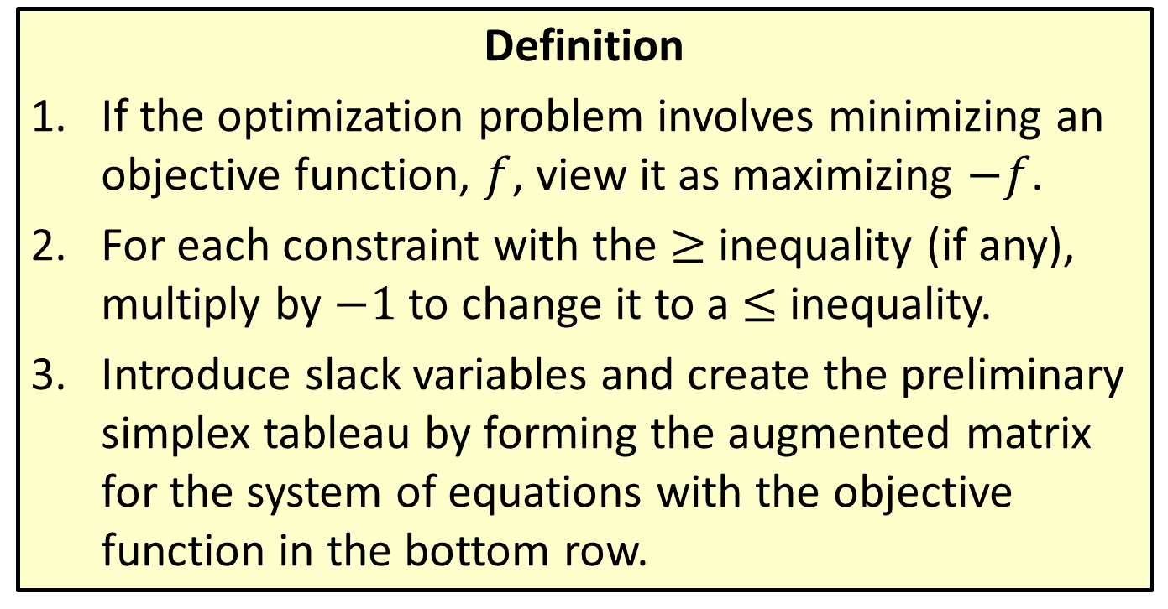
Solving Mixed Constraint Problems Using the Simplex Method
Definition
​If the optimization problem involves minimizing an objective function, $f$, view it as maximizing $−f$.
​For each constraint with the ≥ inequality (if any), multiply by $−1$ to change it to a ≤ inequality.
​Introduce slack variables and create the preliminary simplex tableau by forming the augmented matrix for the system of equations with the objective function in the bottom row.

Slide 18
Solving Mixed Constraint Problems Using the Simplex Method (cont.)
​If there are any negative entries in the last column above the bottom row, use the following steps.
​Choose any other negative value in the same row and use its column as the pivot column.
​In each row except for the last one, divide the entry in the far-right column by the one in the pivot column. The row with the smallest positive quotient will be the pivot row.
​Complete the iteration of the pivoting process, and repeat a. and b. until there are no negative entries in the last column above the bottom row.

Slide 19
Solving Mixed Constraint Problems Using the Simplex Method (cont.)
​Apply the simplex method to the resulting initial tableau, and arrive at an optimal solution.

Slide 20
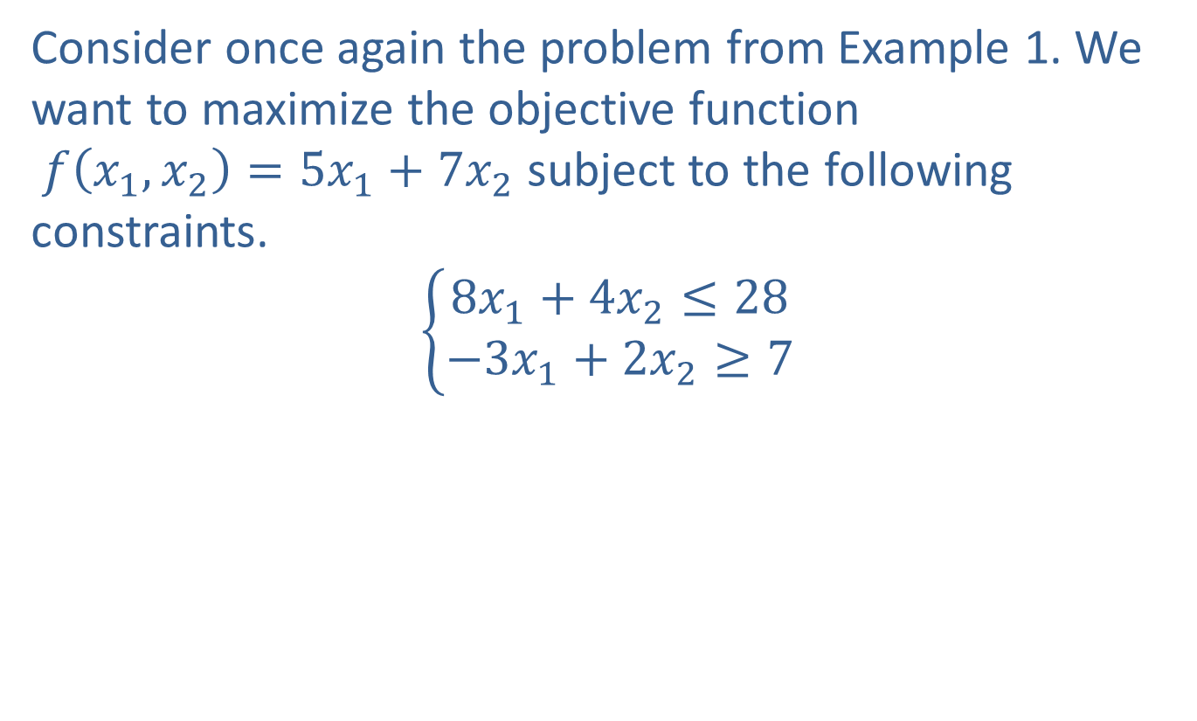
Example 3: Solution to Example 1 Using the Big M Method
Consider once again the problem from Example 1. We want to maximize the objective function $f\left(x_{1},x_{2}\right)=5x_{1}+7x_{2}$ subject to the following constraints.
$$\left\{\begin{aligned}8x_{1}+4x_{2}≤28 \\ −3x_{1}+2x_{2}≥7\end{aligned}\right.$$

Slide 21
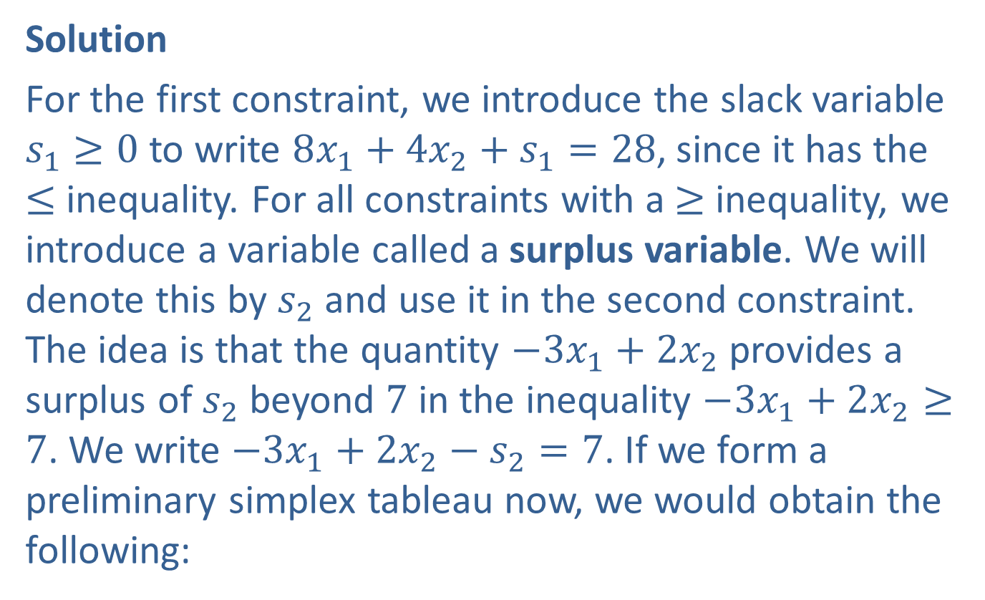
Example 3: Solution to Example 1 Using the Big M Method (cont.)
Solution
For the first constraint, we introduce the slack variable $s_{1}≥0$ to write $8x_{1}+4x_{2}+s_{1}=28$, since it has the ≤ inequality. For all constraints with a ≥ inequality, we introduce a variable called a surplus variable. We will denote this by $s_{2}$ and use it in the second constraint. The idea is that the quantity $−3x_{1}+2x_{2}$ provides a surplus of $s_{2}$ beyond 7 in the inequality $−3x_{1}+2x_{2}≥7$. We write $−3x_{1}+2x_{2}−s_{2}=7$. If we form a preliminary simplex tableau now, we would obtain the following:

Slide 22
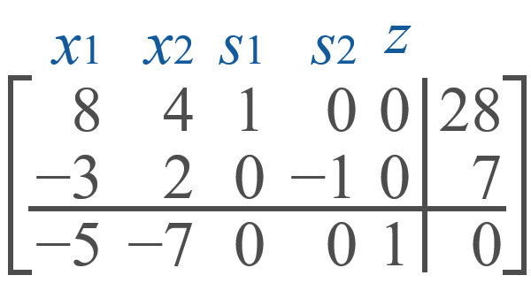
Example 3: Solution to Example 1 Using the Big M Method (cont.)

Slide 23
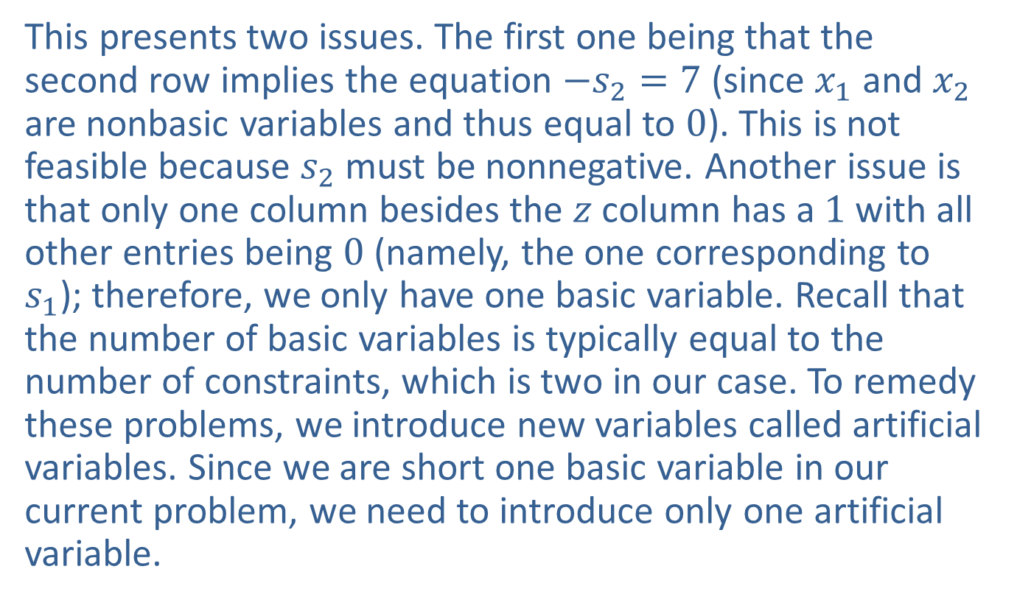
Example 3: Solution to Example 1 Using the Big M Method (cont.)
This presents two issues. The first one being that the second row implies the equation $−s_{2}=7$ (since $x_{1}$ and $x_{2}$ are nonbasic variables and thus equal to 0). This is not feasible because $s_{2}$ must be nonnegative. Another issue is that only one column besides the $z$ column has a 1 with all other entries being 0 (namely, the one corresponding to $s_{1}$); therefore, we only have one basic variable. Recall that the number of basic variables is typically equal to the number of constraints, which is two in our case. To remedy these problems, we introduce new variables called artificial variables. Since we are short one basic variable in our current problem, we need to introduce only one artificial variable.

Slide 24
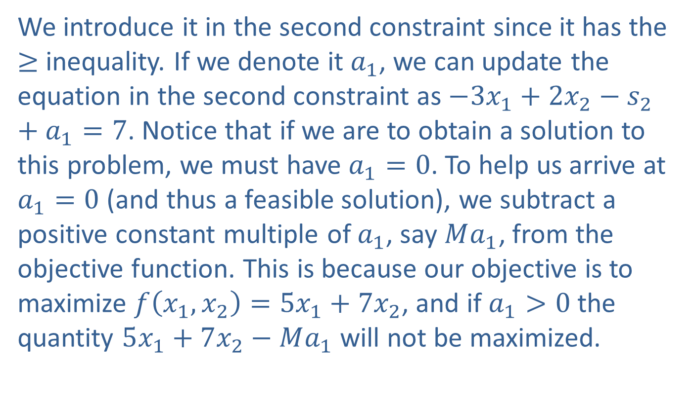
Example 3: Solution to Example 1 Using the Big M Method (cont.)
We introduce it in the second constraint since it has the ≥ inequality. If we denote it $a_{1}$, we can update the equation in the second constraint as $−3x_{1}+2x_{2}−s_{2}+a_{1}=7$. Notice that if we are to obtain a solution to this problem, we must have $a_{1}=0$. To help us arrive at $a_{1}=0$ (and thus a feasible solution), we subtract a positive constant multiple of $a_{1}$, say $Ma_{1}$, from the objective function. This is because our objective is to maximize $f⁡\left(x_{1},x_{2}\right)=5x_{1}+7x_{2}$, and if $a_{1}>0$ the quantity $5x_{1}+7x_{2}−Ma_{1}$ will not be maximized.

Slide 25
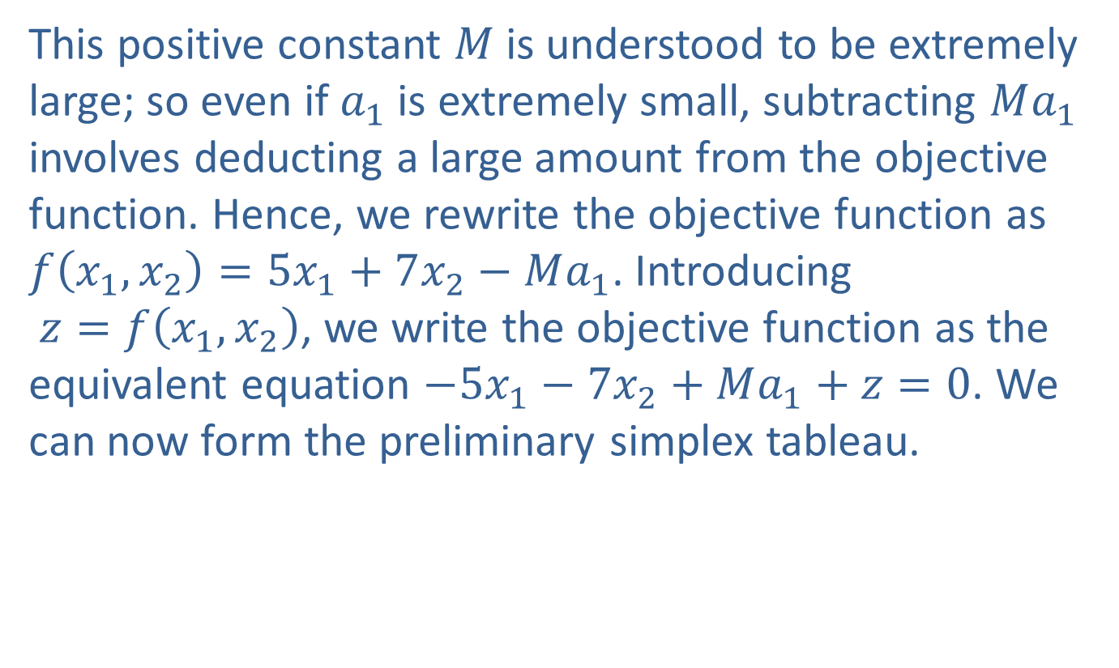
Example 3: Solution to Example 1 Using the Big M Method (cont.)
This positive constant $M$ is understood to be extremely large; so even if $a_{1}$ is extremely small, subtracting $Ma_{1}$ involves deducting a large amount from the objective function. Hence, we rewrite the objective function as $f⁡\left(x_{1},x_{2}\right)=5x_{1}+7x_{2}−Ma_{1}$. Introducing $z=f\left(x_{1},x_{2}\right)$, we write the objective function as the equivalent equation $−5x_{1}−7x_{2}+Ma_{1}+z=0$. We can now form the preliminary simplex tableau.

Slide 26
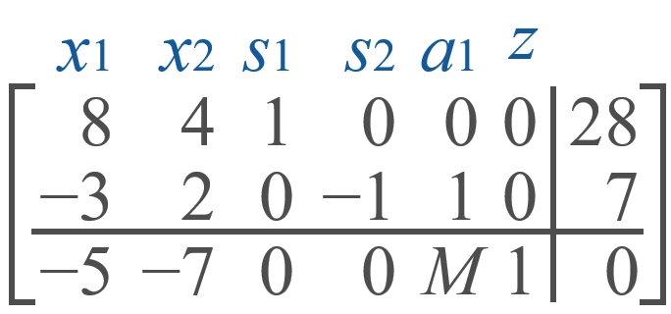
Example 3: Solution to Example 1 Using the Big M Method (cont.)

Slide 27
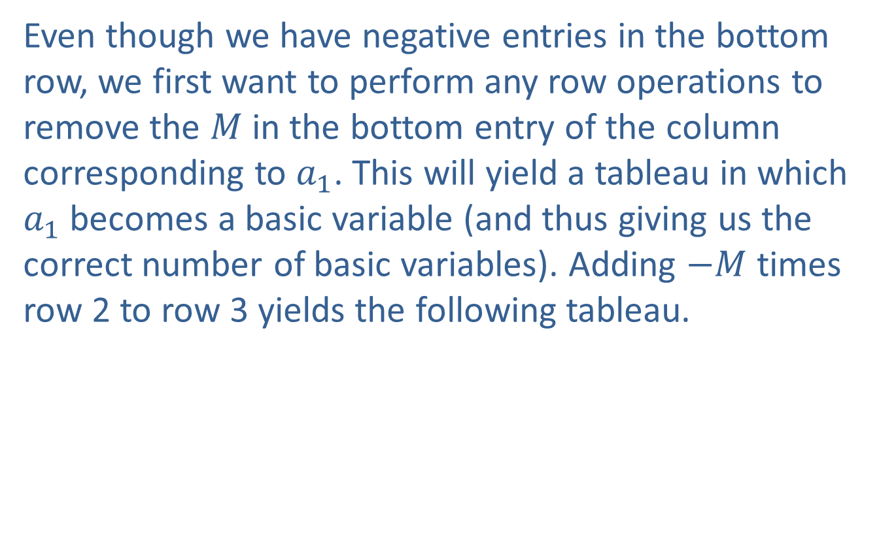
Example 3: Solution to Example 1 Using the Big M Method (cont.)
Even though we have negative entries in the bottom row, we first want to perform any row operations to remove the $M$ in the bottom entry of the column corresponding to $a_{1}$. This will yield a tableau in which $a_{1}$ becomes a basic variable (and thus giving us the correct number of basic variables). Adding $−M$ times row 2 to row 3 yields the following tableau.

Slide 28
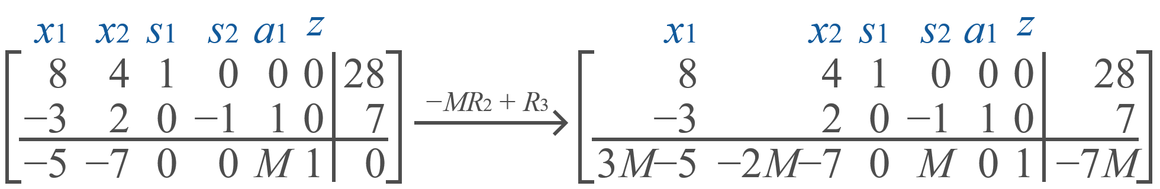
Example 3: Solution to Example 1 Using the Big M Method (cont.)

Slide 29
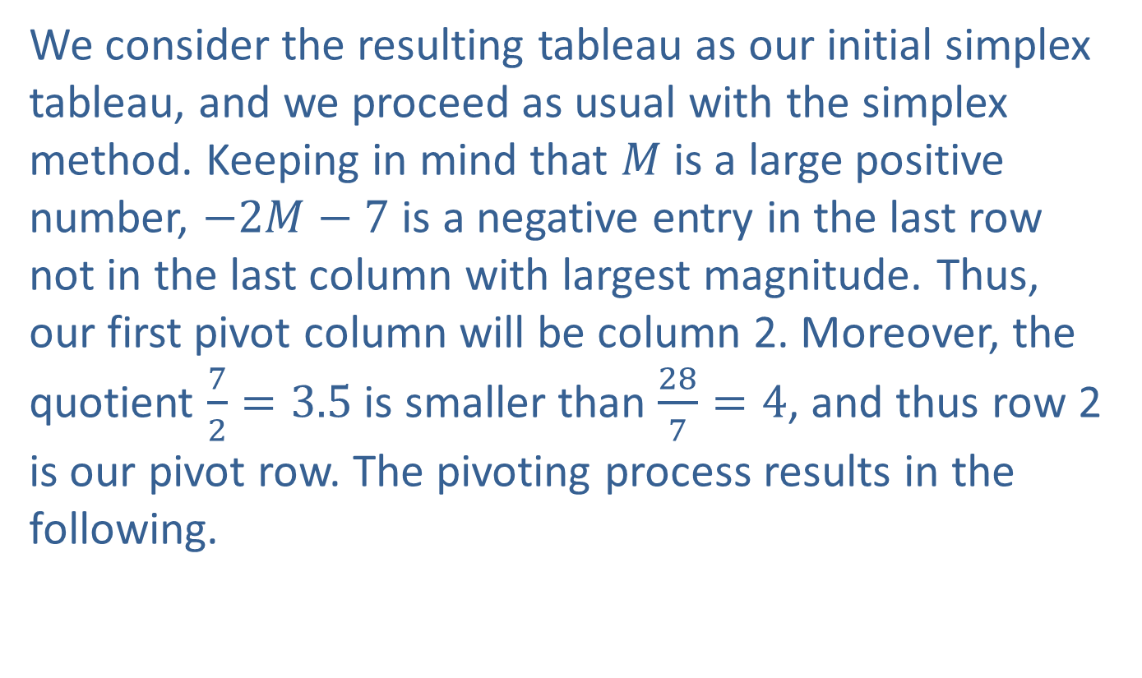
Example 3: Solution to Example 1 Using the Big M Method (cont.)
We consider the resulting tableau as our initial simplex tableau, and we proceed as usual with the simplex method. Keeping in mind that $M$ is a large positive number, $−2M−7$ is a negative entry in the last row not in the last column with largest magnitude. Thus, our first pivot column will be column 2. Moreover, the quotient $\frac{7}{2}=3.5$ is smaller than $\frac{28}{7}=4$, and thus row 2 is our pivot row. The pivoting process results in the following.

Slide 30
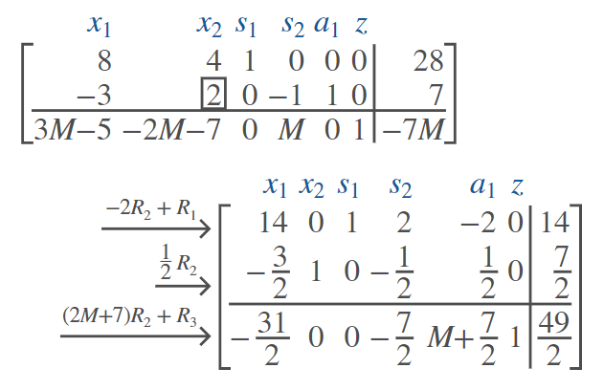
Example 3: Solution to Example 1 Using the Big M Method (cont.)

Slide 31
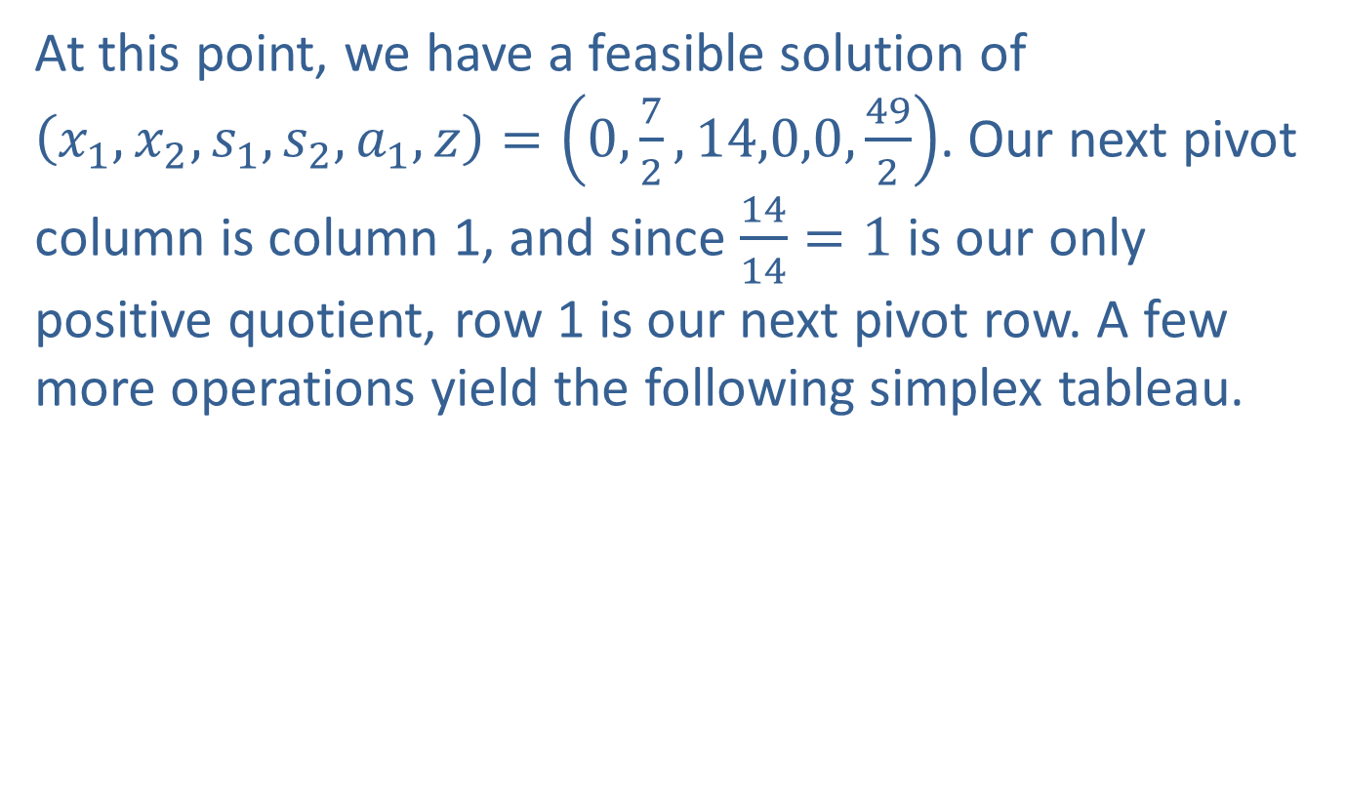
Example 3: Solution to Example 1 Using the Big M Method (cont.)
At this point, we have a feasible solution of $\left(x_{1},x_{2},s_{1},s_{2},a_{1},z\right)=\left(0,\frac{7}{2},14,0,0,\frac{49}{2}\right)$. Our next pivot column is column 1, and since $\frac{14}{14}=1$ is our only positive quotient, row 1 is our next pivot row. A few more operations yield the following simplex tableau.

Slide 32
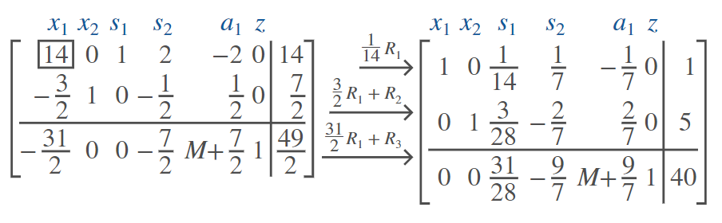
Example 3: Solution to Example 1 Using the Big M Method (cont.)

Slide 33
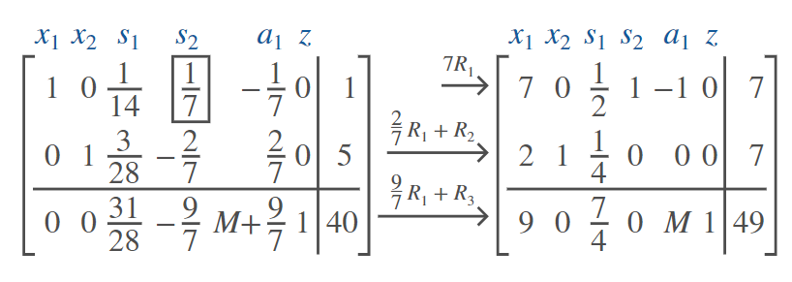

Example 3: Solution to Example 1 Using the Big M Method (cont.)
Finally, we find that $\frac{1}{7}$ is our pivot element (row 1, column 4), and we obtain the following.

Slide 34
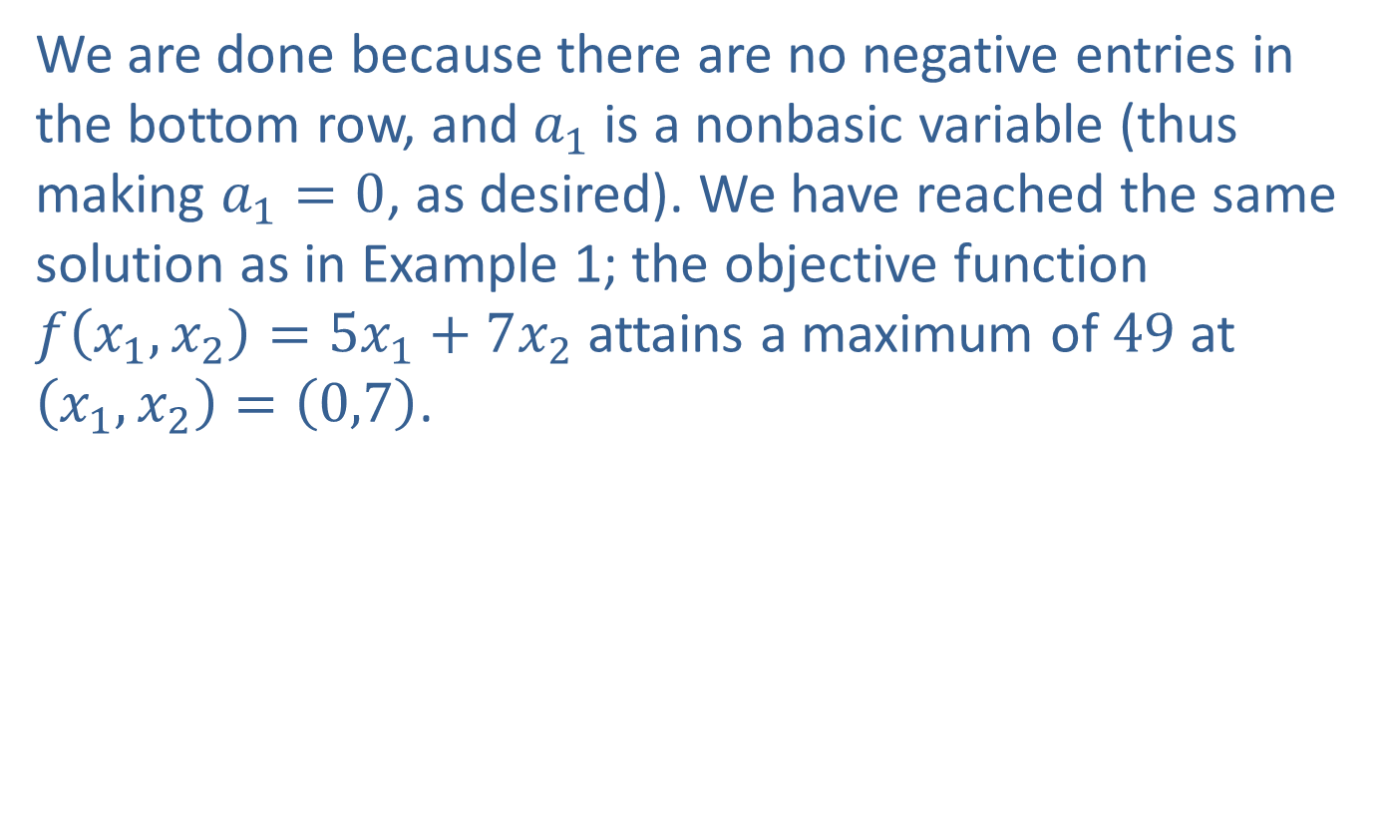
Example 3: Solution to Example 1 Using the Big M Method (cont.)
We are done because there are no negative entries in the bottom row, and $a_{1}$ is a nonbasic variable (thus making $a_{1}=0$, as desired). We have reached the same solution as in Example 1; the objective function $f⁡\left(x_{1},x_{2}\right)=5x_{1}+7x_{2}$ attains a maximum of 49 at $\left(x_{1},x_{2}\right)=\left(0,7\right)$.

Slide 35
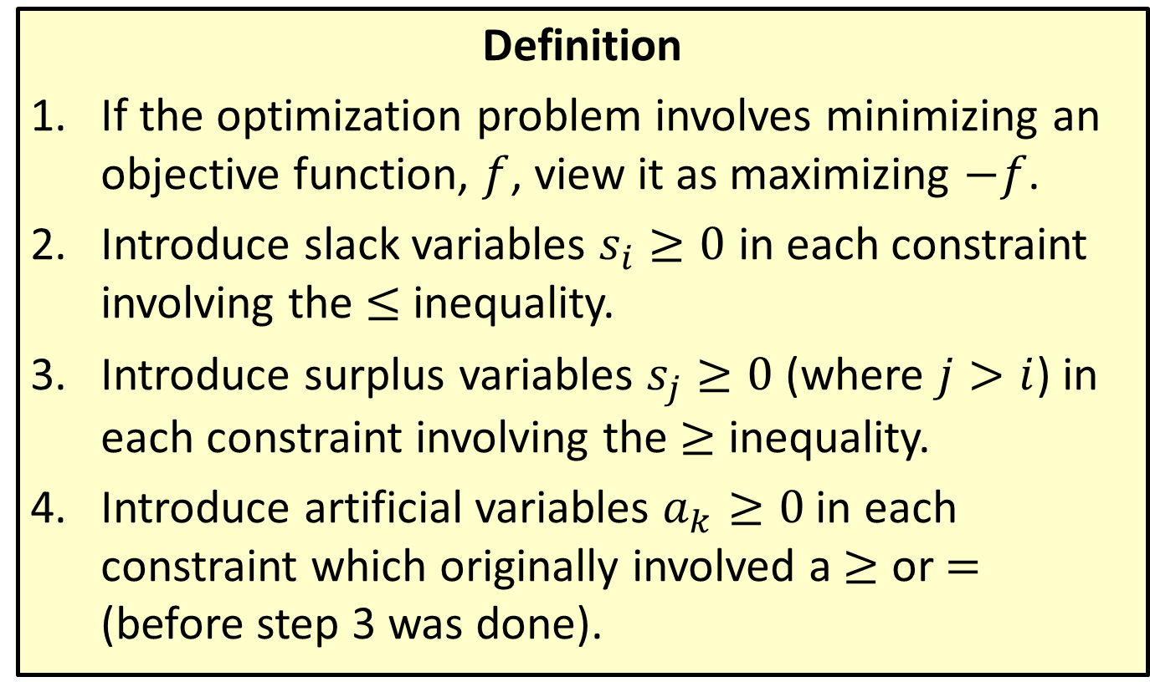
Solving Mixed Constraint Problems Using the Big M Method
Definition
​If the optimization problem involves minimizing an objective function, $f$, view it as maximizing $−f$.
​Introduce slack variables $s_{i}≥0$ in each constraint involving the ≤ inequality.
​Introduce surplus variables $s_{j}≥0$ (where $j>i$) in each constraint involving the ≥ inequality.
​Introduce artificial variables $a_{k}≥0$ in each constraint which originally involved a ≥ or = (before step 3 was done).

Slide 36
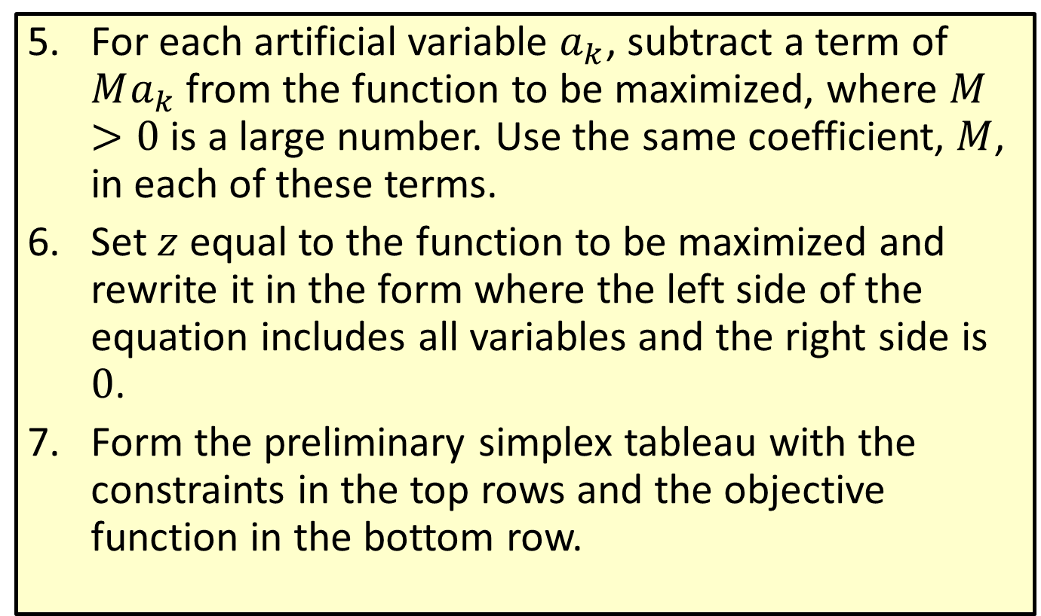
Solving Mixed Constraint Problems Using the Big M Method (cont.)
​For each artificial variable $a_{k}$, subtract a term of $Ma_{k}$ from the function to be maximized, where $M>0$ is a large number. Use the same coefficient, $M$, in each of these terms.
​Set $z$ equal to the function to be maximized and rewrite it in the form where the left side of the equation includes all variables and the right side is 0.
​Form the preliminary simplex tableau with the constraints in the top rows and the objective function in the bottom row.

Slide 37
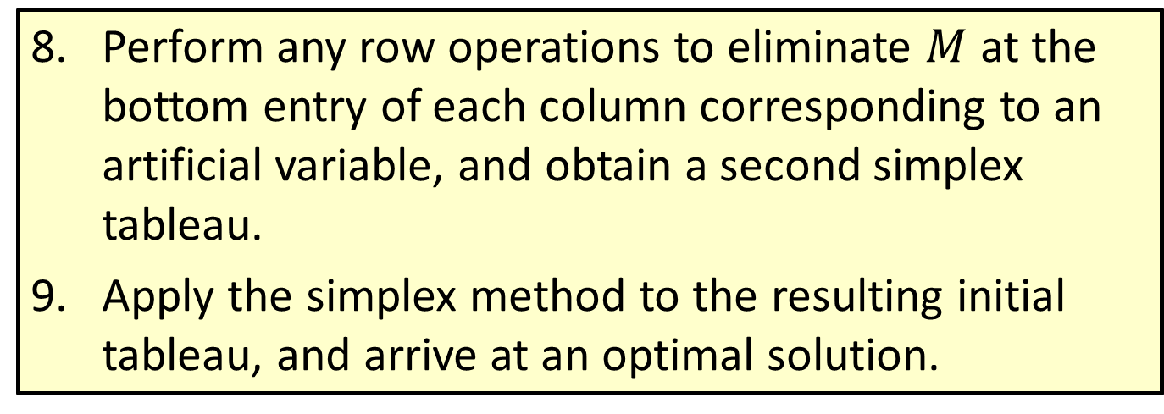
Solving Mixed Constraint Problems Using the Big M Method (cont.)
​Perform any row operations to eliminate $M$ at the bottom entry of each column corresponding to an artificial variable, and obtain a second simplex tableau.
​Apply the simplex method to the resulting initial tableau, and arrive at an optimal solution.

Slide 38
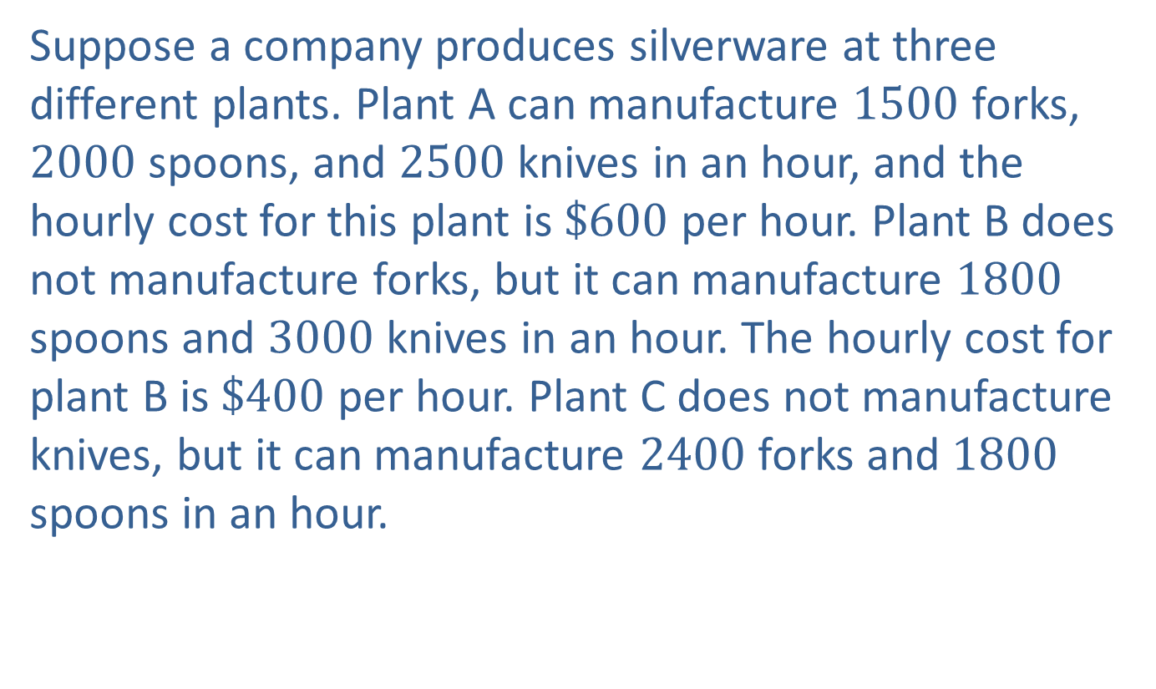
Example 4: An Application Using the Big M Method to Minimize Cost
Suppose a company produces silverware at three different plants. Plant A can manufacture 1500 forks, 2000 spoons, and 2500 knives in an hour, and the hourly cost for this plant is $\$600$ per hour. Plant B does not manufacture forks, but it can manufacture 1800 spoons and 3000 knives in an hour. The hourly cost for plant B is $\$400$ per hour. Plant C does not manufacture knives, but it can manufacture 2400 forks and 1800 spoons in an hour.

Slide 39
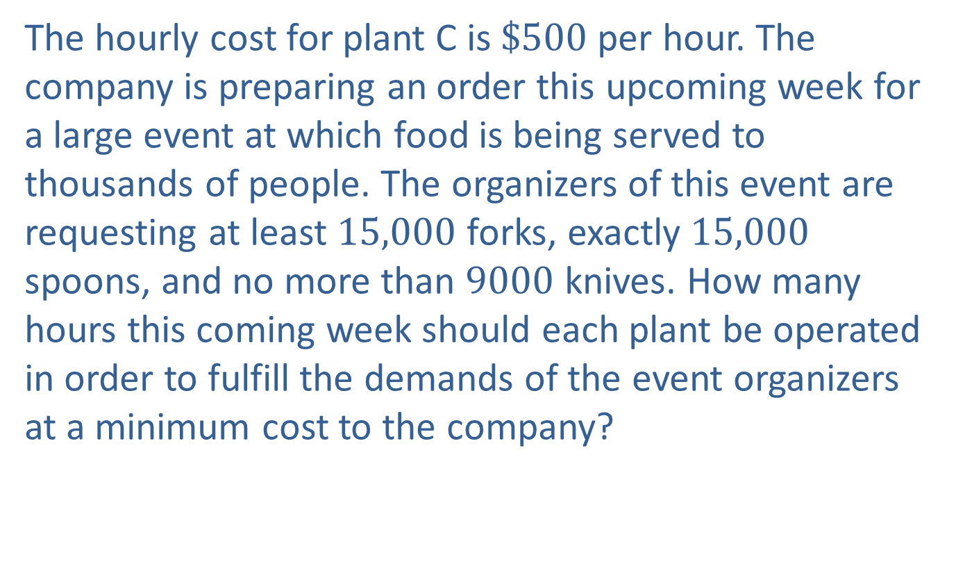
Example 4: An Application Using the Big M Method to Minimize Cost (cont.)
The hourly cost for plant C is $\$500$ per hour. The company is preparing an order this upcoming week for a large event at which food is being served to thousands of people. The organizers of this event are requesting at least 15,000 forks, exactly 15,000 spoons, and no more than 9000 knives. How many hours this coming week should each plant be operated in order to fulfill the demands of the event organizers at a minimum cost to the company?

Slide 40
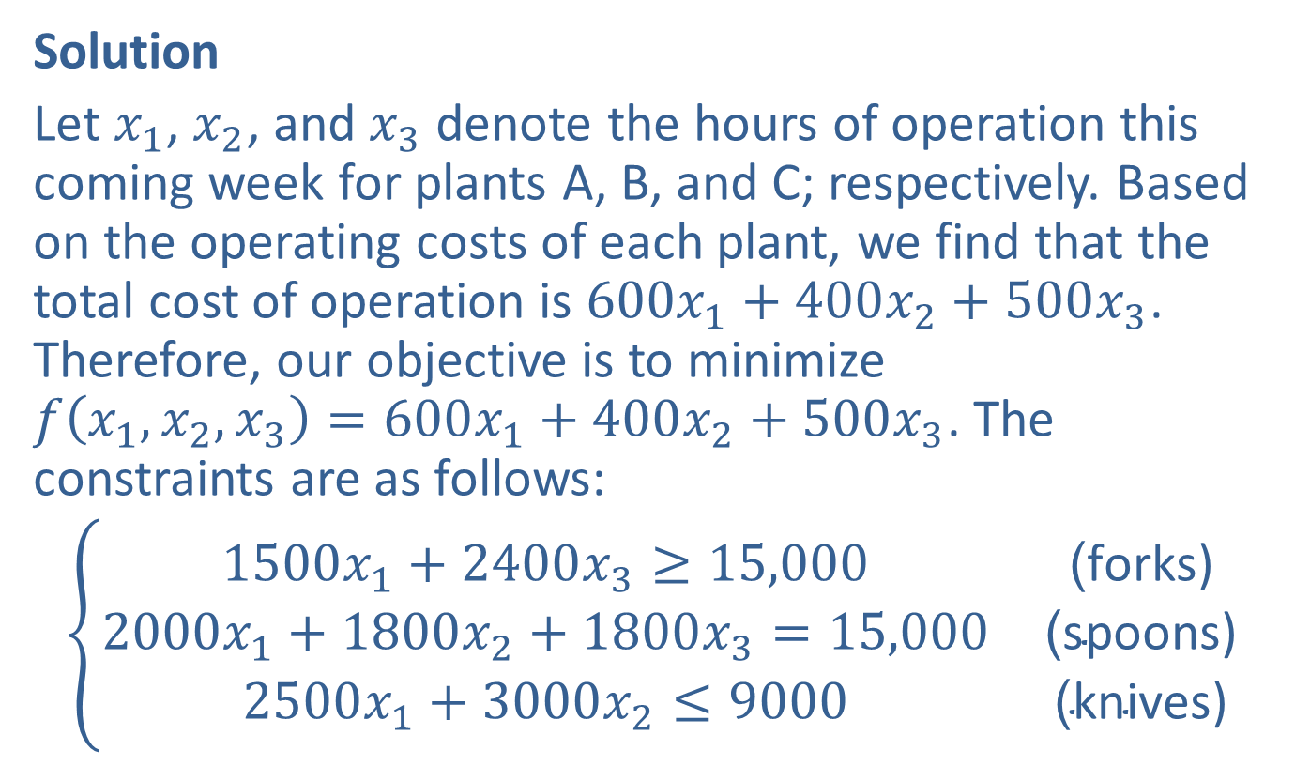
Example 4: An Application Using the Big M Method to Minimize Cost (cont.)
Solution
Let $x_{1}$, $x_{2}$, and $x_{3}$ denote the hours of operation this coming week for plants A, B, and C; respectively. Based on the operating costs of each plant, we find that the total cost of operation is $600x_{1}+400x_{2}+500x_{3}$. Therefore, our objective is to minimize $f\left(x_{1},x_{2},x_{3}\right)=600x_{1}+400x_{2}+500x_{3}$. The constraints are as follows:
$$\left\{\begin{matrix}1500x_{1}+2400x_{3}≥15,000 & \text{(}\text{forks}\text{)} \\ 2000x_{1}+1800x_{2}+1800x_{3}=15,000 & \text{(}\text{spoons}\text{)} \\ 2500x_{1}+3000x_{2}≤9000 & \text{(}\text{knives}\text{)}\end{matrix}\right.$$

Slide 41
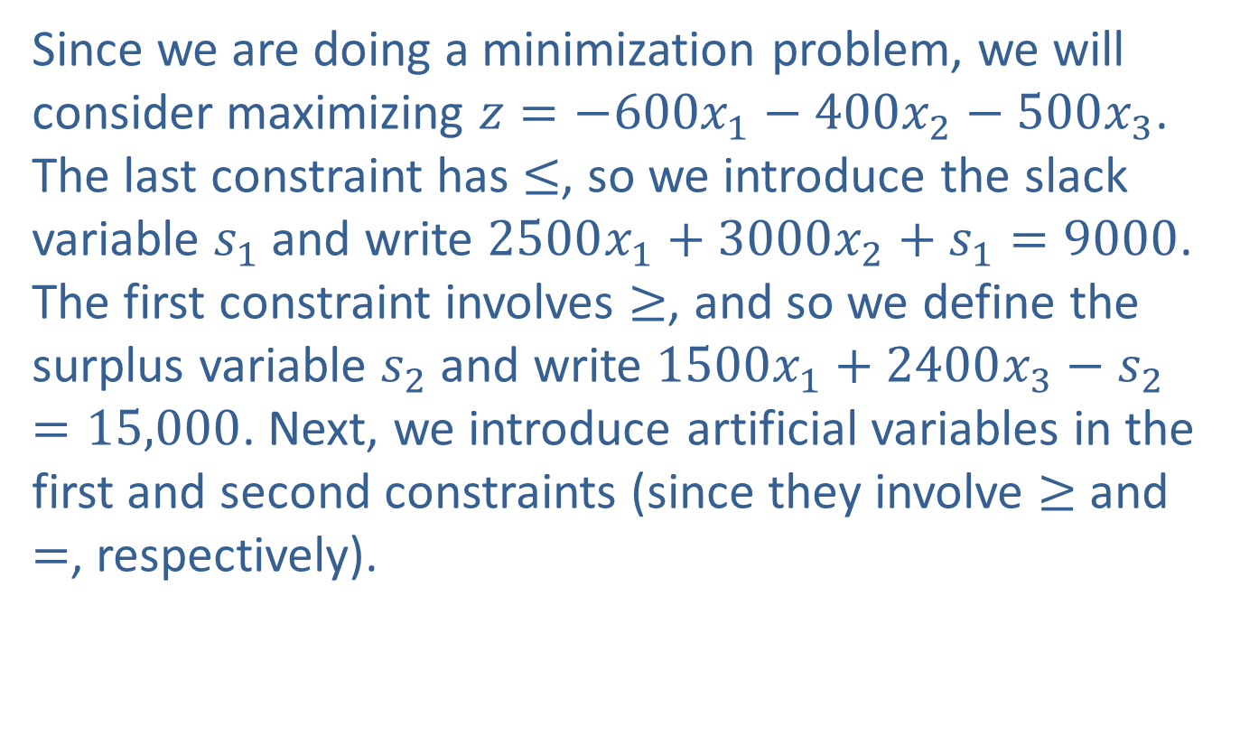
Example 4: An Application Using the Big M Method to Minimize Cost (cont.)
Since we are doing a minimization problem, we will consider maximizing $z=−600x_{1}−400x_{2}−500x_{3}$. The last constraint has ≤, so we introduce the slack variable $s_{1}$ and write $2500x_{1}+3000x_{2}+s_{1}=9000$. The first constraint involves ≥, and so we define the surplus variable $s_{2}$ and write $1500x_{1}+2400x_{3}−s_{2}=15,000$. Next, we introduce artificial variables in the first and second constraints (since they involve ≥ and =, respectively).

Slide 42
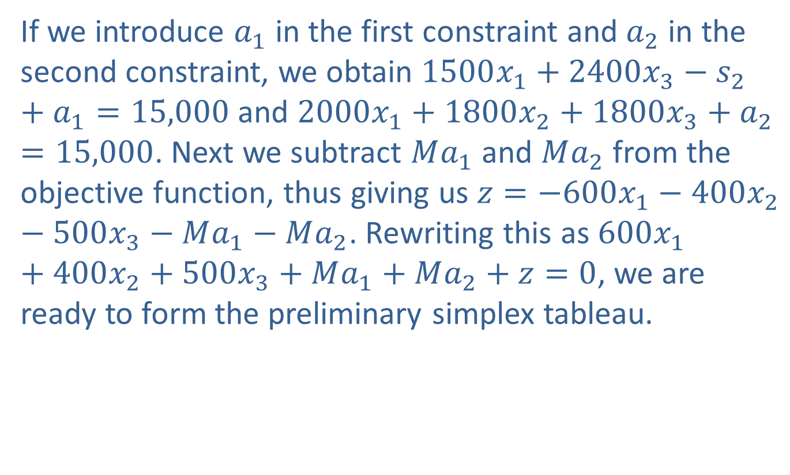
Example 4: An Application Using the Big M Method to Minimize Cost (cont.)
If we introduce $a_{1}$ in the first constraint and $a_{2}$ in the second constraint, we obtain $1500x_{1}+2400x_{3}−s_{2}+a_{1}=15,000$ and $2000x_{1}+1800x_{2}+1800x_{3}+a_{2}=15,000$. Next we subtract $Ma_{1}$ and $Ma_{2}$ from the objective function, thus giving us $z=−600x_{1}−400x_{2}−500x_{3}−Ma_{1}−Ma_{2}$. Rewriting this as $600x_{1}+400x_{2}+500x_{3}+Ma_{1}+Ma_{2}+z=0$, we are ready to form the preliminary simplex tableau.

Slide 43
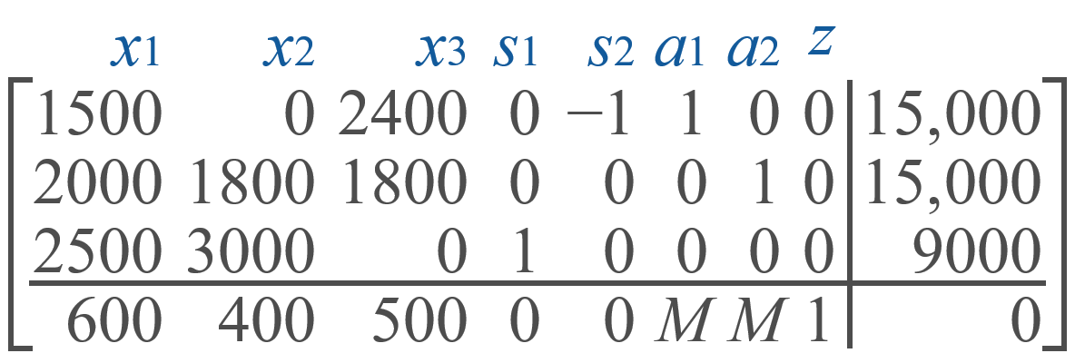
Example 4: An Application Using the Big M Method to Minimize Cost (cont.)

Slide 44

Example 4: An Application Using the Big M Method to Minimize Cost (cont.)
We first perform row operations to eliminate $M$ at the bottom of the columns corresponding to the artificial variables. Two row operations will take care of this and yield the following result.

Slide 45
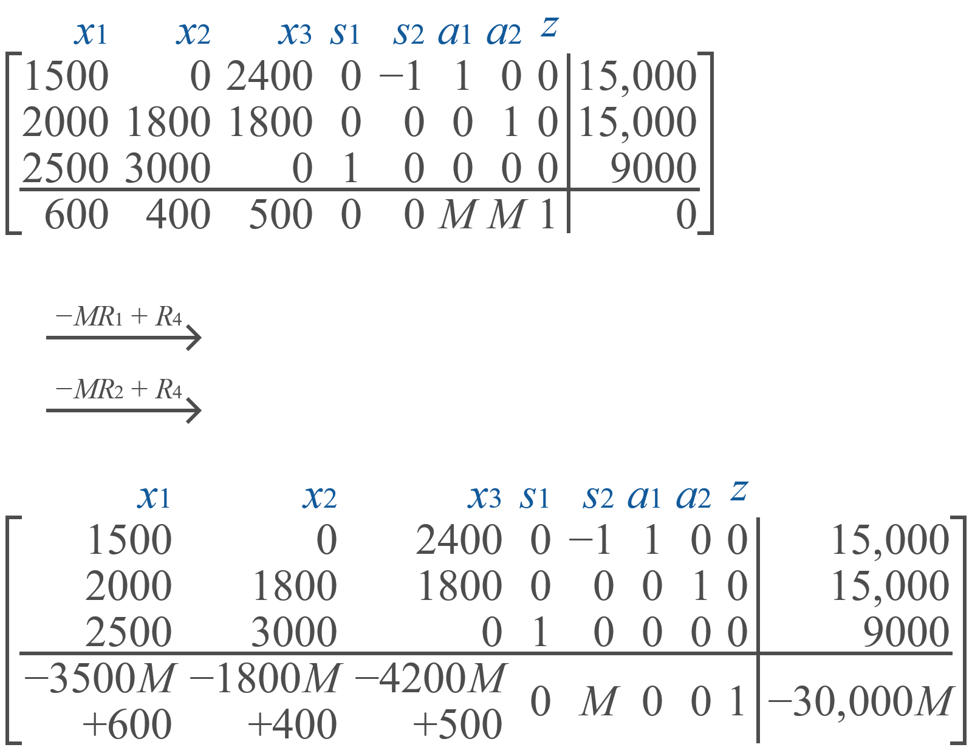
Example 4: An Application Using the Big M Method to Minimize Cost (cont.)

Slide 46
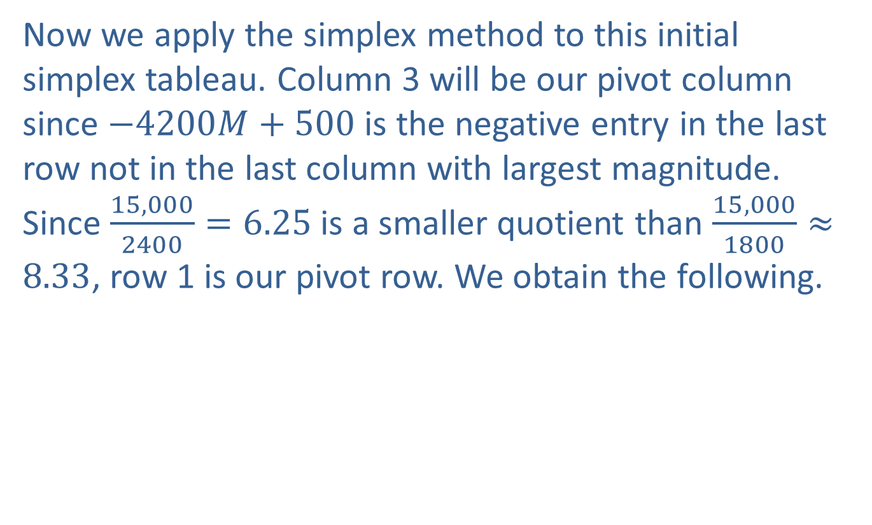
Example 4: An Application Using the Big M Method to Minimize Cost (cont.)
Now we apply the simplex method to this initial simplex tableau. Column 3 will be our pivot column since $−4200M+500$ is the negative entry in the last row not in the last column with largest magnitude. Since $\frac{15,000}{2400}=6.25$ is a smaller quotient than $\frac{15,000}{1800}≈8.33$, row 1 is our pivot row. We obtain the following.

Slide 47
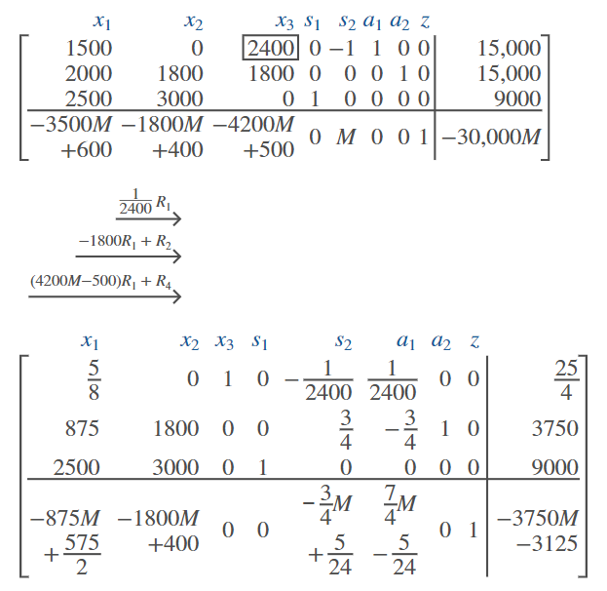
Example 4: An Application Using the Big M Method to Minimize Cost (cont.)

Slide 48

Example 4: An Application Using the Big M Method to Minimize Cost (cont.)
Column 2 is our next pivot column, and row 2 is the next pivot row since $\frac{3750}{1800}≈2.08$ is smaller than $\frac{9000}{3000}=3$. Another iteration of the pivoting process yields the following:

Slide 49
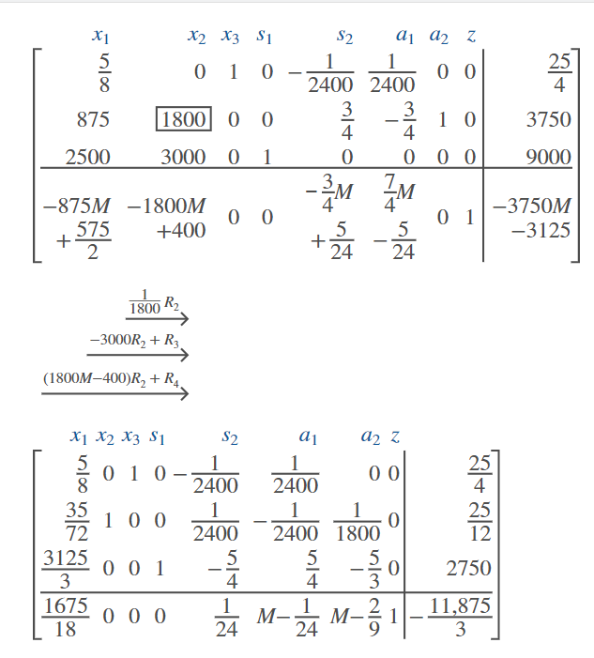
Example 4: An Application Using the Big M Method to Minimize Cost (cont.)

Slide 50
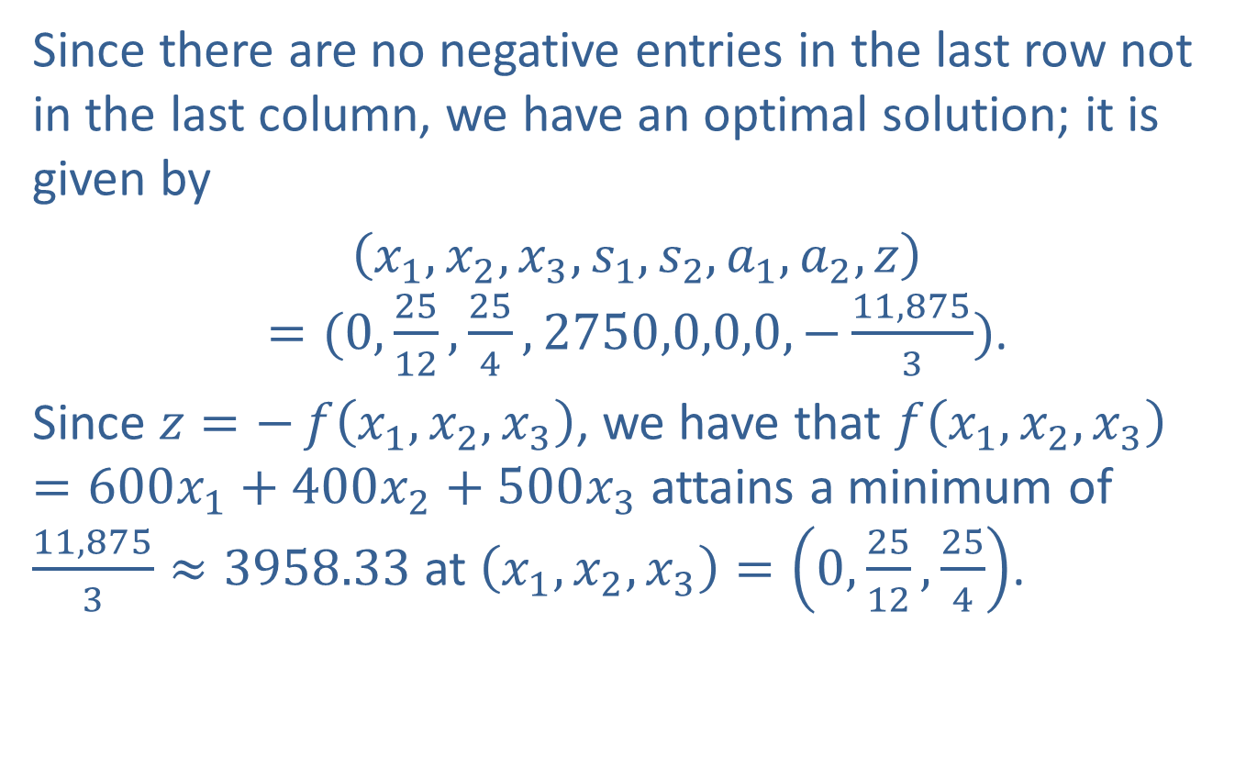
Example 4: An Application Using the Big M Method to Minimize Cost (cont.)
Since there are no negative entries in the last row not in the last column, we have an optimal solution; it is given by
$\left(x_{1},x_{2},x_{3},s_{1},s_{2},a_{1},a_{2},z\right)=(0,\frac{25}{12},\frac{25}{4},2750,0,0,0,−\frac{11,875}{3})$.
Since $z=−f\left(x_{1},x_{2},x_{3}\right)$, we have that $f\left(x_{1},x_{2},x_{3}\right)=600x_{1}+400x_{2}+500x_{3}$ attains a minimum of $\frac{11,875}{3}≈3958.33$ at $\left(x_{1},x_{2},x_{3}\right)=\left(0,\frac{25}{12},\frac{25}{4}\right)$.

Slide 51

Example 4: An Application Using the Big M Method to Minimize Cost (cont.)
Therefore, we conclude that the company should not use plant A, run plant B for $\frac{25}{12}$ hours (2 hours and 5 minutes), and run plant C for $\frac{25}{4}$ hours (6 hours and 15 minutes) this coming week to achieve a minimum cost of $\$3958.33$ to meet the demands of the event organizers.
Note: The value of the slack variable $s_{1}=2750$ means that only $9000−2750=6250$ knives need to be manufactured to fulfill the needs of the event organizers.

