Slide 1
Section 8.2
Operations with Sets

Slide 2
Objectives
Find the cardinal number of a set.
Find unions and intersections of multiple sets.
Read information off of a Venn diagram to solve problems with sets.
Understand terminology related to sets.
Use the Inclusion-Exclusion Principle.

Slide 3
Operations with Sets
When some, but not all, of the elements of one set are contained in the other, the sets are represented as overlapping circles in a Venn diagram. Elements that are common to two sets are referred to as the intersection of the sets.

Slide 4
Intersection
Intersection
The intersection of two sets A and B is the set of all elements common to both A and B. We denote the intersection of A and B as

Slide 5
Example 1: Determining the Intersection of Sets
Find the intersection of the sets A = {n, u, m, b, e, r, s} and B = {r, u, l, e}.
Solution
Since the intersection of two sets consists of all of the elements that appear in both sets, we can see that the intersection of A and B consists of the elements r, u, and e.

Slide 6
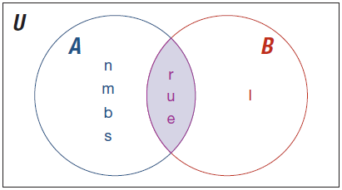
Example 1: Determining the Intersection of Sets (cont.)
We can also use a Venn diagram to find the intersection.
Notice that any elements in the intersection of the Venn diagram are only listed once.

Slide 7
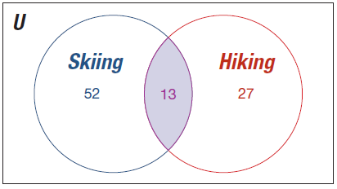
Example 2: Using a Venn Diagram to Find the Intersection
The given Venn diagram represents the number of students that participated in certain activities while on a spring break trip. Determine the number of students that went both hiking and skiing over spring break.

Slide 8
Example 2: Using a Venn Diagram to Find the Intersection (cont.)
Solution
Using the Venn diagram, we can see that 52 students went skiing exclusively on their break, 27 students went hiking exclusively, and 13 students went both skiing and hiking.

Slide 9
Union
Union
The union of two sets A and B is the set of all elements in A or in B. We denote the union of A and B as
A ∪ B = {x | x ∈ A or x ∈ B}.

Slide 10
Example 3: Determining the Union of Sets
Let A = {1, 2, 3, 4, 5}, B = {2, 4, 6, 8}, and
C = {1, 3, 5, 7, 9}. Find the following unions.
a. A ∪ B b. A ∪ C c. B ∪ C
Solution
a. To find the union of sets A and B, we need to find the elements that appear in either set A or set B. The elements of set A are 1, 2, 3, 4, 5 and the elements of set B are 2, 4, 6, 8. We simply combine the items together to create a new set to represent the union. Therefore,

Slide 11
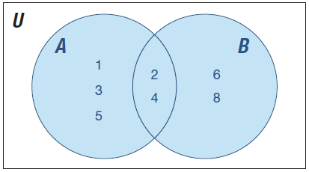
Example 3: Determining the Union of Sets (cont.)
The Venn diagram shown gives us a visual illustration of the union of the elements in set A and in set B.
Note that A ∩ B = {2, 4}.

Slide 12
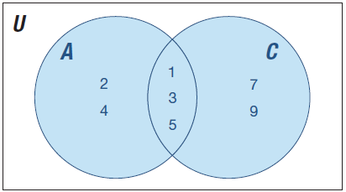
Example 3: Determining the Union of Sets (cont.)
b. Finding the union of sets A and C is done in a similar manner.
Note that A ∩ C = {1, 3, 5}.

Slide 13
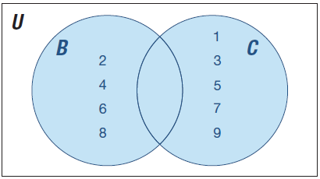
Example 3: Determining the Union of Sets (cont.)
c. Finding the union of sets B and C is also done in a similar manner.
Note that the intersection
of these two sets is empty. Therefore, B ∩ C = ∅.

Slide 14
Example 4: Combining Intersection and Union
Let U = {a, b, c, d, e, . . , z}, M = {m, a, t, h},
N = {m, o, n, e, y}, and K = {i, n, v, e, s, t, o, r}. Find
a. M ∪ (N ∩ K) b. M ∩ (N ∪ K)
Solution
a. In order to find the solution when combining the operations of intersections and unions of sets, it might be best to describe the set first. M ∪ (N ∩ K) is the set of all elements that are in set M or are in N and in K. Let’s do each part and see what we get.

Slide 15
Example 4: Combining Intersection and Union (cont.)
M ∪ (N ∩ K)
= {m, a, t, h} ∪ ({m, o, n, e, y} ∩ {i, n, v, e, s, t, o, r})
Just as in order of operations with numbers, we need to perform the operation in parentheses first. So,
N ∩ K = ({m, o, n, e, y} ∩ {i, n, v, e, s, t, o, r}) = {o, n, e} and

Slide 16
Example 4: Combining Intersection and Union (cont.)
b. Similarly, we can find M ∩ (N ∪ K)

Slide 17
Skill Check #1
Answer: {n, e, t, o}
Skill Check #1
Let, M = {m, a, t, h}, N = {m, o, n, e, y}, and
K = {i, n, v, e, s, t, o, r}. Find K ∩ (M ∪ N ).

Slide 18
Disjoint
Disjoint
Two sets A and B are disjoint if there are no elements in set A that are also contained in set B. In the case where two sets are disjoint, the intersection of those two sets is the null, or empty set, ∅. Therefore, A ∩ B = ∅ when sets A and B are disjoint.

Slide 19
Example 5: Identifying Disjoint Sets
Let U = {all students}, A = {students with GPA < 2.5}, and B = {students with GPA > 3.0}. Determine if sets A and B are disjoint and draw a Venn diagram to illustrate the relationship between sets A and B.
Solution
Since it would be impossible for a student to have a GPA that is less than 2.5 and a GPA greater than 3.0 at the same time, sets A and B are disjoint. We can illustrate the relationship between sets A and B using a Venn diagram.

Slide 20
Example 5: Identifying Disjoint Sets (cont.)
The universal set is represented as all students’ grade point averages of 0.0 to 4.0. Therefore, when sets A and B are described as students with GPAs less than 2.5 and greater than 3.0, respectively, there are no common GPAs. In addition, any student with a GPA between 2.5 and 3.0 is not represented in either set A or set B.

Slide 21
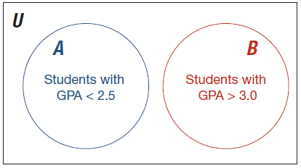
Example 5: Identifying Disjoint Sets (cont.)

Slide 22
De Morgan’s Laws
De Morgan’s Laws
Let A and B be sets. Then,

Slide 23
Example 6: Using De Morgan's Laws
Given sets U = {a, b, c, d, . . . , z}, A = {h, o, u, n, d}, and B = {r, o, c, k}, verify that (A ∪ B)′ = A′ ∩ B′.
Solution
The universal set U consists of all of the letters of the alphabet.
Since
A ∪ B = {h, o, u, n, d} ∪ {r, o, c, k} = {r, o, c, k, h, u, n, d}, we know that
(A ∪ B)′ = {a, b, e, f, g, i, j, l, m, p, q, s, t, v, w, x, y, z}.

Slide 24
Example 6: Using De Morgan's Laws (cont.)
Similarly,
A′ = {a, b, c, e, f, g, i, j, k, l, m, p, q, r, s, t, v, w, x, y, z} and
B′ = {a, b, d, e, f, g, h, i, j, l, m, n, p, q, s, t, u, v, w, x, y, z},
so A′ ∩ B′ = {a, b, e, f, g, i, j, l, m, p, q, s, t, v, w, x, y, z}.
Notice that
Hence we have verified De Morgan’s law for A and B.

Slide 25
Skill Check #2
Skill Check #2
Let U = {a, b, c, . . . , z}, A = {h, o, u, n, d}, and
B = {r, o, c, k}, verify (A ∩ B)′ = A′ ∪ B′.

Slide 26
Skill Check #2
Answer:
A ∩ B = {o}, so (A ∩ B)′ = {a, b, c, d, e, f, g, h, i, j, k, l, m, n, p, q, r, s, t, u, v, w, x, y, z}.
A′ = {a, b, c, e, f, g, i, j, k, l, m, p, q, r, s, t, v, w, x, y, z} and
B′ = {a, b, d, e, f, g, h, i, j, l, m, n, p, q, s, t, u, v, w, x, y, z}, so A′ ∪ B′ = {a, b, c, d, e, f, g, h, i, j, k, l, m, n, p, q, r, s, t, u, v, w, x, y, z}. This gives that (A ∩ B)′ = A′ ∪ B′

Slide 27
Example 7: Determining the Cardinal Number of a Union
Let A = {1, 2, 3, 4, 5} and B = {2, 4, 6, 8}. Find |A ∪ B|.
Solution
In Example 3a., we found that
A ∪ B = {1, 2, 3, 4, 5, 6, 8}. Therefore, the number of elements in the set A ∪ B is |A ∪ B| = 7.

Slide 28
Inclusion-Exclusion Principle
Inclusion-Exclusion Principle
The inclusion-exclusion principle states that the number of elements in the union of two sets A and B is calculated by adding the number of elements in set A to the number of elements in set B, less the number of elements that appear in both sets. We denote this by |A ∪ B| = |A| + |B| − |A ∩ B|.

Slide 29
Example 8: Applying the Inclusion-Exclusion Principle
A standard deck of playing cards has 52 cards (26 of which are red and 26 of which are black) divided into 4 suits (clubs, spades, diamonds, and hearts), where there are 13 of each suit (Ace, 2, 3, 4, 5, 6, 7, 8, 9, 10, Jack, Queen, King). Of these cards, 12 are considered face cards (4 Kings, 4 Queens, and 4 Jacks). Find the number of cards in a standard deck that are either clubs or face cards.

Slide 30
Example 8: Applying the Inclusion-Exclusion Principle (cont.)
Solution
We start the solution by writing what we are looking for using set notation.
|clubs ∪ face cards|
= |clubs| + |face cards| − |clubs ∩ face cards|.
If the set A consists of clubs and the set B consists of face cards, then this is equivalent to
|A ∪ B| = |A| + |B| − |A ∩ B|

Slide 31
Example 8: Applying the Inclusion-Exclusion Principle (cont.)
There are 13 clubs in the deck and there are 12 face cards. However, there are 3 face cards that are also clubs (King of clubs, Queen of clubs, and Jack of clubs). Therefore,
|A ∪ B| = 13 + 12 − 3 = 22.
So, the number of cards that are either clubs or face cards is 22.

Slide 32
Skill Check #3
Answer: 28
Skill Check #3
Find the number of playing cards that are either even (2, 4, 6, 8, 10) or are diamonds.

