Slide 1
Section 8.3
Introduction to Probability

Slide 2
Objective
Calculate classical probabilities.
Calculate empirical probabilities.
Determine if probability is empirical or classical.
Determine sample space.
Determine the sample space.

Slide 3
Introduction to Probability
To begin our discussion of probability, we need to define a few terms. First, a trial, or probability experiment, is any process that produces a random result, such drawing a number from one to ten out of a hat.
This example easily illustrates the possible individual results, called outcomes. For this example, all numbers from one to ten are outcomes.

Slide 4
Introduction to Probability
The set of all possible outcomes is called the sample space for that experiment. For the example of drawing a number from one to ten out of a hat, the sample space is
{1, 2, 3, 4, 5, 6, 7, 8, 9, 10}.

Slide 5
Example 1: Determining Sample Spaces
Identify the sample space for each of the following experiments. Note that the outcomes in a sample space are listed between brackets and separated by commas.
a. Rolling a single die.
b. Birth order gender for two children in a single family.

Slide 6

Example 1: Determining Sample Spaces (cont.)
Solution
a. The sample space consists of all of the possible outcomes of rolling a die. It can land on any of the six sides of the die. Therefore, the sample space is the following.
b. The sample space consists of all possible gender outcomes for a family with two children. Let B = boy and G = girl. The sample space is
{BB, BG, GB, GG}.

Slide 7
Skill Check #1
Skill Check #1
Identify the sample space for tossing two coins together. You can list it inside { } separating the elements by commas.
Answer: {HH, HT, TT, TH}

Slide 8
Trial
Trial
A trial, or probability experiment, is any process that produces a random result.

Slide 9
Outcome
Outcome
The outcomes of a trial are the possible individual results.

Slide 10
Sample Space
Sample Space
The sample space S of a trial is the set of all possible outcomes.

Slide 11
Event
Event
An event E is a group, or subset, of outcomes in the sample space.

Slide 12
Classical Probability
Classical Probability
If all outcomes are equally likely, classical probability is calculated with the formula
P(event) will always be a real number between 0 and 1, inclusive.

Slide 13
Example 2: Calculating Classical Probability
Suppose you were asked to draw a card from a standard deck of 52 cards. A standard deck of cards contains the following cards.

Slide 14
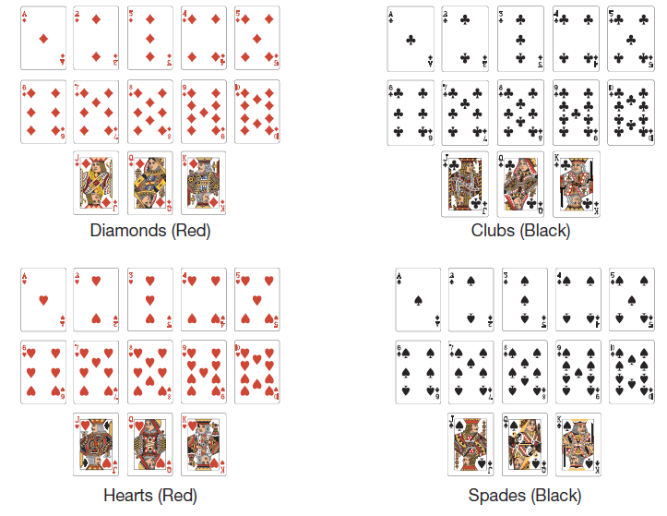
Example 2: Calculating Classical Probability (cont.)

Slide 15
Example 2: Calculating Classical Probability (cont.)
a. What is the probability that the card you draw is red?
b. What is the probability that the card you draw is a diamond?
c. What is the probability that the card you draw is a face card (king, queen, or jack)?
d. What is the probability of drawing a red spade?

Slide 16
Example 2: Calculating Classical Probability (cont.)
Solution
a. Because this is a standard deck of cards we are drawing from, each card has the same probability of being chosen. We know that the sample space contains 52 cards. We also know that since there are two red suits (and two black suits) each with 13 cards, there are 26 possible red cards to choose. So, the probability that the card you draw is red is

Slide 17
Example 2: Calculating Classical Probability (cont.)
b. There are 13 cards in the diamond suit. So the probability that your card is a diamond is
c. Each of the four suits contains three face cards (king, queen, and jack), so there are face cards to choose from. So the probability that your card is a face card is

Slide 18
Example 2: Calculating Classical Probability (cont.)
d. Because all spades are black, it is impossible to draw a red spade. Therefore,
P (red spade) = 0.

Slide 19
Example 3: Calculating Classical Probability
Suppose that you grab a snack from a bag of chocolates that contains 4 caramel with milk chocolate, 4 peppermint with white chocolate, 6 dark chocolate with mint, and 2 raspberry with dark chocolate. What is the probability that you randomly grab a raspberry with dark chocolate for your snack?
Solution
Remember, to find the probability, we first need to know the number of outcomes in the sample space.

Slide 20
Example 3: Calculating Classical Probability (cont.)
We can add together all of the chocolates in the bag to find out the number of possible outcomes.
4 + 4 + 6 + 2 = 16 different chocolates in the bag
Next, we know that there are 2 possible outcomes for the event of choosing a raspberry with dark chocolate. Therefore, the probability of the event is

Slide 21
Empirical Probability
Empirical Probability
If all outcomes are based on an experiment, empirical probability is calculated with the formula
P(event) will always be a real number between 0 and 1, inclusive.

Slide 22
Example 4: Empirical Probability with Multiple Trials
For her elementary school science fair project, Libby is conducting research on the accuracy of the weather prediction from her local news channel. She recorded the forecast and the actual weather for two weeks. The following table shows her results.

Slide 23
Example 4: Empirical Probability with Multiple Trials (cont.)
Table 1: Accuracy of Weather Prediction
Forecast | Actual Weather
Rain | Rain
Chance of snow | Rain
Snow | Snow
Cloudy | Clear
Cloudy | Cloudy
Rain | Rain
Clear | Drizzling rain
Clear | Clear
Cloudy | Clear
Chance of snow | Cloudy
Clear | Clear
Clear | Clear
Rain | Rain
Chance of rain | Cloudy

Slide 24
Example 4: Empirical Probability with Multiple Trials (cont.)
Using empirical probability, what is the probability that the news channel accurately predicts the next day’s weather?
Solution
For Libby to calculate the probability, she needs to count the number of days the weatherman correctly predicted the weather and divide it by 14 (the total number of days she did the experiment).

Slide 25
Example 4: Empirical Probability with Multiple Trials (cont.)
Because Libby can now estimate that the news channel correctly predicts the weather 57% of the time, she knows that this is also the probability that the prediction for the following day’s weather will be correct.

Slide 26
Example 5: Classical vs. Empirical Probability
Determine if the scenarios given are examples of classical or empirical probability techniques.
a. Katie is curious about her chances of winning an
e-reader from the student government association. She polled her friends to find out how many of them filled out the survey to be entered in the contest.
b. Tristan is interested in his chances of winning at the black jack table. He determines the probability of what his next card will be by knowing the cards that have already been played.

Slide 27
Example 5: Classical vs. Empirical Probability (cont.)
c. Based on the recent United States Census, the local government estimates the amount of growth the community will experience in the coming years.
Solution
a. Because Katie is conducting an informal survey and not all students are included, the probability is empirical.

Slide 28
Example 5: Classical vs. Empirical Probability (cont.)
b. This is an example of classical probability since all cards have an equal chance of being dealt at the beginning, and Tristan adjusts his chances by accounting for those cards that have already been drawn.
c. Since the United States Census is actually an incomplete count, any probability calculated from it would be empirical.

