Slide 1
Section 8.4
Counting Principles: Combinations and Permutations

Slide 2
Objective
Calculate factorials.
Determine whether to use a permutation or a combination.
Evaluate permutations and combinations.
Use the Fundamental Counting Principle to find total number of outcomes.

Slide 3
Counting Our Way to Probabilities
It is important to know how many events are in a sample space. That sounds easy enough, and in many cases it is. One way to count these outcomes is by listing all of the outcomes out in an orderly way. Sometimes this is a long process. This section will introduce counting methods for counting the events in a sample space.

Slide 4
Tree Diagram
Tree Diagram
A tree diagram uses branches to indicate possible choices at the next stage of outcomes.

Slide 5
Fundamental Counting Principle
Fundamental Counting Principle
For a sequence of n experiments where the first experiment has k₁ outcomes, the second experiment has k₂ outcomes, the third experiment has k₃ outcomes, and so forth, the total number of possible outcomes for the sequence of experiments is

Slide 6
Replacement
Replacement
With replacement: When counting possible outcomes with replacement, objects are placed back into consideration for the following choice.
Without replacement: When counting possible outcomes without replacement, objects are not placed back into consideration for the following choice.

Slide 7
Example 1: Using the Fundamental Counting Principle with Replacement
In order to log in to your new e-mail account, you must create a password. The requirements are that the password needs to be 8 characters long consisting of 5 lowercase letters followed by 3 numbers. If you are allowed to use a character more than once, that is, with replacement, how many different possibilities are there for passwords?

Slide 8
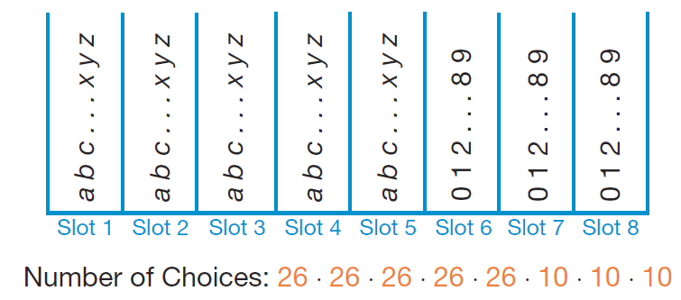
Example 1: Using the Fundamental Counting Principle with Replacement (cont.)
Solution
If we think about each character in the password as a slot to fill, then we have 8 slots that need filling. The first 5 can be filled with letters and the last 3 with digits as the following figure shows.

Slide 9
Example 1: Using the Fundamental Counting Principle with Replacement (cont.)
The first 5 slots contain 26 possibilities each, one for each letter of the alphabet. The last 3 slots have 10 possible possibilities each, one for each digit 0 through 9. Using the Fundamental Counting Principle, we multiply each of the possibilities together to get
(26) (26) (26) (26) (26) (10) (10) (10) = 11,881,376,000 possible passwords for the new e-mail account.

Slide 10
Example 2: Using the Fundamental Counting Principle without Replacement
Let’s change the previous example slightly. The password still needs to be 8 characters long consisting of 5 lowercase letters followed by 3 numbers. However, now the characters may not be duplicated in the password, that is, we say we’re counting without replacement, or without repetition.

Slide 11
Example 2: Using the Fundamental Counting Principle without Replacement (cont.)
Solution
We still have the first 5 slots being filled with letters and the last 3 with numbers. This time our picture changes slightly. The first slot still has a possibility of 26 letters, but the second slot now only has 25 choices since we used one letter for the first slot. Similarly, the third slot has 24 choices, and so forth. The same thing happens with the digits in the last 3 spaces.

Slide 12
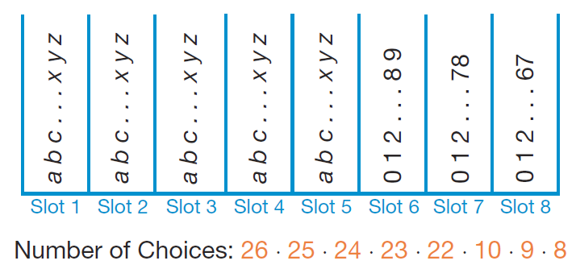
Example 2: Using the Fundamental Counting Principle without Replacement (cont.)
So now we have
(26) (25) (24) (23) (22) (10) (9) (8) = 5,683,392,000 possible passwords. That is almost half of the original amount of passwords possible if we allowed replacement!

Slide 13
n Factorial
n Factorial
In general, n! (read “n factorial”) is the product of all the positive integers less than or equal to n, where n is a positive integer.
Note that 0! is defined to be 1.

Slide 14
Example 3: Calculating Factorials
Calculate the value of the following factorial expressions.
a. 8! b. c. d. e.
Solution
a. Multiply together all the positive integers less than or equal to 8.

Slide 15
Example 3: Calculating Factorials (cont.)
b. Calculate each factorial and then divide.

Slide 16
Example 3: Calculating Factorials (cont.)
c. Because the numbers are so large here, let’s first look at taking a shortcut.
Many of the numbers being multiplied in the numerator and denominator will cancel, so let’s do that first.

Slide 17
Example 3: Calculating Factorials (cont.)
d. Before we can start multiplying numbers, we need to do the subtraction in the denominator. Then we can cancel and multiply.

Slide 18
Example 3: Calculating Factorials (cont.)
e. Before we can start multiplying numbers, we once again need to perform the subtraction in the denominator. Then, notice that
allows us to cancel 3! in the numerator and the denominator before multiplying the remaining values.

Slide 19
Combinations
Combinations
A combination involves choosing a specific number of objects from a particular group of objects, using each only once, when the order in which they are chosen is not important.

Slide 20
Permutations
Permutations
A permutation involves choosing a specific number of objects from a particular group of objects, using each only once, when the order in which they are chosen is important.

Slide 21
Skill Check #1
Skill Check #1
Decide whether you would use a permutation or combination to count the number of outcomes for each of the following scenarios.
a. In how many ways can 1st, 2nd, and 3rd place prizes be handed out to science fair winners if there are 30 students participating?

Slide 22
Skill Check #1 (cont.)
Skill Check #1 (cont.)
b. If each department needs two student representatives from each major on a campus committee, how many ways can the biology department chose the representatives from the
45 students who are majoring in biology?
Answer: a. permutation
b. combination

Slide 23
Combinations and Permutations of n Objects Taken r at a Time
Combinations and Permutations of n Objects Taken r at a Time
The number of ways to select r objects from a total of n objects is found by the following two formulas. (Note that
When order is not important, use the following formula for a combination.

Slide 24
Combinations and Permutations of n Objects Taken r at a Time (cont.)
Combinations and Permutations of n Objects Taken r at a Time (cont.)
When order is important, use the following formula for a permutation.

Slide 25
Example 4: Using Combinations
Let’s calculate the number of possibilities for our sandwich example. Suppose there are 18 toppings to choose from once you’ve decided on bread, meat, and cheese. How many different possible sandwiches are there if you choose 4 different toppings?

Slide 26
Example 4: Using Combinations (cont.)
Solution
The order of sandwich toppings does not change the type of sandwich that is made. Therefore, this is a combination problem where we are choosing 4 toppings from a list of 18. Fill in the combination formula using n = 18 and r = 4.

Slide 27
Example 4: Using Combinations (cont.)
Therefore, there are 3060 different sandwich possibilities—far too many for you to say to a friend, “Just pick me up a turkey sandwich. It doesn’t matter what kind. They’re all alike!”

Slide 28
Example 5: Using Permutations
Consider a race with 140 participants. How many possible outcomes are there for the top three positions of gold, silver, and bronze?
Solution
Since the order of the winners matters in this example, we use a permutation to count the possibilities. We are choosing three runners from the original 140 that ran. Therefore, n = 140 and r = 3. Filling in the permutation formula with these values gives us the following work.

Slide 29
Example 5: Using Permutations (cont.)
So, there are 2,685,480 possible ways the top three spots could be awarded.

Slide 30
Example 6: Using Permutations
How many possible ways are there to arrange the order of appearance for the contestants in the local talent show, if there are 15 contestants all together?
Solution
Again, order is important here because being the first to perform is certainly not the same as performing last, or even second for that matter. So, this is a permutation situation with n = 15. However, for this problem, r is also 15 since all of the contestants are to be chosen for the talent show.

Slide 31
Example 6: Using Permutations (cont.)
Using these values in the permutation formula, we have the following.
Having 1,307,674,368,000 possible choices for the contestant lineup means that they will probably never choose the order by listing out all the possibilities and then randomly drawing one from a hat! Also, note that the result of is the same as 15!.

Slide 32
Permutations with Repeated Objects
Permutations with Repeated Objects
The number of distinguishable permutations of n objects, of which k₁ are all alike, k₂ are all alike, and so forth is given by
where

Slide 33
Example 7: Using Permutations with Repeated Objects
How many different ways can you arrange the letters in the word MISSISSIPPI?
Solution
Because there are repeated letters in the word, and no real distinction is made between each duplicated letter, we need to count the duplicate letters for our formula.

Slide 34
Example 7: Using Permutations with Repeated Objects (cont.)
Note that since the letter M is not duplicated, M = 1 and its factorial is 1! = 1, which will not change our fraction when we include it. This is always the case for unduplicated objects.
There are 11 letters in MISSISSIPPI, so n = 11.

Slide 35
Example 7: Using Permutations with Repeated Objects (cont.)
Substituting these values into the formula, we have
Thus, there are 34,650 ways to arrange the letters in the word MISSISSIPPI.

