Slide 1
Section 9.3
Describing and Analyzing Data

Slide 2
Objectives
Calculate and interpret the five-number summary.
Calculate mean, median, mode, range, and standard deviation.
Understand a five-number summary and a box plot representation.
Understand terminology for analyzing data.
Understand the use of different measures of center.
Use the Empirical rule to estimate characteristics of a data set.
Use the formula for mean to solve applied problems.

Slide 3
Arithmetic Mean
Arithmetic Mean
The mean is the sum of all of the data values divided by the number of data points. Formally, the formula for the population mean is
where x_{i} is the i^{th} data value and N is the number of data values in the population.

Slide 4
Arithmetic Mean (cont.)
Arithmetic Mean (cont.)
The formula for the sample mean is
where x_{i} is the i^{th} data value and n is the number of data values in the sample.

Slide 5
Example 1: Finding the Mean
A sample of the number of sick days employees at Witt’s Insurance Agency took during last year is listed below. Calculate the mean of the sample data.
14, 5, 7, 11, 9, 7, 12, 6
Solution
There are 8 pieces of sample data, so in order to find the sample mean, add all the values together and divide by 8.

Slide 6
Example 1: Finding the Mean (cont.)
Therefore, the mean of this sample is 8.9.

Slide 7
Median
Median
The median of a data set is the middle value in an ordered array of the data.

Slide 8
Example 2: Finding the Median
A VO₂ max score is the maximum amount of oxygen that one's body can transport and use during exercise. It is measured in liters of oxygen per minute (L/min). Given the following VO₂ max scores for 12 women, find the median score.
28.3, 27.7, 23.0, 25.5, 27.1, 26.94,
27.0, 27.52, 26.8, 27.2, 26.97, 27.53

Slide 9
Example 2: Finding the Median (cont.)
Solution
First, put the data in ascending numerical order.
23.0, 25.5, 26.8, 26.94, 26.97, 27.0,
27.1, 27.2, 27.52, 27.53, 27.7, 28.3
Since there are 12 pieces of data, the median will be the value between the middle two data points, 27.0 and 27.1. To find this, add the two together and divide by two.

Slide 10
Example 2: Finding the Median (cont.)
Once again, the value of this “average” is not a member of the data set. However, it is a typical value in the sense that it is located in the middle of the data set when it is arranged numerically.

Slide 11
Mode
Mode
The mode is the value in the data set that occurs most frequently.

Slide 12
Example 3: Finding the Mode
Find the mode of each of the following sets of data. State if the data set is unimodal, bimodal, multimodal, or has no mode.
a. Preferred color of cell phone cases among students
lemon, gunmetal, violet, turquoise, lime, violet, lemon, orange, red, lemon, pink, violet, lime, violet, lemon, pink, gunmetal, red, turquoise, violet, violet, gunmetal, turquoise, red, violet, turquoise, orange, pink, violet, violet, turquoise, violet, pink

Slide 13
Example 3: Finding the Mode (cont.)
b. Favorite football jersey number
32, 18, 99, 12, 7, 10, 28, 56, 13, 16, 19, 51, 23, 78
c. Ages of children at the community playground one afternoon
12, 4, 2, 7, 8, 4, 10, 6, 5, 7, 7, 4, 3
d. Number of ATM withdrawals per hour at the downtown branch of University Bank
10, 13, 9, 13, 9, 14, 10, 14

Slide 14
Example 3: Finding the Mode (cont.)
Solution
a. The color violet occurs more than any other color, so the mode is violet. This data set is unimodal.
b. Each value occurs only once, so there is no mode.
c. The values 4 and 7 both occur an equal number of times, which is more than any other value. Thus, the set is bimodal with the modes 4 and 7.
d. Be careful here. Since each value occurs the same number of times, there is no mode in this data set.

Slide 15
Outlier
Outlier
An outlier is a data value that is extreme compared with the rest of the data values in the set.

Slide 16
Example 4: Finding the Mean, Median, and Mode
Given the following data set, find the mean, median, and mode, and decide which measure of center you think best describes the data set.
16, 44, 15, 48, 14, 77, 11, 84, 26, 61, 15
Solution
To find the mean, add up all of the data values and divide by 11 (the number of data values).

Slide 17
Example 4: Finding the Mean, Median, and Mode (cont.)
To find the median, arrange the values in ascending order and find the middle value.
Median = 26
The mode is the most commonly occurring value. Notice that 15 occurs twice, while all other values occur only once. Therefore, the mode is 15.

Slide 18
Example 4: Finding the Mean, Median, and Mode (cont.)
Although there is a mode, because it only occurs twice while all the other data points occur once, this is not the best descriptor of the “average” piece of data. A mode of 15 does not accurately reflect the middle of the data set since the data ranges from 11 to 84. That leaves the mean and the median. Since there are not any outliers it’s appropriate to use the mean of the data as the measure of center for this data.

Slide 19
Skill Check #1
Skill Check #1
Find the mean, median, and mode of the following data.
8, 12, 10, 11, 13, 12, 15, 9, 11, 16
Answer: Mean: 11.7; Median: 11.5; Mode: 11, 12

Slide 20
Range
Range
The range is the difference between the largest and smallest values in the data set, which tells you the distance covered on the number line between the two extremes.
range = maximum data value – minimum data value

Slide 21
Example 5: Finding the Range
Find the range of the following sets of data.
a. The number of students enrolled as computer science majors over the past 12 semesters
5, 21, 54, 33, 12, 14, 36, 40, 27, 29, 37, 22
b. The number of shoppers at a gas station downtown Monday through Sunday one week
1007, 1010, 1006, 1005, 1054, 1021, 1005

Slide 22
Example 5: Finding the Range (cont.)
Solution
a. The maximum value is 54 and the minimum value is 5, so the range is
54 − 5 = 49.
b. The maximum value for the data set is 1054 and the minimum value is 1005, so the range is also
1054 − 1005 = 49.

Slide 23
Standard Deviation
Standard Deviation
The standard deviation is a measure of how much we might expect a member of the data set to differ from the mean.
The formula for finding the population standard deviation is
where x_{i} is the i^{th} data value, μ is the population mean, and N is the size of the population.

Slide 24
Standard Deviation (cont.)
Standard Deviation (cont.)
For a sample, the standard deviation is
where x_{i} is the i^{th} data value, is the sample mean, and n is the sample size.

Slide 25
Example 6: Calculating Standard Deviation by Hand
Calculate the sample standard deviation for a sample of nine ages of students working with a university theater production of Macbeth.
17, 21, 18, 18, 24, 19, 21, 20, 28
Solution
When calculating the standard deviation by hand, we need to first note the sample size n and find the sample mean With n = 9, the mean is

Slide 26
Example 6: Calculating Standard Deviation by Hand (cont.)
Note that we will round the mean to the nearest hundredth in an effort to minimize any error introduced from rounding.
When calculating standard deviation by hand, it’s helpful to use a table like Table 1 and build up to the formula.

Slide 27
Example 6: Calculating Standard Deviation by Hand (cont.)
Table 1: Sample Standard Deviation
x_{i}
17 | −3.67 | 13.47
21 | 0.33 | 0.11
18 | −2.67 | 7.13
18 | −2.67 | 7.13
24 | 3.33 | 11.09
19 | −1.67 | 2.79
21 | 0.33 | 0.11
20 | −0.67 | 0.45
28 | 7.33 | 53.73
 |  |  

Slide 28
Example 6: Calculating Standard Deviation by Hand (cont.)
We are now ready to substitute the values into the formula for the sample standard deviation.

Slide 29
Example 6: Calculating Standard Deviation by Hand (cont.)
So, the sample standard deviation of ages is approximately 3.5. In other words, the age of the average student in the sample is about 3.5 years different (either younger or older) from the mean age of 20.67.

Slide 30
Example 7: Calculating Standard Deviation Using a Calculator
Use your TI-30XIIS/B or TI-83/84 Plus calculator to find the standard deviation of the following data sets.
a. The following data represent the average number of Tweets per day posted on Twitter for a sample of 24 college students.
Table 2: Tweets Per Day
0.8 | 42.2 | 20.6 | 2.8 | 36.7 | 12.1
18.6 | 6.3 | 5.5 | 11.3 | 3.7 | 0.5
1.2 | 3.7 | 14.9 | 9.4 | 7.3 | 9.5
16.0 | 11.1 | 4.7 | 5.6 | 8.9 | 10.2

Slide 31
Example 7: Calculating Standard Deviation Using a Calculator (cont.)
b. The SAT Critical Reading scores for the senior class at Richmond Prep High is given in Table 3.
Table 3: SAT Critical Reading Scores
520 | 640 | 750 | 620 | 470 | 520
630 | 600 | 590 | 660 | 700 | 580
460 | 600 | 640 | 690 | 530 | 490
500 | 560 | 630 | 760 | 650 | 760
580 | 610 | 710 | 610 | 590 | 570
590 | 550 | 610 | 490 | 630 | 550
590 | 620 | 610 | 600 | 570 | 690

Slide 32



Example 7: Calculating Standard Deviation Using a Calculator (cont.)
Solution
a. In order to calculate the standard deviation using a TI-30XIIS/B calculator, begin by clearing the data lists in the calculator. Then enter the data points as before by using the following commands:
1. Press .
2. Choose 1-VAR and press .
3. Press (X= should appear.

Slide 33

Example 7: Calculating Standard Deviation Using a Calculator (cont.)
4. Enter a data value and press the down arrow key twice, since the frequency is one for each data point.
5. After the last data point is entered, press .
Because the values given are only a sample of students, we want the sample standard deviation. To calculate the sample standard deviation, press . Scroll over to the sample standard deviation, which is denoted by sx in the list of calculated values. From the list we see that s ≈ 10.3.

Slide 34

Example 7: Calculating Standard Deviation Using a Calculator (cont.)
To calculate the standard deviation using the list function on a TI-83/84 Plus calculator,
1. Press , then choose 1:Edit..., and enter your data in L1.
2. Press again and now scroll to the right to CALC.

Slide 35
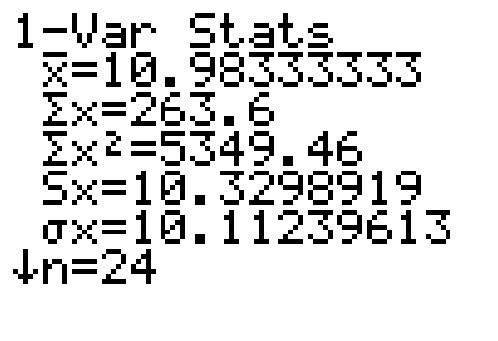
Example 7: Calculating Standard Deviation Using a Calculator (cont.)
3. Choose option 1:1-Var Stats and press
. If your data are in L1, press again since L1 is the default list. If you did not type your data in L1, enter the list where your data are located, such as L2 or L3. (These list names are in blue, above the numeric keys.)

Slide 36
Example 7: Calculating Standard Deviation Using a Calculator (cont.)
A list of numerical statistics will be generated for the data. The beginning of the list is shown in the margin. Because the values given are only a sample of college students, we want the sample standard deviation, which is denoted by s (on the calculator, this is displayed as Sx). From the list we see that s ≈ 10.3.
Since the standard deviation tells us about the average distance away from the mean, we can conclude that student tweeting behavior usually varies from the mean by tens rather than hundreds of tweets.

Slide 37
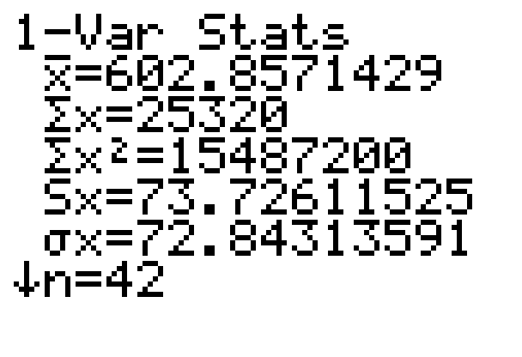
Example 7: Calculating Standard Deviation Using a Calculator (cont.)
b. Begin by clearing the data lists in the calculator. Now enter the data as you did in part a. Since we are told that the values given represent an entire Senior class, we want the population standard deviation, which is denoted by σx. From the list we see that
σ ≈ 72.8.

Slide 38
Example 7: Calculating Standard Deviation Using a Calculator (cont.)
Therefore, we know that SAT Critical Reading scores differ from the mean on average by 72.8 points. While we’ve got the calculator handy, we can see that the mean is actually approximately 602.9. Although there is not an actual score of 602.9, you can see that many of the students scores fall within about 70 points (or 1 standard deviation) of that mean, either larger or smaller.

Slide 39
Skill Check #2
Skill Check #2
Find the population standard deviation for the following data.
8, 12, 10, 11, 13, 12, 15, 9, 11, 16
Answer: 2.4

Slide 40
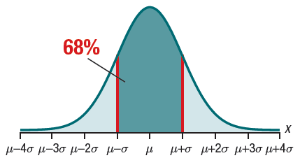
Empirical Rule
Empirical Rule
When the distribution of a set of data is approximately bell-shaped, we can estimate the percentage of data values that fall within a few standard deviations of the mean in the following way.
Approximately 68% of all data points
lie within 1 standard deviation
above and below the mean.

Slide 41
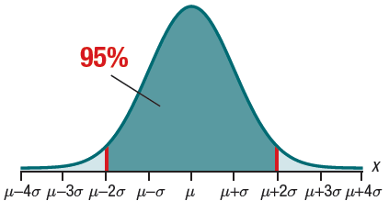
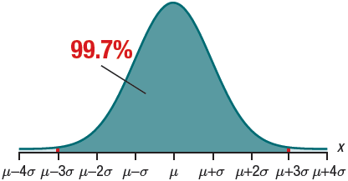
Empirical Rule (cont.)
Empirical Rule (cont.)
Approximately 95% of all data points
lie within 2 standard deviation above
and below the mean.
Approximately 99.7% of all data
points lie within 3 standard deviation
above and below the mean.

Slide 42
Example 8: Using the Empirical Rule
Suppose you suspect that emergency room waiting times for a local hospital have a bell‑shaped distribution. The data have a reported mean of 116.9 minutes and a standard deviation of 56.1 minutes.
a. Identify the range of waiting times that 95% of patients are likely to experience.
b. Estimate the percentage of patients that will wait less than 2 hours and 53 minutes.

Slide 43
Example 8: Using the Empirical Rule (cont.)
Solution
a. By the Empirical Rule, we know that 95% of the data set, which is approximately bell‑shaped, will fall within two standard deviations of the mean. Therefore, we can double the standard deviation and then add and subtract it from the mean to find the range of times that 95% of patients are likely to experience.

Slide 44
Example 8: Using the Empirical Rule (cont.)
So, we can estimate that 95% of patients will wait somewhere between 4.7 minutes and 229.1 minutes.

Slide 45
Example 8: Using the Empirical Rule (cont.)
b. To answer this question, we’ll need to first convert
2 hours and 53 minutes into minutes only, since our mean and standard deviation are both in minutes. Since 2 hours is 120 minutes, add 53 minutes to get a total time of 173 minutes. We know that this time falls above the mean, but by how much? If we subtract the mean, we have

Slide 46
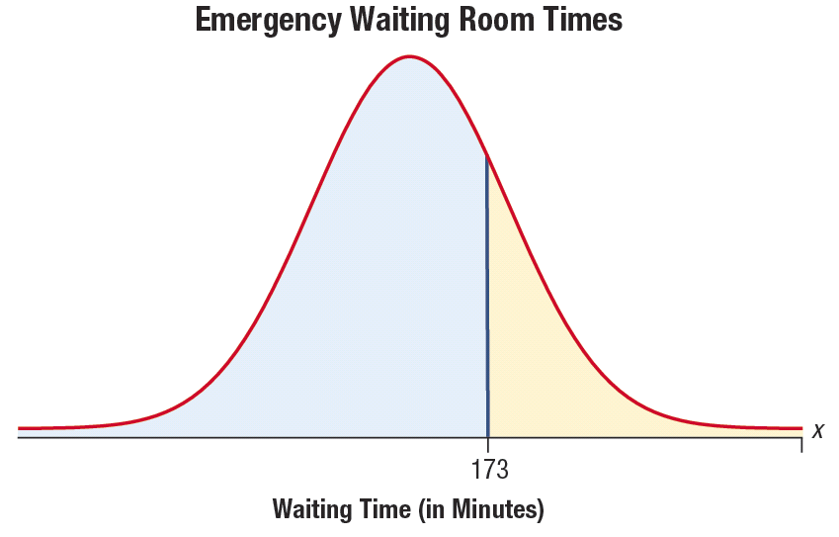
Example 8: Using the Empirical Rule (cont.)
In other words, the time we’re interested in is one standard deviation above the mean. Don’t jump to conclusions here and assume that 68% of the data falls below that. Let’s draw a picture first.

Slide 47
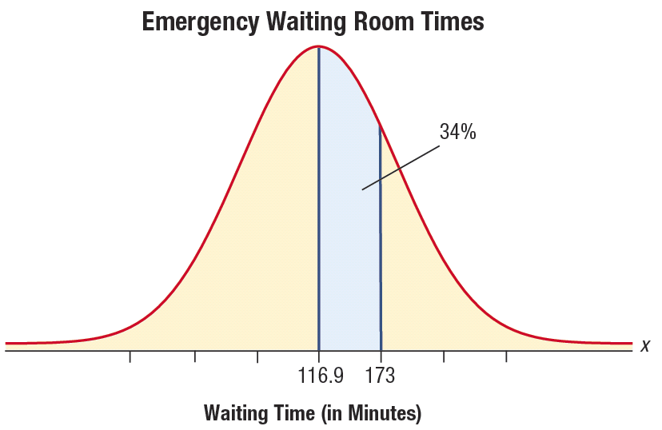
Example 8: Using the Empirical Rule (cont.)
Remember, we want to know what percentage of patients will wait less than 173 minutes. From the Empirical Rule, we know that 68% of data is within one standard deviation, so half of that, 34%, must be between the mean and one standard deviation.

Slide 48
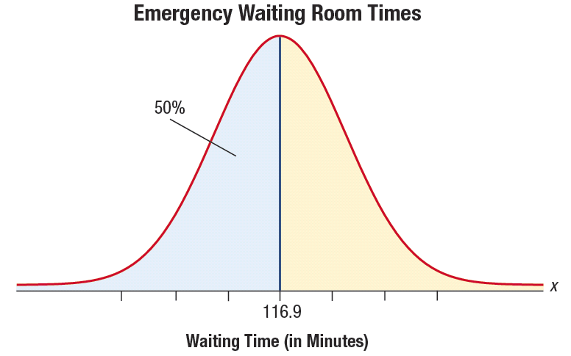
Example 8: Using the Empirical Rule (cont.)
We also know that because of the symmetry of a bell-shaped curve, since the mean is in the middle, half of the data lies below it.

Slide 49
Example 8: Using the Empirical Rule (cont.)
So, putting these two facts together, we have that 50% + 34% = 84% of the data lies below one standard deviation above the mean. In other words, approximately 84% of patients will wait less than
2 hours and 53 minutes.

Slide 50
Percentile
Percentile
Percentiles divide the data into 100 equal parts and tell you approximately what percentage of the data lies at or below a given value.

Slide 51
Example 9: Interpreting Percentiles
Sierra received her scores from taking a mathematics placement test for her chosen university. Choose the best explanation for what it means for her to be in the 61st percentile.
a. She correctly answered 61% of the answers on the test.
b. 61% of people taking the test scored the same as Sierra.
c. Sierra’s score was at least as good as 61% of the people taking the test.
d. Sierra missed 39% of the test questions.

Slide 52
Example 9: Interpreting Percentiles (cont.)
Solution
The correct interpretation of her score is c.: “Sierra’s score was at least as good as 61% of the people taking the test.” Both a. and d. are incorrect because they refer to how many questions she answered correctly on the test and not how she did in comparison to others taking the test. b. is not quite correct because percentiles tell you the percentage that scored at or below you. They are not all necessarily the same score as Sierra’s.

Slide 53
Quartiles
Quartiles
Q₁ = First Quartile = 25th percentile, that is, 25% of the data is less than or equal to this value.
Q₂ = Second Quartile = 50th percentile, that is, 50% of the data is less than or equal to this value.
Q₃ = Third Quartile = 75th percentile, that is, 75% of the data is less than or equal to this value.
By definition, Q₂ will be the same as the median.

Slide 54
Example 10: Interpreting Quartiles
On Karl’s recent standardized test results, the picture graph of his score showed he was above the third quartile in language arts. His classmate, Asher, said his score was at the 70th percentile, while Rylie said hers was at the 79th percentile. Which of the three had the best language arts test score?
Solution
We know the percentile ranks of both Asher and Rylie are the 70th and 79th respectively. What we know about Karl’s score is that it was above the third quartile.

Slide 55
Example 10: Interpreting Quartiles (cont.)
Since the third quartile is the same as the 75th percentile, we know that his score was somewhere at or above the 75th percentile. We can conclude that he did better than Asher, whose score was at the 70th percentile, but can make no definite comparison with Rylie, whose score was at the 79th percentile, because we do not know for sure which one had the best language arts score.

Slide 56
Example 11: Using Excel to Find Data Descriptors
To receive federal financial aid for higher education, students must first complete a Free Application for Federal Student Aid form, commonly called FAFSA. Given the following data gathered from FAFSA on the number of applications by state, use Excel to find the minimum and maximum data values, mean, median, mode, range, and standard deviation for the data.

Slide 57
Example 11: Using Excel to Find Data Descriptors (cont.)
Table 4: 2011–2012 Application Cycle
Quarter 4 |  |  | Quarter 4
State | Number of FAFSA Applications |  | State | Number of FAFSA Applications
Alberta | 31 |  | Canada | 104
American Samoa | 177 |  | Colorado | 28,373
Arizona | 39,134 |  | Connecticut | 14,757
Arkansas | 16,122 |  | Delaware | 4238
Blank | 28,459 |  | District of Columbia | 2958
British Columbia | 36 |  | Federated States of Micronesia | 877
California | 197,594 |  | Florida | 124,874

Slide 58
Example 11: Using Excel to Find Data Descriptors (cont.)
Table 4: 2011–2012 Application Cycle
Quarter 4 |  |  | Quarter 4
State | Number of FAFSA Applications |  | State | Number of FAFSA Applications
Foreign Country | 3042 |  | Kentucky | 22,078
Georgia | 68,669 |  | Labrador | 3
Guam | 695 |  | Louisiana | 23,576
Hawaii | 5211 |  | Maine | 4953
Idaho | 9747 |  | Manitoba | 5
Illinois | 59,081 |  | Marshall Islands | 125
Indiana | 30,127 |  | Maryland | 27,318
Iowa | 12,434 |  | Massachusetts | 23,675
Kansas | 13,366 |  | Mexico | 522

Slide 59
Example 11: Using Excel to Find Data Descriptors (cont.)
Table 4: 2011–2012 Application Cycle
Quarter 4 |  |  | Quarter 4
State | Number of FAFSA Applications |  | State | Number of FAFSA Applications
Michigan | 60,553 |  | Newfoundland | 3
Minnesota | 26,841 |  | New Hampshire | 4511
Mississippi | 20,741 |  | New Jersey | 34,906
Montana | 4245 |  | New Mexico | 11,335
Missouri | 31,919 |  | New York | 82,152
Nebraska | 7742 |  | North Carolina | 57,614
Nevada | 15,014 |  | North Dakota | 2045
New Brunswick | 2 |  | Northern Mariana Islands | 238

Slide 60
Example 11: Using Excel to Find Data Descriptors (cont.)
Table 4: 2011–2012 Application Cycle
Quarter 4 |  |  | Quarter 4
State | Number of FAFSA Applications |  | State | Number of FAFSA Applications
Northwest Territories | 2 |  | Palau | 75
Nova Scotia | 3 |  | Pennsylvania | 45,316
Nunavut | 0 |  | Prince Edward Island | 6
Ohio | 59,066 |  | Puerto Rico | 21,299
Oklahoma | 18,377 |  | Quebec | 35
Ontario | 89 |  | Rhode Island | 4027
Oregon | 20,937 |  | Saskatchewan | 7

Slide 61
Example 11: Using Excel to Find Data Descriptors (cont.)
Table 4: 2011–2012 Application Cycle (cont.)
Quarter 4 |  |  | Quarter 4
State | Number of FAFSA Applications |  | State | Number of FAFSA Applications
South Carolina | 27,203 |  | Virgin Islands | 558
South Dakota | 2941 |  | Washington | 34,980
Tennessee | 32,411 |  | West Virginia | 7091
Texas | 134,463 |  | Wisconsin | 25,411
Utah | 18,628 |  | Wyoming | 2452
Vermont | 1748 |  | Yukon | 7
Virginia | 41,507
Source: Federal Student Aid, “Application Volume Reports,” http://federalstudentaid.ed.gov/datacenter/application.html

Slide 62
Example 11: Using Excel to Find Data Descriptors (cont.)
Solution
You may need to load the Analysis ToolPak in Microsoft Excel. If you do not have the Data Analysis option in the Data tab, follow these steps to load the Analysis ToolPak on a PC.
1. Under the File menu, click on Options.
2. Click Add-Ins (listed on the left side), and then in the Manage box, select Excel Add-ins.
3. Click Go.

Slide 63
Example 11: Using Excel to Find Data Descriptors (cont.)
4. In the Add-Ins available box, select the Analysis ToolPak check box, and then click OK.
If Analysis ToolPak is not listed in the Add-Ins available box, click Browse to locate it.
If you get prompted that the Analysis ToolPak is not currently installed on your computer, click Yes to install it.
5. After you load the Analysis ToolPak, the Data Analysis command is available in the Analysis group on the Data tab.

Slide 64
Example 11: Using Excel to Find Data Descriptors (cont.)
Begin by typing the data into Columns A and B. Go to the Data tab, then Data Analysis, then choose Descriptive Statistics, and click OK. In the Input Range box, enter the cells where your Number of FAFSA Applications data are located. Select New Worksheet Ply and type “Descriptive Statistics” in the box. Click on the box in front of Summary Statistics. The Descriptive Statistics menu should look similar to the following.

Slide 65
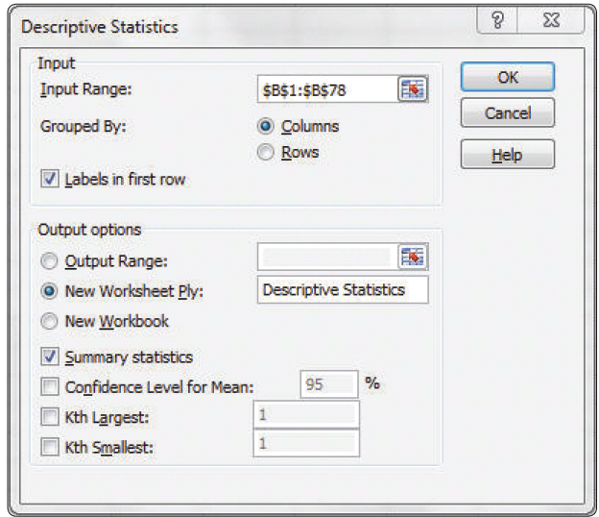
Example 11: Using Excel to Find Data Descriptors (cont.)

Slide 66
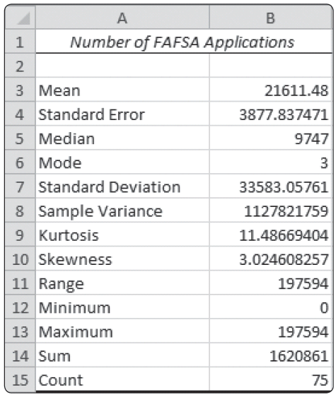
Example 11: Using Excel to Find Data Descriptors (cont.)
Clicking OK should produce the following list of descriptive statistics.

Slide 67
Example 11: Using Excel to Find Data Descriptors (cont.)
From the output, we can see that the values that we are looking for are as follows.
Minimum value = 0
Maximum value = 197,594
Mean = 21,611.5
Median = 9747
Mode = 3
Range = 197,594
Standard deviation = 33,583.1

