Slide 1
HAWKES LEARNING
Algebraic Expressions
Notes:
Hello! Today, we are going to discuss how to simplify and evaluate algebraic expressions.

Slide 2

Definitions
A constant is a single number, like 6 or 18.
A term in an algebraic expression is any single grouping of variables and constants like...
$16$, $\frac{3}{4}x$, $−5.2$, $1.3xy$, ${−5x}^{2}$, ${14b}^{3}$, and $−\frac{x}{y}$
A numerical coefficient is any number in front of a variable .
Example: The term 6x has the constant 6 as the numerical coefficient of the variable x.
Notes:
Let’s start by going through some definitions of terms that we will be using today. A constant is a single number like 6 or 18. A term in an algebraic expression is any single grouping of variables and constants like: 16, 3/4x, negative 5.2, 1.3xy, -5x², 14b³ and negative x over y. A numerical coefficient is any number in front of a variable. As an example, the term 6x has the constant 6 as the numerical coefficient of the variable x.

Slide 3
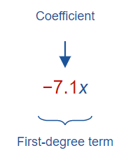
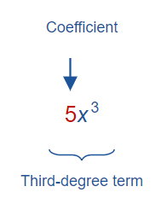
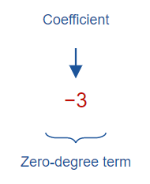
Definitions cont’d
If a term has only one variable, then the exponent of the variable is called the degree of the term.
Notes:
Here is one more definition. If a term has only one variable, then the exponent of the variable is called the degree of the term. In this first example, the variable x is raised to the first power, so the term negative 7.1x is a first-degree term. In this example, the variable x in the term 5x³ is raised to the third power, so this is a third-degree term. In this last example, you can think of negative 3 as being multiplied by x⁰, which is 1, since any variable raised to the zero power is equal to 1. The zero in the exponent of x makes this a zero-degree term.

Slide 4
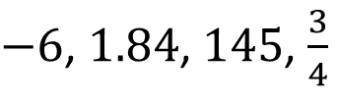
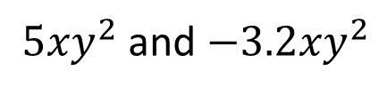
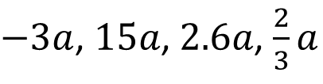
Like Terms
Like terms are either 1) constants or 2) terms that contain the same variables raised to the same powers.
Examples:
$−6$, $1.84$, $145$, $\frac{3}{4}$
$−3a$, $15a$, $2.6a$, $\frac{2}{3}a$
${5xy}^{2}$ and ${−3.2xy}^{2}$
Notes:
Now, let’s talk about like terms. Like terms are either 1) constants or 2) terms that contain the same variables raised to the same powers. Here are some examples. In this first example, you have a set of constants, all of which can be viewed as being multiplied by x⁰. Therefore, all of these constants are like terms. In this example, there is the variable a raised to the first power in each of the terms listed. Since all of these terms have a raised to the first power, they are all like terms. In this last example, both 5xy² and negative 3.2xy² have x times y² as the same two variables raised to the same exponents, making these like terms.

Slide 5

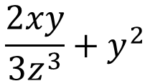
Algebraic Expression
An algebraic expression is a combination of variables and numbers using any of the operations (+, -, x, / ) as well as exponents.
$$\frac{2xy}{{3z}^{3}}+y^{2}$$
$$x^{2}−14$$
Notes:
Now, let’s cover one final definition: algebraic expression. An algebraic expression is a combination of variables and numbers using any of the operations (addition, subtraction, multiplication, division) as well as exponents. Here are two examples of algebraic expressions. x² minus 14 is a combination of x² and 14 using the plus operation. 2xy divided by 3z³ plus y² is another more complicated example of two terms combined again with the plus operation.

Slide 6

Simplifying Algebraic Expressions
If an expression has like terms, combine them using the distributive property:
$$ba+ca=\left(b+c\right)a$$
Notes:
We are now ready to learn how to simplify algebraic expressions by combining like terms. If an expression has like terms, combine them using the distributive property. “ba plus ca” has two like terms, so we factor out the a from the “(b plus c),” and if b and c were numbers, you would add them together to simplify the expression.

Slide 7
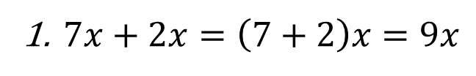
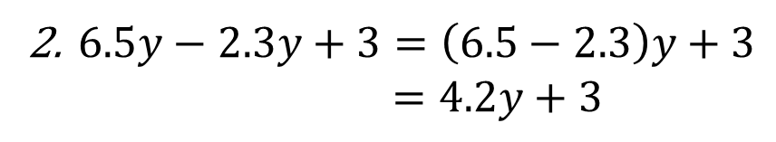
Examples
$7x+2x=\left(7+2\right)x=9x$
$6.5y−2.3y+3=\left(6.5−2.3\right)y+3$
$=4.2y+3$
Distributive property
Notes:
Here are some examples. “7x plus 2x” simplifies to 9x by distributing out the 7 and 2 and then adding them together. “6.5y minus 2.3y plus 3” is simplified by combining the like terms 6.5y and negative 2.3y. When those two terms are combined, we have “4.2y plus 3” as the simplified expression. Notice that the 4.2y and 3 are not like terms, so they cannot be simplified.

Slide 8

Evaluating Algebraic Expressions
Combine like terms, if possible.
Substitute the values given for any variables.
Follow the rules for order of operations.
Notes:
Now, we are ready to evaluate an algebraic expression. To evaluate an algebraic expression, follow these steps. First, combine like terms, if possible. Second, substitute the values given for each variable and third, follow the rules for the order of operations.

Slide 9
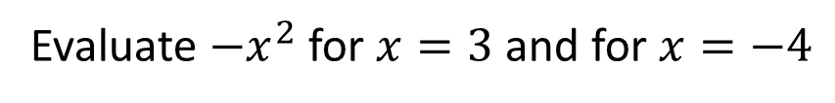
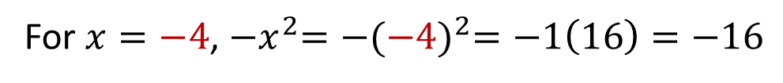
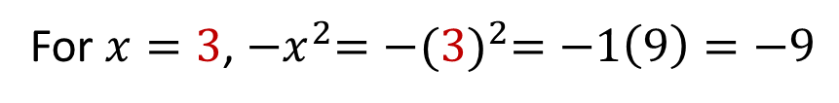
Example 1
Evaluate ${−x}^{2}$ for $x=3$ and for $x=−4$
Solution:
For $x=3$, ${−x}^{2}={−(3)}^{2}=−1\left(9\right)=−9$
For $x=−4$, ${−x}^{2}={−(−4)}^{2}=−1\left(16\right)=−16$
Notes:
Let’s look at Example 1. This example asks you to evaluate the algebraic expression negative x² for both the value 3 and negative 4. Let’s evaluate the expression for x equals 3 first. Notice when you plug in the value of 3 for x, you square the 3 first, and then you apply the negative sign, giving you negative 9 as the value for the expression when x equals 3. When x equals negative 4, you again evaluate the exponent first, giving you a positive 16 for the exponent term, and then when you take into account the negative sign, you end up with negative 16 as the value for the expression when x equals negative 4.

Slide 10
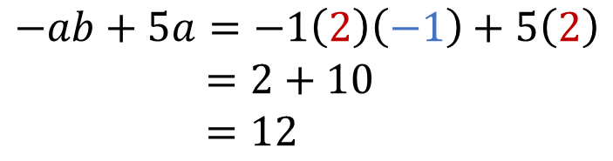
Example 2
Simplify and evaluate $3ab−4ab+6a−a$ for $a=2$, $b=−1$
Solution:
$$3ab−4ab+6a−a=−ab+5a$$
$$−ab+5a=−1\left(2\right)\left(−1\right)+5\left(2\right)$$
$=2+10$
$=12$
Notes:
Example 2 asks you to evaluate the algebraic expression “3ab minus 4ab plus 6a minus a” for a equals 2 and b equals negative 1. First, we combine like terms. The 3ab and negative 4ab combine to give you negative ab, and the 6a and negative a combine to give you 5a. So, after combining like terms, the simplified algebraic expression is negative ab plus 5a. Now, we’re ready to plug in a equals 2 wherever there is an a in the expression and b equals negative 1 wherever there is a b in the expression. This yields 2 plus 10, which is 12.

Slide 11




HAWKES LEARNING

